Slide 1
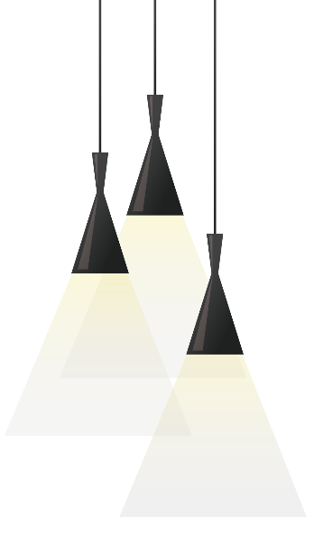
Automatic Music Generator
Mo Fan 115010204
Li Kengjie 115010177
Wang Junce 115010231
Ye Shuqian 115010269
Zhang Ruoqing 115010096

Slide 2
01 / Abstract
02 / Front End
03 / Back End & A Better Choice
CONTENTS

Slide 3
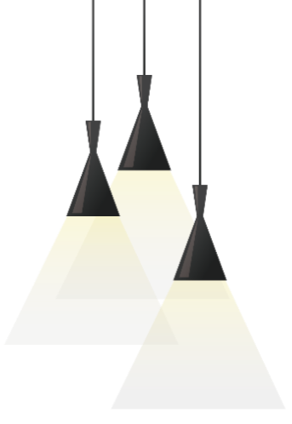
Abstarct:
Re-introduction

Slide 4
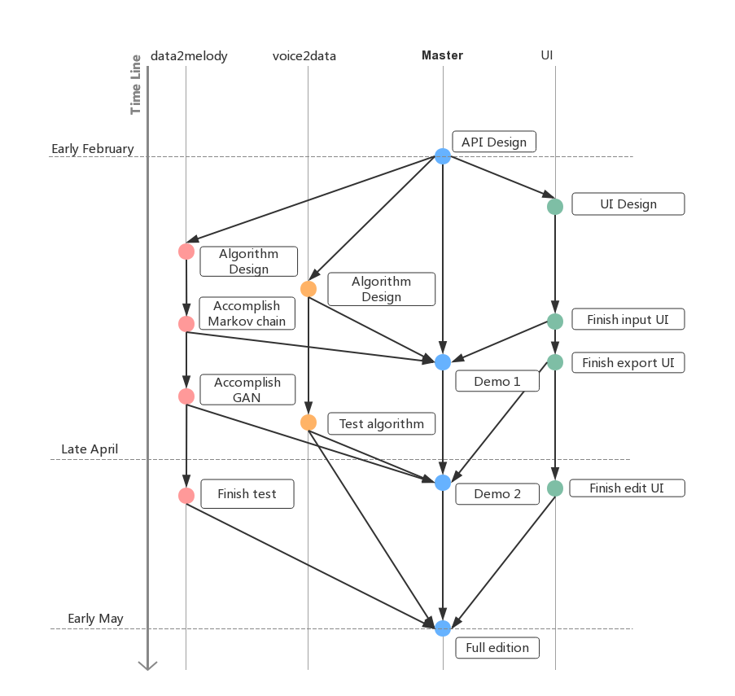
Re-introduction
The automatic melody generator provides the amateur users with the opportunity to compose pieces of melody.
What we have done?
You will have an idea later. :D
← Original Timetable

Slide 5
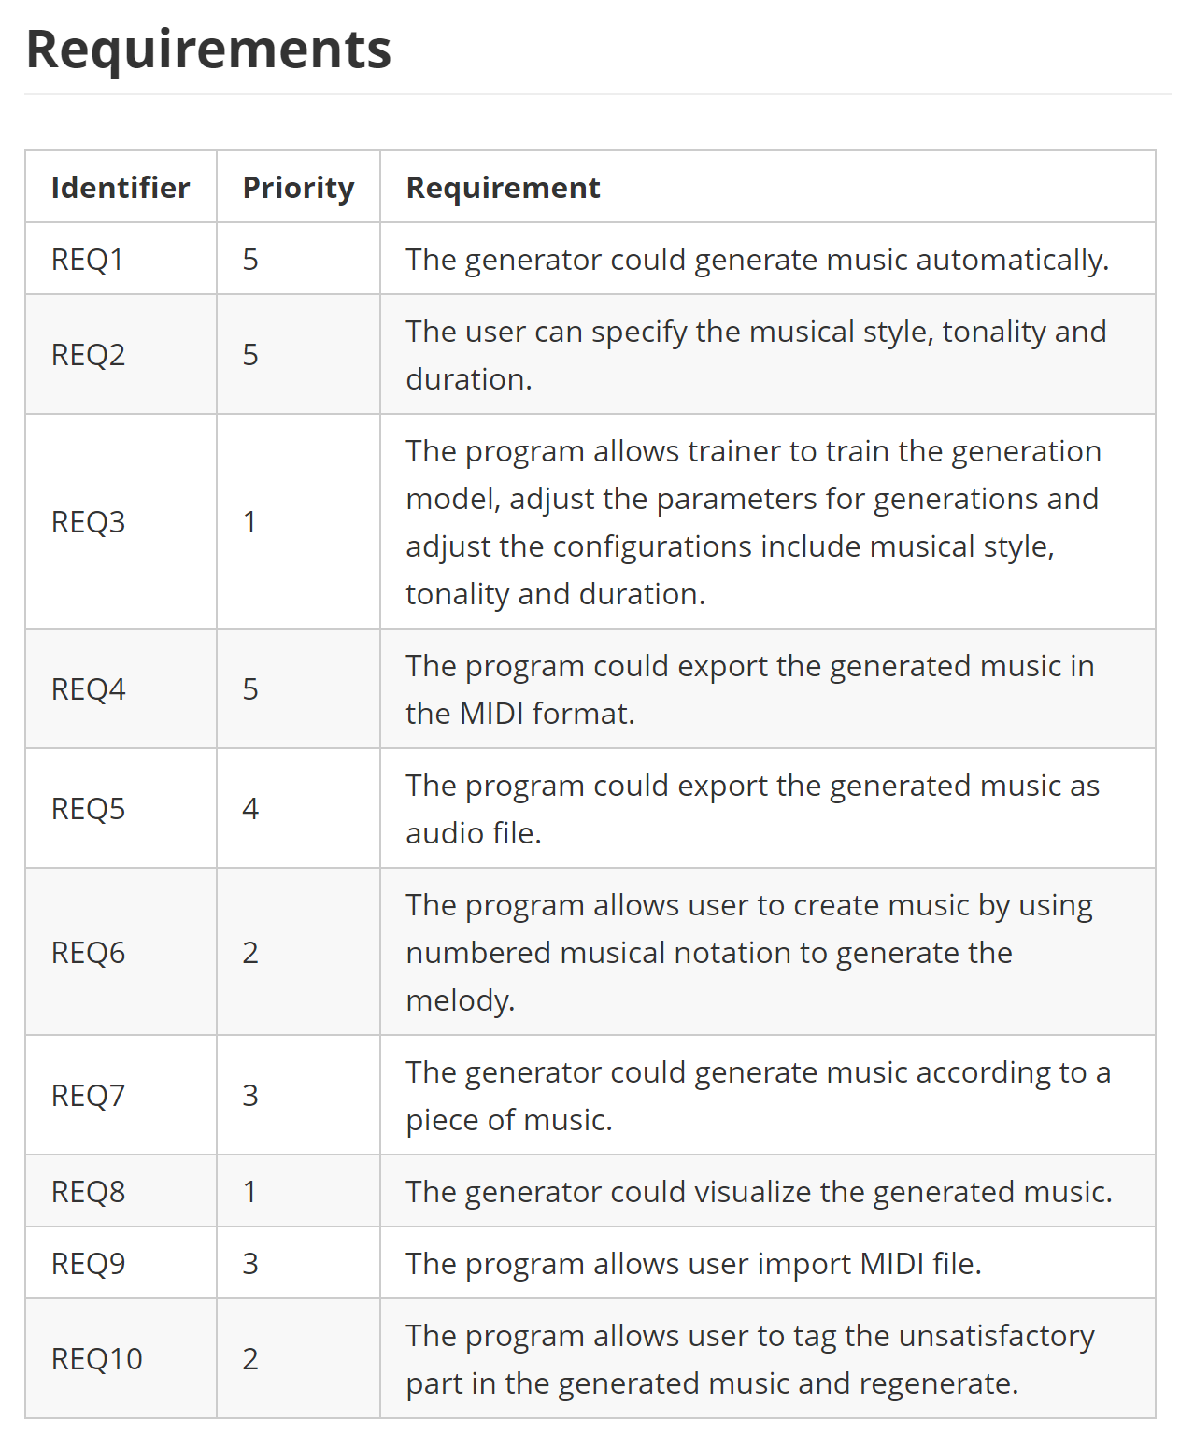
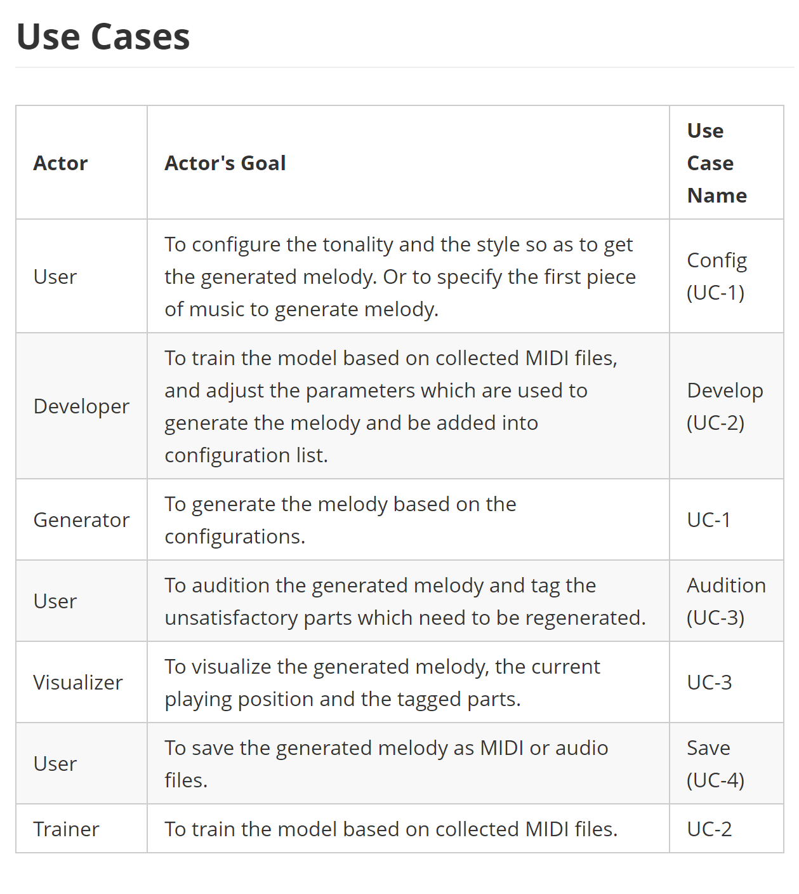
Automatic Melody Generator
The automatic melody generator provides the amateur users with the opportunity to compose pieces of melody.

Slide 6
Front End:
Interactivity

Slide 7
Interactivity
Interactivity
CF
Complete functional
To help users especially none-professional users interactive with the melody, these three principles should be followed: CF, ASAP, WYSIWYG
ASAP
As simple as possible
WYSIWYG
What you see is what you get.
What we have achieved

Slide 8

Back End:
Markov Chain for Short-term Predicition

Slide 9
Stuck in your idea? -- Input data
Fire it up! – Get new notes.
When the user wants to get immediate hints for their composing music within a short-term, for example a bar, the user can input the known music as a sequence to the Markov Chain.
Then the Markov Chain will fulfill the last bar with suitable notes expectedly. Though users can do this time by time, the final effect may not be good since the long-term information is easily lose during the process of Markov Chain.
Choose a Style. -- Transition Matrix
Then user needs to choose a style which the music wanted to be. Each style corresponds to a transition matrix. Several pre-trained transition matrix will be provided in the released version.
Notes:
So, for long-term hints, lets welcome MFF to introduce another algorithm we used – genetic algorithm.

Slide 10
A Better Choice:
Optimization Algorithms

Slide 11

Simulated Annealing Algorithm
(模拟退火算法）
Generate “UNIT”s.
Genetic Algorithm
（遗传算法）
Use “UNIT”s as genes.
A music period is a combination of “UNIT”s
Which can be regarded as a chromosome.
Cross & Mutation.

Slide 12
Phase 4
Unity & Multiple tracks
Train the whole model automatically by dataset.
Phase 3
Modify the evaluation functions,
the rules and the parameters.
Generate music periods which are songful locally.
Phase 2
Phase 1
Generate ACCEPTABLE music periods.

Slide 13

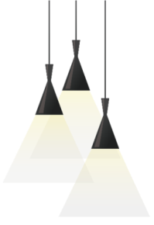
Interactions with Users
User Inputs
Regeneration()
Modification()
Add evalutation constraints to ensure the fluency of the music.
Increase the “upper limit”.
Self-Improvement Model
(?)

Slide 14
Q & A
Thanks all for listening!

