Slide 1
Automatic Melody Generator
Li Kengjie 115010177
Mo Fan 115010204
Wang Junce 115010231
Ye Shuqian 115010269
Zhang Ruoqing 115010096

Slide 2
Purpose & Differences
Main Features
UI Design
Basic Algorithm
Division of Work & Timeline

Slide 3
Purpose & Differences
The automatic melody generator provides the amateur users with the opportunity to compose pieces of melody.
Target User:
all people who are interested in music
especially those who lack knowledge in music theory
Generate? Compose?
Notes:
Nowadays, there are few software that can generate the special melody according to the input from the users. Most of them depend on the default settings of the producers, which means that the melody generated is similar or limited.
What we want to do is to genereate the melody in a more flexble method.
Generate? Compose?

Slide 4
Main Features
Automatically Composing Music
– Software
Semi-automatically Composing Music
– Software + User

Slide 5
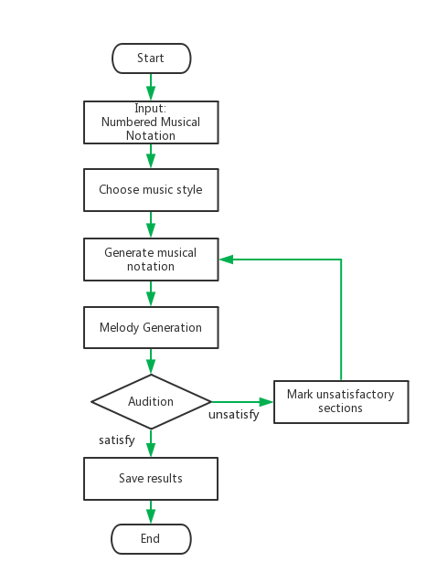

Slide 6
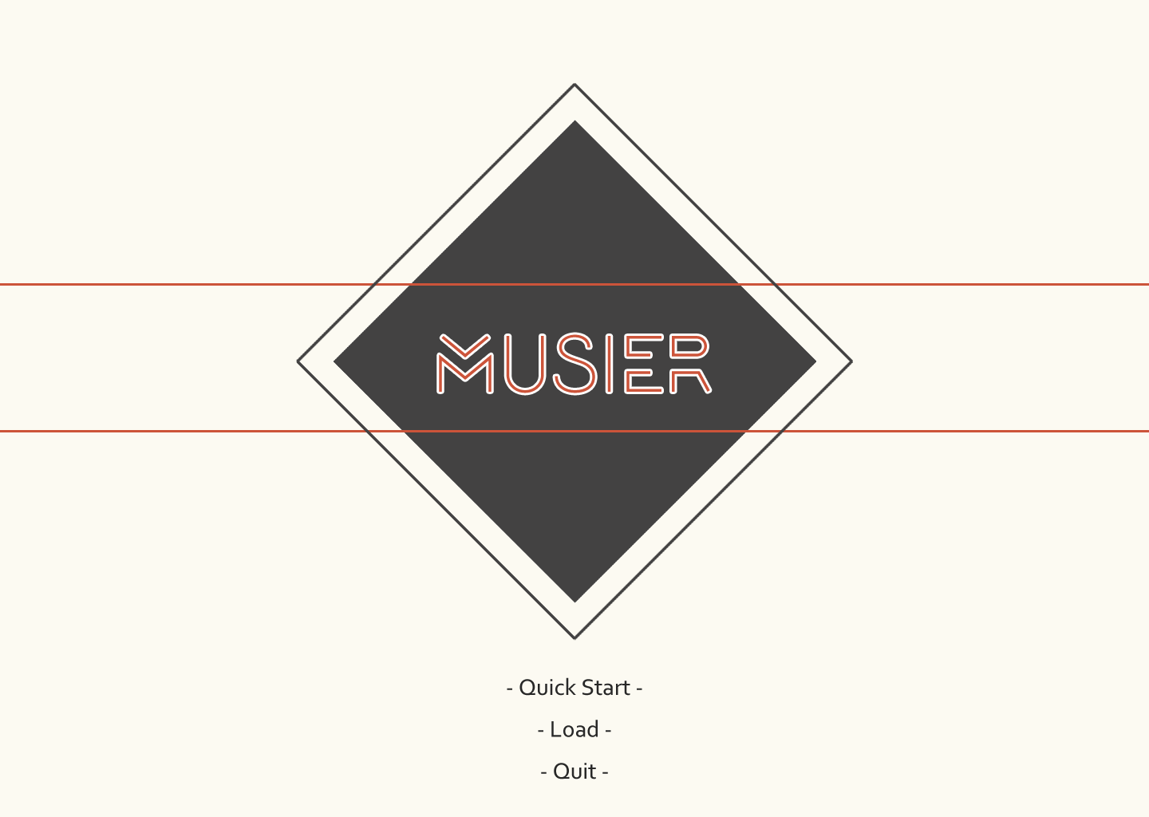
UI Design

Slide 7
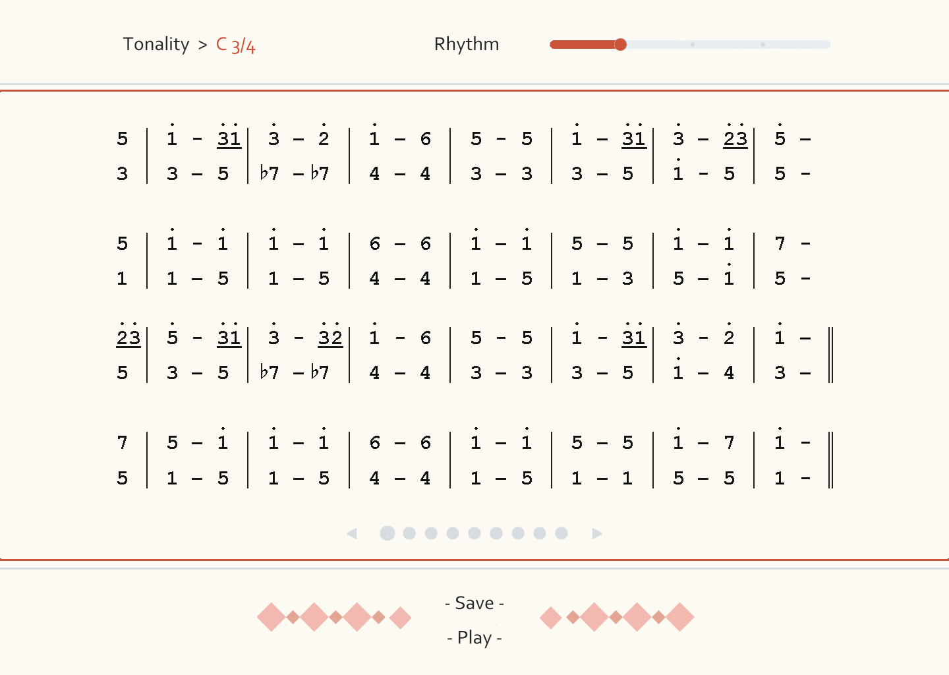
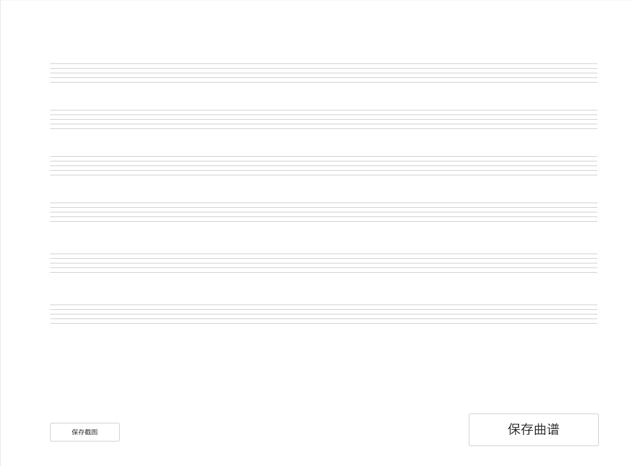
UI Design

Slide 8
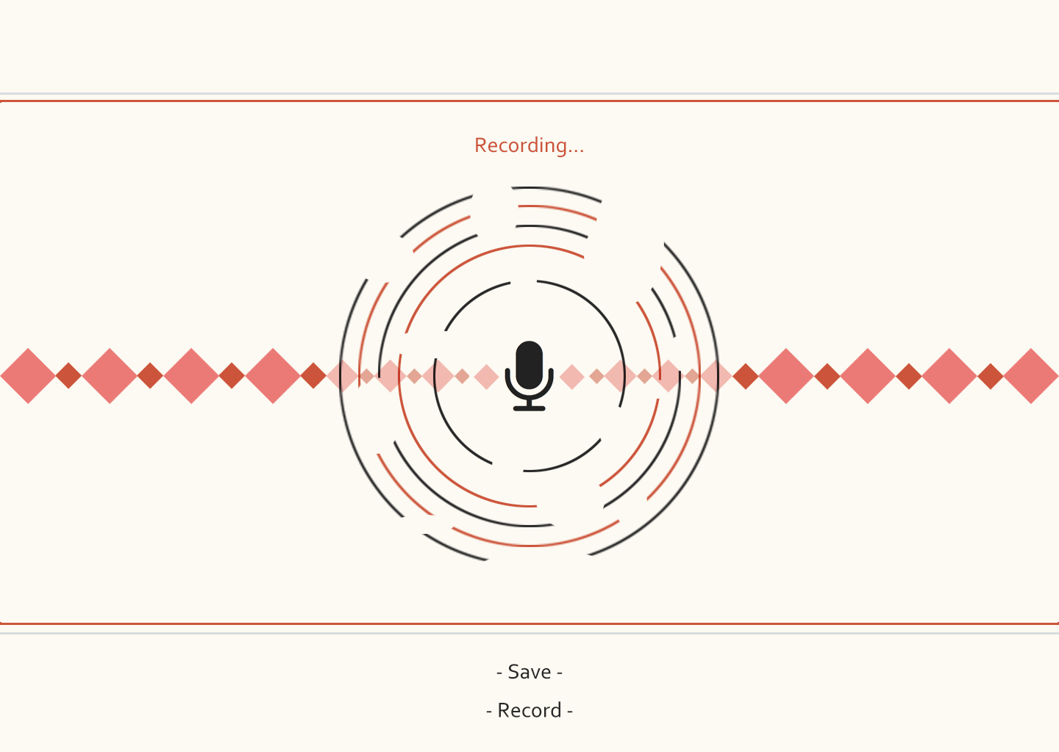
UI Design

Slide 9
Basic Algorithm
◊ Markov Chain
◊ Generative Adversarial Networks (GAN)

Slide 10
Division of Work
◊ 2 group members work for Algorithm.
◊ 2 group members work for UI.
◊ 1 group member works for Data Processing.

Slide 11
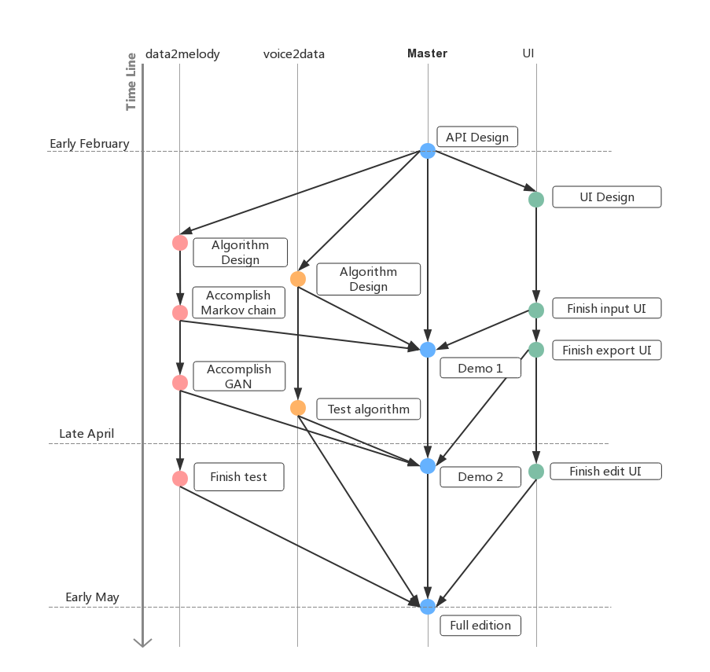
Timeline

Slide 12
Thank you! :D

