Slide 1

Automatic Melody Generator
- Musier -
2018.5.7 Final Presentation
Team#10:
Zhang Ruoqing 115010096
Li Kengjie 115010177
Ye Shuqian 115010269
Mo Fan 115010204
Wang Junce 115010231

Slide 2

Introduction
Technique
Development
Demonstration
CONTENT

Slide 3
PART 01
Introduction

Slide 4

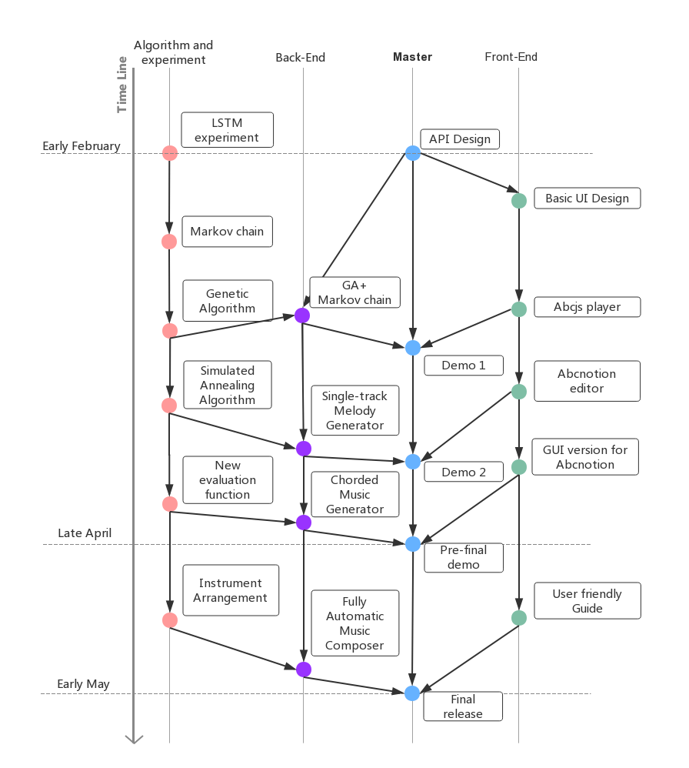
01. Introduction
“The automatic melody generator provides the amateur users with the opportunity to compose pieces of melody.”
Some amateurs may have the dream being composers, but lack professional knowledge.
If you are the one who wants to be a composer, but feeling puzzled with the complex commands, Musier is the one can do you a favour!

Slide 5
PART 02
Technique

Slide 6
02. Technique
Back end
Simulated Annealing Algorithm
Genetic Algorithm
It is applied to generate "UNIT"s. The combination of these two are better than Markov chain.
Use “UNIT”s as genes. A music period is a combination of “UNIT”s, which can be regarded as a chromosome.
Abc Notion
Front end
a shorthand form of musical notation
One part of Format Conversion

Slide 7
PART 03
Development

Slide 8
04. Development
Allow User’s Input
Improve Generation Model
Re-design Home Page
User can enter his thoughts in numbered musical notations by keyboard.
Optimized the logic of generating.
Art style modification.
&
Layout improvement.

Slide 9
PART 04
Demostration
10.20.5.2:8000/app

Slide 10
Thanks all for listening!
2018.5.7 Final Presentation
10.20.5.2:8000/app
github.com/yippp/Musier
- Musier -
Surprises are ready for U!~

