Slide 1

Automatic Music Composer
Mo Fan 115010204
Li Kengjie 115010177
Wang Junce 115010231
Ye Shuqian 115010269
Zhang Ruoqing 115010096

Slide 2

Music Demo
Talk is cheap. I will show you the result.

Slide 3
01 / Our goal
02 / SE Cycle life
03 / Individual contribution
04 / Frontend demo
05/ Problem & Solution
CONTENTS

Slide 4
Our goal

Slide 5
Our goal
Fully automatic music composer
User friendly interactivity

Slide 6
Software Engineering Cycle Life

Slide 7
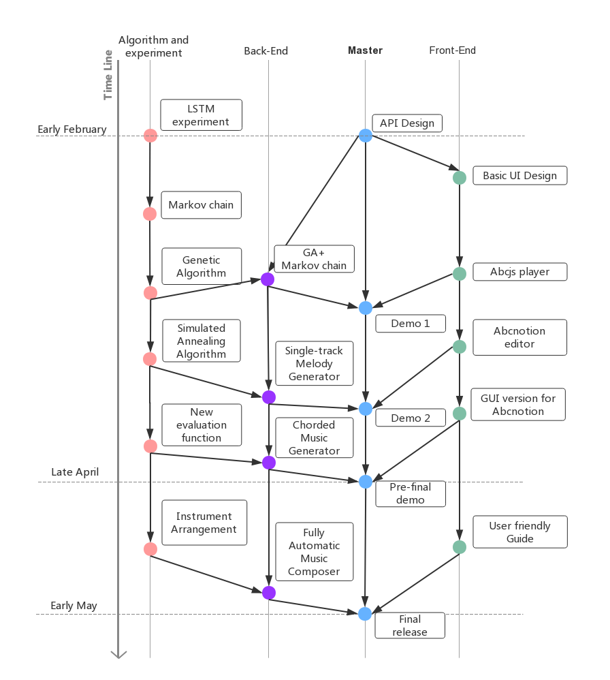
SE Cycle Life
Four parallel timeline:
Algorithm and experiment
Backend development
Master program
Frontend development

Slide 8
Individual contribution

Slide 9
Individual Contribution
Mo Fan
Li Kengjie
Algorithm design and Backend development
Frontend development and documentation
Musier
Zhang Ruoqing
Ye Shuqian
UI design and art design
Product manager and documentation
Wang Junce
API design and documentation
Notes:
So, for long-term hints, lets welcome MFF to introduce another algorithm we used – genetic algorithm.

Slide 10
Frontend Demo

Slide 11
Problems and solutions

Slide 12
Problems and solutions
Problem 1
Different standard for music representation
Solution 1
Using abc notion standard as interface
Problem 2
For the property of genetic algorithm model, last bar ends in established note is not guaranteed.
Solution 2
A pre-defined gene with established ending.
Problem 3
From single track to multiple tracks
Solution 3
A pre-defined dictionary is referenced to generate chord
Problem 4
Blocking wait in GUI
Solution 4
Asynchronous requests

Slide 13
Next Plan

Slide 14


Next Plan
Chord and Arrangement
Change the chord generator to a dynamic programming algorithm. Let the program compose not only melody but also instrument arrangement. A novel algorithm must be applied on it. If possible, add velocity performance to output a wav file.
User Guide
A user-friendly guide for abcnotion. No matter it’s a document page or interactive guide.

Slide 15
Q & A
Thanks all for listening!

