Slide 1
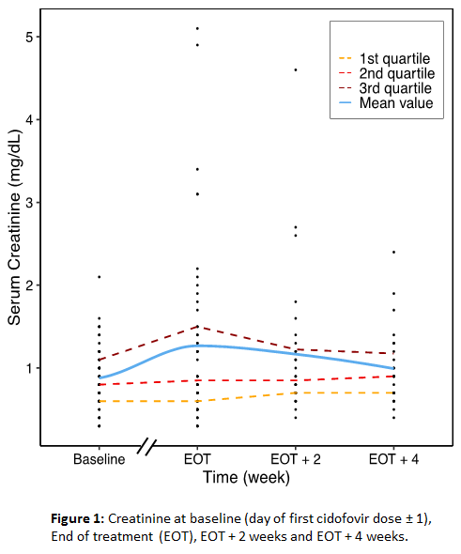
A Single Center Experience with Cidofovir for the treatment of double stranded (ds) DNA viruses in Hematopoietic Cell Transplant (HCT) recipients.
Anat Stern, MD¹, Yiqi Su, MS¹, Dionysios Neofytos, MD, MPH², Genovefa Papanicolaou, MD^{1,3}
¹Infectious Disease Service, Department of Medicine, Memorial Sloan Kettering Cancer Center, New York, NY, ²Infectious Disease Service, Geneva University Hospital, Geneva, Switzerland, ³Medicine, Weill Cornell Medical College, Cornell University, New York, NY
Background
Table 1. Baseline patient characteristics
Figure 2. Serum creatinine
Mean serum creatinine is higher in the end of CDV treatment compared to baseline and later tends to improve.
Creatinine rise is mainly observed in patients in highest quartile of baseline creatinine
Cidofovir (CDV) is a nucleotide analogue antiviral active against all dsDNA viruses relevant in hematopoietic cell transplant (HCT) recipients.
Despite a broad spectrum of activity, CDV utility is limited due to nephrotoxicity.
In this single center study we aimed to evaluate:
CDV administration practice and indications
Serum creatinine (sCr) dynamics following CDV treatment
Factors associated with acute kidney injury (AKI) following CDV treatment
 |  | N=54 (%)
Demographics | Age, Median years (IQR) | 54.5 (44-62)
 | Gender: Female | 28 (52)
HCT characteristics
Donor type | Matched related donor | 12 (22)
 | Matched/Mismatched unrelated donor | 42 (78)
HCT source | Cord blood | 13 (24)
 | Peripheral stem cells | 39 (72)
 | Bone marrow | 2 (4)
HCT manipulation | CD34+ selection | 42 (78)
Immune-suppression | Active GvHD at CDV initiation | 23 (43)
 | Systemic steroid treatment at CDV initiation | 16 (30)
Methods
Retrospective review of adult HCT recipients in MSKCC who received CDV for any indication from 2011 to 2017.
Initiation and duration of CDV treatment were at physicians’ discretion.
CDV exposure and indications, laboratory data and outcomes were extracted from medical records and hospital databases.
Figure 1. Indications for CDV administration
19 patients had concomitant infection with more >1 dsDNA virus (two dsDNA viruses in 14 patients and three in five patients).
Results
Adenovirus
BK virus
CMV
HHV6
N=1
HHV6
N=2
All patients with BK virus
N=21
Of 1,235 HCT recipients, 54 (4.4%) received ≥1 dose of CDV.
Baseline sCr at CDV initiation was 0.88 mg/dL (mean, SD=0.37) while at end of treatment (EOT) it was 1.07 mg/dL (mean, SD=0.57, N=48, P=0.004) and at EOT + 2 weeks it was 1.23 mg/dL (mean, SD=0.72, n=28, P=0.027) .
At EOT, 13 pts (24%) had acute kidney injury (AKI) defined as ≥ 1.5-fold increase of baseline sCr. Of those, 12 (92%) received concomitant nephrotoxic drugs, and in six, AKI was attributed to other etiologies by treating physician.
Of 51 patients with follow-up at EOT, 29 (57%) had clinical response to CDV according to treating physician.
Nineteen patients (35%) died within four weeks from last CDV dose.
All patients with adenovirus
N=35
N=11
N=4
Figure 3. Percentage of patients with AKI at end of CDV treatment by patients subgroups: (A) by time from HCT to first CDV dose; (B) by CDV dose; (C) by baseline creatinine
AKI defined as sCr at end of treatment >1.5 times baseline sCr.
N=5
N=1
N=18
N=6
N=6
All patients with CMV
N=19
Conclusions
Table 2. CDV dosing and administration
In this highly immunocompromised cohort, 24% of patients experienced AKI following CDV treatment.
Concomitant nephrotoxic medications and potential impact of dsDNA viruses on renal function preclude determination of the relative contribution of CDV to AKI.
Safer treatment options are needed for HCT patients with life threatening infections with dsDNA viruses.
 | N=54 (%)
Days from HCT to first CDV dose – median (range) | 88.5 (14-335)
Number of CDV doses - median (range) | 3 (1-13)
Duration of CDV treatment – median (range) | 2 weeks (1-17 weeks)
CDV dose – High dose (3-5 mg/kg, 1/w) | 41 (76%)
Low dose (<1 mg/kg, 1-3/w) | 13 (24%)
AKI No AKI

