Slide 1
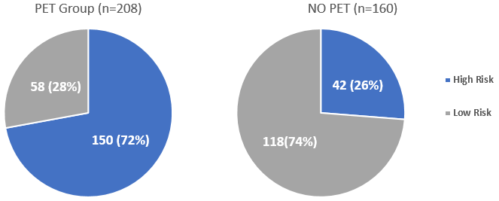
Economic Burden of Cytomegalovirus Infection in CMV-Seropositive (CMV R⁺) Hematopoietic Stem Cell Transplant Recipients Managed With Pre-Emptive Therapy: A Single Center Experience
Jiaqi Fang, MD, MPH¹, Phaedon D. Zavras, MD¹, Yiqi Su, MS¹, Amit D. Raval², PhD, Yuexin Tang², PhD, Miguel-Angel Perales, MD^{2,3}, Sergio A. Giralt, MD^{2,3}, Genovefa A. Papanicolaou, MD^{1,3}
Abstract No: 521
¹Memorial Sloan Kettering Cancer Center, Infectious Disease Service, New York, NY, United States, ²Merck & Co., Inc., Kenilworth, NJ, USA, ³Memorial Sloan Kettering Cancer Center, Bone Marrow Transplant Service, New York, NY, United States, ⁴Weill Cornell Medical College, Cornell University, New York, NY, United States
Background
Results
Cytomegalovirus (CMV) infection is the most common viral infection in allogeneic hematopoietic stem cell transplantation (HCT) recipients
Preemptive therapy (PET) is effective in preventing CMV end-organ disease (EOD) but poses substantial healthcare resource use (HCRU) and cost
Established benchmarks for HCRU and cost in the era of PET are required to perform cost benefit analyses of novel interventions for CMV
Comparison of average LOS (days) by PET use
Proportion of CMV related admissions and costs
Objectives
To compare direct all-cause HCRU and cost in CMV R⁺ by receipt of PET (PET versus no PET) through 180 days post HCT (D180)
To quantify CMV-related HCRU and cost among PET recipients through D180
To compare CMV-related with non CMV related HCRU and cost through D180
Methods
Study Design: Retrospective cohort study
Study Population: CMV R+ adult allogeneic HCT recipients of first peripheral blood or marrow allograft at a single center from 3/2013 to 12/2017
Data Sources: Clinical data including PET reasons and dates of hospitalizations were extracted from the electronic medical records. Inpatient hospital charges were obtained from the Vizient billing database and converted to costs using institutional cost-to-charge ratios, wage index and inflation rate to 2017 US Dollars
CMV monitoring: CMV+ recipients were monitored weekly by quantitative PCR assay starting on day 14 through D180 and managed by PET per standards of care
CMV risk: Patients were categorized in two mutually exclusive groups: Low risk (LR) recipients of unmodified graft from matched related or unrelated donors or High risk (HR): recipients of unmodified graft from mismatched donor or ex vivo T-cell depleted graft from any donor.
PET group: Receipt of pre-emptive antiviral therapy for CMV viremia
Follow-up period: Date of Index HCT to the earliest of D180 or death/relapse/2nd transplant, whichever occurred first.
Healthcare resource utilization:
Length of inpatient stay (LOS) for index admission, and subsequent readmissions by day 180 post HCT
Number of all-cause and CMV-related readmissions by 180 post HCT
CMV-related readmissions were defined as readmissions for initiation of PET, work up or management of CMV End Organ Disease and any readmission where PET was initiated
PET group had longer total LOS from D0 through D180 (p=0.0039) and longer LOS for index HCT admission (p=0.0001) compared with NO PET group
Comparison of average cost per patient by PET use
CMV-related readmissions had higher average cost per episode compared with non CMV-related readmissions in the PET group ($167,701 versus $96,941, p=0.0089)
In the PET group, CMV-related readmissions comprised 37% of all readmissions and incurred 49% of total readmission costs through D180.
Baseline Characteristics
Of 368 HCT recipients, 192 (52%) were HR and 176 (48%) LR
Overall, 208 (56.5%) patients received PET
HR comprised 72% of PET group but only 26% of No PET group.
Conclusion
PET recipients incurred higher total HCRU and cost through D180 as compared with no PET recipients
Among the PET recipients, CMV-related readmissions had a disproportionately high share of total inpatient readmissions costs compared to Non-CMV related readmissions
Future studies are needed to examine the cost-effectiveness of alternative strategies for CMV management
PET group had higher total average inpatient cost per patient through D180 (p=0.0003) and for index HCT admission (p=0.0304) compared with no PET group.
Disclosure: This study was funded by a grant from Merck & Co., Inc

