Slide 1
P0 Investigate: Spend Up + SOI Down
Deep Dive Analysis
Benchmark (Dec 25-31) vs Jan / Feb / Mar MTD Criteria: Avg daily spend UP but SOI DOWN in March vs Benchmark

Slide 2
TIKTOK_US
Spend Up + SOI Down Analysis

Slide 3
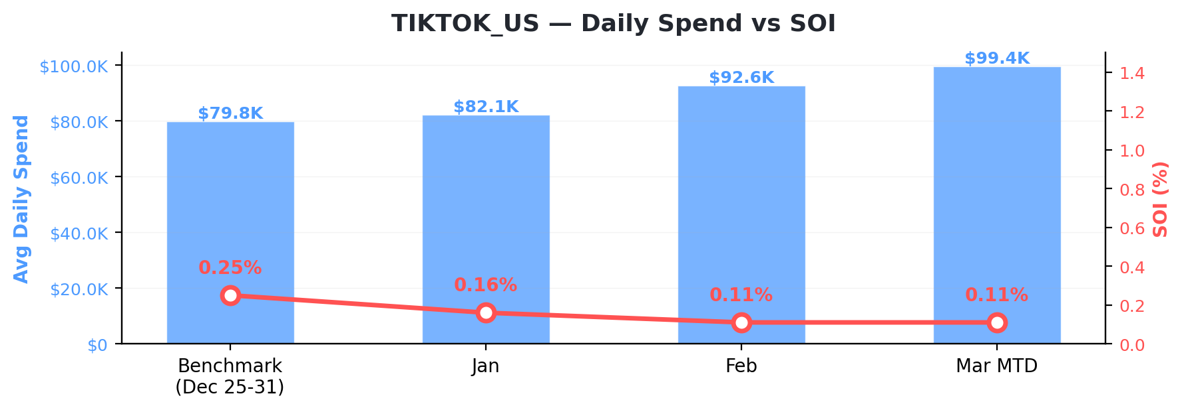
TIKTOK_US
Spend & SOI Trend Overview
Period | Total Spend | Avg Daily Spend | Moloco Installs | Non-Moloco Installs | SOI
BM | $558,791 | $79,827 | 100,541 | 39,578,796 | 0.25%
Jan | $2,545,715 | $82,120 | 385,628 | 242,607,273 | 0.16%
Feb | $2,592,017 | $92,572 | 315,077 | 286,415,280 | 0.11%
Mar | $1,292,768 | $99,444 | 142,537 | 130,004,176 | 0.11%

Slide 4
TIKTOK_US
SOI Impact by App (Benchmark → Mar)
SOI Impact = change in app's Moloco install share of total installs. Negative = unattributed installs growing faster. Highlighted = top spend apps (>=10% share).
App | BM SOI | Mar SOI | SOI Chg | Mar DRR | Spend % | Impact (pp)
TikTok (JP) | — | 0.10% | +0.10% | $2,371 | 2.4% | +0.005
TikTok Lite - Faster TikTok | 0.84% | 0.24% | -0.60% | $1,960 | 2.0% | -0.016
TikTok | 0.24% | 0.11% | -0.13% | $95,295 | 95.7% | -0.133

Slide 5
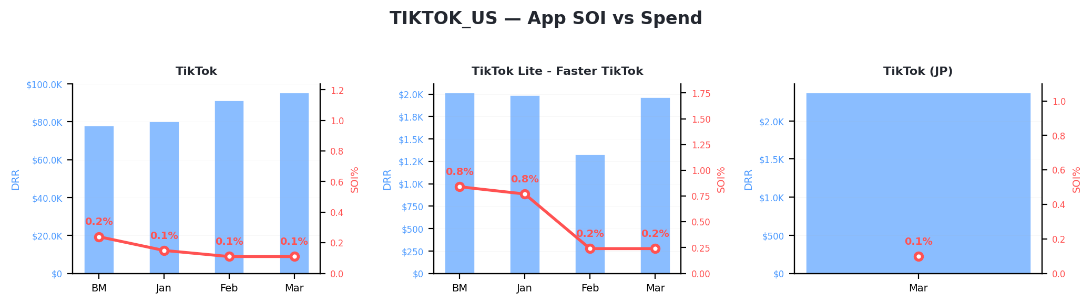
TIKTOK_US
App-Level SOI vs Spend

Slide 6
TIKTOK_US
App-Level Data: Benchmark vs Monthly Trend
App | BM DRR | BM SOI | Jan DRR | Jan SOI | Feb DRR | Feb SOI | Mar DRR | Mar SOI
TikTok | $77,812 | 0.24% | $80,131 | 0.15% | $91,247 | 0.11% | $95,295 | 0.11%
TikTok Lite - Faster TikT | $2,015 | 0.84% | $1,988 | 0.77% | $1,325 | 0.24% | $1,960 | 0.24%
TikTok (JP) | — | — | — | — | — | — | $2,371 | 0.10%

Slide 7
MICROFUN
Spend Up + SOI Down Analysis

Slide 8
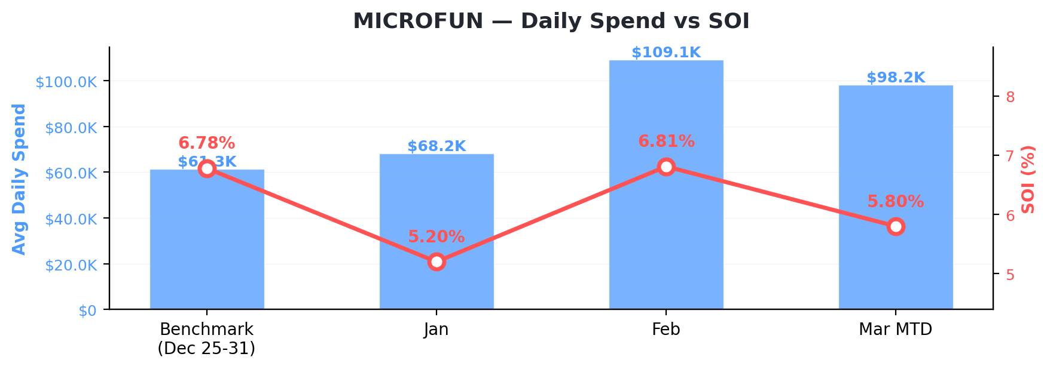
MICROFUN
Spend & SOI Trend Overview
Period | Total Spend | Avg Daily Spend | Moloco Installs | Non-Moloco Installs | SOI
BM | $428,885 | $61,269 | 79,703 | 1,095,761 | 6.78%
Jan | $2,113,053 | $68,163 | 460,466 | 8,387,616 | 5.20%
Feb | $3,053,689 | $109,060 | 491,847 | 6,732,766 | 6.81%
Mar | $1,276,006 | $98,154 | 170,492 | 2,770,709 | 5.80%

Slide 9
MICROFUN
SOI Impact by App (Benchmark → Mar)
SOI Impact = change in app's Moloco install share of total installs. Negative = unattributed installs growing faster. Highlighted = top spend apps (>=10% share).
App | BM SOI | Mar SOI | SOI Chg | Mar DRR | Spend % | Impact (pp)
Flambé: Merge and Cook | — | 6.54% | +6.54% | $5,991 | 6.1% | +0.274
Flambé: Merge & Cook | — | 4.74% | +4.74% | $4,953 | 5.0% | +0.261
Gossip Harbor®: Merge & Story | 6.78% | 5.83% | -0.95% | $87,211 | 88.9% | -1.519

Slide 10
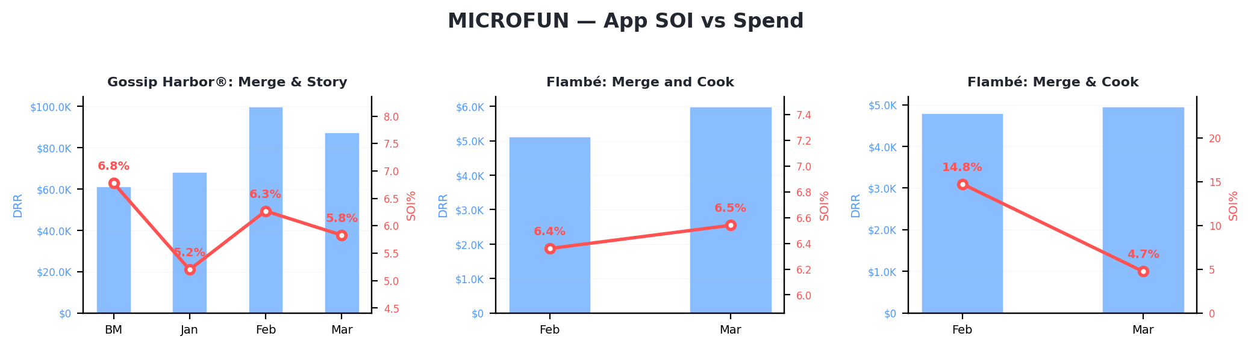
MICROFUN
App-Level SOI vs Spend

Slide 11
MICROFUN
App-Level Data: Benchmark vs Monthly Trend
App | BM DRR | BM SOI | Jan DRR | Jan SOI | Feb DRR | Feb SOI | Mar DRR | Mar SOI
Gossip Harbor®: Merge & S | $61,269 | 6.78% | $68,163 | 5.20% | $99,855 | 6.27% | $87,211 | 5.83%
Flambé: Merge and Cook | — | — | — | — | $5,121 | 6.36% | $5,991 | 6.54%
Flambé: Merge & Cook | — | — | — | — | $4,792 | 14.75% | $4,953 | 4.74%

Slide 12
Learnings
Spend Up + SOI Down Analysis

Slide 13
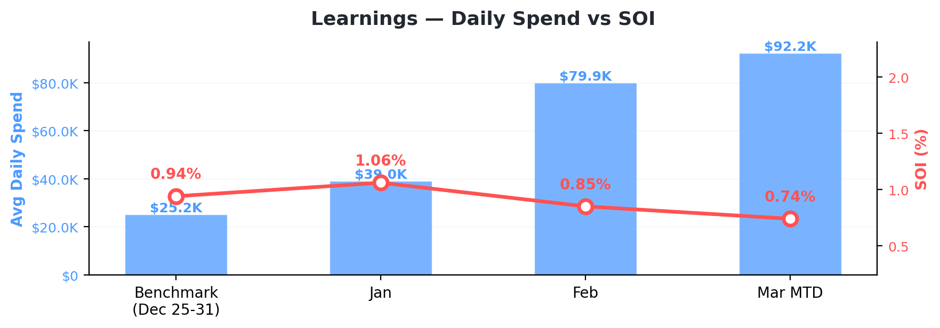
Learnings
Spend & SOI Trend Overview
Period | Total Spend | Avg Daily Spend | Moloco Installs | Non-Moloco Installs | SOI
BM | $176,174 | $25,168 | 103,478 | 10,888,905 | 0.94%
Jan | $1,210,105 | $39,036 | 554,959 | 51,649,161 | 1.06%
Feb | $2,237,231 | $79,901 | 600,105 | 69,769,279 | 0.85%
Mar | $1,198,582 | $92,199 | 264,535 | 35,486,514 | 0.74%

Slide 14
Learnings
SOI Impact by App (Benchmark → Mar)
SOI Impact = change in app's Moloco install share of total installs. Negative = unattributed installs growing faster. Highlighted = top spend apps (>=10% share).
App | BM SOI | Mar SOI | SOI Chg | Mar DRR | Spend % | Impact (pp)
Tile Explorer: Tiles Clear! | — | 4.08% | +4.08% | $14,113 | 15.3% | +0.070
Mystery Town - Merge & Cases | 1.05% | 7.84% | +6.78% | $12,779 | 13.8% | +0.016
Jigsawcard Solitaire Puzzle | — | 1.11% | +1.11% | $991 | 1.1% | +0.008
Wood Block Puzzle: Brain Games | — | 5.23% | +5.23% | $402 | 0.4% | +0.006
Zen Word® - Relax Puzzle Game | — | 0.72% | +0.72% | $494 | 0.5% | +0.006
Tile Explorer - Triple Match | — | 0.01% | +0.01% | $1,382 | 1.5% | +0.005
com.oakever.coloraura | 1.23% | 4.88% | +3.64% | $1,837 | 2.0% | +0.003
Solitaire Word Fun! | — | 1.67% | +1.67% | $391 | 0.4% | +0.003
Sudoku - Brain Puzzle Games | 0.48% | 1.38% | +0.90% | $869 | 0.9% | +0.002
com.oakever.solitaire.associat | — | 0.09% | +0.09% | $310 | 0.3% | +0.000
com.oakever.arrows | — | 0.02% | +0.02% | $71 | 0.1% | +0.000
Match Busters 3D Matching Game | 0.25% | 0.32% | +0.06% | $49 | 0.1% | -0.000
Bible Coloring Paint by Number | 1.16% | — | -1.16% | — | — | -0.001
Bible Coloring Paint By Number | 1.49% | — | -1.49% | — | — | -0.002
Vita Mahjong | 0.58% | 1.09% | +0.50% | $52,956 | 57.3% | -0.004
Solitaire Classic Puzzle Game | 14.04% | 7.23% | -6.81% | $649 | 0.7% | -0.004
Color Aura: Paint by Number | 1.63% | 1.54% | -0.09% | $173 | 0.2% | -0.007
Vita Solitaire for Seniors | 3.96% | 1.54% | -2.42% | $299 | 0.3% | -0.008
Jigsawscapes® - Jigsaw Puzzles | 0.46% | 0.27% | -0.19% | $751 | 0.8% | -0.014
Zen Color - Color By Number | 1.47% | 1.02% | -0.45% | $606 | 0.7% | -0.016
Sudoku - Classic Sudoku Puzzle | 1.43% | 1.31% | -0.12% | $1,859 | 2.0% | -0.042
Paint by Number Coloring Game | 5.22% | 2.65% | -2.57% | $498 | 0.5% | -0.049
Solitaire - Classic Card Games | 14.39% | 1.48% | -12.91% | $987 | 1.1% | -0.172

Slide 15
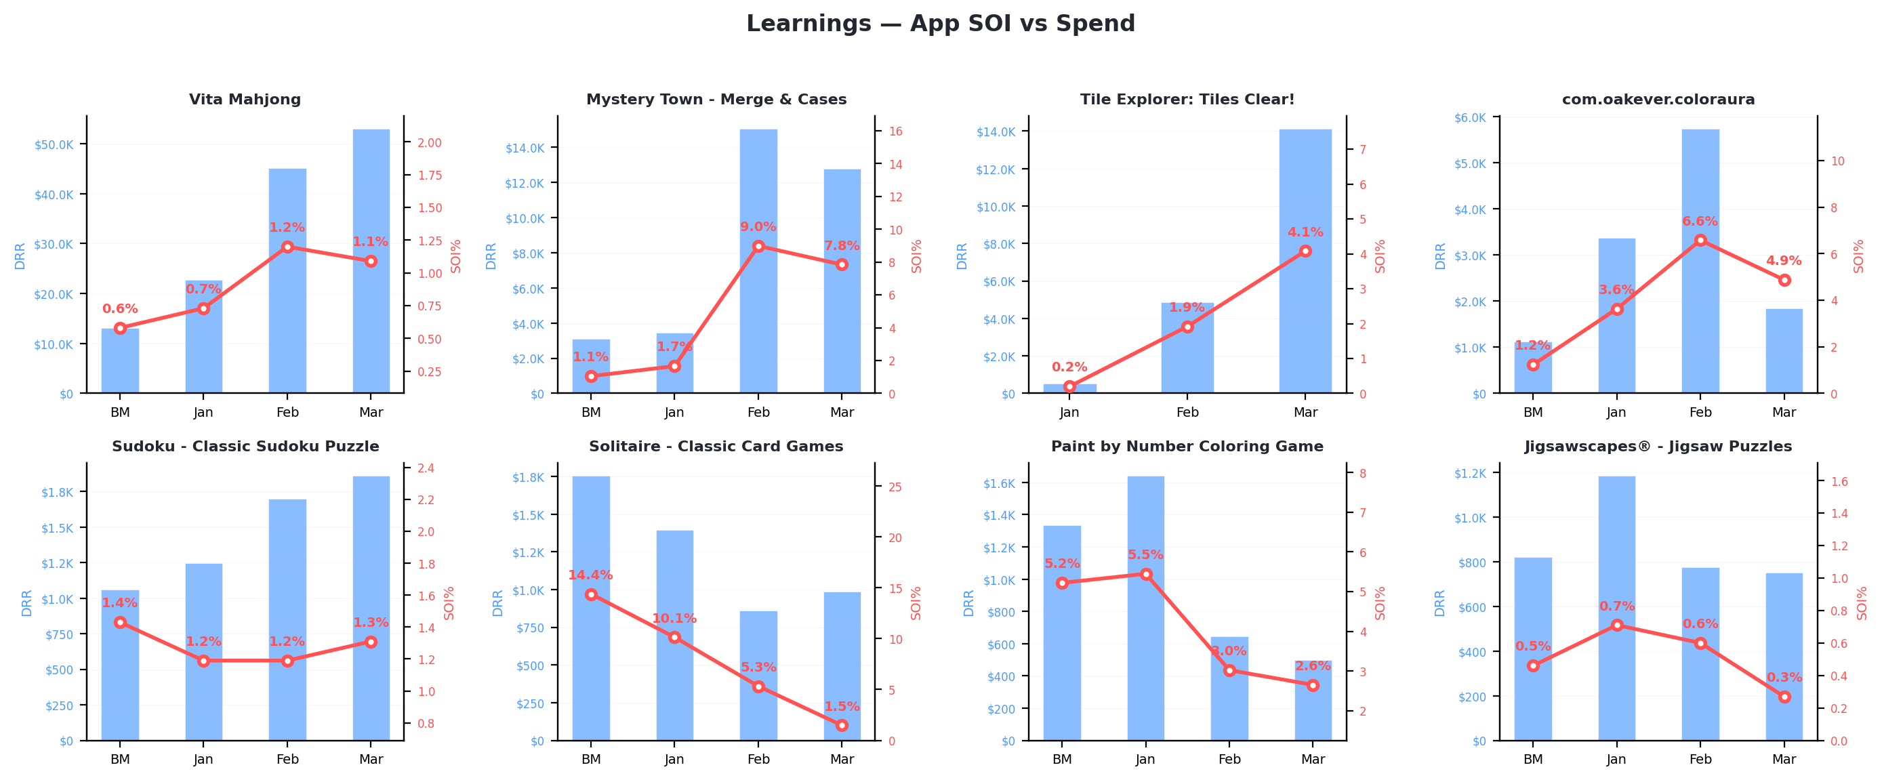
Learnings
App-Level SOI vs Spend

Slide 16
Learnings
App-Level Data: Benchmark vs Monthly Trend
App | BM DRR | BM SOI | Jan DRR | Jan SOI | Feb DRR | Feb SOI | Mar DRR | Mar SOI
Vita Mahjong | $13,136 | 0.58% | $22,684 | 0.73% | $45,149 | 1.20% | $52,956 | 1.09%
Mystery Town - Merge & Ca | $3,115 | 1.05% | $3,457 | 1.66% | $15,036 | 8.98% | $12,779 | 7.84%
Tile Explorer: Tiles Clea | — | — | $512 | 0.20% | $4,872 | 1.92% | $14,113 | 4.08%
com.oakever.coloraura | $1,119 | 1.23% | $3,376 | 3.63% | $5,734 | 6.58% | $1,837 | 4.88%
Sudoku - Classic Sudoku P | $1,062 | 1.43% | $1,247 | 1.19% | $1,699 | 1.19% | $1,859 | 1.31%
Solitaire - Classic Card | $1,753 | 14.39% | $1,393 | 10.14% | $863 | 5.33% | $987 | 1.48%
Paint by Number Coloring | $1,333 | 5.22% | $1,640 | 5.45% | $644 | 3.02% | $498 | 2.65%
Jigsawscapes® - Jigsaw Pu | $819 | 0.46% | $1,184 | 0.71% | $776 | 0.60% | $751 | 0.27%
Zen Color - Color By Numb | $905 | 1.47% | $1,109 | 1.29% | $819 | 1.17% | $606 | 1.02%
Sudoku - Brain Puzzle Gam | $501 | 0.48% | $501 | 0.44% | $735 | 0.85% | $869 | 1.38%
Color Aura: Paint by Numb | $600 | 1.63% | $1,025 | 2.69% | $785 | 2.87% | $173 | 1.54%
Jigsawcard Solitaire Puzz | — | — | $536 | 1.90% | $1,017 | 1.14% | $991 | 1.11%
Solitaire Classic Puzzle | $382 | 14.04% | $463 | 12.73% | $554 | 11.99% | $649 | 7.23%
Tile Explorer - Triple Ma | — | — | — | — | $546 | 0.01% | $1,382 | 0.01%
Vita Solitaire for Senior | $150 | 3.96% | $302 | 1.99% | $210 | 2.13% | $299 | 1.54%
com.oakever.solitaire.ass | — | — | — | — | $457 | 0.36% | $310 | 0.09%
Solitaire Word Fun! | — | — | — | — | $166 | 0.76% | $391 | 1.67%
Zen Word® - Relax Puzzle | — | — | — | — | — | — | $494 | 0.72%
Wood Block Puzzle: Brain | — | — | — | — | $84 | 1.94% | $402 | 5.23%
com.oakever.jigsawcard | — | — | $153 | 2.58% | $141 | 0.01% | — | —
Match Busters 3D Matching | $50 | 0.25% | $50 | 0.33% | $50 | 0.26% | $49 | 0.32%
Bible Coloring Paint by N | $168 | 1.16% | — | — | — | — | — | —
Bible Coloring Paint By N | $123 | 1.49% | — | — | — | — | — | —
com.oakever.arrows | — | — | — | — | — | — | $71 | 0.02%

Slide 17
ZerooGravity
Spend Up + SOI Down Analysis

Slide 18
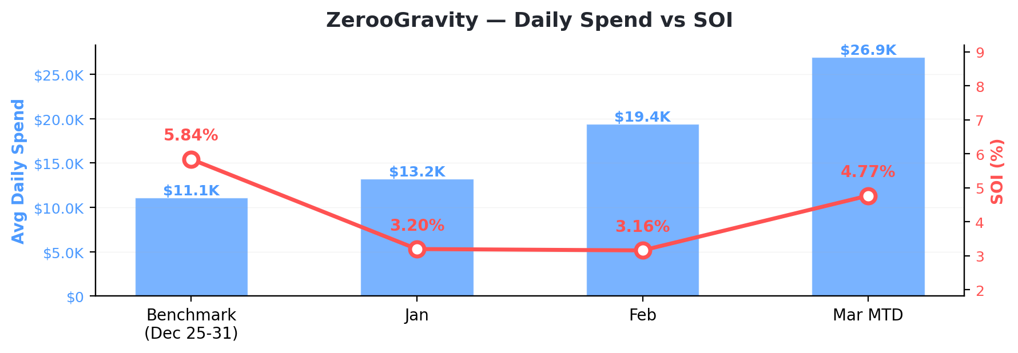
ZerooGravity
Spend & SOI Trend Overview
Period | Total Spend | Avg Daily Spend | Moloco Installs | Non-Moloco Installs | SOI
BM | $77,701 | $11,100 | 3,392 | 54,651 | 5.84%
Jan | $409,079 | $13,196 | 20,854 | 630,342 | 3.20%
Feb | $543,533 | $19,412 | 25,208 | 772,550 | 3.16%
Mar | $350,001 | $26,923 | 13,843 | 276,236 | 4.77%

Slide 19
ZerooGravity
SOI Impact by App (Benchmark → Mar)
SOI Impact = change in app's Moloco install share of total installs. Negative = unattributed installs growing faster. Highlighted = top spend apps (>=10% share).
App | BM SOI | Mar SOI | SOI Chg | Mar DRR | Spend % | Impact (pp)
Jackpot Master™ Slots-Casino | — | 7.36% | +7.36% | $3,852 | 14.3% | +0.744
Jackpot Master™ Slots - Casino | — | 2.31% | +2.31% | $2,275 | 8.5% | +0.571
Jackpot Friends™ Slots Casino | — | 2.67% | +2.67% | $697 | 2.6% | +0.205
Carnival Tycoon: Coin Games | — | 0.23% | +0.23% | $118 | 0.4% | +0.057
Jackpot Friends™-Slots Casino | 5.03% | 8.24% | +3.21% | $3,872 | 14.4% | -0.936
Cash Tornado™ Slots - Casino | 6.20% | 10.07% | +3.87% | $16,109 | 59.8% | -1.713

Slide 20
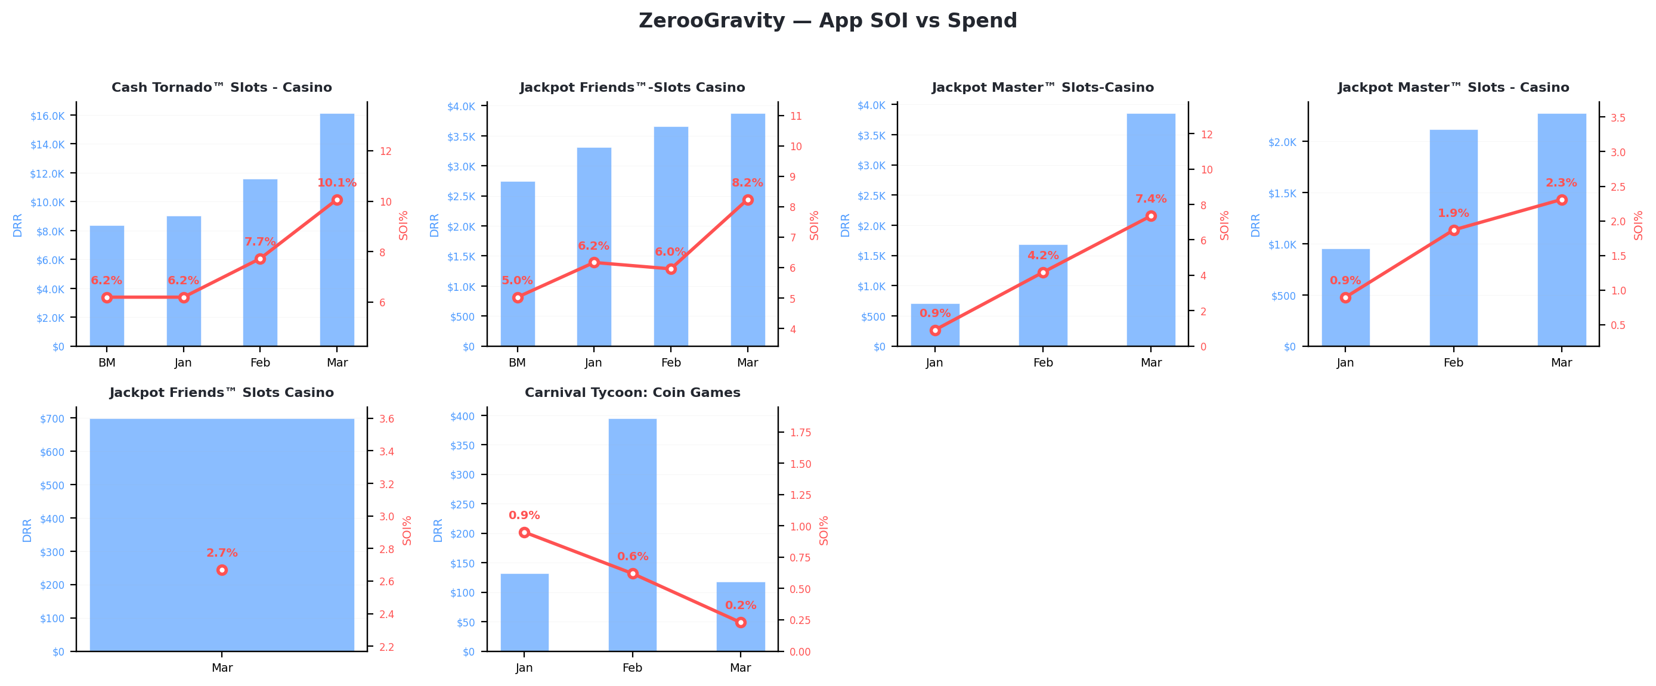
ZerooGravity
App-Level SOI vs Spend

Slide 21
ZerooGravity
App-Level Data: Benchmark vs Monthly Trend
App | BM DRR | BM SOI | Jan DRR | Jan SOI | Feb DRR | Feb SOI | Mar DRR | Mar SOI
Cash Tornado™ Slots - Cas | $8,355 | 6.20% | $9,029 | 6.20% | $11,561 | 7.73% | $16,109 | 10.07%
Jackpot Friends™-Slots Ca | $2,745 | 5.03% | $3,306 | 6.17% | $3,656 | 5.96% | $3,872 | 8.24%
Jackpot Master™ Slots-Cas | — | — | $705 | 0.91% | $1,682 | 4.17% | $3,852 | 7.36%
Jackpot Master™ Slots - C | — | — | $953 | 0.90% | $2,119 | 1.87% | $2,275 | 2.31%
Jackpot Friends™ Slots Ca | — | — | — | — | — | — | $697 | 2.67%
Carnival Tycoon: Coin Gam | — | — | $132 | 0.95% | $394 | 0.62% | $118 | 0.23%

Slide 22
Mattel163_China
Spend Up + SOI Down Analysis

Slide 23
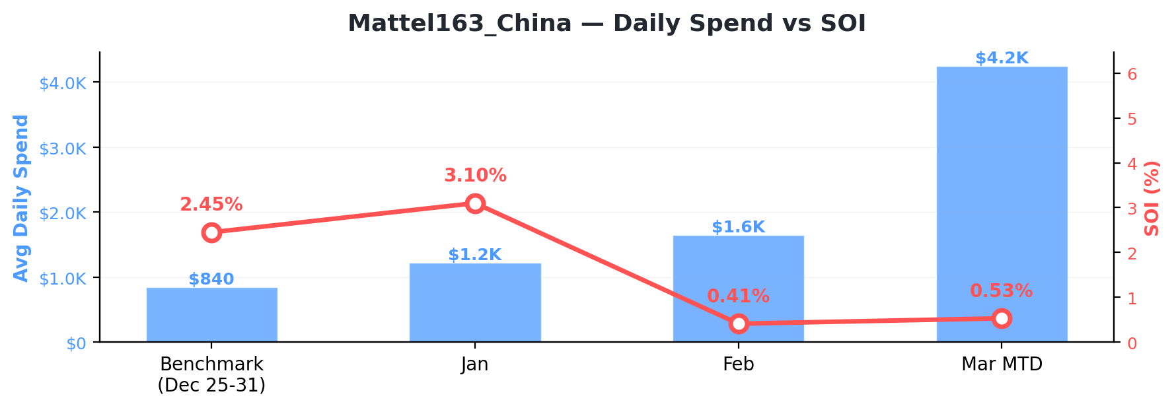
Mattel163_China
Spend & SOI Trend Overview
Period | Total Spend | Avg Daily Spend | Moloco Installs | Non-Moloco Installs | SOI
BM | $5,882 | $840 | 1,258 | 49,992 | 2.45%
Jan | $37,742 | $1,217 | 7,148 | 223,265 | 3.10%
Feb | $46,172 | $1,649 | 9,871 | 2,398,469 | 0.41%
Mar | $55,147 | $4,242 | 13,101 | 2,469,120 | 0.53%

Slide 24
Mattel163_China
SOI Impact by App (Benchmark → Mar)
SOI Impact = change in app's Moloco install share of total installs. Negative = unattributed installs growing faster. Highlighted = top spend apps (>=10% share).
App | BM SOI | Mar SOI | SOI Chg | Mar DRR | Spend % | Impact (pp)
UNO!™ | — | 0.41% | +0.41% | $1,997 | 47.1% | +0.388
Skip-Bo™: Solitaire Card Game | 2.45% | 3.19% | +0.74% | $2,246 | 52.9% | -2.315

Slide 25
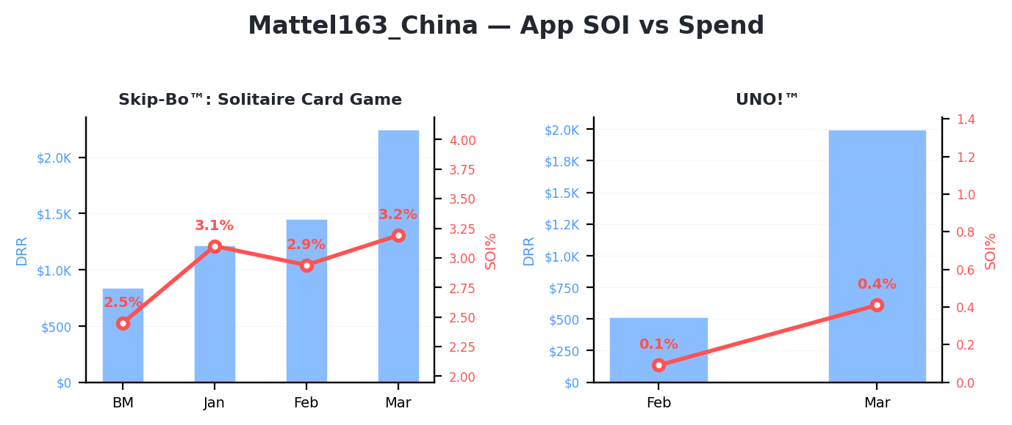
Mattel163_China
App-Level SOI vs Spend

Slide 26
Mattel163_China
App-Level Data: Benchmark vs Monthly Trend
App | BM DRR | BM SOI | Jan DRR | Jan SOI | Feb DRR | Feb SOI | Mar DRR | Mar SOI
Skip-Bo™: Solitaire Card | $840 | 2.45% | $1,217 | 3.10% | $1,448 | 2.94% | $2,246 | 3.19%
UNO!™ | — | — | — | — | $511 | 0.09% | $1,997 | 0.41%

