Slide 1
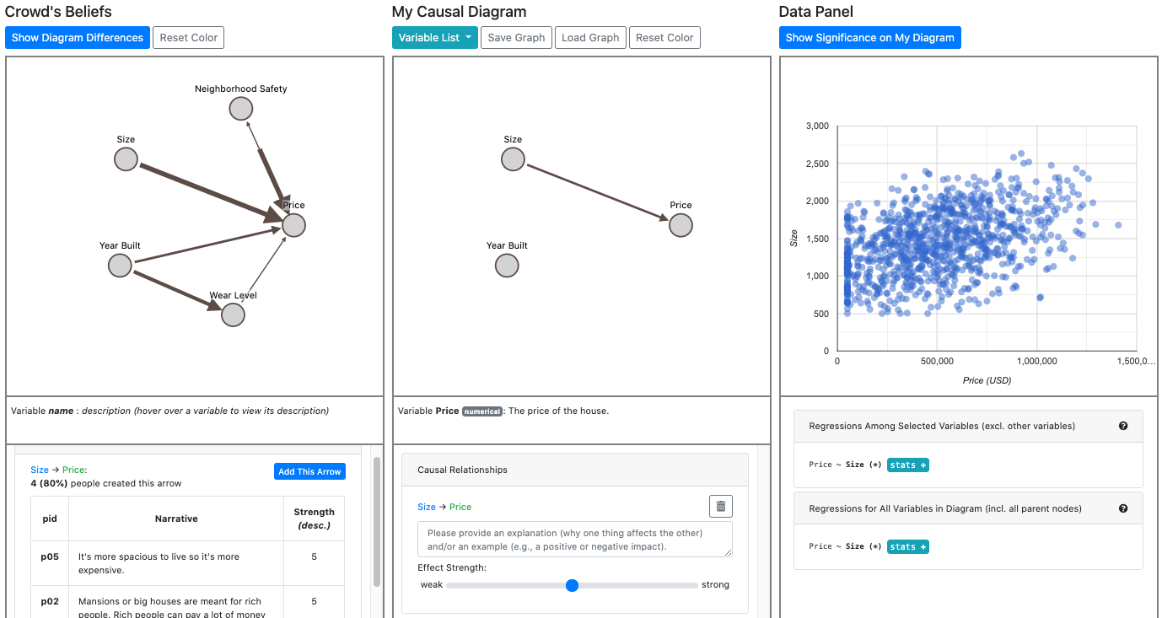
Compare your diagram with the crowd’s
Show significance effects on your diagram
Review other people’s narrative and ratings
Check detailed statistics

Slide 2
Show significance effects on your diagram
Check detailed statistics

Slide 3
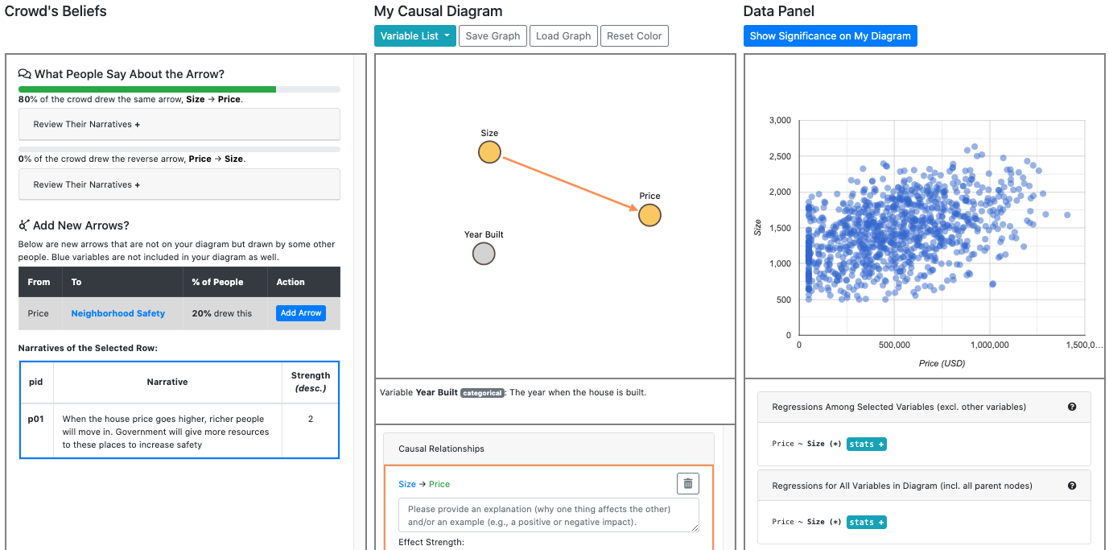
See how other people think about the selected arrow
Show significance effects on your diagram
Find new arrows to add drawn by others
Check detailed statistics

