Slide 1
Bank Marketing Dataset
https://archive.ics.uci.edu/ml/datasets/Bank+Marketing#

Slide 2
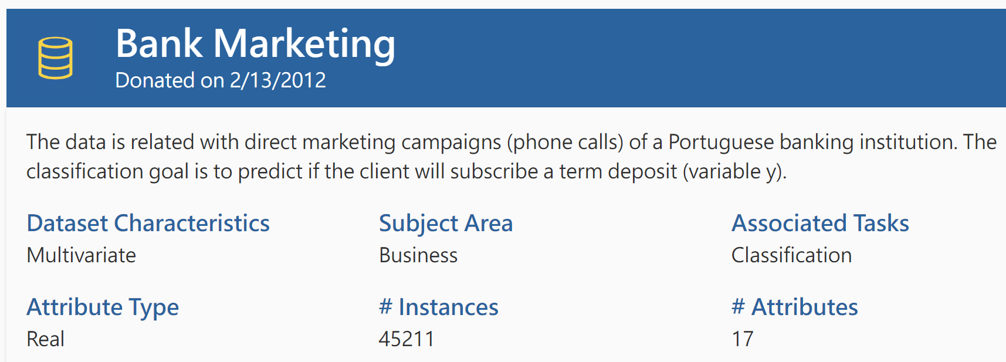
Abstract
The data is related with direct marketing campaigns of a Portuguese banking institution.
The marketing campaigns were based on phone calls.
Often, more than one contact to the same client was required, in order to access if the product (bank term deposit) would be ('yes') or not ('no') subscribed.
Notes:
通常，需要與同一個客戶進行多次聯繫，以便訪問是否要訂購該產品

Slide 3
Dataset Information
We use first data to do analysis.
Index | Dataset | Information
1 | bank-additional-full.csv | all examples (41188) and 20 inputs ordered by date (from May 2008 to November 2010)
2 | bank-additional.csv | 10% of the examples (4119), randomly selected from 1)
3 | bank-full.csv | all examples and 17 inputs (older version of this dataset with less inputs)
4 | bank.csv | 10% of the examples and 17 inputs, randomly selected from 3 (older version of this dataset with less inputs)

Slide 4
Attributes
# Bank client data:
Variables | Type | Information | Variables | Type | Information
age | Numeric | 17 - 98 | default | Categorical | Has credit in default?
job | Categorical | Types of job | housing | Categorical | Has housing Loan?
marital | Categorical | Marital status | loan | Categorical | Has personal loan?
education | Categorical | Degree of education
Notes:
Default: 是否已拖欠信用額？ 違約是未能償還貸款或抵押品的債務，包括利息或本金。當借款人無法及時付款，未付款或無法付款或停止付款時，就會發生違約。如果個人，企業甚至國家不能履行其債務義務，則它們可能會違約。違約風險通常由債權人預先計算。

Slide 5
Attributes
# Related with the last contact of the current campaign
Variables | Type | Information
contact | Categorical | Contact communication type
month | Categorical | Last contact month of year
day_of_week | Categorical | Last contact day of the week
duration | Numeric | Last contact duration, in seconds.
Notes:
聯繫方式: 行動網路、電話
該年最後一次聯繫的月份
該週最後一次聯繫的日子
最後一次聯繫持續的時間(秒)

Slide 6
Attributes
# Other attributes:
Variables | Type | Information
campaign | Numeric | Number of contacts performed during this campaign and for this client
pdays | Numeric | Number of days that passed by after the client was last contacted from a previous campaign
previous | Numeric | Number of contacts performed before this campaign and for this client
poutcome | Categorical | Outcome of the previous marketing campaign
Notes:
在此廣告活動期間與該客戶聯繫次數
上次廣告活動與該客戶最後一次聯繫之後經過的天數
在廣告活動之前與該客戶聯繫次數
先前營銷活動的結果 'failure','nonexistent','success'

Slide 7
Attributes
# Social and economic context attributes
Variables | Type | Information
emp.var.rate | Numeric | Employment variation rate - quarterly indicator
cons.price.idx | Numeric | Consumer price index - monthly indicator
cons.conf.idx | Numeric | Consumer confidence index - monthly indicator
euribor3m | Numeric | Euribor 3 month rate - daily indicator
nr.employed | Numeric | Number of employees - quarterly indicator
Notes:
就業變動率_季度指標
消費者物價指數_月度指標
消費者信心指數_月度指標 主要是為了瞭解消費者對經濟環境的信心強弱程度，透過抽樣調查，反應消費者對目前與往後六個月的經濟景氣、就業情況與個人財務狀況的感受和看法。
Euro Interbank Offered Rate (Euribor) 是報價銀行(the panelbanks)彼此拆借資金的利率。每日計算，並於中央歐洲時間11:00公布。 Euribor有十五個到期日，分別為 1, 2 and 3 weeks and 1, 2, 3, 4, 5, 6, 7, 8, 9, 10, 11 and 12 months. 同業拆借（放）指的是銀行及非銀行金融機構之間為了解決短期內出現的資金餘缺而進行的相互調劑。
員工人數-季度指標

Slide 8
Attributes
# Output variable (desired target)
Variables | Type | Information
Y | Binary | Has the client subscribed a term deposit?
Notes:
客戶是否已訂閱定期存款? Y/N

