Slide 1
Clipper: A low-latency online prediction serving system
Paper Critic
Shangru Yi
2020.02.04

Slide 2
``Clipper: A Low-Latency Online Prediction Serving System‘’ is a system paper in NSDI'17. Machine learning is being deployed in a growing number of applications which demand real-time, accurate, and robust predictions under heavy query load. Model deployment and prediction-serving have received relatively little attention. Within this paper, a general-purpose low-latency prediction serving system, Clipper, is proposed.
Contribution with critics
Evaluation critics

Slide 3
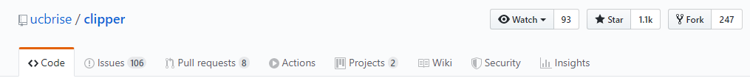
Main Contributions
Model abstraction and modular design with common prediction interface to simplify model deployment (for the changing state-of-art)
Model abstraction
Simplified model deployment
A great effort for heterogeneous model deployment but might not be necessary.
Specific optimization for uniform eco-system, TensorFlow and TensorFlow Serving
The improvement in prevailing machine learning serving system.
Different possible design target for different machine learning platform. (TensorFlow for neural network and HKT for speech recognition)
Notes:
maybe one main platform is enough for problem addressment. And there are possible some specific optimization for uniform eco-system, such as TensorFlow model and TensorFlow Serving.

Slide 4
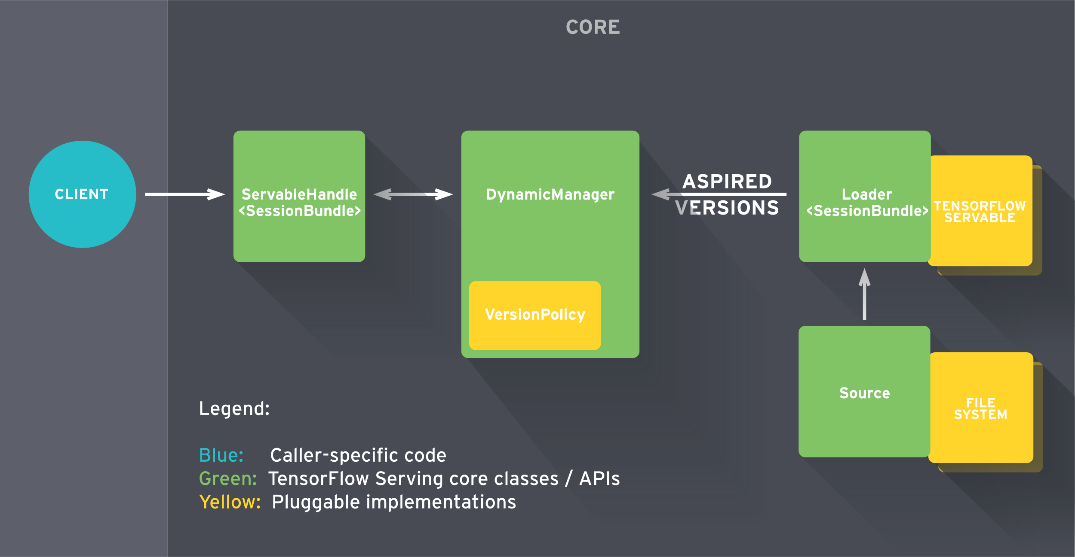
Main Contributions
Maximize the use of batch (dynamic batching) and straggler mitigation techniques to reduce bound tail latency
Dynamic batching (AIMD)
Straggler mitigation
The improvement in prevailing machine learning system, such as TensorFlow serving.
Although it is interesting to the dynamic control of batch size, this technique is not unique but a borrowed notion from control theory.
“enabling fresh algorithm configurations, weights, and other data to be loaded over time. Client may request for a specific version id.”
Notes:
maybe one main platform is enough for problem addressment. And there are possible some specific optimization for uniform eco-system, such as TensorFlow model and TensorFlow Serving.

Slide 5
Main Contributions
Enable online model selection for addressing different features and prediction combine
Online model integration
Different model serving
1. Introduce internal computation burden, comparing with one model.
2. Extra effort to perform model selection by introducing weights. Multiple models require to run simultaneously, which is possible a heavy burden.
3. Computation intensive, while A/B testing is data-intensive.
Notes:
maybe one main platform is enough for problem addressment. And there are possible some specific optimization for uniform eco-system, such as TensorFlow model and TensorFlow Serving.

Slide 6
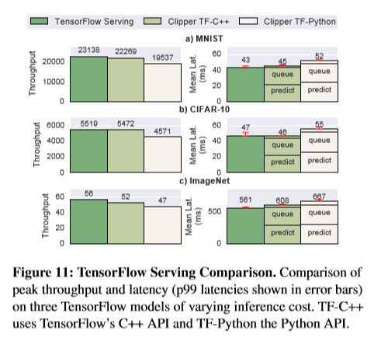
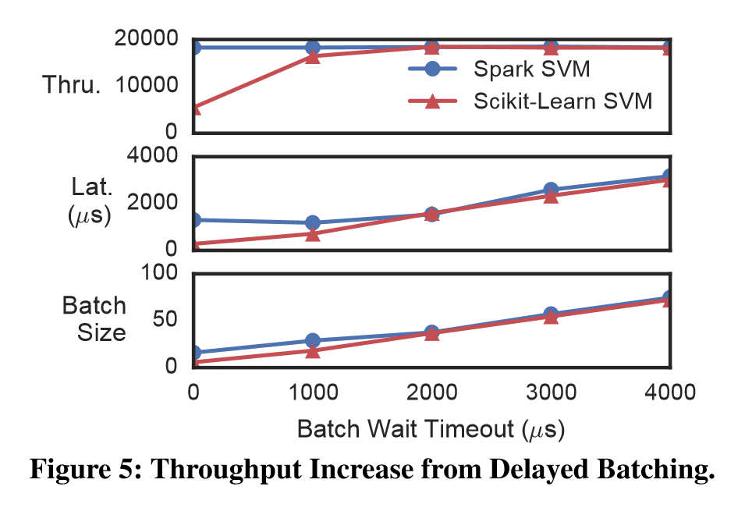
Experiments
The evaluation are performed in a single server and present large-scale machine learning systems are in distributed manner, there is possible scaling and communication concerns for this system.
From the experiments, the performance of TensorFlow Serving are better than this proposed system.

Slide 7
Reference
Crankshaw, Daniel, et al. "Clipper: A low-latency online prediction serving system." 14th {USENIX} Symposium on Networked Systems Design and Implementation ({NSDI} 17). 2017.
Abadi, Martín, et al. "Tensorflow: A system for large-scale machine learning." 12th {USENIX} Symposium on Operating Systems Design and Implementation ({OSDI} 16). 2016.

