Slide 1
Neural Network Viz & Generalization
CS8803 Project Mid-Point Progress
Shangru Yi (syi73)
2020.03.31 – Mid Point

Slide 2
Background & Motivation
State-of-Art
NN Model Abstraction
Heterogeneous Programming
TensorBoard
Azure Machine Learning Studio
Skyline (MLSys 20’)
Proposed Solutions
Project Timeline
High-level Abstraction
Formatted Model Representation
State-of-art Combination
Implementation Timeline
Status Update & On-going
Possible Evaluation (Generality & Easiness)
Notes:
Ashier

Slide 3
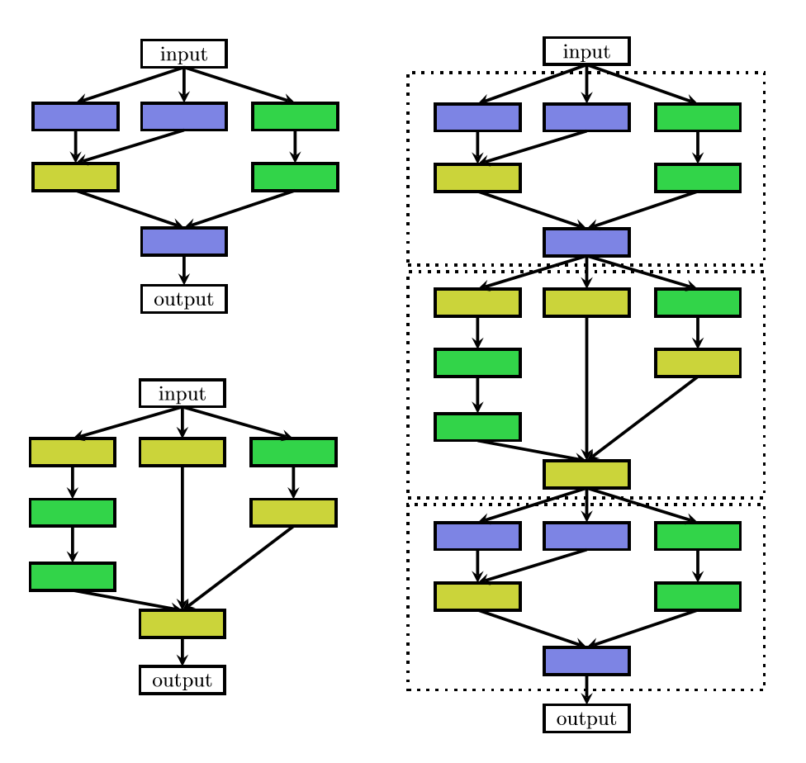
Problem Introduction
“Motivated by hand-crafted architectures consisting of repeated motifs, lots of paper in Neural Architecture Search are proposed to search for such motifs, dubbed cells or blocks. The final architecture is built by stacking these cells in a predefined manner – with search space reduction, more data adaption, useful strategy.”
- Neural Architecture Search: A Survey
What can we improve?
Abstraction
Code Reusage
Readable Structed Programming
Combination with Current Platforms

Slide 4
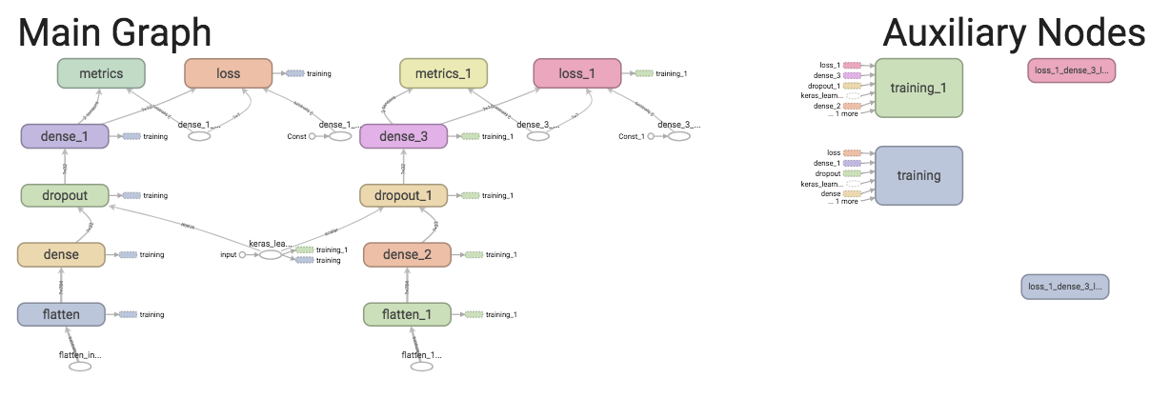
State-of-Art: TensorBoard
Machine learning invariably involves understanding key metrics such as loss and how they change as training progresses. These metrics can help to monitor the training, e.g. checking overfitting if the training is too long.
Graphs dashboard is a powerful tool for examining TensorFlow model, i.e. viewing a conceptual graph of model’s structure and ensure it matches the intended design.
Scalars Dashboard allows one to visualize these metrics using a simple API with little effort.

Slide 5
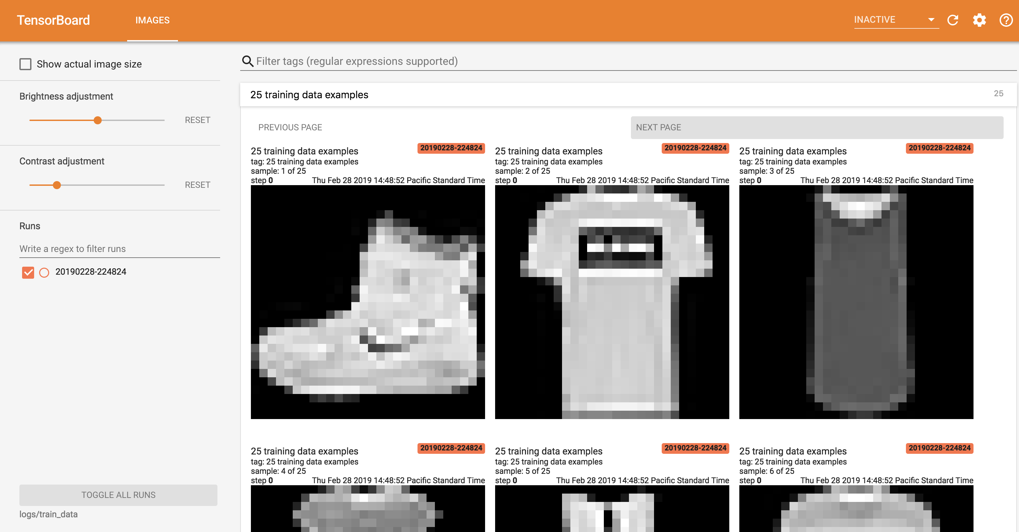
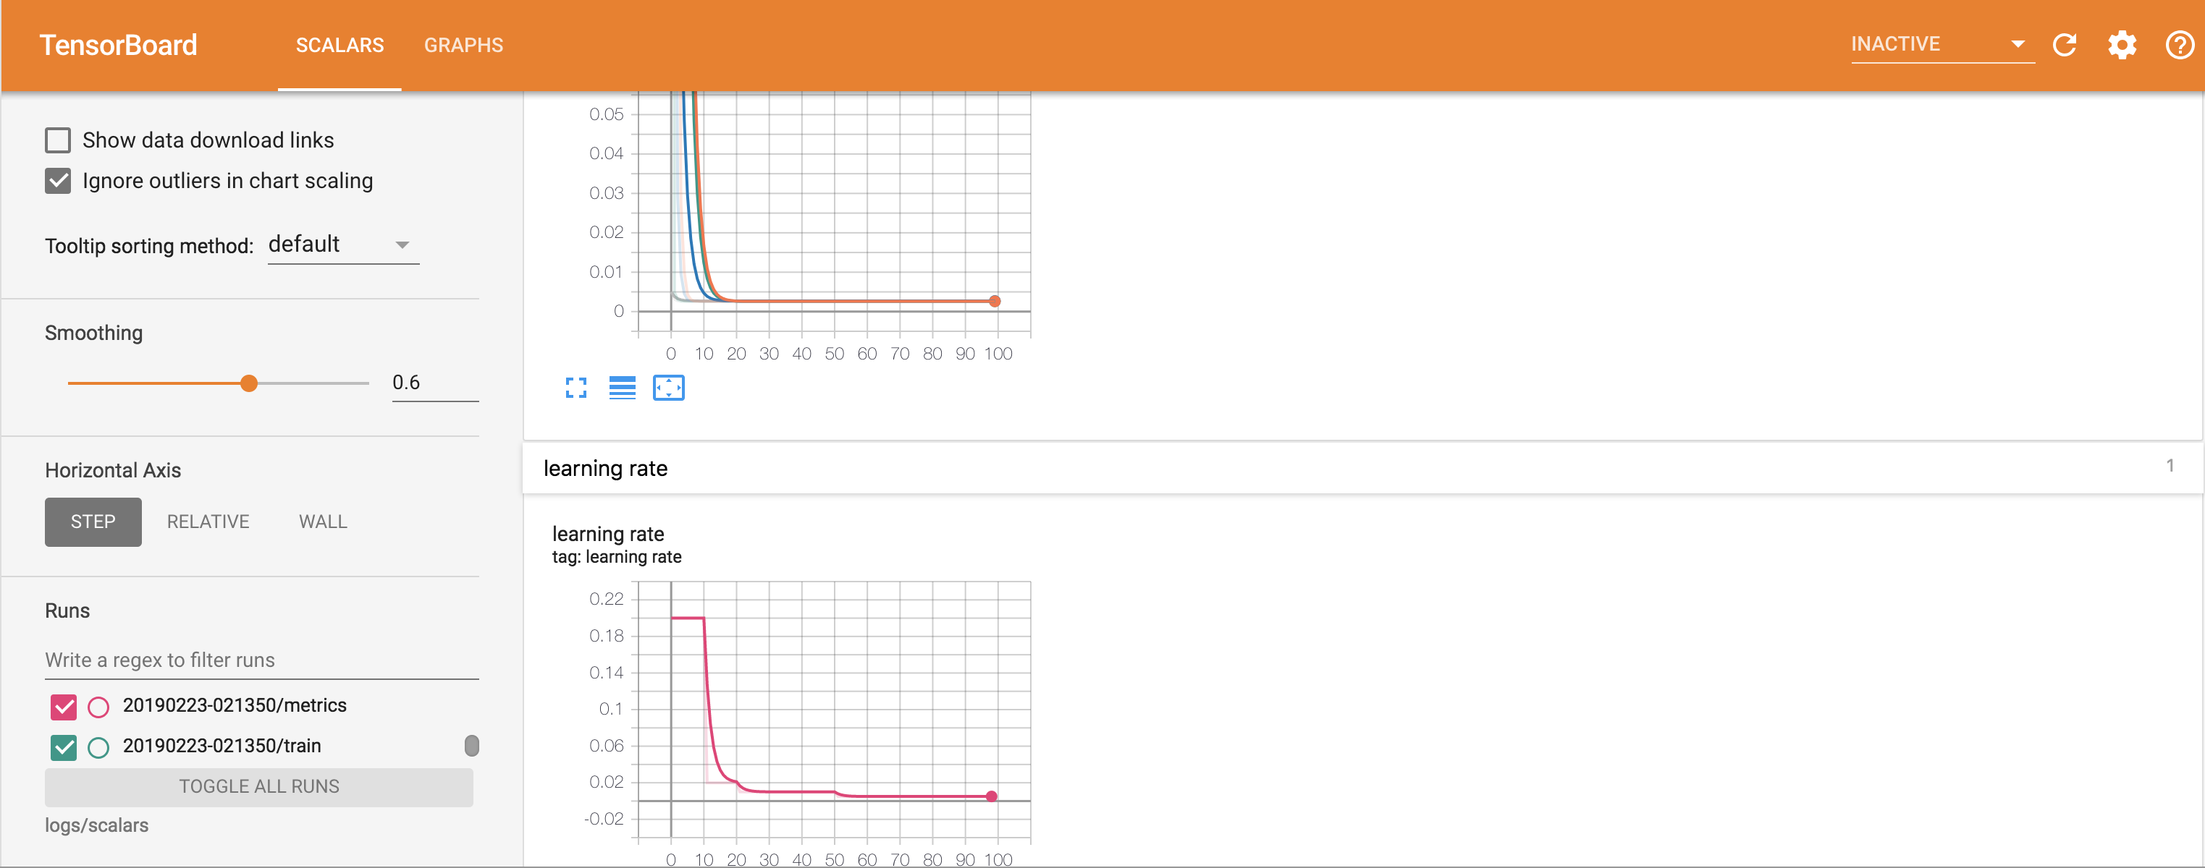
State-of-Art: TensorBoard
Machine learning invariably involves understanding key metrics such as loss and how they change as training progresses. These metrics can help to monitor the training, e.g. checking overfitting if the training is too long.
Graphs dashboard is a powerful tool for examining TensorFlow model, i.e. viewing a conceptual graph of model’s structure and ensure it matches the intended design.
Scalars Dashboard allows one to visualize these metrics using a simple API with little effort.
Good Visualization
Layer Abstraction?
Training Monitor?

Slide 6
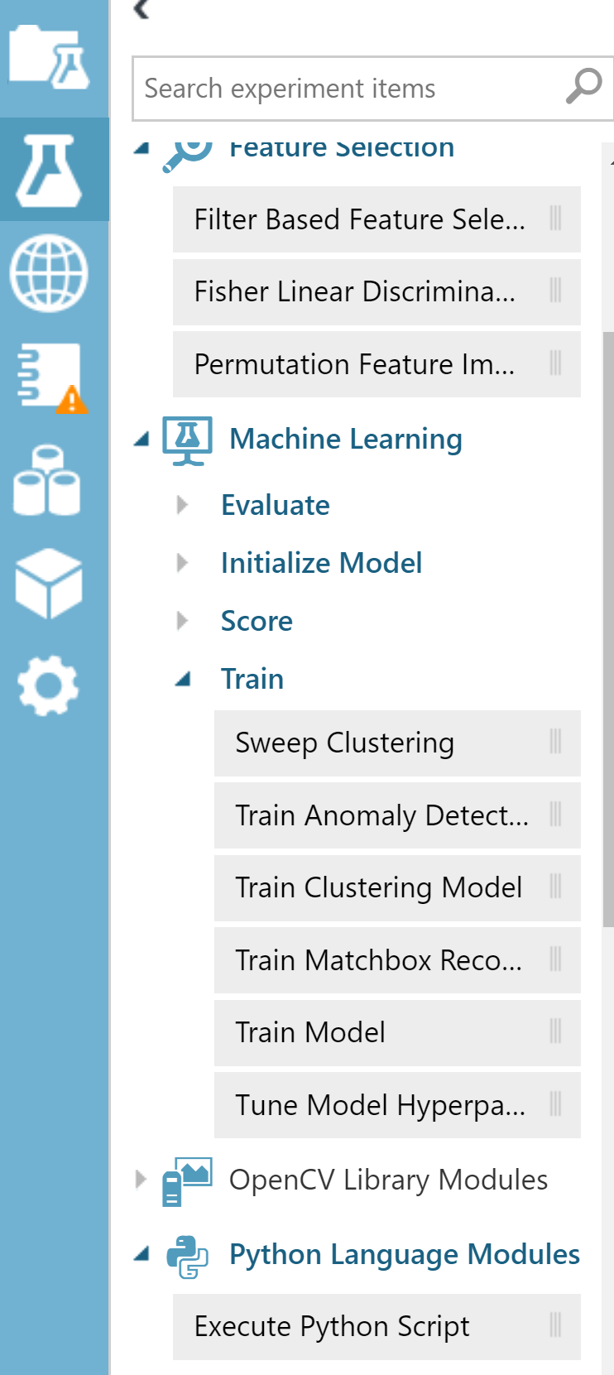
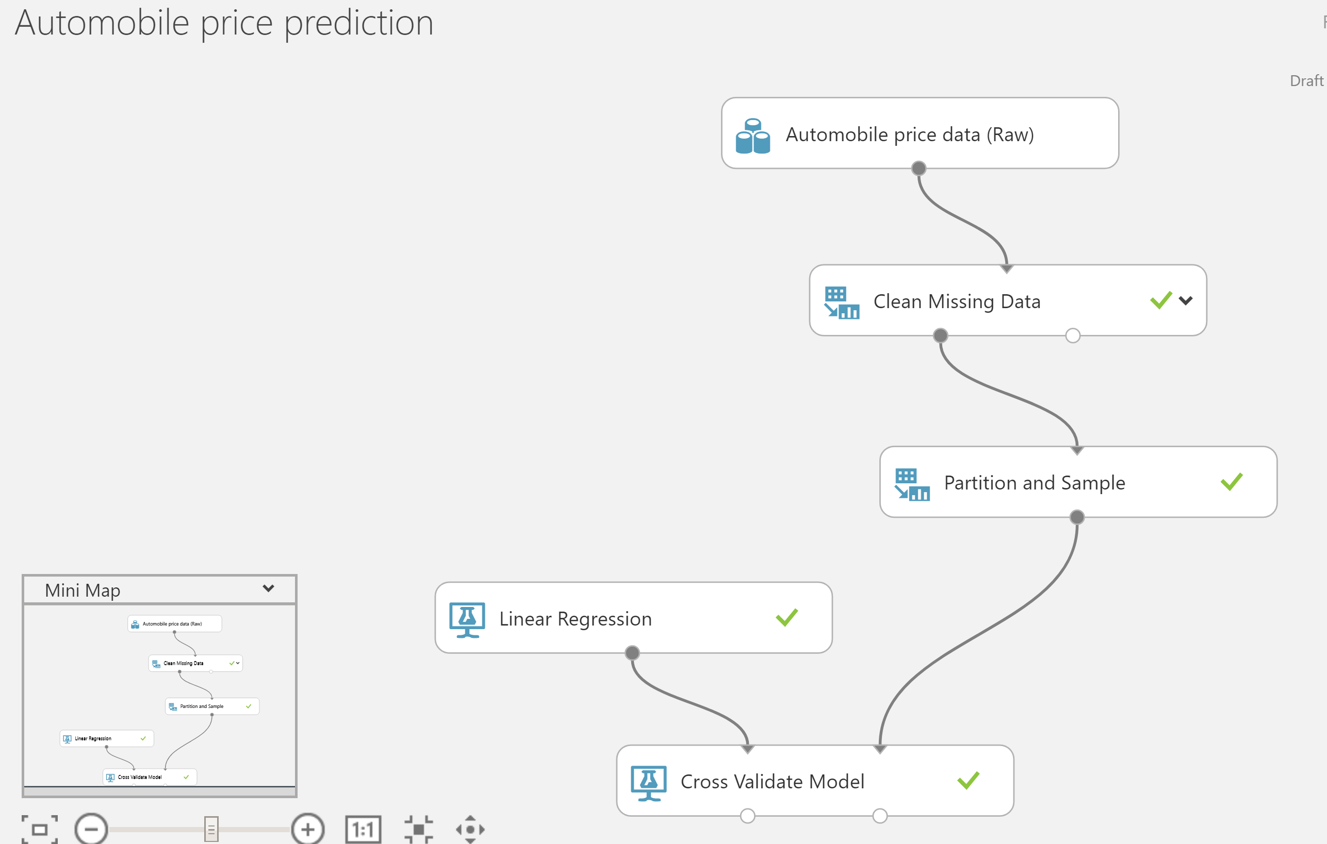
State-of-Art: Azure Machine Learning Studio
Azure Machine Learning Studio is a GUI-based integrated development environment for constructing and operationalizing Machine Learning workflow on Azure. It is a collaborative, drag-and-drop tool that one can use to build, test, and deploy predictive analytics solutions on various data.
Good Generalization
Easy Drag and Place
Traditional ML?
Current Platforms?
Notes:
Ashier

Slide 7
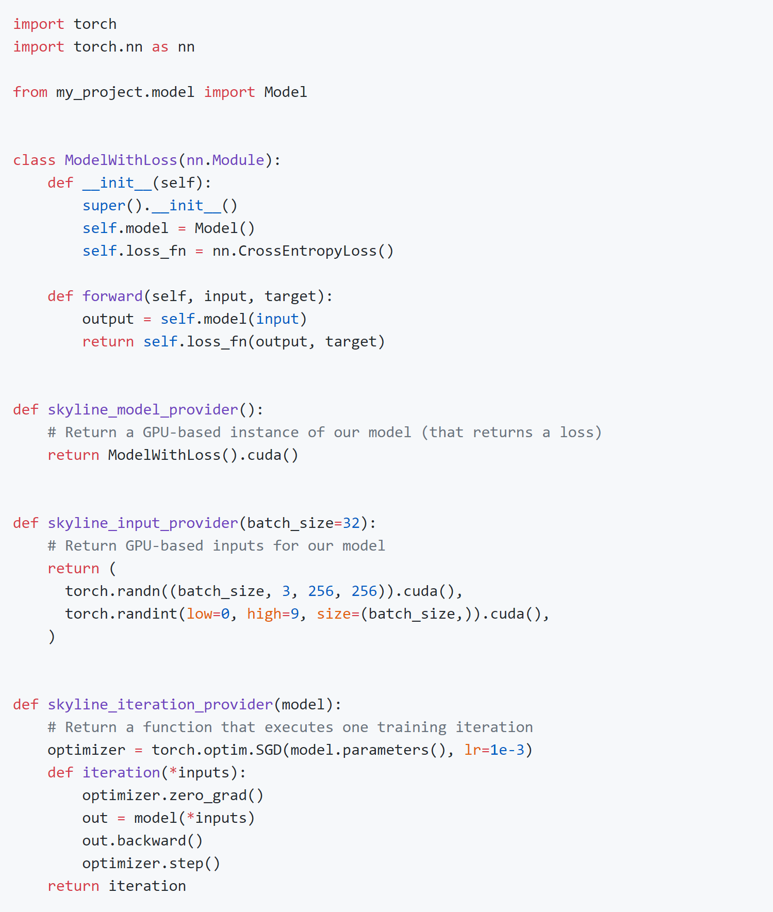
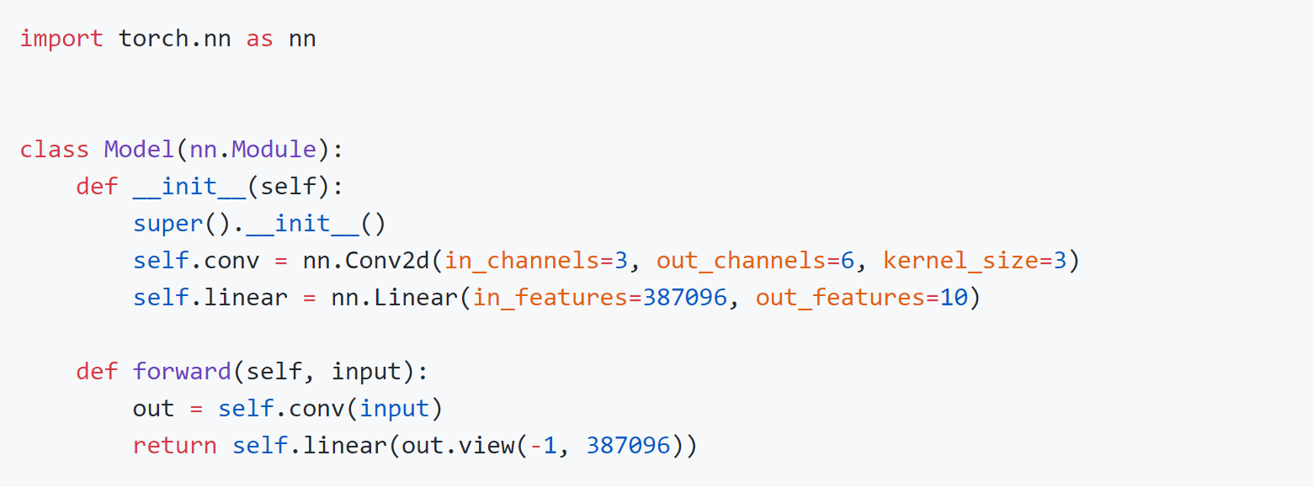
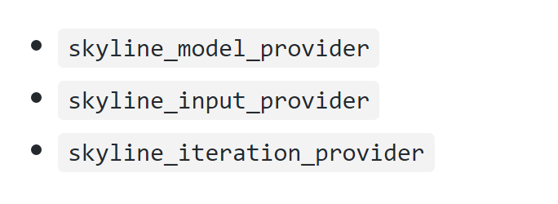
State-of-Art:Skyline (MLSys 20’)
Skyline is a tool used with Atom to profile, visualize, and debug the training performance of PyTorch neural networks.
Binding with PyTorch
On-training Metrics Vis?
Model Structure Vis?

Slide 8
What is Expected?
State-of-art Summary
Low level generalization & abstraction
On-training metrics monitoring - visualization
Not combination with current mainstream platforms
Traditional machine learning (Not NN)
Lack of model structure visualization
Falsifiable Hypothesis
Visualized programming for neural network and user interactions are achievable.
A unified representation format for cross-platform is possible
Above-layer abstraction can speedup model construction and pattern re-usage.
Higher level debugging with possible fine-grained hardware assignment can be solved in an easy way with visualization.
Combination with current in-progress training visualization can bring more convenience.

Slide 9


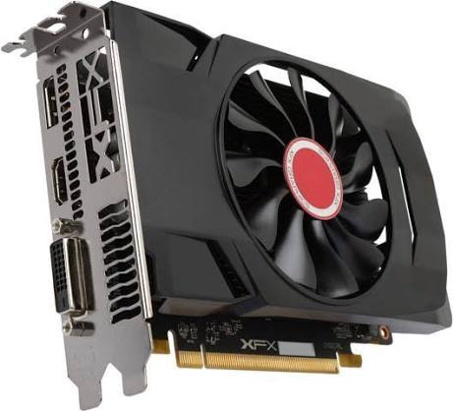

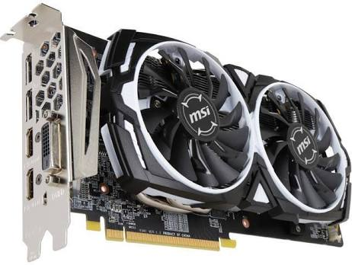
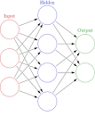
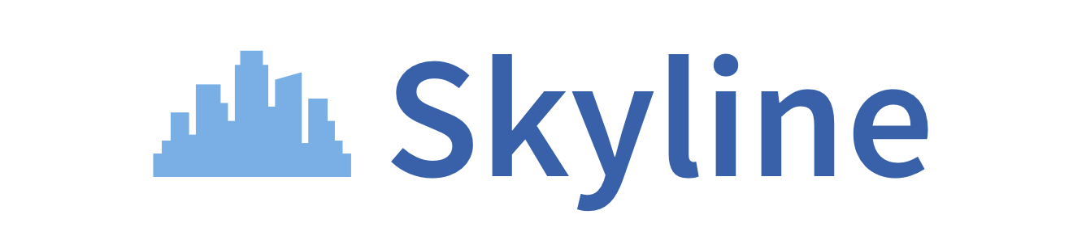
What is Expected?
State-of-art Summary
Low level generalization & abstraction
On-training metrics monitoring - visualization
Not combination with current mainstream platforms
Traditional machine learning (Not NN)
Lack of model structure visualization
What we expect?
Visualized programming
Unified representation format
Above-layer abstraction
Higher level debugging
Hardware assignment
Binding with current platforms – with possible adjustments
Cross Platforms

Slide 10


Proposed Solutions
React + D3
PyTorch + Skyline
Front end visualization
User interactions
Input & output
Bind PyTorch function and argument
Parse parameter to formatted model file and readable programming file
Parse exported model files for further changes
On-training monitoring
Parsing generated model
API provider
Modify Skyline for block supports (if we can do that, otherwise use torch.cuda)

Slide 11
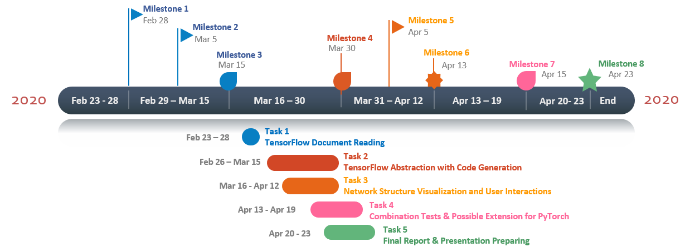
Project Timeline
Previous Agenda
Previous mainly for Tensorflow and Keras

Slide 12
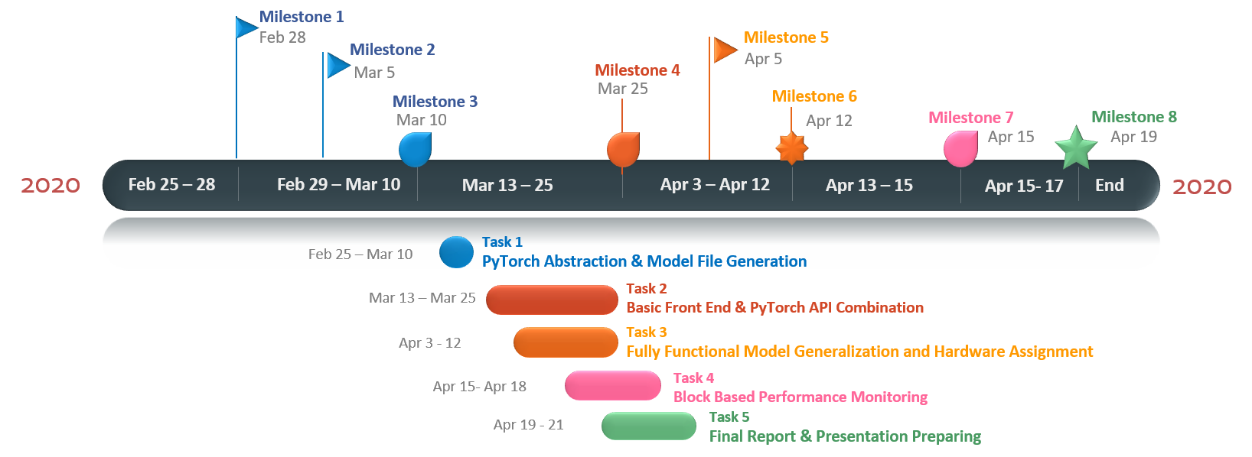
Project Timeline
Not Tensorflow
Add possible supports for Skyline or …

Slide 13
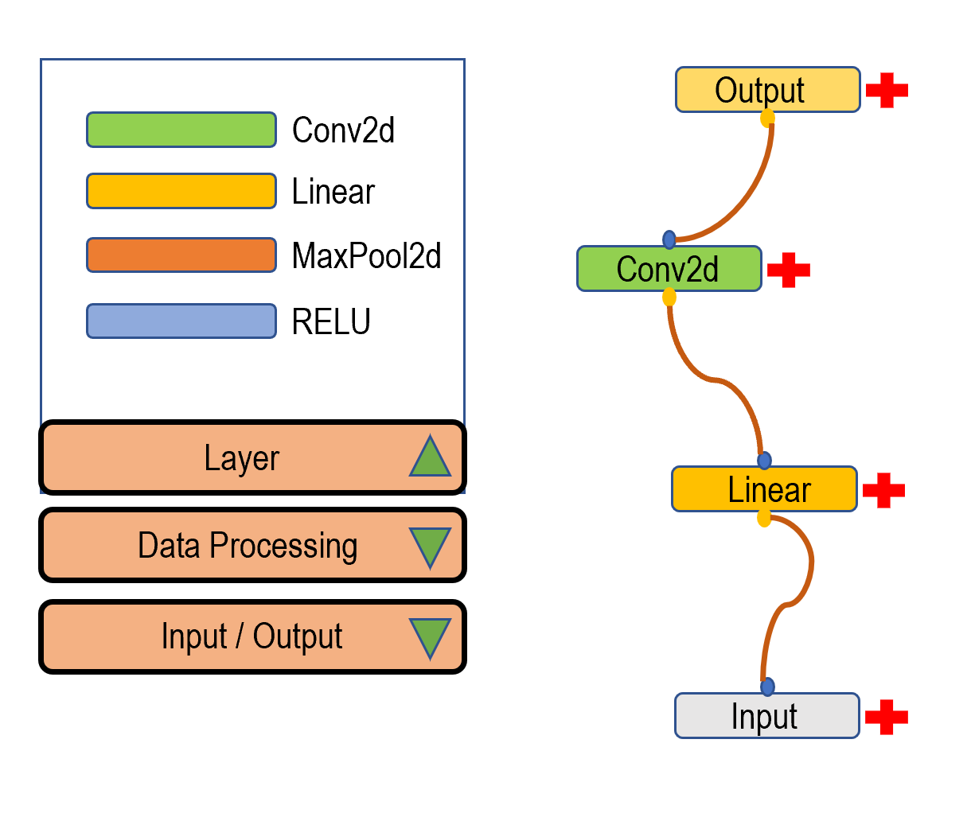
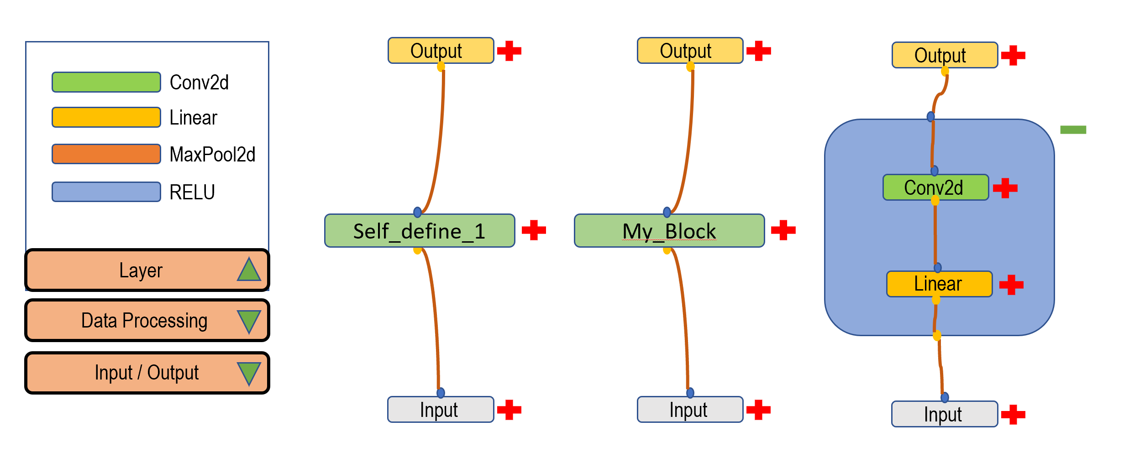
Status Update & On-going
Front end visualization (basic)
User interactions – layer construction
Input & output – finish address binding
Bind PyTorch function and argument – refining
Parse parameter to formatted model file and readable programming file – ongoing
On-training monitoring (Skyline)
Parsing generated model – JSON
Modify Skyline for blocks monitoring – reading ongoing

Slide 14
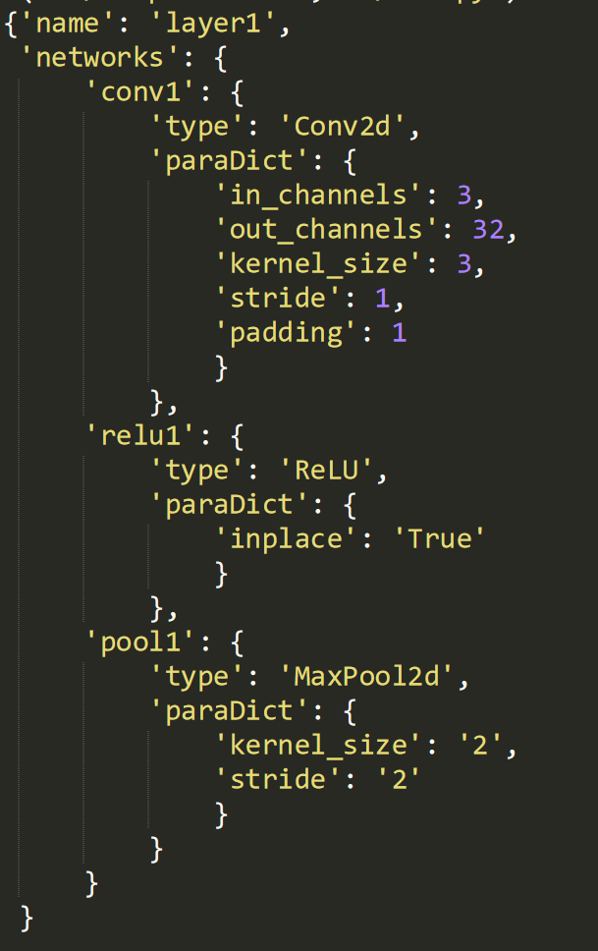
Status Update & On-going
Front end visualization (basic)
User interactions – layer construction
Input & output – finish address binding
Bind PyTorch function and argument – refining
Parse parameter to formatted model file and readable programming file – ongoing
On-training monitoring (Skyline)
Parsing generated model – JSON
Modify Skyline for blocks monitoring – reading ongoing

Slide 15
Possible Evaluations
Network structure visualization
Blocks performance monitoring (not whole model)
Readability of generated programming file
User interactions
……

Slide 16
Reference:
Azure machine learning studio. https://docs.microsoft.com/en-us/azure/machine-learning/studio. Accessed: 2020-03-25
Tensorboard. https://www.tensorflow.org/tensorboard/graphs. Accessed: 2020-03-25.
Skyline. https://github.com/geoffxy/skyline-atom. Accessed: 2020-03-25.
Paszke, Adam, et al. "PyTorch: An imperative style, high-performance deep learning library." Advances in Neural Information Processing Systems. 2019.
Elsken, Thomas, Jan Hendrik Metzen, and Frank Hutter. "Neural architecture search: A survey." arXiv preprint arXiv:1808.05377 (2018).

