Slide 1
CS6241 – Compiler Design
Project Demo
Shangru Yi (syi73)
2021.05.05

Slide 2
Part 1: Infeasible Path
General Illustration
Example
Optimization & Reflections
Implementation
Benchmark Results
Demo
Notes:
Ashier

Slide 3
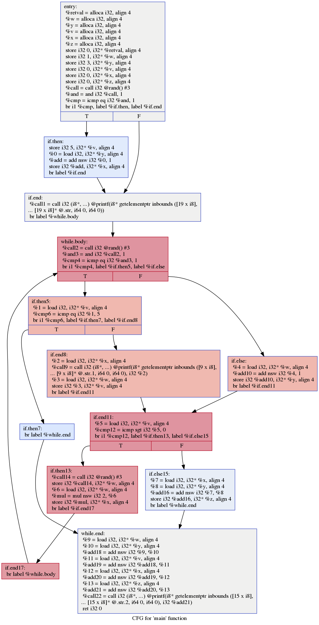
Part 1 Infeasible Path: General Illustration
We focus on the intraprocedural correlation analysis.
Correlated Branch Detection
Path Answer Update
Infeasible Path
Query - (variable, comparator, constant) {var < c ?}
Query (x < 5):
If an instruction store 10 to x, then Query will be resolved as FALSE at that instruction.
If x is the return value of a called function or the argument, the actual value of x is undetermined, then Query will be resolved as UNDEF.
Notes:
For example, we focus on query as x < 5, if we can find an instruction that store a constant 10 to . As for Undef, if the x is the

Slide 4
Part 1 Infeasible Path: General Illustration
We focus on the intraprocedural correlation analysis.
Correlated Branch Detection
Path Answer Update
Infeasible Path
Inst j : {Q2: TRUE}
Q2 = Sub(Q1)
Query - (variable, comparator, constant) {var < c ?}
Inst m : {Q1: FALSE}
Find the instruction where the target query can be resolved to {TRUE, FALSE, UNDEF}.
DFS with Query propagations & substitutions
Inst i : Q1

Slide 5
Part 1 Infeasible Path: General Illustration
We focus on the intraprocedural correlation analysis.
Correlated Branch Detection
Path Answer Update
Infeasible Path
Inst p : {Q1: UNDEF}
Inst n : {Q2: FALSE}
Query - (variable, comparator, constant) {var < c ?}
Inst m : {Q1: FALSE}
Iteratively update the answer for each instruction according the possible paths for answers.
Answer updates & Successors Added
Inst i : {Q1: {TRUE, UNDEF}}
Inst j : {Q2: {FALSE, TRUE}}

Slide 6
Part 1 Infeasible Path: General Illustration
We focus on the intraprocedural correlation analysis.
Inst n :
{Q: {FALSE, UNDEF}}
Correlated Branch Detection
Path Answer Update
Infeasible Path
Inst m :
{Q: {TRUE}}
Query - (variable, comparator, constant) {var < c ?}
Inst j :
{Q: {FALSE, TRUE, UNDEF}}
Find shortest paths for a certain query answer that is unachievable along that path.
Iteratively DFS for shortest infeasible paths
Query Predicate
False
True

Slide 7
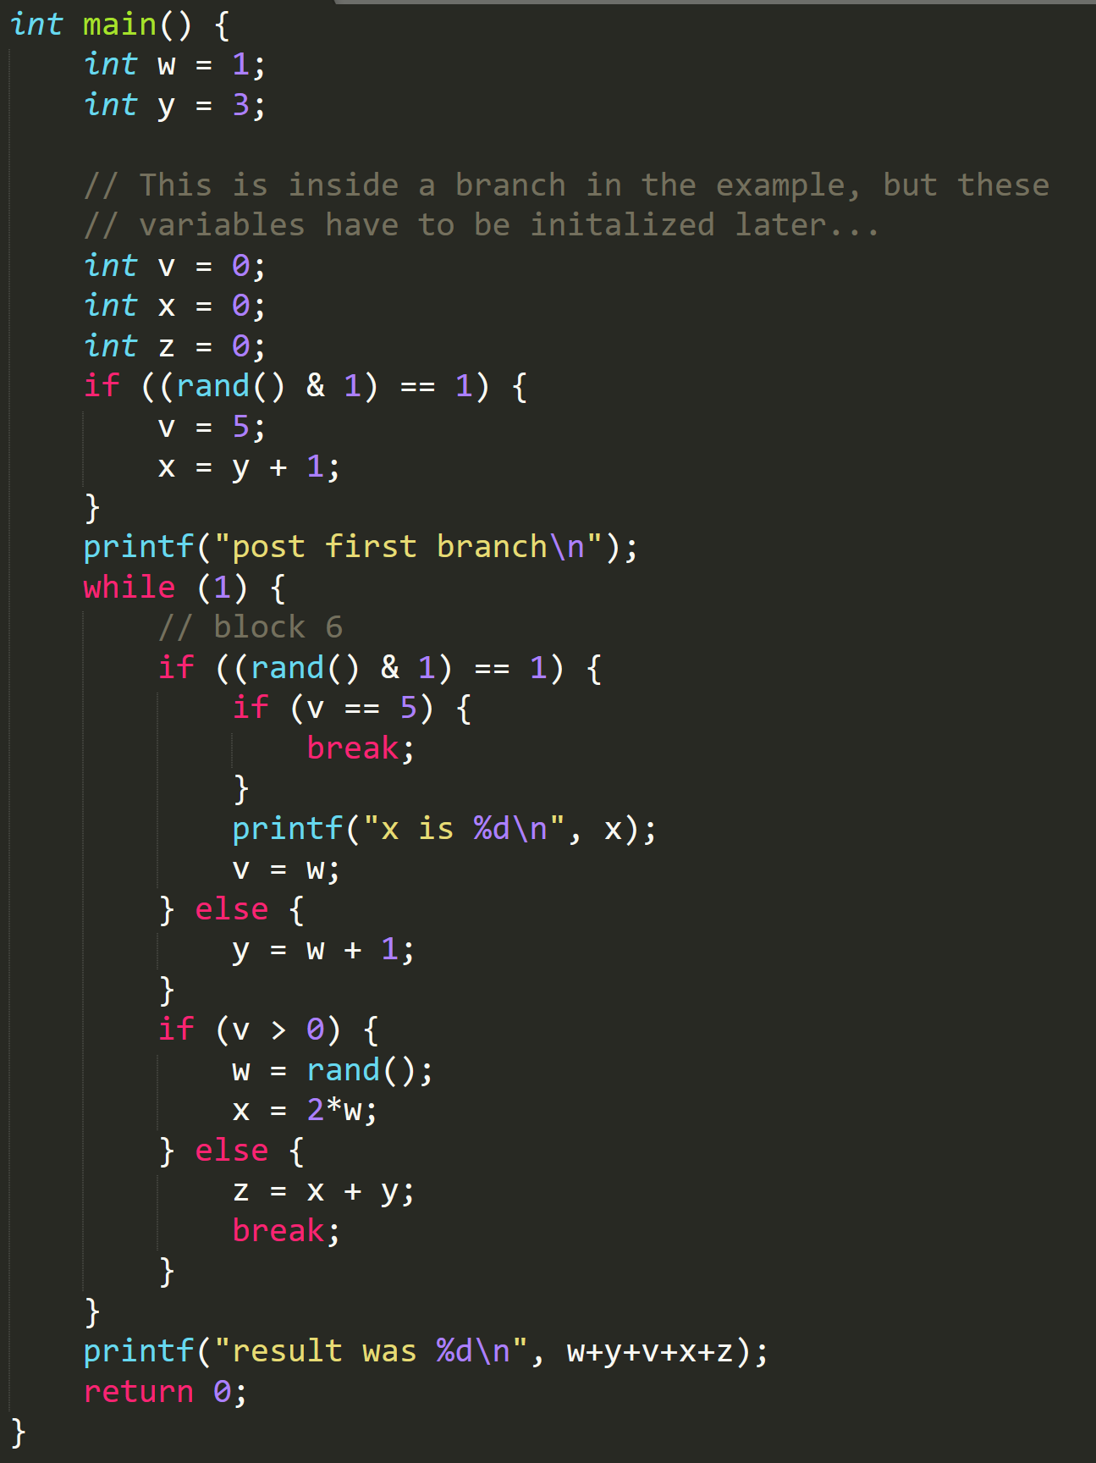
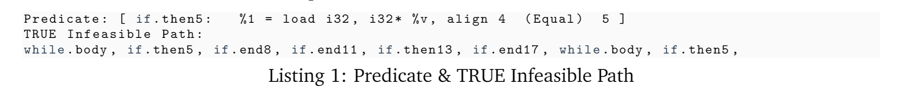
Part 1 Infeasible Path: Example

Slide 8
Part 1 Infeasible Path: Example

Slide 9
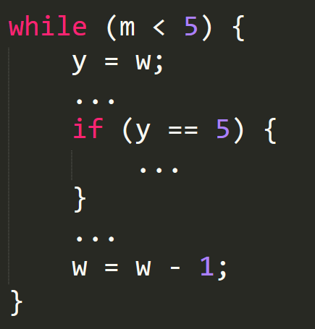
Part 1 Infeasible Path: Optimizations & Reflections
Reconstruct lexical order for queries
e.g. Query { c < x } => Query { x < c }
Initial constant propagation test
e.g. Query { x < y } => Test x or y as constant, if y as constant => Query { x < c }
Binary operation & Reflections (Why paper focus on constant?)
e.g. Query 1 { x < c } => x = y + 1 => Query 2 { y < c – 1}
Query will be substituted forever!
Infinite loops for query substitutions.

Slide 10
Part 1 Infeasible Path: Implementation
Two passes implemented:
Module Pass MetaInfo for predicate meta information (type, total predicates, etc.)
Module Pass InfeasiblePath for correlated branch and infeasible path detections
We first generate IR for benchmarks using Clang and LLVM-link. Then, a reg2mem pass is run on the generated IR to remove phi.
We focus on the load and store instructions.

Slide 11
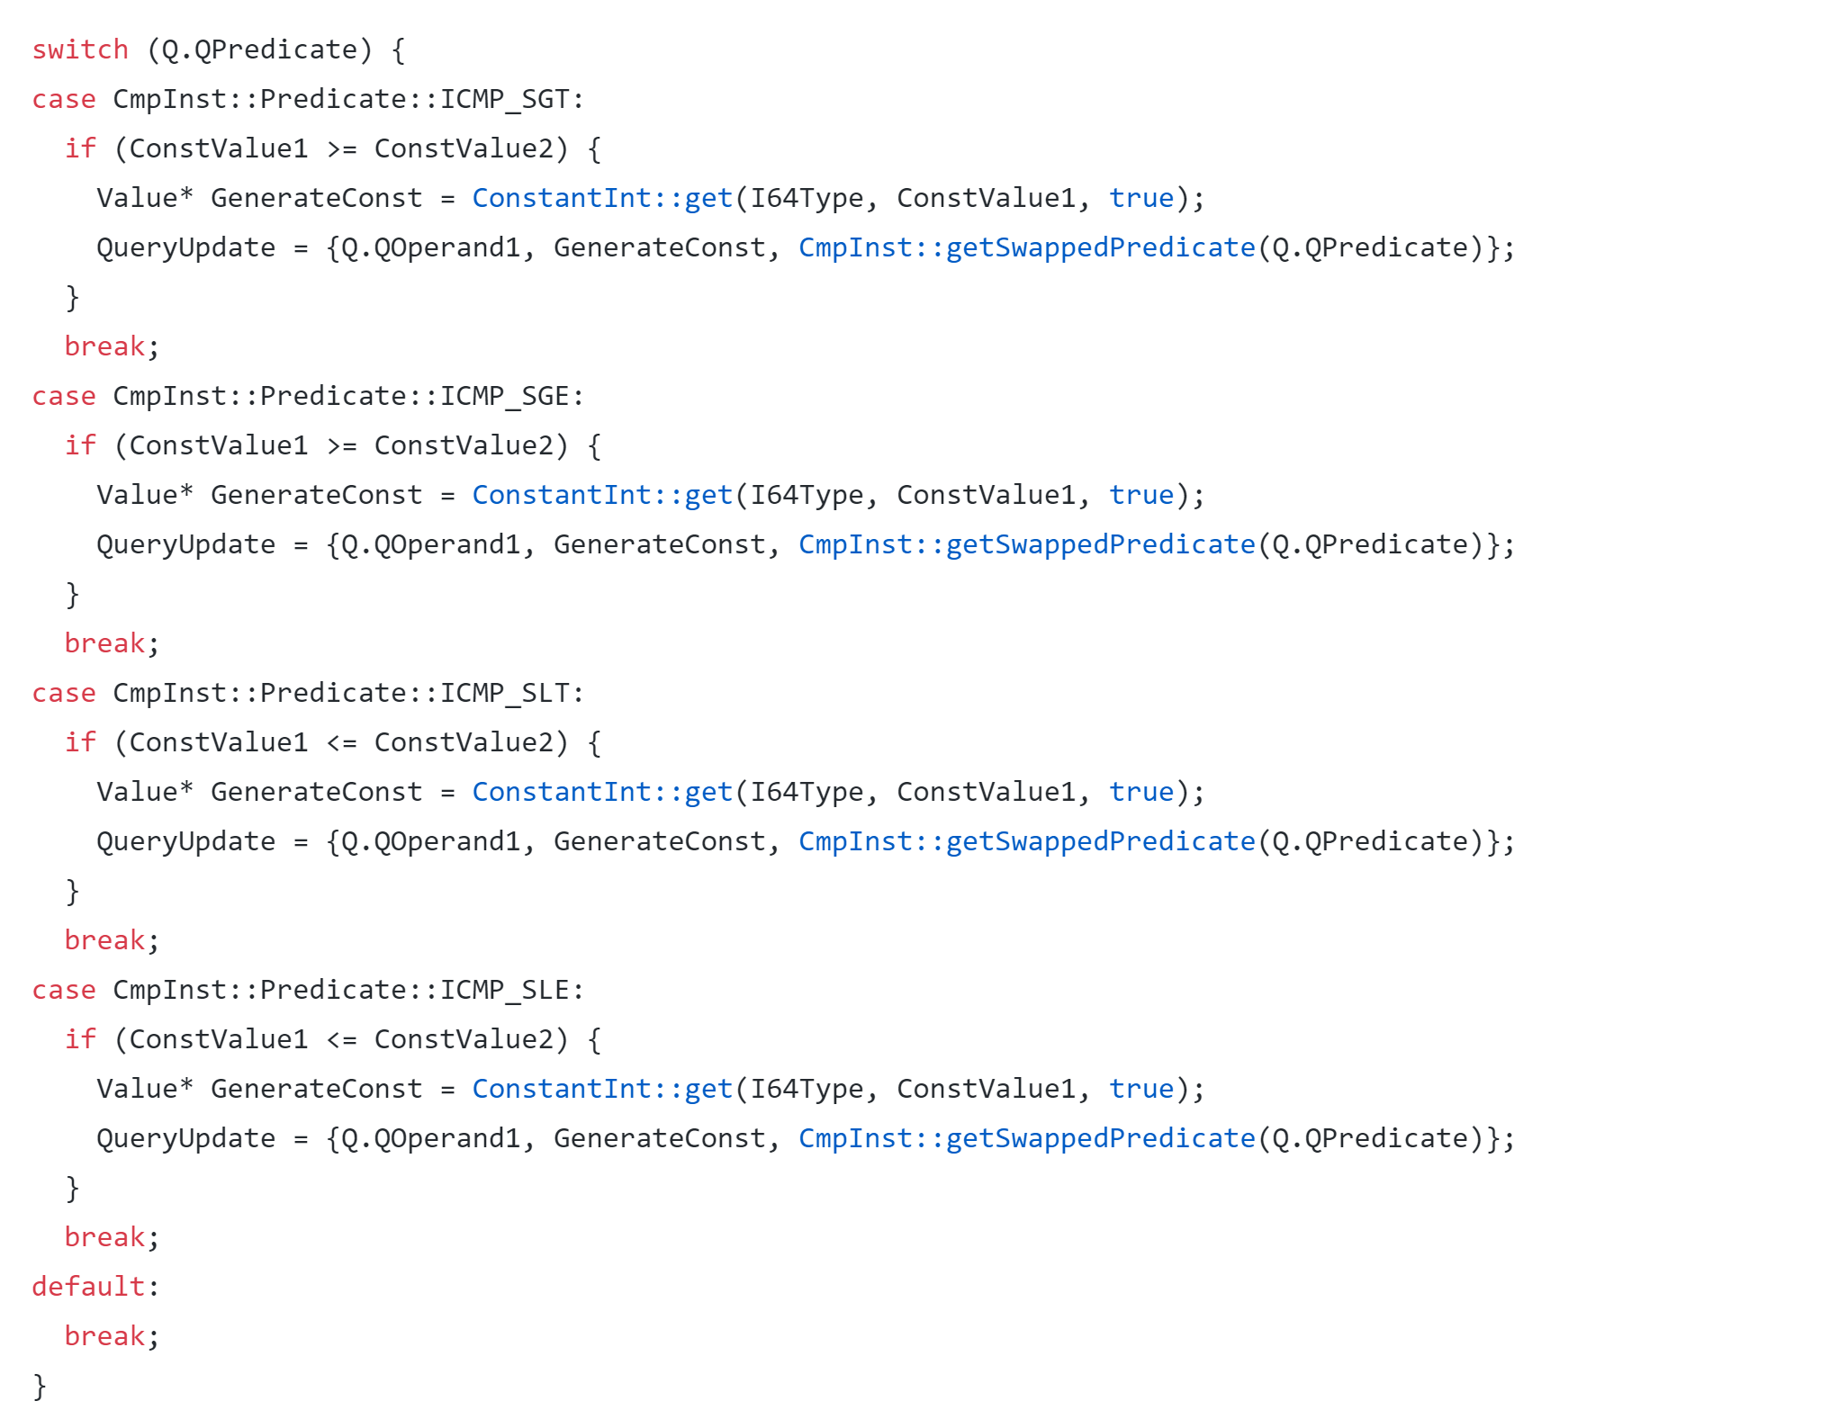
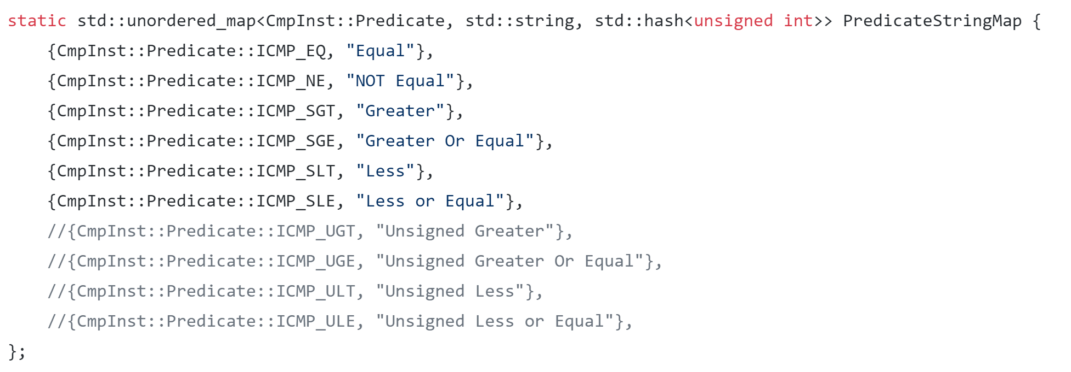
Part 1 Infeasible Path: Implementation
Steps for infeasible path detection - InfeasiblePath Pass:
Substitute query (uniform queries, x = y substitution, simple subsuming {y < 10 && y < 5 => y < 5} , etc.)
Iterative reverse-propagations for query answer resolving (predecessors)
Iterative query answer updates in paths (successors)
While-loop DFS for shortest infeasible paths

Slide 12
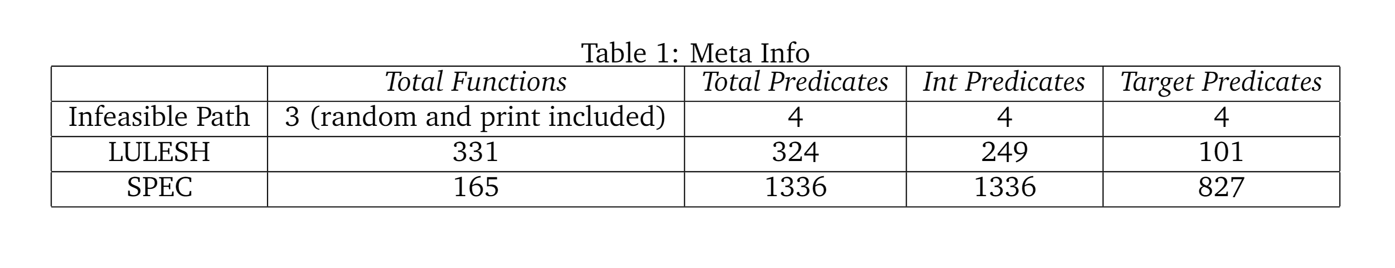
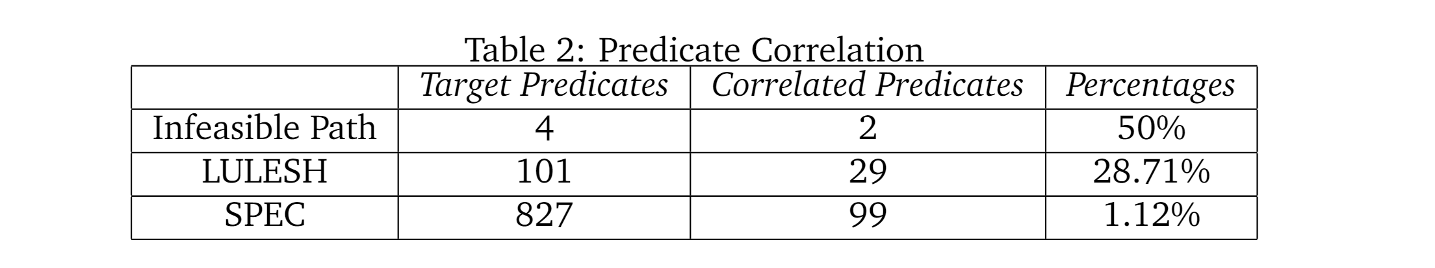
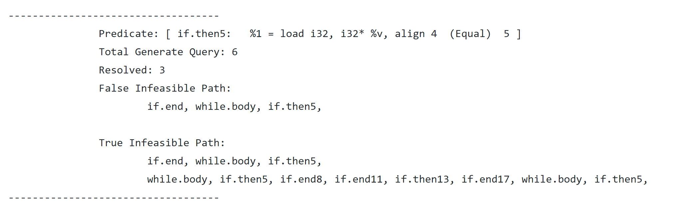
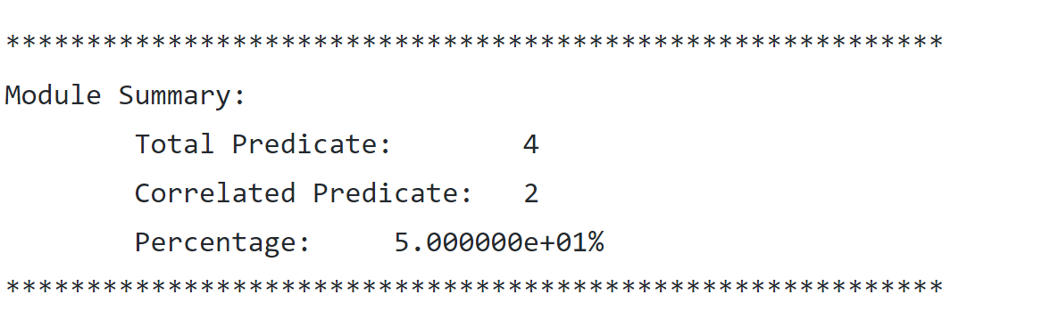
Part 1 Infeasible Path: Benchmark Results
LLVM 11.0.0 (Release and Assert Enable) on Ubuntu 18.04

Slide 13
Part 1 Infeasible Path: Demo

Slide 14
Part 2: Destructive Merge Removal
General Illustration
Example
Implementation
Benchmark Results
Demo
Notes:
Ashier

Slide 15
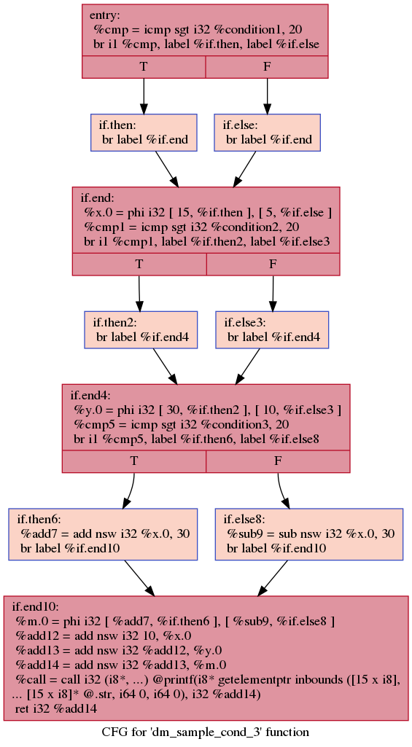
Part 2 Destructive Merge Removal: General Illustration
There are some nodes (phi node in SSA form) will merge the results propagated from predecessors. Due to these merges, some certain values or useful dataflow analysis will be invalidated or disabled.
Destructive Merge
Destructive merges: the basic block (instruction) where some data facts disappears.
Reachable Nodes: the basic block where there is a path to reach it from the destructive merges.
Reachable Nodes

Slide 16
Part 2 Destructive Merge Removal: General Illustration
Influence Nodes: the basic block that where the merge register and its derivatives are used (recursive)
Region of Influences: the basic blocks that are reachable and there is a path passing through it to the Influence Nodes.
Revival Edges：the edge where data fact are merged
Kill Edges: the edge leaving ROI
Edge-based State Transfer Function for block duplications
Revival Edges
ROI
Influence Nodes

Slide 17
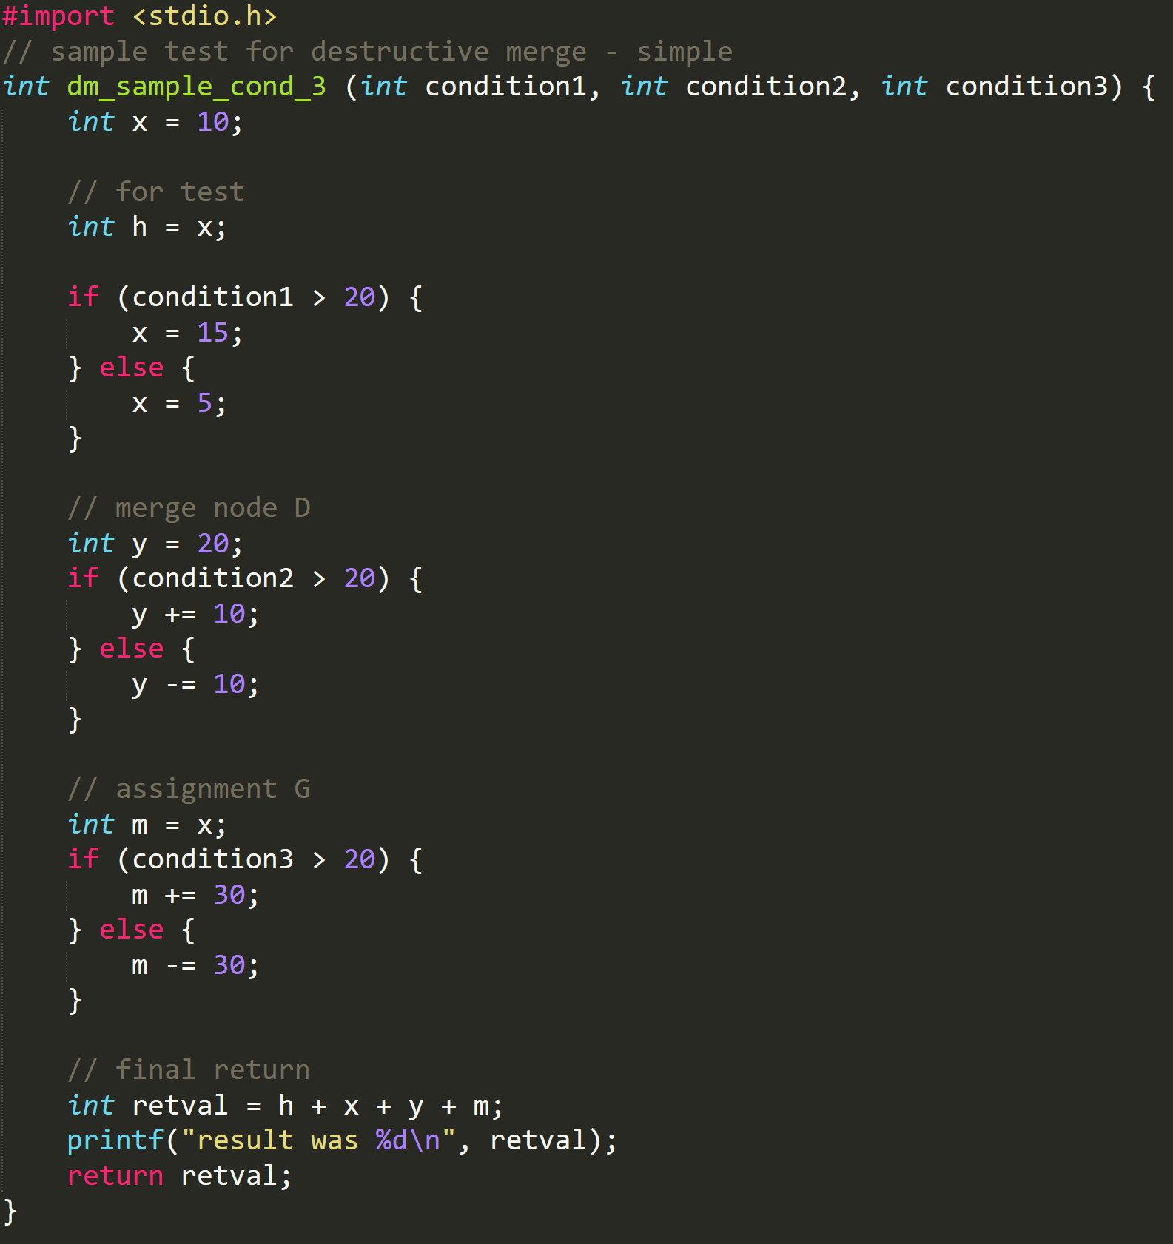
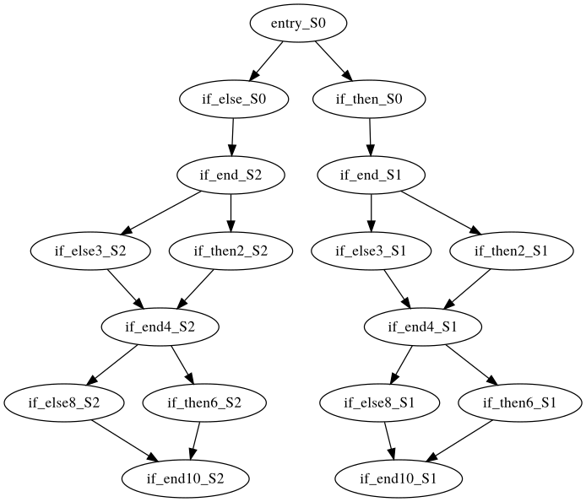
Part 2 Destructive Merge Removal: Example

Slide 18
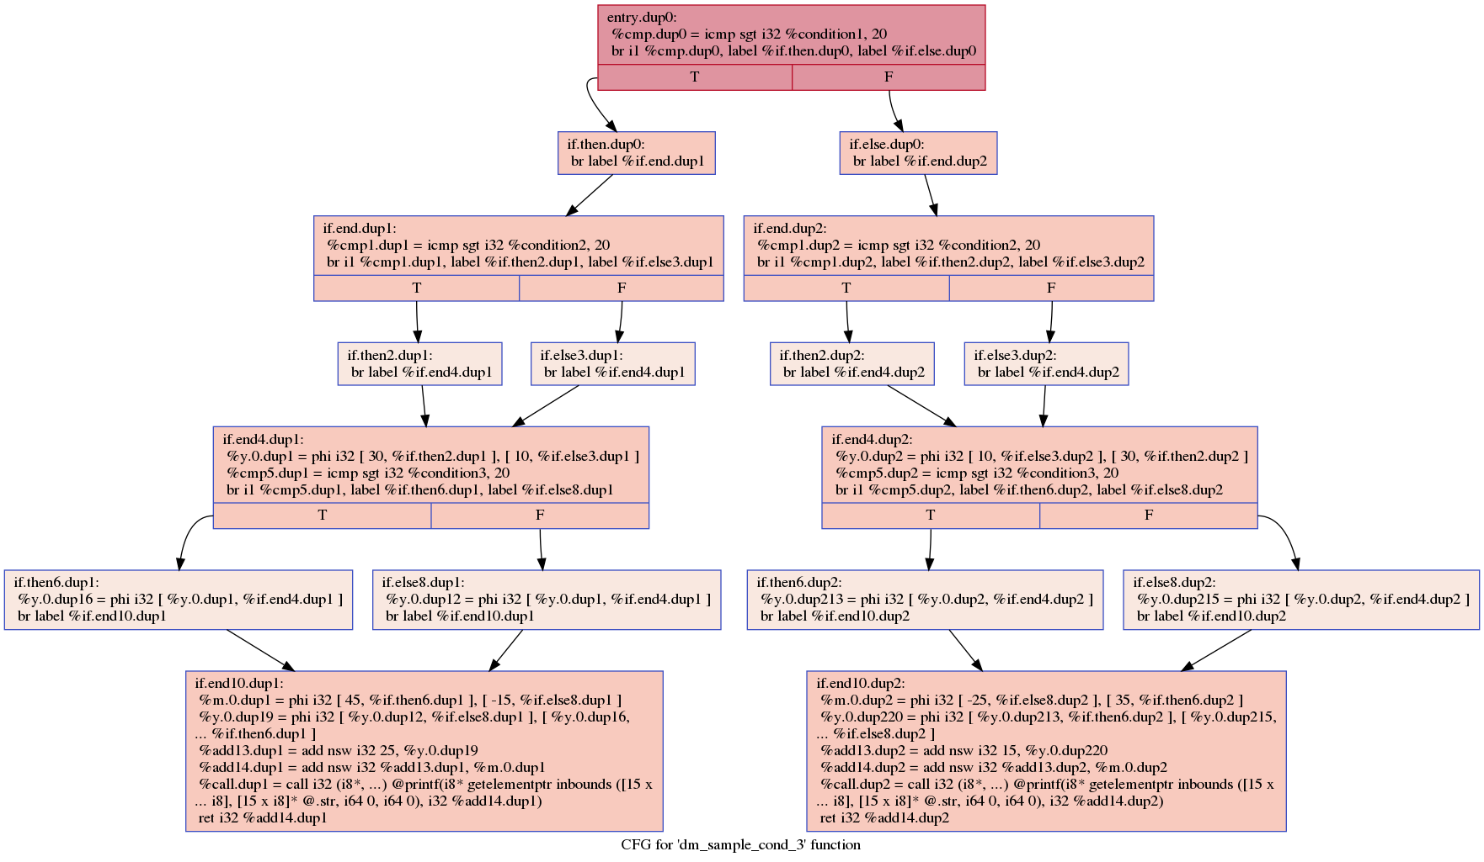
Part 2 Destructive Merge Removal: Example
After splits,
no extra computation required for m !

Slide 19
Part 2 Destructive Merge Removal: Implementation
Three passes implemented:
Module Pass FunctionSplitInfo for destructive merges meta information (fitness, influenced nodes, etc.)
Module Pass FuncCFGSplitInfo for symbolic CFG generation and general profiling (possible removal instructions)
Module Pass ModuleSplitMerge for actual code duplications and meta update information collections
We first generate IR for benchmarks using Clang and LLVM-link.
Then, a mem2reg along with sccp passes are run on the original IR to generate SSA representation and perform initial constant propagation.
We then pass the IR to our pass (ModuleSplitMerge) and a final sccp.

Slide 20
Part 2 Destructive Merge Removal: Implementation
Steps for destructive merge removal - ModuleSplitMerge Pass:
Find Reachable Nodes through iterative method (predecessors updates)
Find Influenced Nodes through recursive method (the usage of a usage)
Generate ROI, Revival Edges, Kill Edges and State Transfer Function.
Generate symbolic CFG for actual code generation
Duplicate blocks according to symbolic CFG and update register and block branches naming
Iterative update insert phi to preserve the SSA dominator information (hard !)
Original code uses register from the grandparents or above, while there is duplication for the parent basic blocks.
We maintain an instruction mapping. Once there is merge in the new CFG, we insert phi for simplicity (extra phi is inserted, while the following sccp pass can remove them).

Slide 21
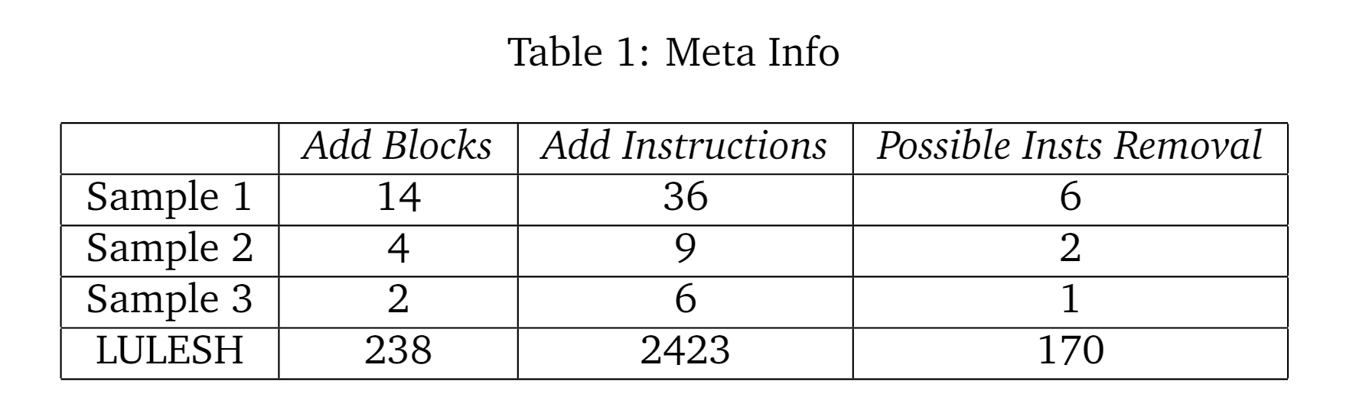
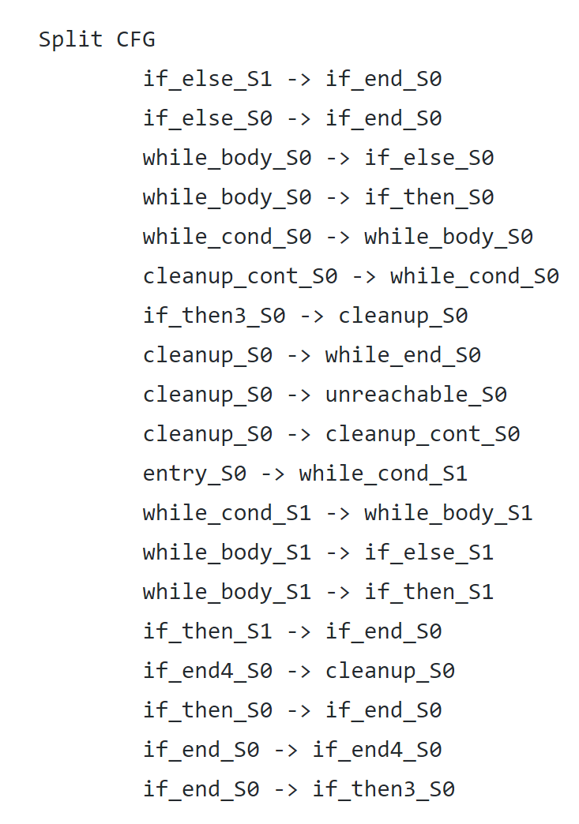
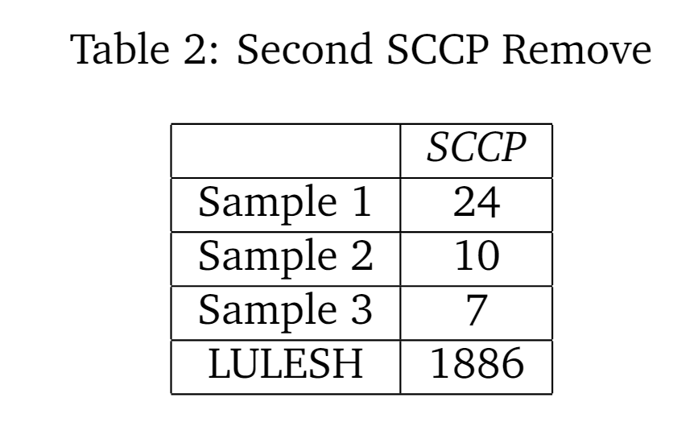
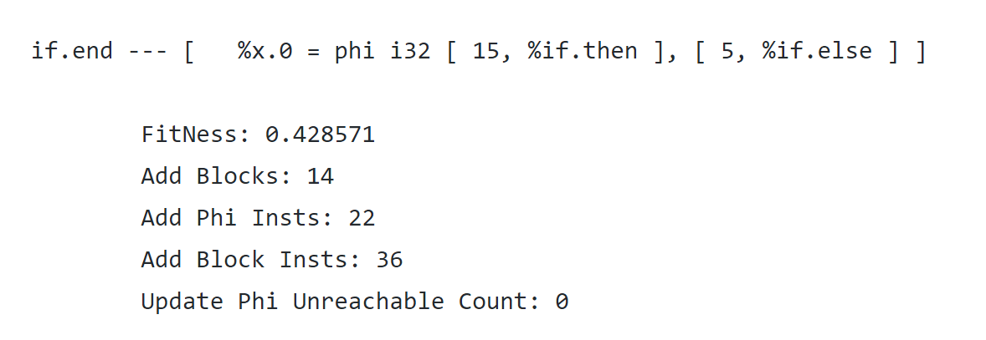
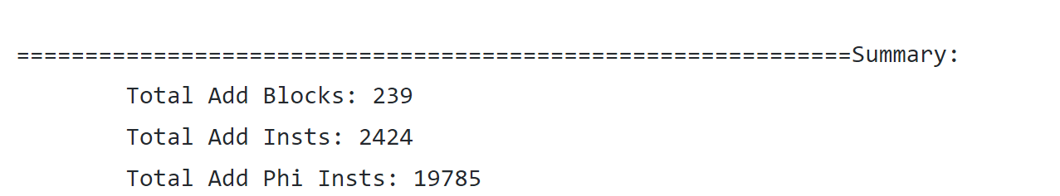
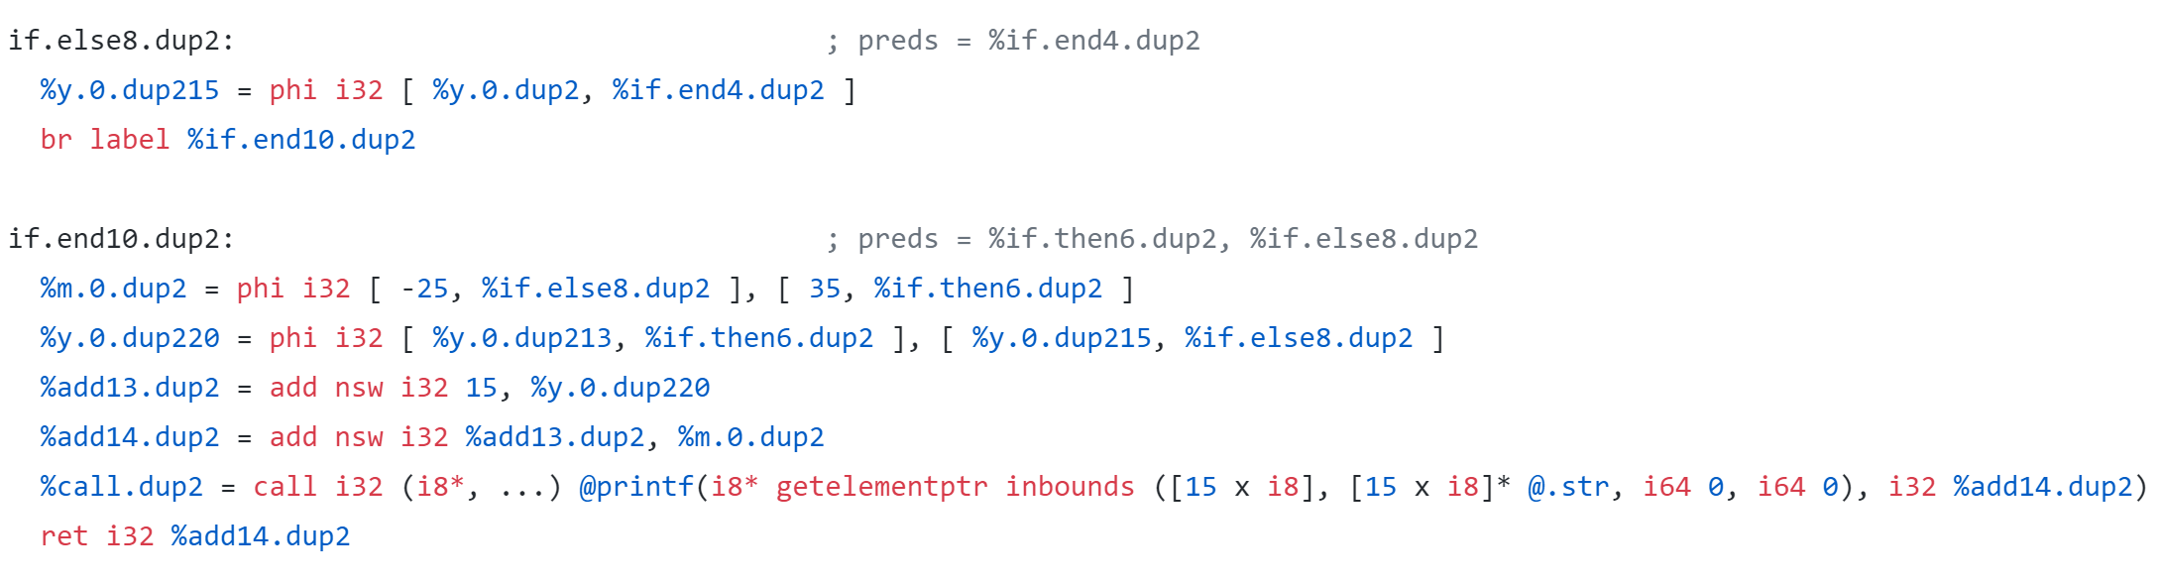
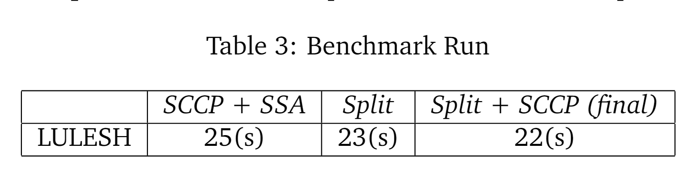
Part 2 Destructive Merge Removal: Benchmark Results
We merely duplicate blocks for destructive merges with fitness higher than 0.2.
SPEC-BZIP does not have such merges. We perform passes on three code sample (two with loop) and LULESH.
LULESH Result:

Slide 22
Part 2 Destructive Merge Removal: Demo

Slide 23
Reference:
Rastislav Bodik, Rajiv Gupta, and Mary Lou Soffa. Refining data flow information using infeasible paths. In Software Engineering—ESEC/FSE’97, pages 361–377. Springer, 1997
Aditya Thakur and R Govindarajan. Comprehensive path-sensitive data-flow analysis. In Proceedings of the6th annual IEEE/ACM international symposium on Code generation and optimization, pages 55–63, 2008

