Slide 1
GCCRisk Control Quantitative Tool – Similarity Analysis
2023/5/26

Slide 2
Project Background
Background
  IdentifyHigh-potential、High-survival-rate'sGCCCustomers,Incorporate intoCompanyRisk Assessment System，ProvideCredit Terms、Credit Limits etc.Financial Support
Similarity Analysis
  Analyze similarity between KA torso customers and GCC top customers to identify high-potential GCC customers
  Based onSimilarity Analysis，Can Further BuildGCCLong-termRetention Model
Basic Method
  Clustering Model+ Multi-dimensional Risk Control Verification

Slide 3
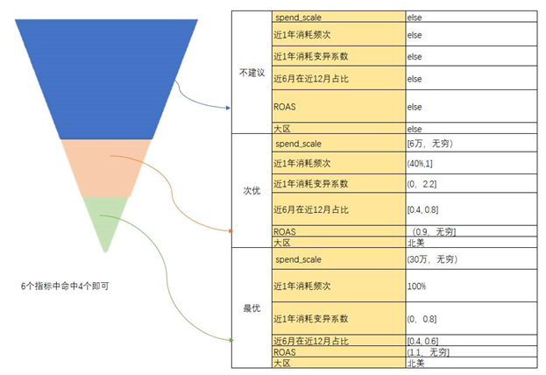
Basic Conclusions
Customer Scope
  Phase 1 analysis target: E-commerce customers
Basic Conclusions
  Through clustering algorithm, customers are divided into 6 clusters. Using payscore, creditscore, compliance rating, and dashboard score to evaluate quality, assigning 3 tiers: Optimal, Sub-optimal, Not Recommended
  Based on factor distribution, determine customer screening rules for each tier
Conclusion Application
  For GCC customers in clustering, reference ratings of "Optimal", "Sub-optimal", "Not Recommended" can be given based on their cluster during prepaid-to-postpaid conversion
  For subsequent GCC customers to evaluate, reference ratings of "Optimal", "Sub-optimal", "Not Recommended" can be given based on tier screening rules
Customer Screening Rules by Tier

Slide 4
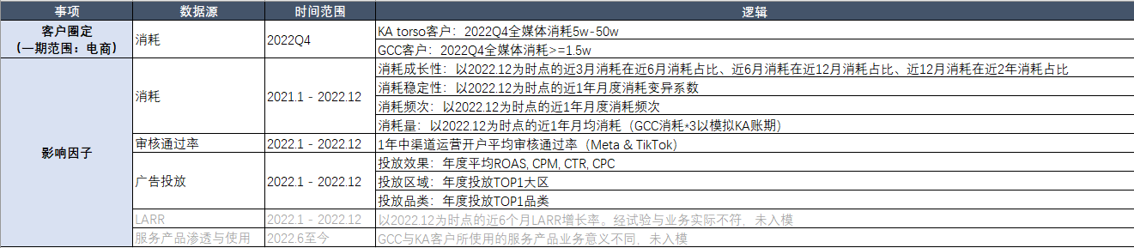

Data Collection and Logic
Data Collection and Feature Logic
Sample Size

Slide 5
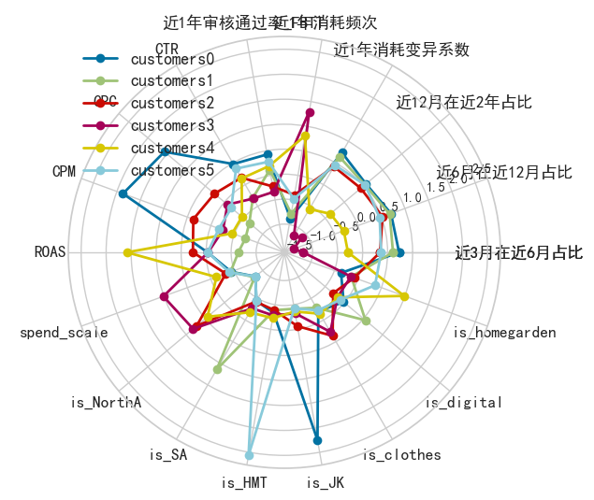
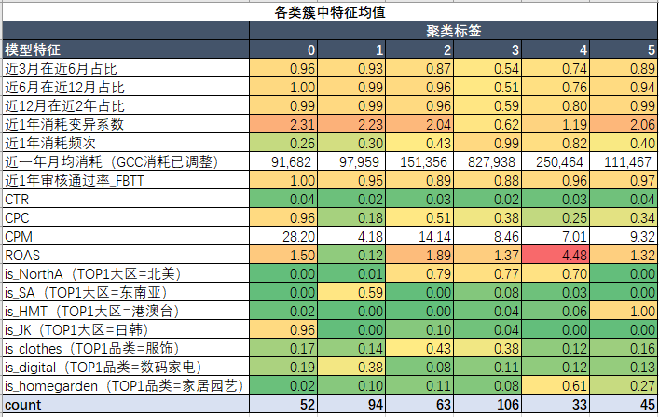
Clustering Model
Algorithm Logic
  Group customers based on model features; customers within same group are similar, different groups are different
Clustering Results
  Since clustering analysis requires computing similarity distances, factors cannot be null. After removing customers with null model factors, there are 393 customers total: 158 KA and 235 GCC.
  After standardizing the 6 model factors, 393 customers are divided into 6 clusters using the K-means algorithm.
  FromRisk Rating、Pay Score、Risk Control Dashboard、Violation Rating4 Dimensions Analyzing 6ClusterCustomer Distribution，Cluster 3 Has Best Overall Quality，Followed by Clusters 2 and 4。
Clusters 3, 2, 4: Stable spending, higher volume, higher frequency; higher audit pass rate; better ad performance; main region is North America

Slide 6
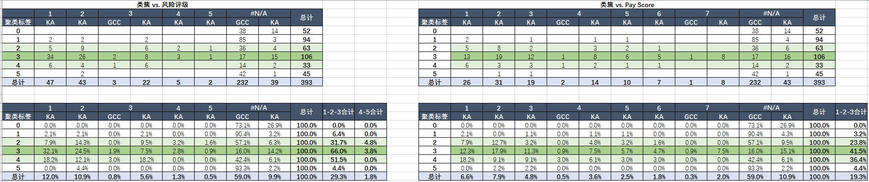
Clustering Results
Cluster CorrespondingRisk RatingandPay ScoreCustomer Distribution
Risk Rating1、2、3isBetter Customers
Customers in Clusters 3, 2, 4，Risk Ratingis1、2、3'sHigher Proportion，OverallRisk RatingBetter
Belonging toCluster3、2、4'sGCCCustomers,Have HigherProbabilityisBetter Customers。Can DefineCluster3Defined as“Optimal”，Cluster2、4Defined as“Sub-optimal” ，OtherClusterDefined as“Not Recommended”
Pay Score segments 1, 2, 3 indicate better customers
Customers in clusters 3, 2, 4 have higher proportion in Pay Score segments 1, 2, 3 with better overall Pay Scores
Belonging toCluster3、2、4'sGCCCustomers,Have HigherProbabilityisBetter Customers。Can DefineCluster3Defined as“Optimal”，Cluster2、4Defined as“Sub-optimal” ，OtherClusterDefined as“Not Recommended”

Slide 7
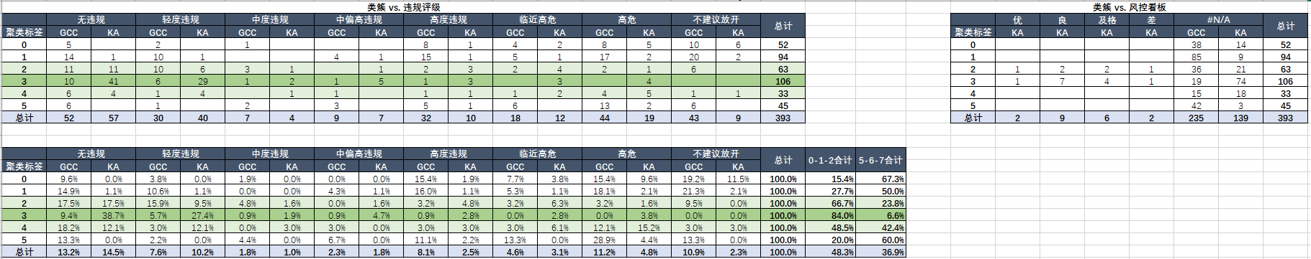
Clustering Results
Violation Rating and Risk Dashboard Rating Customer Distribution by Cluster
Violation RatingIn“No Violation”、“Minor Violation”and“Moderate Violation”（Level Code0、1、2）'sisBetter Customers
Customers in Clusters 3, 2, 4，Violation Ratingis“No Violation”、“Minor Violation”and“Moderate Violation”'sHigher Proportion，OverallViolation RatingBetter
Belonging toCluster3、2、4'sGCCCustomers,Have HigherProbabilityisBetter Customers。Can DefineCluster3Defined as“Optimal”，Cluster2、4Defined as“Sub-optimal”，OtherClusterDefined as“Not Recommended”
Risk dashboard currently has too few rated customers; temporarily not used as reference

Slide 8
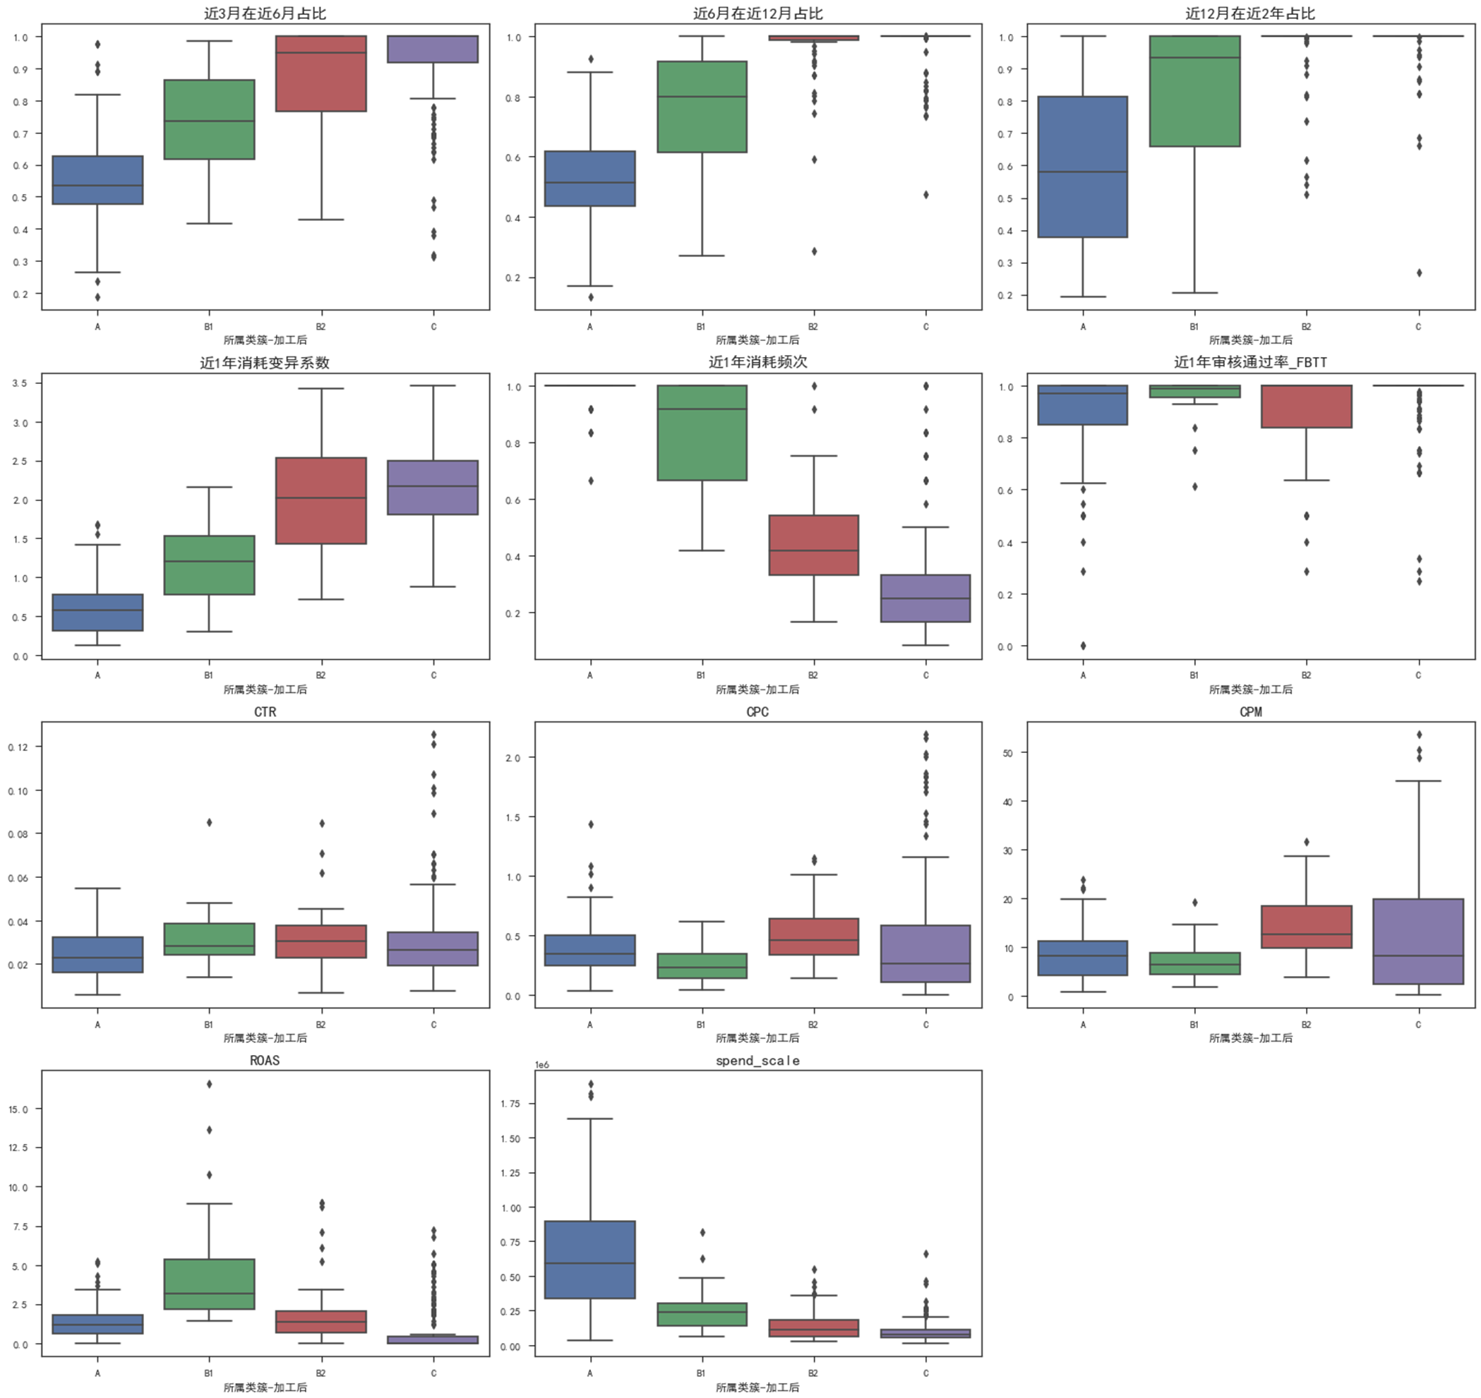
Customer Screening Rules
Analysis Objective
  As mentioned above, evaluate customer quality across 6 clusters from 4 dimensions: risk rating, Pay Score, risk control dashboard, violation rating, assigning tiers: Optimal, Sub-optimal, Not Recommended
  Based on feature distribution, determine common characteristics of each tier and output judgment rules for potential prepaid customers
Feature Selection Results
  6 Features with Significant Tier Differentiation Selected as Rule Indicators:
    Monthly Average Spending
    Spending Frequency in Last Year
    Spending Coefficient of Variation in Last Year
    Last 6 Months Spending as % of Last 12 Months
    ROAS
    TOP1 Region (region as categorical variable, not shown in left-side box plot)
Rule results and conclusion application: see "Basic Conclusions" page above
Main Feature Distribution

Slide 9
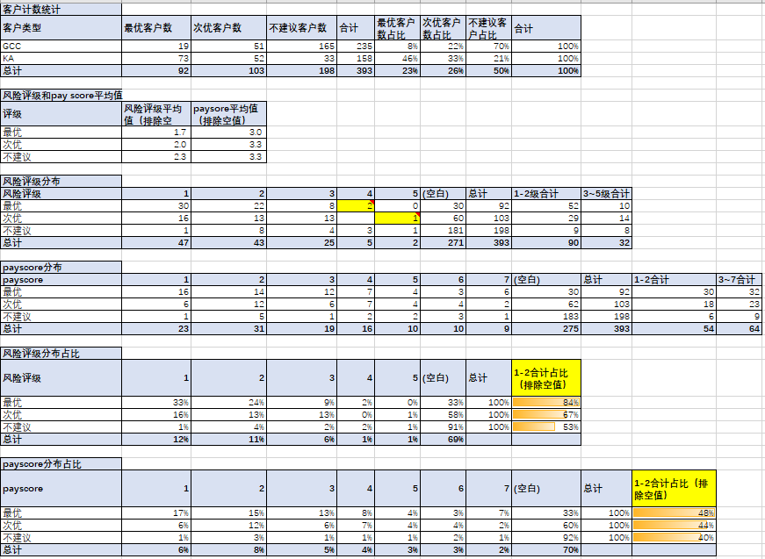


Rule Validation
Validation Details
  E-commerce customers in clustering: quantity distribution and risk rating / PayScore rating distribution after rule screening
  Across Optimal, Sub-optimal, and Not Recommended groups, risk ratings and PayScore ratings show a good-to-poor progression, as expected
  Note:
    InOptimalCustomer Group，Have2Risk Ratingis4'sCustomers,Sample LabelsAllIsGood Samples
    InSub-optimalCustomer Group，Have1Risk Ratingis5Customers,isHangzhou Qijian，isBad Customer。Credit Review Confirmed, QijianDefault ReasonMainlyInvestment Failure，Spending and other metrics atUpper-middle Level。

