Slide 1
Logistic Regression
Classification in Logistic Regression
Notes:
In this lecture we'll see how to do classification with logistic regression and introduce the important sigmoid function

Slide 2
we want a probabilistic classifier
We want a model that can tell us:
p(y=1|x; θ)
p(y=0|x; θ)

Slide 3
The very useful sigmoid or logistic function
Notes:
The sigmoid function The 1/1+e^-z (so-named because it looks like an s) is also called the logistic function. It takes a real value and maps it to the range [0, 1
It is nearly linear around 0 but outlier values get squashed toward 0 or 1.

Slide 4
Idea of logistic regression
We’ll compute w∙x+b
And then we’ll pass it through the sigmoid function:
σ(w∙x+b)
And we'll just treat it as a probability

Slide 5
Turning a probability into a classifier
if w∙x+b > 0
if w∙x+b ≤ 0

Slide 6
Logistic Regression
Learning: Cross-Entropy Loss
Notes:
Let's now turn to learning the parameters for logistic regression. We'll start with the cross-entropy loss function

Slide 7
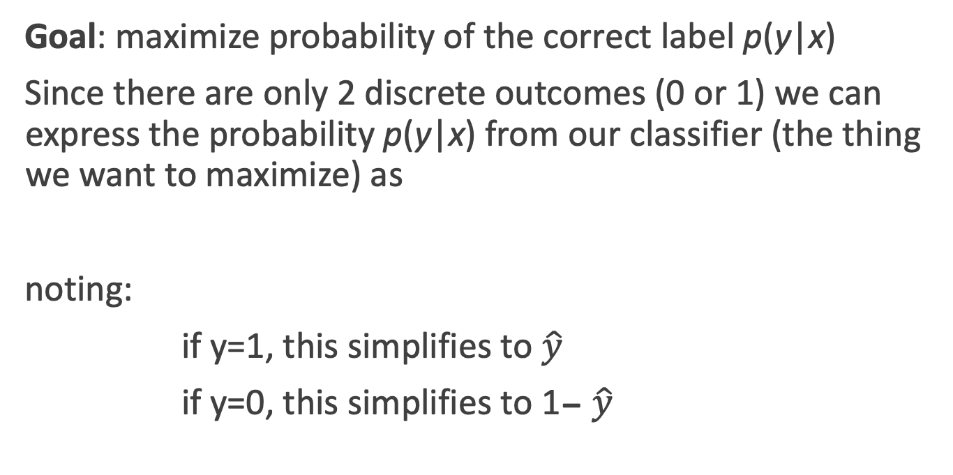
Deriving cross-entropy loss for a single observation x
Goal: maximize probability of the correct label p(y|x)
Since there are only 2 discrete outcomes (0 or 1) we can express the probability p(y|x) from our classifier (the thing we want to maximize) as
noting:
if y=1, this simplifies to $\hat{y}$
if y=0, this simplifies to 1- $\hat{y}$
Notes:
Let’s derive this loss function, applied to a single observation x. We’d like to learn weights that maximize the probability of the correct label, that's p(y|x).

Slide 8
Deriving cross-entropy loss for a single observation x
Goal: maximize probability of the correct label p(y|x)
Maximize:
Now take the log of both sides (mathematically handy)
Whatever values maximize log p(y|x) will also maximize p(y|x)
Maximize:

Slide 9
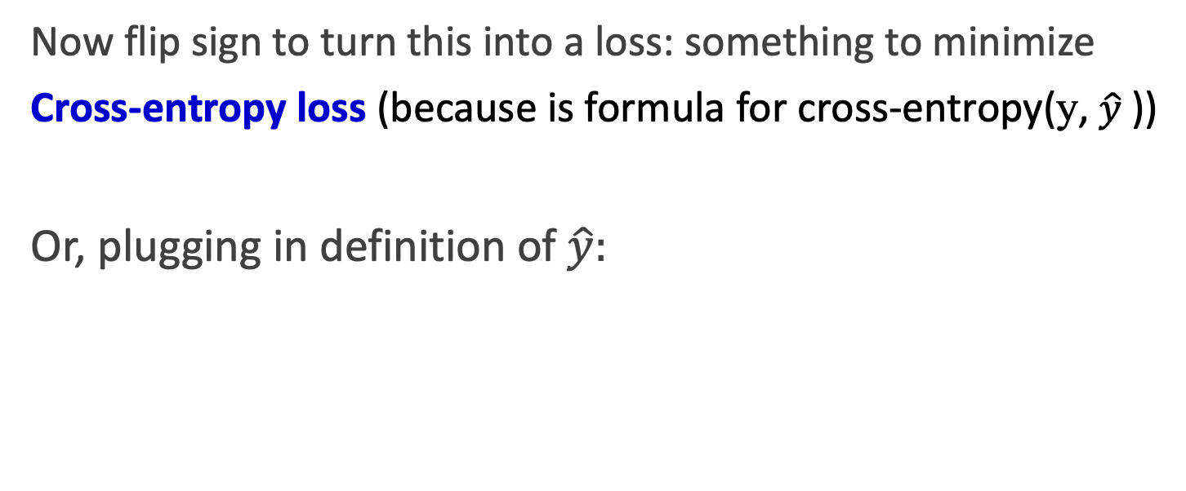
Deriving cross-entropy loss for a single observation x
Goal: maximize probability of the correct label p(y|x)
Maximize:
Now flip sign to turn this into a loss: something to minimize
Cross-entropy loss (because is formula for cross-entropy(y, $\hat{y}$))
Or, plugging in definition of $\hat{y}:$
Minimize:

Slide 10
What are these partial derivatives for logistic regression?
The loss function
The elegant derivative of this function (see textbook 5.8 for derivation)
Notes:
In order to update θ , we need a definition for the gradient ∇L( f (x; θ ), y). Recall that for logistic regression, the cross-entropy loss function is: EQ
It turns out that the derivative of this function for one observation vector x is EQ
Note that the gradient with respect to a single weight w j represents a very intuitive value: the difference between the true y and our estimated yˆ = σ (w · x + b) for that observation, multiplied by the corresponding input value x j .

