Slide 1
大数据存储与处理 大规模文件系统及 Map Reduce 2. 存储模型和文件系统
陈一帅
chenyishuai@gmail.com

Slide 2
How do we use very large amounts of data?
*
Working with big data is not about
code optimization
learning details of todays hardware/software:
GraphLab, Hadoop, Spark, parallel hardware, ….
Working with big data is about
Understanding the cost of what you want to do
Understanding what the tools that are available offer
Understanding how much can be accomplished with linear or nearly-linear operations (e.g., sorting, …)
Understanding how to organize your computations so that they effectively use whatever’s fast
Understanding how to test/debug/verify with large data
* according to William

Slide 3
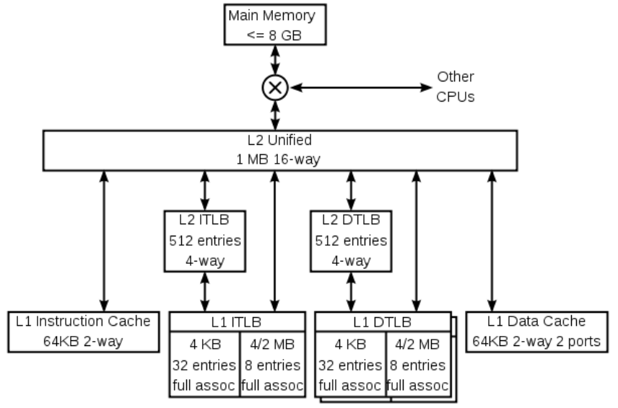
A typical CPU (not to scale)
K8 core in the AMD Athlon 64 CPU
Hard disk (1Tb)
128x bigger
16x bigger
256x bigger
Notes:
16 – me vs chihuhua – or vs midsize car
256 – me vs 2 iphones – or vs a sperm whale or 3 elephants

Slide 4
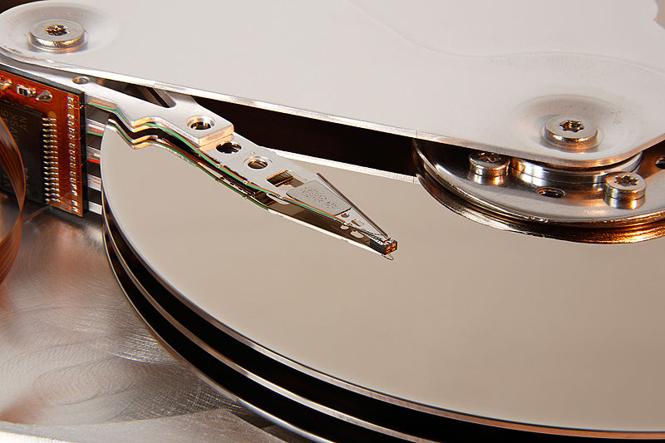
A typical disk
Notes:
16 – me vs chihuhua – or vs midsize car
256 – me vs 2 iphones – or vs a sperm whale or 3 elephants

Slide 5
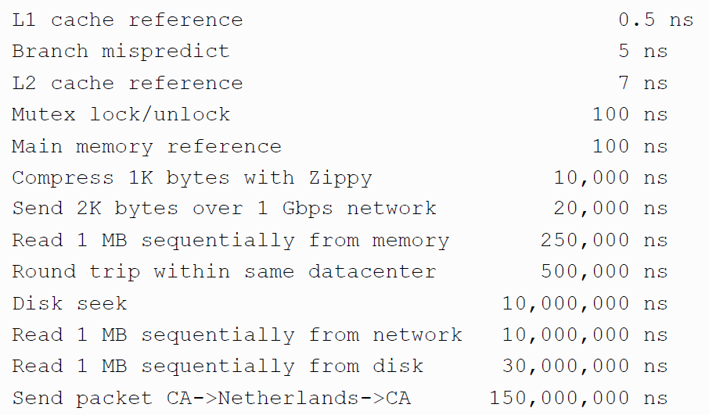
Numbers (Jeff Dean says) Everyone Should Know

Slide 6
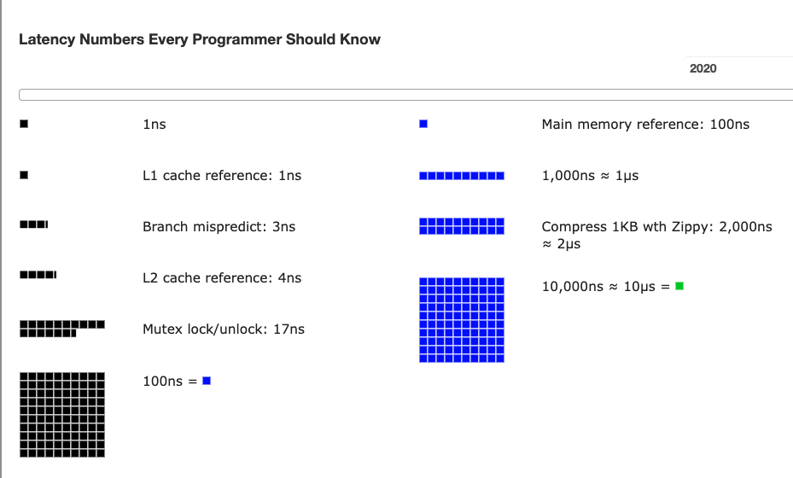
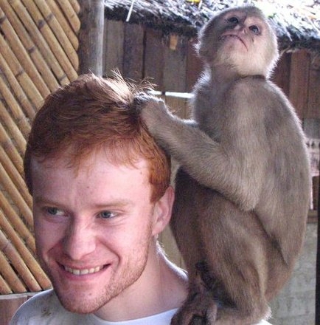
Latency Numbers Every Programmer Should Know
Colin Scott, UCB
http://www.eecs.berkeley.edu/~rcs/research/interactive_latency.html

Slide 7
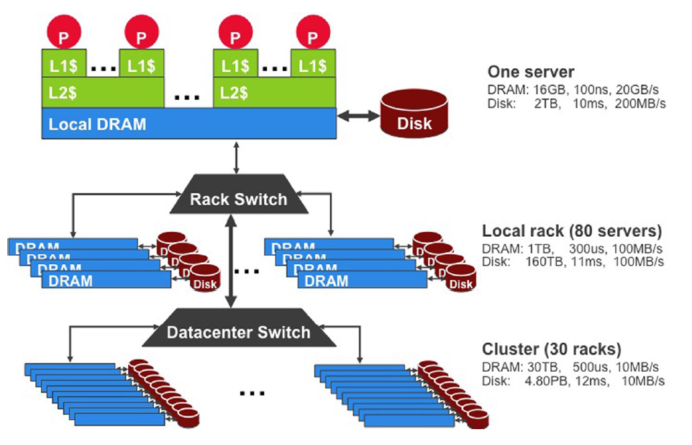
存储结构
USB3.1 10 Gbit/s
SATA 3.0 (6 Gbit/s)
SSD：200 MB/s to 2500 MB/s
Random Access Time：0.1ms vs 2.9-12ms
Source: Barroso and Urs Hölzle (2009)

Slide 8
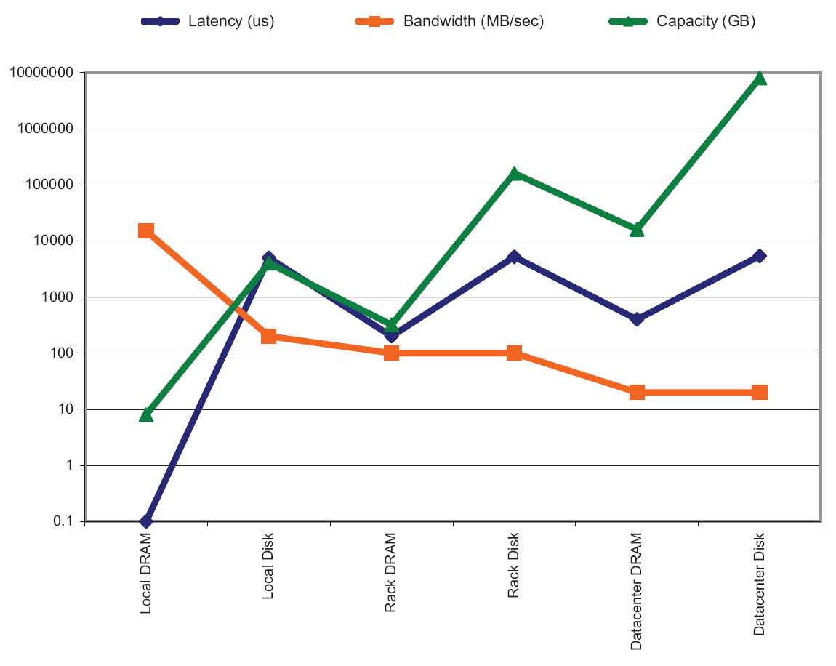
各种存储的容量和性能
Source: Barroso and Urs Hölzle (2009)

Slide 9
What’s Happening with Hardware?
Clock speed: stuck at 3Ghz for ~ 10 years
Net bandwidth doubles ~ 2 years
Disk bandwidth doubles ~ 2 years
SSD bandwidth doubles ~ 3 years
Disk seek speed doubles ~ 10 years
SSD latency nearly saturated

Slide 10
参考：内存性能测试
UCSD大数据课程代码下载
https://courses.edx.org/courses/course-v1:UCSanDiegoX+DSE230x+3T2019/jump_to/block-v1:UCSanDiegoX+DSE230x+3T2019+type@vertical+block@00b140404598481bace4b814653b9335
自学UCSD Memory Hierarchy部分视频，完成每个视频后面的测试题
https://courses.edx.org/courses/course-v1:UCSanDiegoX+DSE230x+3T2019/jump_to/block-v1:UCSanDiegoX+DSE230x+3T2019+type@vertical+block@ba5936549ab14ff9b55e9d3e7ff7b70e
运行UCSD课程代码，2_measuring_performance_of_memory_hierarchy.ipynb，完成对本组电脑性能和硬件指标的测量，进行对比分析，提交实验报告
报告模板：https://docs.google.com/presentation/d/1XvqgINDstiiO_lu-Ke8CJQ7sur_7FcrHH8G_w5yr114/edit#slide=id.p ）

Slide 11
分布式文件系统
DFS：Distributed File Sys

Slide 12
分布式文件系统
GFS
Google File Sys
HDFS
Hadoop Distributed File Sys
存的文件有讲究：
大：GB，TB
Write-once，appended
不常更新

Slide 13
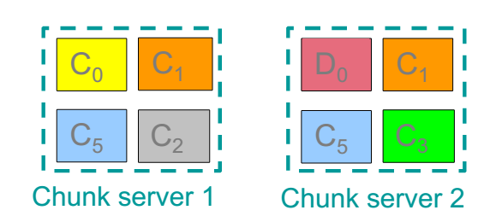
分布式文件系统
大文件分片
Chunk：16 ～ 64MB
多备份
2x 或 3x
放到不同机架上

Slide 14
HDFS Architecture
HDFS namenode
Application
/foo/bar
(file name, block id)
File namespace
HDFS Client
block 3df2
(block id, block location)
instructions to datanode
(block id, byte range)
datanode state
HDFS datanode
HDFS datanode
block data
Linux file system
Linux file system
…
…
Namenode责任
文件系统的基本功能：目录结构，permission，
查询，健康维护
Adapted from (Ghemawat et al., SOSP 2003)

