Slide 1
目标
Direct Teach (10 m)
使用 ES6 的 import（导入）和 export（导出），让不同js文件互相可以看见
词汇: modules 模块, import, export
Notes:
Teacher Notes:
Have your students read aloud the objective.
Students should read through each vocabulary word.

Slide 2

介绍
Direct Teach (10 m)
代码越小，越好管理.
一个模块 module 是写进一个js文件里的一块代码
导入import，导出export 允许js文件分享代码模块
Notes:
Code is easier to manage when it's small. You can imagine that as you try and build more complex applications you’ll need more and more code to perform your various desired tasks. Keeping all of this code in one massive JS file would be quite unruly.
Can use ‘import’ and ‘export’ to manage file size.
You can define a function in one file, and use that function in another file. You can also control what information in your file is accessible to other/external files.
This lets you keep your files focused and small.
image from: https://medium.com/podiihq/es6-modules-imports-and-exports-1e5b552ddca9
https://medium.com/@thejasonfile/a-simple-intro-to-javascript-imports-and-exports-389dd53c3fac

Slide 3
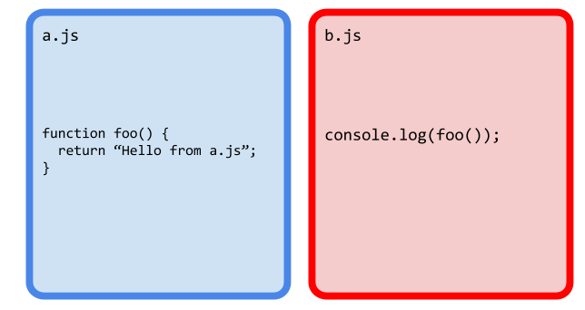
Import & Export
Direct Teach (5 m)
Notes:
I have two files a.js and b.js
what will happen if I run, as is, b.js?

Slide 4
Import & Export
Direct Teach (5 m)
错误!
Notes:
Why would we encounter an error?
Because b.js doesn’t know what the foo function is. We have to ‘import’ this method into b.js

Slide 5
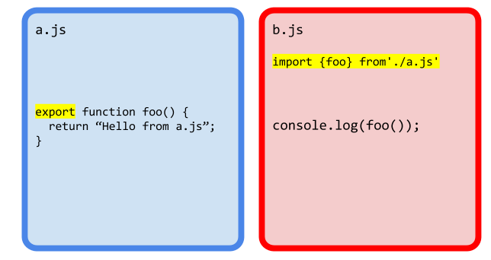
Import 导入 & Export 导出
Direct Teach (5 m)
Notes:
we export the foo function so it can be used in our b.js file
and then we import the foo method from file a.js

Slide 6
Import & Export
Direct Teach (5 m)
Notes:
notice that the function name foo() is the same name that follows the import keyword, enclosed in the brackets

Slide 7
Import & Export
Direct Teach (5 m)
Notes:
also this foo is the method that we call in file b

Slide 8
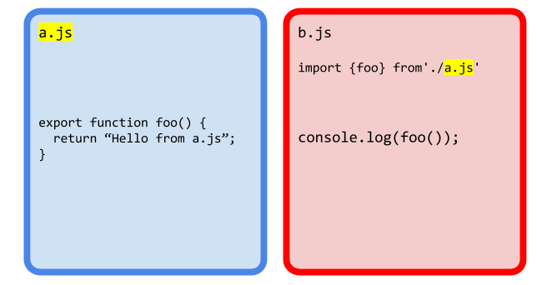
Import & Export
Direct Teach (5 m)
Notes:
also note that in our import statement we’re saying “a.js” because that is the name of the file we want to import.

Slide 9
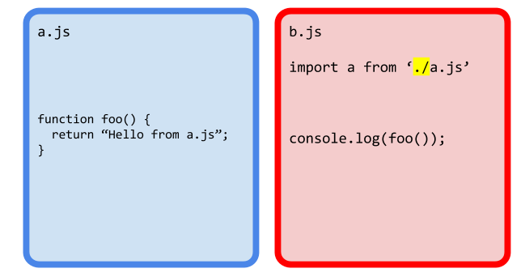
Import & Export
Direct Teach (5 m)
Notes:
So what does the “./” preceding the file name mean?
When talking about a file path, if the path begins with “/” this indicates absolute path. That means to find a particular file, we need to begin in the root of the file system and navigate through the folders given by name.
“./” is a relative file system name. So, we start with the current working directory and apply the navigation operations which are separated by the path separator again ⇒ so “./a.js” is saying, look in the current working directory for a file named “a.js”

Slide 10
演示
Guided Practice (3 m)
导入函数
从“2.js”导出“hi”方法
将“2.js”文件导入“1.js”
Notes:
Activity based on this repl.it

Slide 11
练习
Independent Practice (3 m)
创建第三个文件“3.js”
编写方法“hi”，该方法返回字符串："你好，我在 3.js 文件里!";
将此文件导入“1.js”
在“1.js”中调用方法，点击按钮，将返回字符串插入DOM
Notes:
Should be completed in 1.3 Activity 1 repl.it

Slide 12
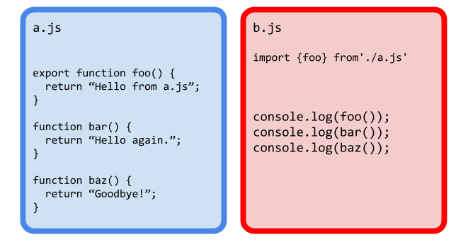
多个函数
Direct Teach (5 m)
Notes:
So what happens if there are multiple functions in a.js that we want to use in b? What do you think will happen here?

Slide 13
多个函数
Direct Teach (5 m)
错误!
Notes:
We’ll get an error -- this is because b.js doesn’t know about the methods bar or baz

Slide 14
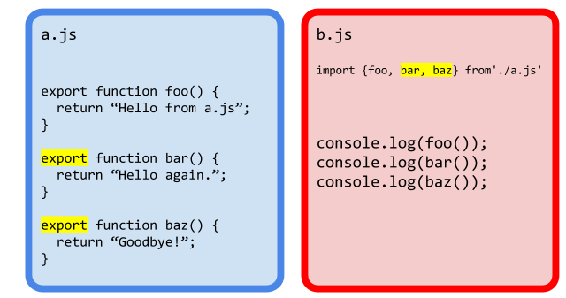
多个函数
Direct Teach (5 m)
Notes:
to export multiple functions we need to add export to these other functions
and pull them in in b.js

Slide 15
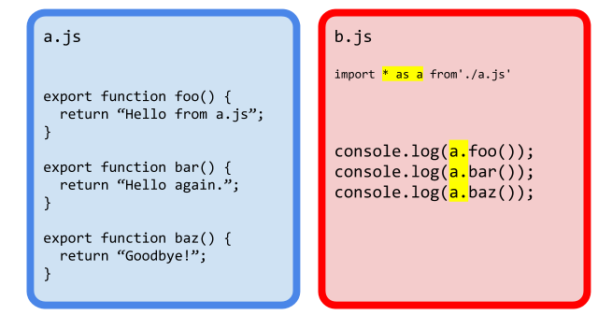
多个函数
Direct Teach (5 m)
Notes:
alternatively, we can just pull in all of the methods in a.js by using the * (maybe a way to remember this is similar to how the * in CSS applies styling to everything)
also notice that the way we call the functions have changed as well.

Slide 16
多个函数
Direct Teach (5 m)
Notes:
notice that we say “as a” and then use dot notation to call each of the methods exported from the file a.js

Slide 17
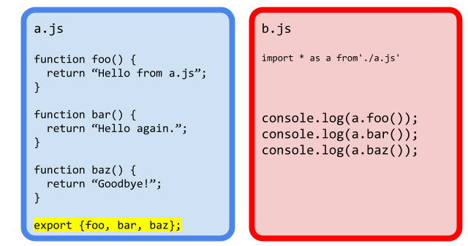
多个函数
Direct Teach (5 m)
Notes:
note that you can move the export statement down to the bottom of your file if you would like.

Slide 18
练习
Guided Practice (3 m)
ex2
Notes:
Activity based on this repl.it

Slide 19
作业
Work Time (60 m)
以银行或者影院售票网站为例
您如何拆分已经编写的代码？
拆分为模块？
Notes:
Teacher Notes:

