Slide 1


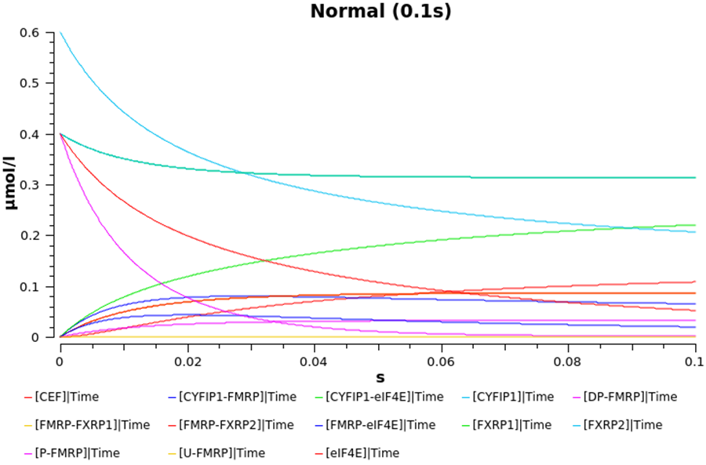
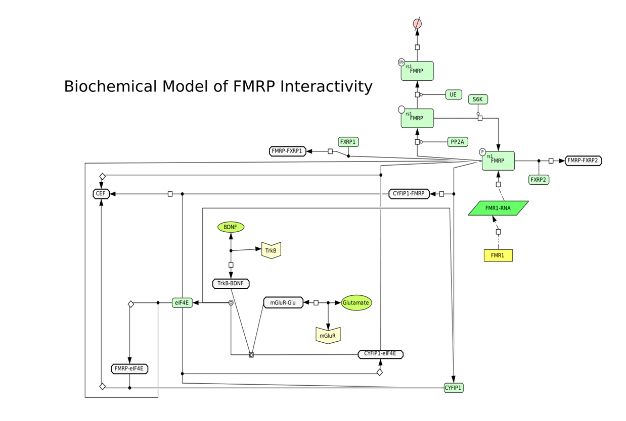
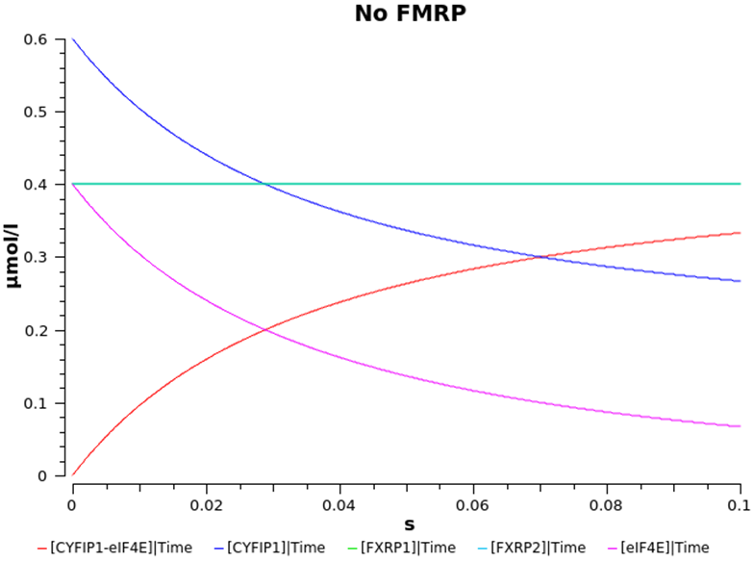
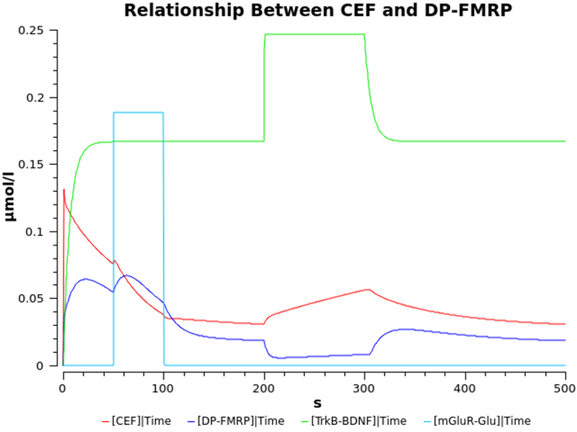
Computational Modelling of FMRP Regulation
Lewis Strachan, Cardinal Newman High School
Introduction
methods
results
In my Nuffield Research Placement I was tasked with creating a computational model of FMRP regulation. FMRP (Fragile X Mental Retardation Protein) is a protein normally expressed in humans and model organisms (e.g. rats, mice) but we are particularly interested in its function in the brain. FMRP has been proven to be a translational repressor (Laggerbauer, 2001) which means that it prevents other proteins being made and this has been shown to be necessary to prevent excess protein synthesis. Unfortunately, there is a genetic neurodevelopmental disorder which is caused by a lack of FMRP: Fragile X Syndrome (FXS).
In non-sufferers of FXS, their FMRP genes have about 5-44 repeats of the CGG triplet (Bagni et al., 2012) which is normal and harmless. Sufferers of FXS have greater than 200 repeats of the CGG triplet (Bagni et al., 2012) which causes the gene to be methylated (silenced) and no FMRP is made.
My computational model includes many key areas of the biochemical interactions of FMRP, including its regulation, its association with the similar proteins FXRP1 and FXRP2, and the formation of the CEF (CYFIP1-eIF4E-FMRP) complex which is the form in which FMRP mediates translational repression. These areas are shown in the diagram below.
The computational model was developed with COPASI (Complex Pathway Simulator) using data from scientific literature and other similar models (you can obtain COPASI from: http://copasi.org/download/). COPASI is mainly used as a deterministic simulator, which means that if you run the model with the same variables several times the results will be the same. This is in contrast to stochastic simulation which means that if the model is run several times then the results will fluctuate. COPASI is a non-spatial modelling software which means that it doesn’t consider factors like collision geometry, activation energy and the position of species that spatial modelling software (e.g. CellBlender) does. Spatial modelling software requires more powerful computers to run on and takes longer to generate a model and obtain results.
The model was run with varied concentrations and reaction rates to investigate specific factors on the biochemical system. The model was run using the Time Course and Parameter Scan tasks. The Time Course task runs the model for a set duration and plots the concentrations of the species over time. The Parameter Scan task is similar to a Time Course but one value (concentration or reaction rate) is varied through a range and this can be used to investigate the effects of the variable on the system. Parameter scans were used to verify if a species’ concentration had a significant impact on the system so we could make estimates for species that we did not know their concentration from current data.
results
The first graph displays the concentrations of all non-constant species in the first 0.1s of the system. This can be said to be the normal operation of the system. In contrast, the other graph displays the concentrations of the same species but the parameters of the model are altered in such a way that FMRP is not present in the system and is not synthesised. This is reflective of the state of the biochemical system in the brain of FXS sufferers. It can be seen that many species are not present in the system due to the loss of FMRP as it is a component of some of these species, and is a precursor to others.
hypotheses
conclusions
The main aim of the investigation was to generate a computational model of FMRP regulation. However, we had some hypotheses that we wished to test:
FMRP is centrally important to the functioning of the system
The regulation of FMRP in turn regulates the system
Receptor binding events play a large role in the regulation of the system
The above graph displays a Time Course that was run for 500s so that we could investigate the effect of neurotransmitters binding to receptors on CEF and dephosphorylated FMRP concentrations. The first “rectangular” spike shows a sharp, temporary increase in mGluR-Glutamate receptor-neurotransmitter complexes and the second is for TrkB-BDNF complexes. It can be seen that mGluR-Glu binding causes a drastic dephosphorylation (due to increased PP2A activity) of FMRP that is quickly rephosphorylated or ubiquitinated and that TrkB-BDNF binding does the opposite but also causes a significant increase in CEF concentration.
By the end of my Nuffield Research Placement I have managed to successfully develop a computational model of FMRP regulation. The model is much larger and more detailed than we had anticipated at the beginning of the placement and due to the presence of receptors and certain enzymes it can be easily integrated into larger models.
From the tests we performed on the model we can conclude that FMRP synthesis is the rate limiting step in the biochemical system, the functioning of the biochemical system is highly dependent on FMRP concentration, and that receptor binding events are key translational effectors.
References
Laggerbauer, B. (2001). Evidence that fragile X mental retardation protein is a negative regulator of translation. Human Molecular Genetics, 10(4), pp.329-338.
Bagni, C., Tassone, F., Neri, G. and Hagerman, R. (2012). Fragile X syndrome: causes, diagnosis, mechanisms, and therapeutics. Journal of Clinical Investigation, 122(12), pp.4314-4322.
Acknowledgements
My thanks go to Mr Richard Fitzpatrick and Dr Melanie Stefan for their supervision.

