Slide 1
NYC Public High Schools
Shiny project presentation
Yisong Tao
10-30-2016

Slide 2
Motivation:
Choosing a high school is one of the first big decisions in life.
New York City offers over 400 public high schools with curriculum spanning all areas.
Provide information about New York City’s public high schools
School districts map
Detailed School Information from 2016 DOE high school directory
2010 and 2012 SAT scores
2011 NYC school survey

Slide 3
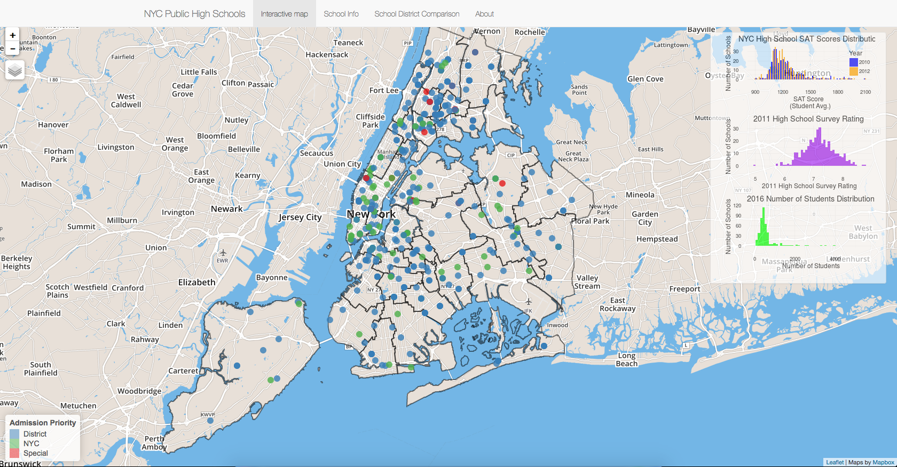
https://yisongtao.shinyapps.io/NYC_HS/

Slide 4
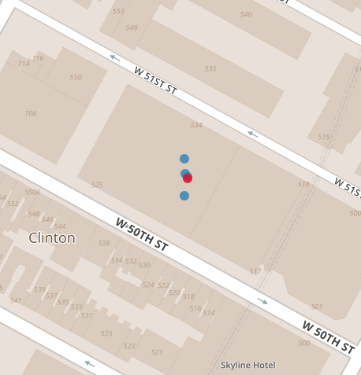
Many NYC schools share campus
437 public high schools, 258 campuses
Some campuses host as many as 6 schools
Used Jitter() when drawing school locations

Slide 5
Let’s see the app in action.

Slide 6
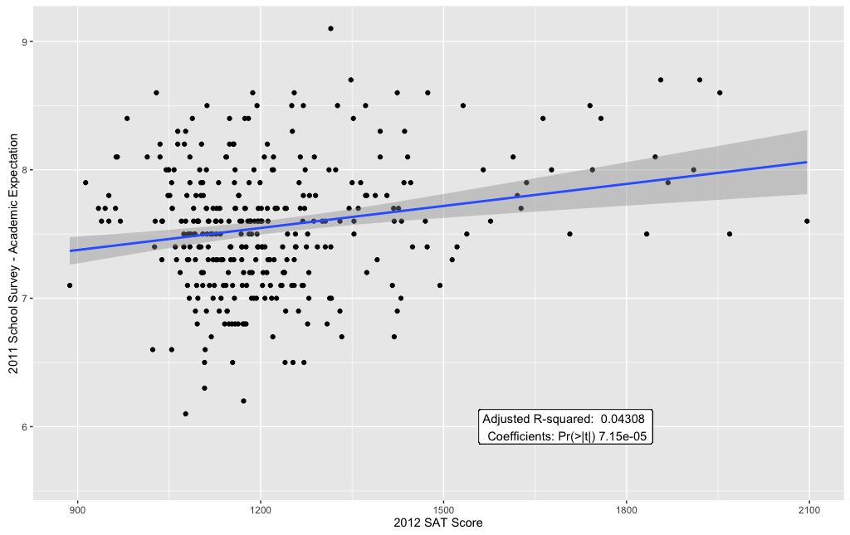
School survey and SAT score:
Both are metrics of a school’s academic performance.
SAT score is objective.
School survey is subjective, a “review”, it reflects how well the school meets the reviewers’ expectations.

Slide 7
Thank you!

