Slide 1

Multivariate Data Analysis Using Topological Signatures
Nov 8
Yitao LI

Slide 2
Overview
Topological data analysis (TDA)
Main focus on today’s presentation
Main contribution of this paper: (2012)
Propose a new visualization technique: persistence ring (but no one is using it now).
Run TDA on real data set – cuneiform tablet. (Clustering)
Cuneiform (楔形文子):
the wedge-shaped characters used in the ancient writing systems

Slide 3
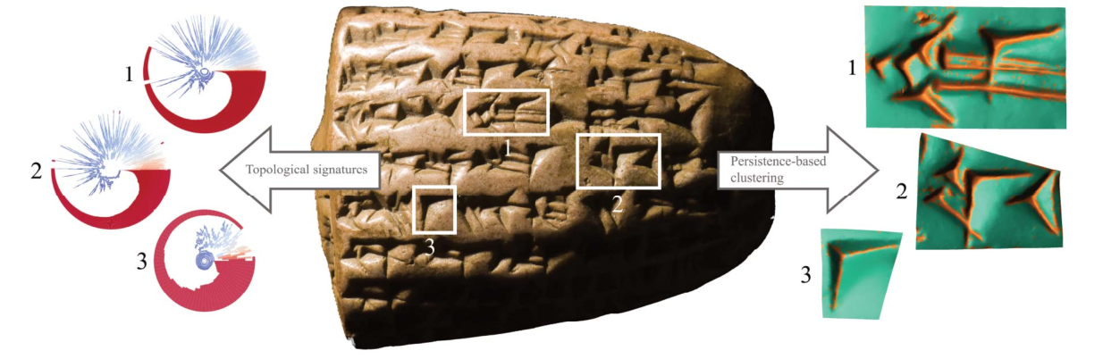
High-resolution surface scan of a cuneiform tablet, which can be described by 16-dimensional vectors.
clustering
The persistence rings
Characters

Slide 4
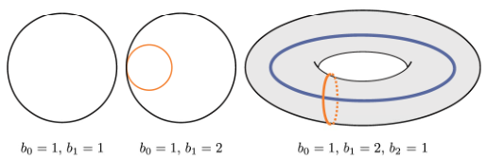
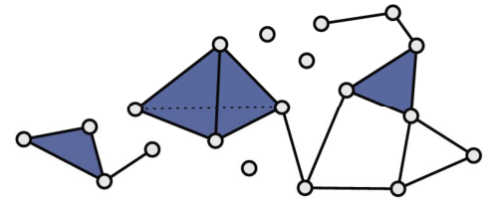
Topological features
nth Betti numbers – nth dimensional holes
0: connected components
1: tunnels
2: voids
…
The topological space is described by simplicial complex.
0-dimensional simplices: vertices
1: edges
2: triangular faces
…

Slide 5
Persistent homology
The real-world data sets are not commonly endowed with a topological structure. Therefore, a standard method is to calculate the Rips graph (Rε).
Rε : a graph with vertices and edges that
Intuitively speaking: the vertices always exist. But edges will appear if the distance between two nodes are smaller than ε.
For example:
When ε = 0: Betti-0 = # vertices
When ε = inf: Betti-0 = 1

Slide 6
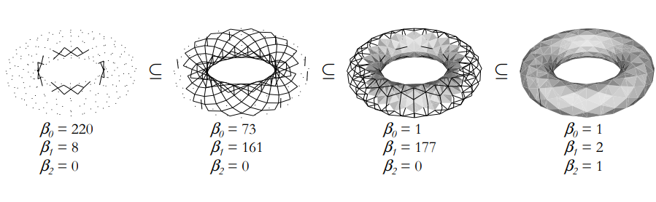
Persistent homology - Filtration
One Rips graph is corresponding to one ε value. When we increase ε from 0 to inf. There will be a sequence of Rips graphs, each of them will have different dimensional holes.
For example:
This dynamic process is called: filtration.
The distance can defined by but not limited to Euclidean distance.

Slide 7
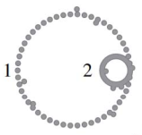
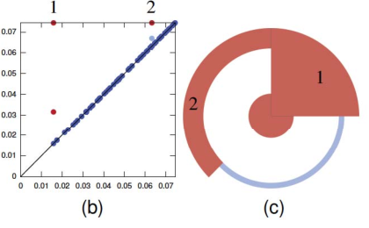
Visualization:
Two nested circles:
Sample with 150 points per each.
Classic: persistence diagram
X axis: birth; Y axis: death
Points at the diagonal means they have a very short lifespan -> Nosie
Color blue: close to diagonal
Persistence Ring:
Angular offset (the radius):
the lifespan
Opening angle:
optimized to avoid overlap
Betti 1
Persistence Diagrams
Persistence Ring

Slide 8
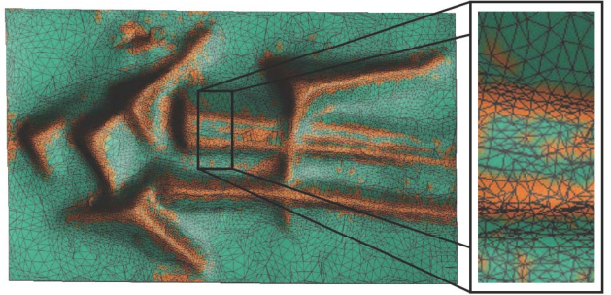
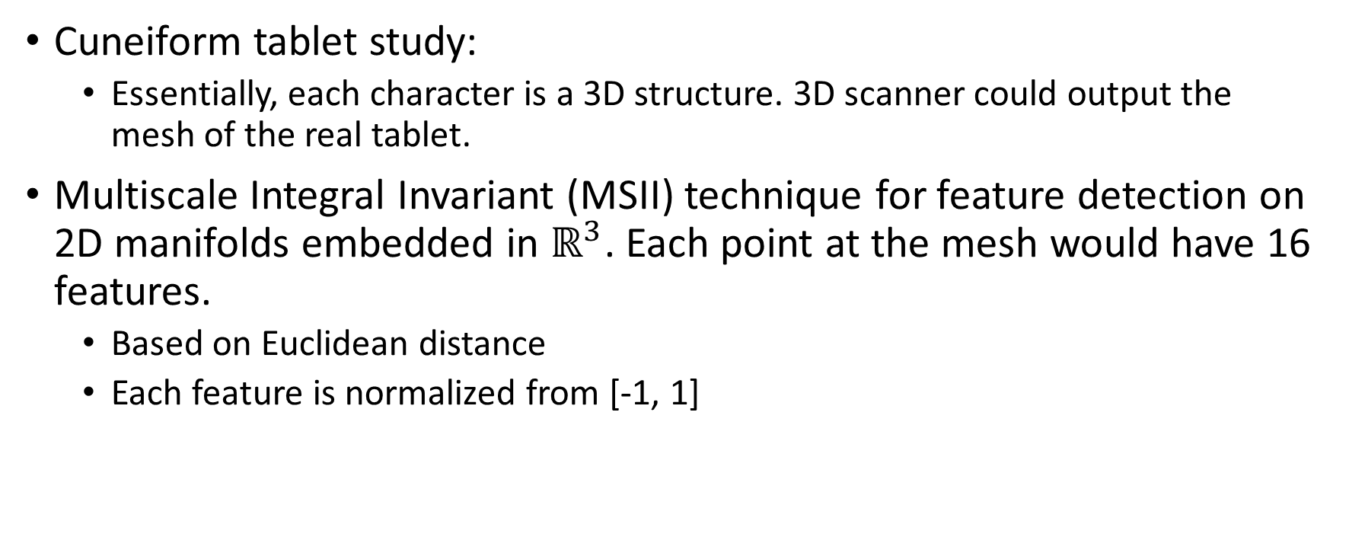
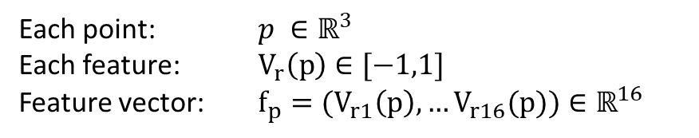
Where does multivariate come into picture?
Cuneiform tablet study:
Essentially, each character is a 3D structure. 3D scanner could output the mesh of the real tablet.
Multiscale Integral Invariant (MSII) technique for feature detection on 2D manifolds embedded in $ℝ^{3}$. Each point at the mesh would have 16 features.
Based on Euclidean distance
Each feature is normalized from [-1, 1]
Each point: $p ∈ℝ^{3}$
Each feature: $V_{r}\left(p\right)∈[−1,1]$
Feature vector: $f_{p}=(V_{r1}\left(p\right),…V_{r16}(p))∈ℝ^{16}$

Slide 9
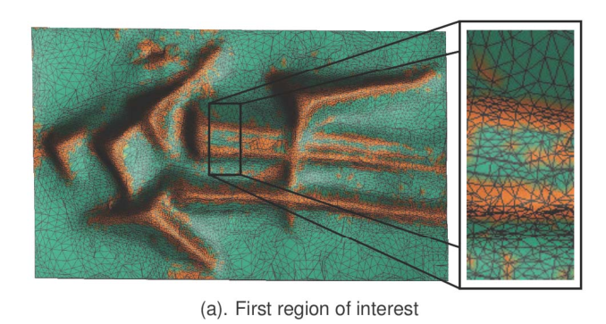
Real-world data set:
Persistence-based clustering
Density is using the distance to a measure (Only requires distance function)
Coarse clusters
Drawing persistence ring per cluster.

Slide 10
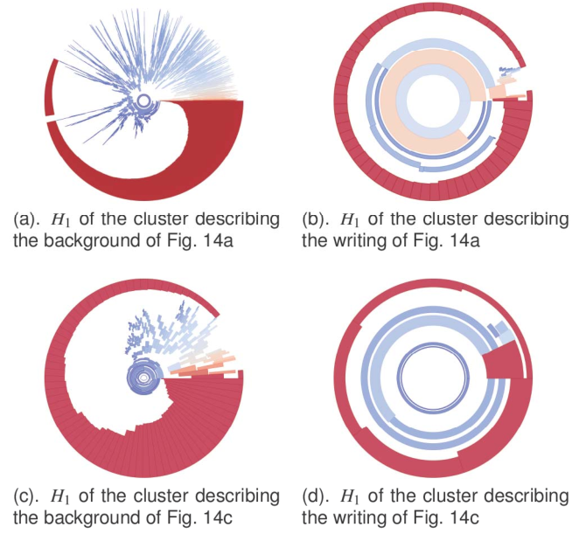
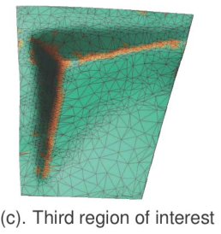
Notes:
Background clusters exhibit same topology regardless of the # vertices.

Slide 11
Conclusion
Achievements:
Clustering: Able to segment tablets into background and writing.
Persistence Ring: Background clusters exhibit same topology regardless of the # vertices.
Final remark:
Cons: failure to extract characters from the tablet (ultimate goal); completed data set is filtered to manually selected regions (due to too many noises); persistence ring technique does not become a common method.
Pros: But this study demonstrate that the potential of topological data analysis, which does provide some insights about high-dimensional data set in this paper.

