Slide 1
Presentation

Slide 2
Topic
Housing price is highly dependent on both the surrounding items and the housing features.
This research gathers historical information on the change of housing price and build a model in order to predict housing price according to features. (using Queen’s historical dataset as example)

Slide 3
Basic analysis
Sale Number Trend
Sale Average Price Trend

Slide 4
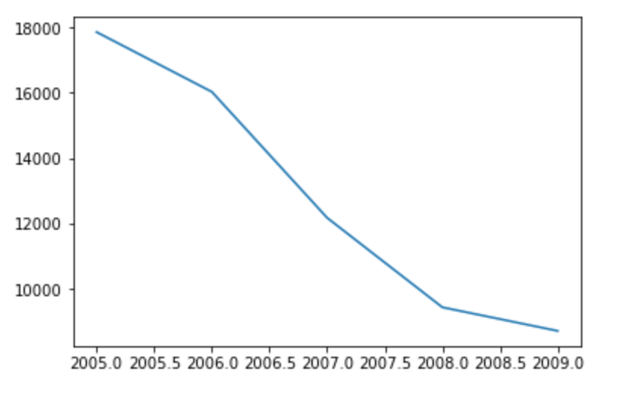
Sale Number Trend

Slide 5
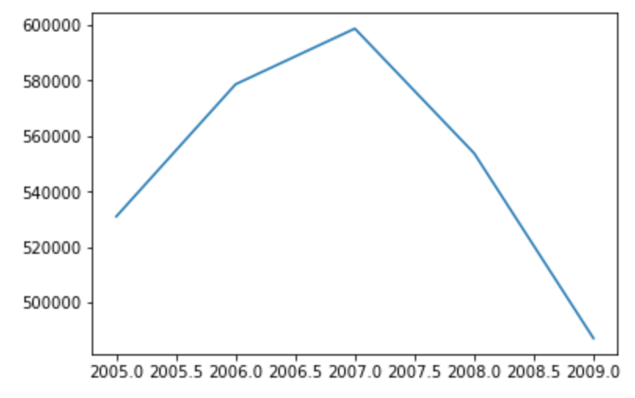
Sale Average Price Trend

Slide 6
Features that matters
location
House features
Surroundings
…

Slide 7

Data accuracy

