Slide 1
UNIVERSITY OF GONDAR • COLLEGE OF INFORMATICS
CAMPUS APPOINTMENT
BOOKING SYSTEM
A Cross-Platform Mobile & Web Solution for Higher Education Scheduling
Course Project: Mobile Application Development (CoIt-3112)
Submitted by: Department of Information Technology (IT) Project Team
Date of Submission: May 2026

Slide 2
THE SCHEDULING CRISIS
The Institutional Bottleneck
• Manual, Paper-Based Workflows:
Traditional office queues waste valuable study hours standing outside offices.
• Zero Real-Time Availability:
Students lack visibility into whether service providers are out-of-office, in a meeting, or free.
• Document Fragmentation & Loss:
Supporting files (medical certificates, registration forms) get misplaced in chaotic email chains.
• Telehealth & Virtual Consultations Gap:
Distance students must manually coordinate virtual meetings, leading to disconnected experiences.
THE BOTTLENECK
1. Chaotic Queues
2. Blind Bookings
3. Missing Documents
4. Fractured Communication
Result: High institutional friction and reduced student academic satisfaction.

Slide 3
PROJECT OBJECTIVES
Core Vision & Objectives
• Unified Digital Scheduler:
Bridge the gap between students and administrative/clinical departments through an intuitive, centralized portal.
• Real-Time Reactive Synchronization:
Enable immediate booking confirmation, cancellation reason tracking, and instant role-based dashboard updates.
• Robust State Preservation (Routing Cache):
Implement background routing cache models so user sessions survive unintended web browser refreshes cleanly.
• Attendance & Validation Automation:
Leverage local secure QR code ticket generation and mobile scanning for quick, authenticated attendance tracking.

Slide 4
SYSTEM ACTORS
Specialized Role Workflows
STUDENT
SERVICE PROVIDER
SYSTEM ADMIN
• Search & Filter Departments
• Select Available Time Slots
• Upload Support Attachments
• Real-Time Text Messaging
• Check-in QR Codes
• Direct Jitsi Telehealth Join
• incoming Booking Pipeline
• Single-Click Confirm/Decline
• Log Decline Explanations
• QR Attendance Scanner
• Global Availability Switch
• In-App Jitsi Video Rooms
• Department Entity Setup
• User Role Elevation Console
• Multi-Department Auditing
• Service Category Tuning
• Session Transaction Logs
• General Analytics Metrics

Slide 5
TECH STACK
High-Level System Architecture
• Front-End (Client Layer):
Cross-platform app built natively with Flutter, using MultiProvider state controllers and SharedPreferences local caching.
• Transport Layer (APIs & Real-time):
HTTP REST APIs via Axios/HTTP clients and WebSockets via Socket.IO for immediate, timezone-aware chats.
• Back-End (Service Layer):
Node.js and Express REST engines secured by JSON Web Token (JWT) authenticators.
• Database (Persistence Layer):
Scalable, cloud-hosted MongoDB Atlas Cluster supporting schema-based collection configurations.
DATA PIPELINE & ARCHITECTURE
[ Flutter Client UI ]
│ ▲ (State Controllers)
▼ │
[ REST APIs & WebSockets ]
│ ▲ (JWT Secured Route)
▼ │
[ Node.js Express Server ]
│ ▲ (Mongoose schemas)
▼ │
[ MongoDB Atlas (Cloud) ]

Slide 6
TECHNICAL INNOVATIONS
Core Engineering Enhancements
1. Routing State Preservation (Web Refresh Recovery):
• Challenge: Organic web browser page refreshes normally wipe out current screen routes.
• Solution: Integrated SharedPreferences state interceptor in all core dashboard screen views, restoring the user's active screen (e.g. `my_appointments` vs `manage_appointments`) upon reload.
2. Conditional Jitsi Meet Video Compilation:
• Challenge: Native Jitsi video SDKs cause build failures and compiler conflicts on Flutter web platforms.
• Solution: Built a Conditional Stub Architecture wrapper using dynamic platform queries (kIsWeb) to load native mobile controllers for apps, falling back to seamless native browser stubs (`js.context.callMethod('open')`) for web clients.

Slide 7
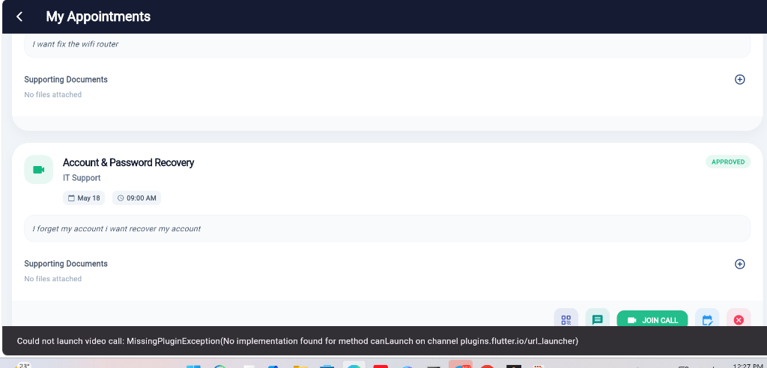
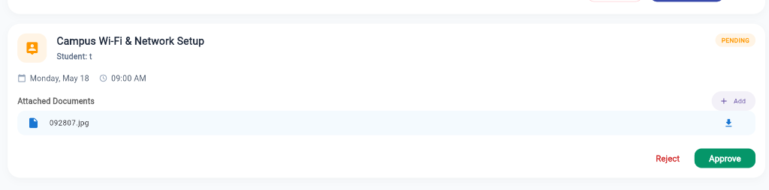
STUDENT & VIDEO INTERFACE
Student Consultation & Jitsi Portals
My Appointments Portal (Student View)
• Displays a chronological list of student appointments with colored status flags.
• In-app deep integration with virtual meeting rooms.
• One-tap 'JOIN CALL' action triggers virtual meeting launchers.
Detail Dashboard (Staff/Advisor View)
• Granular overview of incoming appointment requests.
• Lists download links to file attachments uploaded by students.
• Instant actions: green-lit 'Approve' and red-lit 'Reject'.

Slide 8
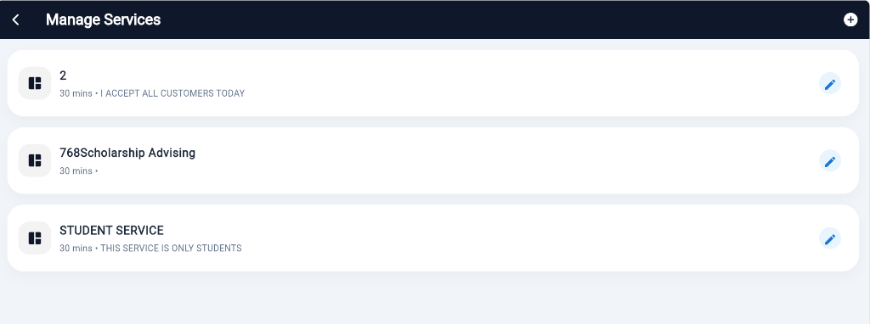
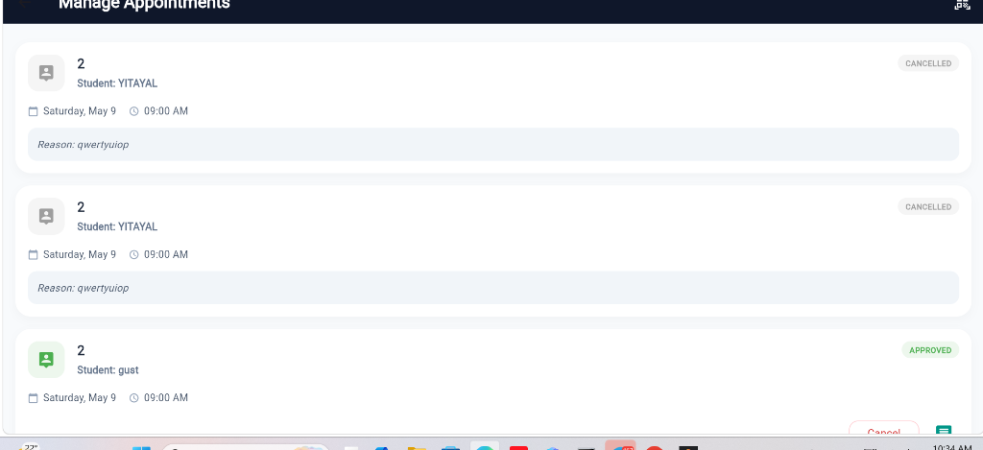
STAFF DASHBOARD
Service & Staff Administration Controls
Service Category Configurator
• Staff/Admin portal to add and manage different services.
• Set customizable service durations (e.g. 30 mins) and link to respective departmental heads.
• Clean grid edit interfaces built using Material Design cards.
Administrative Booking Pipelines
• Comprehensive timeline dashboard listing all student requests.
• Displays dynamic cancellation notices and approved virtual schedules.
• Role-filtered metrics track institutional workloads.

Slide 9
DEPLOYMENT & MIGRATION
Seamless System Deployment
• Live API Cloud Deployments:
Express.js server deployed onto Render hosting servers with static root redirect mappings for web clients.
• Cloud Database Orchestration:
MongoDB local databases successfully migrated to secure MongoDB Atlas cloud instances, configured with role-based accessibility filters.
• Client-Side Executable Compilations:
• Web: Bundles generated via `flutter build web` served automatically as static public middleware assets.
• Android: Release packages (`app-release.apk`) successfully compiled ready for student downloads.
DEPLOYMENT MATRIX
■ BACKEND STACK:
• Hosting: Render Cloud
• DB: MongoDB Atlas (Live)
• Auth: Salter BCrypt / JWT
■ FRONTEND STACK:
• Framework: Flutter 3.x
• Deploy Web: Built-in middleware
• Deploy Android: Release APK

Slide 10
CONCLUSION & FUTURE ROADMAP
A Seamless Future for Campus Scheduling
KEY ACHIEVEMENTS
• Successfully unified student/staff calendars into a responsive, real-time dashboard.
• Overcame web browser reload routing resets using persistence caches.
• Eliminated mobile-web compilation conflicts through conditional stub layers.
FUTURE ENHANCEMENTS
• AI-Driven Auto-Scheduling: Intelligently matching students with optimal advisor time slots.
• Push Notifications: Automatic WhatsApp & SMS alert chains (via Twilio).
• Advanced Office Analytics: Admin reports mapping department load metrics over semesters.

