Slide 1
SALESPERSON TRAINING IN RETAIL STORES
Jonhason Ang
Yiting Wang
Chengzhuang Zheng

Slide 2
Background
A national jewelry retailer has employees’ sales and return performance data for three years 2011, 2012, & 2013.
In 2011, no training program was offered.
In 2012, three training modules were offered: warranty, credit, special events.
In 2013, five additional training modules were offered: celebrity brand, celebration, watches, color, & service skill.
Employees can take any training modules in 2012 and 2013.
Goal: the retailer want to understand the impact of the training program on the sales and return performance.

Slide 3
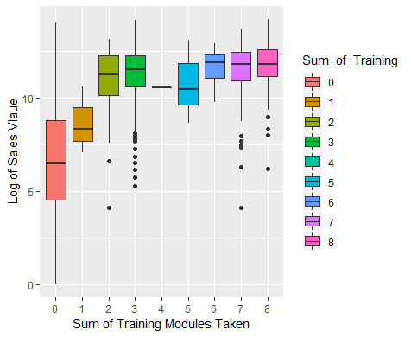
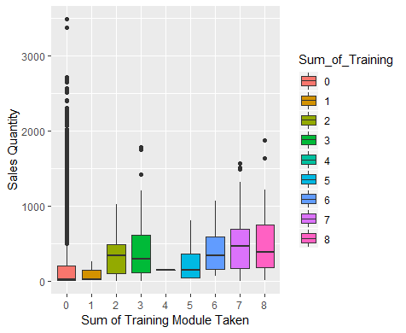
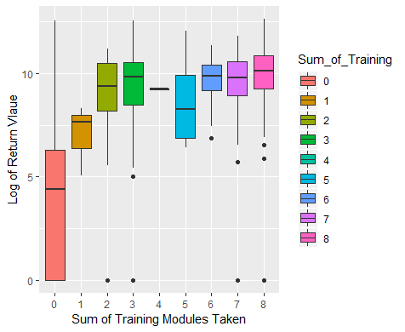
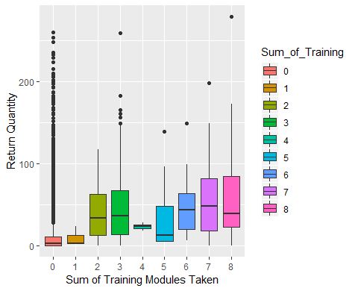
Raw data plots
Need further analysis to derive valuable insights

Slide 4
Question 1: Impact of Training Program on
Salesperson Sales and Return Performance
Dependent Variable: 1) Sales Value 2) Sales Quantity
3) Return Value 4) Return Quantity
Key Independent Variable: Program (0 for 2011,1 for 2012 & 2013)
Interaction Term: Group (if that employee take at least one
training module in year 2012 or 2013)
Control Variables: store_number, year of service, rate of pay, etc.
Two Groups: store managers, salespeople

Slide 5
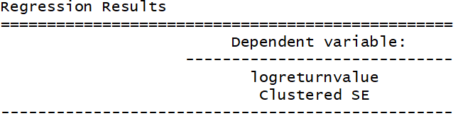
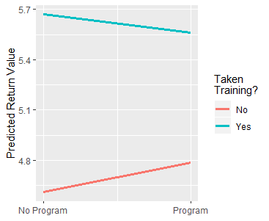
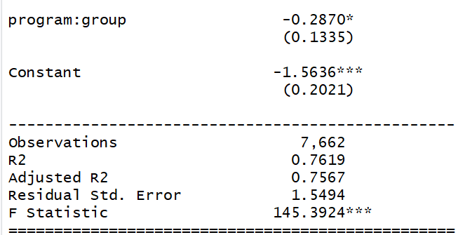
Impact of Training Program on Return Value of Salespeople
The impact of training program on return value is less on salespeople who took the training module.
Notes:
Coefficient of the interaction term is negative and significant, hence we look at the marginal effect to analyze the impact of training program on return values of salespeople. The impact of program decreased as salespeople took at least one training module in the year of 2012 & 2013.

Slide 6
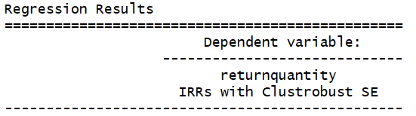
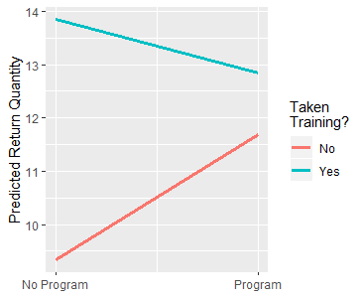
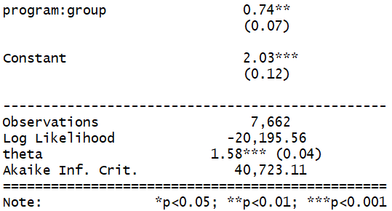
Impact of Training Program on Return Quantity of Salespeople
The impact of training program on return quantity is more on salespeople who took the training module.
Notes:
Coefficient of the interaction term is Positive and significant, hence we look at the marginal effect to analyze the impact of training program on return quantity of salespeople. The impact of program increased as salespeople took at least one training module in the year of 2012 & 2013.

Slide 7
Insights
The impact of training program on sales value and sales quantity cannot be interpreted based on the current data. We do not have a reliable model to make the analysis.
Based on the analysis, we can conclude that by implementing the training program, people who take the training modules would incur less return values but more return quantity. This may due the increased selling skill of the salespeople, so they oversell. Customers will eventually return the products if they do not like the products.

Slide 8
Question 2: Impact of completing at least one
training module on salesperson sales and
return performance?
Dependent Variable: 1) Sales Value 2) Sales Quantity
3) Return Value 4) Return Quantity
Key Independent Variable: Group (1 if completed at least 1 module, 0 otherwise)
IV’s: Marital Status & Dependent
(depends on the model)
Control Variables: store_number, year of service, rate of pay, etc.
Two Groups: store managers, salespeople

Slide 9
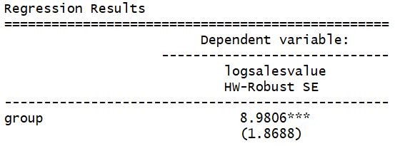
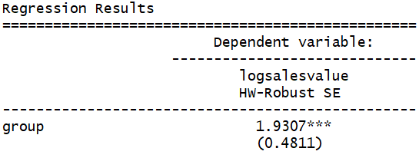
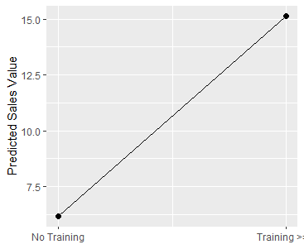
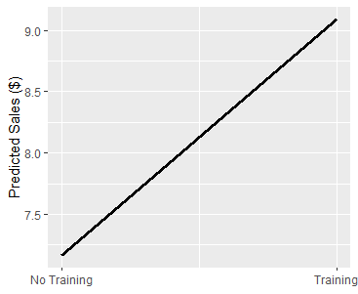
Impact of Taken At Least One Training Module on Sales Value
Salespeople
Store Managers
For salespeople, take at least one training module, will increase the sales value by 898%. For store managers, take at least one training module, will increase the sales value by 193%. We can conclude that taking at least one training module will increase the sales value.

Slide 10
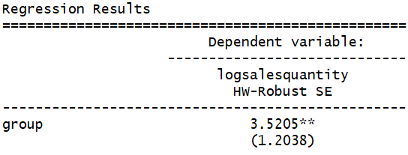
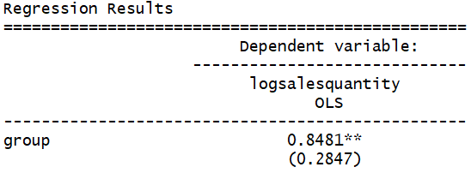
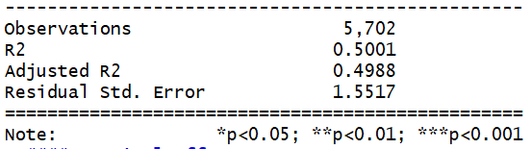
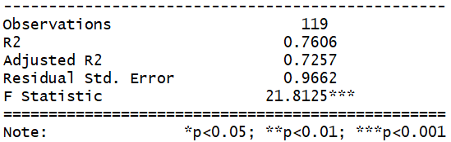
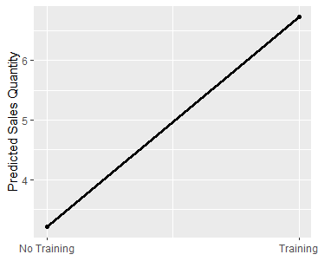

Impact of Taken At Least One Training Module on Sales Quantity
Salespeople
Store Managers
For salespeople, take at least one training module, will increase the sales quantity by 352%. For store managers, take at least one training module, will increase the sales quantity by 84.81%. We can conclude that taking at least one training module will increase the sales quantity.
Notes:
Use 2SLS models to address the endogeneity in the count model.

Slide 11
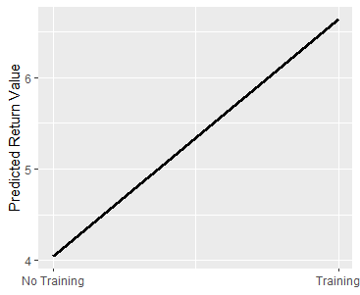
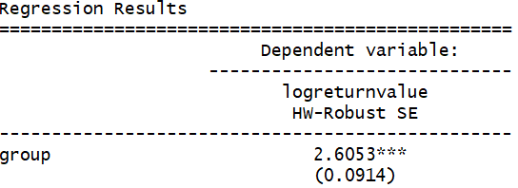
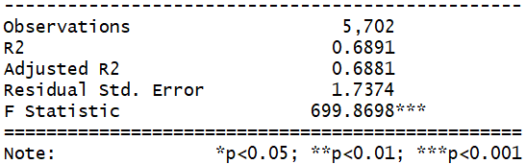
Impact of Taken At Least One Training Module on Return Value for Salespeople
For salespeople, take at least one training module, will increase the return value by 260.5%. This may due to overselling of the salespeople.

Slide 12
Question 3: What is the impact of completing every
additional training module on a salespersons
sales and return performance?
Dependent Variable: 1) Sales Value 2) Sales Quantity
3) Return Value 4) Return Quantity
Key Independent Variable: Sum of training (amount of training a person takes)
IV’s: Marital Status & Dependent
(depends on the model)
Control Variables: store_number, year of service, rate of pay, etc.
Two Groups: salespeople

Slide 13
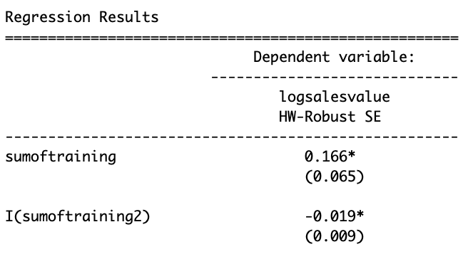
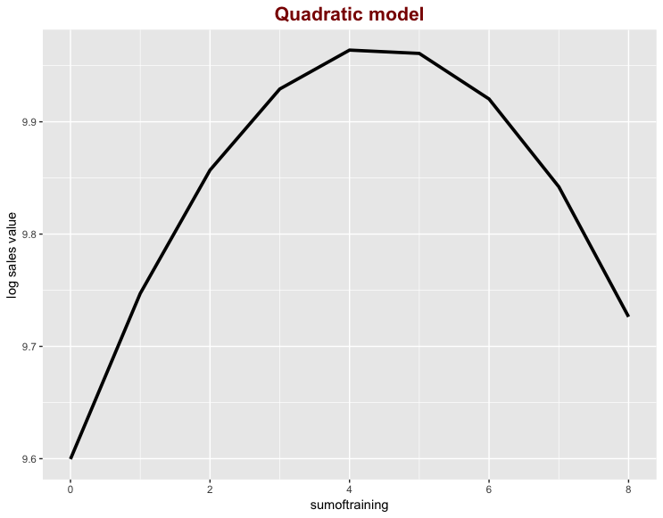
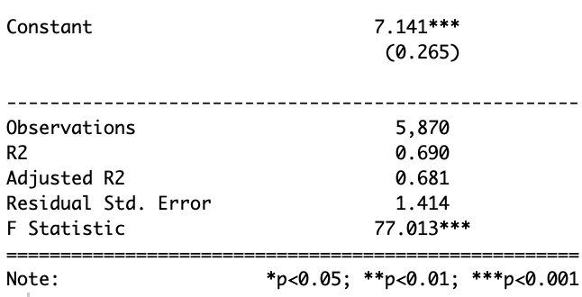
Impact of additional training to sales
Taking up to 4 training will result in increase in sales.
Taking more than 4 training will result in a decrease in sales
Suggestion: Salesperson should only take a max for 4 training module

Slide 14
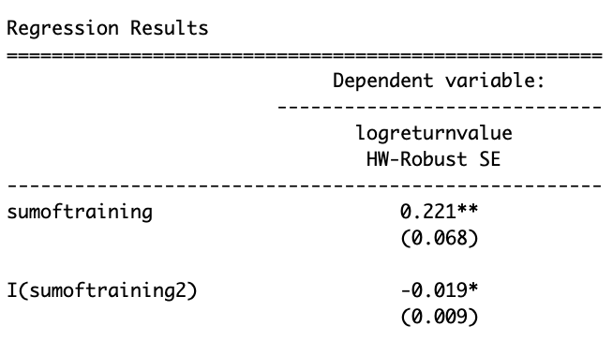
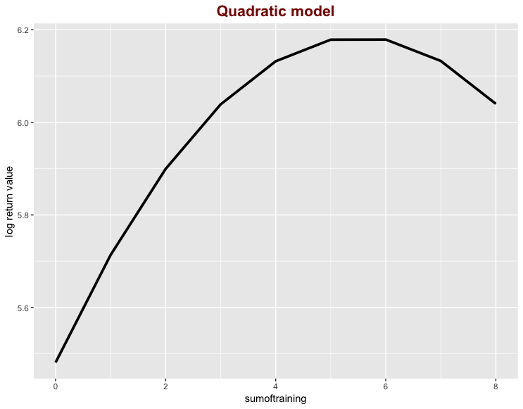

Impact of additional training to return
Taking up to 4 training will result in increase in returns.
Taking more than 4 training will result in a decrease in returns
Suggestion: Salesperson should only take more than 4 training module

Slide 15
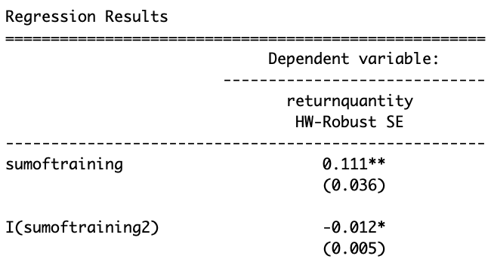
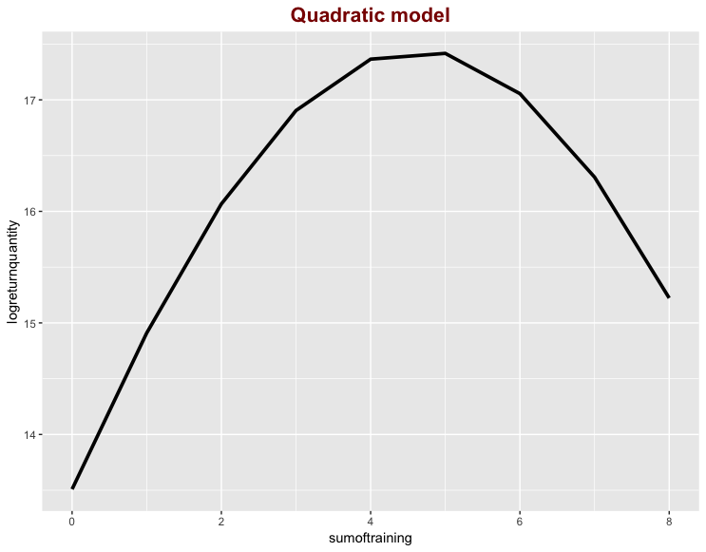
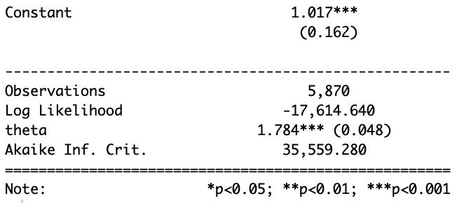
Impact of additional training to reutn quantity
Taking up to 5 training will result in increase in returns quantity.
Taking more than 5 training will result in a decrease in returns quantity
Suggestion: Salesperson should only take more than 5 training module

Slide 16
Question 4: Who benefits more from training: Full time or
Part time employees
Dependent Variable: 1) Sales Value 2) Sales Quantity
3) Return Value 4) Return Quantity
Key Independent Variable: Group (1 if completed at least 1 module, 0 otherwise)
IV’s: Marital Status & Dependent
(depends on the model)
Control Variables: store_number, year of service, rate of pay, etc.
Two Groups: salespeople

Slide 17
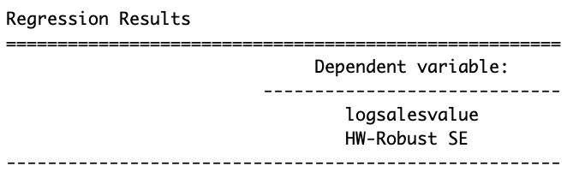
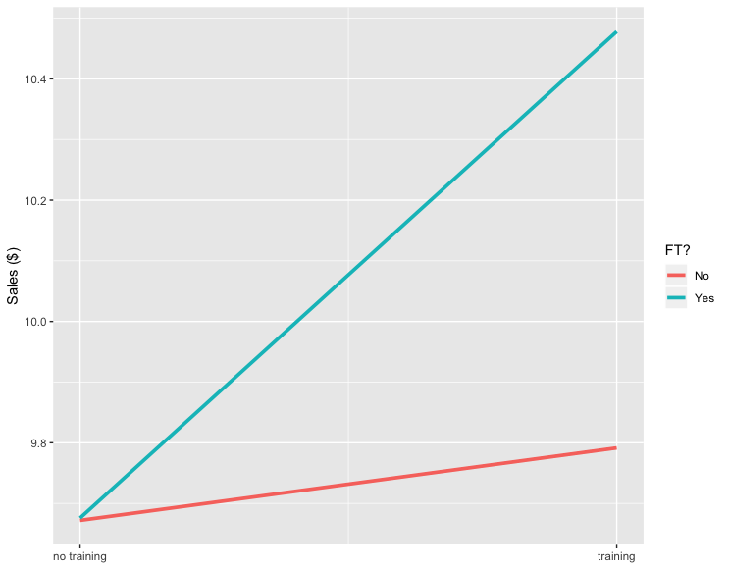
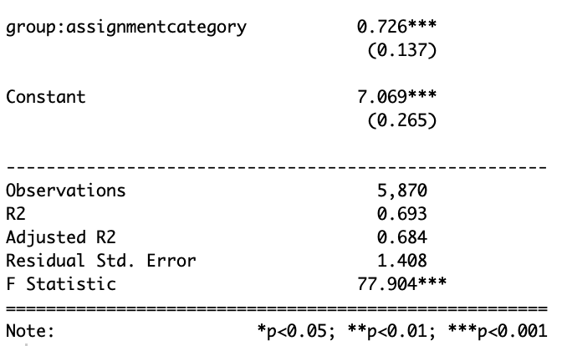
Impact of sales on part time & full time
Part time: Training will result in the increase in sales
Full time: Training will result in the increase in sales
Training on full time employees is more impactful than training on part time employees

Slide 18
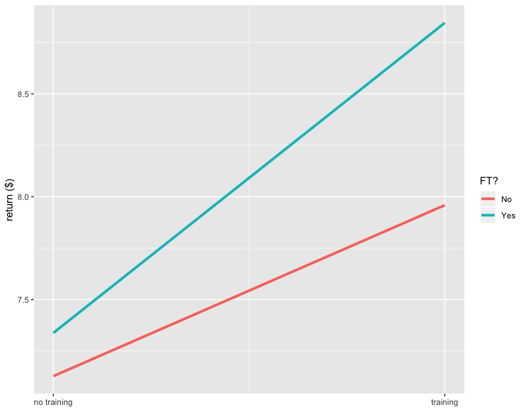
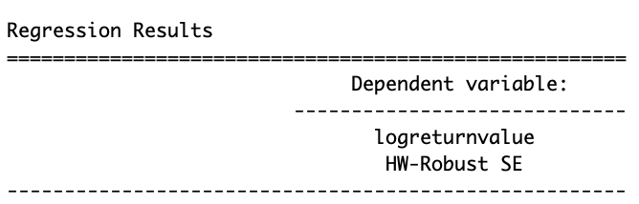
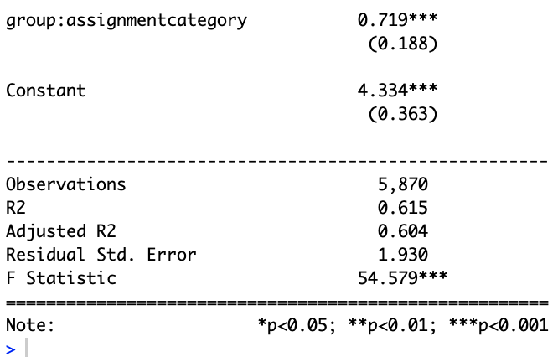
Impact of return on part time & full time
Part time: Training will result in the increase in sales
Full time: Training will result in the increase in sales
Training on full time employees is more impactful than training on part time employees

Slide 19
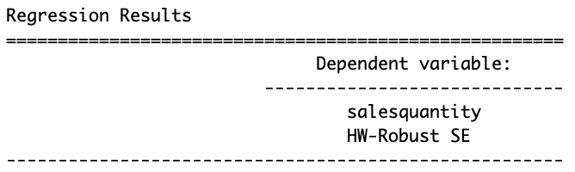
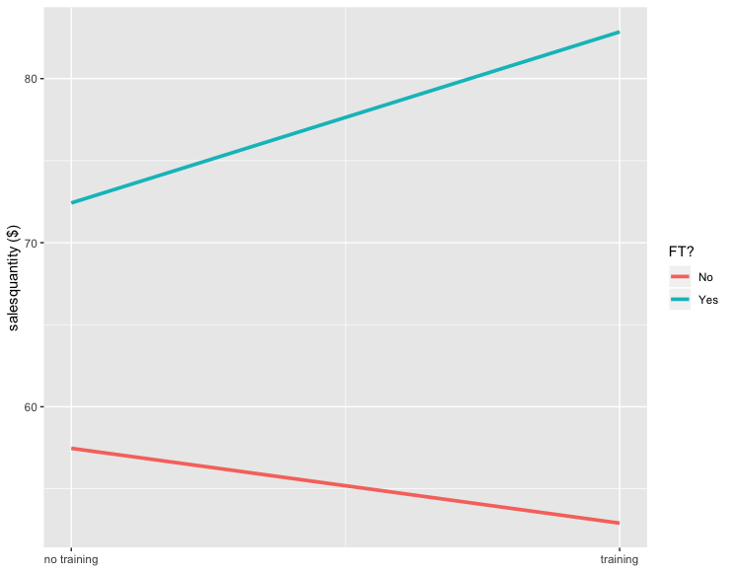
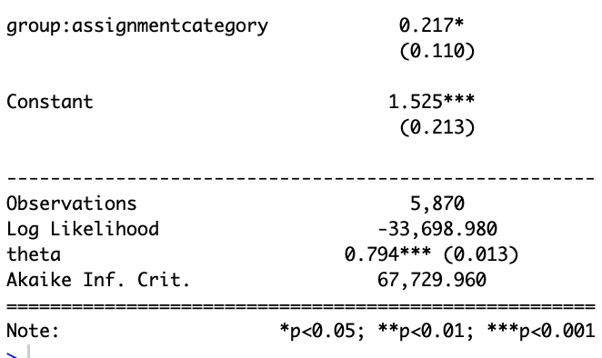
Impact of sales quantity on part time & full time
Part time: Training will result in the increase decrease in sales quantity
Full time: Training will result in the increase in sales
Suggestion: Only train full time employees

Slide 20
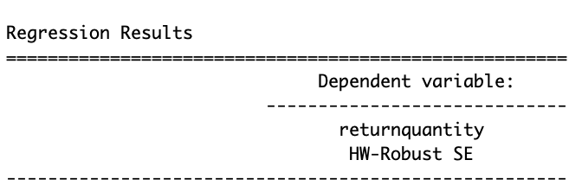
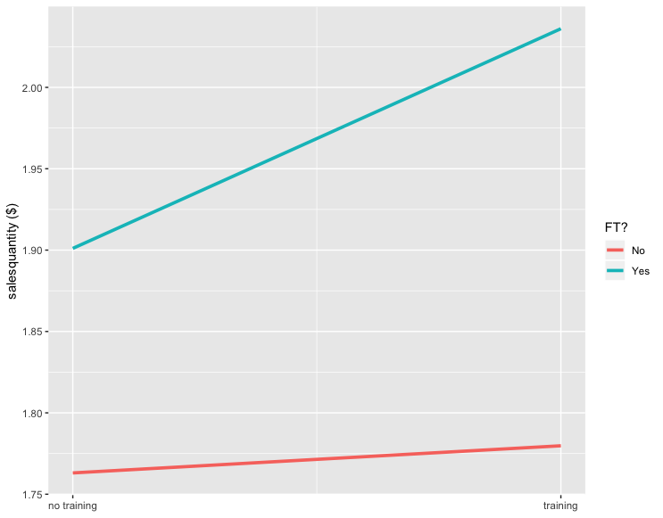
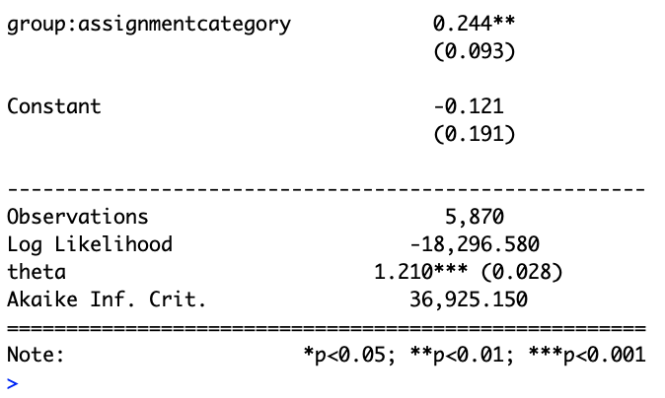
Impact of return quantity on part time & full time
Part time: Training will result in the increase in sales quantity
Full time: Training will result in the slight increase in sales quantity
Training on full time employees is more impactful than training on part time employees

Slide 21
Question 5: Who benefits from the training more:more experienced employees or less experienced employees?
Dependent Variable: 1) Sales Value 2) Sales Quantity
3) Return Value 4) Return Quantity
Key Independent Variable: sum of training modules*service year
IV’s: Marital Status & Dependent
(depends on the model)
Control Variables: store_number, year of service, rate of pay, etc.
Two Groups: store managers, salespeople

Slide 22
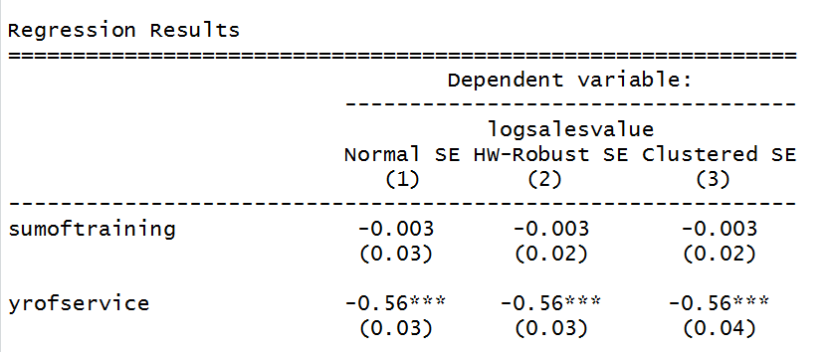
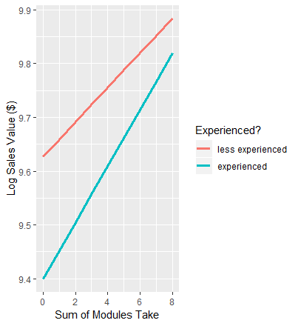
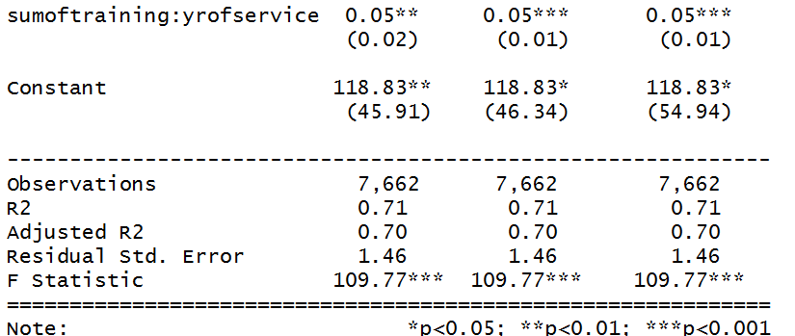
Impact of Training Modules on Experienced Salespeople & Less Experienced Salespeople on Sales Values
The impact of training modules on sales values is greater on experienced salespeople than on less experienced salespeople.

Slide 23
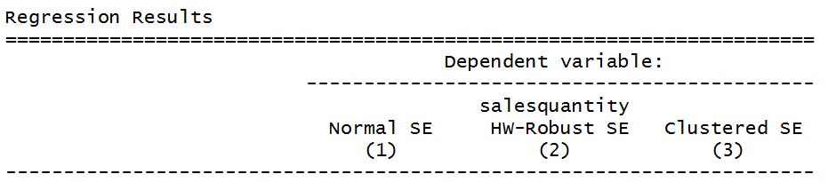
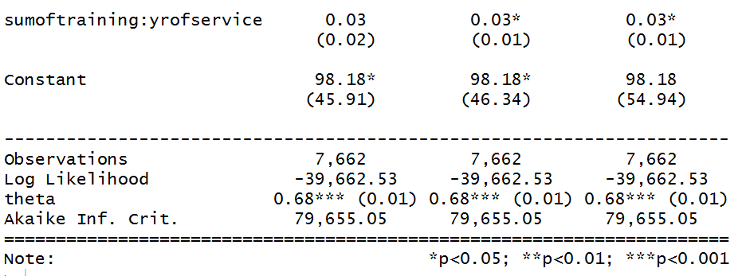
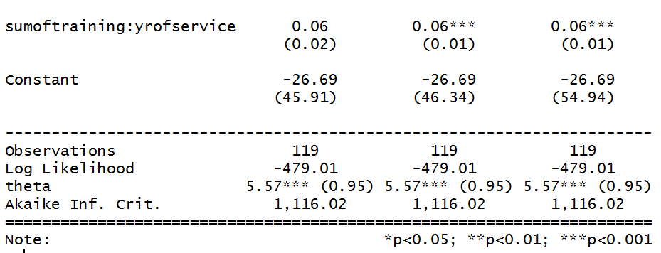
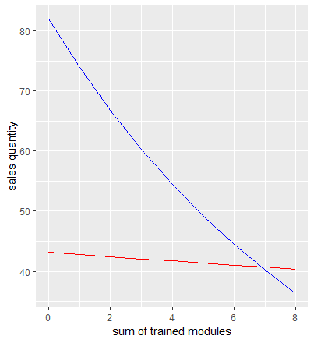
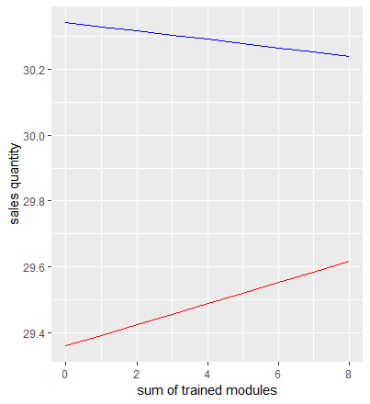

Impact of Training Modules on Experienced Employee & Less Experienced Employee on Sales Quantity
Salespeople
Store Manager
Training on experienced employees is more impactful than training on less experienced employees.

Slide 24
Question 6:Is the impact of training on salesperformance different for employees who completed the service and selling training?
Dependent Variable: 1) Sales Value 2) Sales Quantity
3) Return Value 4) Return Quantity
Key Independent Variable: product knowledge*service_selling module
IV’s: Marital Status & Dependent
(depends on the model)
Control Variables: store_number, year of service, rate of pay, etc.
Two Groups: store managers, salespeople

Slide 25


Conclusion
The impact of training has no statistically significant impact on salesperformance from employee(store manager & salespeople) who take the service and selling training to who did not. Different from what you assumed? The multicollinearity and lack of data(both variables and observation)might be two of the reasons.
Salespeople
Store Manager

Slide 26
Suggestion
Prioritize the training budget for full time employees.
Prioritize the training budget for experienced salespeople and store managers.

Slide 27
Limitations
More data on salespeople would increase the accuracy of final model.
Not enough data for store managers.
Not enough variables to choose feasible IVs.
Missing data on geographic related store informations, limited the quality of final models.
Severe multicollinearity exist in the question 6, may be improve when we have larger dataset

