Slide 1
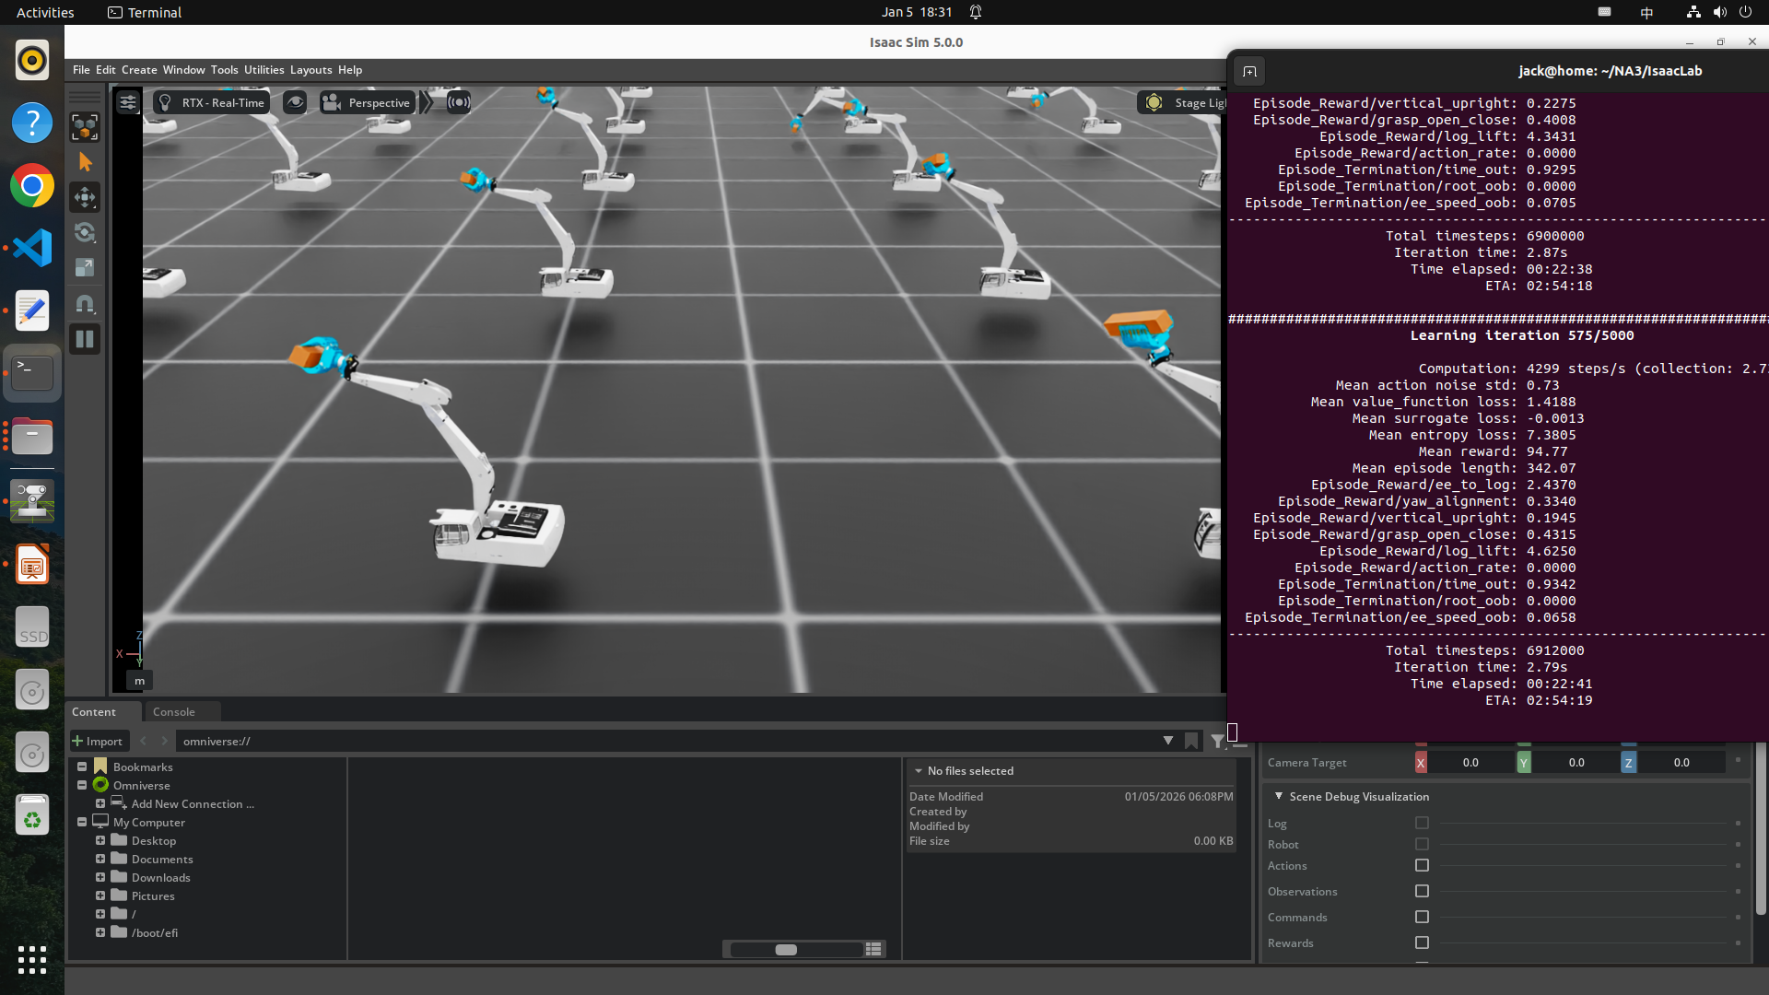
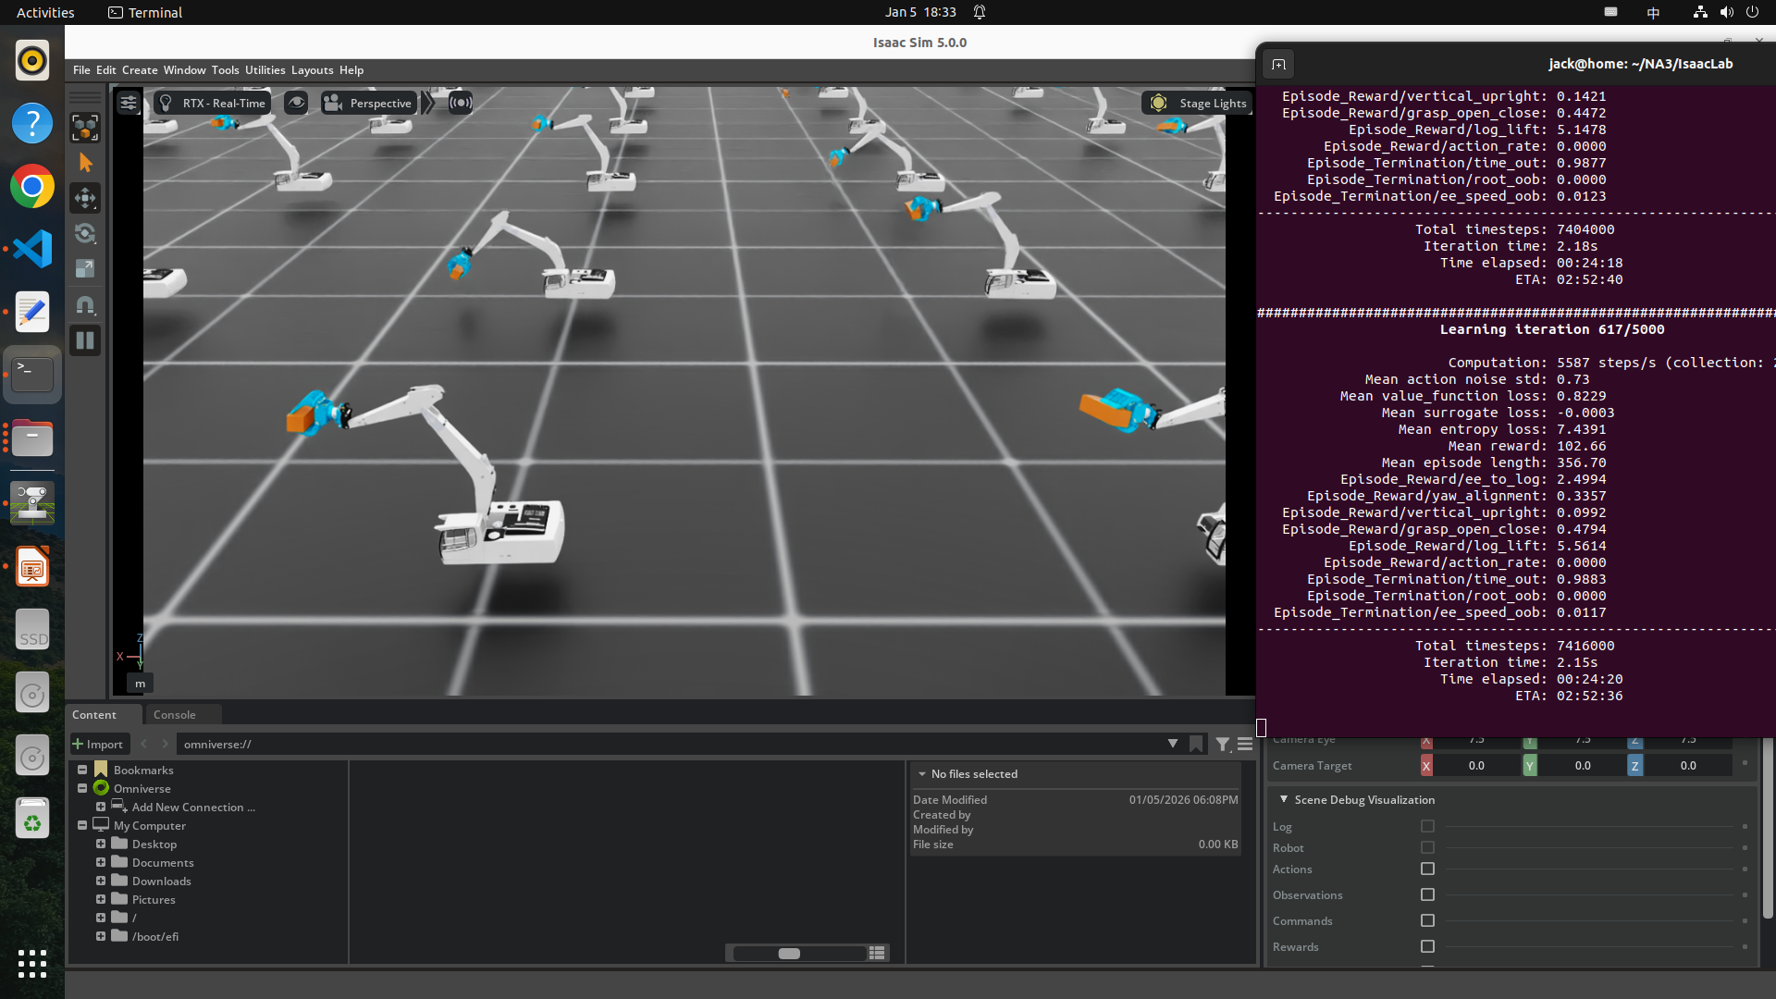
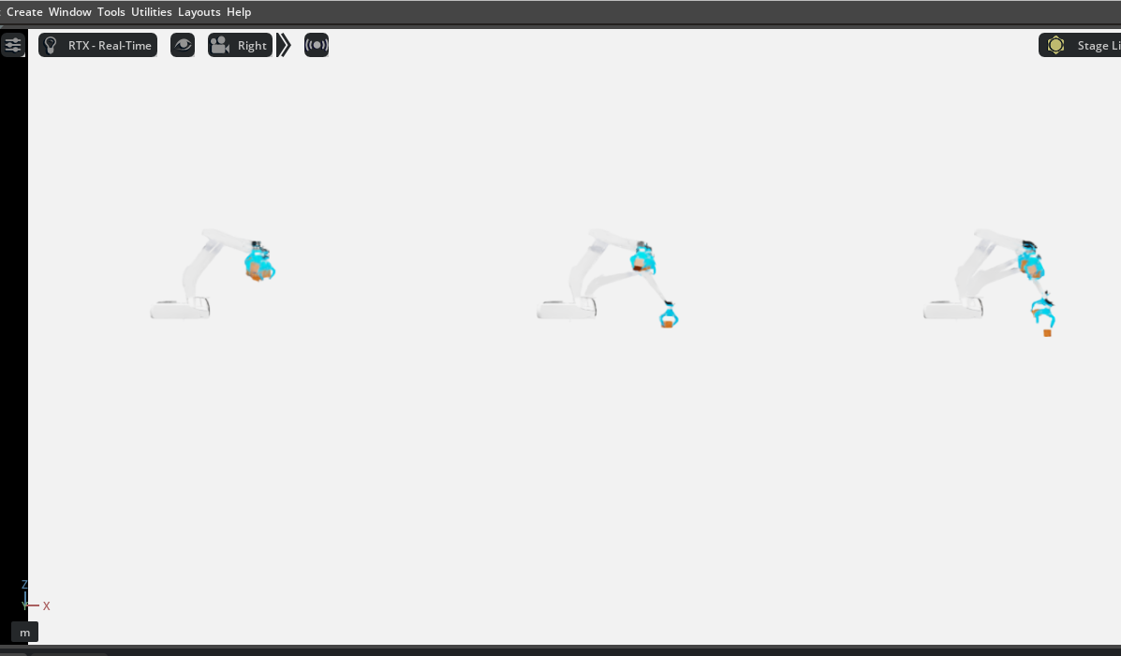
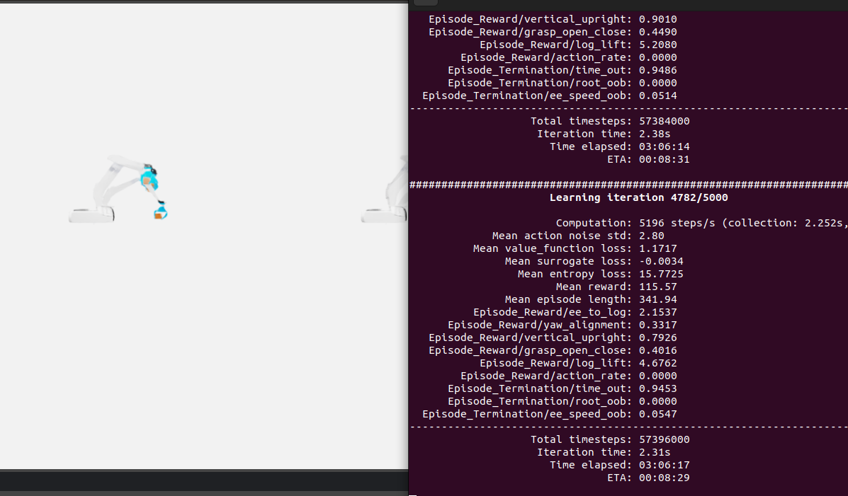
masi_28_1
2026-01-05_18-09-03
events.out.tfevents.1767629354.home.17879.0

Slide 2
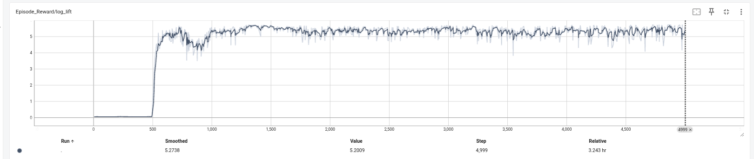
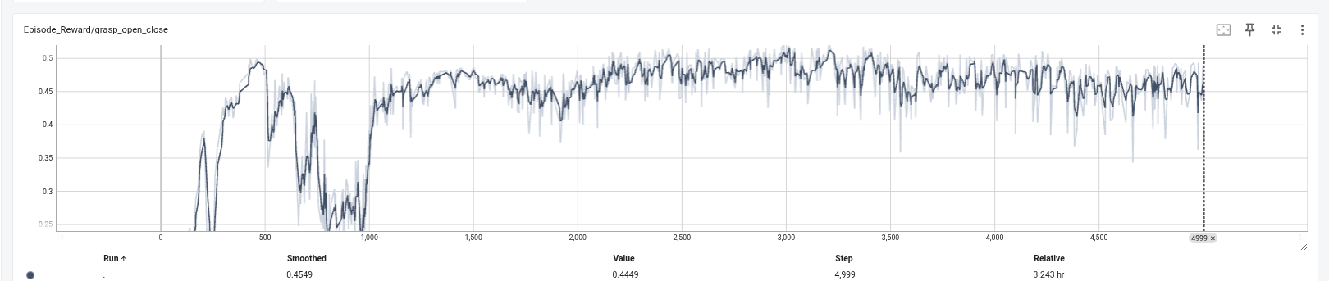
python scripts/reinforcement_learning/rsl_rl/train.py --num_envs 500 \
--task Isaac-Masi-LogIK-train-v0 \
--experiment_name masi_logik
5000/500
tensorboard --logdir . --port 6018 --load_fast=false

Slide 3
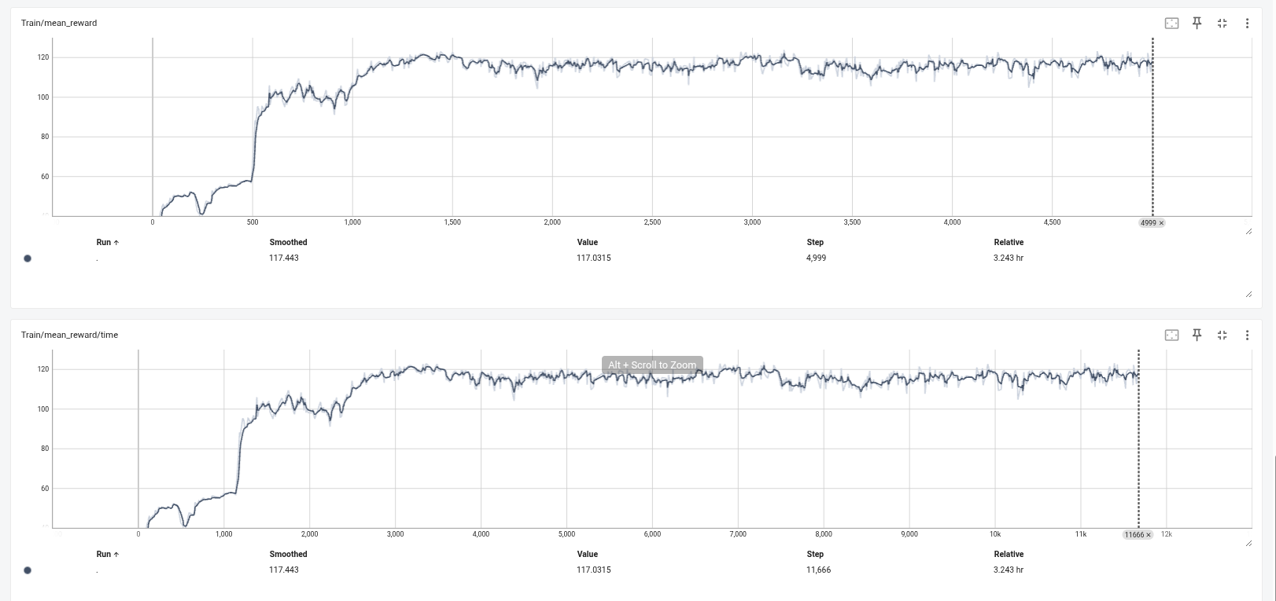
python scripts/reinforcement_learning/rsl_rl/train.py --num_envs 500 \
--task Isaac-Masi-LogIK-train-v0 \
--experiment_name masi_logik
5000/500

Slide 4
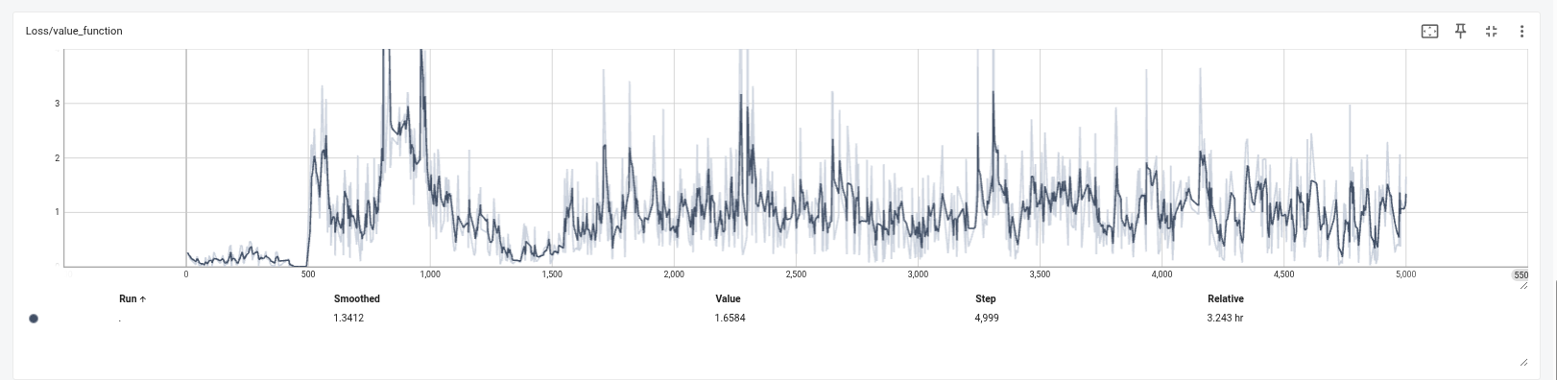
python scripts/reinforcement_learning/rsl_rl/train.py --num_envs 500 \
--task Isaac-Masi-LogIK-train-v0 \
--experiment_name masi_logik
5000/500

Slide 5
ting seed: 42
[INFO]: Base environment:
Environment device : cuda:0
Environment seed : 42
Physics step-size : 0.016666666666666666
Rendering step-size : 0.03333333333333333
Environment step-size : 0.03333333333333333
[INFO]: Time taken for scene creation : 3.104542 seconds
[INFO]: Scene manager: <class InteractiveScene>
Number of environments: 4090
Environment spacing : 2.5
Source prim name : /World/envs/env_0
Global prim paths : []
Replicate physics : True
[INFO]: Starting the simulation. This may take a few seconds. Please wait...
2026-01-05_21-43-36
events.out.tfevents.1767642223.home.31458.0

Slide 6
################################################################
Learning iteration 8600/10000
Computation: 11375 steps/s (collection: 8.577s, learning 0.052s)
Mean action noise std: 13.84
Mean value_function loss: 0.7078
Mean surrogate loss: -0.0008
Mean entropy loss: 23.1809
Mean reward: 122.37
Mean episode length: 349.77
Episode_Reward/ee_to_log: 2.6600
Episode_Reward/yaw_alignment: 0.4580
Episode_Reward/vertical_upright: 0.9721
Episode_Reward/grasp_open_close: 0.5788
Episode_Reward/log_lift: 5.6734
Episode_Reward/action_rate: 0.0000
Episode_Termination/time_out: 0.9777
Episode_Termination/root_oob: 0.0000
Episode_Termination/ee_speed_oob: 0.0223
--------------------------------------------------------------------------------
Total timesteps: 844274160
Iteration time: 8.63s
Time elapsed: 15:10:37
ETA: 02:28:13

Slide 7
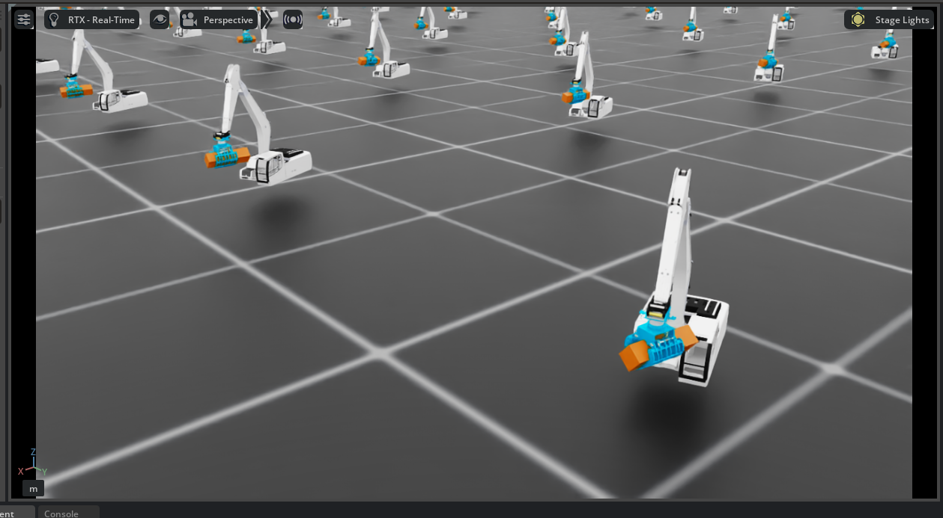
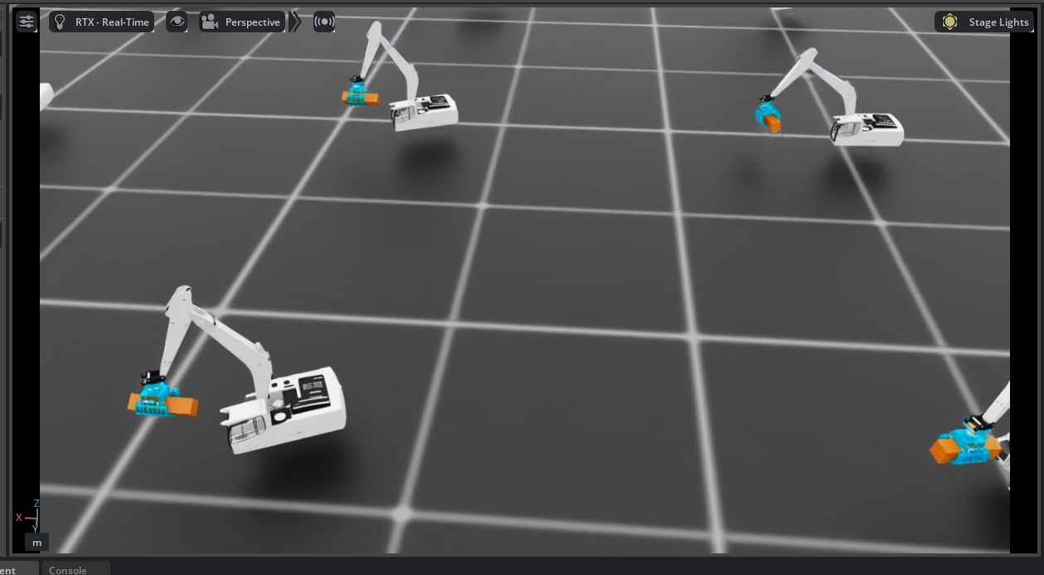
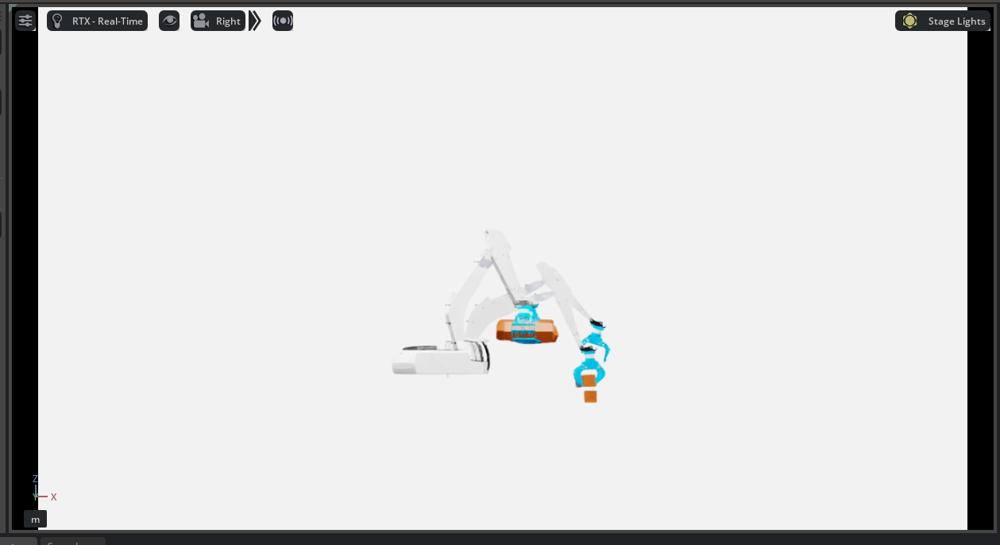
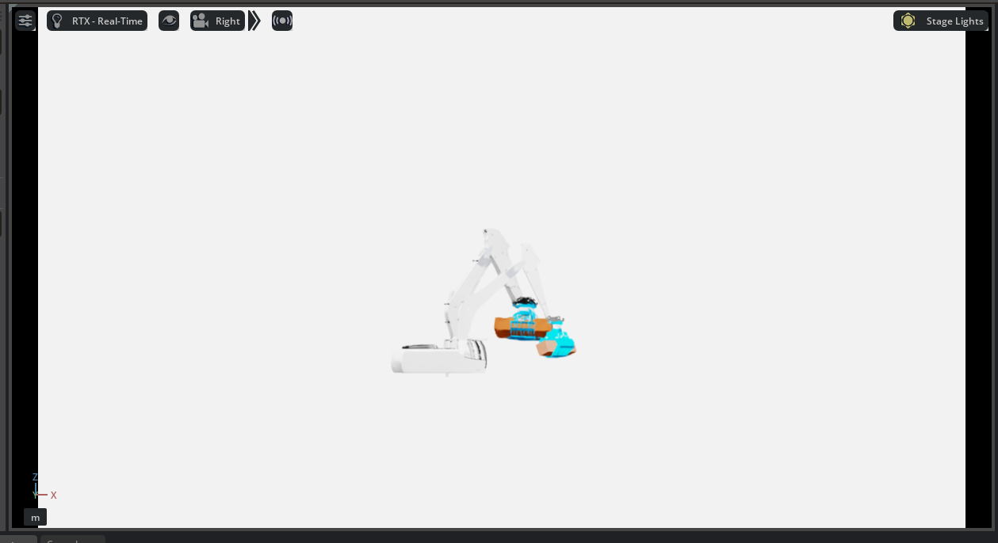
10000 4090
python scripts/reinforcement_learning/rsl_rl/train.py --num_envs 500 \
--task Isaac-Masi-LogIK-train-v0 \
--experiment_name masi_logik \
--load_run 2026-01-05_21-43-36 \
--resume

Slide 8
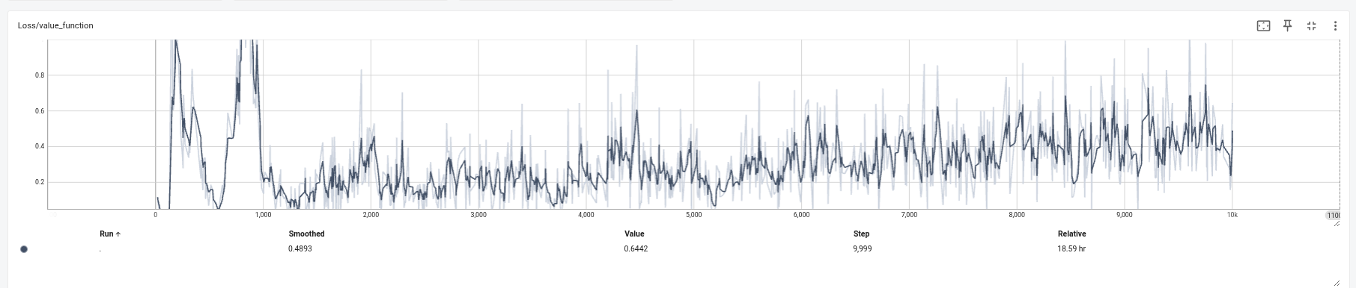
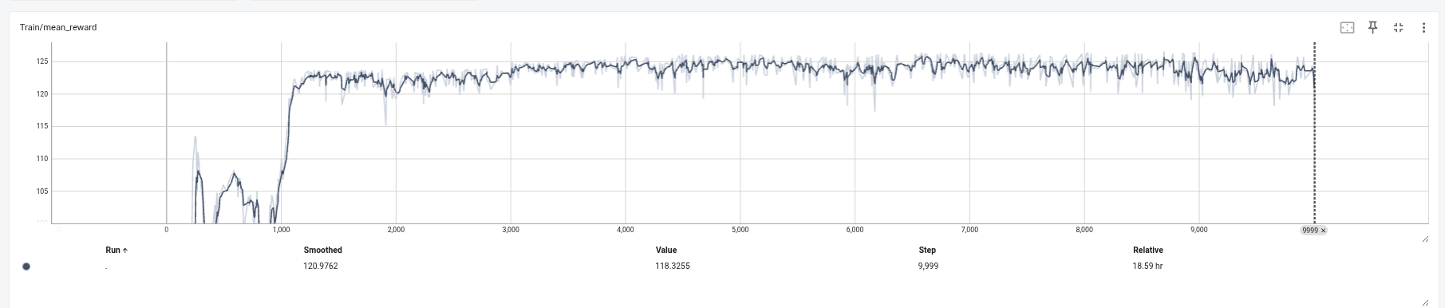
10000 4090

Slide 9
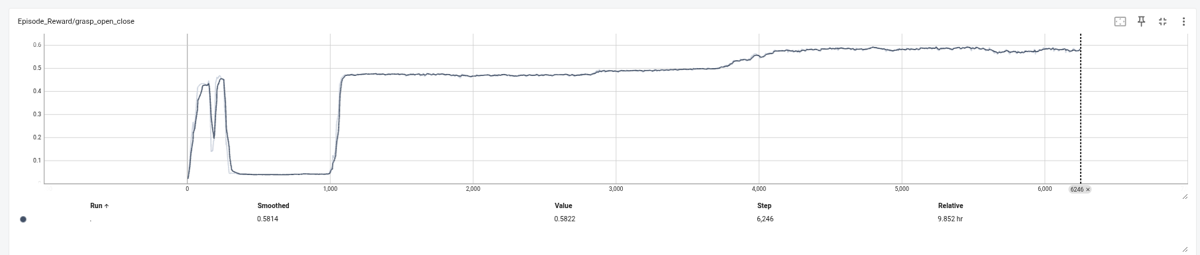
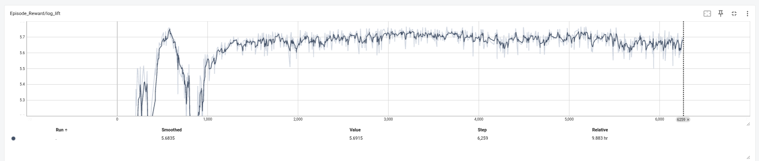
10000 4090

Slide 10
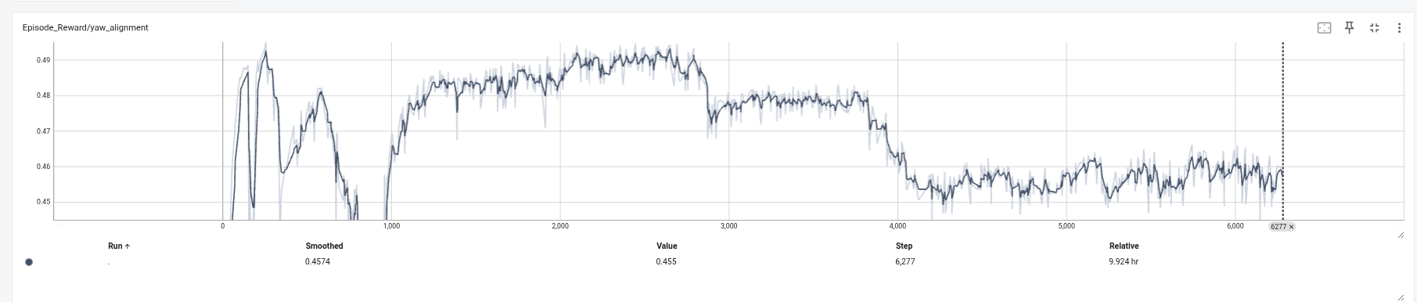
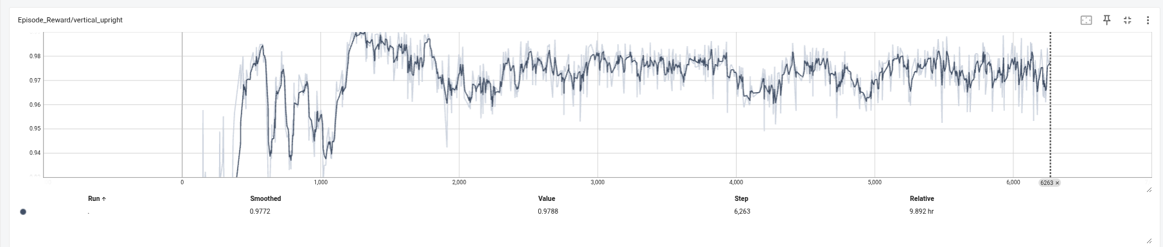
10000 4090

Slide 11
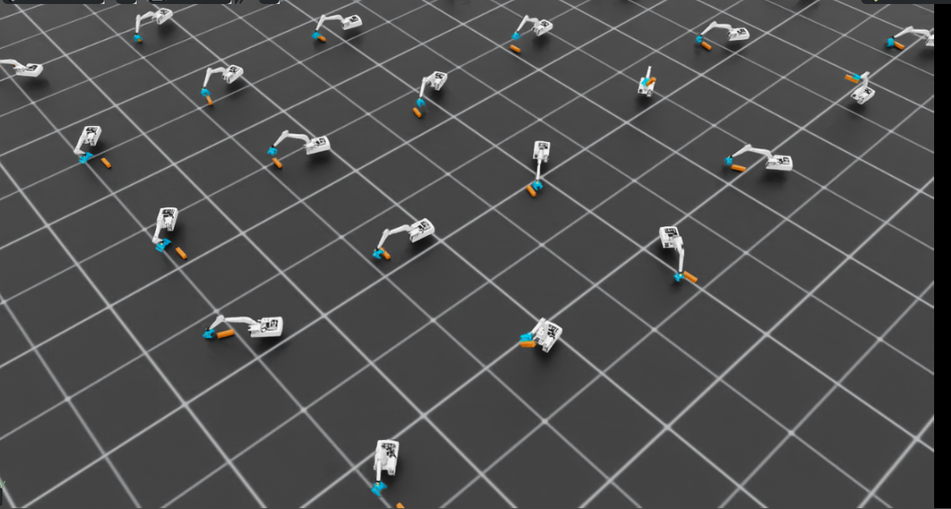
10000 4090
Masi_29_0 180 ~ -180 on the 180 and -180 are dead corner

Slide 12
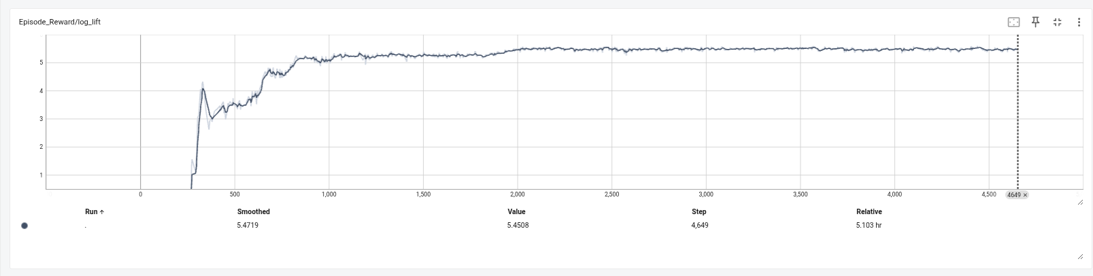
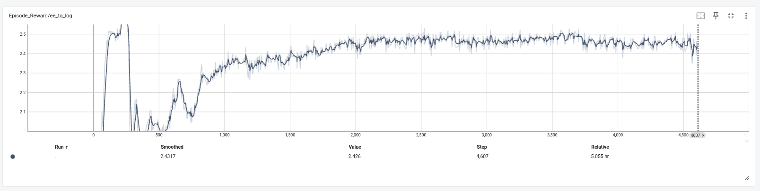
5000 4090
Masi_29_0~1 random
https://youtu.be/jAsTWnVO9FM
"offset_b": (0.55, 0.0, 0.05),129 "circle_radius": 0.55,130 "circle_angle_range": (-1.57079632679, 1.57079632679),130 "circle_angle_range": (-1.0471975512, 1.0471975512),131 "circle_z": 0.05,132 "yaw_range": 0.02,133 },11 unmodified lines145 "log_asset_cfg": SceneEntityCfg("log"),146 "offset_b": (0.55, 0.0, 0.05),147 "circle_radius": 0.55,148 "circle_angle_range": (-1.57079632679, 1.57079632679),148 "circle_angle_range": (-1.0471975512, 1.0471975512),149 "circle_z": 0.05,150 "max_dist": 0.95,151 },

Slide 13
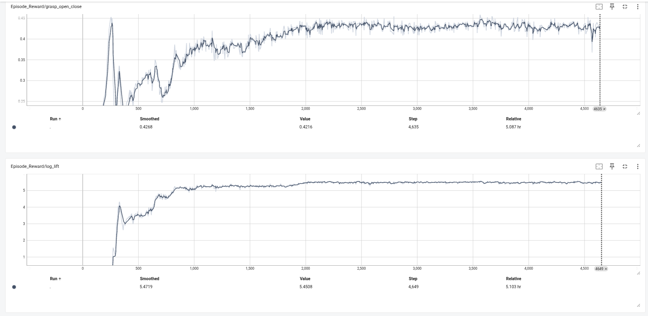
5000 4090

Slide 14
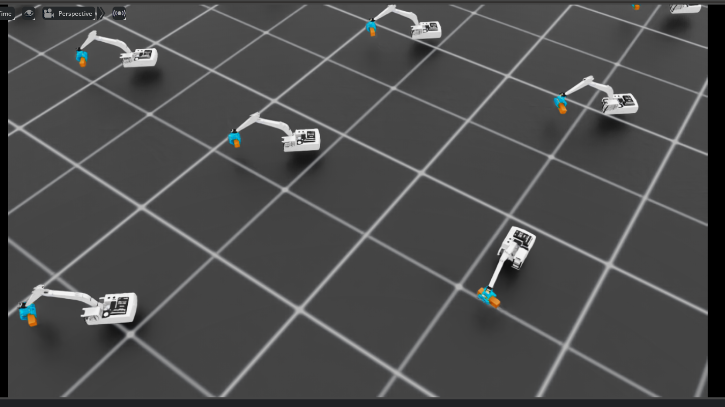

Slide 15
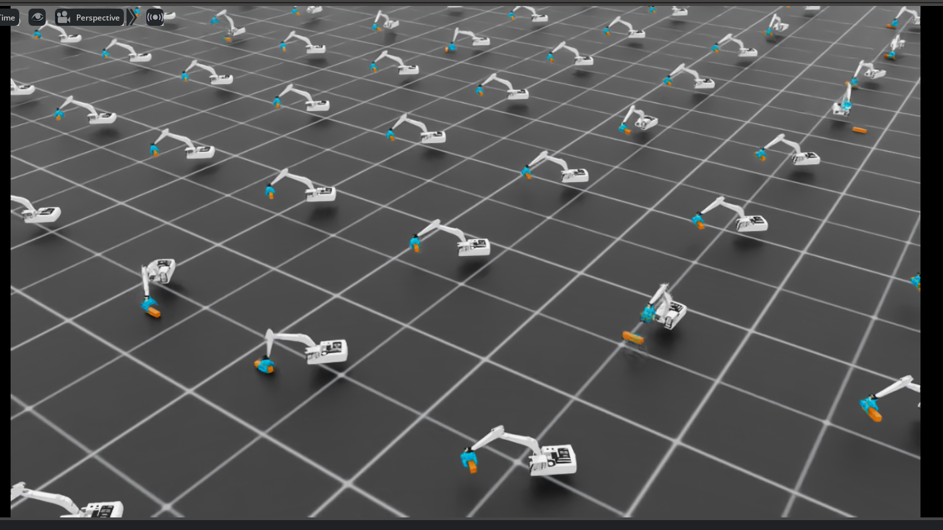

Slide 16
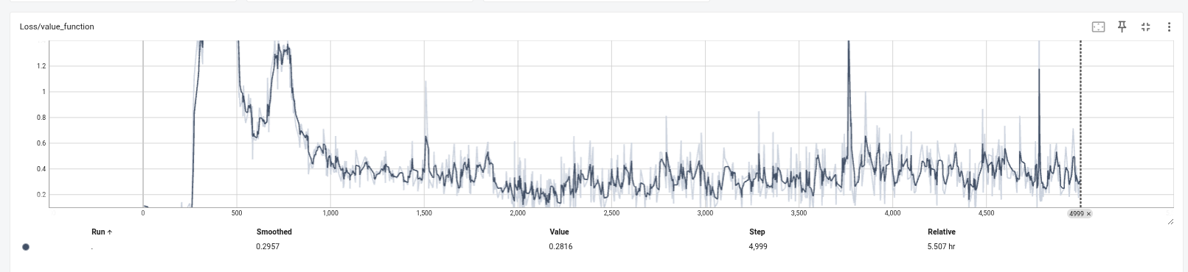
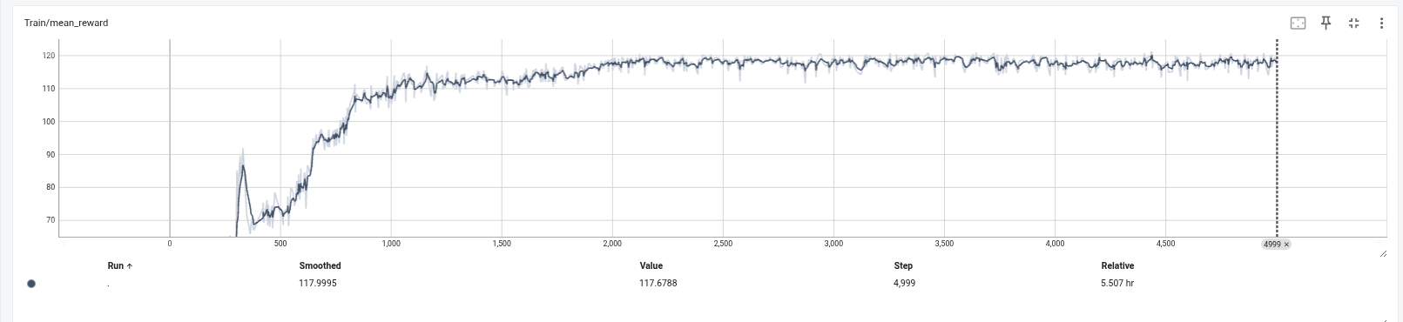
5000 4090

Slide 17
plan2

Slide 18
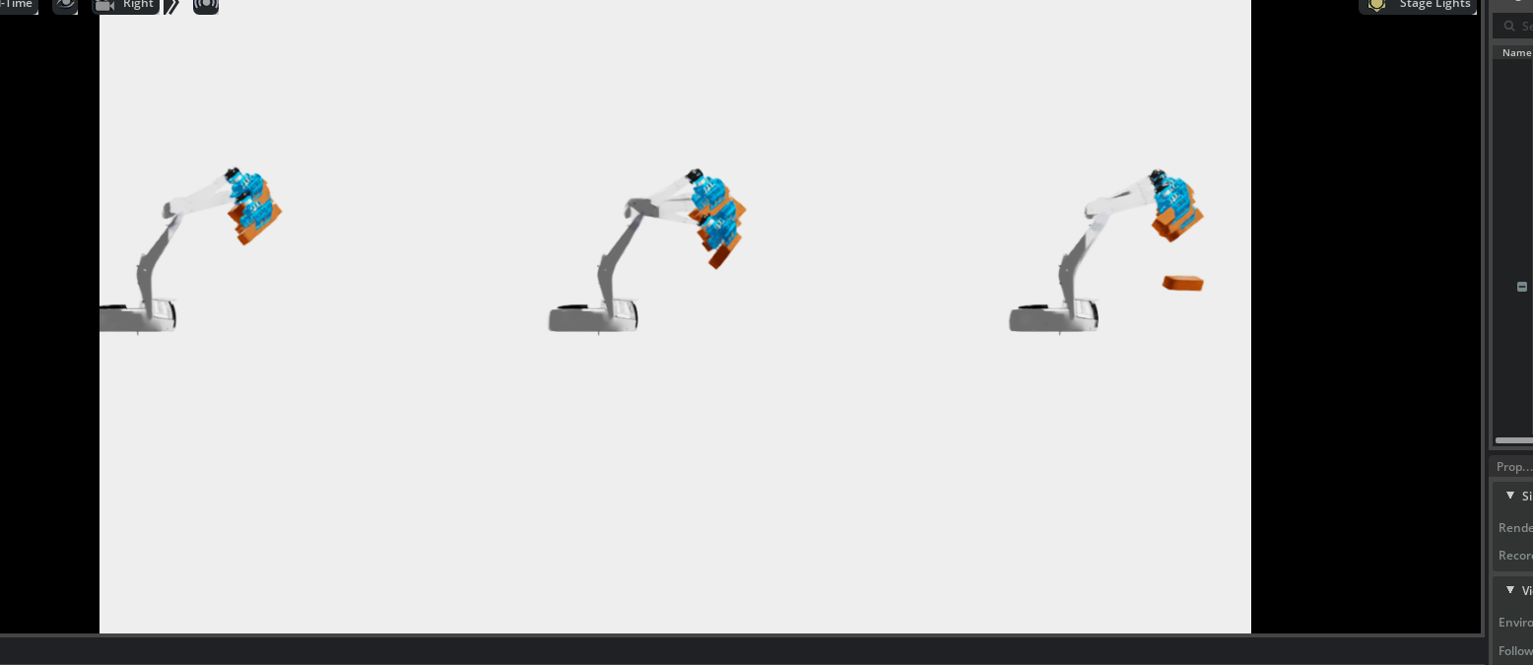
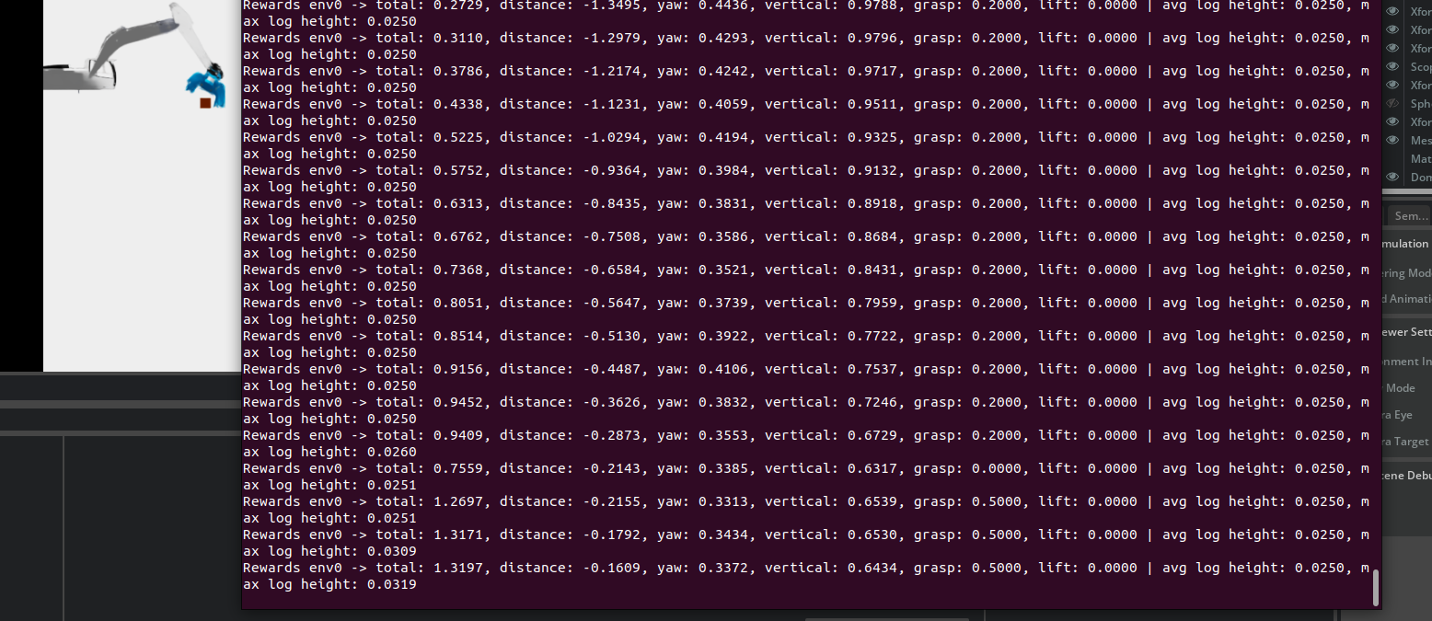
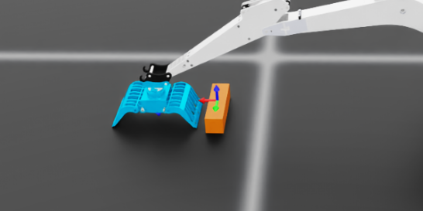

Slide 19
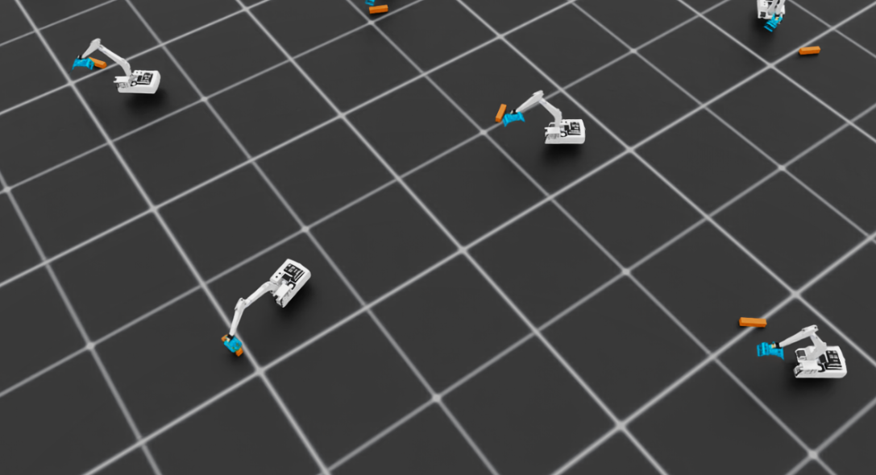
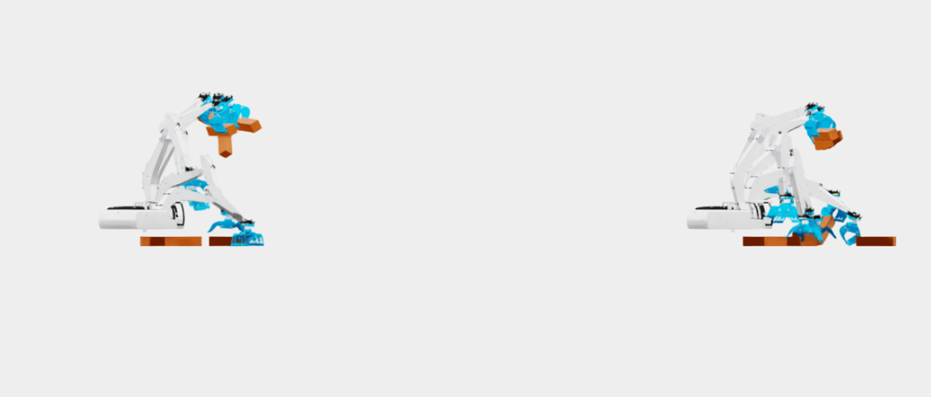
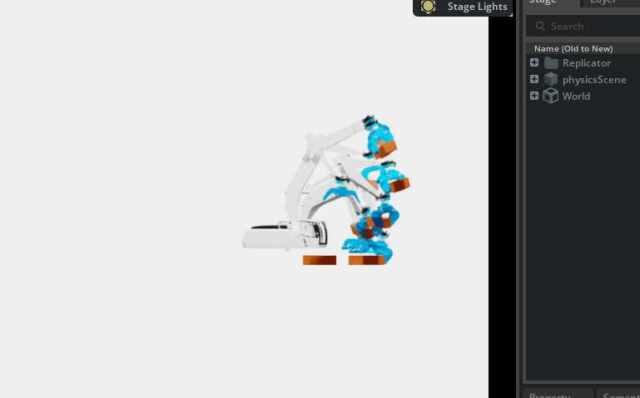
Add dynamic target function that make the Grabber around the base code:2
=> saving checkpoint 'logs/rl_games/masi_direct/2026-01-01_18-37-58/nn/masi_direct.pth'
fps step: 5413 fps step and policy inference: 5350 fps total: 5249 epoch: 125/250 frames: 19046400
fps step: 5608 fps step and policy inference: 5542 fps total: 5433 epoch: 126/250 frames: 19200000
saving next best rewards: [20355.043]
=> saving checkpoint 'logs/rl_games/masi_direct/2026-01-01_18-37-58/nn/masi_direct.pth'
fps step: 5512 fps step and policy inference: 5448 fps total: 5343 epoch: 127/250 frames: 19353600
ps step: 5006 fps step and policy inference: 4954 fps total: 4866 epoch: 248/250 frames: 37939200
saving next best rewards: [32838.46]
=> saving checkpoint 'logs/rl_games/masi_direct/2026-01-01_18-37-58/nn/masi_direct.pth'
fps step: 4990 fps step and policy inference: 4938 fps total: 4851 epoch: 249/250 frames: 38092800
fps step: 5009 fps step and policy inference: 4957 fps total: 4869 epoch: 250/250 frames: 38246400
=> saving checkpoint 'logs/rl_games/masi_direct/2026-01-01_18-37-58/nn/last_masi_direct_ep_250_rew__30362.361_.pth'
MAX EPOCHS NUM!
log_spawn_radius_min = 0.50 # 距离底座中心的最小半径 (米) log_spawn_radius_max = 0.65 # 距离底座中心的最大半径 (米)

Slide 20
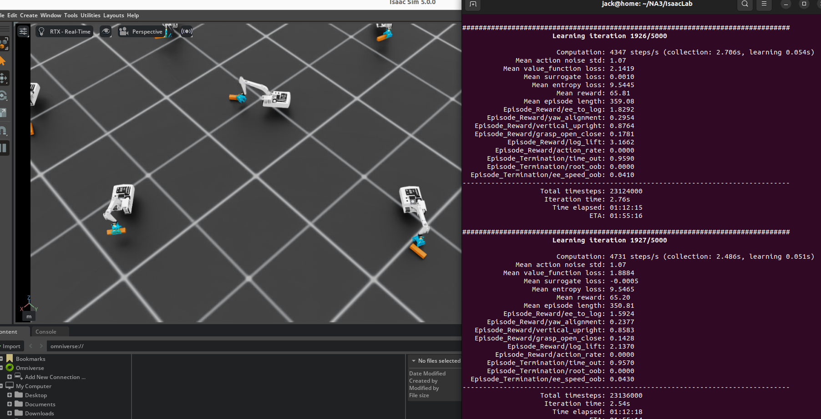
train_2_initial_1.webm
masi30_1.zip

Slide 21
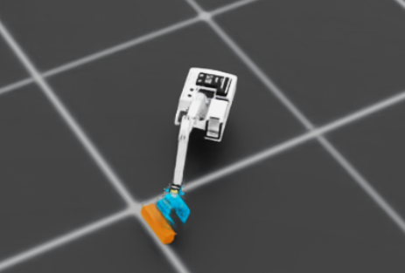
I widened the auto‑grip distances and relaxed the grasp reward threshold so the claws close earlier and stay closed longer. That should make it easier to actually pick the log up.
Changes:
ik_rel_log_env_cfg.py — close_dist 0.08, open_dist 0.12, grasp threshold 0.1.
If this still doesn’t lift, I want to verify you’re training with this exact cfg file. Which config path are you launching? If you want, I can also temporarily set yaw_range to 0 during training to confirm the lift pipeline still works, then re‑enable yaw later.
/home/jack/NA3/IsaacLab/logs/rsl_rl/masi_logik/2026-01-25_22-50-18
"yaw_range": 0.35,
0.35（≈±20°）
Now ±90°（yaw_range = 1.5707963267948966）

Slide 22
31_1_train_1
https://youtu.be/rtYx0ppcatE
30 1 play 1 1000 episodes
2026-01-26_16-47-35
Play, 10000
±90°（yaw_range = 1.5707963267948966）在 ik_rel_log_env_cfg.py。
https://youtu.be/VP38rEwmWuM
https://youtu.be/YJpLcEPTuLo

Slide 23
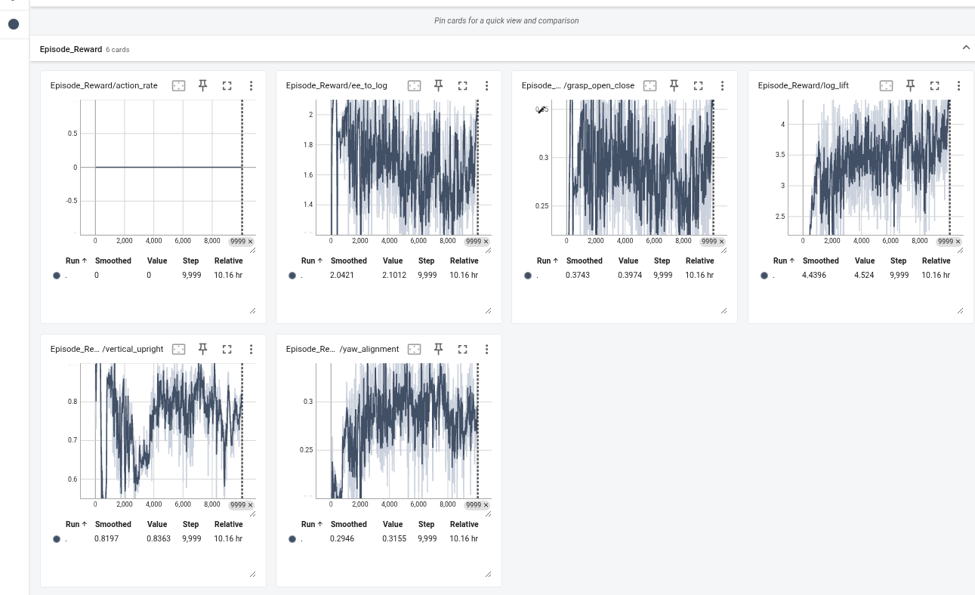

Slide 24
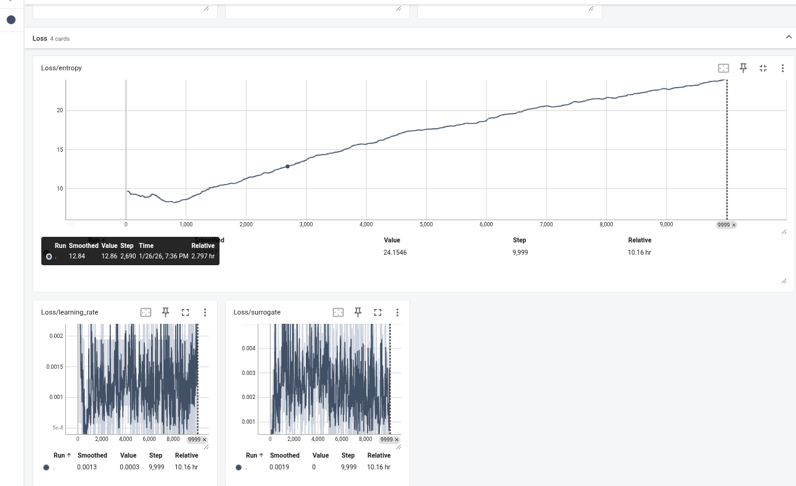

Slide 25
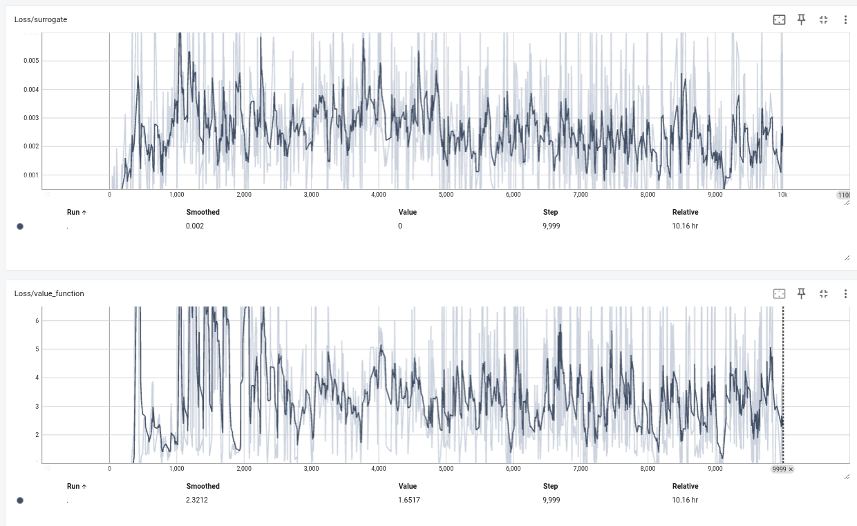

Slide 26
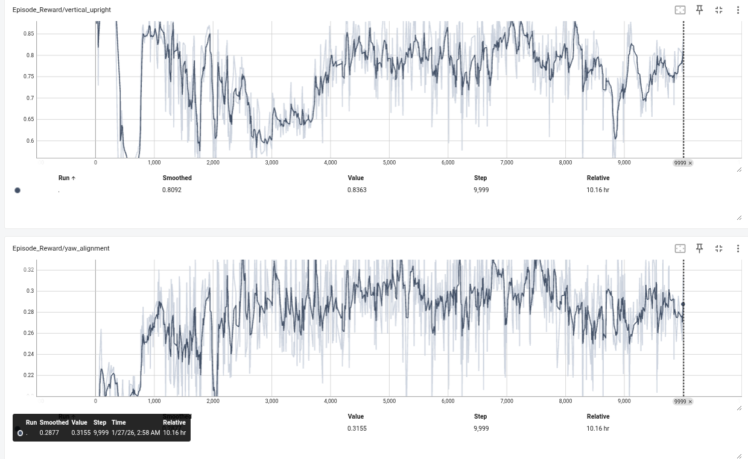

Slide 27
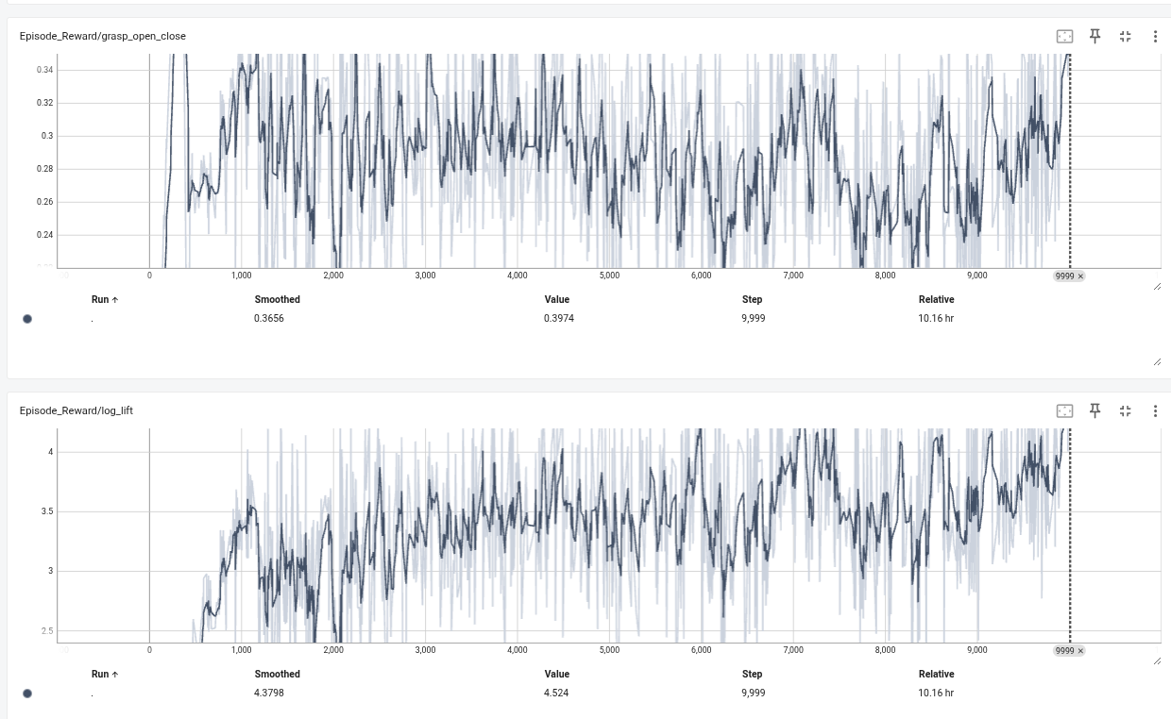

Slide 28
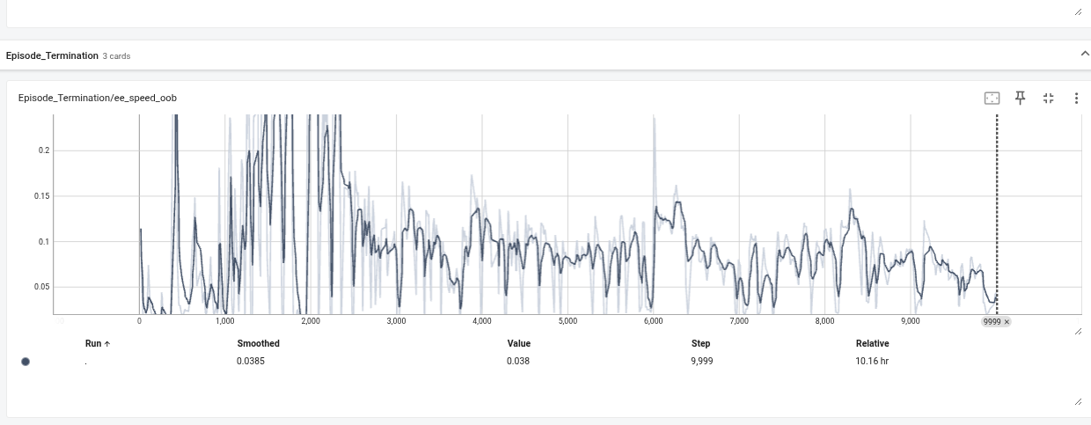

Slide 29
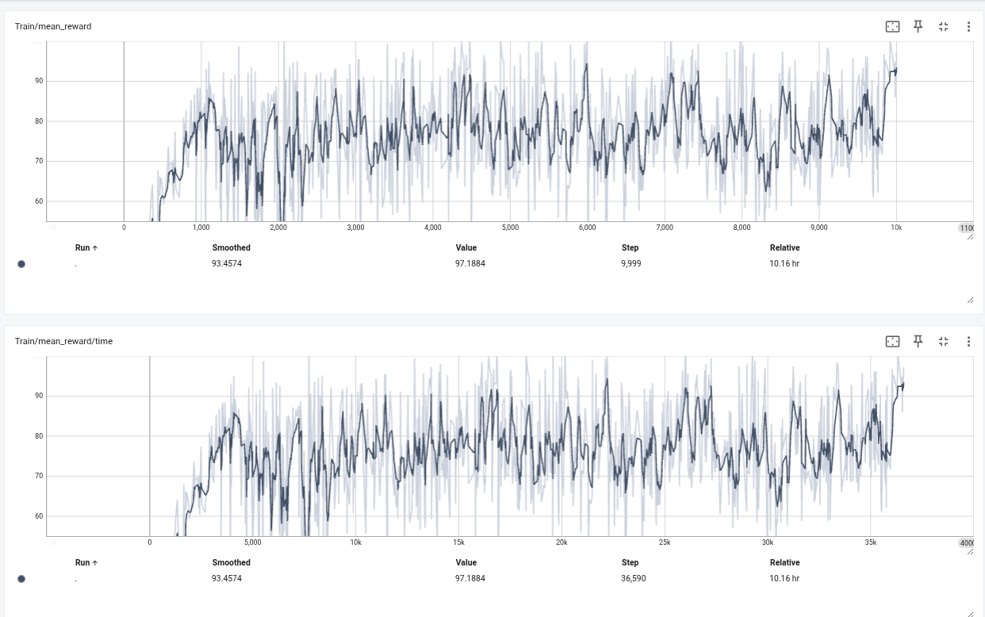

Slide 32
base ≈ test_bench（或者 test_bench + mountboom 这一块底座）
boom ≈ liftboom（第一节大臂，负责 lift）
arm ≈ tiltboom（第二节小臂，负责 tilt）
bucket ≈ scoop（铲斗）
tip ≈ end_point（末端点）
test_bench ──fix_to_scene──> mountboom
└─(revolute_lift)──> liftboom ← 对应原来的 boom 关节（jointBoom）
└─(revolute_tilt)──> tiltboom ← 对应原来的 arm 关节（jointArm）
└─(revolute_scoop)──> scoop ← 对应原来的 bucket 关节（jointBucket）
└─FixedJoint──> end_point ← 对应原来的 tip
<joint name="revolute_tilt" origin="0.20564 0 0.420085" parent="liftboom" child="tiltboom"/>
<joint name="revolute_scoop" origin="0.25 0 0" parent="tiltboom" child="scoop"/>

Slide 33
outline
Topic
Goals
Plans
Study resource/ code

Slide 34
Thesis topic
Simulation-based development for a nonlinear excavator system
(with emphasis on practical feasibility and flexible model choice)

Slide 35
Research Goals
1.Use provided excavator model or similar excavator model from open resource to build environment
2. model-based learning model or reinforcement learning model
3.generate a simulation demo for illustrative tasks (such as log lifting or trajectory tracking).
4.optionally implement and compare different control strategies on simulator environment, such as MPC vs PID;

Slide 36
Thanks

