Slide 1
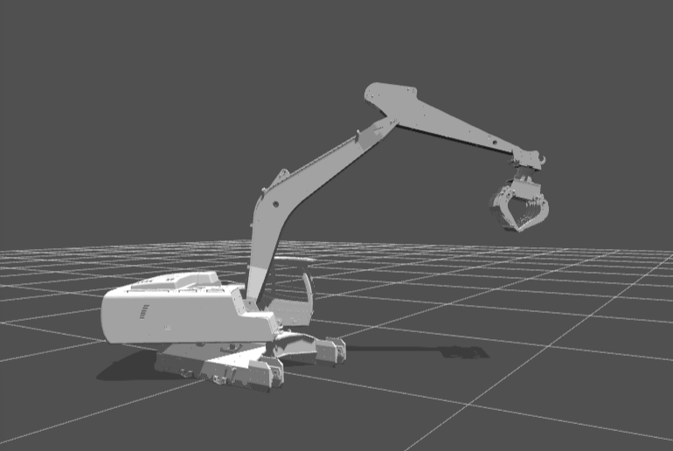
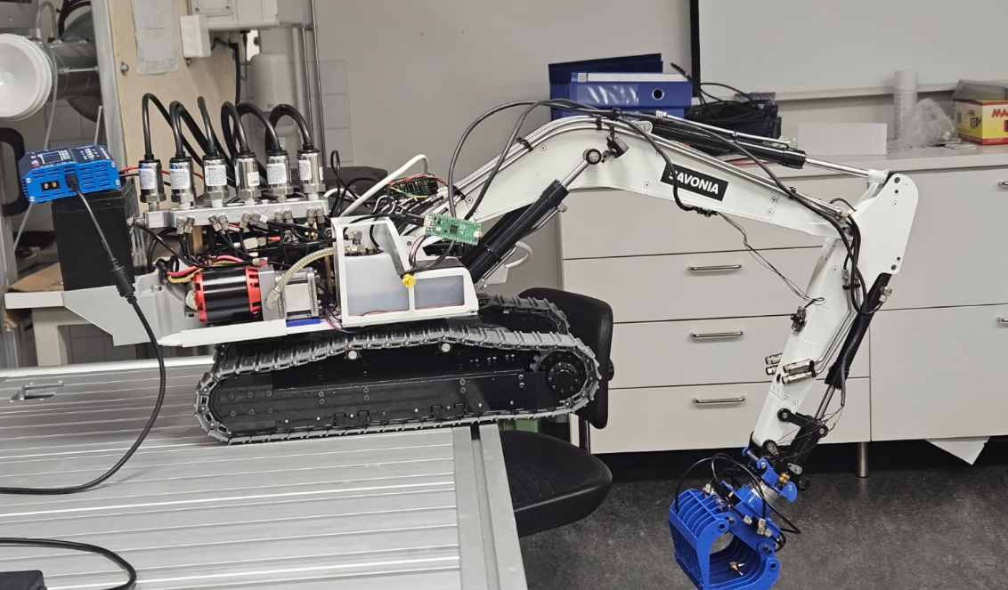

Slide 3
The model algorithm is based on this repo
https://github.com/xuexianlim/eXactMPC

Slide 4
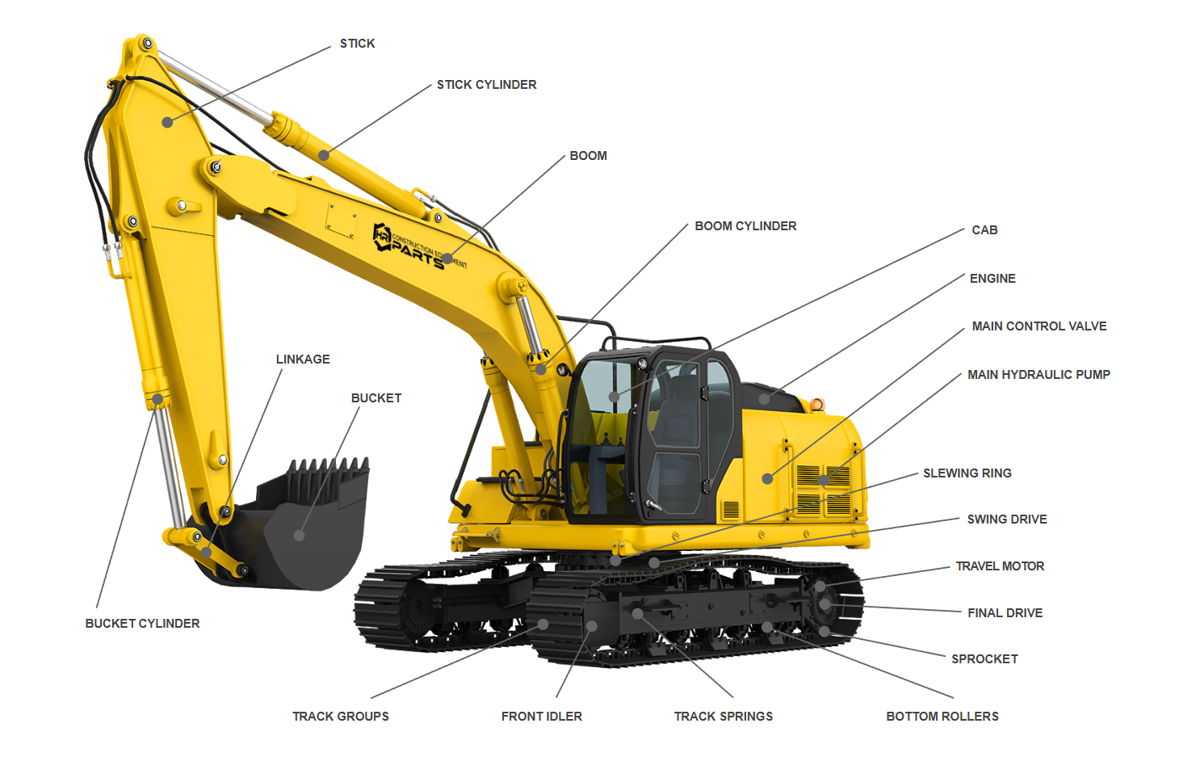
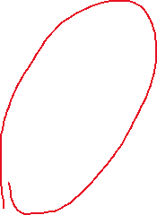
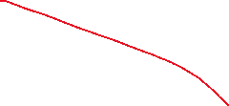

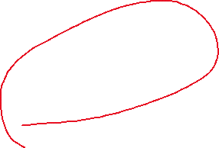
Notes:
https://www.hrparts.com/blog/post/excavator-parts-diagram-interactive?srsltid=AfmBOoow4UQrs_g9Zim_wBUuySZboLPSEy-IT9ZWmgwKT8euKwA0Q84t#bucket-cylinder-def

Slide 5
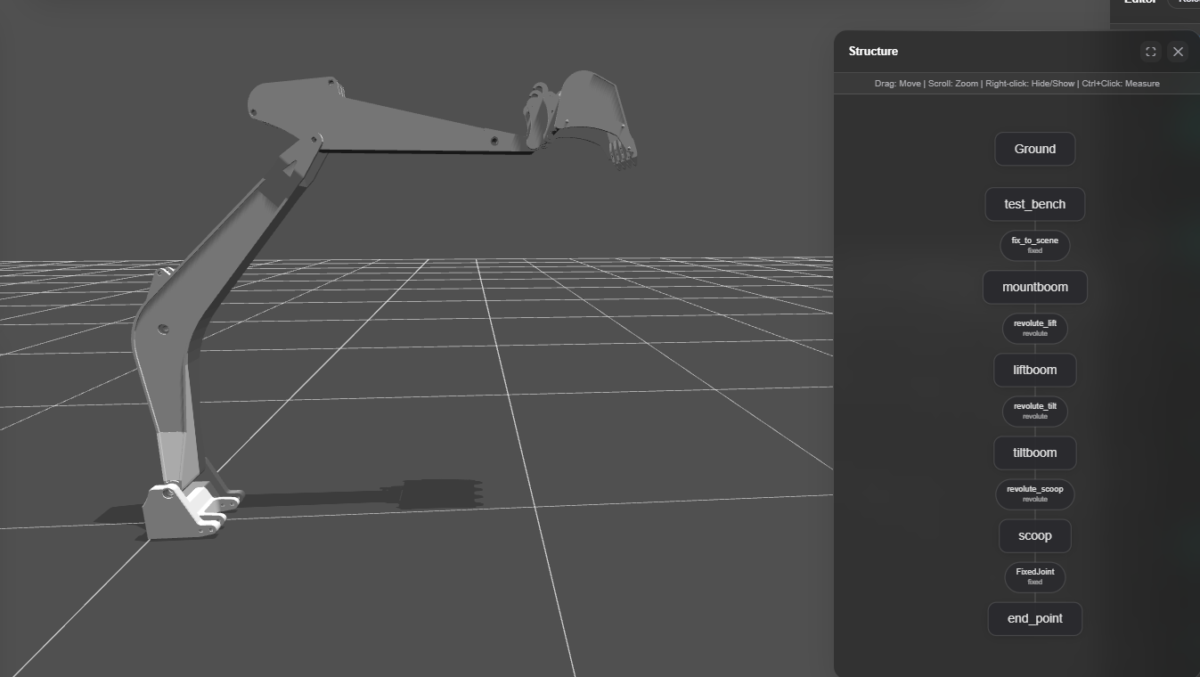

Slide 6
base ≈ test_bench（或者 test_bench + mountboom 这一块底座）
boom ≈ liftboom（第一节大臂，负责 lift）
arm ≈ tiltboom（第二节小臂，负责 tilt）
bucket ≈ scoop（铲斗）
tip ≈ end_point（末端点）
test_bench ──fix_to_scene──> mountboom
└─(revolute_lift)──> liftboom ← 对应原来的 boom 关节（jointBoom）
└─(revolute_tilt)──> tiltboom ← 对应原来的 arm 关节（jointArm）
└─(revolute_scoop)──> scoop ← 对应原来的 bucket 关节（jointBucket）
└─FixedJoint──> end_point ← 对应原来的 tip
<joint name="revolute_tilt" origin="0.20564 0 0.420085" parent="liftboom" child="tiltboom"/>
<joint name="revolute_scoop" origin="0.25 0 0" parent="tiltboom" child="scoop"/>

Slide 7
base yaw （when we get base, rotation fuc.）
How to build the model based MPc as we need
1. a good plugins of algrithem for it
2.we need a perfect and precisise urdf can map the real robot architecture we have , like a mirror better real and virtual.
3. 3D rigid-body dynamics update

Slide 8
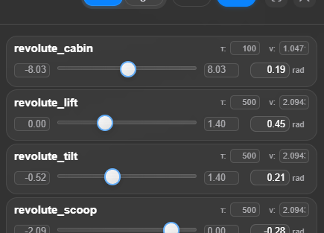
urdf align with real robot
https://viewer.robotsfan.com/

Slide 9
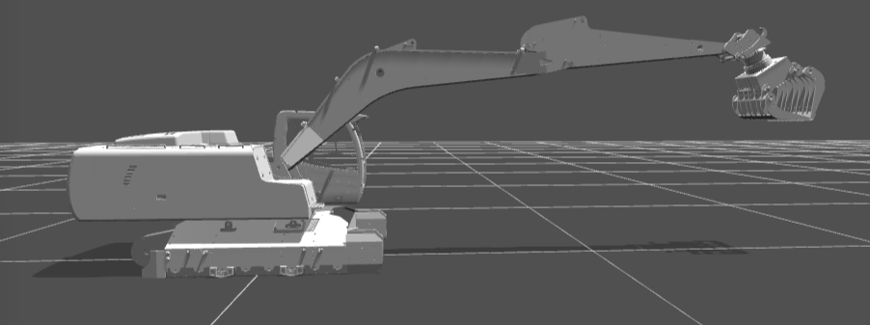
The URDF model allows the robotic arm to adopt a horizontal posture, as shown in the right-hand diagram. However, the current configuration on the left side is incapable of this. Restrictions must have been imposed somewhere, as this behaviour is otherwise implausible. Presently, the arm is unable to fully extend and remains in a contracted state.

Slide 10
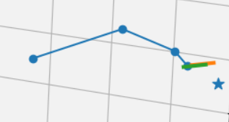

Slide 11
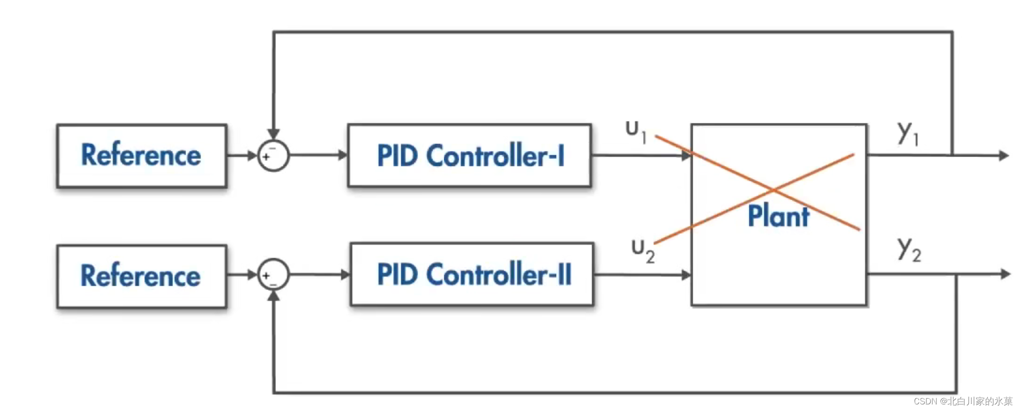
PID limitation

Slide 12
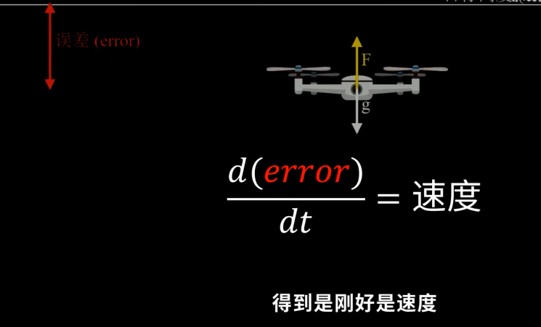
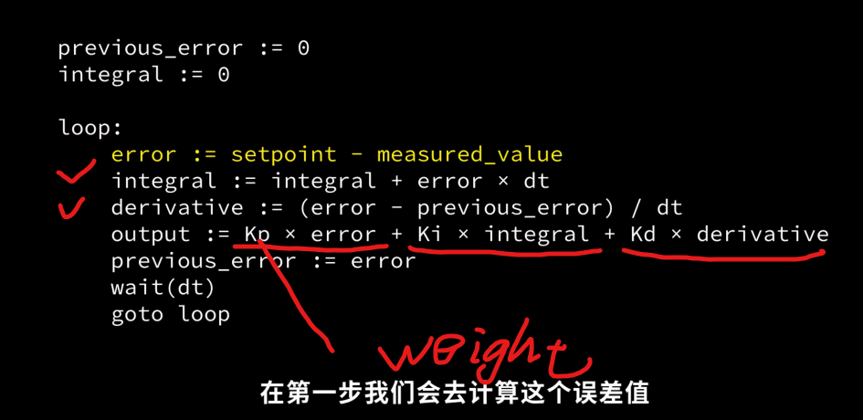
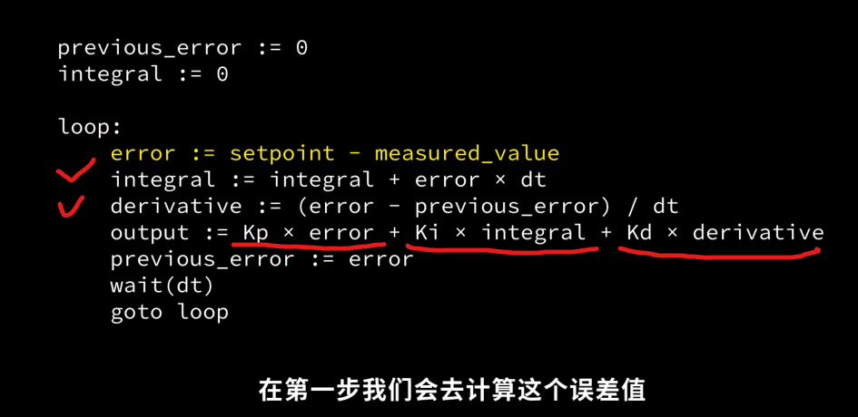
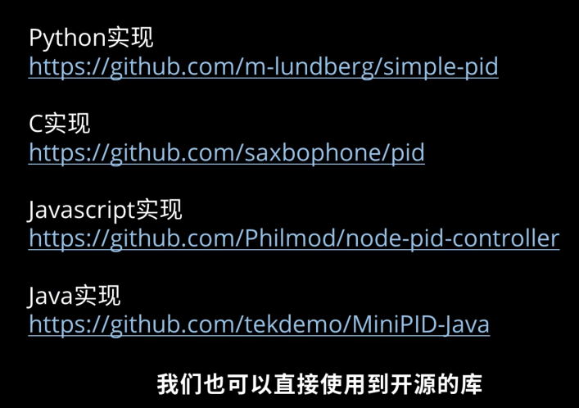
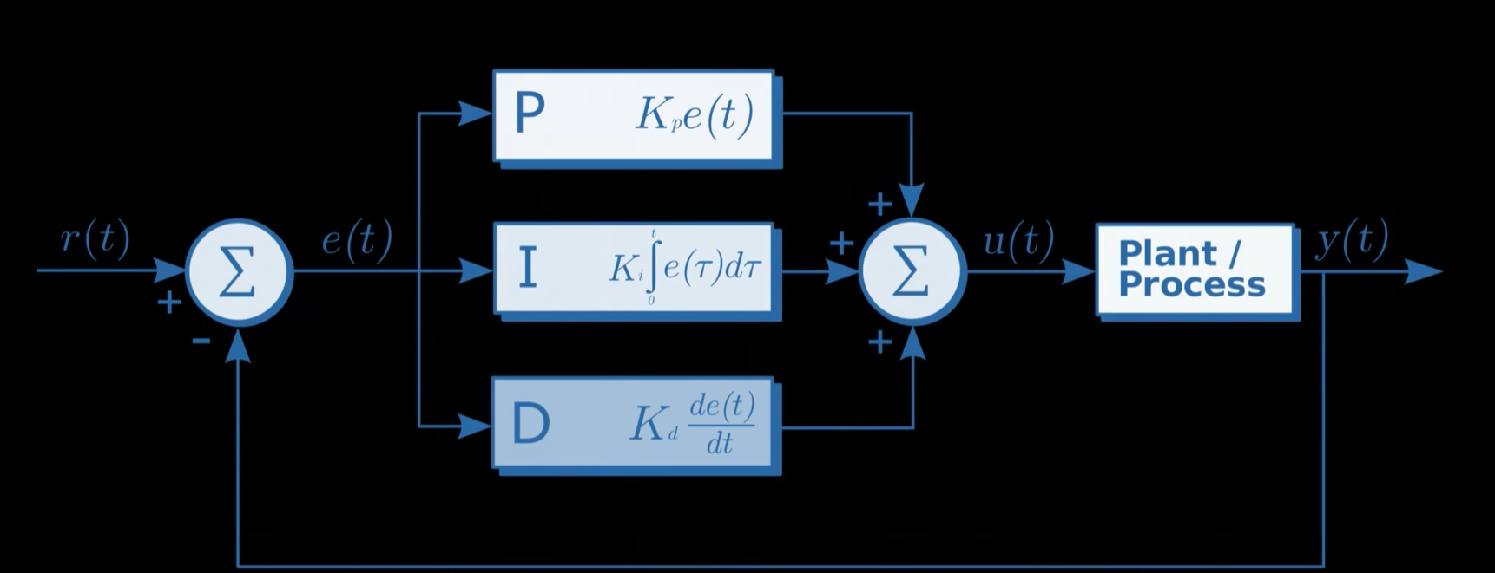
https://github.com/m-lundberg/simple-pid

Slide 13
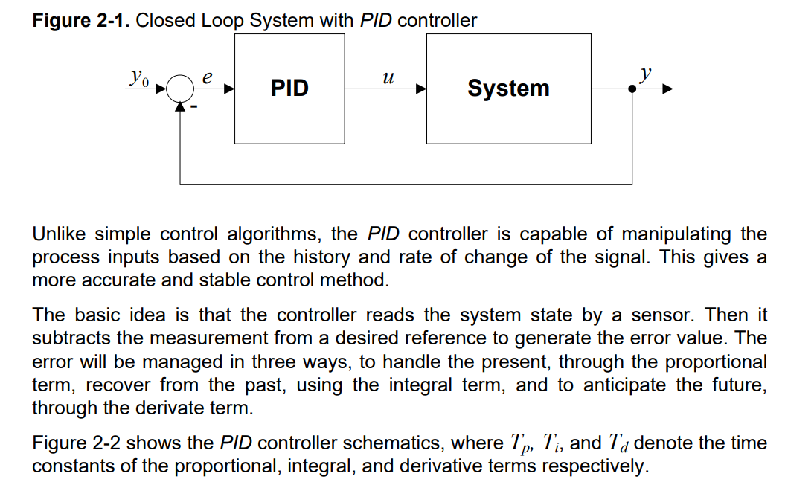
output = self._proportional + self._integral + self._derivative

Slide 14
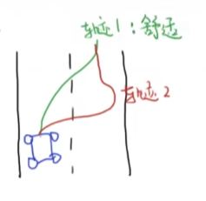
Get the best performance within certain limitation
Cost function (energy consumer)
Constraints: such as joint angle/velocity limits(Physical boundaries) Energy limits Actuator limits
Single-Input Single-Output (SISO)
Reference: r(t)
Output: y(t)
Error:
e(t)=y(t)−r(t)
r(t)
↓
(+)─── e(t) ──► [ Controller ] ──► u(t) ──► [ System ] ──► y(t)
▲ │
└────────────────────────────────────────────┘

Slide 15
Nonlinear MPC for Excavator Arm Control: Goal
Control a 4-DoF excavator arm using Nonlinear MPC
Track end-effector pose in world frame
Explicitly handle joint, velocity, and actuator constraints

Slide 16
System Architecture
Target pose r = [x*, y*, z*, φ*]
01
MPC Optimizer (CasADi + IPOPT)
02
Control input u = joint accelerations
03
Excavator dynamics + Forward Kinematics
04
Measured end-effector pose
05

Slide 17

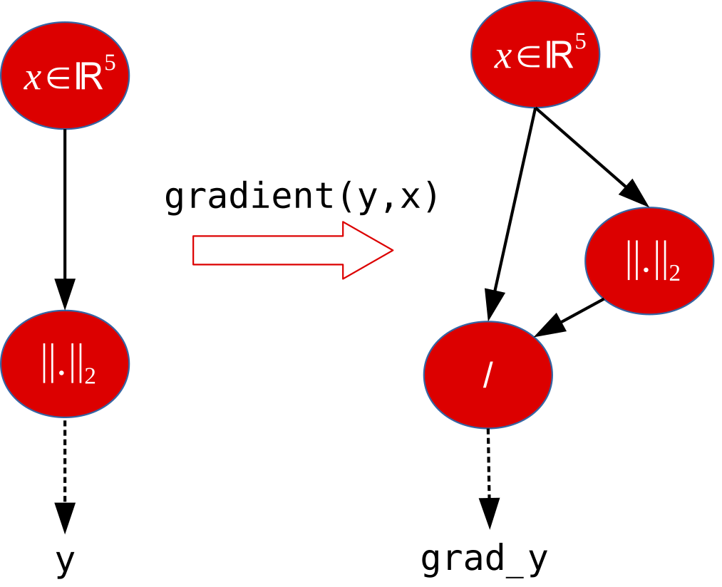
https://web.casadi.org/
https://web.casadi.org/docs/#document-symbolic
CasADi is an open-source tool for nonlinear optimization and algorithmic differentiation.
It facilitates rapid — yet efficient — implementation of different methods for numerical optimal control, both in an offline context and for nonlinear model predictive control (NMPC).

Slide 18
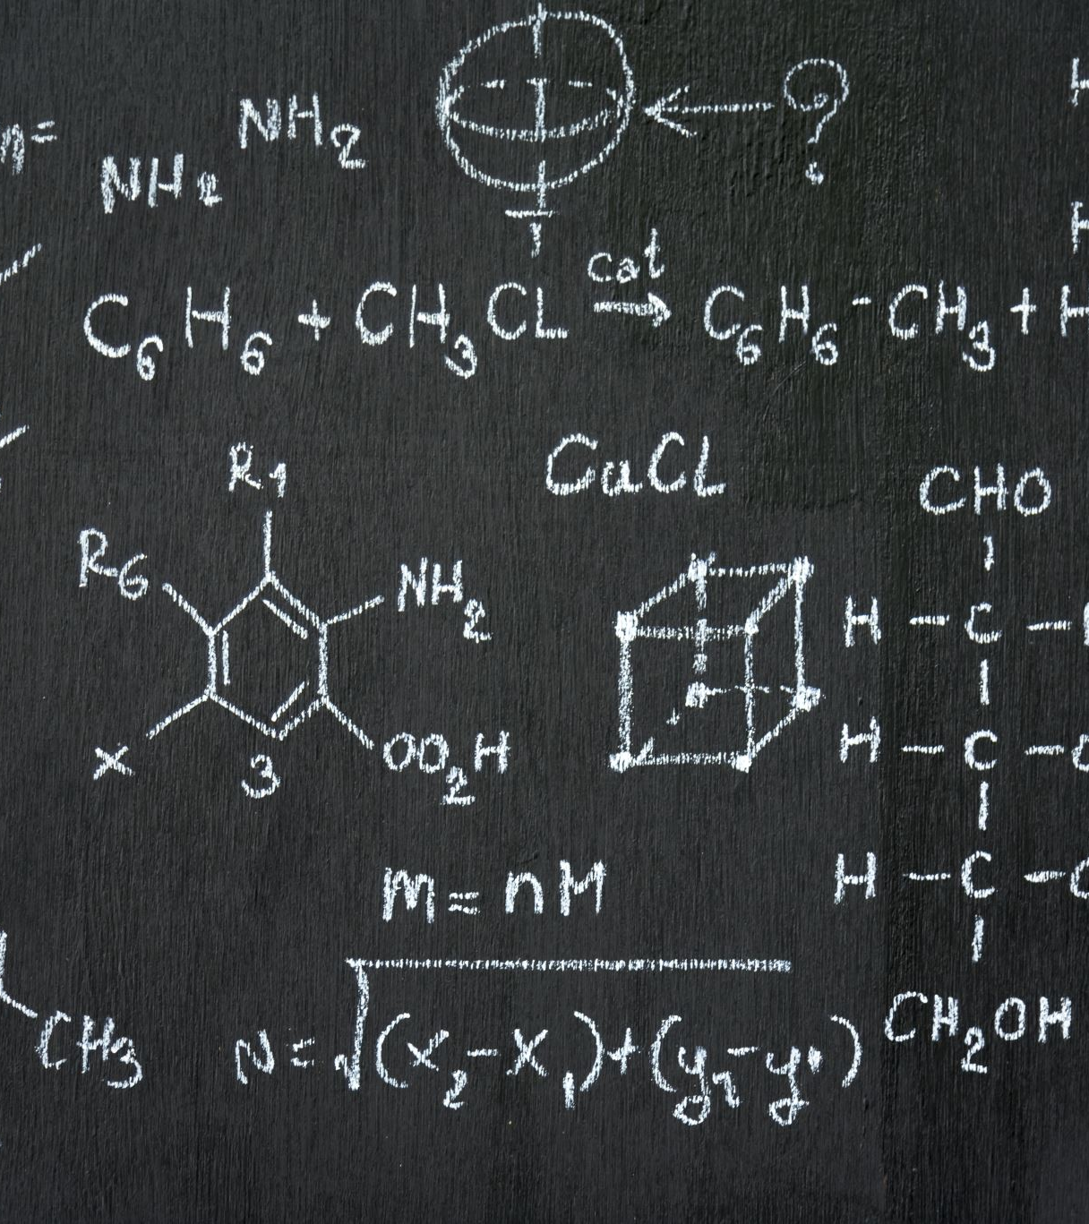
Automatic Differentiation (AD)
CasADi builds a symbolic computation graph of dynamics, cost, and constraints
Automatic Differentiation (AD) computes exact gradients and Jacobians
Provides ∇J, ∂g/∂x, and Hessians required by IPOPT
Enables fast and robust real-time solution of the MPC NLP
No manual derivative derivation needed when the model changes

Slide 19

IPOPT and NLPs
It’s a numerical solver designed for large-scale nonlinear optimization (NLPs, Nonlinear programs);
At each MPC step we formulate a nonlinear program: we optimize a sequence of future joint accelerations to minimize world-frame tracking error while enforcing the discrete dynamics and actuator limits. Because the cost and constraints are nonlinear due to kinematics, this becomes an NLP. We solve it with IPOPT, an interior-point nonlinear optimizer. CasADi provides automatic differentiation, so IPOPT gets exact gradients and Jacobians, which improves convergence and enables real-time execution.

Slide 20
Nonlinear MPC for Excavator Arm
4-DoF excavator arm (yaw + boom–stick–bucket)
World-frame task-space control [x, y, z, φ]
Joint-space MPC with hard constraints

Slide 21
System Model
State: x = [q, q̇], q = [yaw, α, β, γ]
Input: u = q̈ (joint accelerations)
Prediction model: joint-space double integrator

Slide 22
Dynamics Model
qₖ₊₁ = qₖ + q̇ₖ Tₛ + 0.5 uₖ Tₛ²
q̇ₖ₊₁ = q̇ₖ + uₖ Tₛ
Chosen for efficiency and real-time MPC

Slide 23
World-Frame Kinematics
Forward kinematics: q → [x_w, y_w, z_w, φ]
φ = α + β + γ
Yaw maps planar motion into world XY-plane

Slide 24
MPC Formulation
Objective: world-frame pose tracking
Penalize velocities, control effort, control rate
Hard constraints on joints, velocities, accelerations

Slide 25
Receding Horizon Control
Solve
Solve NLP at each control step
Apply
Apply first control input only
Warm
Warm-start next iteration by shifting solution

Slide 26
Implementation
Python + CasADi + IPOPT
World-frame FK/IK used in MPC and GUI
Auxiliary planar model kept for compatibility

Slide 27
Simulation Results
Accurate tracking of world-frame targets
Smooth joint accelerations
No constraint violations observed

Slide 28
This project is based on this open resources but has a huge different and we upgraded this one , adapted to our own.
https://github.com/xuexianlim/eXactMPC
Inherit from this one
2D- 4D
customed visualization tool

Slide 29
Conclusion & Future Work
Unified world-frame MPC for excavator arms
Efficient and constraint-consistent control
Future: hydraulics, soil interaction, real hardware

Slide 30
NLP
Nonlinear programs (NLPs), possibly with integer variables (MINLP), can be solved using block structure or general sparsity exploiting sequential quadratic programming (SQP) or interfaces to IPOPT/BONMIN, BlockSQP, WORHP, KNITRO, SNOPT, SLEQP, and Alpaqa. Solution sensitivities, up to arbitrary order, can be calculated analytically. Quadratic programs (QPs), possibly with integer variables (MIQP), can be solved using a primal-dual active-set method [3] or interfaces to CPLEX, GUROBI, HPIPM, OOQP, qpOASES or HiGHS.

Slide 31
This project is based on this open resources but has a huge different and we upgraded this one , adapted to our own.
Inherit from this one
https://github.com/xuexianlim/eXactMPC

Slide 32
Architecture
mpc_realtime_gui.py: Tkinter + Matplotlib app that is the main entry point. Collects target pose/initial joints, runs a realtime MPC loop (k steps over TSim), calls NLP.solveNLP each tick, advances the plant with the same double-integrator model, and renders a 3D arm, gripper lines, current/desired/predicted markers, and optional tip trajectory. Supports saving frames (MPC_SAVE_FRAMES=1) and logging metrics/plots (MPC_LOG_RESULTS=1).

Slide 33
Architecture
NLPSolver.py:
Builds the CasADi NMPC for 4-DOF joints (yaw + boom/arm/bucket) with horizon N=20, step Ts=T/N. Uses joint-space double-integrator dynamics, URDF-consistent forward kinematics for cost, box constraints on angles/velocities/accelerations, and warm-start shifting. Mode and DutyCycle set operating regime and load factors.

Slide 34
NLPSolver.py:
use the CasADi numeric/symbolic optimization library to build and solve the NLP
use the excavator model utilities (FK/IK, actuator mappings, etc.) used by the solver and visualization.
Imports the DutyCycle enum from the model to pick the load/operating regime (e.g., S1/S2), affecting solver parameters.

Slide 35
Working Flows
Target comes in as world-frame (x, y, z, phi) and is fed into the solver parameters Target XYZ and Target Phi.
Current state x0 (yaw + joints + velocities) is captured and clipped to bounds before being set as the initial state parameter.
For each horizon step k, the planar FK produces TCP (x_c, z_c, phi); yaw rotates it into world TCP (xw, yw, zw).
Cost accumulates tracking error to targetXYZ and targetPhi plus velocity, control effort, and control rate penalties.
Dynamics constraint: x_{k+1} = integrator(x_k, u_k, Ts) enforces the joint-space double integrator.
Box constraints bound yaw, joints, velocities, and accelerations at every step to keep the problem feasible/stable.
Solver (IPOPT) finds the optimal control sequence u[0..N-1]; the GUI extracts u0 and advances the plant with the same integrator.
Warm start: the shifted solution seeds the next MPC call to speed convergence.

Slide 36
How to adjust velocity
# Velocity limits (tunable)
self.qdot_min = -2.0 * np.ones(3, dtype=float)
self.qdot_max = 2.0 * np.ones(3, dtype=float)
self.yawdot_min = -2.0
self.yawdot_max = 2.0

Slide 37
Architecture
excavatorModel.py:
Robot model utilities. Provides URDF-fitted planar forward/inverse kinematics(forwardKinematics, inverseKinematics), actuator length ↔ joint angle mappings, motor speed/torque helpers, and mass/inertia parameters. Also defines DutyCycle presets used by the solver/GUI.

Slide 38
Architecture
excavatorConstants.py:
Geometry and physical constants from the legacy MATLAB model plus URDF-fitted link vectors and TCP offsets (L1/L2, OFF1/OFF2, TCP_DX/TCP_DZ). Shared across model, solver, and visualizers.

Slide 39
Data Flow
User inputs (initial joints, external force, target pose) → GUI normalizes/stores → NLP.solveNLP computes optimal joint accelerations → _plant_step integrates to the next state (clamped to URDF limits) → GUI redraws arm/gripper, updates monitors, and optionally logs metrics → repeat until TSim reached or stopped.

Slide 40
Usage
python mpc_realtime_gui.py. Set MPC_LOG_RESULTS=1 to export time-series plots to Plots/; set MPC_SAVE_FRAMES=1 to dump rendered frames.

Slide 41
2D
python mpc_realtime_gui.py
[URDF] Loaded kinematics: L1=0.4677, L2=0.2497, OFF1=1.1156, OFF2=-0.0097, TCP=(0.0364,-0.0451), BASE=(0.0172,0.0630)
******************************************************************************
This program contains Ipopt, a library for large-scale nonlinear optimization.
Ipopt is released as open source code under the Eclipse Public License (EPL).
For more information visit https://github.com/coin-or/Ipopt
******************************************************************************
=== NLP solve failed, using debug solution ===
Error in Opti::solve [OptiNode] at .../casadi/core/optistack.cpp:217:
.../casadi/core/optistack_internal.cpp:1338: Assertion "return_success(accept_limit)" failed:
Solver failed. You may use opti.debug.value to investigate the latest values of variables. return_status is 'Infeasible_Problem_Detected'
Python_fixed_2_1
casadi

Slide 42
Input parameter
Target X Y Z
Joint angle(default)
URDF：q1∈[0,1.396], q2∈[-0.524,1.396], q3∈[-2.094,0]

Slide 43
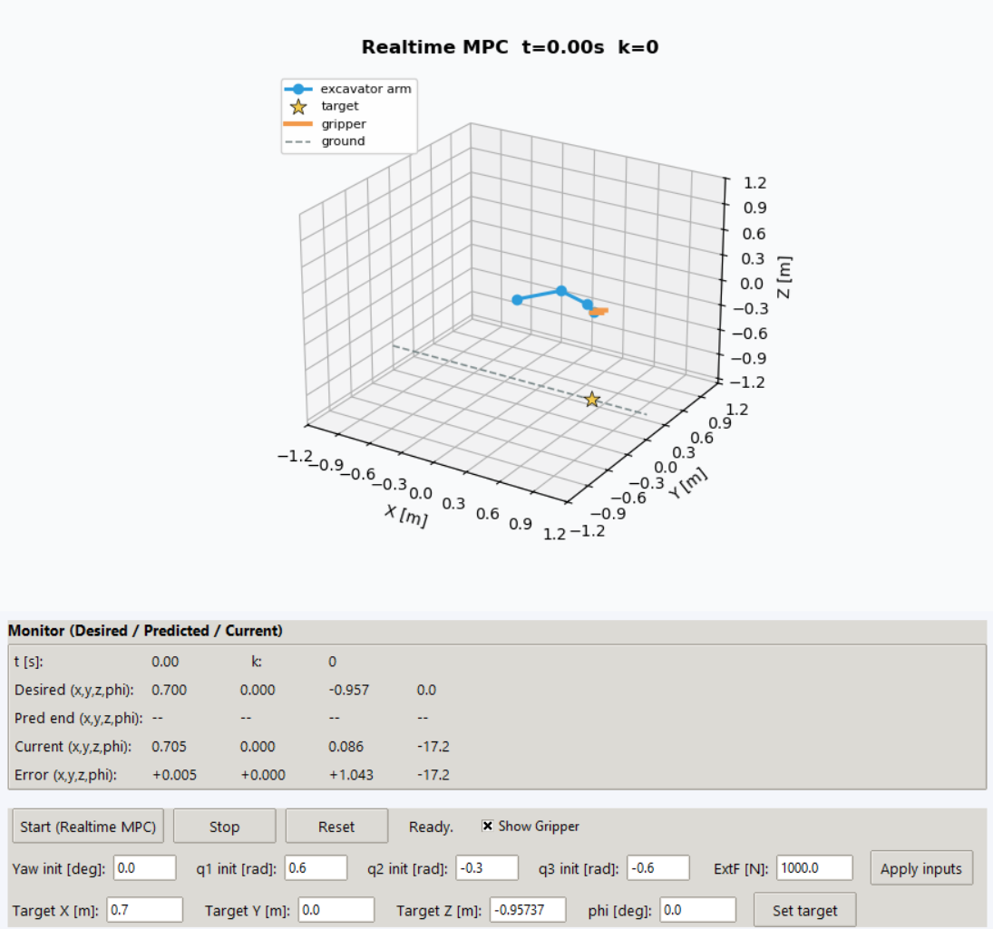
GUI

Slide 44
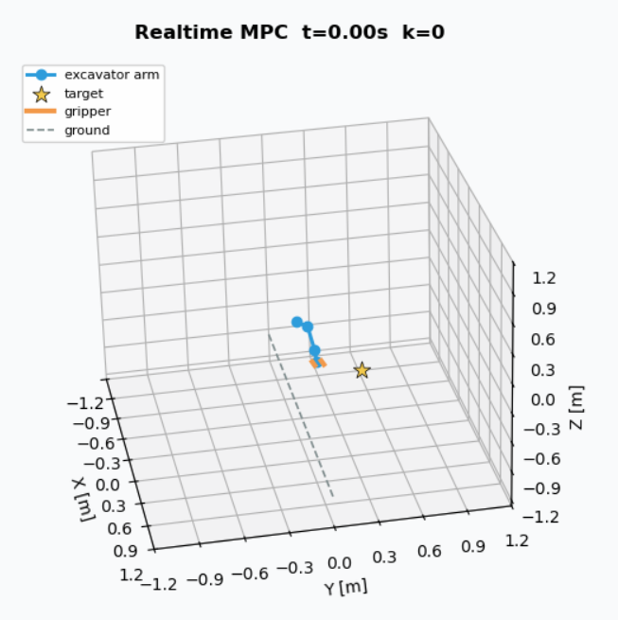
Output

Slide 45
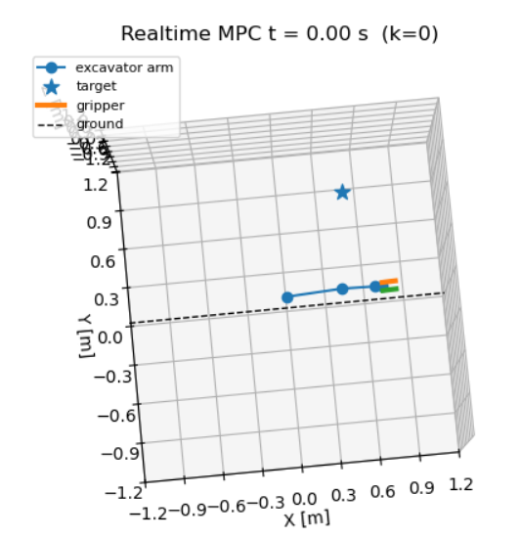
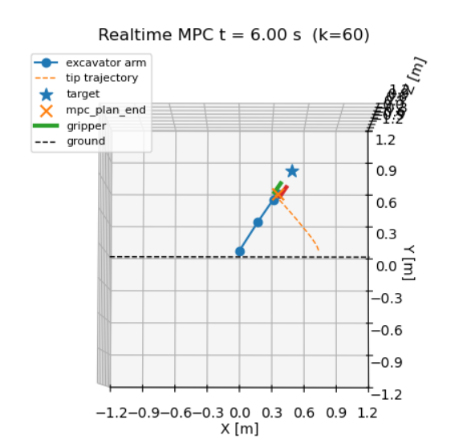
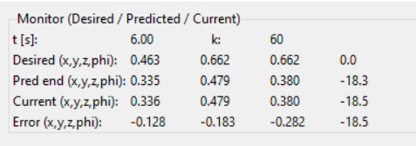
3D
Python_fixed_0601_2016V2

Slide 46
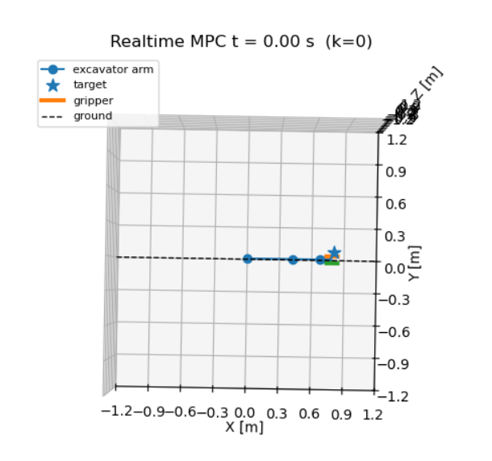
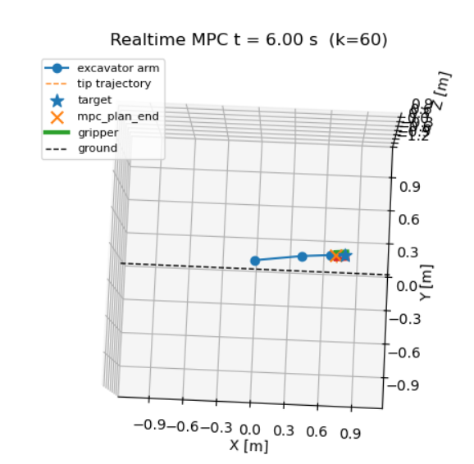
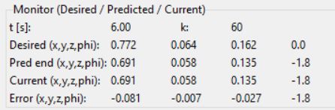
Python_fixed_0601_2016V2

Slide 47
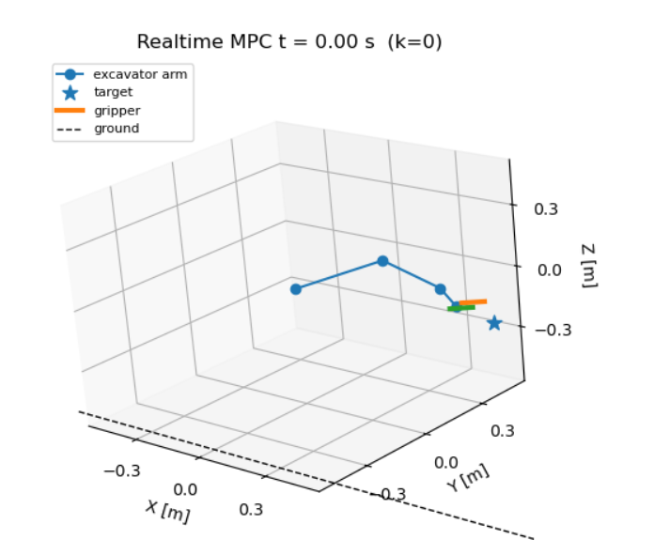
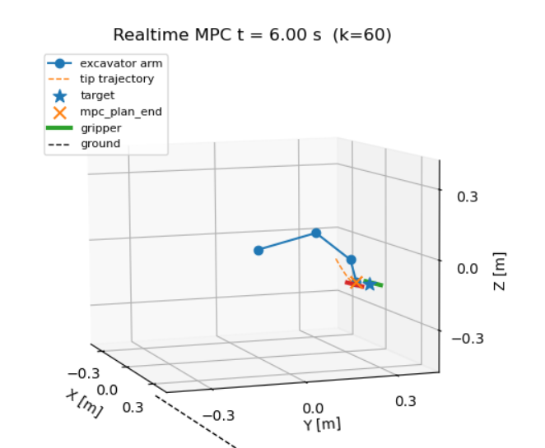
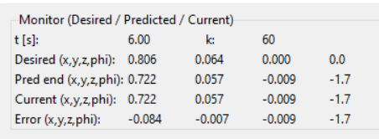
Python_fixed_0601_2016V2

Slide 48
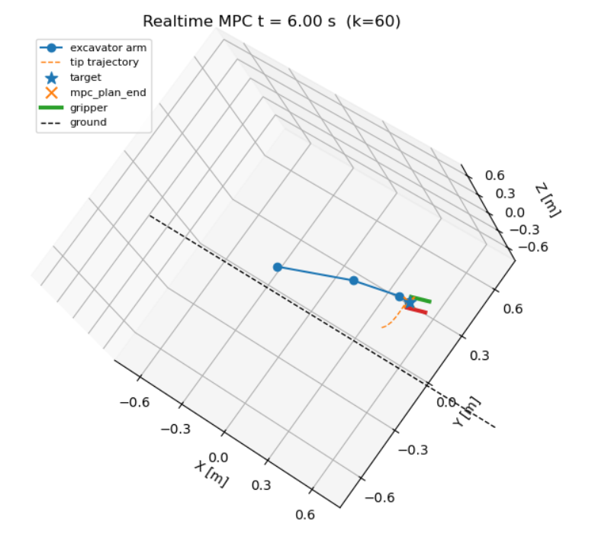
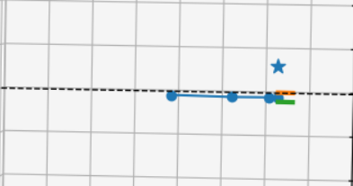
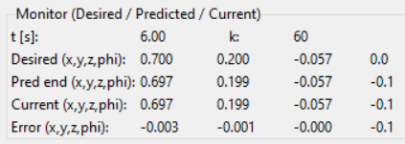
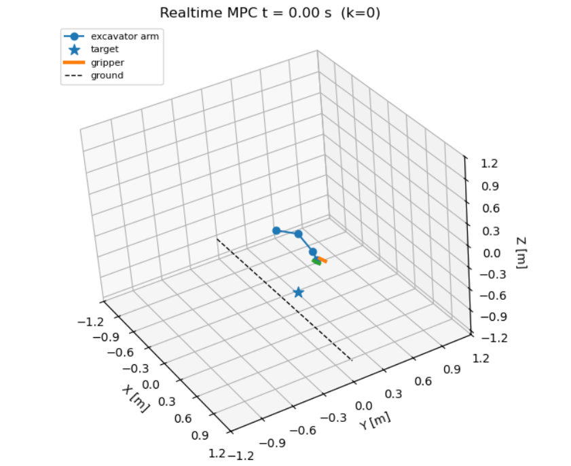
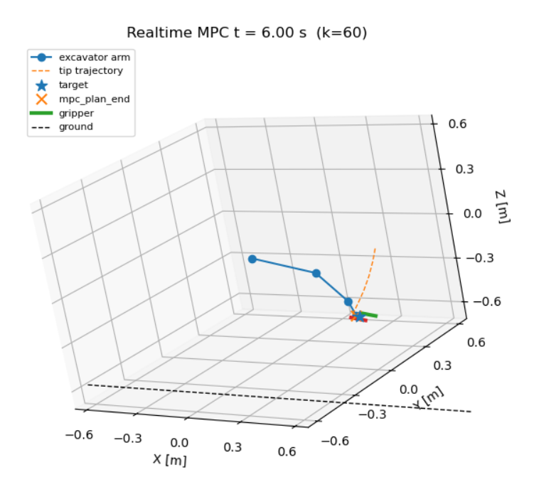
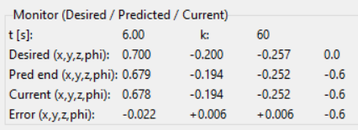
Python_fixed_0601_2016V2_1

Slide 49
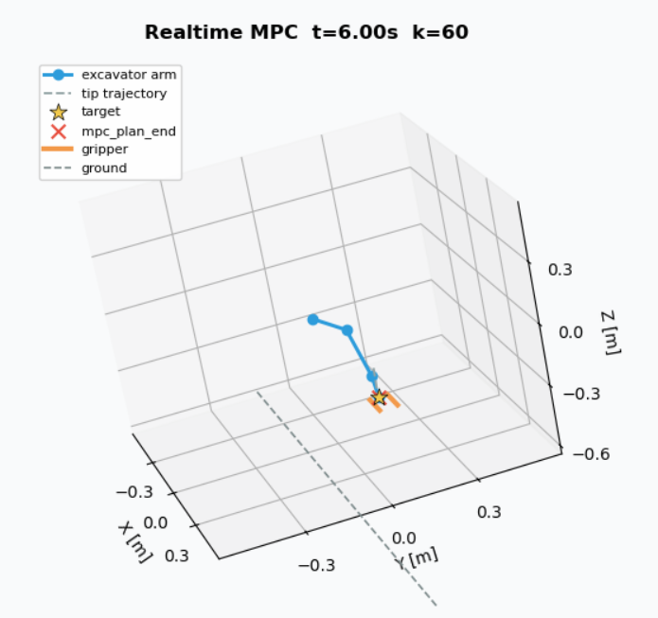
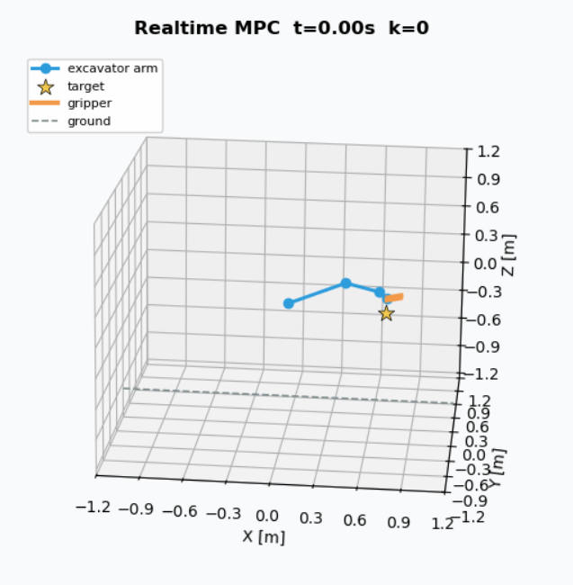
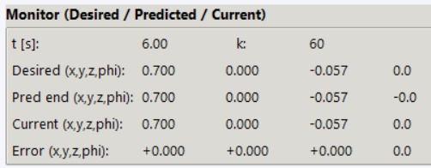
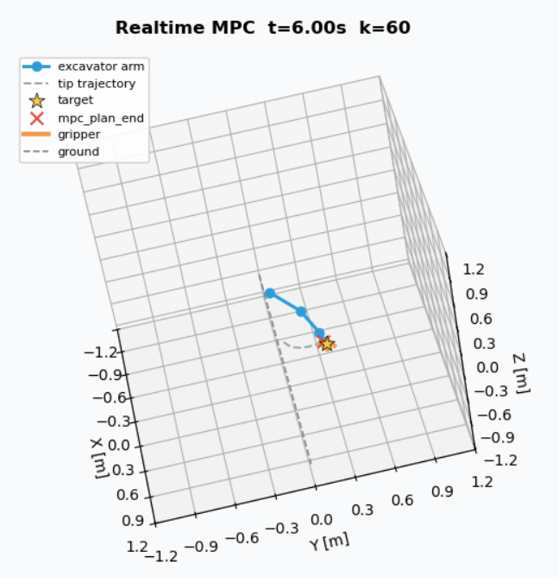
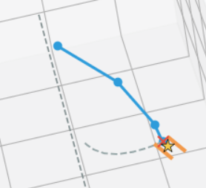
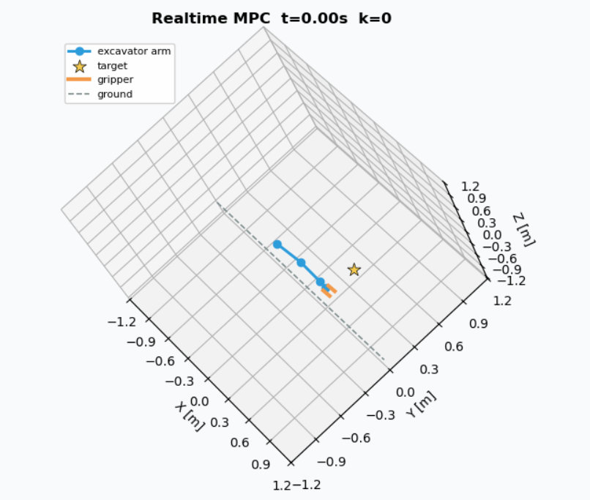
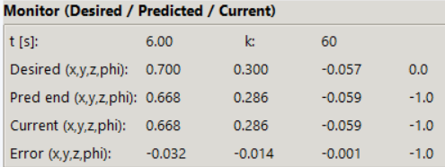

Slide 51
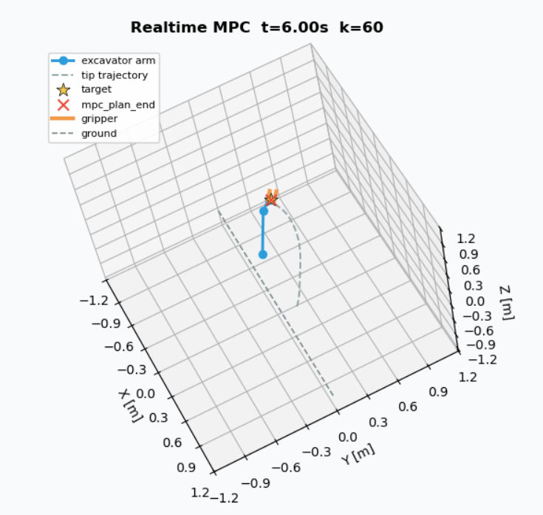
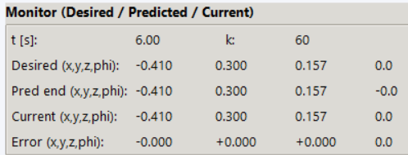
Python_fixed_0601_2016V2_2

Slide 52
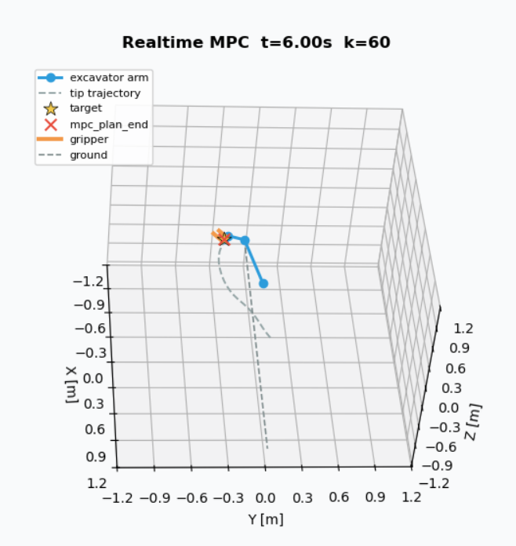
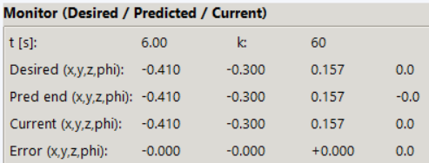
Python_fixed_0601_2016V2_2

Slide 53
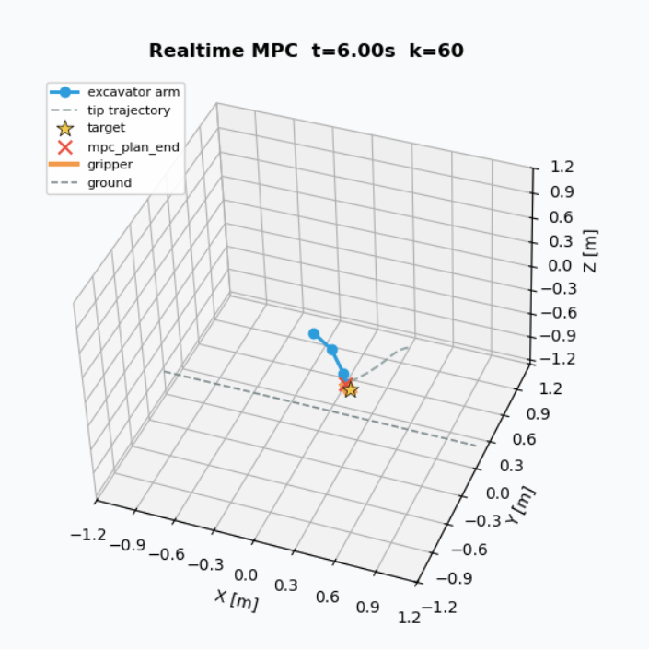
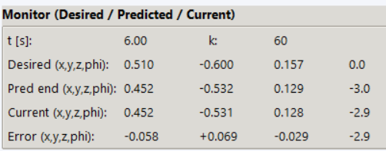
Python_fixed_0601_2016V2_2

Slide 54



Slide 55





Slide 56





Slide 57
summary
ID | Desired_x | Desired_y | Desired_z | Desired_phi_deg | Error_x | Error_y | Error_z | Error_phi_deg | Actual_x | Actual_y | Actual_z | Actual_phi_deg | Error_norm_xyz | Notes
T1 | 0.700 | 0.200 | -0.057 | 0.0 | -0.003 | -0.001 | 0.000 | -0.1 | 0.697 | 0.199 | -0.057 | -0.1 | 0.003 | Small offset
T2 | 0.700 | -0.200 | -0.257 | 0.0 | -0.022 | 0.006 | 0.006 | -0.6 | 0.678 | -0.194 | -0.251 | -0.6 | 0.024 | Moderate y/φ error
T3 | 0.700 | 0.000 | -0.057 | 0.0 | 0.000 | 0.000 | 0.000 | 0.0 | 0.700 | 0.000 | -0.057 | 0.0 | 0.000 | Perfectly aligned
T4 | 0.700 | 0.300 | -0.057 | 0.0 | -0.032 | -0.014 | -0.001 | -1.0 | 0.668 | 0.286 | -0.058 | -1.0 | 0.035 | Larger y/φ error
T5 | -0.410 | 0.300 | 0.157 | 0.0 | 0.000 | 0.000 | 0.000 | 0.0 | -0.410 | 0.300 | 0.157 | 0.0 | 0.000 | Zero residual
T6 | -0.410 | -0.300 | 0.157 | 0.0 | 0.000 | 0.000 | 0.000 | 0.0 | -0.410 | -0.300 | 0.157 | 0.0 | 0.000 | Zero residual
T7 | 0.510 | -0.600 | 0.157 | 0.0 | -0.058 | 0.069 | -0.029 | -2.9 | 0.452 | -0.531 | 0.128 | -2.9 | 0.095 | Worst-case residual
T8 | 0.410 | 0.300 | 0.157 | 0.0 | 0.000 | 0.000 | 0.000 | 0.0 | 0.410 | 0.300 | 0.157 | 0.0 | 0.000 | Zero residual
T9 | 0.700 | 0.000 | -0.057 | 0.0 | 0.000 | 0.000 | 0.000 | 0.0 | 0.700 | 0.000 | -0.057 | 0.0 | 0.000 | Zero residual

Slide 59
Next step
Potential upgrade directions (depending on your thesis/project requirements):
Add a separate yaw objective to the cost function:
For instance, to align the excavator's final yaw with a specific direction, incorporate:
Qψ​(ψ−ψdes​)2
Fully integrate external forces extF into the model:
For example:
Simply introduce an equivalent load in the dynamics;
Alternatively, incorporate an ‘external force resistance’ term into the cost function to compare MPC behaviour with and without external forces.
Record time series:
Store yaw, q1–q3, and tip trajectories in arrays, then plot 2D graphs (e.g., yaw vs. time, tip XY projections) for easier paper/report writing.
Should you decide which aspect to tackle next (e.g., ‘adding a desired trajectory for yaw’ or ‘incorporating extF into the OCP model’), simply let me know. I can modify the corresponding code segments based on your current operational framework.
E:/anacoda/python.exe d:/thesis/excavater/code/eXactMPC_v1/Python_fixed/mpc_realtime_gui.py

Slide 60
Deployment advices
让 MPC 只做高层决策，PID/硬件层负责执行
主要思考一下如何 sim to real alignment

Slide 61
Thesis tips
IPOPT
an algorithm that solves complex optimization problems (finding minimum/maximum of a function) by staying within the feasible region, using "barrier" functions to penalize approaching boundaries, efficiently handling constraints, and moving towards optimal solutions, combining strengths of both linear and nonlinear methods for large-scale problems

Slide 62
PID controller
Reference
Parameters

Slide 63

MPC study Link
https://ch.mathworks.com/help/mpc/gs/what-is-mpc.html
https://ch.mathworks.com/videos/understanding-model-predictive-control-part-2-what-is-mpc--1528106359076.html

Slide 64


MPC study Link
https://ch.mathworks.com/help/mpc/gs/what-is-mpc.html

Slide 65
“为什么不用 PID？
PID：好调、便宜，但很难系统地处理约束，遇到饱和就容易振荡/超调
MPC：计算更重，但能同时做到：
轨迹跟踪
平滑控制（少抖动、手感像老司机）
约束安全（行程/速度/压力限制）
抗扰动（土硬、负载变、坡地）

Slide 66
Get the best performance within certain limitation
Cost function (energy consumer)
Constraints: such as joint angle/velocity limits(Physical boundaries) Energy limits Actuator limits
Single-Input Single-Output (SISO)
Reference: r(t)
Output: y(t)
Error:
e(t)=y(t)−r(t)
r(t)
↓
(+)─── e(t) ──► [ Controller ] ──► u(t) ──► [ System ] ──► y(t)
▲ │
└────────────────────────────────────────────┘

Slide 68
outline
Topic
Goals
Plans
Study resource/ code

Slide 69
Thanks

