Slide 1
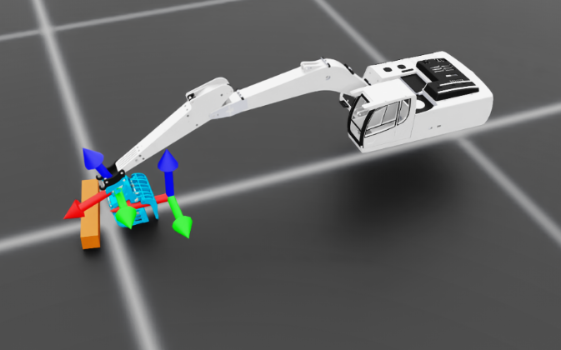
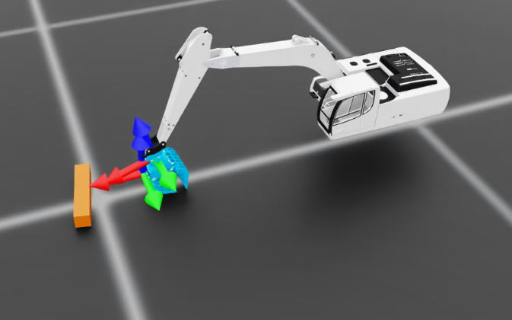
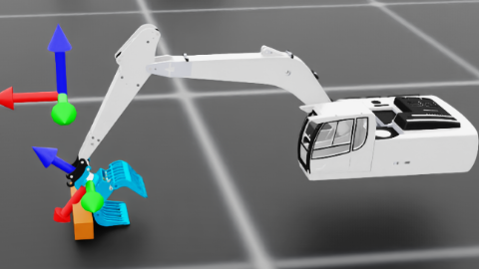
Episode_Reward/action_rate: 0.0000
Metrics/ee_pose/position_error: 0.0680

Slide 2
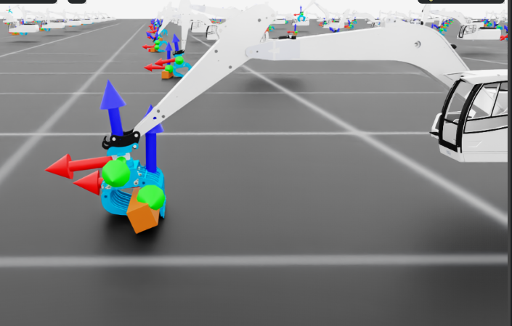
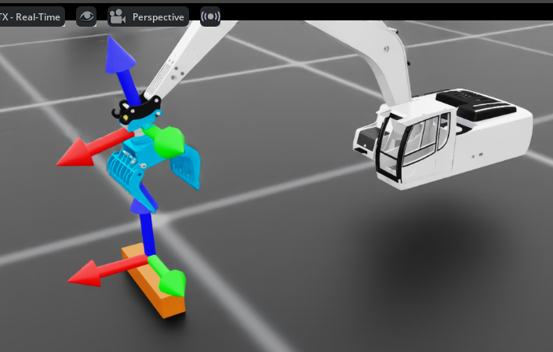
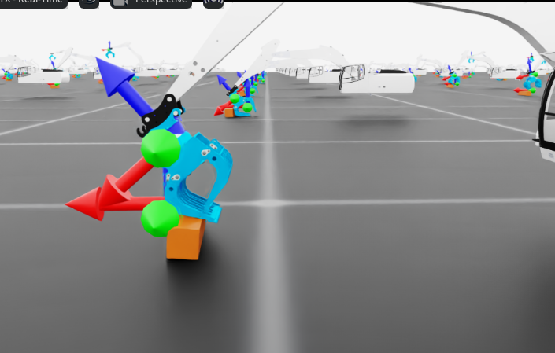

Slide 3
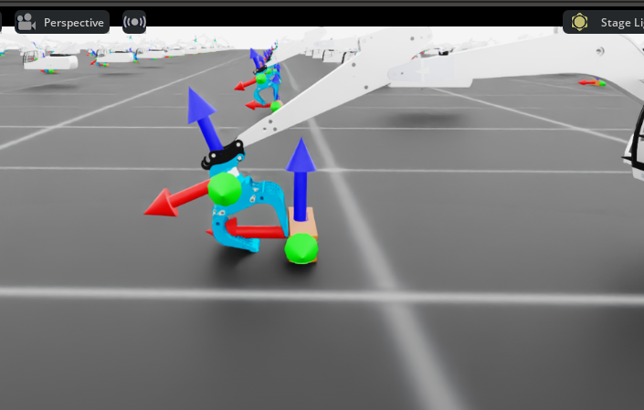
The current issue is that when the claw encounters an obstacle, it doesn't descend vertically. Could we modify the logic so that when the claw attempts to move forward, it shifts downward once it reaches a certain distance from the target point (log)? This way, log would be directly beneath the claw. As the claw wraps around the target, it would exert upward force to lift it.
sync_command_with_log = EventTerm( func=mdp.sync_ee_pose_to_log_center, mode="interval", interval_range_s=(0.0, 0.0), # 每步更新 params={ "command_name": "ee_pose", "robot_asset_cfg": SceneEntityCfg("robot"), "log_asset_cfg": SceneEntityCfg("log"), "z_offset": 0.0, # 目标=log中心；如果想抓上表面可设 0.02 },

Slide 4
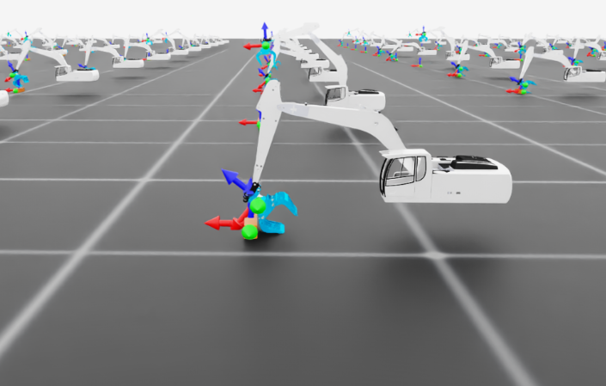
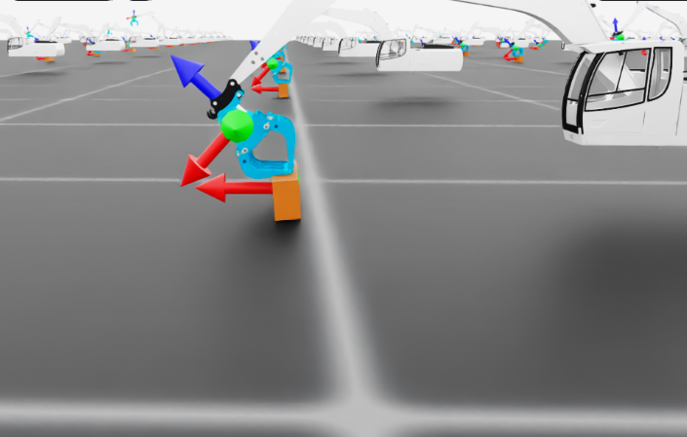
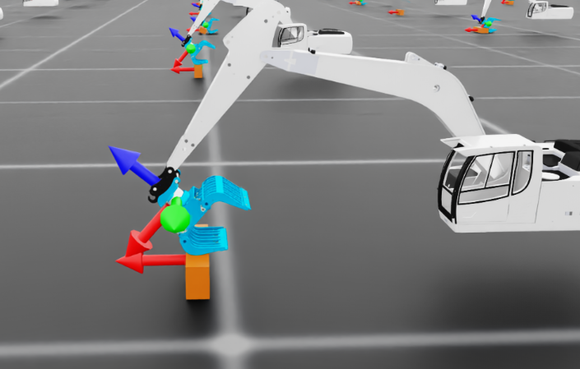
夹爪关节 limit 本来就没到 0.6rad（被物理限位 clamp 了）

Slide 5
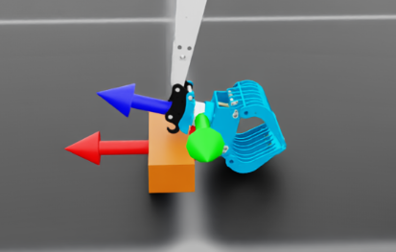
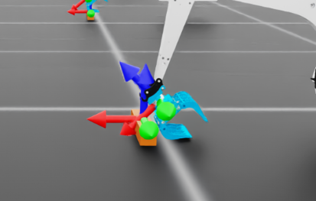
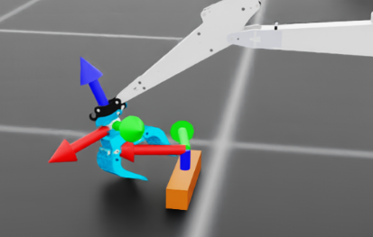
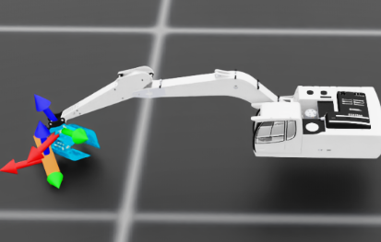
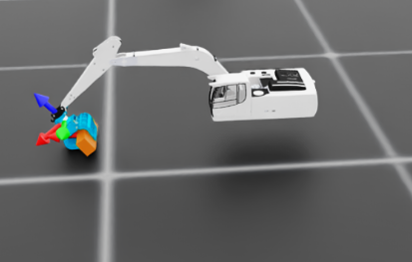
Align with object

Slide 6
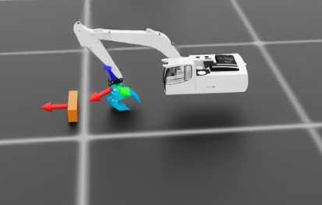
ik_rel_log_env_cfg copy 8 after align ok .py

Slide 7
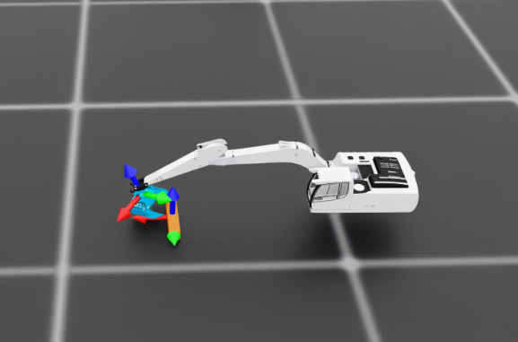
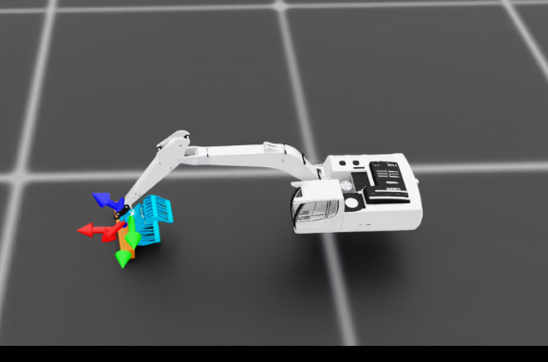
Learning iteration 91/5000
Computation: 4961 steps/s (collection: 2.357s, learning 0.062s)
Mean action noise std: 0.60
Mean value_function loss: 0.0008
Mean surrogate loss: -0.0027
Mean entropy loss: 6.3417
Mean reward: -2.90
Mean episode length: 360.00
Episode_Reward/end_effector_position_tracking: -0.1712
Episode_Reward/end_effector_position_tracking_fine_grained: 0.1862
Episode_Reward/action_rate: 0.0000
Episode_Reward/log_lift_reward: 0.1398
Episode_Reward/end_effector_orientation_tracking: -0.3976
Metrics/ee_pose/position_error: 0.1459
Metrics/ee_pose/orientation_error: 0.9408
Episode_Termination/time_out: 0.9811
Episode_Termination/root_oob: 0.0000
Episode_Termination/ee_speed_oob: 0.0000
Episode_Termination/any_link_speed_oob: 0.0189
Episode_Termination/any_link_oob: 0.0000
Episode_Termination/nan_inf_guard: 0.0000
--------------------------------------------------------------------------------
Total timesteps: 1104000
Iteration time: 2.42s
Time elapsed: 00:03:36
ETA: 03:12:25
masi_v9.zip

Slide 8
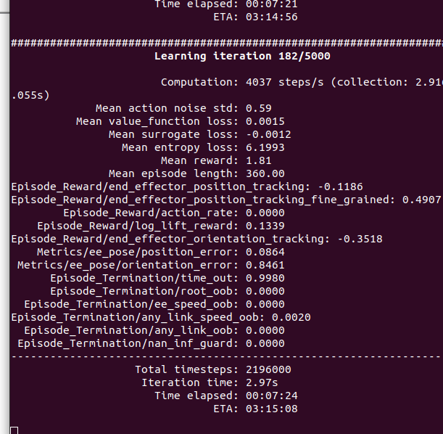
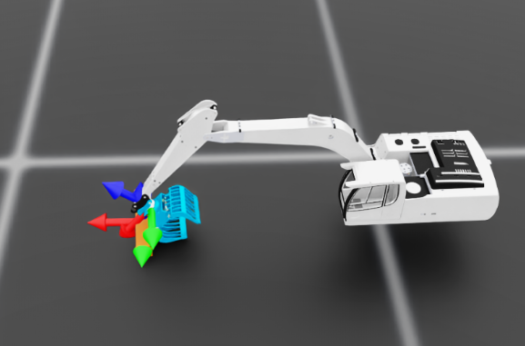
masi_v9.zip

Slide 9
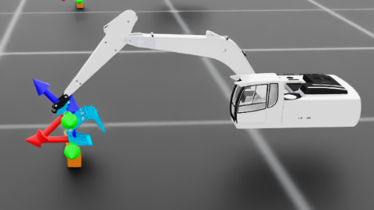
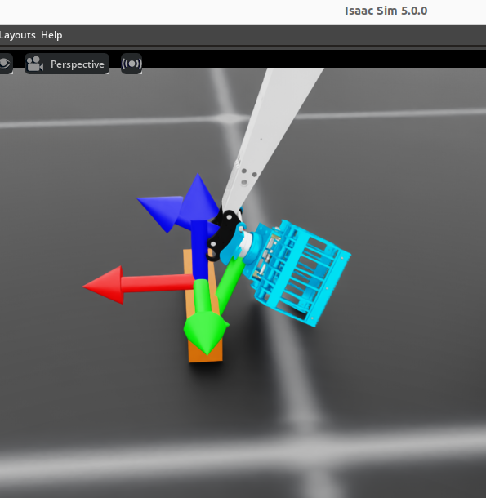
v 9
Lets try
body_offset=DifferentialInverseKinematicsActionCfg.OffsetCfg( # 关键改动：把“虚拟末端”从 gripper_frame 向下挪一段到铲斗前端 # 数值你可以微调，先试 -0.25，如果目标点还在铲斗中间就再缩小一点 pos=[0.0, 0.0, -0.19], # v9 pos=[0.0, 0.0, -0.19], rot=[0.7071068, 0.0, 0.7071068, 0.0], # v9 绕 Y 轴 +90° ), )

Slide 10
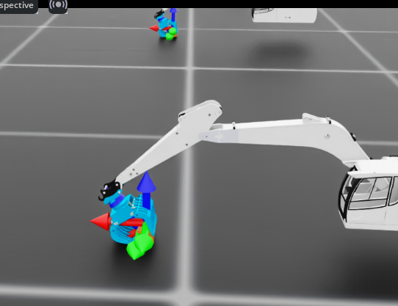
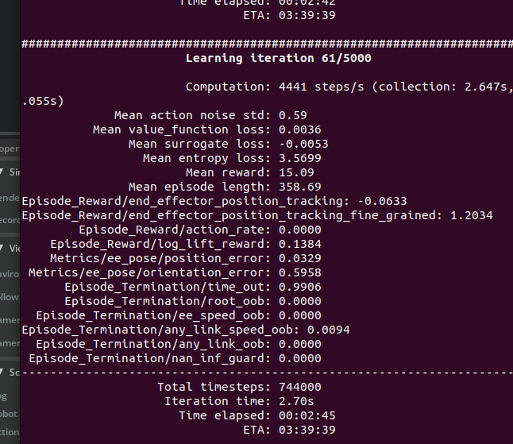
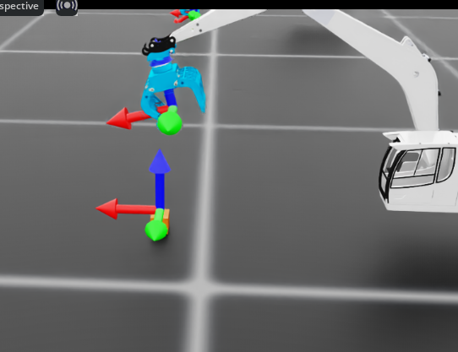
- body_name="gripper_frame",
+ body_name="ee",

Slide 11
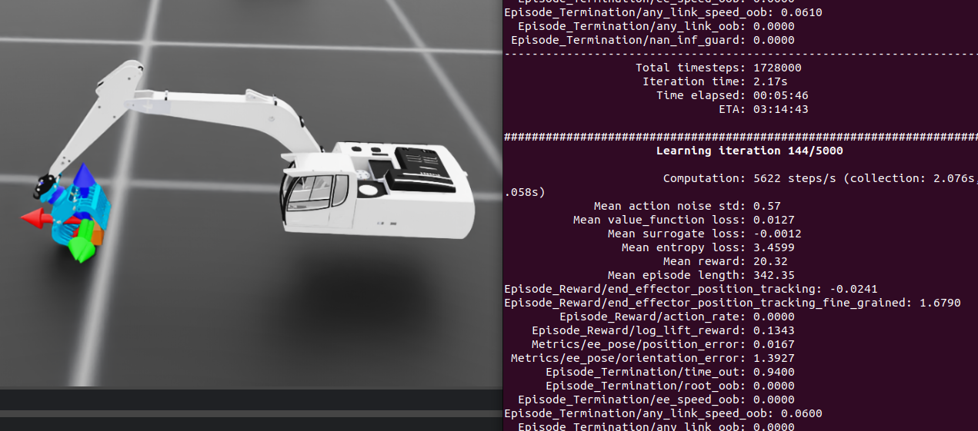
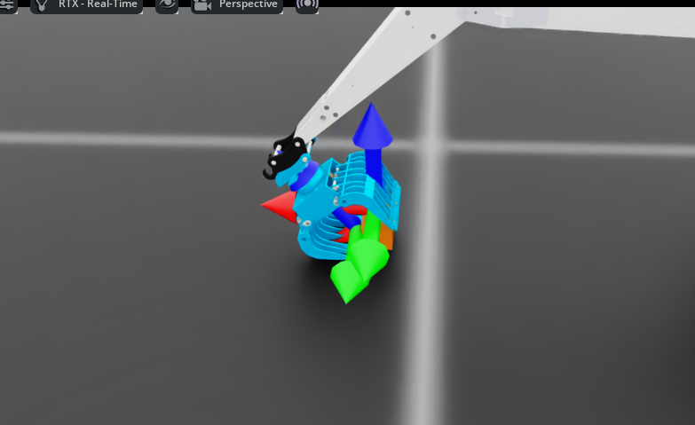
Save v10 version for this modify
Has contained the log but cannot catch and lift it
The current training phase is such that when the claw wraps around the log target, it does not immediately grasp the object. Instead, it continues pushing the object until the claw can no longer wrap around it.
"close_dist": 0.02,
+"close_dist": 0.05, # 先从 5cm 开始
"keep_open_xy": 0.10,
+"keep_open_xy": 0.06, # 对齐要求更严格，否则老是强制张开
"keep_open_z_above": 0.02,
+"keep_open_z_above": 0.01 # 离得不高了就允许夹

Slide 12
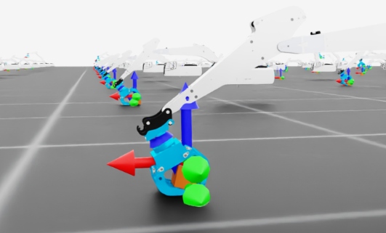
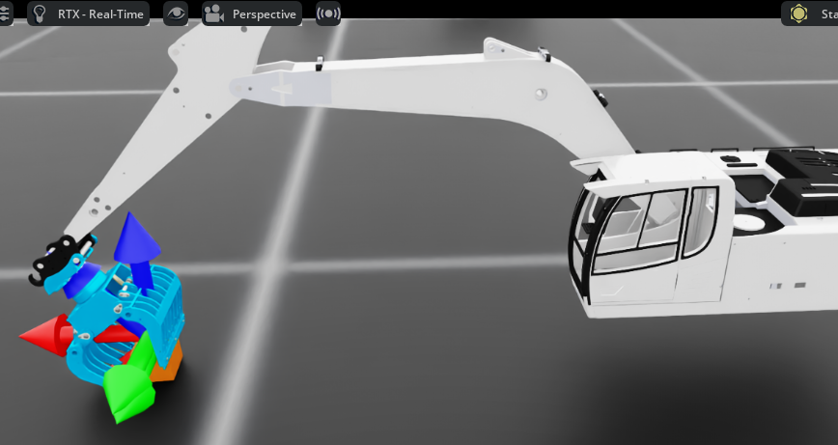
masi_V11
Can contain and grasp but cannot lift
masi_v12.zip
masi_v13.zip

Slide 13
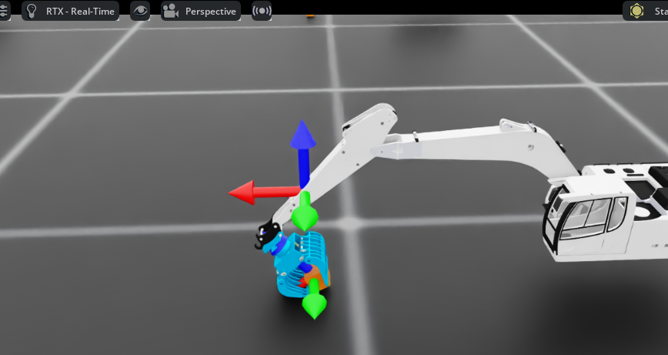
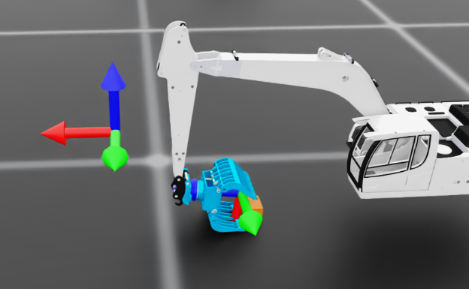
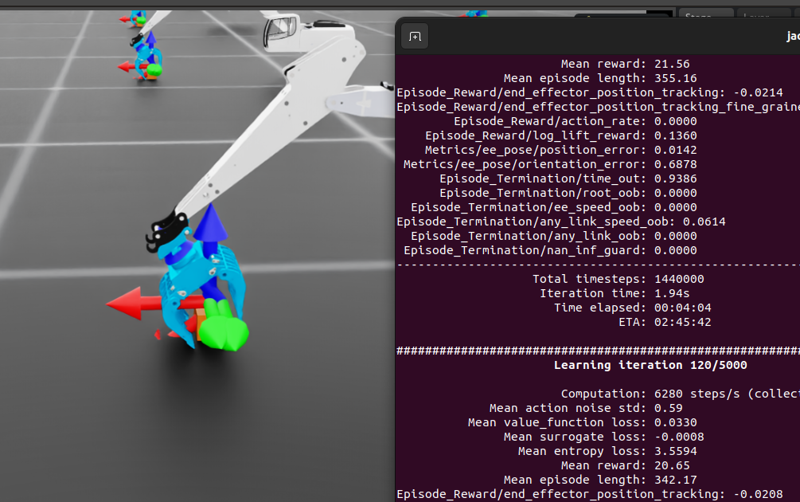
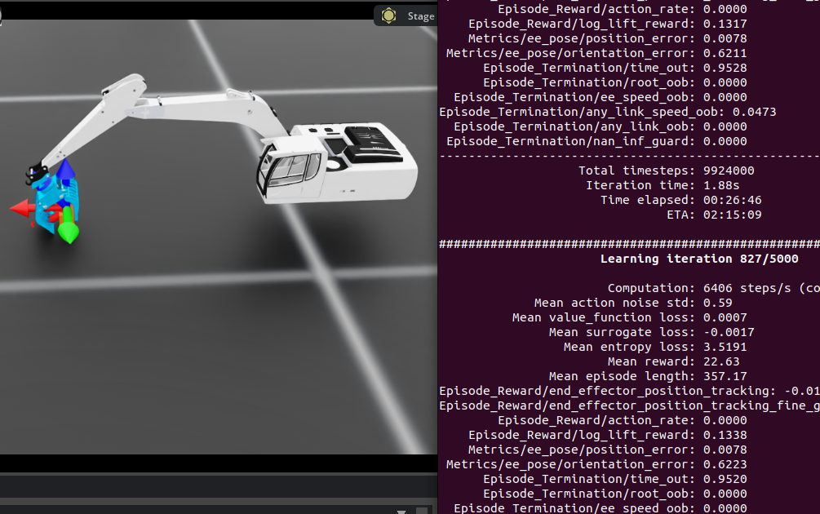
masi_v14.zip
Modified: When the log is wrapped, it moves upward, but the claw remains firmly gripped on the log entity.
Can contain and grasp but cannot lift

Slide 14
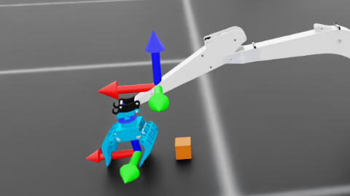
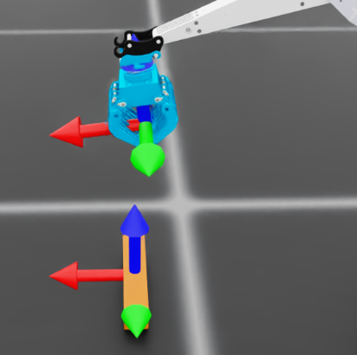
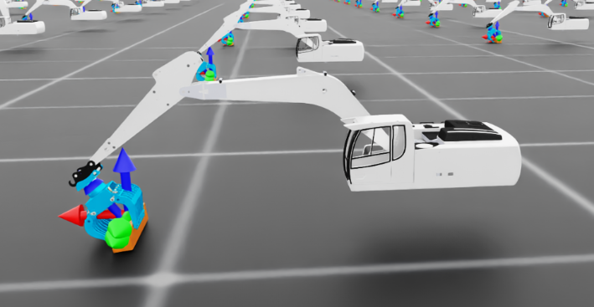
masi_v15.zip
Modified: When the log is wrapped, it moves upward, but the claw remains firmly gripped on the log entity.
Eetu help check the model (17.12.2025)
19.12.2025:
masi_v17 recovery for this version
The target has already soared halfway up, yet its claws still scrape the ground.

Slide 15
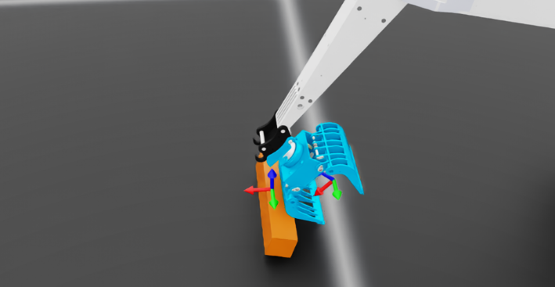
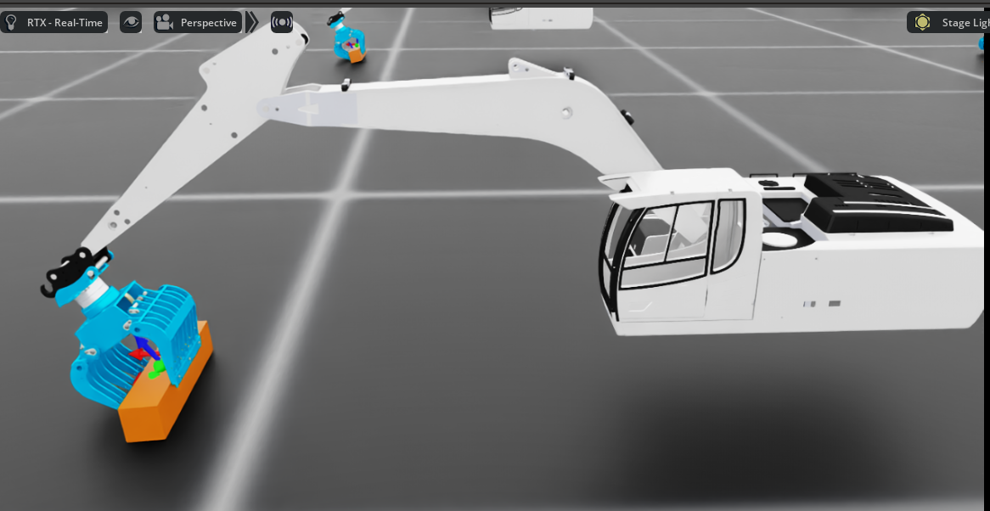
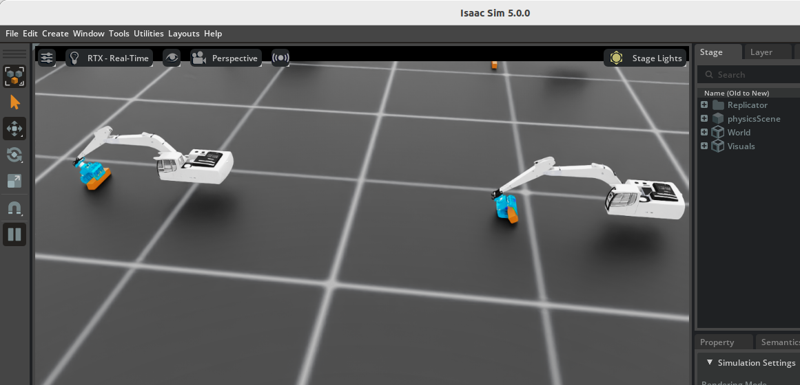
masi_v18.zip
masi_v15.zip
Modified: When the log is wrapped, it moves upward, but the claw remains firmly gripped on the log entity.

Slide 16
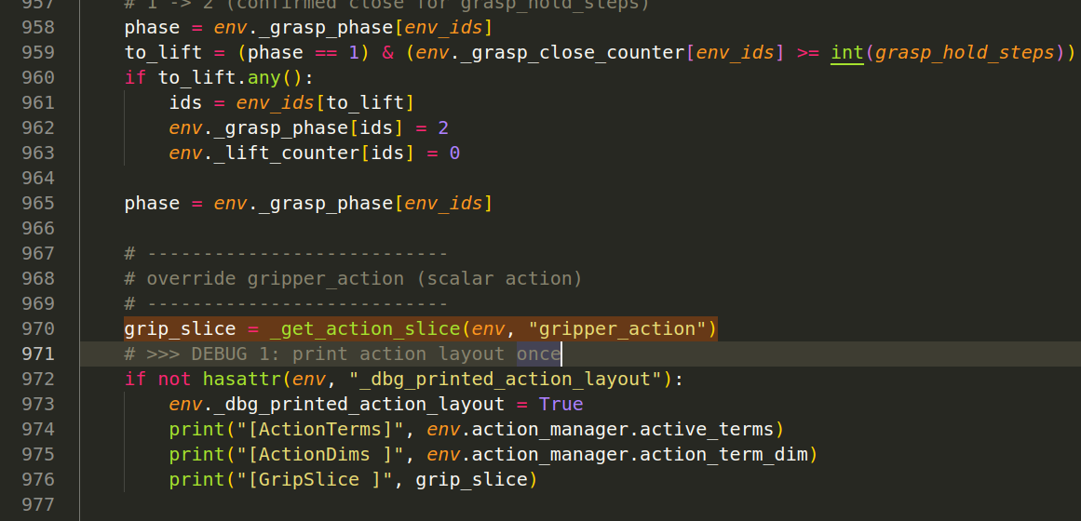
[ActionTerms] ['arm_action', 'gripper_action']
[ActionDims ] [3, 1]
[GripSlice ] slice(3, 4, None)
[ActionTerms] ['arm_action', 'gripper_action']
[ActionDims ] [3, 1]
[GripSlice ] slice(3, 4, None)
[DBG] claw_joint_ids = [5, 6]
[ActionTerms] ['arm_action', 'gripper_action']
[ActionDims ] [3, 1]
[GripSlice ] slice(3, 4, None)
[DBG] claw_joint_ids = [5, 6]
[DBG] claw joint_pos = [0.058184847235679626, -0.05750758945941925]
[DBG] claw joint_pos_target= [0.800000011920929, -0.800000011920929]
[DBG] phase(eid) = 0

Slide 17
masi_v18_2 and 3,4 (event) just stable than before
t_limits` property will be deprecated in a future release. Please use `joint_pos_limits` instead.
[DBG] inferred claw limits = [[-0.8726646304130554, 0.5061454772949219], [-0.8726646304130554, 0.5061454772949219]]
[DBG] cur(claw) = [0.058184847235679626, -0.05750758945941925]
[DBG] inferred claw open_tgt = [0.47856926918029785, -0.8450884222984314]
[DBG] inferred claw close_tgt= [-0.8450884222984314, 0.47856926918029785]
[DBG] claw joint_pos = [0.058184847235679626, -0.05750758945941925]
[DBG] claw joint_pos_target= [0.47856926918029785, -0.8450884222984314]
[DBG] phase(eid) = 0
[DBG] v_ee(world_up in EE frame) = [-0.006549802143126726, -1.0523775983983796e-07, 0.9999785423278809]

Slide 18
masi_v18_2 and 3,4 (event) just stable than before 19.11.2025 18:24
[DBG] d_xy= 0.09066011011600494 dz_top= 0.22005146741867065 approaching= True ready_to_close= False close_xy/close_z= 0.06 0.06 keep_open_z_above= 0.32
[DBG] d_xy / dz_top / dist_top = 0.09066011011600494 0.22005146741867065 0.23799559473991394
[DBG] approaching / ready_to_close = True False
[DBG] params close_dist/keep_open_xy/keep_open_z_above = 0.06 0.08 0.32
[DBG] claw_joint_ids = [5, 6]
[DBG] inferred claw limits = [[-0.8726646304130554, 0.5061454772949219], [-0.8726646304130554, 0.5061454772949219]]
[DBG] cur(claw) = [0.058184847235679626, -0.05750758945941925]
[DBG] inferred claw open_tgt = [0.47856926918029785, -0.8450884222984314]
[DBG] inferred claw close_tgt= [-0.8450884222984314, 0.47856926918029785]
[DBG] claw joint_pos = [0.058184847235679626, -0.05750758945941925]
[DBG] claw joint_pos_target= [0.47856926918029785, -0.8450884222984314]
[DBG] phase(eid) = 0
[DBG] v_ee(world_up in EE frame) = [-0.006549802143126726, -1.0523775983983796e-07, 0.9999785423278809]
"close_dist": 0.10, # 原来 0.06 太严
"keep_open_xy": 0.12, # 原来 0.08 太严（你现在 d_xy=0.0906）

Slide 19
[DBG] d_xy= 0.09066011011600494 dz_top= 0.22005146741867065 approaching= False ready_to_close= False close_xy/close_z= 0.1 0.1 keep_open_z_above= 0.32
[DBG] d_xy / dz_top / dist_top = 0.09066011011600494 0.22005146741867065 0.23799559473991394
[DBG] approaching / ready_to_close = False False
[DBG] params close_dist/keep_open_xy/keep_open_z_above = 0.1 0.12 0.32
[DBG] claw_joint_ids = [5, 6]
[DBG] inferred claw limits = [[-0.8726646304130554, 0.5061454772949219], [-0.8726646304130554, 0.5061454772949219]]
[DBG] cur(claw) = [0.058184847235679626, -0.05750758945941925]
[DBG] inferred claw open_tgt = [0.47856926918029785, -0.8450884222984314]
[DBG] inferred claw close_tgt= [-0.8450884222984314, 0.47856926918029785]
[DBG] claw joint_pos = [0.058184847235679626, -0.05750758945941925]
[DBG] claw joint_pos_target= [0.47856926918029785, -0.8450884222984314]
[DBG] phase(eid) = 0
[DBG] v_ee(world_up in EE frame) = [-0.006549802143126726, -1.0523775983983796e-07, 0.9999785423278809]

Slide 20
[DBG] d_xy= 0.09066011011600494 dz_top= 0.22005146741867065 approaching= False ready_to_close= True close_xy/close_z= 0.1 0.25 keep_open_z_above= 0.32
[DBG] d_xy / dz_top / dist_top = 0.09066011011600494 0.22005146741867065 0.23799559473991394
[DBG] approaching / ready_to_close = False True
[DBG] params close_dist/keep_open_xy/keep_open_z_above = 0.1 0.12 0.32
[DBG] claw_joint_ids = [5, 6]
[DBG] inferred claw limits = [[-0.8726646304130554, 0.5061454772949219], [-0.8726646304130554, 0.5061454772949219]]
[DBG] cur(claw) = [0.058184847235679626, -0.05750758945941925]
[DBG] inferred claw open_tgt = [0.47856926918029785, -0.8450884222984314]
[DBG] inferred claw close_tgt= [-0.8450884222984314, 0.47856926918029785]
[DBG] claw joint_pos = [0.058184847235679626, -0.05750758945941925]
[DBG] claw joint_pos_target= [-0.8450884222984314, 0.47856926918029785]
[DBG] phase(eid) = 1
[DBG] v_ee(world_up in EE frame) = [-0.006549802143126726, -1.0523775983983796e-07, 0.9999785423278809]

Slide 21
[DBG] d_xy= 0.09066011011600494 dz_top= 0.22005146741867065 approaching= False ready_to_close= True close_xy/close_z= 0.1 0.25 keep_open_z_above= 0.32
[DBG] d_xy / dz_top / dist_top = 0.09066011011600494 0.22005146741867065 0.23799559473991394
[DBG] approaching / ready_to_close = False True
[DBG] params close_dist/keep_open_xy/keep_open_z_above = 0.1 0.12 0.32
[DBG] claw_joint_ids = [5, 6]
[DBG] inferred claw limits = [[-0.8726646304130554, 0.5061454772949219], [-0.8726646304130554, 0.5061454772949219]]
[DBG] cur(claw) = [0.058184847235679626, -0.05750758945941925]
[DBG] inferred claw open_tgt = [0.47856926918029785, -0.8450884222984314]
[DBG] inferred claw close_tgt= [-0.8450884222984314, 0.47856926918029785]
[DBG] claw joint_pos = [0.058184847235679626, -0.05750758945941925]
[DBG] claw joint_pos_target= [-0.8450884222984314, 0.47856926918029785]
[DBG] phase(eid) = 1
[DBG] grasp_close_counter(eid) = 1
[DBG] v_ee(world_up in EE frame) = [-0.006549802143126726, -1.0523775983983796e-07, 0.9999785423278809]

Slide 22
[DBG] d_xy= 0.09066011011600494 dz_top= 0.22005146741867065 approaching= False ready_to_close= True close_xy/close_z= 0.1 0.25 keep_open_z_above= 0.32
[DBG] d_xy / dz_top / dist_top = 0.09066011011600494 0.22005146741867065 0.23799559473991394
[DBG] params close_dist/keep_open_xy/keep_open_z_above = 0.1 0.12 0.32
[DBG] claw_joint_ids = [5, 6]
[DBG] inferred claw limits = [[-0.8726646304130554, 0.5061454772949219], [-0.8726646304130554, 0.5061454772949219]]
[DBG] cur(claw) = [0.058184847235679626, -0.05750758945941925]
[DBG] inferred claw open_tgt = [0.47856926918029785, -0.8450884222984314]
[DBG] inferred claw close_tgt= [-0.8450884222984314, 0.47856926918029785]
[DBG] claw joint_pos = [0.058184847235679626, -0.05750758945941925]
[DBG] claw joint_pos_target= [-0.8450884222984314, 0.47856926918029785]
[DBG] phase(eid) = 1
[DBG] grasp_close_counter(eid) = 1
[DBG] v_ee(world_up in EE frame) = [-0.006549802143126726, -1.0523775983983796e-07, 0.9999785423278809]
2025-12-19T

Slide 23
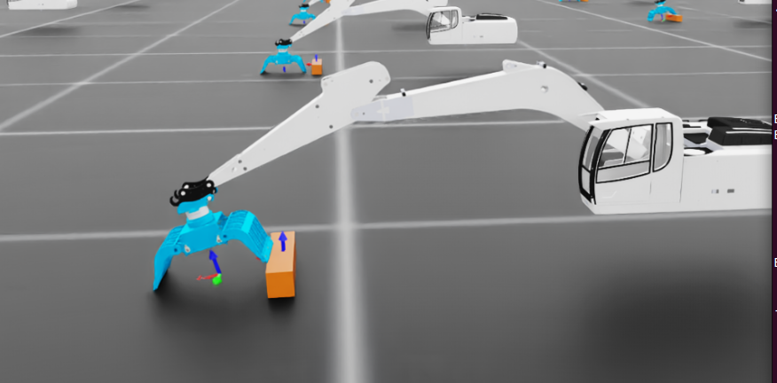
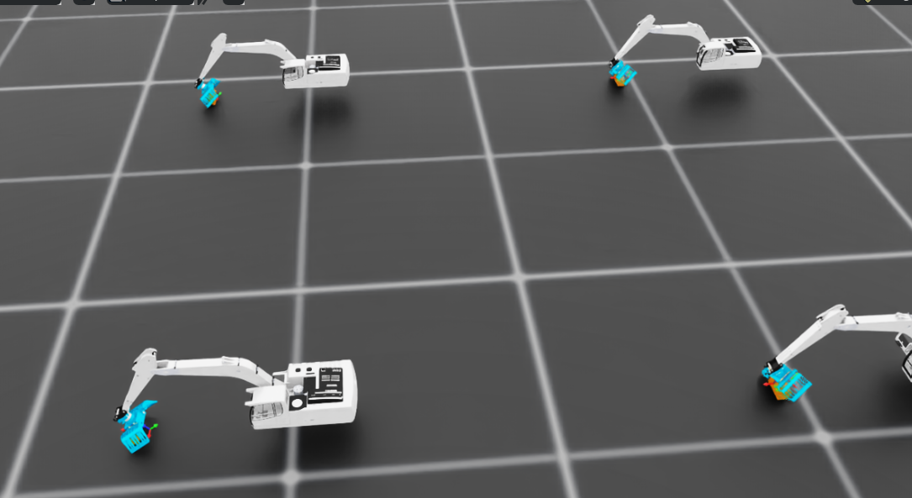
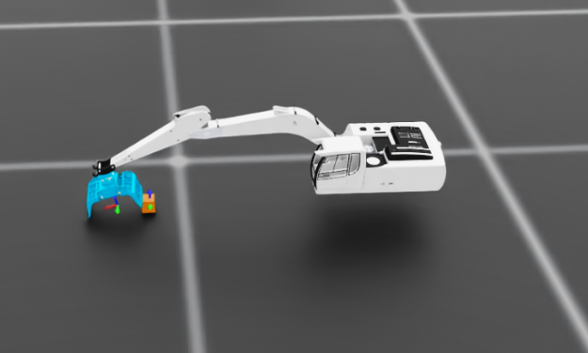
masi_v19_1
Computation: 6040 steps/s (collection: 1.926s, learning 0.060s)
Mean action noise std: 0.59
Mean value_function loss: 0.0285
Mean surrogate loss: -0.0007
Mean entropy loss: 3.5971
Mean reward: 7.58
Mean episode length: 351.63
Episode_Reward/end_effector_position_tracking: -0.1103
Episode_Reward/end_effector_position_tracking_fine_grained: 0.6745
Episode_Reward/action_rate: 0.0000
Episode_Reward/log_lift_reward: 0.1323
Metrics/ee_pose/position_error: 0.0825
Metrics/ee_pose/orientation_error: 0.2427
Episode_Termination/time_out: 0.9848
Episode_Termination/root_oob: 0.0000
Episode_Termination/ee_speed_oob: 0.0000
Episode_Termination/any_link_speed_oob: 0.0152
Episode_Termination/any_link_oob: 0.0000
Episode_Termination/nan_inf_guard: 0.0000
-----------------------------------------------

Slide 24
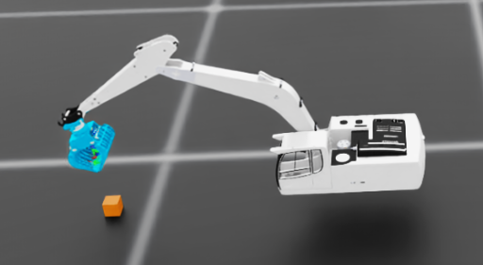
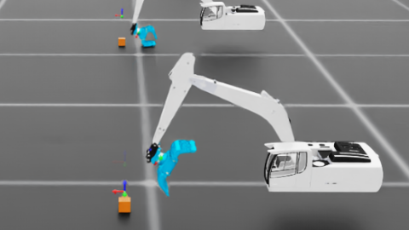
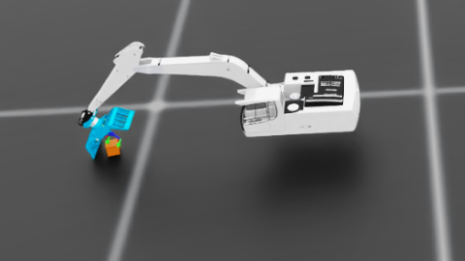
[DBG] phase= 2 d_xy= 0.058763016015291214 dz(center)= -0.13232935965061188 approach= False ready_close= False c_cnt= 0 l_cnt= 60
################################################################################
masi_V20_1_patched
masi_v19_2.zip better open clips
masi_v19_3

Slide 25
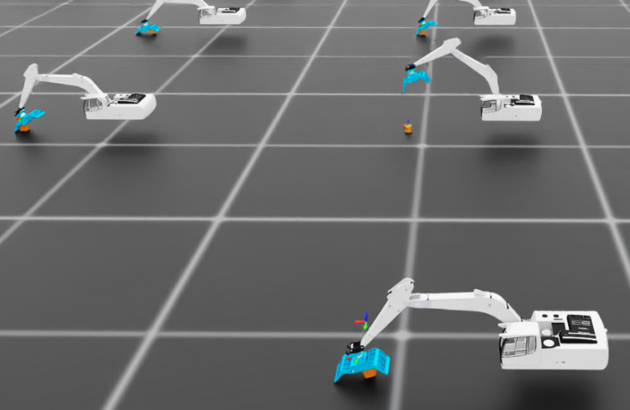
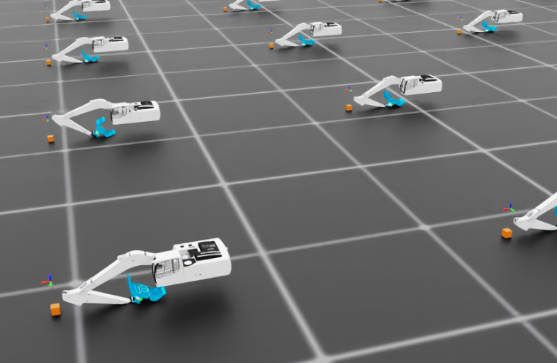
masi_V20_1_patched

Slide 26
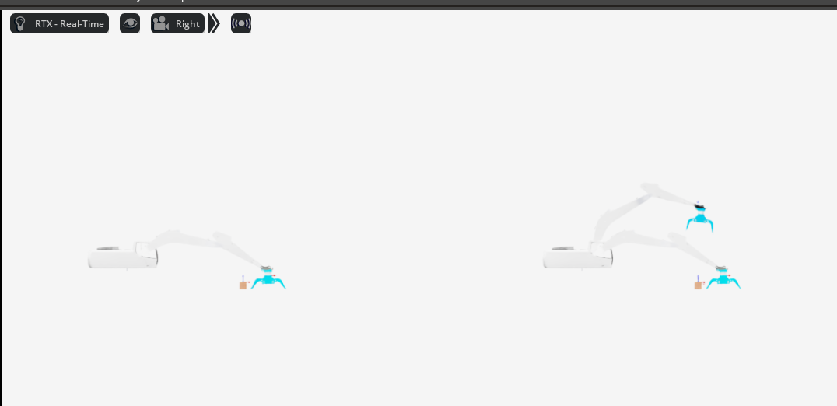
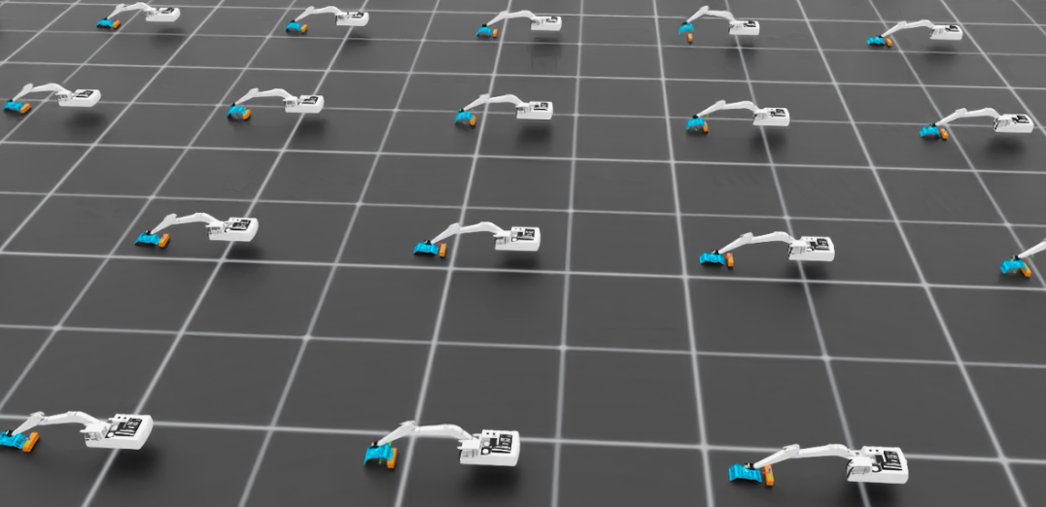


masi_v22_1.zip
masi_v22_1_direct_aligned_v2
How does this directRL align the target to lift the robotic arm upward? Analyze it first, then tell me how to adapt it. The main issues with our current managebase are: 1. The probability of triggering the grasp is very low. 2. It fails to trigger the lift-up action.
masi_v22_1_direct_aligned.zip

Slide 27

masi_v22_1_manager_direct_aligned (1)
masi_v23 xiugaile 22

Slide 28



###########################################################################
################################################################################
Learning iteration 245/5000
Computation: 4466 steps/s (collection: 2.630s, learning 0.057s)
Mean action noise std: 0.59
Mean value_function loss: 339.9729
Mean surrogate loss: -0.0005
Mean entropy loss: 2.6822
Mean reward: 690.28
Mean episode length: 357.38
Episode_Reward/ee_to_log_distance: -0.9381
Episode_Reward/yaw_alignment: 0.4978
Episode_Reward/vertical_upright: 0.3418
Episode_Reward/grasp_open_close: 0.0590
Episode_Reward/log_lift: 62.3997
Episode_Reward/action_rate: 0.0000
Metrics/ee_pose/position_error: 0.5032
Metrics/ee_pose/orientation_error: 0.9708
Episode_Termination/time_out: 0.9780
Episode_Termination/root_oob: 0.0000
Episode_Termination/ee_speed_oob: 0.0000
Episode_Termination/any_link_speed_oob: 0.0220
Episode_Termination/any_link_oob: 0.0000
Episode_Termination/nan_inf_guard: 0.0000
--------------------------------------------------------------------------------
Total timesteps: 2952000
Iteration time: 2.69s
Time elapsed: 00:11:05
ETA: 03:34:24
masi_pefect_one_V25_21_12.zip

Slide 29


masi_v25_2_lift_1
Learning iteration 194/5000
masi_v25_4_ok_lift

Slide 30

...
"max_pos_step": 0.005, # ★5mm/次
"blend": 0.15, # ★更平滑
"lift_z": 0.18,
Computation: 4022 steps/s (collection: 2.924s, learning 0.059s)
Mean action noise std: 0.59
Mean value_function loss: 0.0043
Mean surrogate loss: -0.0019
Mean entropy loss: 2.6838
Mean reward: 3.55
Mean episode length: 357.87
Episode_Reward/ee_to_log_distance: -0.7390
Episode_Reward/yaw_alignment: 0.4860
Episode_Reward/vertical_upright: 0.5202
Episode_Reward/grasp_open_close: 0.0647
Episode_Reward/log_lift: 0.0000
Episode_Reward/action_rate: 0.0000
Metrics/ee_pose/position_error: 0.2416
Metrics/ee_pose/orientation_error: 0.5969
Episode_Termination/time_out: 0.8573
Episode_Termination/root_oob: 0.0000
Episode_Termination/ee_speed_oob: 0.0000
Episode_Termination/any_link_speed_oob: 0.1427
Episode_Termination/any_link_oob: 0.0000
Episode_Termination/nan_inf_guard: 0.0000
--------------------------------------------------------------------------------
Total timesteps: 744000
Iteration time: 2.98s
Time elapsed: 00:02:58
ETA: 03:56:53
"max_pos_step": 0.01,
"blend": 0.2,
“revolute_cabin” 这个 DOF 太强：一旦 PPO 学到一点“更激进”的策略，它会开始大量用 cabin

Slide 31
d/log_lift: 0.0017
Iteration 41/500
###############################################################
Learning iteration 23/5000
Computation: 4343 steps/s (collection: 2.705s, learning 0.058s)
Mean action noise std: 0.60
Mean value_function loss: 0.0036
Mean surrogate loss: -0.0009
Mean entropy loss: 2.7221
Mean reward: 4.00
Mean episode length: 359.57
Episode_Reward/ee_to_log_distance: -0.9521
Episode_Reward/yaw_alignment: 0.3718
Episode_Reward/vertical_upright: 0.7709
Episode_Reward/grasp_open_close: 0.1434
Episode_Reward/log_lift: 0.0328
Episode_Reward/action_rate: 0.0000
Metrics/ee_pose/position_error: 0.1668
Metrics/ee_pose/orientation_error: 0.2558
Episode_Termination/time_out: 0.9840
Episode_Termination/root_oob: 0.0000
Episode_Termination/ee_speed_oob: 0.0000
Episode_Termination/any_link_speed_oob: 0.0160
Episode_Termination/any_link_oob: 0.0000
Episode_Termination/nan_inf_guard: 0.0000
--------------------------------------------------------------------------------
Total timesteps: 288000
Iteration time: 2.76s
Time elapsed: 00:01:04
ETA: 03:43:01
joint_names=["revolute_lift", "revolute_tilt", "revolute_scoop","revolute_gripper"], body_name=EE_BODY, controller=DifferentialIKControllerCfg( command_type="position", use_relative_mode=True, ik_method="dls", ik_params={"lambda_val": 0.08}, ), scale=0.01,
masi_pefect_one_V25_21_12

Slide 32
Learning iteration 99/5000
joint_names=["revolute_lift", "revolute_tilt", "revolute_scoop"], body_name=EE_BODY, controller=DifferentialIKControllerCfg( command_type="position", use_relative_mode=True, ik_method="dls", ik_params={"lambda_val": 0.08}, ),
Computation: 4279 steps/s (collection: 2.742s, learning 0.062s)
Mean action noise std: 0.59
Mean value_function loss: 17.4053
Mean surrogate loss: -0.0001
Mean entropy loss: 2.6700
Mean reward: 28.13
Mean episode length: 281.23
Episode_Reward/ee_to_log_distance: -0.7992
Episode_Reward/yaw_alignment: 0.3471
Episode_Reward/vertical_upright: 0.2407
Episode_Reward/grasp_open_close: 0.0847
Episode_Reward/log_lift: 1.8576
Episode_Reward/action_rate: 0.0000
Metrics/ee_pose/position_error: 0.3413
Metrics/ee_pose/orientation_error: 1.7418
Episode_Termination/time_out: 0.6718
Episode_Termination/root_oob: 0.0000
Episode_Termination/ee_speed_oob: 0.0000
Episode_Termination/any_link_speed_oob: 0.3282
Episode_Termination/any_link_oob: 0.000
Learning iteration 114/5000
Computation: 4283 steps/s (collection: 2.742s, learning 0.059s)
Mean action noise std: 0.59
Mean value_function loss: 76.2998
Mean surrogate loss: -0.0001
Learning iteration 140/5000
Computation: 4230 steps/s (collection: 2.776s, learning 0.060s)
Mean action noise std: 0.59
Mean value_function loss: 28.9996
Learning iteration 192/5000
Computation: 4527 steps/s (collection: 2.594s, learning 0.057s)
Mean action noise std: 0.59
Mean value_function loss: 121.4887

Slide 33
log_lift = RewTerm(
func=mdp.log_lift_linear_reward,
weight=1.0,
params={
"log_cfg": SceneEntityCfg("log"),
"log_z0": 0.03,
"lift_scale": 150.0, # 500 -> 150（先稳住）
},
)
class RewardsCfg:
ee_to_log_distance = RewTerm(..., weight=1.0, params={...})
yaw_alignment = RewTerm(..., weight=1.0, params={...})
vertical_upright = RewTerm(..., weight=1.0, params={...})
grasp_open_close = RewTerm(..., weight=1.0, params={...})
log_lift = RewTerm(..., weight=1.0, params={...})
action_rate = RewTerm(func=mdp.safe_action_rate_l2, weight=-0.001)
0.5
##########################################################
Learning iteration 4/5000
Computation: 7301 steps/s (collection: 1.584s, learning 0.060s)
Mean action noise std: 0.60
Mean value_function loss: 0.0025
Mean surrogate loss: -0.0018
Mean entropy loss: 2.7265
Mean reward: 0.00
Mean episode length: 89.22
Episode_Reward/ee_to_log_distance: -0.2147
Episode_Reward/yaw_alignment: 0.0753
Episode_Reward/vertical_upright: 0.1239
Episode_Reward/grasp_open_close: 0.0288
Episode_Reward/log_lift: 0.0000
Episode_Reward/action_rate: 0.0000
Learning iteration 286/5000
Computation: 6287 steps/s (collection: 1.851s, learning 0.057s)
Mean action noise std: 0.57
Mean value_function loss: 0.0004
Mean surrogate loss: -0.0023
Mean entropy loss: 2.5756
Mean reward: 3.00
Mean episode length: 325.08
Episode_Reward/ee_to_log_distance: -0.4869
Episode_Reward/yaw_alignment: 0.2288
Episode_Reward/vertical_upright: 0.4255
Episode_Reward/grasp_open_close: 0.0930
Episode_Reward/log_lift: 0.0000
Episode_Reward/action_rate: 0.0000
Metrics/ee_pose/position_error: 0.1154
Metrics/ee_pose/orientation_error: 0.2086
Episode_Termination/time_out: 0.9278
Episode_Termination/root_oob: 0.0000
Episode_Termination/ee_speed_oob: 0.0000
Episode_Termination/any_link_speed_oob: 0.0723
Episode_Termination/any_link_oob: 0.0000

Slide 34


masi_26_1.zip
Similar with 25 4

Slide 35


Masi_27_1 totally different version
Learning iteration 719/5000
Computation: 5263 steps/s (collection: 2.221s, learning 0.059s)
Mean action noise std: 0.45
Mean value_function loss: 0.0005
Mean surrogate loss: 0.0030
Mean entropy loss: 2.5630
Mean reward: 57.86
Mean episode length: 360.00
Episode_Reward/ee_to_log: 2.8202
Episode_Reward/yaw_alignment: 0.4892
Episode_Reward/vertical_upright: 0.9932
Episode_Reward/grasp_open_close: 0.4561
Episode_Reward/log_lift: 0.0532
Episode_Reward/action_rate: 0.0000
Episode_Termination/time_out: 1.0000
Episode_Termination/root_oob: 0.0000
Episode_Termination/ee_speed_oob: 0.0000
--------------------------------------------------------------------------------
Total timesteps: 8640000
Iteration time: 2.28s
Time elapsed: 00:24:25
ETA: 02:25:12

Slide 36

masi_28_1
what the key factors to influcing he Log the value still so lower(still around 0.0532) when training , it indicate no any lifted Log action or have being triggered

Slide 37




masi_28_1
2026-01-05_18-09-03
events.out.tfevents.1767629354.home.17879.0

Slide 38


python scripts/reinforcement_learning/rsl_rl/train.py --num_envs 500 \
--task Isaac-Masi-LogIK-train-v0 \
--experiment_name masi_logik
5000/500
tensorboard --logdir . --port 6018 --load_fast=false

Slide 39

python scripts/reinforcement_learning/rsl_rl/train.py --num_envs 500 \
--task Isaac-Masi-LogIK-train-v0 \
--experiment_name masi_logik
5000/500

Slide 40

python scripts/reinforcement_learning/rsl_rl/train.py --num_envs 500 \
--task Isaac-Masi-LogIK-train-v0 \
--experiment_name masi_logik
5000/500

Slide 41
10000 4090 15 hours

Slide 42
ting seed: 42
[INFO]: Base environment:
Environment device : cuda:0
Environment seed : 42
Physics step-size : 0.016666666666666666
Rendering step-size : 0.03333333333333333
Environment step-size : 0.03333333333333333
[INFO]: Time taken for scene creation : 3.104542 seconds
[INFO]: Scene manager: <class InteractiveScene>
Number of environments: 4090
Environment spacing : 2.5
Source prim name : /World/envs/env_0
Global prim paths : []
Replicate physics : True
[INFO]: Starting the simulation. This may take a few seconds. Please wait...
2026-01-05_21-43-36
events.out.tfevents.1767642223.home.31458.0

Slide 43
################################################################
Learning iteration 8600/10000
Computation: 11375 steps/s (collection: 8.577s, learning 0.052s)
Mean action noise std: 13.84
Mean value_function loss: 0.7078
Mean surrogate loss: -0.0008
Mean entropy loss: 23.1809
Mean reward: 122.37
Mean episode length: 349.77
Episode_Reward/ee_to_log: 2.6600
Episode_Reward/yaw_alignment: 0.4580
Episode_Reward/vertical_upright: 0.9721
Episode_Reward/grasp_open_close: 0.5788
Episode_Reward/log_lift: 5.6734
Episode_Reward/action_rate: 0.0000
Episode_Termination/time_out: 0.9777
Episode_Termination/root_oob: 0.0000
Episode_Termination/ee_speed_oob: 0.0223
--------------------------------------------------------------------------------
Total timesteps: 844274160
Iteration time: 8.63s
Time elapsed: 15:10:37
ETA: 02:28:13

Slide 44




10000 4090
python scripts/reinforcement_learning/rsl_rl/train.py --num_envs 500 \
--task Isaac-Masi-LogIK-train-v0 \
--experiment_name masi_logik \
--load_run 2026-01-05_21-43-36 \
--resume

Slide 45
10000 4090
python scripts/reinforcement_learning/rsl_rl/train.py --num_envs 500 \
--task Isaac-Masi-LogIK-train-v0 \
--experiment_name masi_logik \
--load_run 2026-01-05_21-43-36 \
--resume
https://github.com/yitingHH-bit/eXactMPC_v1/blob/main/fixed_version/2026-01-05_21-43-36/model_9999.pt

Slide 46


10000 4090

Slide 47


10000 4090

Slide 48


10000 4090

Slide 49
10000 4090

Slide 50
10000 4090

Slide 51


5000 4090
Masi_29_0~1 random
https://youtu.be/jAsTWnVO9FM
"offset_b": (0.55, 0.0, 0.05),129 "circle_radius": 0.55,130 "circle_angle_range": (-1.57079632679, 1.57079632679),130 "circle_angle_range": (-1.0471975512, 1.0471975512),131 "circle_z": 0.05,132 "yaw_range": 0.02,133 },11 unmodified lines145 "log_asset_cfg": SceneEntityCfg("log"),146 "offset_b": (0.55, 0.0, 0.05),147 "circle_radius": 0.55,148 "circle_angle_range": (-1.57079632679, 1.57079632679),148 "circle_angle_range": (-1.0471975512, 1.0471975512),149 "circle_z": 0.05,150 "max_dist": 0.95,151 },

Slide 52

5000 4090

Slide 53


Slide 54


Slide 55


5000 4090

Slide 56
plan2

Slide 57
10000 4090

Slide 58
plan2

Slide 59



Slide 60



Add dynamic target function that make the Grabber around the base code:2
=> saving checkpoint 'logs/rl_games/masi_direct/2026-01-01_18-37-58/nn/masi_direct.pth'
fps step: 5413 fps step and policy inference: 5350 fps total: 5249 epoch: 125/250 frames: 19046400
fps step: 5608 fps step and policy inference: 5542 fps total: 5433 epoch: 126/250 frames: 19200000
saving next best rewards: [20355.043]
=> saving checkpoint 'logs/rl_games/masi_direct/2026-01-01_18-37-58/nn/masi_direct.pth'
fps step: 5512 fps step and policy inference: 5448 fps total: 5343 epoch: 127/250 frames: 19353600
ps step: 5006 fps step and policy inference: 4954 fps total: 4866 epoch: 248/250 frames: 37939200
saving next best rewards: [32838.46]
=> saving checkpoint 'logs/rl_games/masi_direct/2026-01-01_18-37-58/nn/masi_direct.pth'
fps step: 4990 fps step and policy inference: 4938 fps total: 4851 epoch: 249/250 frames: 38092800
fps step: 5009 fps step and policy inference: 4957 fps total: 4869 epoch: 250/250 frames: 38246400
=> saving checkpoint 'logs/rl_games/masi_direct/2026-01-01_18-37-58/nn/last_masi_direct_ep_250_rew__30362.361_.pth'
MAX EPOCHS NUM!
log_spawn_radius_min = 0.50 # 距离底座中心的最小半径 (米) log_spawn_radius_max = 0.65 # 距离底座中心的最大半径 (米)

Slide 62
base ≈ test_bench（或者 test_bench + mountboom 这一块底座）
boom ≈ liftboom（第一节大臂，负责 lift）
arm ≈ tiltboom（第二节小臂，负责 tilt）
bucket ≈ scoop（铲斗）
tip ≈ end_point（末端点）
test_bench ──fix_to_scene──> mountboom
└─(revolute_lift)──> liftboom ← 对应原来的 boom 关节（jointBoom）
└─(revolute_tilt)──> tiltboom ← 对应原来的 arm 关节（jointArm）
└─(revolute_scoop)──> scoop ← 对应原来的 bucket 关节（jointBucket）
└─FixedJoint──> end_point ← 对应原来的 tip
<joint name="revolute_tilt" origin="0.20564 0 0.420085" parent="liftboom" child="tiltboom"/>
<joint name="revolute_scoop" origin="0.25 0 0" parent="tiltboom" child="scoop"/>

Slide 63
outline
Topic
Goals
Plans
Study resource/ code

Slide 64
Thesis topic
Simulation-based development for a nonlinear excavator system
(with emphasis on practical feasibility and flexible model choice)

Slide 65
Research Goals
1.Use provided excavator model or similar excavator model from open resource to build environment
2. model-based learning model or reinforcement learning model
3.generate a simulation demo for illustrative tasks (such as log lifting or trajectory tracking).
4.optionally implement and compare different control strategies on simulator environment, such as MPC vs PID;

Slide 66
Thanks

