Slide 1
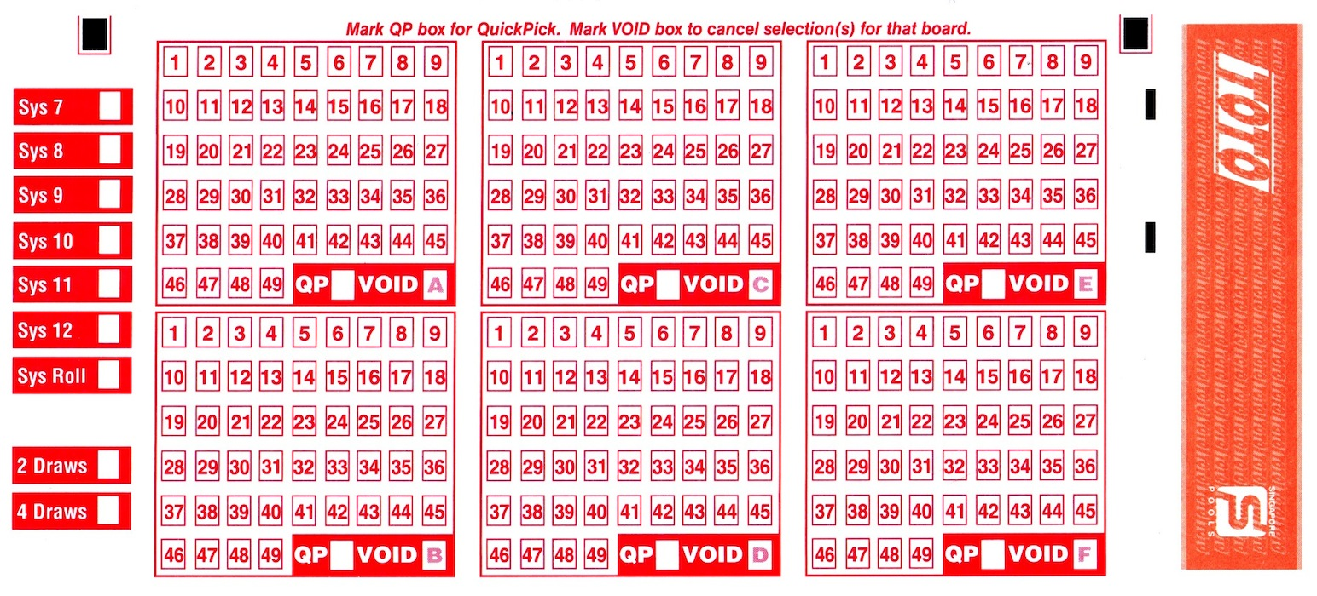



Toto Number Guidebook
Based on 2014-2020 data

Slide 2
Data Cleaning
Change Date datatype from string to Datetime
There was a change in Toto rule on 2014-10-07; since the data starts from 2014-11-13, there would not be inconsistency affecting the analysis
No missing data
Data error in entry
Repeated winning number 48 in a single draw on 2018-10-18. Since it is only 1 entry, dropping the data would not affect the analysis
Rest of the data complies with the rule of no 0 or >49
Add 'Weekday' column to indicate if the draw is on Monday or Thursday
Require data cleaning for Sunday and Friday data (no draw on these days)
Drop 2016-12-15 (Friday) and 2018-07-08 (Sunday). There are Thursday and following Monday data
Replace the rest of Friday data to Thursday. There are missing Thursday data entry, hence safe to assume the draws result are for Thursday.

Slide 3
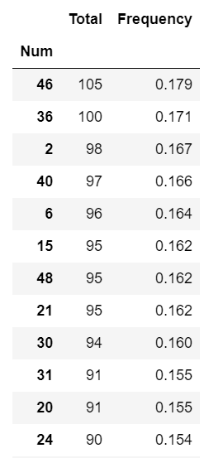
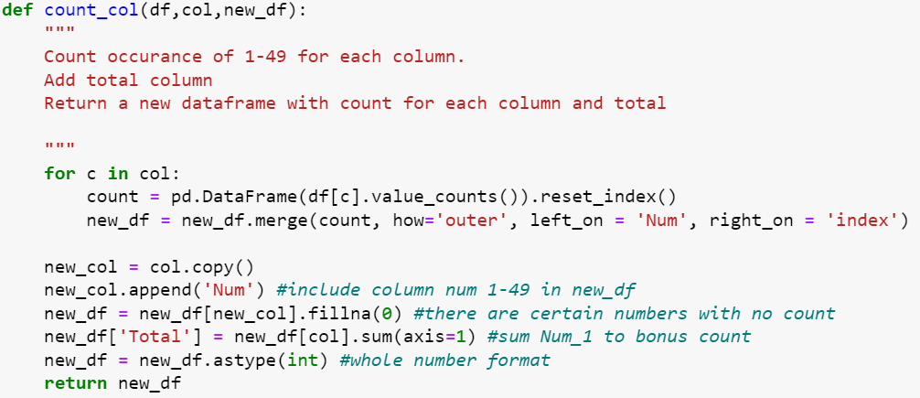
Common Winning Numbers (What numbers to pick?)
Top 12 Most Common Numbers
(Helpful table to fast pick numbers)
Table is derived from counting the total occurrences of Num 1-49. These 12 number would be able to cover purchases under system 12.
Disclaimer!: Chances of number appearing is low
Even though these are the most common winning number, the frequency of occurrences is only around 15-18% out of 586 draws.
Frequency = Total count/ no. of draw
Method
Create empty dataframe with draw number 1-49
Loop through each column to count each number as a new dataframe
Merge to the empty dataframe
Sum all count from Num1_6 and bonus to get total

Slide 4
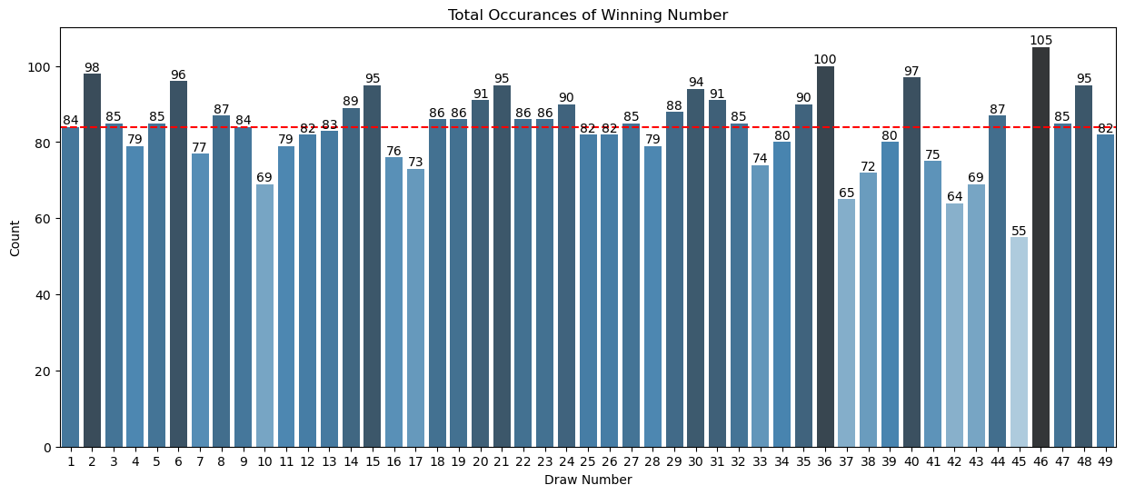
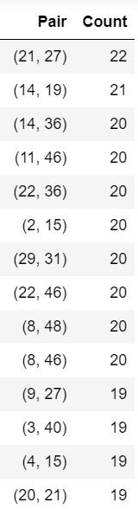
Helpful to eliminate too many numbers to buy dilemma
Common Winning Numbers (What numbers to pick?)
Pairs of number likely to appear together
Average: 84
Is your lucky number winning?
Method for numbers pair table
Completely random with no clear pattern
Numbers reconsider buying due to very low occurrences and below average count of 84:
45, 42, 37, 10, 17 and 16
Create a list of numbers 1-49.
Create a pair_count function: Use itertools package – chain and combinations to create pairs from number list. Collections package-Counter to quickly create dictionary. Set all dictionary value to zero. Output: {(1,2): 0, (1,3):0,….}
For loop to get each row draw number, use pair_count function to create pairs in that single draw and add count to keys.

Slide 5
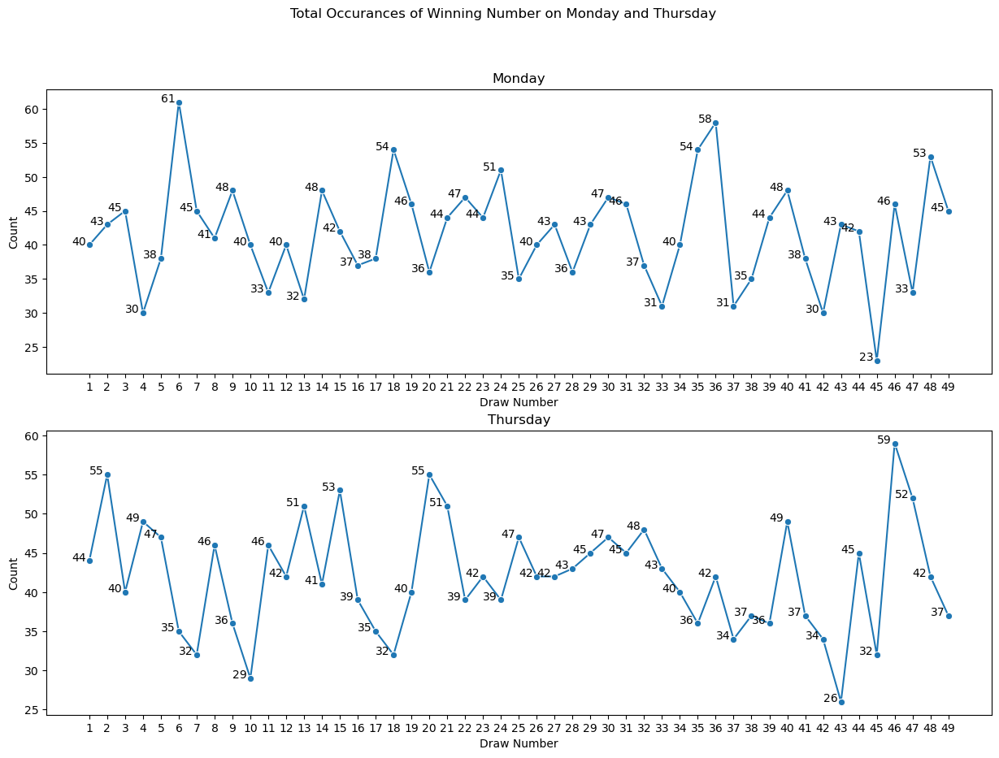
Difference between Mon/Thurs draw (When to buy?)
For certain numbers, buying on a particular day would have a higher chance of winning.
E.g The most common winning number 46 would have a higher chances of appearing on Thursday (12% more likely)
Large difference for number 6 with around 1.7 times more likely to win on Monday
There are also numbers with no apparent difference in buying on any day.
E.g Number 30, 31 and 40
Method
Split Mon and Thur data as individual dataframe
Apply the count_col function previously defined in slide 3
Plot Mon and Thur separately as subplot

Slide 6
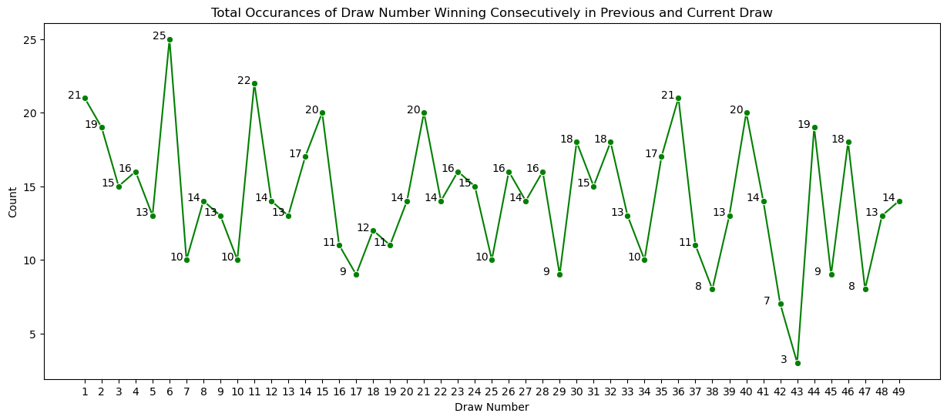
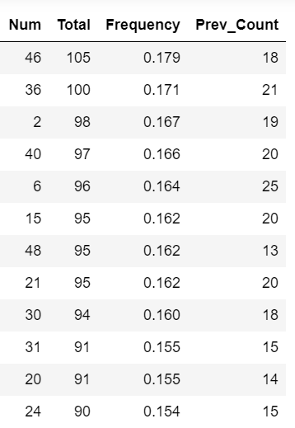
Number Likely to Repeat in the Next Draw
Top 12 Most Common Numbers
There are cases where numbers tend to repeat in consecutive draws.
The top 12 numbers are more likely to appear in consecutive draws; This is expected given that the chances of them winning are higher than the rest (base win are higher).
There are exceptions such as 48, with high total count but low prev_count compared to the rest in top 12
Another exception Is no. 37 with lower total count (65) but have a rather high chance of appearing consecutively (11). A possible strategy to buy No.37 is to wait for it to occur in the previous draw.
Method
Create empty dictionary with draw number as key, value=0
For loop to get previous row and current row.
Nested for loop, if num current row appear in prev row (n-1), add +1 to dict value according to num key

Slide 7
Number Likely to Repeat in the Next Draw
Top 12 Most Common Numbers
There are cases where numbers tend to repeat in consecutive draws.
The top 12 numbers are more likely to appear in consecutive draws; This is expected given that the chances of them winning are higher than the rest (base win are higher).
There are exceptions such as 48, with high total count but low prev_count compared to the rest in top 12
Another exception Is no. 37 with lower total count (65) but have a rather high chance of appearing consecutively (11). A possible strategy to buy No.37 is to wait for it to occur in the previous draw.
Method
Create empty dictionary with draw number as key, value=0
For loop to get previous row and current row.
Nested for loop, if num current row appear in prev row (n-1), add +1 to dict value according to num key

Slide 8

-End-
Thank you!
Best of luck!

