Slide 1
SCC.201 Databases
2024 - Week 2 – Relational Database.
Uraz C Turker

Slide 2
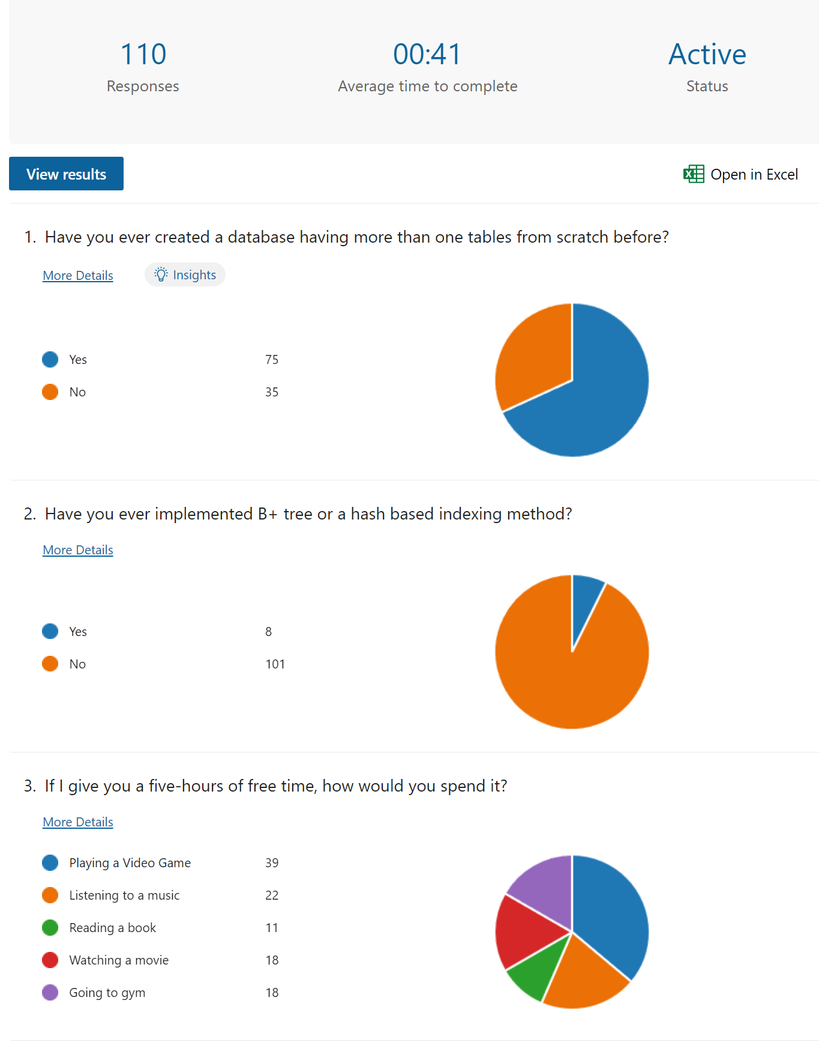

Slide 3
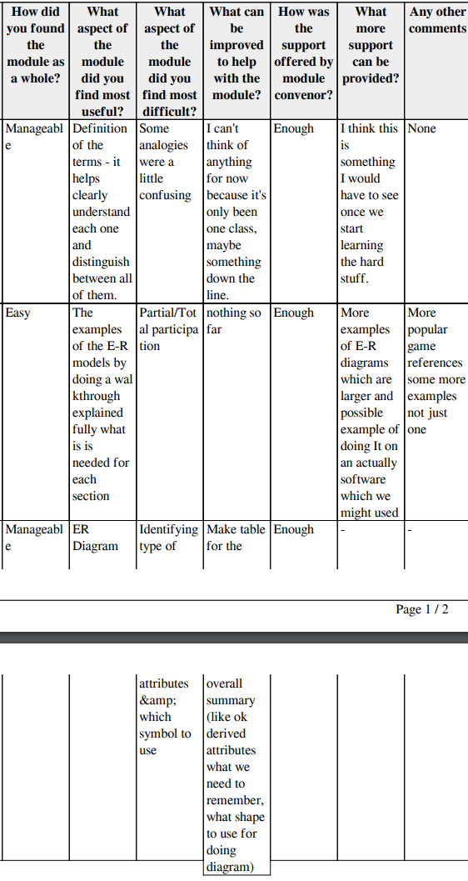
Feedbacks

Slide 4
Reading tasks
Chapter 1,
Section 2.2 under Chapter 2,
Sections 4.1, and 4.2 under Chapter 4 of
Book Database Systems A Practical Approach to Design, Implementation, and Management.

Slide 5
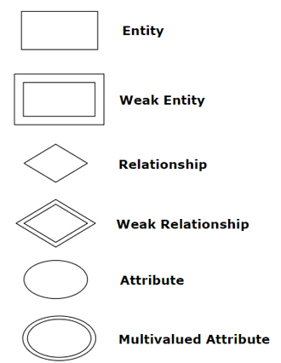
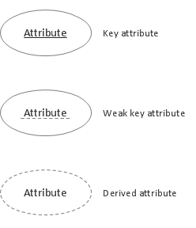


What have we learnt so far?
We learn key ER concepts which allows us to design relational databases.
set
One
set
Many
set
Total participation
set
Partial participation
ISA relation

Slide 6
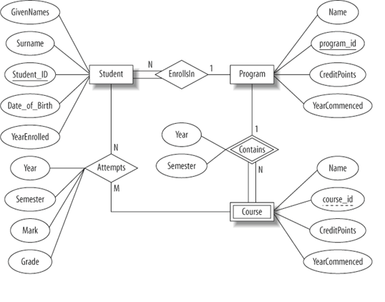
What have we learnt so far?
A student …… enrol in …… program.

Slide 7
What have we learnt so far?
A student must enrol in …… program.

Slide 8
What have we learnt so far?
A student must enrol in …. program.

Slide 9
What have we learnt so far?
A student must enrol in one program.

Slide 10
What have we learnt so far?
A student must enrol in one program.
It has GivenNames, Surname, StudentID, Date_of_Birth, YearEnrolled attributes, where StudentID is a primary key.

Slide 11
What have we learnt so far?
Program …… have ….. students.

Slide 12
What have we learnt so far?
Program …… have many students.

Slide 13
What have we learnt so far?
Program …… have many students.

Slide 14
What have we learnt so far?
Program may have many students.

Slide 15
What have we learnt so far?
Program may have many students.
It has name, program_iD, CreditPoints, YearCommenced where program_iD is a primary key.

Slide 16
What have we learnt so far?
When a program is deleted, the DBMS automatically deletes all related courses. (weak entity)

Slide 17
What have we learnt so far?
When a program is deleted, the DBMS automatically deletes all related courses. (weak entity)
It has Name, course_id, CreditPoints, YearCommenced where course_id is the weak key.

Slide 18
What have we learnt so far?
Program ….. have ….. courses

Slide 19
What have we learnt so far?
Program …… have many courses

Slide 20
What have we learnt so far?
Program …… have many courses

Slide 21
What have we learnt so far?
Program may have many courses

Slide 22
What have we learnt so far?
A student … attempt … courses.
A course .. be attempted by …. students.

Slide 23
What have we learnt so far?
A student … attempt … courses.
A course .. be attempted by …. students.

Slide 24
What have we learnt so far?
A student may attempt … courses.
A course .. be attempted by …. students.

Slide 25
What have we learnt so far?
A student may attempt … courses.
A course … be attempted by … students.

Slide 26
What have we learnt so far?
A student may attempt many courses.
A course … be attempted by … students.

Slide 27
What have we learnt so far?
A student may attempt many courses.
A course …. be attempted by …. students.

Slide 28
What have we learnt so far?
A student may attempt many courses.
A course may be attempted by …. students.

Slide 29
What have we learnt so far?
A student may attempt many courses.
A course may be attempted by many students.

Slide 31
Learning Outcomes
You will learn concepts regarding the relational model, such as:
Integrity constraints, key constraints, schema, tuple, domain.
After this week, you will learn how to
Convert a given ERD into the relational model.

Slide 32
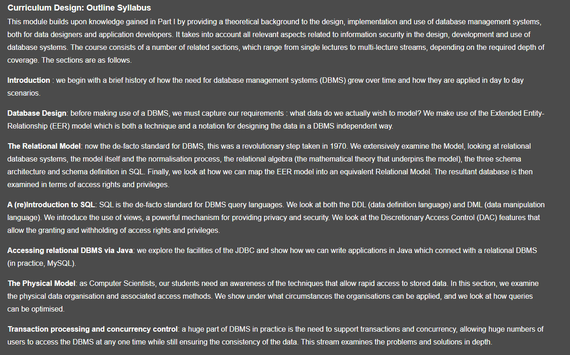
This lecture
We will start learning the Relational Model.
Schema and definition.
Integrity constraints.
Key constraints
Referential Integrity

Slide 33
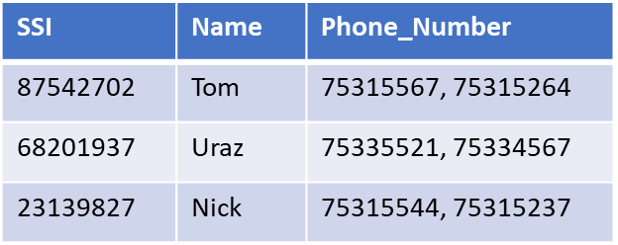

That is, we will start learning correspondence between ERD and Relational database.
ER diagram
Relation.
SSI
Name
SSI
Name
Mechanic
Phone_Number.
Mechanic
Phone_Number

Slide 34
Relational Database: Definitions
Instead of Entity Sets and Entities
We use relation as a set of rows or tuples (i.e., all rows are distinct) with description.
Rows/Tuples
Notes:
3

Slide 35
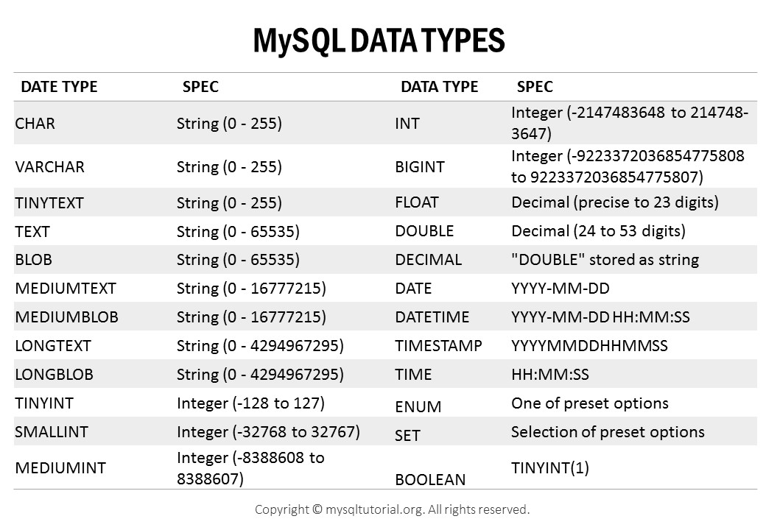
Relational Database: Definitions
Relation: made up of 2 parts:
Instance: a table with rows and columns.
#Rows = cardinality, #fields/attributes = degree / arity.
Relation Schema (RS): specifies the relation’s name and type (domain) of each column.
Write the Relation Schema for the given Relation Instance.
Students(sid: INT, name: TEXT, login: TEXT, age: INT, gpa: DOUBLE).
Name of the attribute: Domain of the attribute
Notes:
3

Slide 36

Relational Database: Definitions
https://quake.fandom.com/wiki/Weapon_(Q1)
Weapon | Damage | Ammo Type | Maximum Ammo | Fire Mode | Rate of Fire (rpm) | Muzzle Velocity (m/s) | Maximum Range (m)
Axe | 20 | None | ∞ | Single | 120 | - | -
Shotgun | 24 | Shells | 100 | Pump-action | 120 | 380 | 78
Super Shotgun | 56 | Shells | 100 | Pump-action | 85 | 380 | 78
Nailgun | 9 | Nails | 200 | Automatic | 600 | 110 | 229
Super Nailgun | 18 | Nails | 200 | Automatic | 600 | 158 | 229
Grenade Launcher | 120 | Rockets | 100 | Semi-auto | 100 | 22.8 | -
Relation: made up of 2 parts:
Instance: a table with rows and columns.
#Rows = cardinality, #fields/attributes = degree / arity.
Relation Schema (RS): specifies the relation’s name and type (domain) of each column.
Write the Relation Schema for the given Relation Instance.
Weapons(Weapon: TEXT, Damage: INT, AmmoType: TEXT,
MaximumAmmo: INT, FireMode: TEXT,
RateofFire: INT, MuzzleVelocity:DOUBLE, MaximumRange: INT).
Notes:
3

Slide 37
Relational Database: Definitions
Relation: made up of 2 parts:
Instance: a table with rows and columns.
#Rows = cardinality, #fields/attributes = degree / arity.
Relation Schema (RS): specifies the relation’s name and type (domain) of each column.
Write the Relation Schema for the given Relation Instance.
Teams(Team_ID: INT, Wins: INT, Loses: INT, Name: TEXT, Leader: TEXT).
Notes:
3

Slide 38
Relational Database: Definitions
Relation: made up of 2 parts:
Instance: a table with rows and columns.
#Rows = cardinality, #fields/attributes = degree / arity.
Relation Schema (RS): specifies the relation’s name and type (domain) of each column.
Write the Relation Schema for the given Relation Instance.
Teams(Team_ID: INT, Wins: INT, Loses: INT, Name: TEXT, Leader: TEXT).
What would happen if I made a mistake and entered the following row of data?
<Uraz, Uraz, u.turker@lancaster.ac.uk ,41,4>
Notes:
3

Slide 39
Relational model (Syntax vs Semantics)
Model | Weight | ChassisN | Max_Speed
BMW 3.21 | 1400 | 12h37 | 200
Toyota_Corolla | 1300 | 84t34 | 200
Hyundai E.GLS | 1400 | 43j5h2 | 210
What else can go wrong?
What would happen if I erase a key value?
Data kept by a DBMS must obey some rules!
To prevent these, relational databases are built upon logical rules (constraints) set by
Real-world rules (Context), designers’ choices, functions, etc., using DDL.
These rules establish what we call the integrity of the data
Integrity of the data is protected by DBMS if INTEGRITY CONSTRAINTS ARE GIVEN.

Slide 40
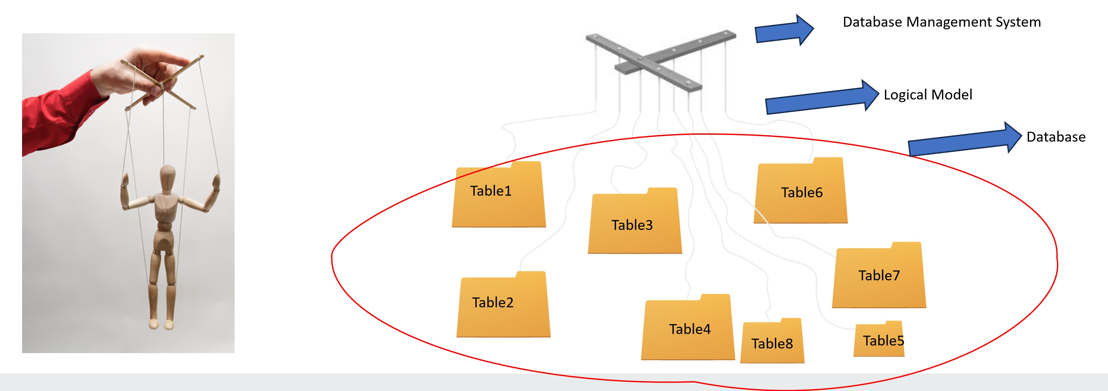
Relational Database: Definitions
Integrity Constraints are a part of the Logical Model and are provided to the DBMS while tables are created.
Notes:
3

Slide 41
Definitions : Integrity Constraints (ICs)
Integrity constraint (IC): a condition that must be true for any database instance.
A legal instance of a relation satisfies all specified ICs.
DBMS should not allow illegal instances.
If the DBMS checks ICs, stored data is more faithful to real-world meaning.
Avoids data entry errors, too!
1) Domain constraint: In any database instance, a value of the attribute must be an element of the attribute’s domain (gpa is a DOUBLE-valued attribute, so we can only store DOUBLE values in related cells) as set in RS.
Students(sid: INT, name: TEXT, login: TEXT, age: INT, gpa: DOUBLE).
“1177” | Uraz | u.turker@cs | 39 | NA
Domain constraint breached
(gpa is a DOUBLE value, Na is a TEXT)
Notes:
5

Slide 42

Definitions : Integrity Constraints (ICs)
Map | Vehicle | Occupants | Type
Erangel | Buggy | 2 | Land
Miramar | PG-117 | 5 | Water
Vikendi | C-130 | 100 | AIR
2) Entity Integrity constraint: A key value cannot be duplicated or left empty in any instance.
Once a DB Admin sets a key, the DBMS must inspect every modification on the data w.r.t the key value.
DB Admin’s task (using DDL) is to set the primary key for the data.
DBMS has built-in functions to protect key constraints; to activate those functions, DBA must identify them using DDL (week 4!).
Write the Relational Schema for this table
PubG(Map: TEXT, Vehicle: Text, Occupants: INT, Type: Text, PRIMARY KEY: Map).

Slide 43
Relational Database: Definitions
Relation: made up of 2 parts:
Instance: a table with rows and columns.
#Rows = cardinality, #fields/attributes = degree / arity.
Relation Schema (RS): specifies the relation’s name and type (domain) of each column.
Write the Relation Schema for the given Relation Instance.
Ammunition(Weight: TEXT, cost: INT, owner: TEXT, explosive: BOOLEAN, Type: INT, PRIMARY KEY: owner).
Notes:
3

Slide 44
Relational Database: Definitions
Relation: made up of 2 parts:
Instance: a table with rows and columns.
#Rows = cardinality, #fields/attributes = degree / arity.
Relation Schema (RS): specifies the relation’s name and type (domain) of each column.
Write the Relation Schema for the given Relation Instance.
Teams(Team_ID: INT, Wins: INT, Loses: INT, Name: TEXT, Leader: TEXT, PRIMARY KEY: Team_ID).
Notes:
3

Slide 45
Referential integrity: How about relationships?
How do we set the integrity of relationships?
Max_Speed
Weight
SSI
Name
Model
Length (mm)
Repairs
Car
Mechanic
Phone_Number

Slide 46
Relationship sets
We inform DBMS regarding the referential integrity for relationship sets while creating them using Foreign Keys (in DDL).

Slide 47
Referential integrity: Another key! Foreign keys
Foreign keys: a peripheral attribute that establishes referential integrity between entity sets.
Model | Weight | Length (mm) | Max_Speed
BMW 3.21 | 1400 | 2501 | 200
Toyota_Corolla | 1300 | 3321 | 200
Hyundai E.GLS | 1400 | 3895 | 210
Max_Speed
Weight
SSI
Name
Model
Length (mm)
Repairs
Car
Mechanic
Phone_Number

Slide 48
Referential integrity: Another key! Foreign keys
Foreign keys: a peripheral attribute that establishes referential integrity between entity sets.
It requires either i) importing the Primary Key attribute of one table to the other table or ii) creating a new table that holds the primary keys of the tables in relation.
Model | Weight | Length (mm) | Max_Speed
BMW 3.21 | 1400 | 2501 | 200
Toyota_Corolla | 1300 | 3321 | 200
Hyundai E.GLS | 1400 | 3895 | 210
Max_Speed
Weight
SSI
Name
Model
Length (mm)
Repairs
Car
Mechanic
Phone_Number

Slide 49
Referential integrity: Another key! Foreign keys
Foreign keys: a peripheral attribute that establishes referential integrity between entity sets.
It requires either i) importing the Primary Key attribute of one table to the other table or
Model | Weight | Length (mm) | Max_Speed
BMW 3.21 | 1400 | 2501 | 200
Toyota_Corolla | 1300 | 3321 | 200
Hyundai E.GLS | 1400 | 3895 | 210
Max_Speed
Weight
SSI
Name
Model
Length (mm)
Repairs
Car
Mechanic
Phone_Number

Slide 50
Referential integrity: Another key! Foreign keys
Foreign keys: a peripheral attribute that establishes referential integrity between entity sets.
It requires either i) importing the Primary Key attribute of one table to the other table or
Model | Weight | Length (mm) | Max_Speed
BMW 3.21 | 1400 | 2501 | 200
Toyota_Corolla | 1300 | 3321 | 200
Hyundai E.GLS | 1400 | 3895 | 210
Model
BMW 3.21
Toyota_Corolla
Hyundai E.GLS
Max_Speed
Weight
SSI
Name
Model
Length (mm)
Repairs
Car
Mechanic
Phone_Number

Slide 51
Referential integrity: Another key! Foreign keys
Values might be in different order!
Model | Weight | Length (mm) | Max_Speed
BMW 3.21 | 1400 | 2501 | 200
Toyota_Corolla | 1300 | 3321 | 200
Hyundai E.GLS | 1400 | 3895 | 210
Model
Toyota_Corolla
Hyundai E.GLS
BMW 3.21
Max_Speed
Weight
SSI
Name
Model
Length (mm)
Repairs
Car
Mechanic
Phone_Number

Slide 52
Referential integrity: Another key! Foreign keys
Foreign keys: a peripheral attribute that establishes referential integrity between entity sets.
It requires either i) importing the Primary Key attribute of one table to the other table oor ii) creating a new table that holds the primary keys of the tables in relation.
Model | Weight | Length (mm) | Max_Speed
BMW 3.21 | 1400 | 2501 | 200
Toyota_Corolla | 1300 | 3321 | 200
Hyundai E.GLS | 1400 | 3895 | 210
Model | SIS
Toyota_Corolla | 87542..
Hyundai E.GLS | 68201..
BMW 3.21 | 2313..
Max_Speed
Weight
SSI
Name
Model
Length (mm)
Repairs
Car
Mechanic
Phone_Number

Slide 53
Referential integrity: Foreign keys
Foreign key: `logical pointer’.
Model | Weight | Length (mm) | Max_Speed
BMW 3.21 | 1400 | 2501 | 200
Toyota_Corolla | 1300 | 3321 | 200
Hyundai E.GLS | 1400 | 3895 | 210
Model
Toyota_Corolla
Hyundai E.GLS
BMW 3.21
Max_Speed
Weight
SSI
Name
Model
Length (mm)
Repairs
Car
Mechanic
Phone_Number

Slide 54
Properties of foreign keys
Foreign key must:
Have the same name and domain/type as the referencing relation.
Related entities must have the same values.
Model | Weight | Length (mm) | Max_Speed
BMW 3.21 | 1400 | 2501 | 200
Toyota_Corolla | 1300 | 3321 | 200
Hyundai E.GLS | 1400 | 3895 | 210
Model
Toyota_Corolla
Hyundai E.GLS
BMW 3.21
REFERENCING
RELATION
Max_Speed
REFERENCED
RELATION
Weight
SSI
Name
Model
Length (mm)
Repairs
Car
Mechanic
Phone_Number

Slide 55
Properties of foreign keys
Foreign key must:
Have the same name and domain/type as the referencing relation.
Related entities must have the same values.
Model | Weight | Length (mm) | Max_Speed
BMW 3.21 | 1400 | 2501 | 200
Toyota_Corolla | 1300 | 3321 | 200
Hyundai E.GLS | 1400 | 3895 | 210
Model
Toyota
Hyundai E.GLS
BMW 3.21
REFERENCED
RELATION
Max_Speed
Cannot happen
REFERENCING
RELATION
Weight
SSI
Name
Model
Length (mm)
Repairs
Car
Mechanic
Phone_Number

Slide 56

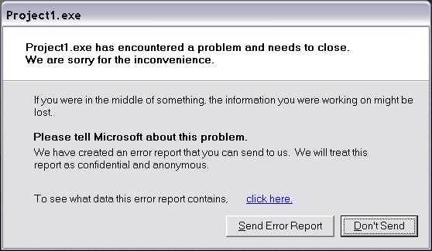
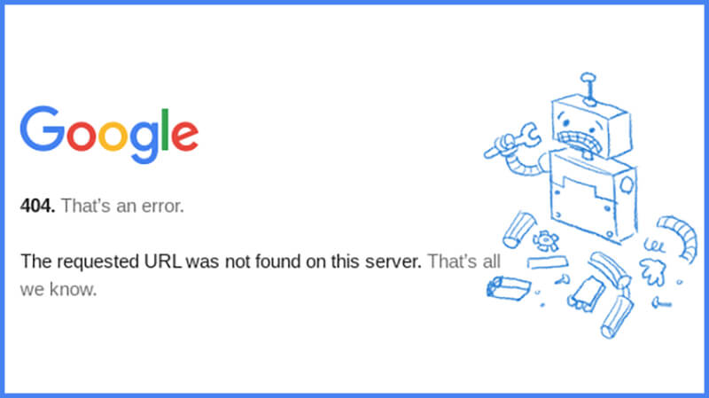
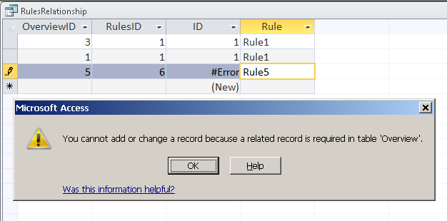
Referential integrity: Foreign keys
If all foreign key constraints are enforced, referential integrity is achieved, i.e., no dangling references, dissimilar values, etc.
Can you name a data model w/o referential integrity?
Links in HTML.
Pointers in C++.
Phone numbers recorded in your phone.
In Database.

Slide 57
Foreign Key in action.
Customers | Customer# | Name | Street | City | Country
 | AT01 | Alan Turing | Maida Vale | London | UK
 | JB01 | Jean Bartik | Woodland Walk | Pennsylvania | USA
 | MH01 | Margaret Hamilton | 300 E Street | Pennsylvania | USA
 | AL01 | Ada Lovelace | Hucknall Road | Nottingham | UK
 | EC01 | Edgar F. Codd | 15 Parks Road | Oxford | UK
Find primary keys and foreign keys and also mark referencing relations.
Items | Item# | Description | Category
 | 0001 | Hard Disk Drive | Internal Hardware
 | 0002 | 16GB RAM | Internal Hardware
 | 0003 | Mechanical Keyboard | Peripherals
 | 0004 | LCD 32” HD Monitor | Display
 | 0005 | 2200 RTX GPU 11GB | Internal Hardware
Find the total quantity and items for orders of customers living in “Pennsylvania”.
Orders | Order# | Item# | Customer# | Delivery_date | Quantity
 | Or0022 | 0002 | MH01 | 2020-02-10 | 2
 | Or0023 | 0004 | AL01 | 2020-01-30 | 1
 | Or0024 | 0001 | AT01 | 2020-02-05 | 1
 | Or0025 | 0005 | JB01 | 2020-02-06 | 1
 | Or0026 | 0003 | EC01 | 2020-02-01 | 3
 | Or0027 | 0004 | JB01 | 2020-02-03 | 6
Process “Customers”
Then “Orders” and “Items” using Foreign Keys.
->9, LCD32” Monitor, 2200 RTX GPU 11GB, 16GBram.
Can you draw the ER diagram for these relations? (May be next week!)

Slide 58
Lets continue
Model | Weight | Length (mm) | Max_Speed
BMW 3.21 | 1400 | 2501 | 200
Toyota_Corolla | 1300 | 3321 | 200
Hyundai E.GLS | 1400 | 3895 | 210
Car (Model:TEXT, Weight:INT, Length(mm):INT,Max_Speed:INT, PRIMARY KEY:Model)
Previously
Relational Model
Relation
Table with data (Instance)
Relational Schema i.e., signature of the relation
Integrity Constraints:
Domain Constraint: For each attribute, all values must be within the attribute’s domain.
Entity Integrity Constraint: The primary key field cannot be empty and duplicated.
Referential Integrity: Preserving the relationships and integrities of tables in relation
Foreign key: a logical pointer that relates entities based on primary keys.

Slide 59
Strategies to enforce Referential Integrity
Students
Consider Students and Enrolled; sid in Enrolled is a foreign key that references Students.
What should be done if an Enrolled tuple with a non-existent student id is inserted?
Reject it!
Enrolled
1177 | SCC201 | A
Notes:
13

Slide 60
Strategies to enforce Referential Integrity
What should be done if a Students tuple (say 53650) is deleted?
Also delete all Enrolled tuples that refer to it.
Disallow deletion of a Students tuple that is referred to.
Set sid in Enrolled tuples that refer to it to a default sid.
(In SQL, also: Set sid in Enrolled tuples that refer to it to a special value null, denoting `unknown’ or `inapplicable’.)
What happens if the primary key of the Students tuple is updated (53650 to 00001)?
Notes:
13

Slide 61
Referential Integrity in SQL/92
SQL/92 supports all 4 options on deletes and updates.
Default is NO ACTION (delete/update is rejected)
CASCADE (also delete all tuples that refer to deleted tuple)
SET NULL / SET DEFAULT (sets foreign key value of referencing tuple)
Notes:
14

Slide 62
Lets speculate about ICs. for the following tables.
Customers | Customer# | Name | Street | City | Country
 | AT01 | Alan Turing | Maida Vale | London | UK
 | JB01 | Jean Bartik | Woodland Walk | Pennsylvania | USA
 | MH01 | Margaret Hamilton | 300 E Street | Pennsylvania | USA
 | AL01 | Ada Lovelace | Hucknall Road | Nottingham | UK
 | EC01 | Edgar F. Codd | 15 Parks Road | Oxford | UK
Assume these tables.
Do tables obey key constraints?
Do tables obey domain constraints?
What are the foreign keys?
“Print the orders of Customers whose Customer number starts with A?”
Items | Item# | Description | Category
 | 0001 | Hard Disk Drive | Internal Hardware
 | 0002 | 16GB RAM | Internal Hardware
 | 0003 | Mechanical Keyboard | Peripherals
 | 0004 | LCD 32” HD Monitor | Display
 | 0005 | 2200 RTX GPU 11GB | Internal Hardware
Orders | Order# | Item# | Customer# | Delivery_date | Quantity
 | Or0022 | 0002 | MH01 | 2020-02-10 | 2
 | Or0023 | 0004 | AL01 | 2020-01-30 | 1
 | Or0024 | 0001 | AT01 | 2020-02-05 | 1
 | Or0025 | 0005 | JB01 | 2020-02-06 | 1
 | Or0026 | 0003 | EC01 | 2020-02-01 | 3
 | Or0027 | 0004 | JB01 | 2020-02-03 | 6

Slide 63


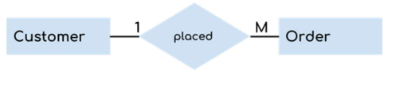
Integrity Constraints for relational databases.
Integrity of data: it is the state of data in which data obeys the constraints set by DBA.
1) Domain constraints.
Values in tuples should obey types of attributes. (You should not provide text to INT field)
2) Entity Integrity constraints.
Keys of a relation must be unique, non-redundant, and not Null (entity integrity constraint).
3) Referential integrity.
How are two relations related to each other? (We will see in a minute.)
The relation must be made by using keys,
The DBMS must preserve this relation.

Slide 64
How do we derive Foreign Keys and ICs for different relationship types?
“A car can be repaired by at most one mechanic.
A mechanic can repair at most one type of car.”
Max_Speed
Weight
SSI
Name
Brand
1
Repairs
1
Car
Mechanic
PhoneN
1 to 1 relation having partial participation on both sides:
Select one table (randomly) as the referenced table and the other as the referencing table.
Import the primary key of the referenced table to the referencing one.
This key will be the foreign key and declare it its foreign key:
Car(Brand:TEXT,Weight:INT,Length:DOUBLE,Max_Speed:INT, PRIMARY KEY:BRAND)
Mec_Rep(SSI:TEXT,Name:TEXT,Phone:TEXT,Brand:TEXT, PRIMARY KEY:SSI, Foreign Key: Brand REFERENCING:CAR)
Do you think that this is enough?
Car(Brand:TEXT,Weight:INT,Length:DOUBLE,Max_Speed:INT, PRIMARY KEY:BRAND)
Mec_Rep(SSI:TEXT,Name:TEXT,Phone:TEXT,Brand:TEXT, PRIMARY KEY:SSI, Foreign Key: Brand REFERENCING:CAR, Brand is Unique, on Delete SET NULL)

Slide 65
How do we derive Foreign Keys and ICs for different relationship types?
“A car can be repaired by at most one mechanic.
A mechanic can repair at most one type of car.”
Max_Speed
Weight
SSI
Name
Brand
1
Repairs
1
Car
Mechanic
PhoneN
1 to 1 relation having partial participation on both sides:
Select one table (randomly) as the referenced table and the other as the referencing table.
Import the primary key of the referenced table to the referencing one.
This key will be the foreign key and declare it its foreign key:
Car(Brand:TEXT,Weight:INT,Length:DOUBLE,Max_Speed:INT, PRIMARY KEY:BRAND)
Mec_Rep(SSI:TEXT,Name:TEXT,Phone:TEXT,Brand:TEXT, PRIMARY KEY:SSI, Foreign Key: Brand REFERENCING:CAR)
Do you think that this is enough?
Car(Brand:TEXT,Weight:INT,Length:DOUBLE,Max_Speed:INT, PRIMARY KEY:BRAND)
Mec_Rep(SSI:TEXT,Name:TEXT,Phone:TEXT,Brand:TEXT, PRIMARY KEY:SSI, Foreign Key: Brand REFERENCING:CAR, Brand is Unique, on Delete SET NULL)

Slide 66
How do we derive Foreign Keys and ICs for different relationship types?
“A car can be repaired by at most one mechanic.
A mechanic can repair at most one type of car.”
Max_Speed
Weight
SSI
Name
Referenced Table
Brand
1
Repairs
1
Car
Mechanic
PhoneN
1 to 1 relation having partial participation on both sides:
Select one table (randomly) as the referenced table and the other as the referencing table.
Import the primary key of the referenced table to the referencing one.
This key will be the foreign key and declare it its foreign key:
Car(Brand:TEXT,Weight:INT,Length:DOUBLE,Max_Speed:INT, PRIMARY KEY:BRAND)
Mec_Rep(SSI:TEXT,Name:TEXT,Phone:TEXT,Brand:TEXT, PRIMARY KEY:SSI, Foreign Key: Brand REFERENCING:CAR)
Do you think that this is enough?
Car(Brand:TEXT,Weight:INT,Length:DOUBLE,Max_Speed:INT, PRIMARY KEY:BRAND)
Mec_Rep(SSI:TEXT,Name:TEXT,Phone:TEXT,Brand:TEXT, PRIMARY KEY:SSI, Foreign Key: Brand REFERENCING:CAR, Brand is Unique, on Delete SET NULL)

Slide 67
How do we derive Foreign Keys and ICs for different relationship types?
“A car can be repaired by at most one mechanic.
A mechanic can repair at most one type of car.”
Max_Speed
Weight
SSI
Name
Brand
1
Repairs
1
Car
Mechanic
PhoneN
1 to 1 relation having partial participation on both sides:
Select one table (randomly) as the referenced table and the other as the referencing table.
Import the primary key of the referenced table to the referencing one.
This key will be the foreign key and declare it its foreign key:
Car(Brand:TEXT,Weight:INT,Length:DOUBLE,Max_Speed:INT, PRIMARY KEY:BRAND)
Mec_Rep(SSI:TEXT,Name:TEXT,Phone:TEXT,Brand:TEXT, PRIMARY KEY:SSI, Foreign Key: Brand REFERENCING:CAR)
Do you think that this is enough?
Car(Brand:TEXT,Weight:INT,Length:DOUBLE,Max_Speed:INT, PRIMARY KEY:BRAND)
Mec_Rep(SSI:TEXT,Name:TEXT,Phone:TEXT,Brand:TEXT, PRIMARY KEY:SSI, Foreign Key: Brand REFERENCING:CAR, Brand is Unique, on Delete SET NULL)

Slide 68
How do we derive Foreign Keys and ICs for different relationship types?
“A car can be repaired by at most one mechanic.
A mechanic can repair at most one type of car.”
Max_Speed
Weight
SSI
Name
Brand
1
Repairs
1
Car
Mechanic
PhoneN
1 to 1 relation having partial participation on both sides:
Select one table (randomly) as the referenced table and the other as the referencing table.
Import the primary key of the referenced table to the referencing one.
This key will be the foreign key and declare it its foreign key:
Car(Brand:TEXT,Weight:INT,Length:DOUBLE,Max_Speed:INT, PRIMARY KEY:BRAND)
Mec_Rep(SSI:TEXT,Name:TEXT,Phone:TEXT,Brand:TEXT, PRIMARY KEY:SSI, Foreign Key: Brand REFERENCING:CAR)
Do you think that this is enough?
Car(Brand:TEXT,Weight:INT,Length:DOUBLE,Max_Speed:INT, PRIMARY KEY:BRAND)
Mec_Rep(SSI:TEXT,Name:TEXT,Phone:TEXT,Brand:TEXT, PRIMARY KEY:SSI, Foreign Key: Brand REFERENCING:CAR, Brand is Unique, on Delete SET NULL)

Slide 69
How do we derive Foreign Keys and ICs for different relationship types?
“A car can be repaired by at most one mechanic.
A mechanic can repair at most one type of car.”
Max_Speed
Weight
SSI
Name
Brand
1
Repairs
1
Car
Mechanic
PhoneN
1 to 1 relation having partial participation on both sides:
Select one table (randomly) as the referenced table and the other as the referencing table.
Import the primary key of the referenced table to the referencing one.
This key will be the foreign key and declare it its foreign key:
Car(Brand:TEXT,Weight:INT,Length:DOUBLE,Max_Speed:INT, PRIMARY KEY:BRAND)
Mec_Rep(SSI:TEXT,Name:TEXT,Phone:TEXT,Brand:TEXT, PRIMARY KEY:SSI, Foreign Key: Brand REFERENCING:CAR)
Do you think that this is enough?
Car(Brand:TEXT,Weight:INT,Length:DOUBLE,Max_Speed:INT, PRIMARY KEY:BRAND)
Mec_Rep(SSI:TEXT,Name:TEXT,Phone:TEXT,Brand:TEXT, PRIMARY KEY:SSI, Foreign Key: Brand REFERENCING:CAR, Brand is Unique, on Delete SET NULL)

Slide 70
How do we derive Foreign Keys and ICs for different relationship types?
“A car can be repaired by at most one mechanic.
A mechanic can repair at most one type of car.”
Max_Speed
Weight
SSI
Name
Brand
1
Repairs
1
Car
Mechanic
PhoneN
1 to 1 relation having partial participation on both sides:
Select one table (randomly) as the referenced table and the other as the referencing table.
Import the primary key of the referenced table to the referencing one.
This key will be the foreign key and declare it its foreign key:
Car(Brand:TEXT,Weight:INT,Length:DOUBLE,Max_Speed:INT, PRIMARY KEY:BRAND)
Mec_Rep(SSI:TEXT,Name:TEXT,Phone:TEXT,Brand:TEXT, PRIMARY KEY:SSI, Foreign Key: Brand REFERENCING:CAR)
Do you think that this is enough?
Car(Brand:TEXT,Weight:INT,Length:DOUBLE,Max_Speed:INT, PRIMARY KEY:BRAND)
Mec_Rep(SSI:TEXT,Name:TEXT,Phone:TEXT,Brand:TEXT, PRIMARY KEY:SSI, Foreign Key: Brand REFERENCING:CAR, Brand is Unique, on Delete SET NULL)

Slide 71
How do we derive Foreign Keys and ICs for different relationship types?
“A car can be repaired by at most one mechanic.
A mechanic can repair at most one type of car.”
Max_Speed
Weight
SSI
Name
Brand
1
Repairs
1
Car
Mechanic
PhoneN
1 to 1 relation having partial participation on both sides:
Select one table (randomly) as the referenced table and the other as the referencing table.
Import the primary key of the referenced table to the referencing one.
This key will be the foreign key and declare it its foreign key:
Car(Brand:TEXT,Weight:INT,Length:DOUBLE,Max_Speed:INT, PRIMARY KEY:BRAND)
Mec_Rep(SSI:TEXT,Name:TEXT,Phone:TEXT,Brand:TEXT, PRIMARY KEY:SSI, Foreign Key: Brand REFERENCING:CAR)
Do you think that this is enough?
Car(Brand:TEXT,Weight:INT,Length:DOUBLE,Max_Speed:INT, PRIMARY KEY:BRAND)
Mec_Rep(SSI:TEXT,Name:TEXT,Phone:TEXT,Brand:TEXT, PRIMARY KEY:SSI, Foreign Key: Brand REFERENCING:CAR, Brand is Unique, on Delete SET NULL)

Slide 72
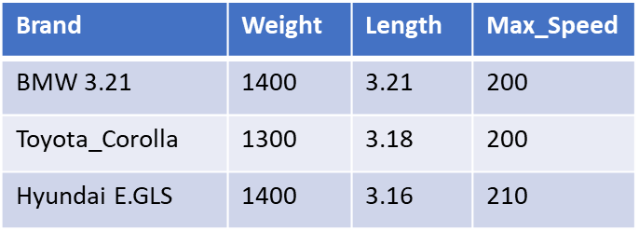
How do we derive Foreign Keys and ICs for different relationship types?
“A car can be repaired by at most one mechanic.
A mechanic can repair at most one type of car.”
Max_Speed
Weight
SSI
Name
Brand
1
Repairs
1
Car
Mechanic
PhoneN
1 to 1 relation having partial participation on both sides:
Car(Brand:TEXT,Weight:INT,Length:DOUBLE,Max_Speed:INT, PRIMARY KEY:BRAND)
Mec_Rep(SSI:TEXT,Name:TEXT,Phone:TEXT,Brand:TEXT, PRIMARY KEY:SSI, Foreign Key: Brand REFERENCING:CAR)
SSI | Name | Phone_Number
87542702 | Tom | 75315567
68201937 | Uraz | 75335521
23139827 | Nick | 75315544
Brand
Toyota_Corolla
Hyundai E.GLS
BMW 3.21

Slide 73
How do we derive Foreign Keys and ICs for different relationship types?
“A car can be repaired by at most one mechanic.
A mechanic can repair at most one type of car.”
Max_Speed
Weight
SSI
Name
Brand
1
Repairs
1
Car
Mechanic
PhoneN
1 to 1 relation having partial participation on both sides:
Car(Brand:TEXT,Weight:INT,Length:DOUBLE,Max_Speed:INT, PRIMARY KEY:BRAND)
Mec_Rep(SSI:TEXT,Name:TEXT,Phone:TEXT,Brand:TEXT, PRIMARY KEY:SSI, Foreign Key: Brand REFERENCING:CAR)
SSI | Name | Phone_Number
87542702 | Tom | 75315567
68201937 | Uraz | 75335521
23139827 | Nick | 75315544
43279823 | Thanos | 72352362
Brand
Toyota_Corolla
Hyundai E.GLS
BMW 3.21
BMW 3.21

Slide 74
How do we derive Foreign Keys and ICs for different relationship types?
“A car can be repaired by at most one mechanic.
A mechanic can repair at most one type of car.”
Max_Speed
Weight
SSI
Name
Brand
1
Repairs
1
1 to 1 relations
Car
Mechanic
PhoneN
SSI | Name | Phone_Number
87542702 | Tom | 75315567
68201937 | Uraz | 75335521
23139827 | Nick | 75315544
Brand
Toyota_Corolla
Hyundai E.GLS
BMW 3.21
Car(Brand:TEXT,Weight:INT,Length:DOUBLE,Max_Speed:INT, PRIMARY KEY:BRAND)
Mec_Rep(SSI:TEXT,Name:TEXT,Phone:TEXT,Brand:TEXT, PRIMARY KEY:SSI, Foreign Key: Brand REFERENCING:CAR, Brand is Unique, on Delete SET NULL)
The repairs relation is one-to-one. Therefore, for every SSI, there must exist one Brand. Moreover, as Brand cannot repeat, we use the UNIQUE keyword.

Slide 75
How do we derive Foreign Keys and ICs for different relationship types?
“A car can be repaired by at most one mechanic.
A mechanic can repair at most one type of car.”
Max_Speed
Weight
SSI
Name
Brand
1
Repairs
1
1 to 1 relations
Car
Mechanic
PhoneN
SSI | Name | Phone_Number
87542702 | Tom | 75315567
68201937 | Uraz | 75335521
23139827 | Nick | 75315544
Brand
Toyota_Corolla
Hyundai E.GLS
BMW 3.21
Car(Brand:TEXT,Weight:INT,Length:DOUBLE,Max_Speed:INT, PRIMARY KEY:BRAND)
Mec_Rep(SSI:TEXT,Name:TEXT,Phone:TEXT,Brand:TEXT, PRIMARY KEY:SSI, Foreign Key: Brand REFERENCING:CAR, Brand is UNIQUE, on Delete SET NULL)
The repairs relation is one-to-one. Therefore, for every SSI, there must exist one Brand. Moreover, as Brand cannot repeat, we use the UNIQUE keyword.

Slide 76
How do we derive Foreign Keys and ICs for different relationship types?
“A car can be repaired by at most one mechanic.
A mechanic can repair at most one type of car.”
Max_Speed
Weight
SSI
Name
Brand
1
Repairs
1
1 to 1 relations
Car
Mechanic
PhoneN
SSI | Name | Phone_Number
87542702 | Tom | 75315567
68201937 | Uraz | 75335521
23139827 | Nick | 75315544
Brand
Toyota_Corolla
Hyundai E.GLS
BMW 3.21
Car(Brand:TEXT,Weight:INT,Length:DOUBLE,Max_Speed:INT, PRIMARY KEY:BRAND)
Mec_Rep(SSI:TEXT,Name:TEXT,Phone:TEXT,Brand:TEXT, PRIMARY KEY:SSI, Foreign Key: Brand REFERENCING:CAR, Brand is UNIQUE, on Delete SET NULL)
Assume I delete the tuple “BMW 3.21, 1400, 3.21, 200” from the CAR table. What value should DBMS set for the Mechanic that can repair BMW 3.21?

Slide 77
How do we derive Foreign Keys and ICs for different relationship types?
“A car can be repaired by at most one mechanic.
A mechanic can repair at most one type of car.”
Max_Speed
Weight
SSI
Name
Brand
1
Repairs
1
1 to 1 relations
Car
Mechanic
PhoneN
SSI | Name | Phone_Number
87542702 | Tom | 75315567
68201937 | Uraz | 75335521
23139827 | Nick | 75315544
Brand
Toyota_Corolla
Hyundai E.GLS
BMW 3.21
Car(Brand:TEXT,Weight:INT,Length:DOUBLE,Max_Speed:INT, PRIMARY KEY:BRAND)
Mec_Rep(SSI:TEXT,Name:TEXT,Phone:TEXT,Brand:TEXT, PRIMARY KEY:SSI, Foreign Key: Brand REFERENCING:CAR, Brand is UNIQUE, on Delete SET NULL)
Assume I delete the tuple “BMW 3.21, 1400, 3.21, 200” from the CAR table. What value should DBMS set for the Mechanic that can repair BMW 3.21?
Since the Repairs Relation partially participates in both ends, I can select SET NULL or SET DEFAULT.

Slide 78
How do we derive Foreign Keys and ICs for different relationship types?
“A car can be repaired by at most one mechanic.
A mechanic can repair at most one type of car.”
Max_Speed
Weight
SSI
Name
Brand
1
Repairs
1
1 to 1 relations
Car
Mechanic
PhoneN
SSI | Name | Phone_Number
87542702 | Tom | 75315567
68201937 | Uraz | 75335521
23139827 | Nick | 75315544
Brand
Toyota_Corolla
Hyundai E.GLS
BMW 3.21
Car(Brand:TEXT,Weight:INT,Length:DOUBLE,Max_Speed:INT, PRIMARY KEY:BRAND)
Mec_Rep(SSI:TEXT,Name:TEXT,Phone:TEXT,Brand:TEXT, PRIMARY KEY:SSI, Foreign Key: Brand REFERENCING:CAR, Brand is UNIQUE, on Delete SET NULL/DEFAULT)
Assume I delete the tuple “BMW 3.21, 1400, 3.21, 200” from the CAR table. What value should DBMS set for the Mechanic that can repair BMW 3.21?
Since the Repairs Relation partially participates in both ends, I can select SET NULL or SET DEFAULT.

Slide 79
Referential Integrity
“A car can be repaired by at most one mechanic.
A mechanic can repair at most one type of car.”
If a tuple (say 2nd tuple) is to be deleted from referenced table (CAR)
Get the primary key value of the tuple (Toyota_Corolla).
Find all the tuples with values (Toyota_Corolla) in the referencing table (MEC_REPAIR)
If SET DEFAULT -> Select all such tuples in the referencing table (MEC_REPAIR) and set the foreign key value to a default value (you have to specify this) of these tuples in the referencing table (CAR). And delete tuples in CAR
Max_Speed
Weight
SSI
Name
Brand
1
Repairs
1
Car
Mechanic
PhoneN
CAR
MEC_REPAIR
Price
10
23
12
SSI | Name | Phone_Number
87542702 | Tom | 75315567
68201937 | Uraz | 75335521
23139827 | Nick | 75315544

Slide 80
Referential Integrity
“A car can be repaired by at most one mechanic.
A mechanic can repair at most one type of car.”
If a tuple (say 2nd tuple) is to be deleted from referenced table (CAR)
Get the primary key value of the tuple (Toyota_Corolla).
Find all the tuples with values (Toyota_Corolla) in the referencing table (MEC_REPAIR)
If SET DEFAULT -> Select all such tuples in the referencing table (MEC_REPAIR) and set the foreign key value to a default value (you have to specify this) of these tuples in the referencing table (CAR). And delete tuples in CAR
Max_Speed
Weight
SSI
Name
Brand
1
Repairs
1
Car
Mechanic
PhoneN
CAR
MEC_REPAIR
Price
10
23
12
SSI | Name | Phone_Number
87542702 | Tom | 75315567
68201937 | Uraz | 75335521
23139827 | Nick | 75315544

Slide 81
Referential Integrity
“A car can be repaired by at most one mechanic.
A mechanic can repair at most one type of car.”
If a tuple (say 2nd tuple) is to be deleted from referenced table (CAR)
Get the primary key value of the tuple (Toyota_Corolla).
Find all the tuples with values (Toyota_Corolla) in the referencing table (MEC_REPAIR)
If SET DEFAULT -> Select all such tuples in the referencing table (MEC_REPAIR) and set the foreign key and set the foreign key value to a default value (you have to specify this) of these tuples in the referencing table (CAR). And delete tuples in CAR
Max_Speed
Weight
SSI
Name
Brand
1
Repairs
1
Car
Mechanic
PhoneN
CAR
MEC_REPAIR
Price
10
23
12
SSI | Name | Phone_Number
87542702 | Tom | 75315567
68201937 | Uraz | 75335521
23139827 | Nick | 75315544

Slide 82
Referential Integrity
“A car can be repaired by at most one mechanic.
A mechanic can repair at most one type of car.”
If a tuple (say 2nd tuple) is to be deleted from referenced table (CAR)
Get the primary key value of the tuple (Toyota_Corolla).
Find all the tuples with values (Toyota_Corolla) in the referencing table (MEC_REPAIR)
If SET DEFAULT -> Select all such tuples in the referencing table (MEC_REPAIR) and set the foreign key and set the foreign key value to a default value (you have to specify this) of these tuples in the referencing table (MEC_REPAIR). And delete tuples in CAR
Max_Speed
Weight
SSI
Name
Brand
1
Repairs
1
Car
Mechanic
PhoneN
CAR
MEC_REPAIR
Price
10
23
12
SSI | Name | Phone_Number
87542702 | Tom | 75315567
68201937 | Uraz | 75335521
23139827 | Nick | 75315544
DEFAULT

Slide 83
Referential Integrity
“A car can be repaired by at most one mechanic.
A mechanic can repair at most one type of car.”
If a tuple (say 2nd tuple) is to be deleted from referenced table (CAR)
Get the primary key value of the tuple (Toyota_Corolla).
Find all the tuples with values (Toyota_Corolla) in the referencing table (MEC_REPAIR)
If SET DEFAULT -> Select all such tuples in the referencing table (MEC_REPAIR) and set the foreign key and set the foreign key value to a default value (you have to specify this) of these tuples in the referencing table (MEC_REPAIR). And delete tuples in CAR
Max_Speed
Weight
SSI
Name
Brand
1
Repairs
1
Car
Mechanic
PhoneN
CAR
MEC_REPAIR
Price
10
23
12
SSI | Name | Phone_Number
87542702 | Tom | 75315567
68201937 | Uraz | 75335521
23139827 | Nick | 75315544
DEFAULT

Slide 84
Referential Integrity
“A car can be repaired by at most one mechanic.
A mechanic can repair at most one type of car.”
If a tuple (say 2nd tuple) is to be deleted from referenced table (CAR)
Get the primary key value of the tuple (Toyota_Corolla).
Find all the tuples with values (Toyota_Corolla) in the referencing table (MEC_REPAIR)
If SET NULL -> Select all these tuples in the referencing table (MEC_REPAIR) and set the foreign key value to a NULL value of these tuples in the referencing table (CAR).
Max_Speed
Weight
SSI
Name
Brand
1
Repairs
1
Car
Mechanic
PhoneN
CAR
MEC_REPAIR
Price
10
23
12
SSI | Name | Phone_Number
87542702 | Tom | 75315567
68201937 | Uraz | 75335521
23139827 | Nick | 75315544

Slide 85
Referential Integrity
“A car can be repaired by at most one mechanic.
A mechanic can repair at most one type of car.”
If a tuple (say 2nd tuple) is to be deleted from referenced table (CAR)
Get the primary key value of the tuple (Toyota_Corolla).
Find all the tuples with values (Toyota_Corolla) in the referencing table (MEC_REPAIR)
If SET NULL -> Select all these tuples in the referencing table (MEC_REPAIR) and set the foreign key value to a NULL value of these tuples in the referencing table (MEC_REPAIR).
Max_Speed
Weight
SSI
Name
Brand
1
Repairs
1
Car
Mechanic
PhoneN
CAR
MEC_REPAIR
Price
10
23
12
SSI | Name | Phone_Number
87542702 | Tom | 75315567
68201937 | Uraz | 75335521
23139827 | Nick | 75315544
NULL

Slide 86
Referential Integrity
“A car can be repaired by at most one mechanic.
A mechanic can repair at most one type of car.”
If a tuple (say 2nd tuple) is to be deleted from referenced table (CAR)
Get the primary key value of the tuple (Toyota_Corolla).
Find all the tuples with values (Toyota_Corolla) in the referencing table (MEC_REPAIR)
If SET NULL -> Select all these tuples in the referencing table (MEC_REPAIR) and set the foreign key value to a NULL value of these tuples in the referencing table (MEC_REPAIR).
And delete the tuples in the referenced table (CAR).
Max_Speed
Weight
SSI
Name
Brand
1
Repairs
1
Car
Mechanic
PhoneN
CAR
MEC_REPAIR
Price
10
23
12
SSI | Name | Phone_Number
87542702 | Tom | 75315567
68201937 | Uraz | 75335521
23139827 | Nick | 75315544
NULL

Slide 87
How do we derive Foreign Keys and ICs for different relationship types?
“A car can be repaired by at most one mechanic.
A mechanic must repair one type of car.”
Max_Speed
Weight
SSI
Name
Brand
1
Repairs
1
1 to 1 relations
Car
Mechanic
PhoneN
Total Participation: Mechanic Must Repair One Type of Car
SSI | Name | Phone_Number
87542702 | Tom | 75315567
68201937 | Uraz | 75335521
23139827 | Nick | 75315544
Brand
Toyota_Corolla
Hyundai E.GLS
BMW 3.21
Car(Brand:TEXT,Weight:INT,Length:DOUBLE,Max_Speed:INT, PRIMARY KEY:BRAND)
Mec_Rep(SSI:TEXT,Name:TEXT,Phone:TEXT,Brand:TEXT, PRIMARY KEY:SSI, Foreign Key: Brand REFERENCING:CAR, Brand is UNIQUE, Brand NOT NULL, on Delete CASCADE)
Since the Repairs relation is one-to-one, the Brand must be UNIQUE.
Since for every SSI There must exist Brand (total participation), Brand cannot be NULL and when a tuple from the referenced table (Car) is removed, DBMS either reject this deletion or CASCADE this deletion

Slide 88
How do we derive Foreign Keys and ICs for different relationship types?
“A car can be repaired by at most one mechanic.
A mechanic must repair one type of car.”
Max_Speed
Weight
SSI
Name
Brand
1
Repairs
1
1 to 1 relations
Car
Mechanic
PhoneN
Total Participation: Mechanic Must Repair One Type of Car
SSI | Name | Phone_Number
87542702 | Tom | 75315567
68201937 | Uraz | 75335521
23139827 | Nick | 75315544
Brand
Toyota_Corolla
Hyundai E.GLS
BMW 3.21
Car(Brand:TEXT,Weight:INT,Length:DOUBLE,Max_Speed:INT, PRIMARY KEY:BRAND)
Mec_Rep(SSI:TEXT,Name:TEXT,Phone:TEXT,Brand:TEXT, PRIMARY KEY:SSI, Foreign Key: Brand REFERENCING:CAR, Brand is UNIQUE, Brand NOT NULL, on Delete CASCADE)
Since the Repairs relation is one-to-one, the Brand must be unique.
Since for every SSI There must exist Brand (total participation), Brand cannot be NULL and when a tuple from the referenced table (Car) is removed, DBMS either reject this deletion or CASCADE this deletion

Slide 89
How do we derive Foreign Keys and ICs for different relationship types?
“A car can be repaired by at most one mechanic.
A mechanic must repair one type of car.”
Max_Speed
Weight
SSI
Name
Brand
1
Repairs
1
1 to 1 relations
Car
Mechanic
PhoneN
Total Participation: Mechanic Must Repair One Type of Car
SSI | Name | Phone_Number
87542702 | Tom | 75315567
68201937 | Uraz | 75335521
23139827 | Nick | 75315544
Brand
Toyota_Corolla
Hyundai E.GLS
BMW 3.21
Car(Brand:TEXT,Weight:INT,Length:DOUBLE,Max_Speed:INT, PRIMARY KEY:BRAND)
Mec_Rep(SSI:TEXT,Name:TEXT,Phone:TEXT,Brand:TEXT, PRIMARY KEY:SSI, Foreign Key: Brand REFERENCING:CAR, Brand is UNIQUE, Brand NOT NULL, on Delete CASCADE)
Since the Repairs relation is one-to-one, the Brand must be unique.
Since for every SSI There must exist Brand (total participation), Brand cannot be NULL and when a tuple from the referenced table (Car) is removed, DBMS either reject this deletion or CASCADE this deletion

Slide 90
How do we derive Foreign Keys and ICs for different relationship types?
“A car can be repaired by at most one mechanic.
A mechanic must repair one type of car.”
Max_Speed
Weight
SSI
Name
Brand
1
Repairs
1
1 to 1 relations
Car
Mechanic
PhoneN
Total Participation: Mechanic Must Repair One Type of Car
SSI | Name | Phone_Number
87542702 | Tom | 75315567
68201937 | Uraz | 75335521
23139827 | Nick | 75315544
Brand
Toyota_Corolla
Hyundai E.GLS
BMW 3.21
Car(Brand:TEXT,Weight:INT,Length:DOUBLE,Max_Speed:INT, PRIMARY KEY:BRAND)
Mec_Rep(SSI:TEXT,Name:TEXT,Phone:TEXT,Brand:TEXT, PRIMARY KEY:SSI, Foreign Key: Brand REFERENCING:CAR, Brand is UNIQUE, Brand NOT NULL, on Delete CASCADE/REJECT)
Since the Repairs relation is one-to-one, the Brand must be unique.
Since for every SSI There must exist Brand (total participation), Brand cannot be NULL, and when a tuple from the referenced table (Car) is removed, DBMS either REJECT this deletion or CASCADE this deletion.

Slide 91
Referential Integrity
“A car can be repaired by at most one mechanic.
A mechanic must repair one type of car.”
If a tuple (say 2nd tuple) is to be deleted from referenced table (CAR)
Get the primary key value of the tuple (Toyota_Corolla).
Find all the tuples with values (Toyota_Corolla) in the referenced table (MEC_REPAIR)
If CASCADE -> Delete all these tuples in the referenced table (MEC_REPAIR) and delete the tuple in the referencing table (CAR).
If REJECT-> Do NOT allow deletion of the tuple in the referencing table (CAR)
Max_Speed
Weight
SSI
Name
Brand
1
Repairs
1
Car
Mechanic
PhoneN
CAR
MEC_REPAIR
Price
10
23
12
SSI | Name | Phone_Number
87542702 | Tom | 75315567
68201937 | Uraz | 75335521
23139827 | Nick | 75315544

Slide 92
Referential Integrity
“A car can be repaired by at most one mechanic.
A mechanic must repair one type of car.”
If a tuple (say 2nd tuple) is to be deleted from referenced table (CAR)
Get the primary key value of the tuple (Toyota_Corolla).
Find all the tuples with values (Toyota_Corolla) in the referenced table (MEC_REPAIR)
If CASCADE -> Delete all these tuples in the referenced table (MEC_REPAIR) and delete the tuple in the referencing table (CAR).
If REJECT-> Do NOT allow deletion of the tuple in the referencing table (CAR)
Max_Speed
Weight
SSI
Name
Brand
1
Repairs
1
Car
Mechanic
PhoneN
CAR
MEC_REPAIR
Price
10
23
12
SSI | Name | Phone_Number
87542702 | Tom | 75315567
68201937 | Uraz | 75335521
23139827 | Nick | 75315544

Slide 93
Referential Integrity
“A car can be repaired by at most one mechanic.
A mechanic must repair one type of car.”
If a tuple (say 2nd tuple) is to be deleted from referenced table (CAR)
Get the primary key value of the tuple (Toyota_Corolla).
Find all the tuples with values (Toyota_Corolla) in the referencing table (MEC_REPAIR)
If CASCADE -> Delete all these tuples in the referenced table (MEC_REPAIR) and delete the tuple in the referencing table (CAR).
If REJECT-> Do NOT allow deletion of the tuple in the referencing table (CAR)
Max_Speed
Weight
SSI
Name
Brand
1
Repairs
1
Car
Mechanic
PhoneN
CAR
MEC_REPAIR
Price
10
23
12
SSI | Name | Phone_Number
87542702 | Tom | 75315567
68201937 | Uraz | 75335521
23139827 | Nick | 75315544

Slide 94
Referential Integrity
“A car can be repaired by at most one mechanic.
A mechanic must repair one type of car.”
If a tuple (say 2nd tuple) is to be deleted from referenced table (CAR)
Get the primary key value of the tuple (Toyota_Corolla).
Find all the tuples with values (Toyota_Corolla) in the referencing table (MEC_REPAIR)
If CASCADE -> Delete all these tuples in the referencing table (MEC_REPAIR) and delete the tuple in the referencing table (CAR).
If REJECT-> Do NOT allow deletion of the tuple in the referencing table (CAR)
Max_Speed
Weight
SSI
Name
Brand
1
Repairs
1
Car
Mechanic
PhoneN
CAR
MEC_REPAIR
Price
10
12
SSI | Name | Phone_Number
87542702 | Tom | 75315567
23139827 | Nick | 75315544

Slide 95
Referential Integrity
“A car can be repaired by at most one mechanic.
A mechanic must repair one type of car.”
If a tuple (say 2nd tuple) is to be deleted from referenced table (CAR)
Get the primary key value of the tuple (Toyota_Corolla).
Find all the tuples with values (Toyota_Corolla) in the referencing table (MEC_REPAIR)
If CASCADE -> Delete all these tuples in the referencing table (MEC_REPAIR) and delete the tuple in the referenced table (CAR) OR
If REJECT-> Do NOT allow deletion of the tuple in the referencing table (CAR)
Max_Speed
Weight
SSI
Name
Brand
1
Repairs
1
Car
Mechanic
PhoneN
CAR
MEC_REPAIR
Price
10
12
SSI | Name | Phone_Number
87542702 | Tom | 75315567
23139827 | Nick | 75315544

Slide 96
Referential Integrity
“A car can be repaired by at most one mechanic.
A mechanic must repair one type of car.”
If a tuple (say 2nd tuple) is to be deleted from referenced table (CAR)
Get the primary key value of the tuple (Toyota_Corolla).
Find all the tuples with values (Toyota_Corolla) in the referencing table (MEC_REPAIR)
If CASCADE -> Delete all these tuples in the referencing table (MEC_REPAIR) and delete the tuple in the referenced table (CAR) OR
If REJECT-> Do NOT allow deletion of the tuple in the referencing and in the referenced table (CAR)
Max_Speed
Weight
SSI
Name
Brand
1
Repairs
1
Car
Mechanic
PhoneN
CAR
MEC_REPAIR
Price
10
23
12
SSI | Name | Phone_Number
87542702 | Tom | 75315567
68201937 | Uraz | 75335521
23139827 | Nick | 75315544

Slide 97
How do we derive Foreign Keys and ICs for different relationship types?
“A car must be repaired by one mechanic.
A mechanic can repair at most one type of car.”
Max_Speed
Weight
SSI
Name
Brand
1
Repairs
1
1 to 1 relations
Car
Mechanic
PhoneN
SSI | Name | Phone_Number
87542702 | Tom | 75315567
68201937 | Uraz | 75335521
23139827 | Nick | 75315544
Brand
Toyota_Corolla
Hyundai E.GLS
BMW 3.21
Study this one…

Slide 98
How do we derive Foreign Keys and ICs for different relationship types?
“A car must be repaired by one mechanic.
A mechanic must repair one type of car.”
Max_Speed
Weight
SSI
Name
Brand
1
Repairs
1
1 to 1 relations
Car
Mechanic
PhoneN
SSI | Name | Phone_Number
87542702 | Tom | 75315567
68201937 | Uraz | 75335521
23139827 | Nick | 75315544

Slide 99
How do we derive Foreign Keys and ICs for different relationship types?
“A car must be repaired by one mechanic.
A mechanic must repair one type of car.”
Max_Speed
Weight
SSI
Name
Brand
1
Repairs
1
1 to 1 relations
Car
Mechanic
PhoneN
SSI | Brand
87542702 | Toyota_Corolla
68201937 | Hyundai E.GLS
23139827 | BMW 3.21
SSI | Name | Phone_Number
87542702 | Tom | 75315567
68201937 | Uraz | 75335521
23139827 | Nick | 75315544
Car(Brand:TEXT,Weight:INT,Length:DOUBLE,Max_Speed:INT, Primary Key:Brand)
Car_Rep_Mec(Brand:TEXT, SSI: TEXT)
Mec (SSI:TEXT,Name:TEXT,Phone:TEXT, Primary key: SSI)

Slide 100
How do we derive Foreign Keys and ICs for different relationship types?
“A car must be repaired by one mechanic.
A mechanic must repair one type of car.”
Max_Speed
Weight
SSI
Name
Brand
1
Repairs
1
1 to 1 relations
Car
Mechanic
PhoneN
SSI | Brand
87542702 | Toyota_Corolla
68201937 | Hyundai E.GLS
23139827 | BMW 3.21
SSI | Name | Phone_Number
87542702 | Tom | 75315567
68201937 | Uraz | 75335521
23139827 | Nick | 75315544
Car(Brand:TEXT,Weight:INT,Length:DOUBLE,Max_Speed:INT, Primary Key:Brand)
Car_Rep_Mec(Brand:TEXT, SSI: TEXT, Primary key (SSI,Brand), Foreign Key SSI referencing Mec, Foreign Key Brand referencing Car, On delete CASCADE/Reject, Brand is UNIQUE, SSI is Unique)
Mec (SSI:TEXT,Name:TEXT,Phone:TEXT, Primary key: SSI)

Slide 101
How do we derive Foreign Keys and ICs for different relationship types?
“A car can be repaired by many mechanics.
A mechanic can repair at most one type of car.”
Price
Max_Speed
Weight
SSI
Name
Brand
1
Repairs
N
1 to Many relations
(Same for Many to 1 relations)
Car
Mechanic
PhoneN

Slide 102
How do we derive Foreign Keys and ICs for different relationship types?
“A car can be repaired by many mechanics.
A mechanic can repair at most one type of car.”
Price
Max_Speed
Weight
SSI
Name
Brand
1
Repairs
N
1 to Many relations
(Same for Many to 1 relations)
Car
Mechanic
PhoneN
Price
10
23
12
SSI | Name | Phone_Number
87542702 | Tom | 75315567
68201937 | Uraz | 75335521
23139827 | Nick | 75315544

Slide 103
How do we derive Foreign Keys and ICs for different relationship types?
“A car can be repaired by many mechanics.
A mechanic can repair at most one type of car.”
Price
Max_Speed
Weight
SSI
Name
Brand
1
Repairs
N
1 to Many relations
(Same for Many to 1 relations)
Car
Mechanic
PhoneN
Price
10
23
12
SSI | Name | Phone_Number
87542702 | Tom | 75315567
68201937 | Uraz | 75335521
23139827 | Nick | 75315544

Slide 104
How do we derive Foreign Keys and ICs for different relationship types?
“A car can be repaired by many mechanics.
A mechanic can repair at most one type of car.”
Price
Max_Speed
Weight
SSI
Name
Brand
1
Repairs
N
1 to Many relations
(Same for Many to 1 relations)
Car
Mechanic
PhoneN
Price
10
23
12
SSI | Name | Phone_Number
87542702 | Tom | 75315567
68201937 | Uraz | 75335521
23139827 | Nick | 75315544

Slide 105
How do we derive Foreign Keys and ICs for different relationship types?
“A car can be repaired by many mechanics.
A mechanic can repair at most one type of car.”
Price
Max_Speed
Weight
SSI
Name
Brand
1
Repairs
N
1 to Many relations
(Same for Many to 1 relations)
Car
Mechanic
PhoneN
Price
10
23
12
SSI | Name | Phone_Number
87542702 | Tom | 75315567
68201937 | Uraz | 75335521
23139827 | Nick | 75315544
Car (Brand:TEXT,Weight: INT, Length:DOUBLE, Max_Speed:INT, Primary key: Brand)

Slide 106
How do we derive Foreign Keys and ICs for different relationship types?
“A car can be repaired by many mechanics.
A mechanic can repair at most one type of car.”
Price
Max_Speed
Weight
SSI
Name
Brand
1
Repairs
N
1 to Many relations
(Same for Many to 1 relations)
Car
Mechanic
PhoneN
Price
10
23
12
SSI | Name | Phone_Number
87542702 | Tom | 75315567
68201937 | Uraz | 75335521
23139827 | Nick | 75315544
Car (Brand:TEXT,Weight: INT, Length:DOUBLE, Max_Speed:INT, Primary key: Brand)
Mec_R (Brand:TEXT,Price: INT, SSI:INT, Name:TEXT, Phone_Number:TEXT ,Primary key: SSI, Foreign Key Brand referencing Car.

Slide 107
How do we derive Foreign Keys and ICs for different relationship types?
“A car can be repaired by many mechanics.
A mechanic can repair at most one type of car.”
Price
Max_Speed
Weight
SSI
Name
Brand
1
Repairs
N
1 to Many relations
(Same for Many to 1 relations)
Car
Mechanic
PhoneN
Price
10
23
12
SSI | Name | Phone_Number
87542702 | Tom | 75315567
68201937 | Uraz | 75335521
23139827 | Nick | 75315544
Car (Brand:TEXT,Weight: INT, Length:DOUBLE, Max_Speed:INT, Primary key: Brand)
Mec_R (Brand:TEXT,Price: INT, SSI:INT, Name:TEXT, Phone_Number:TEXT ,Primary key: SSI, Foreign Key Brand referencing Car. ON DELETE SET NULL/DEFAULT ).

Slide 108
How do we derive Foreign Keys and ICs for different relationship types?
“A car can be repaired by many mechanics.
A mechanic can repair at most one type of car.”
Price
Max_Speed
Weight
SSI
Name
Brand
1
Repairs
N
1 to Many relations
(Same for Many to 1 relations)
Car
Mechanic
PhoneN
Price
10
23
12
11
SSI | Name | Phone_Number
87542702 | Tom | 75315567
68201937 | Uraz | 75335521
23139827 | Nick | 75315544
23761281 | Alex | 73828732
BMW 3.21
Car (Brand:TEXT,Weight: INT, Length:DOUBLE, Max_Speed:INT, Primary key: Brand)
Mec_R (Brand:TEXT,Price: INT, SSI:INT, Name:TEXT, Phone_Number:TEXT ,Primary key: SSI, Foreign Key Brand referencing Car. ON DELETE NULL/DEFAULT ). (Should I need to say SSI UNIQUE?)

Slide 109
How do we derive Foreign Keys and ICs for different relationship types?
“A car can be repaired by many mechanics.
A mechanic must repair one type of car.”
Price
Max_Speed
Weight
SSI
Name
Brand
1
Repairs
N
1 to Many relations
(Same for Many to 1 relations)
Car
Mechanic
PhoneN
Price
10
23
12
11
SSI | Name | Phone_Number
87542702 | Tom | 75315567
68201937 | Uraz | 75335521
23139827 | Nick | 75315544
23761281 | Alex | 73828732
BMW 3.21
Car (Brand:TEXT,Weight: INT, Length:DOUBLE, Max_Speed:INT, Primary key: Brand)
Mec_R (Brand:TEXT,Price: INT, SSI:INT, Name:TEXT, Phone_Number:TEXT ,Primary key: SSI, Foreign Key Brand referencing Car.

Slide 110
How do we derive Foreign Keys and ICs for different relationship types?
“A car can be repaired by many mechanics.
A mechanic must repair one type of car.”
Price
Max_Speed
Weight
SSI
Name
Brand
1
Repairs
N
1 to Many relations
(Same for Many to 1 relations)
Car
Mechanic
PhoneN
Price
10
23
12
11
SSI | Name | Phone_Number
87542702 | Tom | 75315567
68201937 | Uraz | 75335521
23139827 | Nick | 75315544
23761281 | Alex | 73828732
BMW 3.21
Car (Brand:TEXT,Weight: INT, Length:DOUBLE, Max_Speed:INT, Primary key: Brand)
Mec_R (Brand:TEXT,Price: INT, SSI:INT, Name:TEXT, Phone_Number:TEXT ,Primary key: SSI, Foreign Key Brand referencing Car. On Delete CASCADE/REJECT, BRAND CANNOT BE NULL )

Slide 111
How do we derive Foreign Keys and ICs for different relationship types?
“A car can be repaired by many mechanics.
A mechanic can repair many types of car.”
Price
Max_Speed
Weight
SSI
Name
Brand
N
Repairs
N
Car
Mechanic
PhoneN
Many to Many (N-N, N-M, X-Y,….)
Price
10
23
12
SSI | Name | Phone_Number
87542702 | Tom | 75315567
68201937 | Uraz | 75335521
23139827 | Nick | 75315544

Slide 112
How do we derive Foreign Keys and ICs for different relationship types?
“A car can be repaired by many mechanics.
A mechanic can repair many types of car.”
Price
Max_Speed
Weight
SSI
Name
Brand
N
Repairs
N
Car
Mechanic
PhoneN
Many to Many (N-N, N-M, X-Y,….)
Price
10
23
12
SSI | Name | Phone_Number
87542702 | Tom | 75315567
68201937 | Uraz | 75335521
23139827 | Nick | 75315544
Car (Brand:TEXT,Weight: INT, Length:DOUBLE, Max_Speed:INT, Primary key: Brand.
Rep (Price:Integer).
Mec (SSI:TEXT, Name:TEXT, Phone_Number:TEXT, Primary key SSI).

Slide 113
How do we derive Foreign Keys and ICs for different relationship types?
“A car can be repaired by many mechanics.
A mechanic can repair many types of car.”
Price
Max_Speed
Weight
SSI
Name
Brand
N
Repairs
N
Car
Mechanic
PhoneN
Many to Many (N-N, N-M, X-Y,….)
Price | SSI
10 | 87542702
23 | 68201937
12 | 23139827
SSI | Name | Phone_Number
87542702 | Tom | 75315567
68201937 | Uraz | 75335521
23139827 | Nick | 75315544
Car (Brand:TEXT,Weight: INT, Length:DOUBLE, Max_Speed:INT, Primary key: Brand.
Rep(Price:INT,SSI:INT,Brand:TEXT,Primary Key {SSI,BRAND} Foreign Key SSI referencing Mec, Foreign Key Brand referencing Car.)
Mec (SSI:TEXT, Name:TEXT, Phone_Number:TEXT, Primary key SSI).
Allows combinations!

Slide 114
How do we derive Foreign Keys and ICs for different relationship types?
“A car can be repaired by many mechanics.
A mechanic must repair at least one type of car.”
Price
Max_Speed
Weight
SSI
Name
Brand
N
Repairs
N
Car
Mechanic
PhoneN
Many to Many (N-N, N-M, X-Y,….)
Price | SSI
10 | 87542702
23 | 68201937
12 | 23139827
SSI | Name | Phone_Number
87542702 | Tom | 75315567
68201937 | Uraz | 75335521
23139827 | Nick | 75315544
Car (Brand:TEXT,Weight: INT, Length:DOUBLE, Max_Speed:INT, Primary key: Brand.
Rep(Price:Integer,SSI:INT,Brand:TEXT, Primary Key {SSI,BRAND} Foreign Key SSI referencing Mec, Foreign Key Brand referencing Car
Mec (SSI:TEXT, Name:TEXT, Phone_Number:TEXT, Primary key SSI).

Slide 115
How do we derive Foreign Keys and ICs for different relationship types?
“A car can be repaired by many mechanics.
A mechanic must repair at least one type of car.”
Price
Max_Speed
Weight
SSI
Name
Brand
N
Repairs
N
Car
Mechanic
PhoneN
Many to Many (N-N, N-M, X-Y,….)
Price | SSI
10 | 87542702
23 | 68201937
12 | 23139827
SSI | Name | Phone_Number
87542702 | Tom | 75315567
68201937 | Uraz | 75335521
23139827 | Nick | 75315544
Car (Brand:TEXT,Weight: INT, Length:DOUBLE, Max_Speed:INT, Primary key: Brand.
Rep(Price:Integer,SSI:INT,Brand:TEXT,Primary Key {SSI,BRAND} Foreign Key SSI referencing Mec, Foreign Key Brand referencing Car, BRAND CANNOT NULL, ON DELETE CASCADE).
Mec (SSI:TEXT, Name:TEXT, Phone_Number:TEXT, Primary key SSI).

Slide 116
Weak entity sets
Player(PID:INT,PName:TEXT)
PName
Date
In a weak-entity set, the existence of an entity depends on the existence of an entity in the entity set in relation!
PID
Payment Amount
Player
Subs.
Inventory
If a player is deleted from the game server, the inventory information must be deleted.
Inv_Subs(PID:INT,PaymentAmound:TEXT,Date:date
,Primary key :{PID,DATE}, foreign key PID, referencing Player, on delete: cascade, PID cannot be null)

Slide 117
Exercise
First Name
Address
NoOfEmps
Last Name
DName
RegNum
BDate
Department
1
Enrols
N
Student
HoD
Gender
M
1
Takes
Runs
N
N
Course
CName
Description

Slide 118
Recall
First Name
Address
NoOfEmps
Last Name
DName
RegNum
BDate
Department
1
Enrols
N
Student
HoD
Gender
M
1
Takes
Runs
N
N
Course
CName
Description

Slide 119
Exercise solutions
Department(DName TEXT NOT NULL, HoD TEXT, NoOfEmp INTEGER, PRIMARY KEY(DName))
StudentsEnrol(firstName TEXT, lastName TEXT, RegNumber INTEGER NOT NULL, Address TEXT, BDate TEXT, Gender TEXT, DepName TEXT, PRIMARY KEY (RegNumber), FOREIGN KEY(DepName) REFERENCES Department(DName) ON DELETE SET NULL)
CourseRuns(CName TEXT NOT NULL, Desc TEXT, DepName TEXT, PRIMARY KEY (CName), FOREIGN KEY(DepName) REFERENCES Department(DName) ON DELETE SET NULL)
StTakesCourse(CName TEXT NOT NULL, RegNumber INTEGER NOT NULL, PRIMARY KEY(CNAME,RegNumber), FOREIGN KEY (CName) REFERENCES CourseRuns(CName ), ON DELETE SET NULL, FOREIGN KEY (RegNumber) REFERENCES StudentsEnrol(RegNumber), ON DELETE SET NULL)
NoOfEmps
First Name
Address
Last Name
RegNum
DName
BDate
Department
1
Enrols
N
Student
HoD
M
Gender
1
Takes
Runs
N
Course
N
CName
Description

Slide 120
Exercise solutions
Department(DName TEXT NOT NULL, HoD TEXT, NoOfEmp INTEGER, PRIMARY KEY(DName))
StudentsEnrol(firstName TEXT, lastName TEXT, RegNumber INTEGER NOT NULL, Address TEXT, BDate TEXT, Gender TEXT, DepName TEXT, PRIMARY KEY (RegNumber), FOREIGN KEY(DepName) REFERENCES Department(DName) ON DELETE SET NULL)
CourseRuns(CName TEXT NOT NULL, Desc TEXT, DepName TEXT, PRIMARY KEY (CName), FOREIGN KEY(DepName) REFERENCES Department(DName) ON DELETE SET NULL)
StTakesCourse(CName TEXT NOT NULL, RegNumber INTEGER NOT NULL, PRIMARY KEY(CNAME,RegNumber), FOREIGN KEY (CName) REFERENCES CourseRuns(CName ), ON DELETE SET NULL, FOREIGN KEY (RegNumber) REFERENCES StudentsEnrol(RegNumber), ON DELETE SET NULL)
NoOfEmps
First Name
Address
Last Name
RegNum
DName
BDate
Department
1
Enrols
N
Student
HoD
M
Gender
1
Takes
Runs
N
Course
N
CName
Description

Slide 121
Exercise solutions
Department(DName TEXT NOT NULL, HoD TEXT, NoOfEmp INTEGER, PRIMARY KEY(DName))
StudentsEnrol(firstName TEXT, lastName TEXT, RegNumber INTEGER NOT NULL, Address TEXT, BDate TEXT, Gender TEXT, DepName TEXT, PRIMARY KEY (RegNumber), FOREIGN KEY(DepName) REFERENCES Department(DName) ON DELETE SET NULL)
CourseRuns(CName TEXT NOT NULL, Desc TEXT, DepName TEXT, PRIMARY KEY (CName), FOREIGN KEY(DepName) REFERENCES Department(DName) ON DELETE SET NULL)
StTakesCourse(CName TEXT NOT NULL, RegNumber INTEGER NOT NULL, PRIMARY KEY(CNAME,RegNumber), FOREIGN KEY (CName) REFERENCES CourseRuns(CName ), ON DELETE SET NULL, FOREIGN KEY (RegNumber) REFERENCES StudentsEnrol(RegNumber), ON DELETE SET NULL)
NoOfEmps
First Name
Address
Last Name
RegNum
DName
BDate
Department
1
Enrols
N
Student
HoD
M
Gender
1
Takes
Runs
N
Course
N
CName
Description

Slide 122
Exercise solutions
Department(DName TEXT NOT NULL, HoD TEXT, NoOfEmp INTEGER, PRIMARY KEY(DName))
StudentsEnrol(firstName TEXT, lastName TEXT, RegNumber INTEGER NOT NULL, Address TEXT, BDate TEXT, Gender TEXT, DepName TEXT, PRIMARY KEY (RegNumber), FOREIGN KEY(DepName) REFERENCES Department(DName) ON DELETE SET NULL)
CourseRuns(CName TEXT NOT NULL, Desc TEXT, DepName TEXT, PRIMARY KEY (CName), FOREIGN KEY(DepName) REFERENCES Department(DName) ON DELETE SET NULL)
StTakesCourse(CName TEXT NOT NULL, RegNumber INTEGER NOT NULL, PRIMARY KEY(CNAME,RegNumber), FOREIGN KEY (CName) REFERENCES CourseRuns(CName ), ON DELETE SET NULL, FOREIGN KEY (RegNumber) REFERENCES StudentsEnrol(RegNumber), ON DELETE SET NULL)
NoOfEmps
First Name
Address
Last Name
RegNum
DName
BDate
Department
1
Enrols
N
Student
HoD
M
Gender
1
Takes
Runs
N
Course
N
CName
Description

Slide 123
Exercise solutions
Department(DName TEXT NOT NULL, HoD TEXT, NoOfEmp INTEGER, PRIMARY KEY(DName))
StudentsEnrol(firstName TEXT, lastName TEXT, RegNumber INTEGER NOT NULL, Address TEXT, BDate TEXT, Gender TEXT, DepName TEXT, PRIMARY KEY (RegNumber), FOREIGN KEY(DepName) REFERENCES Department(DName) ON DELETE SET NULL)
CourseRuns(CName TEXT NOT NULL, Desc TEXT, DepName TEXT, PRIMARY KEY (CName), FOREIGN KEY(DepName) REFERENCES Department(DName) ON DELETE SET NULL)
StTakesCourse(CName TEXT NOT NULL, RegNumber INTEGER NOT NULL, PRIMARY KEY(CNAME,RegNumber), FOREIGN KEY (CName) REFERENCES CourseRuns(CName ), ON DELETE SET NULL, FOREIGN KEY (RegNumber) REFERENCES StudentsEnrol(RegNumber), ON DELETE SET NULL)
NoOfEmps
First Name
Address
Last Name
RegNum
DName
BDate
Department
1
Enrols
N
Student
HoD
M
Gender
1
Takes
Runs
N
Course
N
CName
Description

Slide 124
Exercise solutions
Department(DName TEXT NOT NULL, HoD TEXT, NoOfEmp INTEGER, PRIMARY KEY(DName))
StudentsEnrol(firstName TEXT, lastName TEXT, RegNumber INTEGER NOT NULL, Address TEXT, BDate TEXT, Gender TEXT, DepName TEXT, PRIMARY KEY (RegNumber), FOREIGN KEY(DepName) REFERENCES Department(DName) ON DELETE SET NULL)
CourseRuns(CName TEXT NOT NULL, Desc TEXT, DepName TEXT, PRIMARY KEY (CName), FOREIGN KEY(DepName) REFERENCES Department(DName) ON DELETE SET NULL)
StTakesCourse(CName TEXT NOT NULL, RegNumber INTEGER NOT NULL, PRIMARY KEY(CNAME,RegNumber), FOREIGN KEY (CName) REFERENCES CourseRuns(CName ), ON DELETE SET NULL, FOREIGN KEY (RegNumber) REFERENCES StudentsEnrol(RegNumber), ON DELETE SET NULL)
NoOfEmps
First Name
Address
Last Name
RegNum
DName
BDate
Department
1
Enrols
N
Student
HoD
M
Gender
1
Takes
Runs
N
Course
N
CName
Description

Slide 125
Summary
Relational Model is where we translate ER or EER to a mathematical representation called Relations.
A Relation has two components: An Instance and A Relational Schema (RS).
While writing the RS, the domain of attributes (to enforce Domain Integrity), the primary key (to enforce Entity Integrity), foreign keys (to enforce Referential Integrity) and Multiplicity and Participation constraints must be provided.
We saw UNIQUE, CANNOT BE NULL, SET NULL/DEFAULT, ON DELETE REJECT/CASCADE to enforce multiplicity and participation constraints.
For a given ERD there can be more than one RS.

Slide 126
Summary
Relational Model is where we translate ER or EER to a mathematical representation called Relations.
A Relation has two components: An Instance and A Relational Schema (RS).
While writing the RS, the domain of attributes (to enforce Domain Integrity), the primary key (to enforce Entity Integrity), foreign keys (to enforce Referential Integrity) and Multiplicity and Participation constraints must be provided.
We saw UNIQUE, CANNOT BE NULL, SET NULL/DEFAULT, ON DELETE REJECT/CASCADE to enforce multiplicity and participation constraints.
For a given ERD there can be more than one RS.

Slide 127
Summary
Relational Model is where we translate ER or EER to a mathematical representation called Relations.
A Relation has two components: An Instance and A Relational Schema (RS).
While writing the RS, the domain of attributes (to enforce Domain Integrity), the primary key (to enforce Entity Integrity), foreign keys (to enforce Referential Integrity) and Multiplicity and Participation constraints must be provided.
We saw UNIQUE, CANNOT BE NULL, SET NULL/DEFAULT, ON DELETE REJECT/CASCADE to enforce multiplicity and participation constraints.
For a given ERD there can be more than one RS.

Slide 128
Summary
Relational Model is where we translate ER or EER to a mathematical representation called Relations.
A Relation has two components: An Instance and A Relational Schema (RS).
While writing the RS, the domain of attributes (to enforce Domain Integrity), the primary key (to enforce Entity Integrity), foreign keys (to enforce Referential Integrity) and Multiplicity and Participation constraints must be provided.
We saw UNIQUE, CANNOT BE NULL, SET NULL/DEFAULT, ON DELETE REJECT/CASCADE to enforce multiplicity and participation constraints.
For a given ERD there can be more than one RS.

Slide 129
Summary
Relational Model is where we translate ER or EER to a mathematical representation called Relations.
A Relation has two components: An Instance and A Relational Schema (RS).
While writing the RS, the domain of attributes (to enforce Domain Integrity), the primary key (to enforce Entity Integrity), foreign keys (to enforce Referential Integrity) and Multiplicity and Participation constraints must be provided.
We saw UNIQUE, CANNOT BE NULL, SET NULL/DEFAULT, ON DELETE REJECT/CASCADE to enforce multiplicity and participation constraints.
For a given ERD there can be more than one RS.

Slide 130
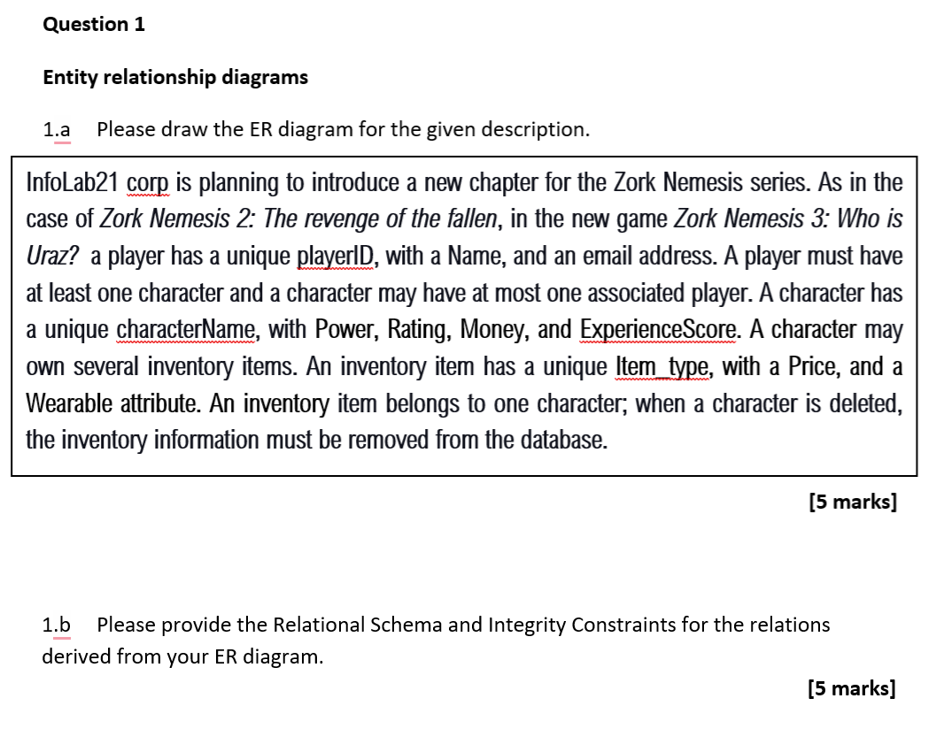
Related exam question.

Slide 131
ERD
charactername
power
price
Item_type
email
Player
1
Character
N
1
OWN.
N
OWN.
Inventory
ID
name
rating
wearable
money
experiencescore

Slide 132
RS
charactername
power
price
Item_type
email
Player
1
Character
N
1
OWN.
N
OWN.
Inventory
ID
name
rating
wearable
money
experiencescore
Player_OWN_ Character (name:TEXT, email:TEXT, ID:INT, power:INT, money:INT, rating:INT, experiencescore:INT, charactername:TEXT, PRIMARK KEY:charactername)
Inventory_OWN(item_type:INT, price:INT, wearable:BOOLEAN, charactername:TEXT, FOREIGN KEY: charactername REFERENCING Player_OWN_ Character, ON DELETE CASCADE, item_type is UNIQUE, PRIMARY KEY{item_type,charactername} )

Slide 133
RS
charactername
power
price
Item_type
email
Player
1
Character
N
1
OWN.
N
OWN.
Inventory
ID
name
rating
wearable
money
experiencescore
Player_OWN_ Character (name:TEXT, email:TEXT, ID:INT, power:INT, money:INT, rating:INT, experiencescore:INT, charactername:TEXT, PRIMARK KEY:charactername)
Inventory_OWN(item_type:INT, price:INT, wearable:BOOLEAN, charactername:TEXT, FOREIGN KEY: charactername REFERENCING Player_OWN_ Character, ON DELETE CASCADE, item_type is UNIQUE, PRIMARY KEY{item_type,charactername} )

