Slide 1
SCC.201 Databases
2024 - Week 8 B+ Trees and Hashing
Uraz Turker

Slide 2
Recap
Last time we covered
Secondary Files
Primary indexes
Clustering indexes
Secondary indexes
Multi-level indexes

Slide 3
Tree structures – a reminder
A
Root node, level 0
Node B Subtree
B
C
D
Nodes at level 1
E
F
G
H
I
Nodes at level 2
J
K
Nodes at level 3

Slide 4
Search tree
Special type of tree used to guide search for a record, given a value of one of an attribute’s records (aka the search field)
Consider search tree, order p
A Node contains at most p-1 search values (K) and p pointers (P)

Slide 5
Search tree
Special type of tree used to guide search for a record, given a value of one of an attribute’s records (aka the search field)
The maximum number of search values is called order p.
A Node contains at most p-1 search values (K) and p pointers (P)

Slide 6
Search tree
Special type of tree used to guide search for a record, given a value of one of an attribute’s records (aka the search field)
The maximum number of search values is called order p.
A Node contains at most p-1 search values (K) and p pointers (P)
A Binary Tree has order p=2 and its node contains one search value and has two pointers.

Slide 7
Search tree
Special type of tree used to guide search for a record, given a value of one of an attribute’s records (aka the search field)
The maximum number of search values is called order p.
A Node contains at most p-1 search values (K) and p pointers (P)
q <= p and
K₁ < K₂ < … < K_{q-1}
P₁ | K₁ | … | K_{i-1} | P_{i} | K_{i} | … | K_{q-1} | P_{q}
Each p is pointer to child node or null pointer
X
X
X
X < K₁
K_{i-1} < X < K_{i}
K_{q-1} < X

Slide 8
Search tree
To search for value X we follow the appropriate pointer P_{i} according to the constraints on the previous slide
Tree here is of order p=3
 | 5
Search for 8
This subtree contains X < 5
This subtree contains X > 5
 | 3
 | 6 |  | 9
 | 1
 | 7 |  | 8
 | 12
This subtree contains X < 3
This subtree contains 6 < X < 9
This subtree contains X > 9

Slide 9
Search tree
Can be used as a mechanism to search for records stored in a disk file
Values in the tree are values of search fields for files (e.g. an indexing field)
Each value is associated with a pointer to a record or a disk block containing a record
Search tree can itself be stored on disk
Algorithms required for inserting and deleting values whilst maintaining constraints
Such algorithms typically do not ensure the tree is balanced…

Slide 10
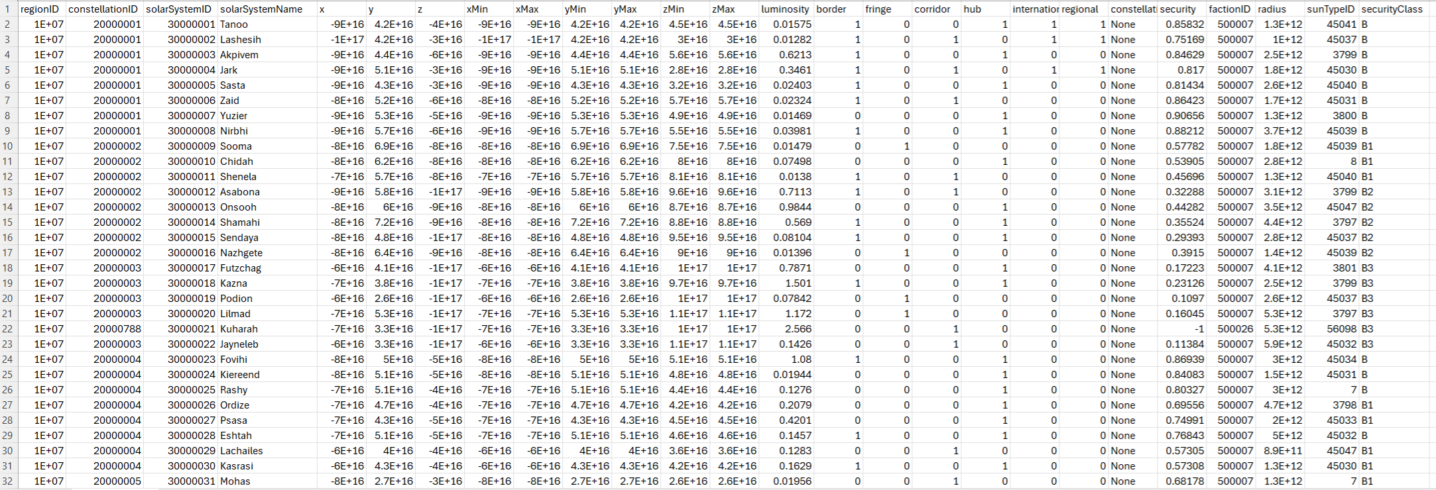
A Search Tree
A
B
Hard Disk
D
Data file (File)
E
J
F
G
H
I
I

Slide 11
An unbalanced tree
A
Root node, level 0
B
C
D
Nodes at level 1
E
F
G
H
I
Nodes at level 2
J
K
Nodes at level 3
Leaf node

Slide 12
Another unbalanced tree
56
Root node, level 0
40
30
Nodes at level 1
20
Nodes at level 2
25
Nodes at level 3
ptr
Leaf node

Slide 13
An unbalanced tree
Does not have all leaf nodes at same level of the tree
Depth of tree is not minimised for a given set of keys
As records updated and deleted, tree may become skewed, with some branches going much deeper than others
May result in wasted storage space
Unpredictable search times as some keys may require far more tree traversal than others

Slide 14
Let’s get started

Slide 15

LECTURE

Slide 16
A table holding records
Attr1 | Attr2 | Attr4 | Attr4
2 | a | X | 10
1 | a | X | 9
36 | b | Y | 4
34 | b | Y | 3
89 | b | X | 5
67 | a | X | 8
103 | a | Y | 2
105 | b | Y | 7
107 | a | Y | 6
115 | b | Y | 1

Slide 17
A heap file allocated on blocks holding records
Attr1 | Attr2 | Attr4 | Attr4
2 | a | X | 10
1 | a | X | 9
36 | b | Y | 4
34 | b | Y | 3
89 | b | X | 5
67 | a | X | 8
103 | a | Y | 2
103 | a | Y | 2
105 | b | Y | 7
107 | a | Y | 6
115 | b | Y | 1
Ordering field

Slide 18
Sorted file allocated on blocks and sorted based on a key or non-key attribute
Attr1 | Attr2 | Attr3 | Attr4
1 | a | ***** | *****
2 | a | ***** | *****
34 | b | ***** | *****
36 | b | ***** | *****
67 | a | ***** | *****
89 | b | ***** | *****
 | a | ***** | *****
103 | b | ***** | *****
105 | a | ***** | *****
107 | b | ***** | *****
115 | b | ***** | *****
Clustering field
Attr1 | Attr2 | … | Attrn
2 | a | ***** | *****
1 | a | ***** | *****
67 | a | ***** | *****
103 | a | ***** | *****
107 | a | ***** | *****
36 | b | ***** | *****
 |  | ***** | *****
34 | b | ***** | *****
89 | b | ***** | *****
105 | b | ***** | *****
115 | b | ***** | *****
Ordering field
Ordering field
Ordering field
Ordering field
Clustering field

Slide 19
Primary index on a sorted file allocated to disk blocks where sorting is done on an ordering field
Ordering field
Attr1 | Attr2 | Attr3 | Attr4
1 | a | ***** | *****
2 | a | ***** | *****
34 | b | ***** | *****
36 | b | ***** | *****
67 | a | ***** | *****
89 | b | ***** | *****
 | a | ***** | *****
103 | b | ***** | *****
105 | a | ***** | *****
107 | b | ***** | *****
115 |  | ***** | *****
pointer | Attr1
 | 1
 | 103
Ordering field
Ordering field

Slide 20
Primary index on a sorted file allocated on disk blocks where sorting is done on an ordering field(1)
Attr2 | Pointer
a
b
Clustering field
Attr1 | Attr2 | Attr3 | Attr4
2 | a | ***** | *****
1 | a | ***** | *****
67 | a | ***** | *****
103 | a | ***** | *****
107 | a | ***** | *****
36 | b | ***** | *****
 |  | ***** | *****
34 | b | ***** | *****
89 | b | ***** | *****
105 | b | ***** | *****
115 | b | ***** | *****
Ordering field
Clustering field

Slide 21
OR

Slide 22
Primary index on a sorted file allocated on disk blocks where sorting is done on an ordering field(2)
Attr1 | Attr2 | Attr3 | Attr4
2 | a | ***** | *****
1 | a | ***** | *****
67 | a | ***** | *****
103 | a | ***** | *****
107 | a | ***** | *****
Next Block Pointer
36 | b | ***** | *****
34 | b | ***** | *****
89 | b | ***** | *****
105 | b | ***** | *****
115 | b | ***** | *****
pointer | Attr1
a
b
Clustering field
Ordering field
Clustering field

Slide 23
A secondary index is on a sorted file (ordering key) allocated on disk blocks where indexing is done on a key field.
Ordering field
Secondary Index Key field
pointer | Attr4
 | 1
 | 2
 | 3
 | 4
 | 5
 | 6
 | 7
 | 8
 | 9
 | 10
Attr1 | Attr2 | Attr3 | Attr4
1 | a | X | 9
2 | a | X | 10
34 | b | Y | 3
36 | b | Y | 4
67 | a | X | 8
89 | b | X | 5
 | a | ***** | *****
103 | b | Y | 2
105 | a | Y | 7
107 | b | Y | 6
115 |  | Y | 1
Ordering field
Ordering field
Secondary Index Key field

Slide 24
A secondary index on a sorted file (ordering key) is allocated on disk blocks where indexing is done on a non-key field. (1)
Ordering field
Secondary Index Clustering field
pointer | Attr3
 | X
 | X
 | X
 | X
 | Y
 | Y
 | Y
 | Y
 | Y
 | Y
Attr1 | Attr2 | Attr3 | Attr4
1 | a | X | 9
2 | a | X | 10
34 | b | Y | 3
36 | b | Y | 4
67 | a | X | 8
89 | b | X | 5
 | a | ***** | *****
103 | b | Y | 2
105 | a | Y | 7
107 | b | Y | 6
115 |  | Y | 1
Ordering field
Ordering field
Secondary Index Clustering field

Slide 25
OR

Slide 26
A secondary index on a sorted file (ordering key) is allocated on disk blocks where indexing is done on a non-key field. (2)
Ordering field
Secondary Index Clustering field
ptr | ptr | ptr | ptr
Attr1 | Attr2 | Attr3 | Attr4
1 | a | X | 9
2 | a | X | 10
34 | b | Y | 3
36 | b | Y | 4
67 | a | X | 8
89 | b | X | 5
 | a | ***** | *****
103 | b | Y | 2
105 | a | Y | 7
107 | b | Y | 6
115 |  | Y | 1
pointer | Attr3
 | X
 | Y
Ordering field
ptr | ptr | ptr | ptr | ptr | ptr
Ordering field
Secondary Index Clustering field

Slide 27
Tree
Tree with order p=2
X
<X
>X
If there are n elements, at every level, we reduce the search space to n/2, so the search requires log_2(n) steps of computation on average

Slide 28
Tree
Tree with order p=3
X < Y
<X
X<..<Y
>Y
If there are n elements, at every level, we reduce the search space to n/3, so the search requires log_3(n) steps of computation on average

Slide 29
Tree
Tree with order p=4
Z < X < Y
<Z
Z<…<X
X<..<Y
>Y
If there are n elements, at every level, we reduce the search space to n/3, so the search requires log_4(n) steps of computation on average

Slide 30
A Search Tree
A
B
Hard Disk
D
Data file (File)
E
J
F
G
H
I
I

Slide 31
Trees may be unbalanced..
https://www.cs.usfca.edu/~galles/visualization/BST.html

Slide 32
The B-tree

Slide 33
What is a B-tree?
Specialised case of search tree with additional constraints to:
Ensure the tree always remains balanced
Minimise space wasted by deletion
B-tree of order p is a tree which satisfies the following properties:
Every node has at most p children
Every internal node (non-leaf) has at least p/2 children
Every non-leaf node has at least 2 children
All leaves are kept on the same level!
Non-leaf node with k children contains k-1 keys

Slide 34
A B-tree is:
NOT a binary tree!!!
Binary tree is a special case of tree structure with at most 2 child nodes per node
B stands for balanced!

Slide 35
Formal definition:
B-tree of order p, when used as an access structure on a key attribute to search for records, can be defined as:
Each internal node is of the form:
<P₁, <K_{1,} Pr₁ >, P₂, <K_{2,} Pr₂>, … , <K_{q-1}, Pr_{q-1}>, P_{q}>
Where q <= p.
P_{i} is a tree pointer to another node in the tree
Pr_{i} is a data pointer to record with search key value = K_{i} (or to data block containing record)
Within each node we have K₁ < K₂ < … < K_{q-1}
For all search key values X in subtree P_{i} (the i^{th} subtree), we have:
K_{i-1} < X < K_{i} for 1 < i < q; X < K_{i} for I = 1; and K_{i-1} < X for i=q
Each node has at most p tree pointers

Slide 36
Formal definition cont. :
Each node, except root and leaf nodes, has a least ⎡(p/2)⎤ tree pointers. The root node has at least two tree pointers unless it is the only node in the tree
A node with q tree pointers, q<=p, has q-1 search key field values (and hence q-1 data pointers)
All leaf nodes are at the same level. Leaf nodes have same structure as internal nodes except that all tree pointers P_{i} are NULL

Slide 37
Node in a B-tree with q – 1 search values:
P₁
K₁ | Pr₁
P₂ …
K_{i-1} | Pr_{i-1}
P_{i}
K_{i} | Pr_{i}
…
K_{q-1} | Pr_{q-1}
P_{q}
Tree pointer
X
X
X
Data pointer
X < K₁
K_{i-1} < X < K_{i}
K_{q-1} < X

Slide 38
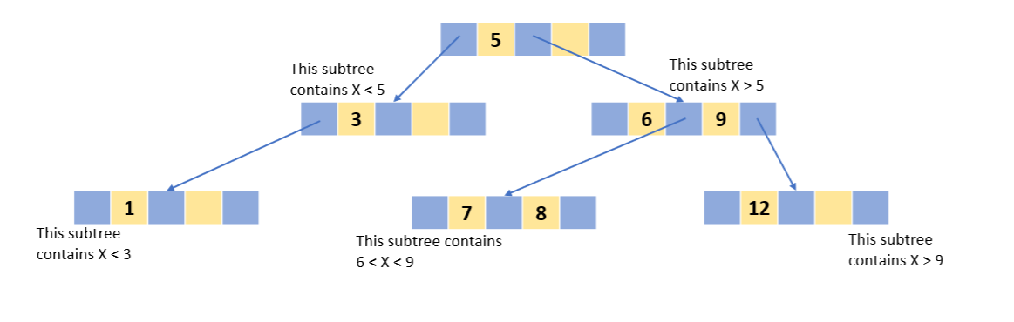
B-tree, order p= 3, and every node has two search values. (data pointers omitted)
 | 5 |  | 8
 | 1 |  | 3
 | 6 |  | 7
 | 9 |  | 12
Compare with the original search tree
Tree is balanced all leave nodes on level 1
All tree pointers at level 1 are NULL
Original search tree

Slide 39
Notes
In previous examples all search values K are unique – this is case if tree is accessing based on a key field
B-tree on a non-key field, change definition of file pointers, Pr_{i} to a block (or cluster) containing pointers to file records

Slide 40
Explore some trees
https://www.cs.usfca.edu/~galles/visualization/BTree.html
Courtesy of University Of San Francisco
Experiment and see how the following are handled:
Insertions
Deletions
Searches

Slide 41
Root node insertion
B-tree starts with single root node (which is also leaf)
When root is full with p-1 search key values and insertion attempted
Root splits into two nodes at level 1
Middle value is kept in the root node
Rest of values split evenly between the other two nodes
4
9
13

Slide 42
Non-root node insertion
When a non-root node is full, and a new entry is inserted
Node split into two nodes at the same level
Middle entry is moved to parent node along with two pointers to new split nodes
If a parent node is full, it is also split
Splitting can thus propagate all the way to the root node by creating a new level if the root is split.
31
4
9
13

Slide 43
Deletion
If deleting value causes the node to be less than half full
It is combined with neighbouring nodes
Combination of nodes can also propagate to root
Node deletion can reduce the number of tree levels
This allows more efficient usage of storage space

Slide 44

Check your self

Slide 45
The B+tree

Slide 46
B+trees
Variation of the B-tree
Commonly used for implementing dynamic, multi-level indexes
In B-tree, every value of the search field appears at some level in tree along with the data pointer
In B+tree, data pointers are only stored at leaf nodes of the tree, along with a value for the search field ∴
The structure of leaf nodes differs from the structure of internal nodes
Leaf nodes are usually linked to provide ordered access on search fields to records

Slide 47
B+trees contd.
Thus leaf nodes similar to base level of an index
Internal nodes of B+ tree correspond to other levels of multi-level index
Some search field values from leave nodes may be repeated in internal nodes to guide search

Slide 48
B+trees internal nodes.
Each internal node has at most P pointers
Each internal node (excluding root) has at least ⎡p/2⎤ tree pointers. Root node has at least two tree pointers if it is an internal node
An internal node with q tree pointers, q <= p, has q-1

Slide 49
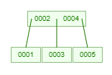
Internal node structure
P₁ | K₁ | … | K_{i-1} | P_{i} | K_{i} | … | K_{q-1} | P_{q}
Each p is a tree pointer
X
X
X
X < K₁
K_{i-1} < X < K_{i}
K_{q-1} < X
q <= p and
K₁ < K₂ < … < K_{q-1}
?

Slide 50
Root node insertion
B-tree starts with single root node (which is also leaf)
When root is full with p-1 search key values and insertion attempted
Root splits into two nodes at level 1
Middle value is copied up to the root node
Rest of values split evenly between the other two nodes
Root
4
9
9

Slide 51
Root node insertion
B-tree starts with single root node (which is also leaf)
When root is full with p-1 search key values and insertion attempted
Root splits into two nodes at level 1
Middle value is copied up to the root node
Rest of values split evenly between the other two nodes
Root
4
9
9
13

Slide 52
Root node insertion
B-tree starts with single root node (which is also leaf)
When root is full with p-1 search key values and insertion attempted
Root splits into two nodes at level 1
Middle value is copied up to the root node
Rest of values split evenly between the other two nodes
9
New Root
4
9
13

Slide 53
Root node insertion
B-tree starts with single root node (which is also leaf)
When root is full with p-1 search key values and insertion attempted
Root splits into two nodes at level 1
Middle value is copied up to the root node
Rest of values split evenly between the other two nodes
9
New Root
4
9
13

Slide 54
Root node insertion
B-tree starts with single root node (which is also leaf)
When root is full with p-1 search key values and insertion attempted
Root splits into two nodes at level 1
Middle value is copied up to the root node
Rest of values split evenly between the other two nodes
9
New Root
4
9
13

Slide 55
Leaf node insertion
When a non-root node is full, and a new entry is inserted
Node split into two nodes at the same level
Middle entry is copied to parent node along with two pointers to new split nodes
If a parent node is full, it is also split
Splitting can thus propagate all the way to the root node by creating a new level if the root is split.
31
4
9
9

Slide 56
Leaf node insertion
When a non-root node is full, and a new entry is inserted
Node split into two nodes at the same level
Middle entry is copied to parent node along with two pointers to new split nodes
If a parent node is full, it is also split
Splitting can thus propagate all the way to the root node by creating a new level if the root is split.
31
4
9
9
Leaf node

Slide 57
Leaf node insertion
When a non-root node is full, and a new entry is inserted
Node split into two nodes at the same level
Middle entry is copied to parent node along with two pointers to new split nodes
If a parent node is full, it is also split
Splitting can thus propagate all the way to the root node by creating a new level if the root is split.
31
4
9
9
13
Leaf node

Slide 58
Leaf node insertion
When a non-root node is full, and a new entry is inserted
Node split into two nodes at the same level
Middle entry is copied to parent node along with two pointers to new split nodes
If a parent node is full, it is also split
Splitting can thus propagate all the way to the root node by creating a new level if the root is split.
31
4
9
9
13
Leaf node

Slide 59
Leaf node insertion
When a non-root node is full, and a new entry is inserted
Node split into two nodes at the same level
Middle entry is copied to parent node along with two pointers to new split nodes
If a parent node is full, it is also split
Splitting can thus propagate all the way to the root node by creating a new level if the root is split.
9
31
4
9
13
Leaf node

Slide 60
Leaf node insertion
When a non-root node is full, and a new entry is inserted
Node split into two nodes at the same level
Middle entry is copied to parent node along with two pointers to new split nodes
If a parent node is full, it is also split
Splitting can thus propagate all the way to the root node by creating a new level if the root is split.
9
31
4
9
13
New Leaf nodes

Slide 61
Leaf node insertion
When a non-root node is full, and a new entry is inserted
Node split into two nodes at the same level
Middle entry is copied to parent node along with two pointers to new split nodes
If a parent node is full, it is also split
Splitting can thus propagate all the way to the root node by creating a new level if the root is split.
9
31
4
9
13
New Leaf nodes

Slide 62
Internal node insertion
When a non-root node is full, and a new entry is inserted
Node split into two nodes at the same level
Middle entry is pushed to parent node along with two pointers to new split nodes
If a parent node is full, it is also split
Splitting can thus propagate all the way to the root node by creating a new level if the root is split.
31
4
9
Internal Node

Slide 63
Internal node insertion
When a non-root node is full, and a new entry is inserted
Node split into two nodes at the same level
Middle entry is pushed to parent node along with two pointers to new split nodes
If a parent node is full, it is also split
Splitting can thus propagate all the way to the root node by creating a new level if the root is split.
31
4
9
13
Internal Node

Slide 64
Internal node insertion
When a non-root node is full, and a new entry is inserted
Node split into two nodes at the same level
Middle entry is pushed to parent node along with two pointers to new split nodes
If a parent node is full, it is also split
Splitting can thus propagate all the way to the root node by creating a new level if the root is split.
31
4
9
13
Internal Node

Slide 65
Internal node insertion
When a non-root node is full, and a new entry is inserted
Node split into two nodes at the same level
Middle entry is pushed to parent node along with two pointers to new split nodes
If a parent node is full, it is also split
Splitting can thus propagate all the way to the root node by creating a new level if the root is split.
9
31
4
13
New Internal Nodes

Slide 66
Internal node insertion
When a non-root node is full, and a new entry is inserted
Node split into two nodes at the same level
Middle entry is pushed to parent node along with two pointers to new split nodes
If a parent node is full, it is also split
Splitting can thus propagate all the way to the root node by creating a new level if the root is split.
9
31
4
13
New Internal Nodes

Slide 67
B+trees leaf nodes.
No more P pointers in node structure pointing at subtrees (it is a leaf after all)
Each leaf node has at least ⎡p/2⎤ values
All leaf nodes at same level
A P_{previous} pointer can also be included

Slide 68
Leaf node structure
K₁ | Pr₁
K₂ | Pr₂
…
K_{i} | Pr_{i}
…
K_{q-1} | Pr_{q-1}
P_{next}
Pointer to next leaf node
Data Pointer
q <= p and
K₁ < K₂ < … < K_{q-1}

Slide 69
B+trees
Since internal nodes contain search values and tree pointers without any data pointers, more entries can be packed into internal node of a B+ tree than for a similar B-tree
For same block size, order P will be larger for a B+ tree
∴ fewer levels
∴ improved search time
Order P can be different for internal nodes and leaf nodes as they have different structures

Slide 70
B-trees and B+trees
Analysis and simulation have shown that after many random insertions and deletions on B-trees and B+trees
Nodes approximately 69% full when no. of values in tree stabilises
Node splitting and combination occurs rarely
∴ Insertion and deletion becomes efficient
If number of values grows, tree will expand without problems
Splitting of nodes may occur, so some insertions may take more time

Slide 71
Explore some B+ trees
https://www.cs.usfca.edu/~galles/visualization/BPlusTree.html
Courtesy of University Of San Francisco
Experiment and see how the following are handled:
Insertions
Deletions
Searches

Slide 72

B+ Tree

Slide 73
B+ Trees in Practice
Typical order: 150. (log_150 (N)) Typical fill-factor (# of empty search value/#number of search values): 67%.
average fanout (number of pointers leaving a node) = 133
Typical capacities:
Height 4: 133⁴ = 312,900,700 records
Height 3: 133³ = 2,352,637 records
Can often hold top levels in buffer pool:
Level 1 = 1 page = 8 Kbytes
Level 2 = 133 pages = 1 Mbyte
Level 3 = 17,689 pages = 133 MBytes

Slide 74
Let’s get started

Slide 75
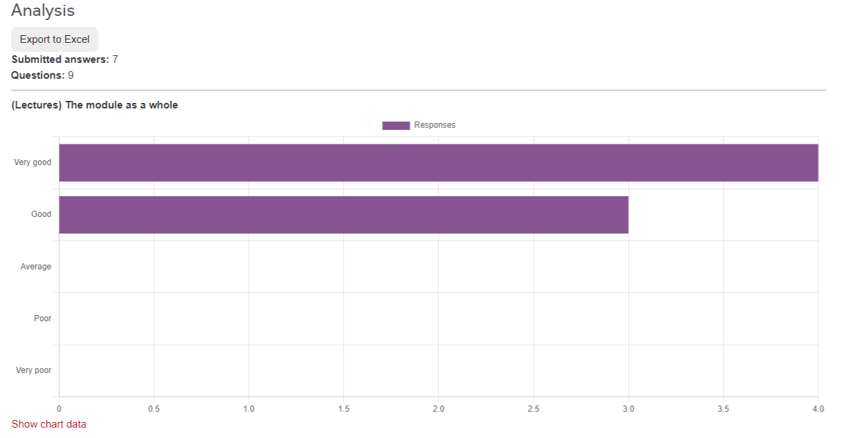
From you

Slide 76

From you

Slide 77
From you

Slide 78
From you

Slide 79

From You

Slide 80
From You

Slide 81
Previously
Search tree (order = p)
Minimum number of tree pointers per node is Ceil(p/2)
Minimum number of key values per node is Ceil(p/2) -1
B Tree insertion
Split based on “push-up” values
B+ Tree insertion
Except for internal nodes, the split is based on “copy-up” values.
Because….

Slide 82
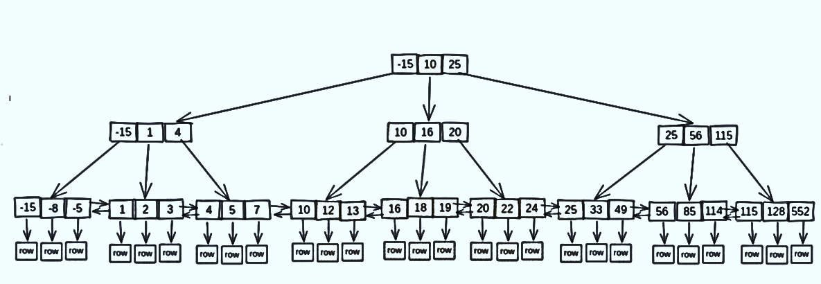
Search between 11-33

Slide 83
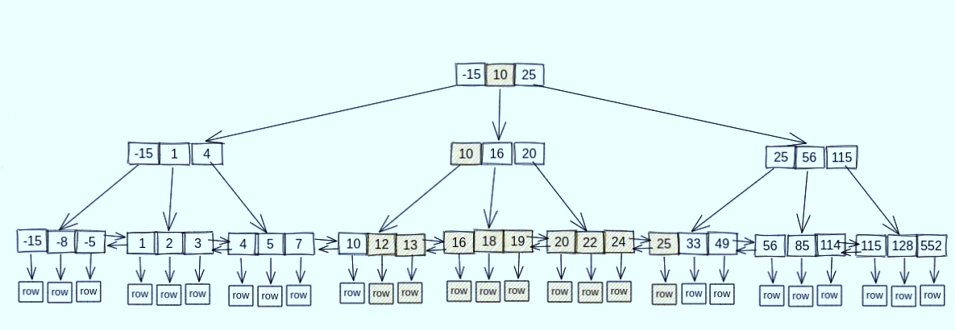
Search between 11-33
6 Node accesses have been made.

Slide 84
Ordered files and B-trees
These structures are very good for search
Binary search allows for very efficiently finding records in very large datasets
But it’s not the only or necessarily always the fastest way to find something (still need to do log_p (N) search)..
Searching for something v. just ‘knowing’ where it is…
A hash table and hashing function gives us a mechanism for obtaining the location of a data item directly (either a memory location or disk block in which the record is stored)
Find in O(1)!

Slide 85
What is a hash?
Hash function is any function that maps a data item (of arbitrary size) to a fixed (usually an integer) value
H(23949837) ->1 H(uraz)->85
H(85729302) ->2 H(Luke)->96
Hash table (also called a hash map) is a data structure that implements an associative array or dictionary.
maps many keys to values
Hash function (h) is applied to hash field value to yield the address of the disk block in which record is stored.
For most records located in this way, only need a single block access to retrieve the record.
Very very fast under certain circumstances

Slide 86
What is a hash?
Hash function is any function that maps a data item (of arbitrary size) to a fixed (usually an integer) value
H(23949837) ->1 H(uraz)->85
H(85729302) ->2 H(Luke)->96
Hash table (also called a hash map) is a data structure that implements an associative array or dictionary.
maps many keys to values
Hash function (h) is applied to hash field value to yield the address of the disk block in which record is stored.
For most records located in this way, only need a single block access to retrieve the record.
Very very fast under certain circumstances

Slide 87
What is a hash?
Hash function is any function that maps a data item (of arbitrary size) to a fixed (usually an integer) value
H(23949837) ->1 H(uraz)->85
H(85729302) ->2 H(Luke)->96
Hash table (also called a hash map) is a data structure that implements an associative array or dictionary.
maps many keys to values
Hash function (h) is applied to hash field value to yield the address of the disk block in which record is stored.
For most records located in this way, only need a single block access to retrieve the record.
Very very fast under certain circumstances

Slide 88
Internal hashing

Slide 89
Internal hashing
Hashing is also used as an internal search structure within a program
Can be used whenever a group of records accessed exclusively by using the value of one field called the hash field
If hash field is also key field it is referred to as the hash key
Implemented as a hash table using an array of records
Imagine an array with index range 0 to M-1
We have M available slots whose addresses correspond to the array indexes
Choose a hashing function that transforms hash field value x into integer such that:
0 <= X <= M-1

Slide 90
Internal hashing
Slot | Name | NI_Num | DOB
0
1
2
3
4
429665
674814
399745
…
M-2
M-1
Hash function f(x)- transforms hash field value into an index value

Slide 91
Example hashing functions
One common hash function is: h(K) = K mod M
Returns remainder of integer of hash field value K after division by M
Remember M is no of slots in hash table so operation ensures h(K) returns result between 0 and M-1
Value, h(K), is used as the address for the record
Requires an integer value to calculate
All binary data can be represented as integer, e.g. character strings can use ascii codes of characters

Slide 92
More hashing functions
Folding example for string “Uraz”
For each character, find the ASCII value, multiply it by a prime number, and add it to the sum.
Folding:
Apply
arithmetic functions such as addition
or
Logical function such as exclusive OR
To different portions of hash field values to calculate hash address
Or simply pick some digits of hash field value e.g. 2nd, 4th and 6th digit to form hash address
The hash address should be computationally cheap to calculate

Slide 93
Using 2nd, 4th, 6th digit…
Slot | Name | NI_Num | DOB
000
…
…
783
784
000000
674814
399745
870833
…
975
…
M-1
M = 1000 to hold all possible hash values

Slide 94
Using 2nd, 4th, 6th digit…
Slot | Name | NI_Num | DOB
000
…
…
783
784
000000
674814
399745
870833
783
…
975
…
M-1
274893
M = 1000 to hold all possible hash values

Slide 95
Hash collisions
Occur when multiple value of hashing field result in same output from the hashing function
More likely to occur when number of possible slots M is small compared to the possible number of hash field values
Ideal hashing function will minimise collisions whilst still being cheap to calculate
Strategy needed to handle (resolve) conflicts

Slide 96
Collision resolution
Open addressing
Proceed from the already occupied position specified by the hash
Check subsequent positions in order
Until an unused position is found
Logically simple to implement
But
If no. of collisions is large, the hash table order begins to degrade
Multiple hashing
Apply a second hash function if the first results in a collision
If another collision occurs, use open addressing or apply a third hash, then use open addressing

Slide 97
Collision resolution (2)
Chaining
In addition to our main locations 0 … M-1
Extend array with a number of overflow positions
Additionally, pointer field added to each record location
Collision is resolved by placing new record in unused overflow location and setting occupied hash address pointer to address of overflow location
Thus a linked list of overflow locations is maintained

Slide 98
Chaining
Pos.. | Data fields | Overflow Pointer
0
1 |  | M
2
3
4 |  | M+4
M-2 |  | M+1
M-1
M |  | M+2
M+1
M+2
M+N-1
Address space
Overflow space

Slide 99
Internal hashing
So that’s how we can use hashing in main memory
Gives us a very rapid lookup mechanism
Where we are using equality for search
Doesn’t work for SELECT * WHERE X > Value
Can we apply something similar to secondary storage too?

Slide 100
Dynamic hashing: Extendible hashing

Slide 101
Dynamic hashing
Easier to expand or shrink a file (compared with static hashing)
Takes advantage of the fact:
The result of applying a hash function is always a non-negative integer
Can be represented as a binary number

Slide 102
Extendible hashing
Directory consisting of array of 2^{d} bucket addresses is maintained
d is called the global depth of the directory
Integer value corresponding to the first (high-order/low-order) d bits of the hash value is used as an index into the array to determine the directory entry
Address in the entry determines in which bucket corresponding records are stored

Slide 103
Extendible hashing
Does not require a distinct bucket for each of the 2^{d} directory entries
Several directory entries with the same first d’(local depth) bits may contain the same bucket address
Records that hash to these locations fit in a single bucket

Slide 104
Extendible hashing
d’ is called the local depth
Stored with each bucket
Number of bits on which bucket contents are based
Expansion and shrinkage
Value of d can be increased or decreased by 1 at a time
In this event, the number of entries in the directory array is doubled or halved
Doubling needed if bucket with d’ = d overflows
Halving is needed if (possibly after some deletions) d > d’ for all buckets

Slide 105
Extendible hashing
+ve: Performance does not degrade as file grows
In static hashing, collisions increase and overflow chains become large
+ve: No space allocated for future growth
It’s all handled dynamically for additional buckets
+ve: Space overhead for directory is negligible
Maximum directory size is 2b – where b is number of bits in hash value

Slide 106
Extendible hashing
+ve: Splitting causes minor reorganisation in most cases
Only records in one bucket are redistributed to two new buckets
-ve: Reorg expensive when directory needs to be doubled or halved
-ve: Two disk-block accesses required
Directory must be searched before accessing buckets
Overall performance penalty is minor
Desirable choice for dynamic files

Slide 107
Extendible hashing example

Slide 108
Extendible Hashing Example
Values
12 | 01100
17 | 10001
10 | 01010
6 | 00110
24 | 11000
14 | 01110
5 | 00101
20 | 10100
1 | 00001
13 | 01101
7 | 00111
4 | 00100
22 | 10110
d=1
0
1
 |  | d’=1
 |  | d’=1

Slide 109
Extendible Hashing Example
Values
12 | 01100
17 | 10001
10 | 01010
6 | 00110
24 | 11000
14 | 01110
5 | 00101
20 | 10100
1 | 00001
13 | 01101
7 | 00111
4 | 00100
22 | 10110
d=1
0
1
12
 |  | d’=1
 |  | d’=1

Slide 110
Extendible Hashing Example
Values
12 | 01100
17 | 10001
10 | 01010
6 | 00110
24 | 11000
14 | 01110
5 | 00101
20 | 10100
1 | 00001
13 | 01101
7 | 00111
4 | 00100
22 | 10110
d=1
0
1
12
 |  | d’=1
17
 |  | d’=1

Slide 111
Extendible Hashing Example
Values
12 | 01100
17 | 10001
10 | 01010
6 | 00110
24 | 11000
14 | 01110
5 | 00101
20 | 10100
1 | 00001
13 | 01101
7 | 00111
4 | 00100
22 | 10110
d=1
0
1
12
 |  | d’=1
10
17
 |  | d’=1

Slide 112
Extendible Hashing Example
Values
12 | 01100
17 | 10001
10 | 01010
6 | 00110
24 | 11000
14 | 01110
5 | 00101
20 | 10100
1 | 00001
13 | 01101
7 | 00111
4 | 00100
22 | 10110
d=1
0
1
d=2
00
01
10
11
12
 |  | d’=1
10
 |  | d’=2
 |  | d’=2
17
12
10
 |  | d’=1
17
 |  | d’=1
No room in block…
… so must increase global depth

Slide 113
Extendible Hashing Example
Values
12 | 01100
17 | 10001
10 | 01010
6 | 00110
24 | 11000
14 | 01110
5 | 00101
20 | 10100
1 | 00001
13 | 01101
7 | 00111
4 | 00100
22 | 10110
d=2
00
01
10
11
6
 |  | d’=2
Now there’s room for 6
 |  | d’=2
12
10
17
 |  | d’=1

Slide 114
Extendible Hashing Example
Values
12 | 01100
17 | 10001
10 | 01010
6 | 00110
24 | 11000
14 | 01110
5 | 00101
20 | 10100
1 | 00001
13 | 01101
7 | 00111
4 | 00100
22 | 10110
d=2
00
01
10
11
6
 |  | d’=2
 |  | d’=2
12
10
17
24
 |  | d’=1

Slide 115
Extendible Hashing Example
Values
12 | 01100
17 | 10001
10 | 01010
6 | 00110
24 | 11000
14 | 01110
5 | 00101
20 | 10100
1 | 00001
13 | 01101
7 | 00111
4 | 00100
22 | 10110
d=2
00
01
10
11
d=3
000
001
010
011
100
101
110
111
6
6
 |  | d’=2
 |  | d’=2
 |  | d’=2
12
10
17
24
10
 |  | d’=1
 |  | d’=3
 |  | d’=3
12
 |  | d’=1
17
24
No room in block…
… so must increase global depth again

Slide 116
Extendible Hashing Example
Values
12 | 01100
17 | 10001
10 | 01010
6 | 00110
24 | 11000
14 | 01110
5 | 00101
20 | 10100
1 | 00001
13 | 01101
7 | 00111
4 | 00100
22 | 10110
d=3
000
001
010
011
100
101
110
111
6
 |  | d’=2
10
 |  | d’=3
 |  | d’=3
12
14
 |  | d’=1
17
24

Slide 117
Extendible Hashing Example
Values
12 | 01100
17 | 10001
10 | 01010
6 | 00110
24 | 11000
14 | 01110
5 | 00101
20 | 10100
1 | 00001
13 | 01101
7 | 00111
4 | 00100
22 | 10100
d=3
000
001
010
011
100
101
110
111
6
 |  | d’=2
5
10
 |  | d’=3
 |  | d’=3
12
14
 |  | d’=1
17
24

Slide 118
Extendible Hashing Example
Values
12 | 01100
17 | 10001
10 | 01010
6 | 00110
24 | 11000
14 | 01110
5 | 00101
20 | 10100
1 | 00001
13 | 01101
7 | 00111
4 | 00100
22 | 10110
d=3
000
001
010
011
100
101
110
111
6
 |  | d’=2
5
10
 |  | d’=3
 |  | d’=3
12
14
 |  | d’=1
17
24
No room in block…

Slide 119
Extendible Hashing Example
Values
12 | 01100
17 | 10001
10 | 01010
6 | 00110
24 | 11000
14 | 01110
5 | 00101
20 | 10100
1 | 00001
13 | 01101
7 | 00111
4 | 00100
22 | 10110
d=3
000
001
010
011
100
101
110
111
6
 |  | d’=2
5
10
 |  | d’=3
 |  | d’=3
12
14
 |  | d’=2
17
20
Here we can simply split block in two
 |  | d’=2
24

Slide 120
Extendible Hashing Example
Values
12 | 01100
17 | 10001
10 | 01010
6 | 00110
24 | 11000
14 | 01110
5 | 00101
20 | 10100
1 | 00001
13 | 01101
7 | 00111
4 | 00100
22 | 10110
d=3
000
001
010
011
100
101
110
111
6
No room in block but can be split in two
 |  | d’=2
5
10
 |  | d’=3
 |  | d’=3
12
14
 |  | d’=2
17
20
 |  | d’=2
24

Slide 121
Extendible Hashing Example
Values
12 | 01100
17 | 10001
10 | 01010
6 | 00110
24 | 11000
14 | 01110
5 | 00101
20 | 10100
1 | 00001
13 | 01101
7 | 00111
4 | 00100
22 | 10110
d=3
000
001
010
011
100
101
110
111
1
 |  | d’=3
 |  | d’=3
6
5
10
 |  | d’=3
 |  | d’=3
12
14
 |  | d’=2
17
20
 |  | d’=2
24

Slide 122
Extendible Hashing Example
Values
12 | 01100
17 | 10001
10 | 01010
6 | 00110
24 | 11000
14 | 01110
5 | 00101
20 | 10100
1 | 00001
13 | 01101
7 | 00111
4 | 00100
22 | 10110
d=3
000
001
010
011
100
101
110
111
d=4
0000
0001
0010
0011
0100
0101
0110
0111
1000
1001
1010
1011
1100
1101
1110
1111
1
 |  | d’=3
1
 |  | d’=3
 |  | d’=3
6
5
 |  | d’=3
6
5
10
10
 |  | d’=3
 |  | d’=3
 |  | d’=3
 |  | d’=4
12
14
12
 |  | d’=2
17
20
 |  | d’=4
14
 |  | d’=2
24
 |  | d’=2
17
20
No room in block and must increase global depth again
 |  | d’=2
24

Slide 123
Extendible Hashing Example
Values
12 | 01100
17 | 10001
10 | 01010
6 | 00110
24 | 11000
14 | 01110
5 | 00101
20 | 10100
1 | 00001
13 | 01101
7 | 00111
4 | 00100
22 | 10110
d=4
0000
0001
0010
0011
0100
0101
0110
0111
1000
1001
1010
1011
1100
1101
1110
1111
1
 |  | d’=3
 |  | d’=3
6
5
10
 |  | d’=3
 |  | d’=4
12
13
 |  | d’=4
14
 |  | d’=2
17
20
 |  | d’=2
24

Slide 124
Extendible Hashing Example
Values
12 | 01100
17 | 10001
10 | 01010
6 | 00110
24 | 11000
14 | 01110
5 | 00101
20 | 10100
1 | 00001
13 | 01101
7 | 00111
4 | 00100
22 | 10110
d=4
0000
0001
0010
0011
0100
0101
0110
0111
1000
1001
1010
1011
1100
1101
1110
1111
1
 |  | d’=3
 |  | d’=3
No room in block but can be split in two
6
5
10
 |  | d’=3
 |  | d’=4
12
13
 |  | d’=4
14
 |  | d’=2
17
20
 |  | d’=2
24

Slide 125
Extendible Hashing Example
Values
12 | 01100
17 | 10001
10 | 01010
6 | 00110
24 | 11000
14 | 01110
5 | 00101
20 | 10100
1 | 00001
13 | 01101
7 | 00111
4 | 00100
22 | 10110
d=4
0000
0001
0010
0011
0100
0101
0110
0111
1000
1001
1010
1011
1100
1101
1110
1111
1
 |  | d’=3
 |  | d’=4
5
 |  | d’=4
6
7
10
 |  | d’=3
 |  | d’=4
12
13
 |  | d’=4
14
 |  | d’=2
17
20
 |  | d’=2
24

Slide 126
Extendible Hashing Example
Values
12 | 01100
17 | 10001
10 | 01010
6 | 00110
24 | 11000
14 | 01110
5 | 00101
20 | 10100
1 | 00001
13 | 01101
7 | 00111
4 | 00100
22 | 10110
d=4
0000
0001
0010
0011
0100
0101
0110
0111
1000
1001
1010
1011
1100
1101
1110
1111
1
 |  | d’=3
 |  | d’=4
5
4
 |  | d’=4
6
7
10
 |  | d’=3
 |  | d’=4
12
13
 |  | d’=4
14
 |  | d’=2
17
20
 |  | d’=2
24

Slide 127
Extendible Hashing Example
Values
12 | 01100
17 | 10001
10 | 01010
6 | 00110
24 | 11000
14 | 01110
5 | 00101
20 | 10100
1 | 00001
13 | 01101
7 | 00111
4 | 00100
22 | 10110
d=4
0000
0001
0010
0011
0100
0101
0110
0111
1000
1001
1010
1011
1100
1101
1110
1111
1
 |  | d’=3
 |  | d’=4
5
4
 |  | d’=4
6
7
10
 |  | d’=3
 |  | d’=4
12
13
 |  | d’=4
14
 |  | d’=2
No room in block but can be split in two
17
20
 |  | d’=2
24

Slide 128
Extendible Hashing Example
Values
12 | 01100
17 | 10001
10 | 01010
6 | 00110
24 | 11000
14 | 01110
5 | 00101
20 | 10100
1 | 00001
13 | 01101
7 | 00111
4 | 00100
22 | 10110
d=4
0000
0001
0010
0011
0100
0101
0110
0111
1000
1001
1010
1011
1100
1101
1110
1111
1
 |  | d’=3
 |  | d’=4
5
4
 |  | d’=4
6
7
10
 |  | d’=3
 |  | d’=4
12
13
 |  | d’=4
14
 |  | d’=3
17
 |  | d’=3
20
22
 |  | d’=2
24

Slide 129
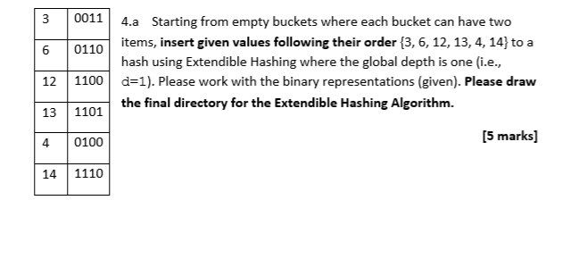
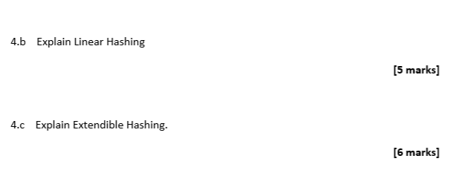
Exam Questions
d=1
0
1
3 | 6 | d’=1
12 | 13 | d’=1
d=2
00
01
10
11
3 |  | d’=2
6 | 4 | d’=2
12
 | 13 | d’=1

Slide 130
d=3
000
001
010
011
100
101
110
111
3 |  | d’=2
d=1
0
1
3 | 6 | d’=1
6 | 4 | d’=2
12 | 13 | d’=1
 |  | d’=2
d=2
00
01
10
11
12
 | 13 | d’=3
3 |  | d’=2
14 |  | d’=3
6 | 4 | d’=2
12
 | 13 | d’=2

Slide 131
Summary
Hashing (internal or external) can provide for extremely rapid access to specific records
Especially those where the hash value is key field
Effective hashing requires sensible choice of hashing function
Minimise collisions
Efficient space allocation
Only works for equality searches, not comparison or range etc
Not all DBMS support hashing (Sqlite only offers b-tree search)

