Slide 1


Slide 2
SCC.201 Databases
2024 –Week 9 – MULTIUSER DATABASES: Concurrency and Transaction Management, Durability of Transactions and Crash Recovery
Uraz C Turker

Slide 3

On Extendible Hashing.

Slide 4
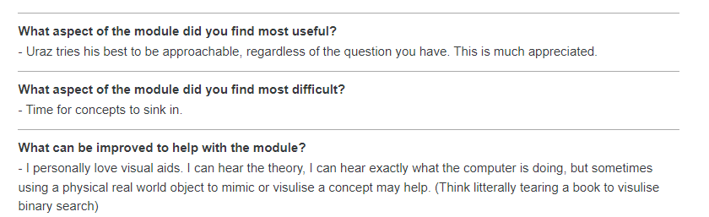
From you

Slide 5
From you

Slide 7
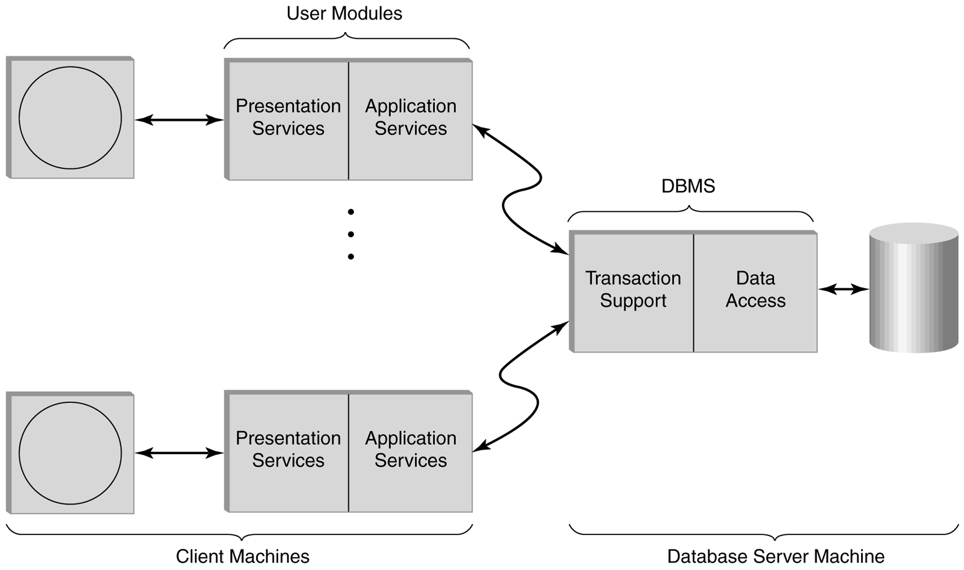
Two-tiered multiuser distributed transaction processing system. Databases and Transaction Processing (Lewis, Bernstein, Kifer)

Slide 8

Anatomy of a transaction
Consider the following scenario: “Player B bought a product that costs £100 from player A; however, during this transaction, the game server also applies interest payments (6%).”
That is, the server should bring the pages containing players’ bank account info to buffer-pool, make the transfer (£100 from bank account B to A), and increase the balances.

Slide 9
Anatomy of a transaction
Consider the following scenario: “Player B bought a product that costs £100 from player A; however, during this transaction, the game server also applies interest payments (6%).”
That is, the server should bring the pages containing players’ bank account info to buffer-pool, make the transfer (£100 from bank account B to A), and increase the balances.
TRANSACTION 1

Slide 10
Anatomy of a transaction
Consider the following scenario: “Player B bought a product that costs £100 from player A; however, during this transaction, the game server also applies interest payments (6%).”
That is, the server should bring the pages containing players’ bank account info to buffer-pool, make the transfer (£100 from bank account B to A), and increase the balances.
TRANSACTION 2

Slide 11
Anatomy of a transaction
Consider the following scenario: “Player B bought a product that costs £100 from player A; however, during this transaction, the game server also applies interest payments (6%).”
That is, the server should bring the pages containing players’ bank account info to buffer-pool, make the transfer (£100 from bank account B to A), and increase the balances.

Slide 12
Anatomy of a transaction
Consider the following scenario: “Player B bought a product that costs £100 from player A; however, during this transaction, the game server also applies interest payments (6%).”
That is, the server should bring the pages containing players’ bank account info to buffer-pool, make the transfer (£100 from bank account B to A), and increase the balances.
From the DBMS point of view, there are two transactions:
UPDATE PLAYERS SET BALANCE=BALANCE+100, WHERE PLAYER NAME=A;
UPDATE PLAYERS SET BALANCE=BALANCE-100, WHERE PLAYER NAME=B;

Slide 13
Anatomy of a transaction
Consider the following scenario: “Player B bought a product that costs £100 from player A; however, during this transaction, the game server also applies interest payments (6%).”
That is, the server should bring the pages containing players’ bank account info to buffer-pool, make the transfer (£100 from bank account B to A), and increase the balances.
From the DBMS point of view, there are two transactions:
UPDATE PLAYERS SET BALANCE=BALANCE+100, WHERE PLAYER NAME=A;
UPDATE PLAYERS SET BALANCE=BALANCE-100, WHERE PLAYER NAME=B;
TRANSACTION 1

Slide 14
Anatomy of a transaction
Consider the following scenario: “Player B bought a product that costs £100 from player A; however, during this transaction, the game server also applies interest payments (6%).”
That is, the server should bring the pages containing players’ bank account info to buffer-pool, make the transfer (£100 from bank account B to A), and increase the balances.
From the DBMS point of view, there are two transactions:
UPDATE PLAYERS SET BALANCE=BALANCE+100, WHERE PLAYER NAME=A;
UPDATE PLAYERS SET BALANCE=BALANCE-100, WHERE PLAYER NAME=B;
UPDATE PLAYERS SET BALANCE=BALANCE*1.06, WHERE PLAYER NAME=A;
UPDATE PLAYERS SET BALANCE=BALANCE*1.06, WHERE PLAYER NAME=B;
TRANSACTION 1

Slide 15
Anatomy of a transaction
Consider the following scenario: “Player B bought a product that costs £100 from player A; however, during this transaction, the game server also applies interest payments (6%).”
That is, the server should bring the pages containing players’ bank account info to buffer-pool, make the transfer (£100 from bank account B to A), and increase the balances.
From the DBMS point of view, there are two transactions:
UPDATE PLAYERS SET BALANCE=BALANCE+100, WHERE PLAYER NAME=A;
UPDATE PLAYERS SET BALANCE=BALANCE-100, WHERE PLAYER NAME=B;
UPDATE PLAYERS SET BALANCE=BALANCE*1.06, WHERE PLAYER NAME=A;
UPDATE PLAYERS SET BALANCE=BALANCE*1.06, WHERE PLAYER NAME=B;
TRANSACTION 1
TRANSACTION 2

Slide 16
Anatomy of a transaction
UPDATE PLAYERS SET BALANCE=BALANCE+100, WHERE PLAYER NAME=A;
UPDATE PLAYERS SET BALANCE=BALANCE-100, WHERE PLAYER NAME=B;
ever, during this transaction, the game server also applies interest payments (6%).”
That is, the server should bring the pages containing players’ bank account info, make the

Slide 17
Anatomy of a transaction
UPDATE PLAYERS SET BALANCE=BALANCE+100, WHERE PLAYER NAME=A;
UPDATE PLAYERS SET BALANCE=BALANCE-100, WHERE PLAYER NAME=B;
ever, during this transaction, the game server also applies interest payments (6%).”
That is, the server should bring the pages containing players’ bank account info, make the
T1: BEGIN A=A+100, B=B-100 END

Slide 18
Anatomy of a transaction
UPDATE PLAYERS SET BALANCE=BALANCE+100, WHERE PLAYER NAME=A;
UPDATE PLAYERS SET BALANCE=BALANCE-100, WHERE PLAYER NAME=B;
ever, during this transaction, the game server also applies interest payments (6%).”
That is, the server should bring the pages containing players’ bank account info, make the UPDATE PLAYERS SET BALANCE=BALANCE*1.06, WHERE PLAYER NAME=A;
UPDATE PLAYERS SET BALANCE=BALANCE*1.06, WHERE PLAYER NAME=B;
T1: BEGIN A=A+100, B=B-100 END

Slide 19
Anatomy of a transaction
UPDATE PLAYERS SET BALANCE=BALANCE+100, WHERE PLAYER NAME=A;
UPDATE PLAYERS SET BALANCE=BALANCE-100, WHERE PLAYER NAME=B;
ever, during this transaction, the game server also applies interest payments (6%).”
That is, the server should bring the pages containing players’ bank account info, make the UPDATE PLAYERS SET BALANCE=BALANCE*1.06, WHERE PLAYER NAME=A;
UPDATE PLAYERS SET BALANCE=BALANCE*1.06, WHERE PLAYER NAME=B;
T1: BEGIN A=A+100, B=B-100 END
T2: BEGIN A=1.06*A, B=1.06*B END

Slide 20
Transactions in SQL
UPDATE PLAYER_NAME
SET au_fname = newName
WHERE au_id = idString
This is an auto-commit transaction with only one statement; there are, as we saw, multi-statement transactions as well.
REF:http://www.sqlteam.com/article/introduction-to-transactions

Slide 21
Concurrency
Interleaving the execution of the operations such as the money transfer and account sum.
Concurrency is needed for performance reasons (ex: using the CPU when somebody else is accessing the disk)
user1
user2
user3
user4
T1: BEGIN A=A+100, B=B-100 END
T2: BEGIN A=1.06*A, B=1.06*B END
Database

Slide 22
Concurrency
A users program may be doing many different operations but from a database point of view, only R/W operations are of interest.
A transaction is the DBMS’s abstract view of a user program: a sequence of reads and writes performed as a single logical unit of work
Ex: Transaction1: Account1 = Account1 + 100
Ex: Transaction1: R(Account1), Write(Account1)
T1: BEGIN A=A+100, B=B-100 END
T2: BEGIN A=1.06*A, B=1.06*B END
A read operation
A data item ‘A’
A data item ‘B’
T1: R(A), W(A), R(B), W(B)
T2: R(A), W(A), R(B), W(B)
T1: R(A), W(A), R(B), W(B)
T2: R(A), W(A), R(B), W(B)
A write operation

Slide 23
Schedules
A schedule is a list of actions from a set of transactions
A well-formed schedule is one where the actions of a particular transaction T are in the same order as they appear in T
For example
There is no guarantee that T1 will execute before T2 or vice versa if both are submitted concurrently.
T1: BEGIN A=A+100, B=B-100 END
T2: BEGIN A=1.06*A, B=1.06*B END
T1: R(A), W(A), R(B), W(B)
T2: R(A), W(A), R(B), W(B)
CPU EXECUTION ORDER: R_{T1}(A), W_{T1}(A), R_{T2}(A), W_{T2}(A), R_{T1}(B), W_{T1}(B), R_{T2}(B), W_{T2}(B)

Slide 24
Schedules cont.
A complete schedule is one that contains an abort or commit action for every transaction that occurs in the schedule
A serial schedule is one where the actions of different transactions are not interleaved

Slide 25
Example
Consider two transactions
Intuitively, the first transaction is transferring £100 from B’s account to A’s account. The second is crediting both accounts with a 6% interest payment.
T1: BEGIN A=A+100, B=B-100 END
T2: BEGIN A=1.06*A, B=1.06*B END

Slide 26
Example (Contd.)
T1: BEGIN A=A+100, B=B-100 END
T2: BEGIN A=1.06*A, B=1.06*B END
Consider a possible interleaving (schedule):
T1: A=A+100, B=B-100
T2: A=1.06*A, B=1.06*B
A=(A+100)*1.06
B=(B-100)*1.06
This is OK. But what about:
T1: A=A+100, B=B-100
T2: A=1.06*A, B=1.06*B
A=(A+100)*1.06
B=(B*1.06)-100
The DBMS’s view of the second schedule:
T1: R(A), W(A), R(B), W(B)
T2: R(A), W(A), R(B), W(B)

Slide 27
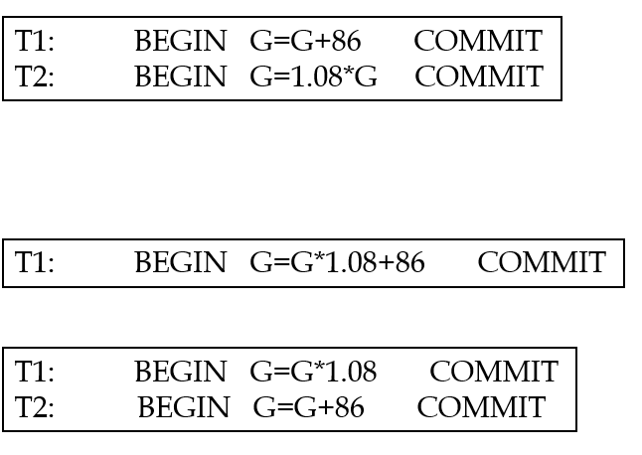

Check your understanding
NOT A SCHEDULE

Slide 28

What was the problem?

Slide 29
Reservation problem
Seinfeld requests a reservation

Slide 30
Reservation problem
Seinfeld requests a reservation
Uraz Requests a reservation

Slide 31
Reservation problem
Seinfeld requests a reservation
Waiter A accepts the reservation
Uraz Requests a reservation

Slide 32
Reservation problem
Seinfeld requests a reservation
Waiter A accepts the reservation
Uraz Requests a reservation
Waiter B accepts the reservation

Slide 33
Reservation problem
Seinfeld requests a reservation
Waiter A accepts the reservation
Uraz Requests a reservation
Waiter B accepts the reservation

Slide 34
Reservation problem
Seinfeld requests a reservation
Waiter A accepts the reservation
Uraz Requests a reservation
Waiter B accepts the reservation
Who came first?

Slide 35
Conflicting operations (tasks)
Two operations are said to be conflicting if all the following conditions are satisfied:
They belong to different transactions
They operate on the same data item
At Least one of them is a write operation
A read operation
A data item ‘A’
A data item ‘B’
T1: R(A), W(A), R(B), W(B)
T2: R(A), W(A), R(B), W(B)
A write operation

Slide 36
How do we avoid conflicts that lead to “Reservation”? The ACID Properties of transactions for concurrency
Atomicity
Consistency
Isolation
Durability

Slide 37
Atomicity of Transactions
A very important property guaranteed by the DBMS for all transactions is that they are atomic. That is, a user can think of a transaction as always executing all its actions in one step, or not executing any actions at all.
DBMS logs all actions so that it can undo the actions of aborted transactions.
LOG
Transaction
Begin
Transaction
Abort
head
rollback

Slide 38
Atomicity of Transactions
A transaction might commit after completing all its actions, or it could abort (or be aborted by the DBMS) after executing some actions.
Transaction
Begin
Transaction
Commit
Transaction
Begin
Transaction
Abort

Slide 39
Consistency
Users are responsible for ensuring transaction consistency
when run to completion against a consistent database instance, the transaction leaves the database consistent
For example, consistency criterion that my inter-account-transfer transaction does not change the total amount of money in the accounts!
Database consistency is the property that every transaction sees a consistent database instance. It follows from transaction atomicity, isolation and transaction consistency
Integrity Constraints!

Slide 40
Isolation
Guarantee that even though transactions may be interleaved, the net effect is identical to executing the transactions serially
For example, if transactions T1 and T2 are executed concurrently, the net effect is equivalent to executing
T1 followed by T2, or
T2 followed by T1
NOTE: The DBMS provides no guarantee of effective order of execution

Slide 41

Durability
DBMS uses the log to ensure durability
If the system crashed before the changes made by a completed transaction are written to disk, the log is used to remember and restore these changes when the system is restarted
Again, this is handled by the recovery manager

Slide 42
Scheduling Transactions
Serial schedule: Schedule that does not interleave the actions of different transactions.
T1
T2
T1: A=A+100, B=B-100 T2: A=1.06*A,B=1.06*B

Slide 43
Scheduling Transactions
Equivalent schedules:
Schedules involving the same set of operations on the same data objects
Schedules that leave database with state after executing them in any order.
Schedule 1
T1: R(A), W(A), R(B), W(B)
T2: R(A), W(A)
Schedule 2
T1: R(A), W(A), R(B), W(B)
T2: R(A), W(A)

Slide 44
Scheduling Transactions
Equivalent schedules:
Schedules with the same set of operations on the same data objects
And, for any database state, the effect (on the set of objects in the database) of executing the first schedule is identical to the effect of executing the second schedule.
DB’
Schedule 1
DB’ = DB’’
DB
DB’’
Schedule 2

Slide 45
Scheduling Transactions
Serializable schedule: A schedule that is equivalent to some serial execution of the transactions.
Schedule 1
T1: R(A), W(A), R(B), W(B)
T2: R(A), W(A)
Serial Schedule A
T1: R(A), W(A), R(B), W(B)
T2: R(A), W(A)
Serial Schedule B
T1: R(A), W(A), R(B), W(B)
T2: R(A), W(A)

Slide 46
Anomalies with Interleaved Execution
Reading Uncommitted Data (WR Conflicts, “dirty reads”):
T1: R(A), W(A), R(B), W(B), Abort
T2: R(A), W(A), C

Slide 47
Anomalies with Interleaved Execution
Unrepeatable Reads (RW Conflicts):
T1: R(A), R(A), W(A), C
T2: R(A), W(A), C

Slide 48
Anomalies with Interleaved Execution
Overwriting Uncommitted Data (WW Conflicts):
T1: W(A), W(B), C
T2: W(A), W(B), C

Slide 49
Lock-Based Concurrency Control
Each transaction must obtain a S (shared) lock on object before reading, and an X (exclusive) lock on object before writing.
An S or X lock is released when the corresponding object is no longer needed.
Ex: T1: S(A), R(A), Release_S(A), X(B), W(B), Release_X(B) …

Slide 50
Lock-Based Concurrency Control
X conflicts with X and S
No transaction can obtain an X lock on an object if some other transaction has an X or S lock on that object.
No transaction can obtain an S lock on an object if some other transaction has an X lock on that object
S locks do not conflict with each other
Multiple transactions may obtain an S lock on the same object

Slide 51
Lock-Based Concurrency Control
Strict Two-phase Locking (Strict 2PL) Protocol:
Each transaction must obtain a S (shared) lock on object before reading, and an X (exclusive) lock on object before writing.
All locks held by a transaction are released when the transaction completes
If a transaction holds an X lock on an object, no other transaction can get a lock (S or X) on that object.
Strict 2PL allows only serializable schedules.

Slide 52
Conflict Serializable Schedules
Two schedules are conflict equivalent if:
Involve the same actions of the same transactions
Every pair of conflicting actions are ordered the same way
Schedule 1
T1: R(A), W(A), R(B), W(B)
T2: R(A), W(A) R(B)
Schedule 2
T1: R(A), W(A), R(B), W(B)
T2: R(A), W(A) R(B)

Slide 53
Conflict Serializable Schedules
Schedule S is conflict serializable if S is conflict equivalent to SOME serial schedule!
Schedule 1
T1: R(A), W(A), R(B), W(B)
T2: R(A), W(A) R(B)
Schedule 2 (serial)
T1: R(A), W(A), R(B), W(B)
T2: R(A), W(A), R(B)

Slide 54
Example
A schedule that is not conflict serializable.
T1: R(A), W(A), R(B), W(B)
T2: R(A), W(A), R(B), W(B)
Schedule
Serial1
T1: R(A), W(A), R(B), W(B)
T2: R(A), W(A), R(B), W(B)
Serial2
T1: R(A), W(A), R(B), W(B)
T2: R(A), W(A), R(B), W(B)

Slide 55
Let’s begin

Slide 56
Previously
A read operation
A data item ‘A’
A data item ‘B’
T1: R(A), W(A), R(B), W(B)
T2: R(A), W(A), R(B), W(B)
A write operation
Transaction: a program in execution, basic database management system process unit.
A transaction consists of a sequence of Read and write operations followed by Commit or Abort.
A multi-user database has to serve more than one user simultaneously, so instead of executing transactions as a whole, it interleaves transactions and processes operations of different transactions.
Interleaving a set of transactions is called a Schedule.
A schedule usually contains operations from number of transactions.
Some of these operations are conflicting
They operate on the same data item,
They belong to different transactions,
One of the operation is a Write operation.
These conflicting operations lead to RW, WR, WW abnormalities (The reservation Problem in Seinfeld)
A Conflicting operation
A Schedule
T1: R(A), W(A), R(B), W(B)
T2: R(A), W(A), R(B), W(B)
CPU EXECUTION ORDER: R_{T1}(A), W_{T1}(A), R_{T2}(A), W_{T2}(A), R_{T1}(B), W_{T1}(B), R_{T2}(B), W_{T2}(B)

Slide 57
Previously
To avoid these issues, we have
Atomicity
Consistency (“leave it as you found it”)
Isolation
Durability
These are implemented by
Obeying integrity constraints (users)
Strict Two-Phase Locking Algorithm
The Recovery Manager.
Strict Two-Phase Locking Algorithm:
Before operating on a data item
Require a Shared Lock (S) to read the data item
Require an Exclusive Lock (X) to write on the data item
Hold all the locks till the transaction Commits or Aborts.
S2PL algorithm leads to Serialisable schedule:
A schedule is called Serialisable iff its execution leads to a DB state that is equivalent to a DB state reached after executing transactions in some serial order.
T1: R(A)W(A), R(B) W(B) T2: R(A)W(A), R(B) W(B)
A serial Schedule

Slide 58
Previously
A Serialisable schedule is very restrictive. We do not need to worry about non-conflicting operations (we do not need to serialise them).
We need to focus on conflicting operations, so we require a conflict schedule equivalent to a serial schedule.
Two schedules are conflict equivalent if:
They involve the same actions of the same transactions
Every pair of conflicting actions are ordered the same way.
How do we check if a schedule is conflict-Serialisable?

Slide 59
How to check conflict serializability?
Precedence graph: (a.k.a serializability graph)
One node per transaction;
edge from Ti to Tj if Ti has a conflicting action with Tj and Ti precedes Tj.

Slide 60
Example
A schedule that is not conflict serializable:
The cycle in the graph reveals the problem. The output of T1 depends on T2, and vice-versa.
Theorem: Schedule is conflict serializable if and only if its presedence graph is acyclic (Proof by contradiction)
T1: R(A), W(A), R(B), W(B)
T2: R(A), W(A), R(B), W(B)
A
T1
T2
Presedence graph
B

Slide 61

Check your Understanding.

Slide 62
Deadlocks
Deadlock: Cycle of transactions waiting for locks to be released by each other (side effect of S2PL).
Two ways of dealing with deadlocks:
Deadlock prevention
Deadlock detection

Slide 63
Deadlock Detection
Create a wait-for graph:
Nodes are transactions
There is an edge from Ti to Tj if Ti is waiting for Tj to release a lock
Periodically check for cycles in the waits-for graph

Slide 64
Deadlock Detection (Continued)
Example:
T1: S(A), R(A), S(B)
T2: X(B),W(B) X(C)
T3: S(C), R(C)
T4: X(B)
T1
T2
T4
T3

Slide 65
Deadlock Detection (Continued)
Example:
T1: S(A), R(A), S(B)
T2: X(B),W(B) X(C)
T3: S(C), R(C)
T4: X(B)
T1
T2
T4
T3

Slide 66
Deadlock Detection (Continued)
Example:
T1: S(A), R(A), S(B)
T2: X(B),W(B) X(C)
T3: S(C), R(C)
T4: X(B)
T1
T2
T4
T3

Slide 67
Deadlock Detection (Continued)
Example:
T1: S(A), R(A), S(B)
T2: X(B),W(B) X(C)
T3: S(C), R(C)
T4: X(B)
T1
T2
T4
T3

Slide 68
Deadlock Detection (Continued)
Example:
T1: S(A), R(A), S(B)
T2: X(B),W(B) X(C)
T3: S(C), R(C) X(B)
T4: X(B)
T1
T2
DEADLOCK!
T4
T3

Slide 69
Deadlock Prevention
Assign priorities based on timestamps. Assume Ti wants a lock that Tj holds. Two policies are possible:
Wait-Die: If Ti has higher priority, Ti waits for Tj; otherwise, Ti aborts
Wound-wait: If Ti has higher priority, Tj aborts; otherwise, Ti waits

Slide 70
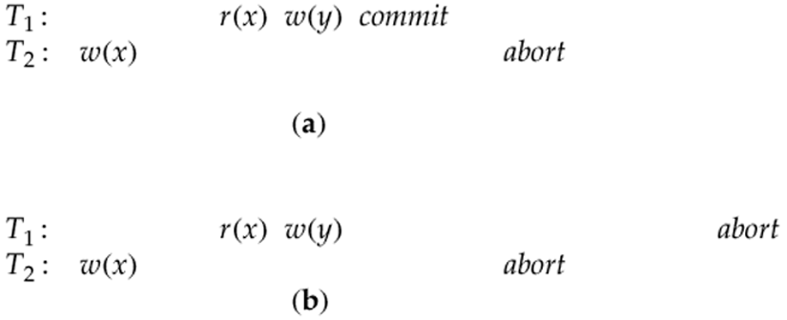
Recorverable schedule
Recoverable schedules: a transaction T is not allowed to Commit until all other transactions that wrote values that T read have committed.
Is a or b recoverable?

Slide 71

Cascading Aborts
Recoverable schedule that illustrates a cascaded abort. T₃ aborts, forcing T₂ to abort, which then forces T₁ to abort. (Cascading Aborts)

Slide 72
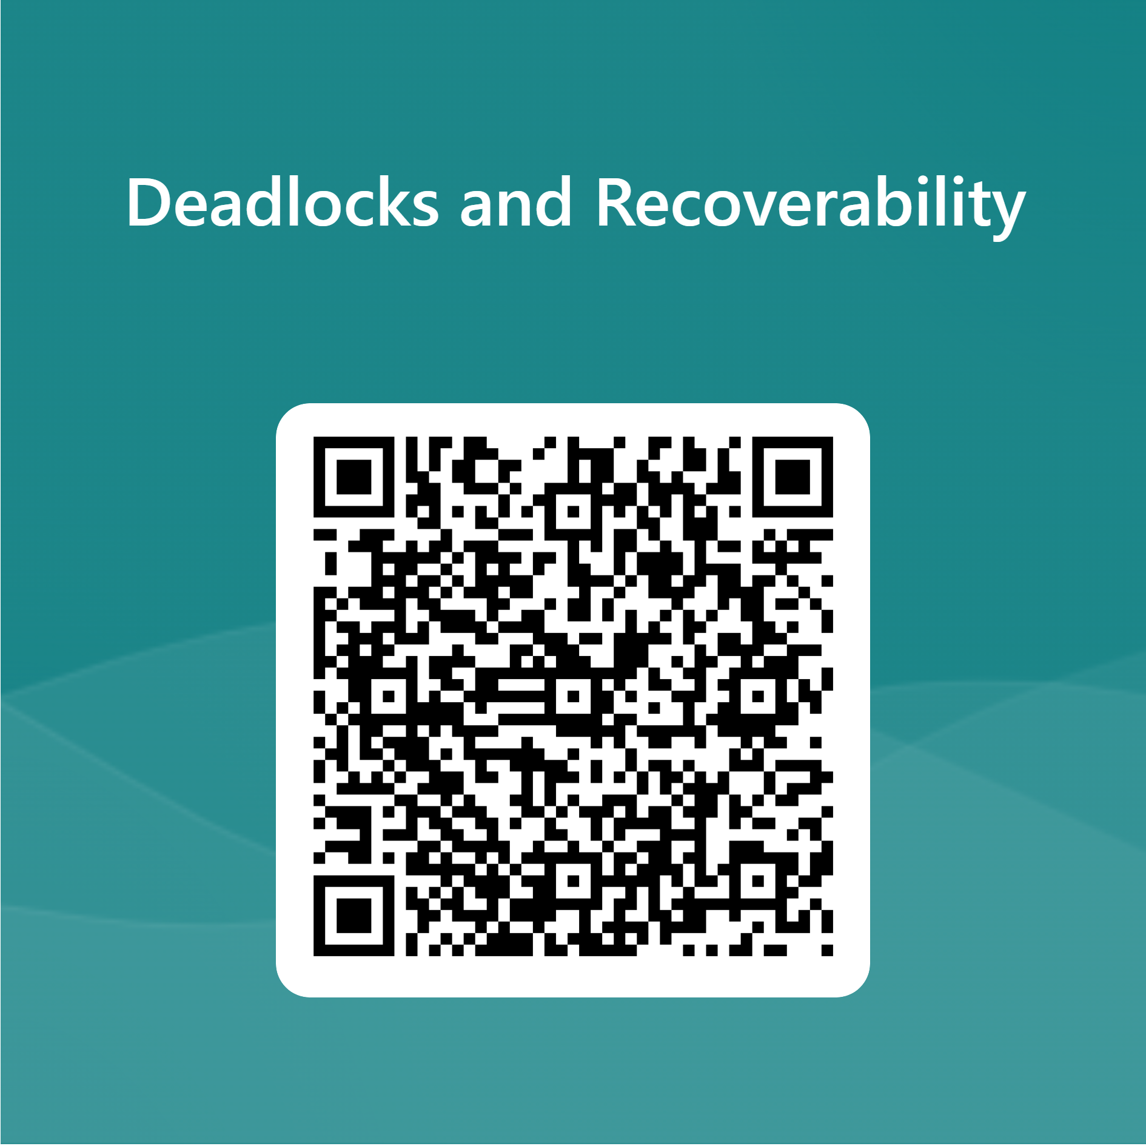
Check your understanding

Slide 73
Aborting a Transaction
If a transaction Ti is aborted,
all its actions have to be undone.
if Tj reads an object last written by Ti, Tj must be aborted as well! (called cascading aborts )
T1: R(A), W(A), R(B), Abort
T2: R(A) ,Abort

Slide 74
Aborting a Transaction
Most systems avoid cascading aborts by releasing a transaction’s locks only at commit time (S2PL).
If Ti writes an object, Tj can read this only after Ti commits.
In order to undo the actions of an aborted transaction, the DBMS maintains a log in which every write is recorded.
Log is also used to recover from system crashes: all active transactions at the time of the crash are aborted when the system comes back up.

Slide 75
System Crashes
System failure due to:
Problem in the processor
Problem in the memory due to a bug
Power loss -> loss of memory (since it is volatile)
In case of system failure, the recovery procedure is executed to restore the database in a consistent state.
Extra measures needed in case of media failure

Slide 76
The Log
The following actions are recorded in the log:
Ti writes an object: the old value and the new value.
Log record must go to disk before the change
Ti commits/aborts: a log record indicating this action.
Log records are chained together by transaction ID, so it’s easy to undo a specific transaction.
Log is often duplexed and archived on stable storage (log).
All log-related activities (and in fact, all CC-related activities such as lock/unlock, dealing with deadlocks etc.) are handled transparently by the DBMS.

Slide 77
Recovering From a Crash
There are 3 phases in the ARIES recovery algorithm/standard:
Analysis: Scan the log forward (from the most recent checkpoint) to identify all active Xacts and dirty pages in the buffer pool at the time of the crash.
Redo: Redoes all updates to dirty pages in the buffer pool, as needed, to ensure that all logged updates are in fact carried out and written to disk.
Undo: The writes of all Xacts that were active at the crash are undone (by restoring the before value of the update, which is in the log record for the update), working backwards in the log. (Some care must be taken to handle the case of a crash occurring during the recovery process!)

Slide 78
Motivation
Atomicity:
Transactions may abort (“Rollback”).
Durability:
What if DBMS stops running
checkpoint
crash!
T1
T2
T3
T4
T5
Desired Behavior after system restarts:
T1, T2 & T3 should be durable.
T4 & T5 should be aborted (effects not seen).
T1:R(A), W(A), R(B), W(B) Commit
T2: R(A), W(A), R(B), W(B) Commit
T3: W(C)Commit
T4: R(D) W(D)
T5: R(E)W(E)

Slide 79
Crash Recovery: Big Picture, ARIES algorithm
Oldest trsct active at crash
Start from a checkpoint (found via master record).
Three phases. Need to:
Figure out which transacts committed since checkpoint, which failed (Analysis), restore Transaction Table, Buffer Pool
REDO all actions.
(repeat history)
UNDO effects of failed transacts.
The oldest dirty page in the buffer
Last chkpt
CRASH
A
R
U

Slide 80
Basic Idea: Logging
Record actions taken in database, in a log.
Sequential writes to log (put it on a separate disk).
Minimal info (diff) written to log, so multiple updates fit in a single log page.
Log: An ordered list of actions
Log record contains:
<TID, pageID, offset, length, old data, new data>
and additional control info (which we’ll see soon).

Slide 81
Type of Log Records in the Log
Possible log record types:
Update
Commit
Abort
End (signifies the end of commit or abort)
Compensation Log Records (CLRs)
for UNDO actions
LogRecord fields:
LSN
prevLSN
TID
type
pageID
update
records
only
length
offset
before-image
after-image
T1:(LSN=1)W(A) (prevLSN=1), (LSN=3) W(B) (prevLSN=1)
T2: (LSN=2), W(A) (prevLSN=2), (LSN=4) W(B) (prevLSN=2)

Slide 82
The Big Picture: What’s Stored Where?
LOG
RAM
DB
LogRecords
LSN
prevLSN
TID
type
pageID
length
offset
before-image
after-image

Slide 83

Check your understanding

Slide 84
WHEN TO COMMIT LOG RECORDS!! Write-Ahead Logging (WAL)
Log records
flushed to log
The Write-Ahead Logging Protocol:
1) Must force the log record for an update before the corresponding data page gets to disk.
2) Must write all log records for a transaction before commit.
#1 guarantees Atomicity.
#2 guarantees Durability.
“Log tail”
in RAM

Slide 85
WAL & the Log
DB
RAM
LSNs
pageLSNs
flushedLSN
Each log record has a unique Log Sequence Number (LSN).
LSNs are always increasing.
Each data page contains a pageLSN.
The LSN of the most recent log record for an update to that page.
System keeps track of flushedLSN.
The max LSN flushed so far.
WAL: Before a page is written,
pageLSN ≤ flushedLSN
Log records
flushed to disk
pageLSN
“Log tail”
in RAM

Slide 86
Other Log-Related State
Transaction Table:
One entry per active transaction
Contains TID, status (running/commited/aborted), and lastLSN.
Dirty Page Table:
One entry per dirty page in buffer pool.
Contains recLSN -- the LSN of the log record which first caused the page to be dirty.
recLSN(A)=1, recLSN(B)=3
T1:(LSN=1)W(A) (prevLSN=1), (LSN=3) W(B) (prevLSN=1) lastLSN=3
T2: (LSN=2), W(A) (prevLSN=2), (LSN=4) W(B) (prevLSN=2) lastLSN=4

Slide 87
The Big Picture: What’s Stored Where
LOG
RAM
DB
LogRecords
Data Pages
each
with a
pageLSN: most recent log made changes
transact Table
lastLSN
status
Dirty Page Table
recLSN
flushedLSN
LSN
prevLSN
TID
type
pageID
length
master record
offset
before-image
after-image

Slide 88
Checkpointing
Periodically, the DBMS creates a checkpoint, in order to minimize the time taken to recover in the event of a system crash. Write to log:
begin_checkpoint record: Indicates when chkpt began.
end_checkpoint record: Contains current transact table and dirty page table. This is a `fuzzy checkpoint’:
Other transactions continue to run, so these tables are accurate only as of the time of the begin_checkpoint record.
Store the LSN of the chkpt record in a safe place (master record).

Slide 89
Simple Transaction Abort
For now, consider an explicit abort of a transaction.
No crash involved.
We want to “play back” the log in reverse order, UNDOing updates.
Get lastLSN of transact from transact table.
Can follow the chain of log records backwards via the prevLSN field.
T1
kill_count = kill_count +5;
Ammo = Ammo – 1500;
Money = Money – £1.000.000
Damage = Damage + 100800
Abort
T1
LSN =1, prevLSN=1
LSN = 2 prevLSN=1
LSN = 3 prevLSN=2
LSN = 4 prevLSN=3

Slide 90
Abort, cont.
To perform UNDO, must have a lock on data!
No problem!
Before restoring old value of a page, write a CLR:
You continue logging while you UNDO!!
CLR has one extra field: undonextLSN
Points to the next LSN to undo (i.e. the prevLSN of the record we’re currently undoing).
CLRs never Undone (but they might be Redone when repeating history: guarantees Atomicity!)
At end of UNDO, write an “end” log record.
T1:(LSN=1)R(kill_count)W(kill_count) (prevLSN=1), (LSN=2) R(Ammo)W(Ammo)(prevLSN=1)…
(LSN=3)R(Money)W(Money) (prevLSN=2), (LSN=4)R(Damage)W(Damage) (prevLSN=3),lastLSN=4

Slide 91
Undoing..
T1
(LSN=1)R(kill_count)W(kill_count) (prevLSN=1), (LSN=2) R(Ammo)W(Ammo)(prevLSN=1)…
(LSN=3)R(Money)W(Money) (prevLSN=2), (LSN=4)R(Damage)W(Damage) (prevLSN=3),lastLSN=4
lastLSN(CLR)
undonextLSN = 2
lastLSN(CLR)
undonextLSN = 3
Undo Damage +100800
Undo Money -£1.000.000

Slide 92
Transaction Commit
Write commit type log to log.
All log records up to transact’s lastLSN are flushed.
Guarantees that flushedLSN <= lastLSN.
Note that log flushes are sequential, synchronous writes to disk.
Many log records per log page.
Commit() returns.
Write end type log record to log.

Slide 93
Crash Recovery: Big Picture, ARIES algorithm
Oldest log rec. of trsct active at crash
Start from a checkpoint (found via master record).
Three phases. Need to:
Figure out which transacts committed since checkpoint, which failed (Analysis), restore Transaction Table, Buffer Pool
REDO all actions.
(repeat history)
UNDO effects of failed transacts.
Smallest recLSN in dirty page table after Analysis
Last chkpt
CRASH
A
R
U

Slide 94
Recovery: The Analysis Phase
Reconstruct state (TransactionTable, Buffer Pool)at checkpoint.
via end_checkpoint record.
Scan log forward from checkpoint.
End log record: Remove trans from Trans table.
Other records: If not exists add transaction to Transaction table, set lastLSN=LSN, change transaction status to C if it is commit.
Update record: If page P is not in Dirty Page Table, Add P to D.P.T., set its recLSN=LSN.

Slide 95
Recovery: The REDO Phase
We repeat History to reconstruct the state of the crash:
Reapply all updates (even of aborted transacts!), and redo CLRs (that is, redo the undo’s).
Scan forward from the log containing the smallest recLSN in D.P.T.
For each CLR or update log LSN, REDO the action if the page is NOT more uptodate than this record:
REDO when an Affected page is in D.P.T. and has pageLSN (in DB) <LSN. [if page has recLSN > LSN, no need to read a page in from disk to check pageLSN]
To REDO an action:
Reapply logged action.
Set pageLSN to LSN. No additional logging!

Slide 96
Recovery: The UNDO Phase
ToUndo={ l | l a lastLSN of a “loser” Trans}
Repeat:
Choose largest LSN among ToUndo.
If this LSN is a CLR and undonextLSN==NULL
Write an End record for this trans.
If this LSN is a CLR, and undonextLSN != NULL
Add undonextLSN to ToUndo
Else this LSN is an update. Undo the update, write a CLR, add prevLSN to ToUndo.
Until ToUndo is empty.

Slide 97
Summary of Logging/Recovery
Recovery Manager guarantees Atomicity & Durability.
Use WAL to allow STEAL/NO-FORCE.
LSNs identify log records; linked into backwards chains per transaction (via prevLSN).
pageLSN allows comparison of data page and log records.

Slide 98
Summary, Cont.
Checkpointing: A quick way to limit the amount of log to scan on recovery.
Recovery works in 3 phases:
Analysis: Forward from checkpoint.
Redo: Forward from oldest recLSN.
Undo: Backward from end to first LSN of oldest transact alive at crash.
Upon Undo, write CLRs.
Redo “repeats history”: Simplifies the logic!
Question: What happens if DBMS UNDOING during the CRASH!

