Slide 1
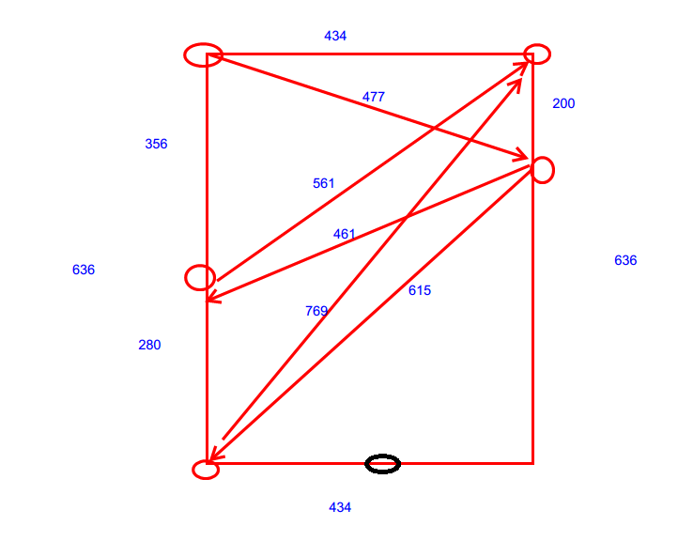
0x1
0x6
1
126
3
280
0x3
250
0x5

