Slide 1
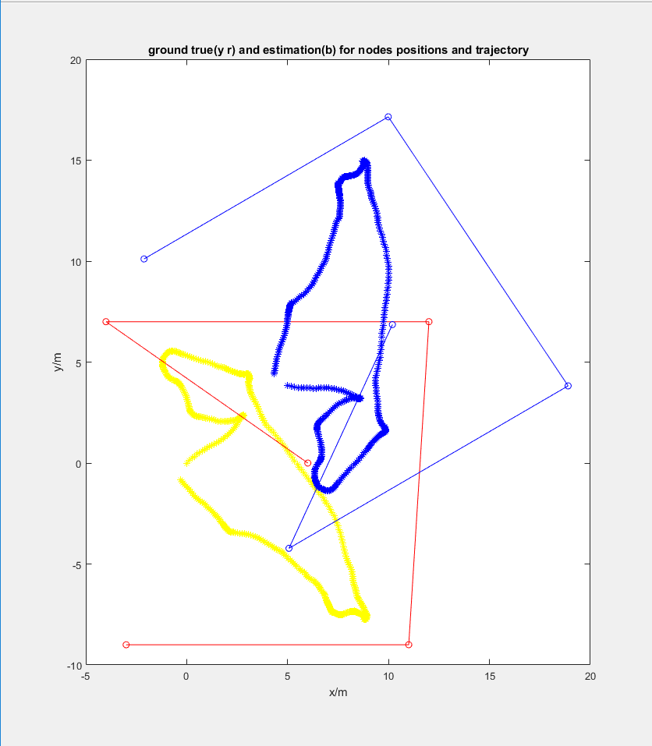
simulation result

Slide 2
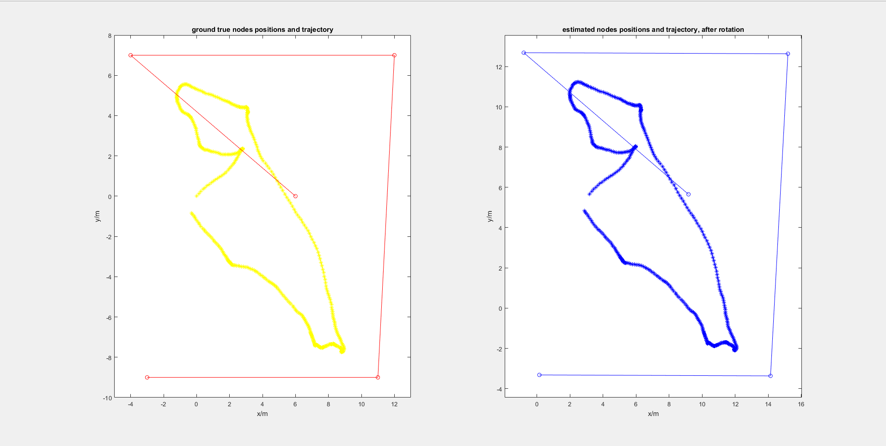
after rotation

Slide 3
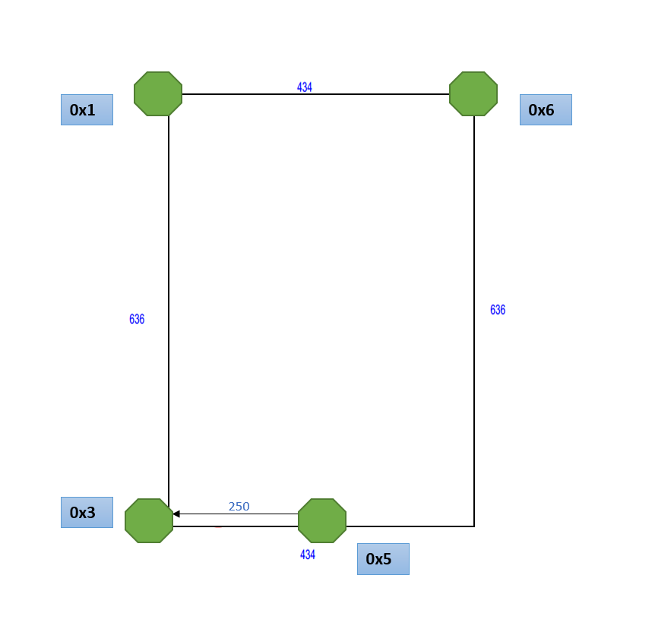
experiment: true position of the nodes

Slide 4
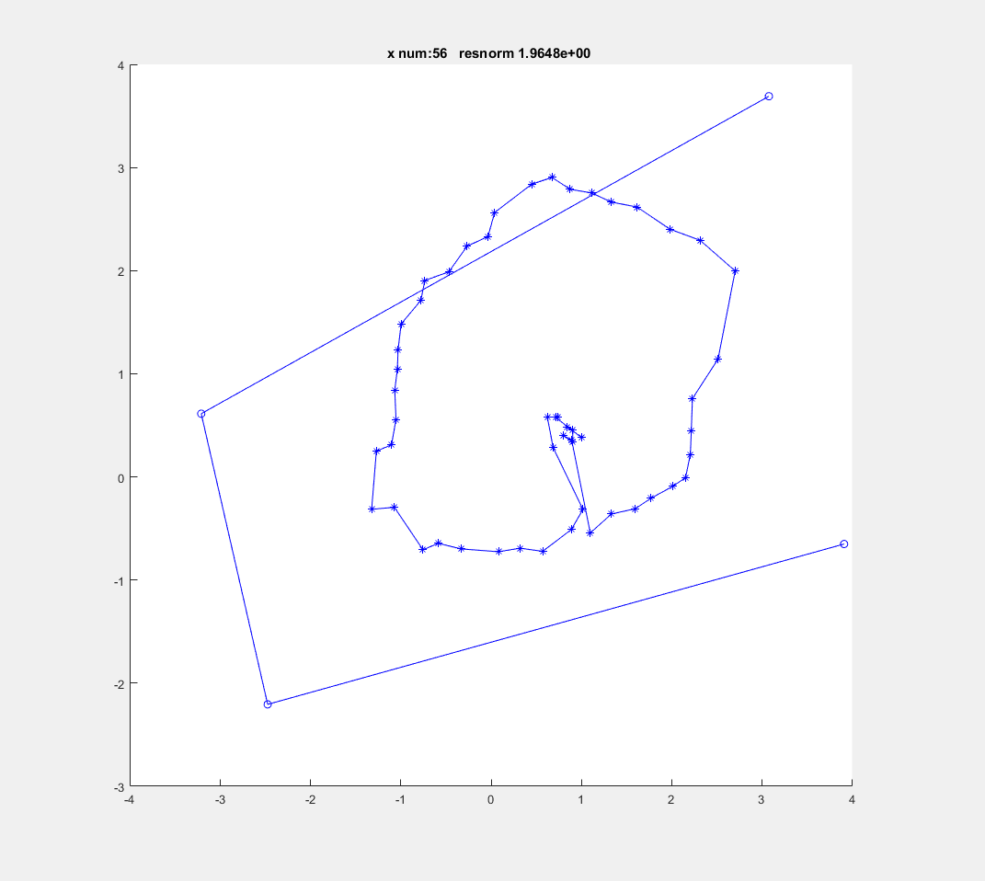
self_calibration algorithm output
with hardware collected data

Slide 5
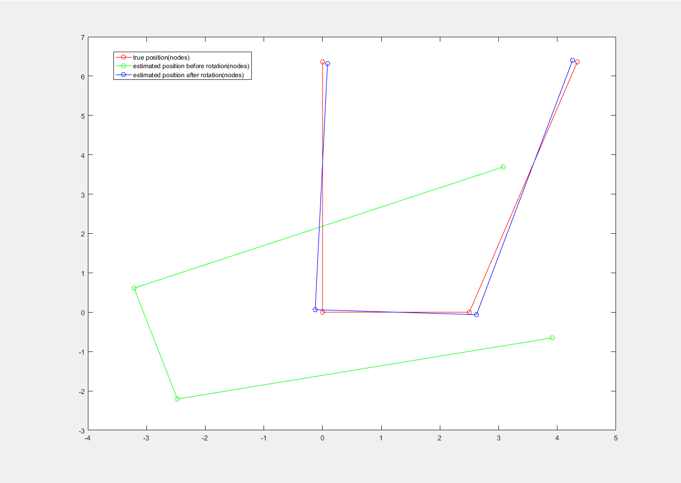
rotation with only nodes

Slide 6
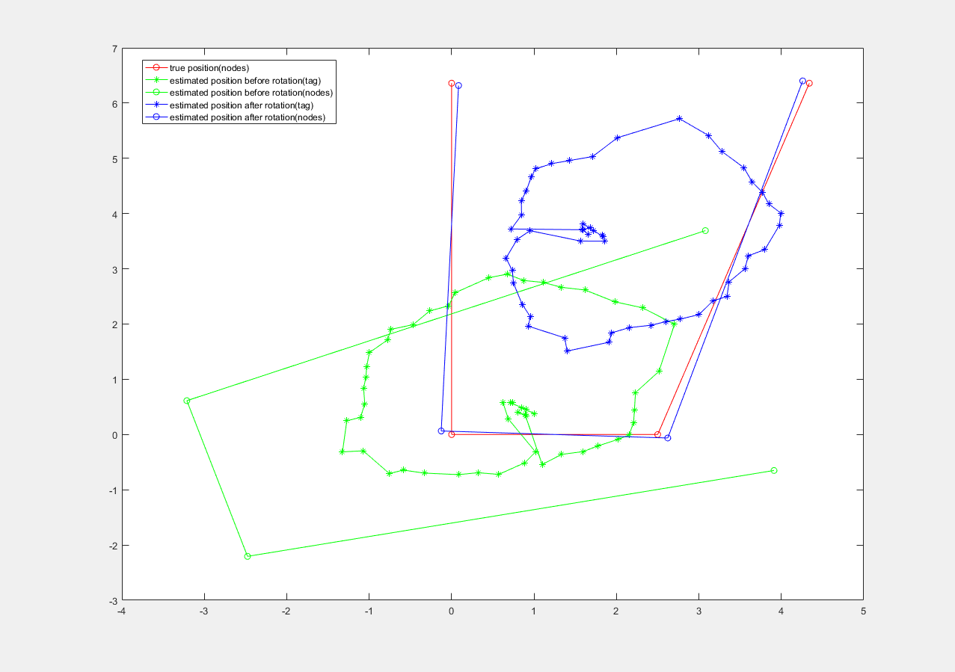
rotation with tag trajectory and nodes

