Slide 1
Indoor Localization based on
Extended Kalman Filter and
Calibration-free method
Authors:
Supervisors:
Examinors:
Yitong Quan
Dr.-Ing. Fabian Höflinger
Dr.-Ing. Rui Zhang
Prof. Dr. Leonhard Reindl
Dr. Rüdiger Quay

Slide 2
Outline
Motivation
Scope of Work
Result
Conclusion
2/12/1016
Detection of Principal Directions in Unknown Environments for Autonomous Navigation

Slide 3
Outline
Motivation
Scope of Work
Result
Conclusion
2/12/1016
Detection of Principal Directions in Unknown Environments for Autonomous Navigation

Slide 4

Motivation
Aim:
accurate localization
task 1
Data Collection
task 2
Algorithm Develop
2/12/1016
Detection of Principal Directions in Unknown Environments for Autonomous Navigation

Slide 5
Motivation - data collection
GPS
outdoor
Utral-Sound
indoor +
not interfere with electromagnetic waves+
multipath(NLOS) -
UWB
indoor+
penetrating through((NLOS))+
not affected other devices due to its high bandwidth +
2/12/1016
Detection of Principal Directions in Unknown Environments for Autonomous Navigation

Slide 6
Motivation - algorithm development
more robust: random noise, multipath, system error, data missing
less information needed: nodes positions
2/12/1016
Detection of Principal Directions in Unknown Environments for Autonomous Navigation

Slide 7
Outline
Motivation
Scope of Work
Result
Conclusion
2/12/1016
Detection of Principal Directions in Unknown Environments for Autonomous Navigation

Slide 8
Scope of Work
Hardware Improvement
1, sampling rate
2, date obtained rate
Algorithm
Development
1, EKF
2, EKF with seperate way
3, self-calibration localization
2/12/1231
Detection of Principal Directions in Unknown Environments for Autonomous Navigation

Slide 9
Scope of Work
Hardware Improvement
1, sampling rate
2, date obtained rate
Algorithm
Development
1, EKF
2, EKF with seperate way
3, self-calibration localization
2/12/1231
Detection of Principal Directions in Unknown Environments for Autonomous Navigation

Slide 10
Scope of Work - Hardware Improvement
improvement achieved by
loop end condition added
Energy mode changed
mutex(mutual exclusion) added
2/12/1016
Detection of Principal Directions in Unknown Environments for Autonomous Navigation

Slide 11
Scope of Work - Hardware Improvement
loop end condition added
before
only RTC
after
RTC
boolean to detect the tasks accomplishment
2/12/1016
Detection of Principal Directions in Unknown Environments for Autonomous Navigation

Slide 12
Scope of Work - Hardware Improvement
improvement achieved by
loop end condition added
Energy mode changed
mutex(mutual exclusion) added
2/12/1016
Detection of Principal Directions in Unknown Environments for Autonomous Navigation

Slide 13
Scope of Work - Hardware Improvement
Energy mode changed
before
EM3 (Energy Mode)
after
EM2 (Energy Mode)
 | EM3 | EM2
low-frequency oscillator | off | on
RTC | off | on
WDOG | off | on
consumption | 0.5 µA | 0.9 µA
2/12/1016
Detection of Principal Directions in Unknown Environments for Autonomous Navigation

Slide 14
Scope of Work - Hardware Improvement
improvement achieved by
loop end condition added
Energy mode changed
mutex(mutual exclusion) added
2/12/1016
Detection of Principal Directions in Unknown Environments for Autonomous Navigation

Slide 15
Scope of Work - Hardware Improvement
mutex(mutual exclusion) added
l
2/12/1016
Detection of Principal Directions in Unknown Environments for Autonomous Navigation

Slide 16
Scope of Work - Hardware Improvement
Energy mode changed
before
EM3 (Energy Mode)
after
EM2 (Energy Mode)
 | EM3 | EM2
low-frequency oscillator | off | on
RTC | off | on
WDOG | off | on
consumption | 0.5 µA | 0.9 µA
2/12/1016
Detection of Principal Directions in Unknown Environments for Autonomous Navigation

Slide 17
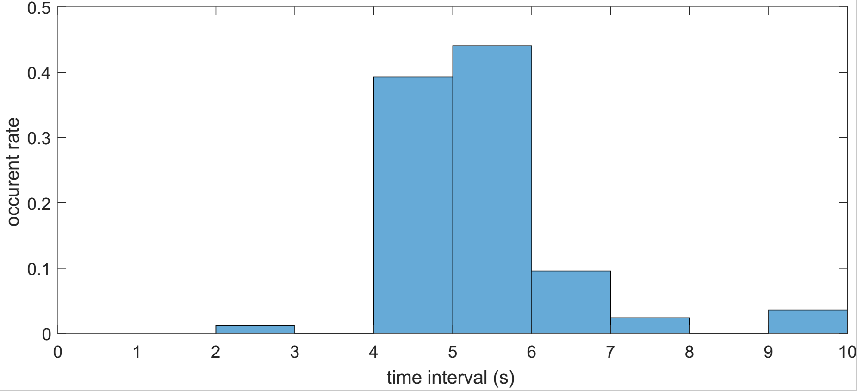
Scope of Work - Hardware Improvement
- sampling rate
time interval of each sampling cycle (before)
mean: 5.2s 0.2Hz
in details (numbers)
2/12/1016
Detection of Principal Directions in Unknown Environments for Autonomous Navigation

Slide 18
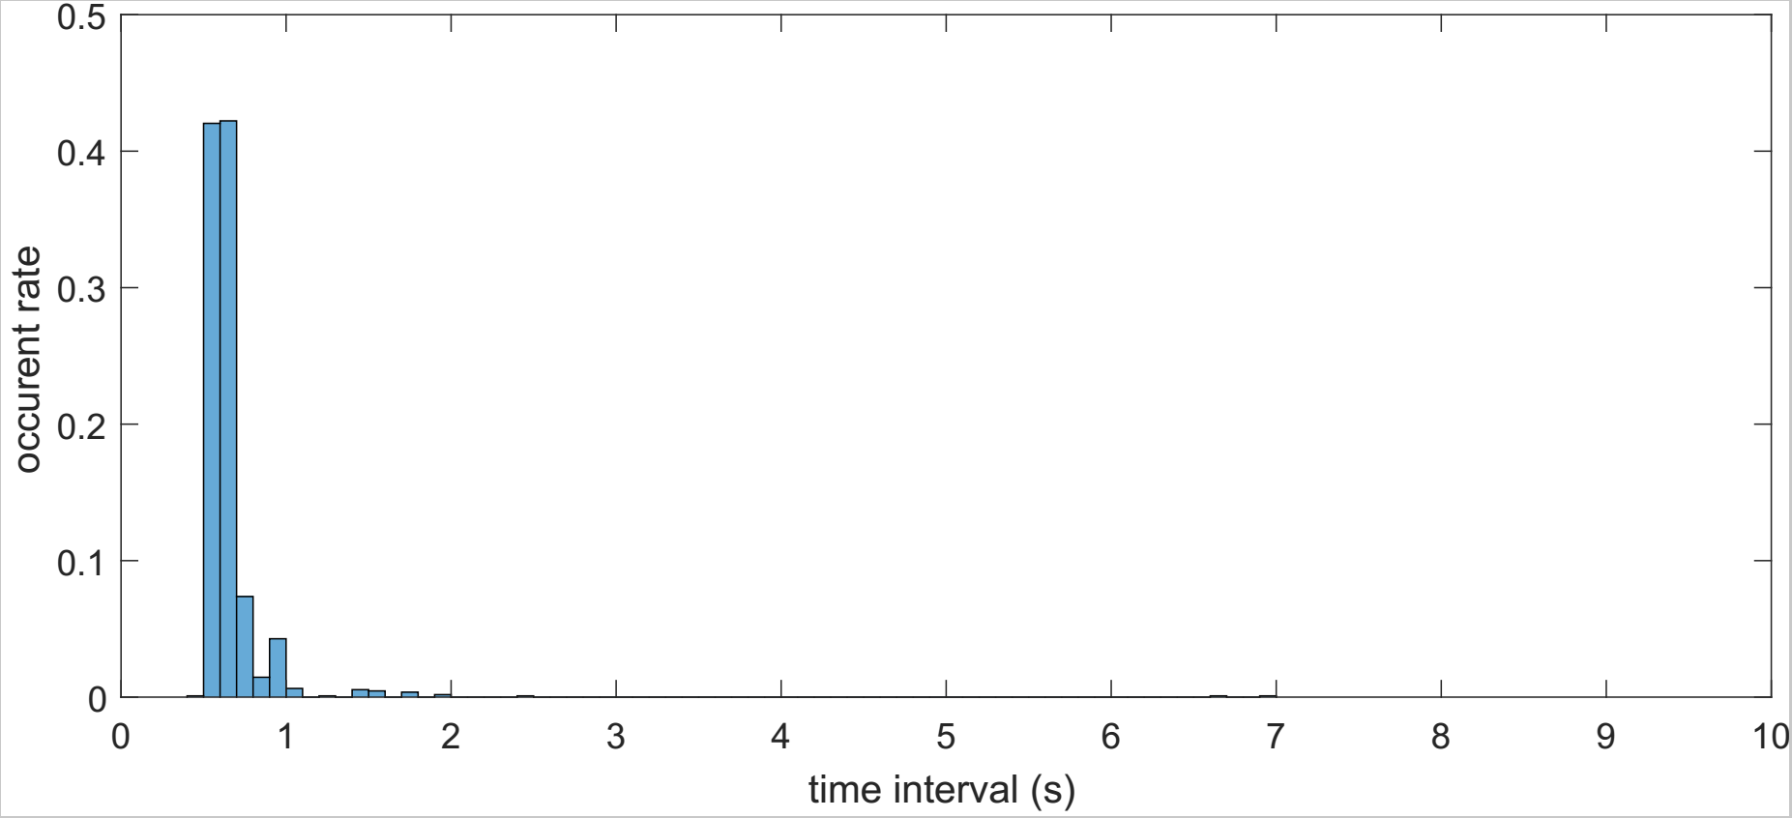
Scope of Work - Hardware Improvement
- sampling rate
time interval of each sampling cycle (after)
mean: 0.7s 1.5Hz
before
after
2/12/1016
Detection of Principal Directions in Unknown Environments for Autonomous Navigation

Slide 19
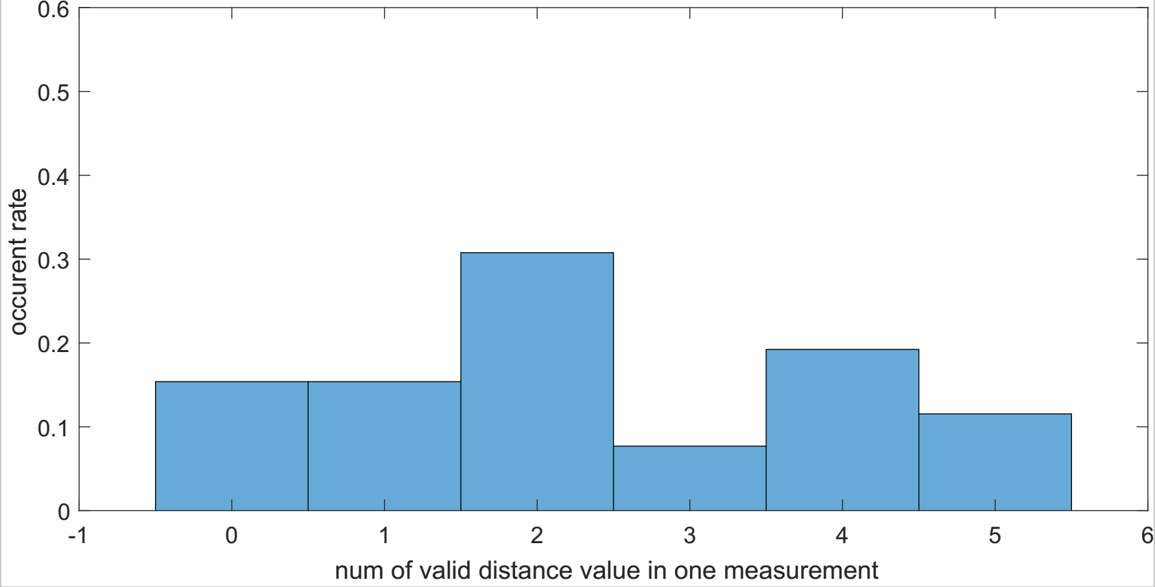
Scope of Work - Hardware Improvement
- date obtained rate
date obtained rate comparision (before)
before
after
2/12/1016
Detection of Principal Directions in Unknown Environments for Autonomous Navigation

Slide 20
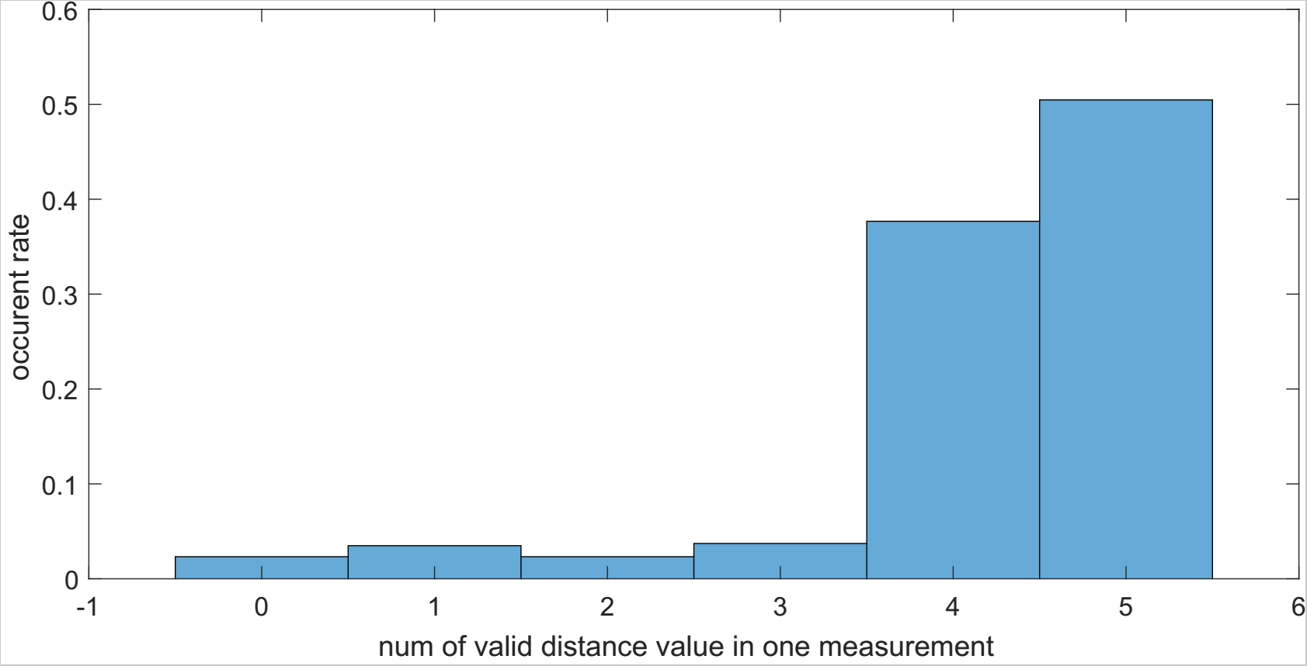
Scope of Work - Hardware Improvement
- sampling rate
date obtained rate comparision (after)
in details (numbers)
1
2/12/1016
Detection of Principal Directions in Unknown Environments for Autonomous Navigation

Slide 21
Scope of Work - Algorithm Development
Algorithm Development
1, EKF
2, EKF with seperate way
3, self-calib
2/12/1016
Detection of Principal Directions in Unknown Environments for Autonomous Navigation

Slide 22
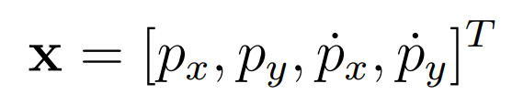


Scope of Work - Algorithm Development
- EKF
state vactor
state transition model
observation model
a
2/12/1016
Detection of Principal Directions in Unknown Environments for Autonomous Navigation

Slide 23
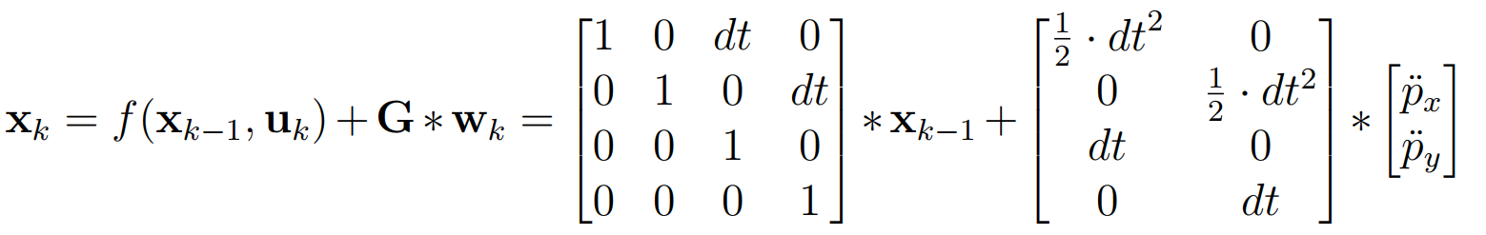
Scope of Work - Algorithm Development
state transition model
2/12/1016
Detection of Principal Directions in Unknown Environments for Autonomous Navigation

Slide 24
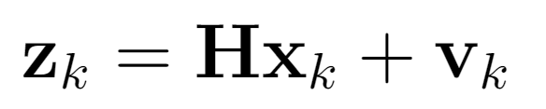
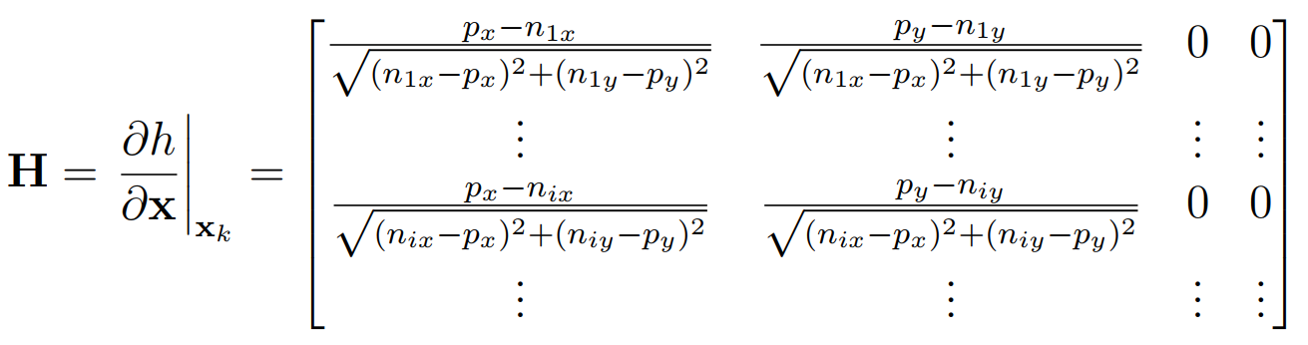
Scope of Work - Algorithm Development
observation model
2/12/1016
Detection of Principal Directions in Unknown Environments for Autonomous Navigation

Slide 25
Scope of Work - Algorithm Development
Algorithm Development
1, EKF
2, EKF with seperate way
3, self-calib
2/12/1016
Detection of Principal Directions in Unknown Environments for Autonomous Navigation

Slide 26
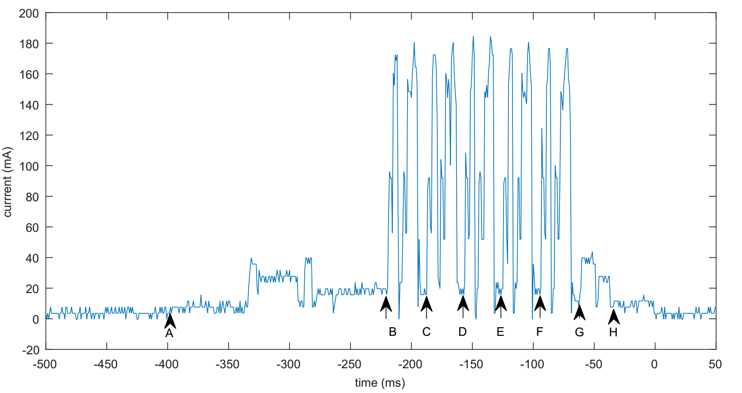

Scope of Work - Algorithm Development
sampling cycle of mobile tag (with 5 anchor nodes)
+1
+2
2/12/1016
Detection of Principal Directions in Unknown Environments for Autonomous Navigation

Slide 27
Scope of Work - Algorithm Development
update using one measurements set (contains 5 measurements)
normal EKF
EKF with seperate way
+4
+3
+1
+2
2/12/1016
Detection of Principal Directions in Unknown Environments for Autonomous Navigation

Slide 28
Scope of Work - Algorithm Development
- self-calibration
localize the nodes and tag simultaneous
allow the absent of the positions of the node
2/12/1016
Detection of Principal Directions in Unknown Environments for Autonomous Navigation

Slide 29





Scope of Work - Algorithm Development
- self-calibration
unknow: n anchor nodes
m samples from tag's trajectory
in total variables
known: distace values
equation system can be solved when
2/12/1016
Detection of Principal Directions in Unknown Environments for Autonomous Navigation

Slide 30
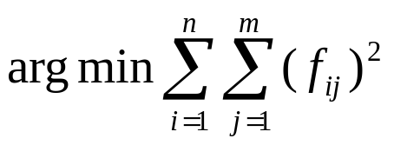
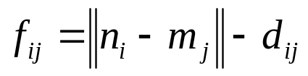
Scope of Work - Algorithm Development
- self-calibration
optimization method (Levenberg-Marquardt algorithm)
2/12/1016
Detection of Principal Directions in Unknown Environments for Autonomous Navigation

Slide 31
Outline
Motivation
Scope of Work
Result
Conclusion
2/12/1016
Detection of Principal Directions in Unknown Environments for Autonomous Navigation

Slide 32
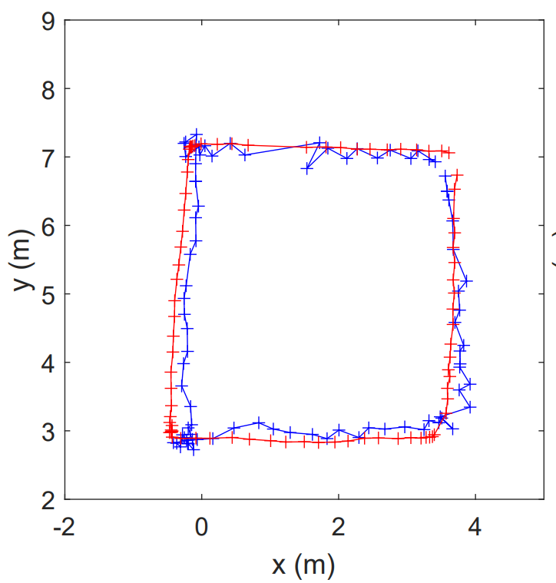
Result - EKF
a
2/12/1016
Detection of Principal Directions in Unknown Environments for Autonomous Navigation

Slide 33
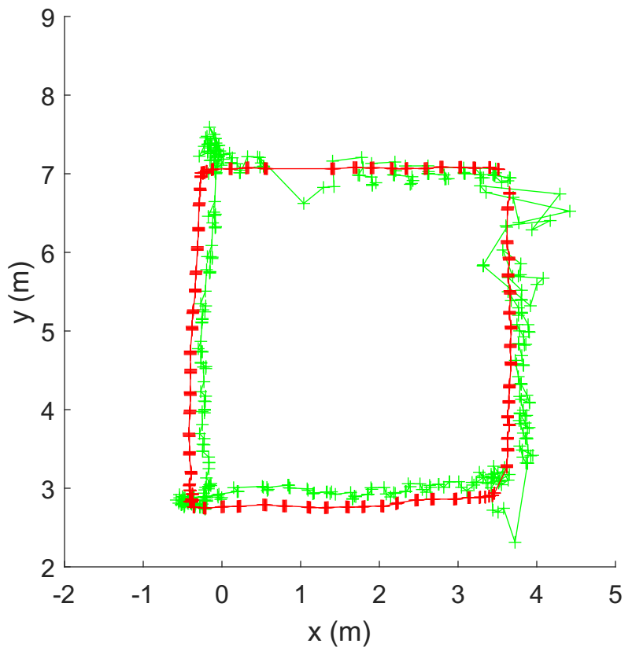
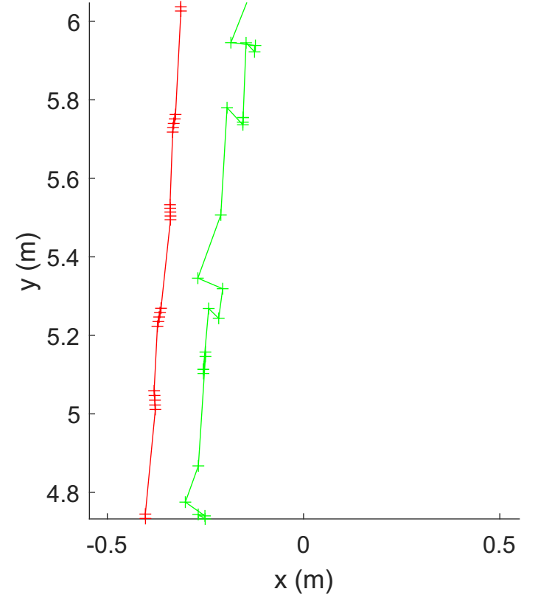
Result - EKF with seperate way
a
a
2/12/1016
Detection of Principal Directions in Unknown Environments for Autonomous Navigation

Slide 34
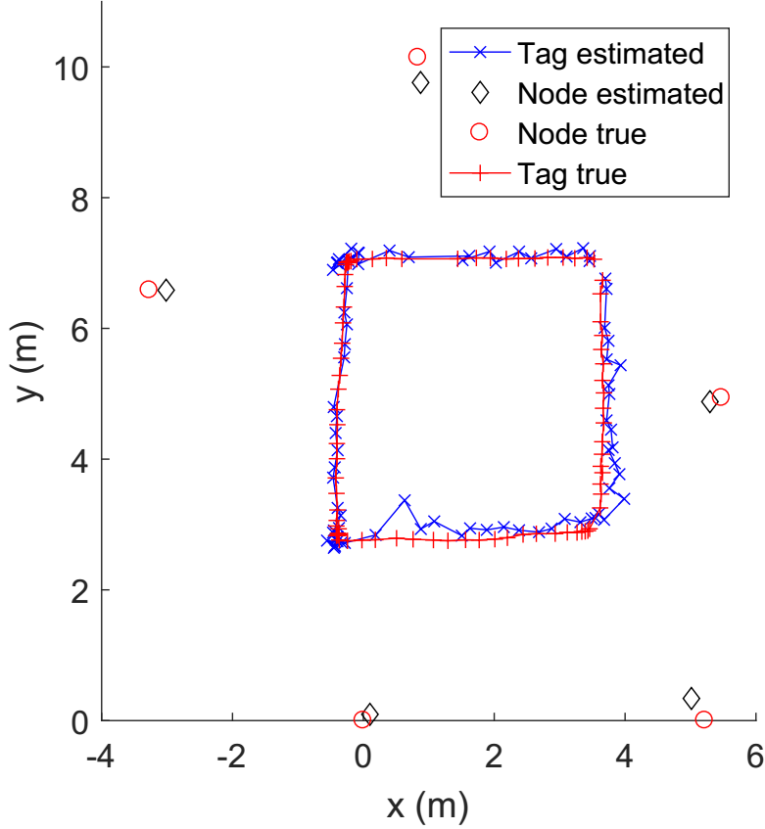
Result - self-calibration
2/12/1016
Detection of Principal Directions in Unknown Environments for Autonomous Navigation

Slide 35
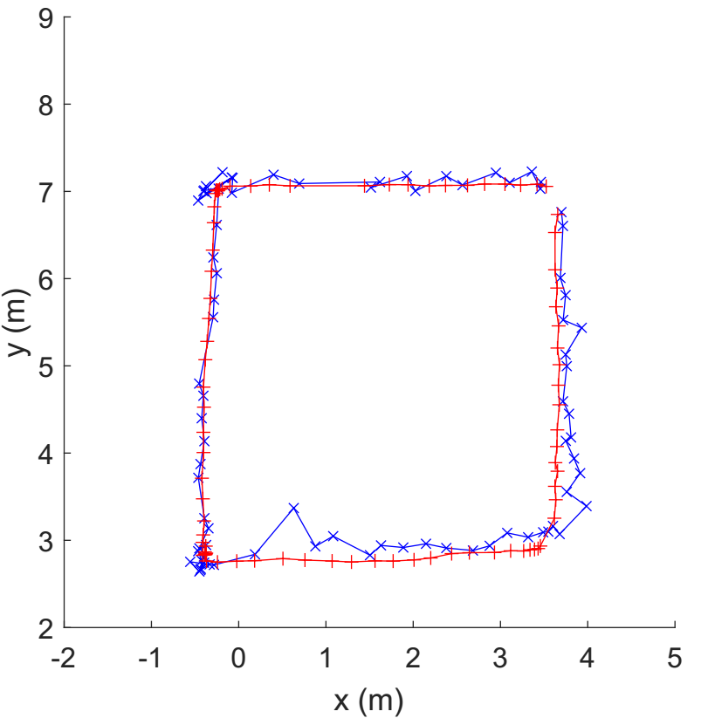
Result - comparision
EKF self-calibration
2/12/1016
Detection of Principal Directions in Unknown Environments for Autonomous Navigation

Slide 36
Outline
Motivation
Scope of Work
Result
Conclusion
2/12/1016
Detection of Principal Directions in Unknown Environments for Autonomous Navigation

Slide 37
Conclusion
Hardware: sampling rate increased
data obtained rate increased
Algorithm: 3 algorithms built
recover trajectory succeed
2/12/1016
Detection of Principal Directions in Unknown Environments for Autonomous Navigation

Slide 38
The End
Thank you for your attention!
2/12/1016
Detection of Principal Directions in Unknown Environments for Autonomous Navigation

Slide 39
needed to be done PPT
页尾》 时间。标题
rename EKF with seperate way
2/12/1016
Detection of Principal Directions in Unknown Environments for Autonomous Navigation

Slide 40
请在此处添加标题
sdadsa
asda
asd
a
a
a

Slide 41
sdadsa
asda
asd
a
a
a

Slide 42
Outline
Motivation
Approach
Result
Path Planning
Conclusion
2/12/1016
Detection of Principal Directions in Unknown Environments for Autonomous Navigation

Slide 43
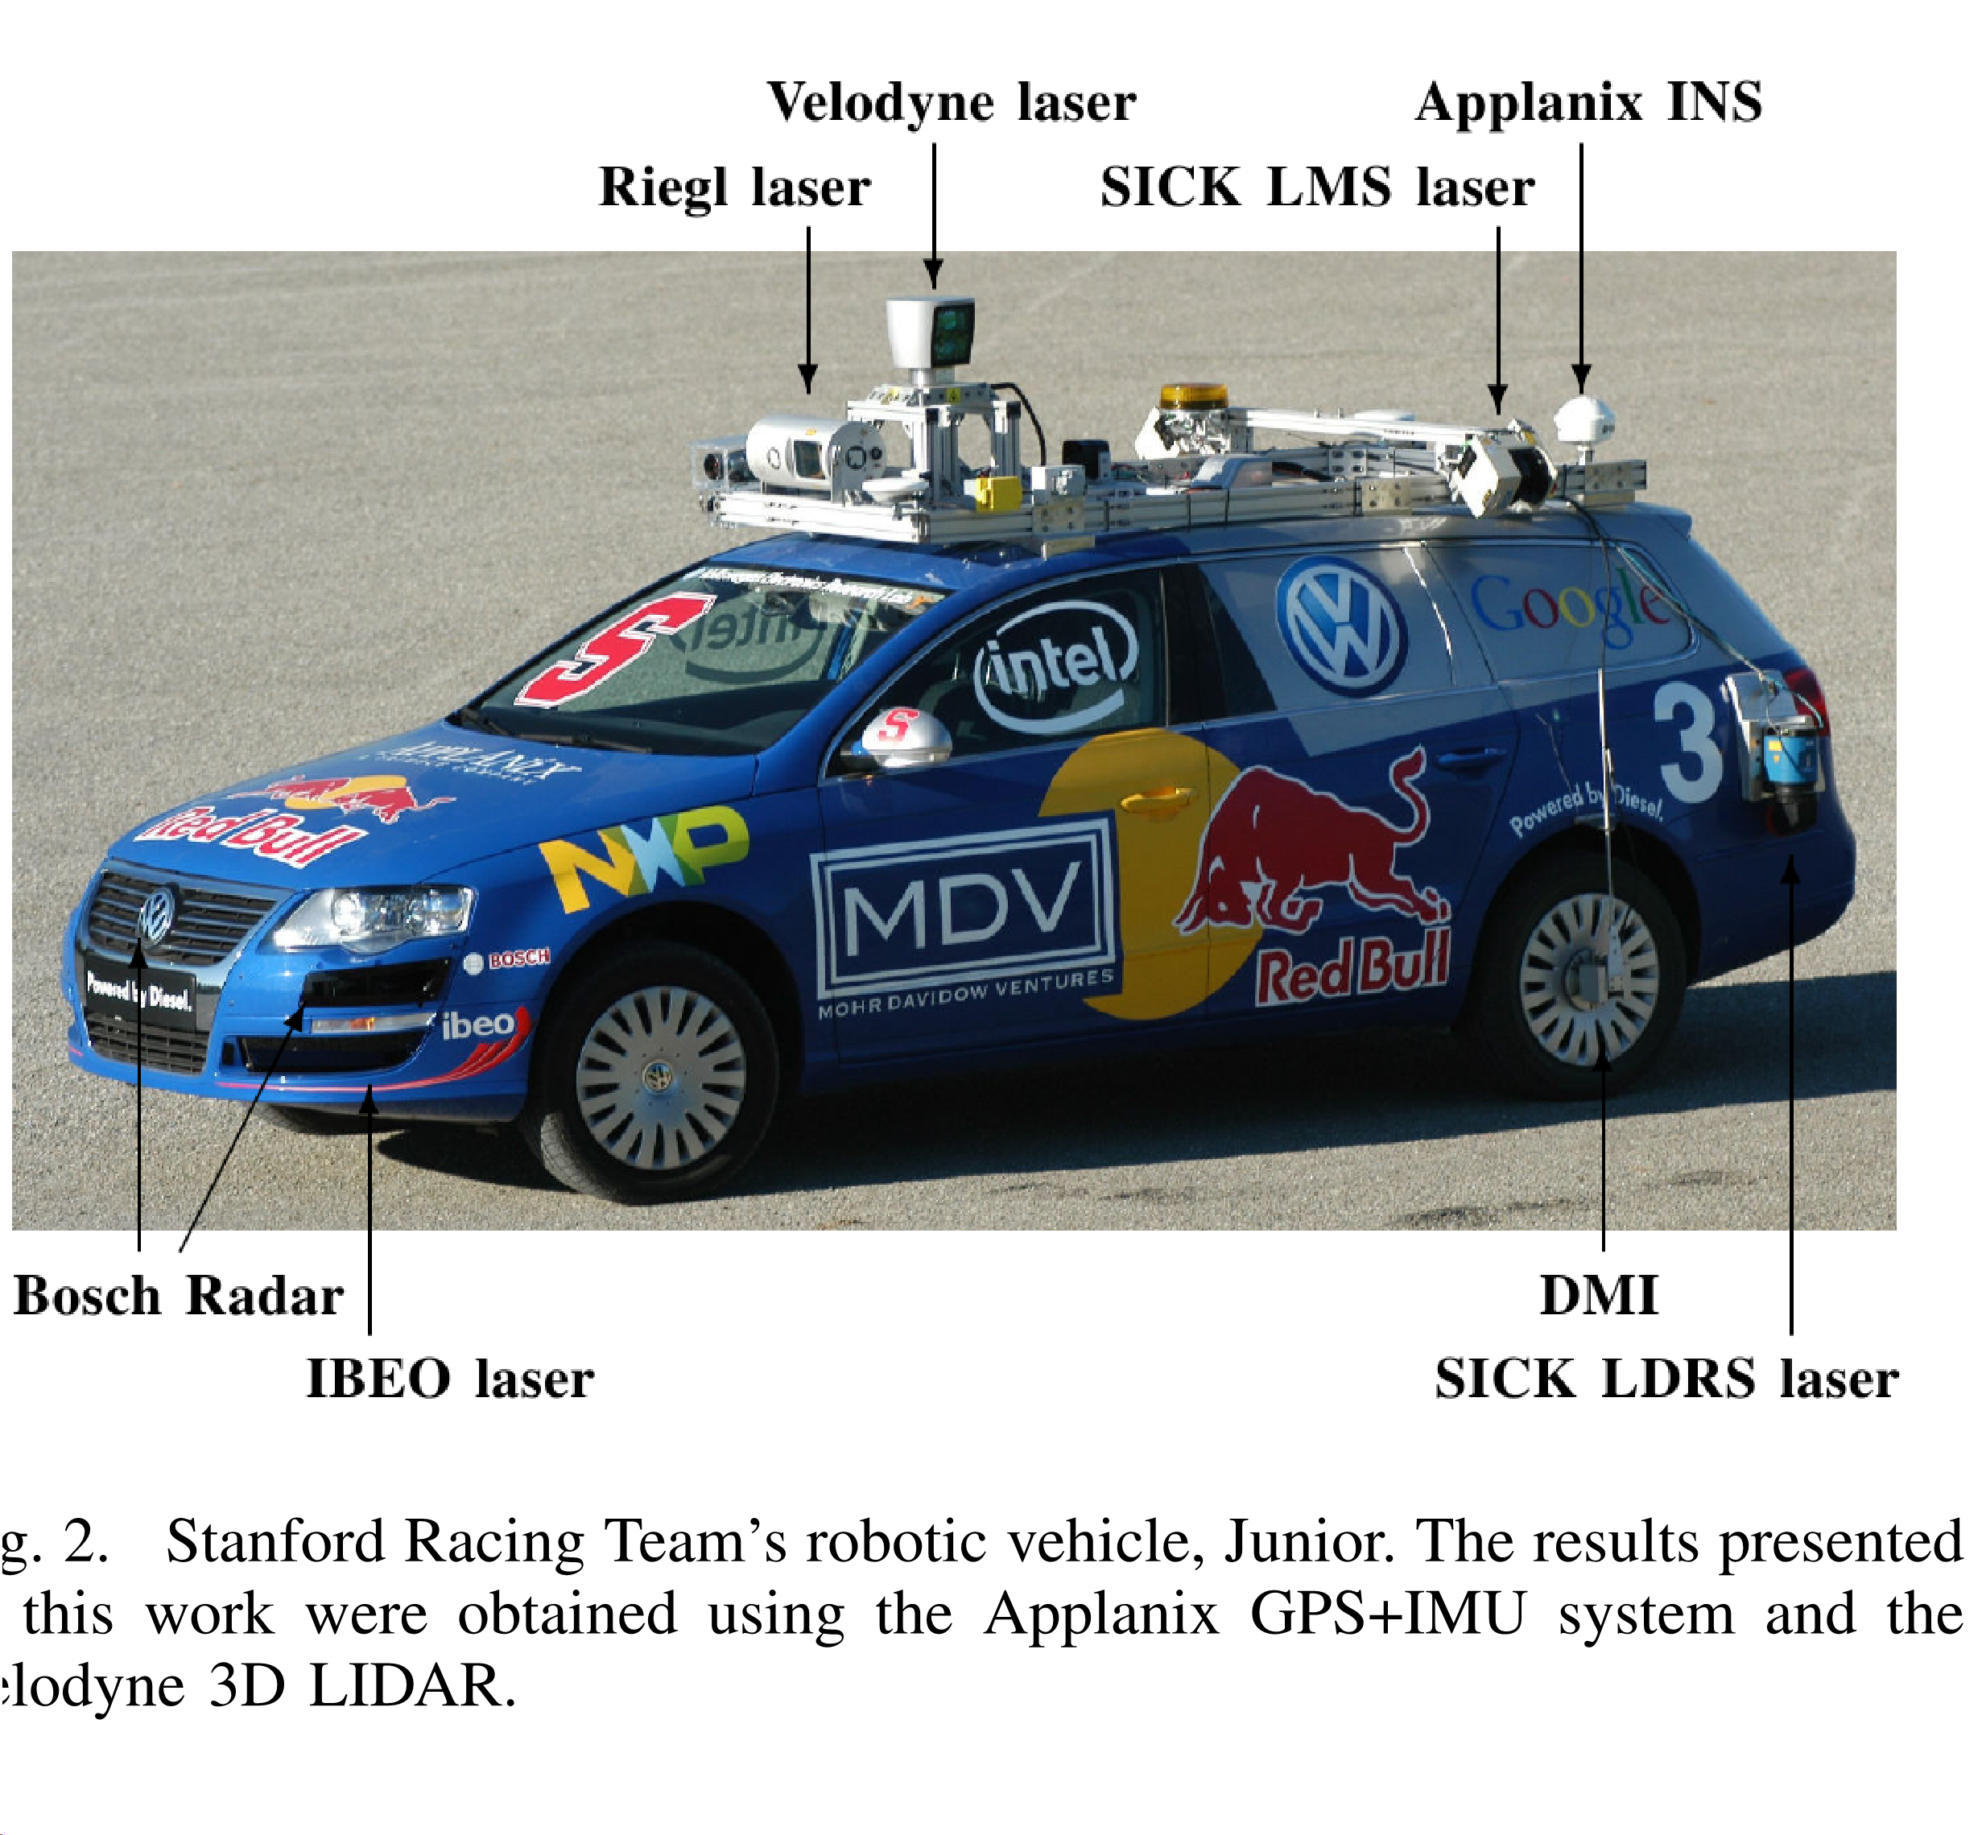
2/12/1016
Detection of Principal Directions in Unknown Environments for Autonomous Navigation

Slide 44
Conclusion
current and future work:
Combination of
· obstacle data with visual camera data
· surface-reflectivity data from LIDARs for detecting
to recognize more advanced features in unknown
environments and their use in path planning.
2/12/1016
Detection of Principal Directions in Unknown Environments for Autonomous Navigation

Slide 45
WHAT IS LIDAR SENSOR
2/12/1016
Detection of Principal Directions in Unknown Environments for Autonomous Navigation

Slide 46
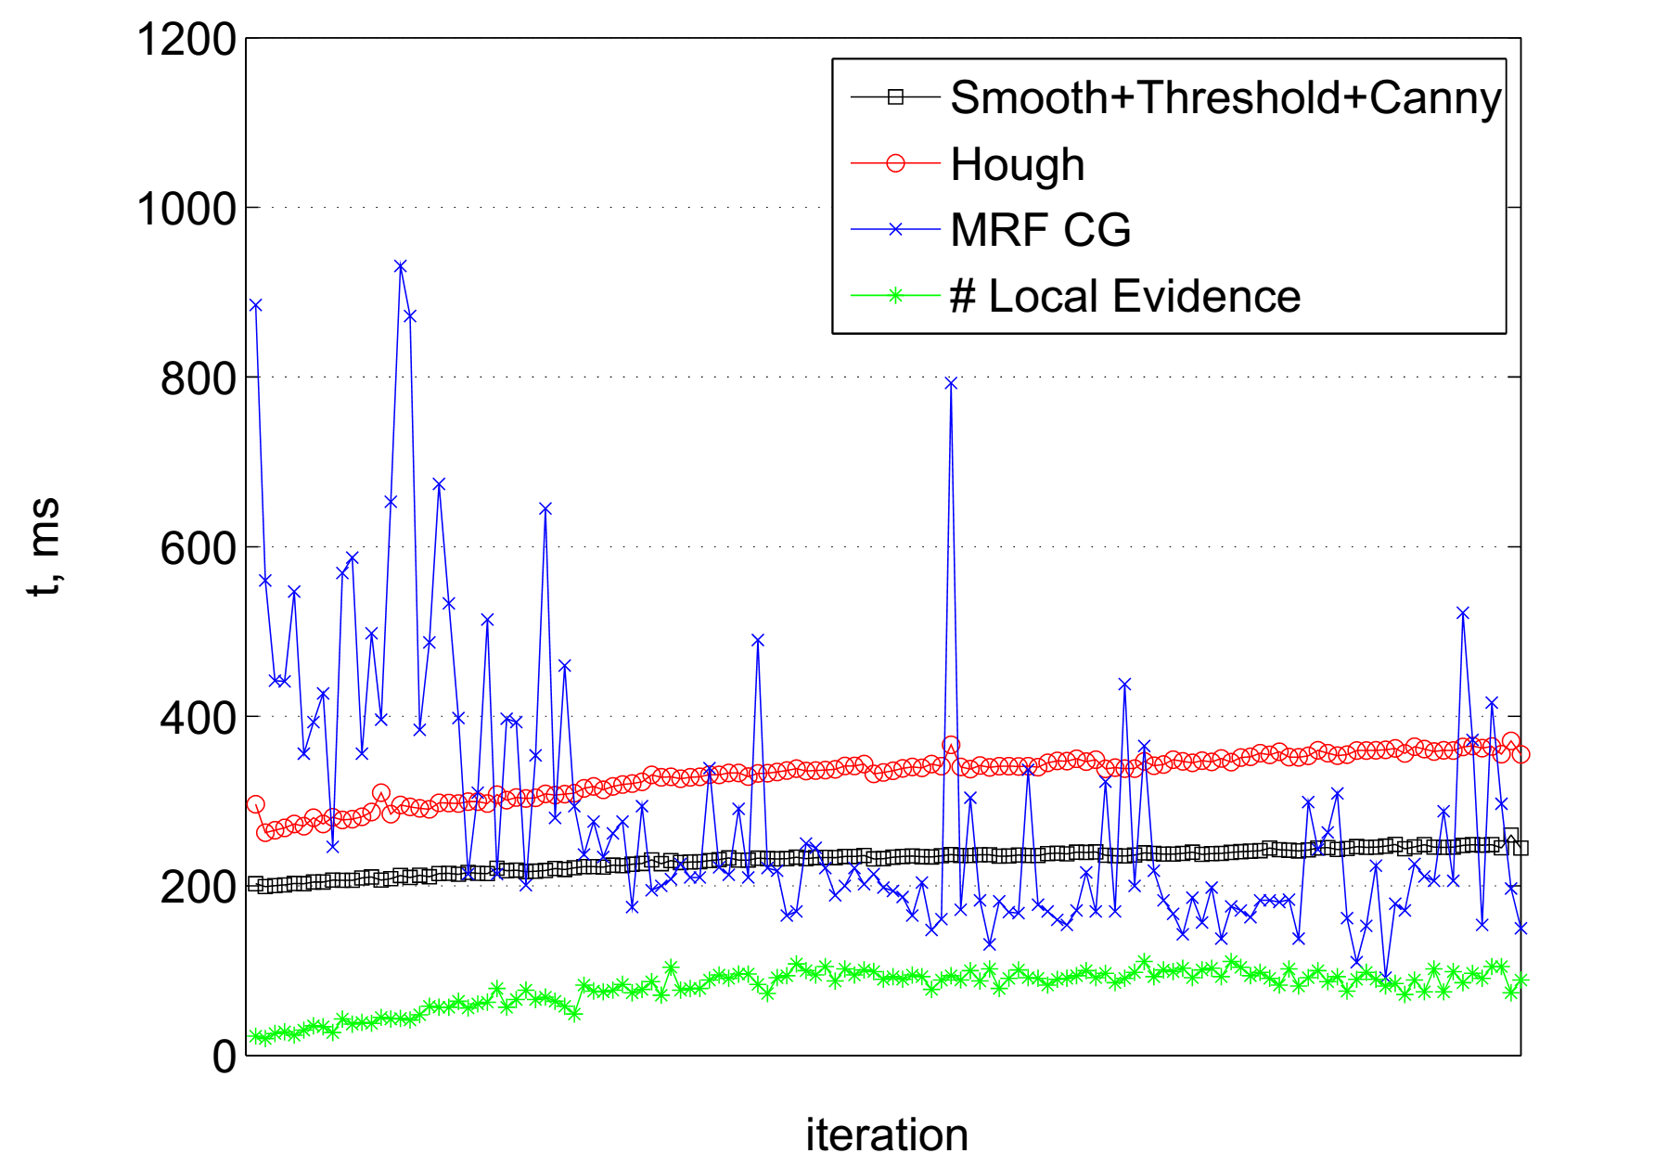
2/12/1016
Detection of Principal Directions in Unknown Environments for Autonomous Navigation

