Slide 1
ArrayTrack[11]
0.23 m
Ubicarse[11]
0.39
GPS
WiFi
Ultrasound
UWB
[3]
1.9 m
[2]
4.9 m
[7], [8]
0.1 m
ASSIST[11]
0.29 m
EKF-LWCR
0.20 m
OM
0.21 m
EKF-MC1
0.22 m
EKF-MC2
0.25 m

Slide 2
GPS
WiFi
Ultrasound
UWB
[3]
1.9 m
[2]
4.9 m
ArrayTrack[11]
0.23 m
Ubicarse[11]
0.39
[7], [8]
0.1 m
ASSIST[11]
0.29 m
OM
0.21 m
EKF-MC1
0.22 m
EKF-MC2
0.25 m

Slide 3
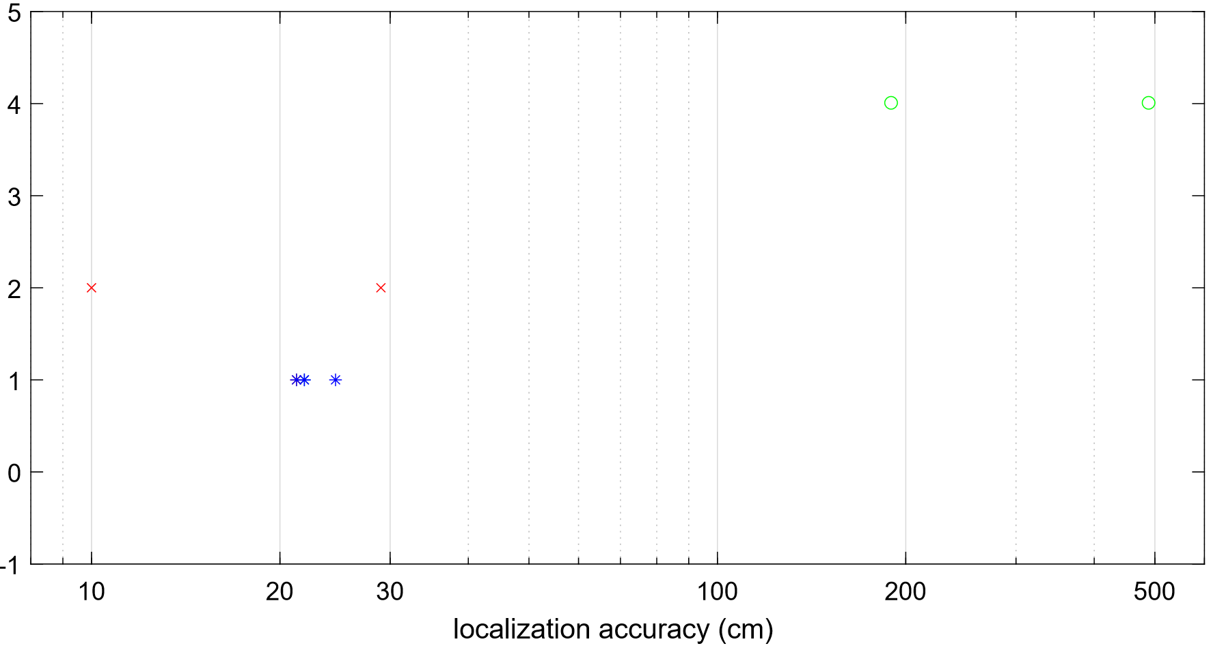
GPS
WiFi
Ultrasound
UWB
[3] : 190 cm
[2] : 490 cm
*
*
ArrayTrack [11] : 23 cm
*
*
Ubicarse [11] : 39 cm
*
[7][8]: 10 cm
*
ASSIST [11]: 29 cm
*
EKF-LWCR: 20 cm
*
OM: 21 cm
*
EKF-MC1: 22 cm
*
EKF-MC2: 25 cm
[3]
1.9 m
EKF-MC2
0.25 m
[2]
4.9 m
[7], [8]
0.1 m
OM
0.21 m
EKF-LWCR
0.20 m
ArrayTrack[11]
0.23 m
ASSIST [11]
0.29 m
EKF-MC1
0.22 m
Ubicarse[11]
0.39

