Slide 1
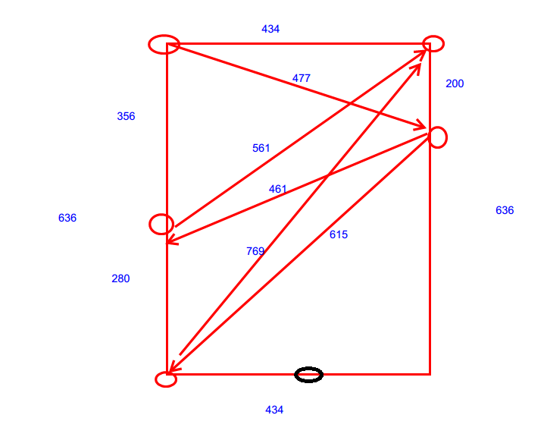
0x1
0x6
ENTRANCE
ELEVATOR
1
126
0x5
0x2
2
3
280
STAIR
250
0x3
0x4

