Slide 1
Indoor Localization using
Ultra-wideband
Authors:
Supervisors:
Yitong Quan
Prof. Dr. Leonhard Reindl
Dr. Rüdiger Quay

Slide 2
Outline
Motivation
Scope of Work
Result
Conclusion

Slide 3

Motivation
Aim:
Accurate Indoor Localization using UWB
Task 1
Data Collect System Improvement
Task 2
System Performance Evaluation

Slide 4
Motivation
UWB(Ultrasound or Electromagnetic signal)
GPS
- Outdoor
Ultrasound
+ Indoor
- Multipath(NLOS)
UWB
+ Indoor
+ High bandwidth
+ High resolution
+ Penetrating
through walls
- Multipath(NLOS)
UWB: Ultra-wideband

Slide 5
Motivation
UWB(Ultrasound or Electromagnetic signal)
GPS
- Outdoor
Ultrasound
+ Indoor
- Multipath(NLOS)
UWB
+ Indoor
+ High bandwidth
+ High resolution
+ Penetrating
through walls
- Multipath(NLOS)
UWB: Ultra-wideband

Slide 6
Motivation
UWB(Ultrasound or Electromagnetic signal)
GPS
- Outdoor
Ultrasound
+ Indoor
- Multipath(NLOS)
UWB
+ Indoor
+ High bandwidth
+ High resolution
+ Penetrating
through walls
- Multipath(NLOS)
UWB: Ultra-wideband

Slide 7
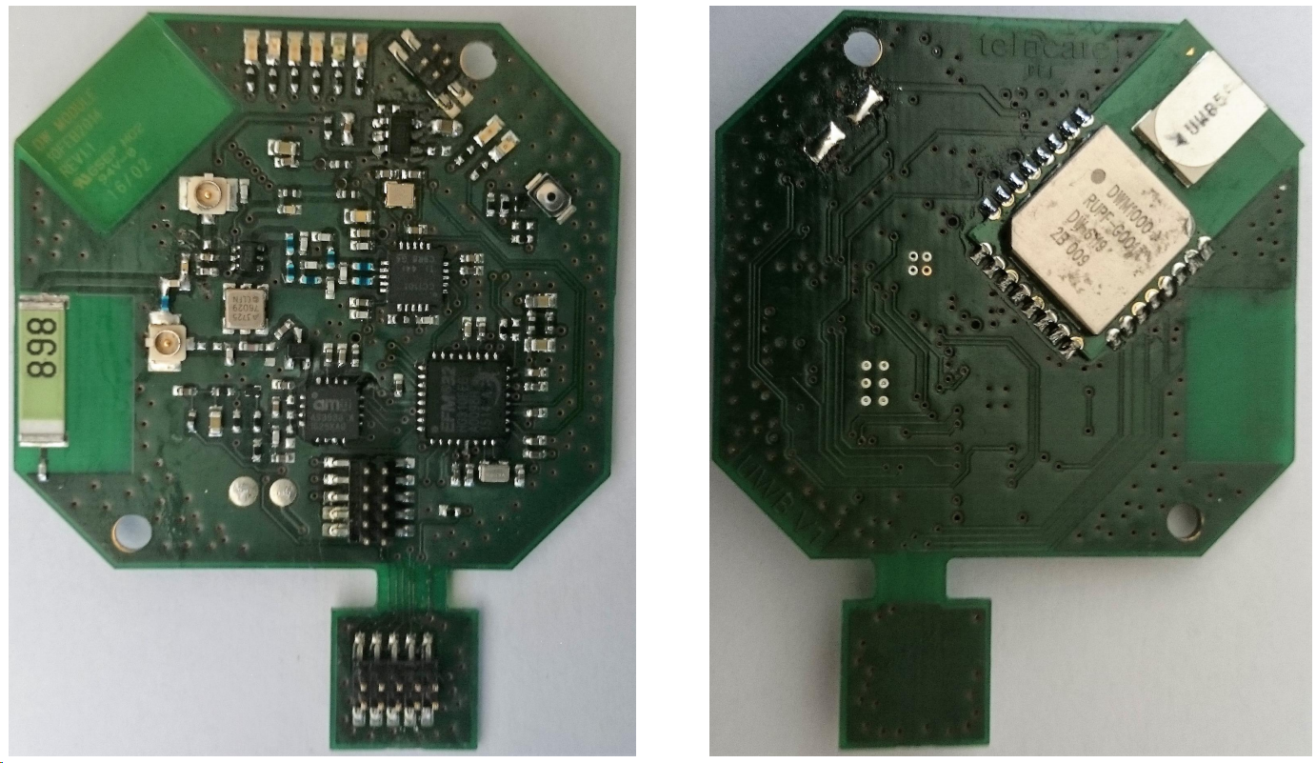
UWB
range 3.1 GHz to 10.6 GHz
limited transmit power of -41dBm/MHz
very low power density levels
for short-distance indoor application
+ UWB communication
- Sampling rate low, 0.2Hz
- Data obtained rate low, 0.46%
UWB devices: anchor node and mobile tag, Telocate
[Patrick Fehrenbach,Master Thesis]

Slide 8
UWB
range 3.1 GHz to 10.6 GHz
limited transmit power of -41dBm/MHz
very low power density levels
for short-distance application
+ UWB communication
- Sampling rate low, 0.2Hz
- Data obtained rate low, 46%
UWB devices: anchor node and mobile tag, Telocate

Slide 9
Scope of Work
UWB System Improvement
System Performance Evaluation
Estimation of positions of tag using EKF
Estimation of positions of tag and nodes simultaneously
loop end condition
sampling rate
energy mode changed
data obtained rate
mutex(mutual exclusion)

Slide 10
Scope of Work
UWB System Improvement
System Performance Evaluation
Estimation of positions of tag using EKF
Estimation of positions of tag and nodes simultaneously
(1 tag and 5 nodes)
loop end condition
sampling rate
energy mode changed
data obtained rate
mutex(mutual exclusion)

Slide 11
UWB System Improvement
Loop end condition
Energy mode changed
RTC
&&
Detection of task accomplishment
RTC only
Energy Mode 3
Energy Mode 2
 | Energy Mode 3 | Energy Mode 2
low-frequency oscillator | off | on
RTC | off | on
WDOG | off | on
consumption | 0.5 µA | 0.9 µA

Slide 12
UWB System Improvement
Mutex(mutual exclusion) added
time of flight
set_RTC
set_RTC
set_RTC
received_msg1&& check
send_msg_1
send_msg_1
received_msg3&& check
set_RTC
received_msg3&& check
send_msg_3
send_msg_2
received_msg2&& check
send_msg_2
end
end
NODE_1
end
TAG
NODE_2

Slide 13
UWB System Improvement
Mutex(mutual exclusion) added
set_RTC
set_RTC
send_msg_1
send_msg_1
received_msg3&& check
received_msg3&& check
send_msg_2
send_msg_2
end
end
NODE_1
NODE_2

Slide 14
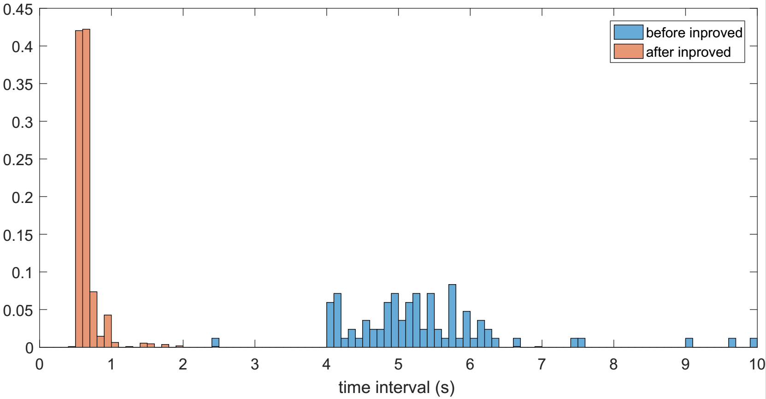
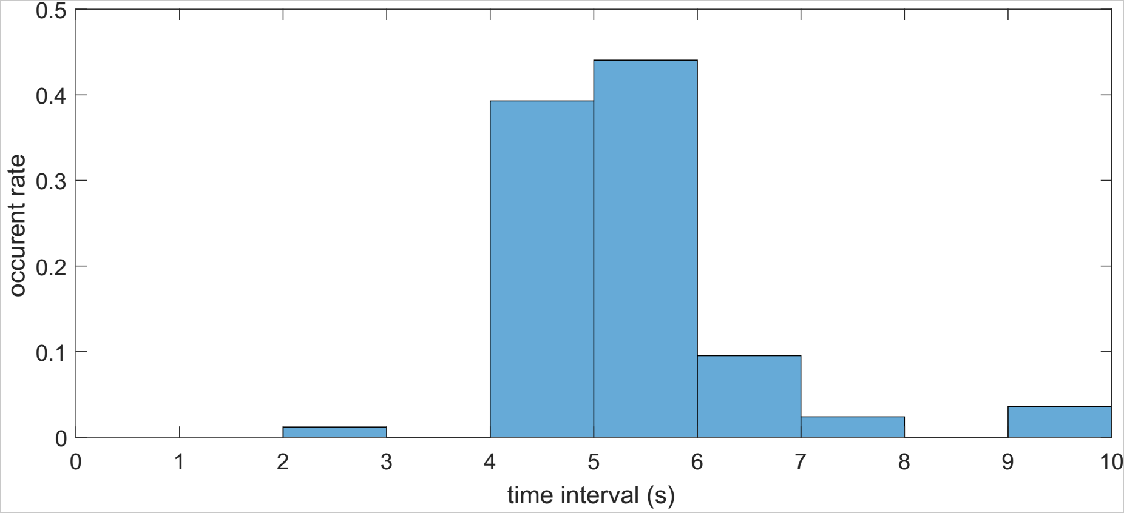


Sampling Rate
in details (numbers)
 | time interval (mean) | sampling rate (mean)
before improved | 5.2s | 0.2Hz
after improved | 0.7s | 1.5Hz

Slide 15
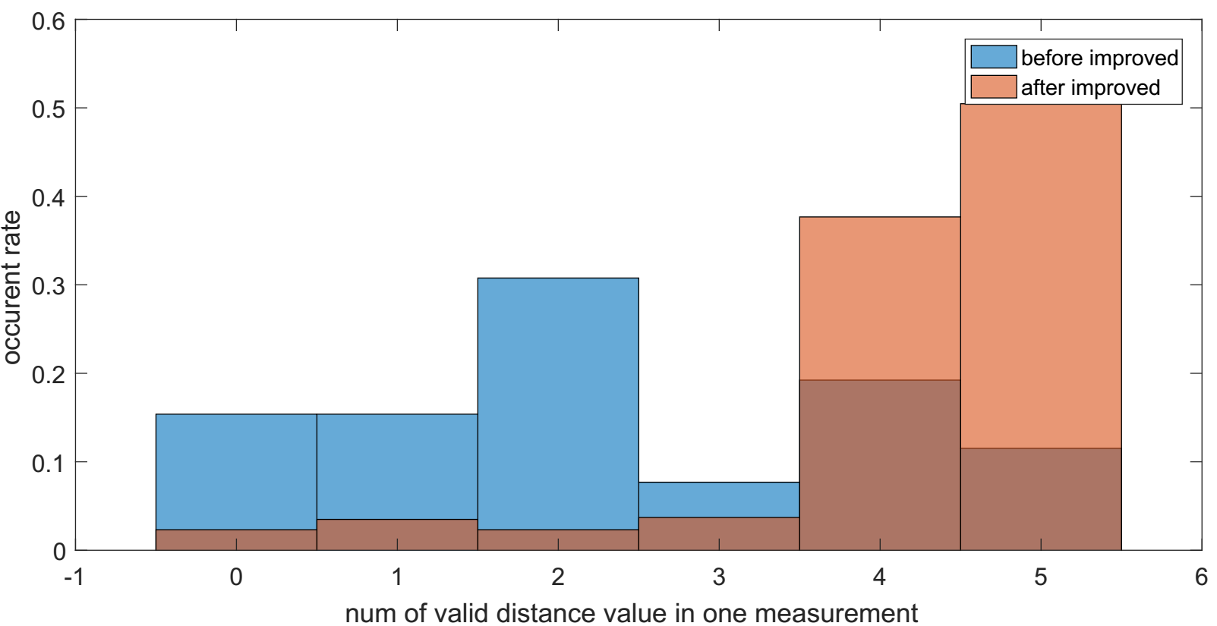
Data Obtained Rate
in details (numbers)
 | data obtained rate
before improved | 0.463
after improved | 0.842

Slide 16
System Performance Evaluation
Positions of tag estimation with different combinations of measurements using EKF
Within each sampling cycle, 30 ms time gap between measurement from nodes
Estimation of positions of tag and nodes simultaneously (Calibration-free Localization)
  no preknowledge of nodes' positions are needed
1, how much error will hav my this 30ms
2, small enough to leads to large error in prediction step
EKF updates
1. per 5 measurements
2. per measurement
time

Slide 17
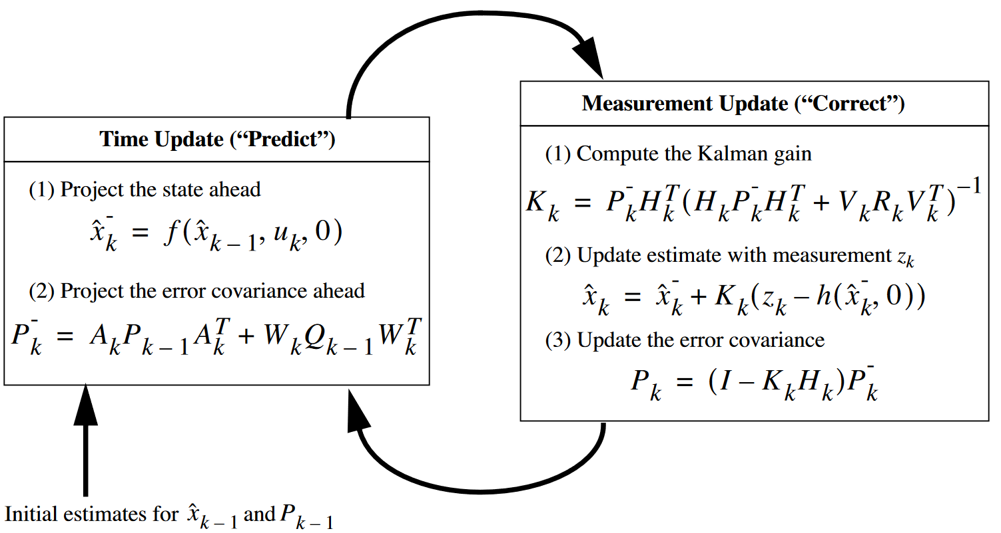
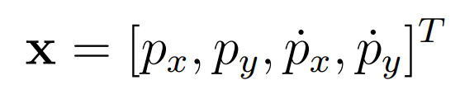
EKF
state vactor
state transition model
observation model

Slide 18
Calibration-free Localization
2D environment
Assume: N nodes, M samples from tag's trajectory
Unknown: 2*(M+N)
Known: M*N measurements
Solvable: 2*(M+N) <= M*N

Slide 19
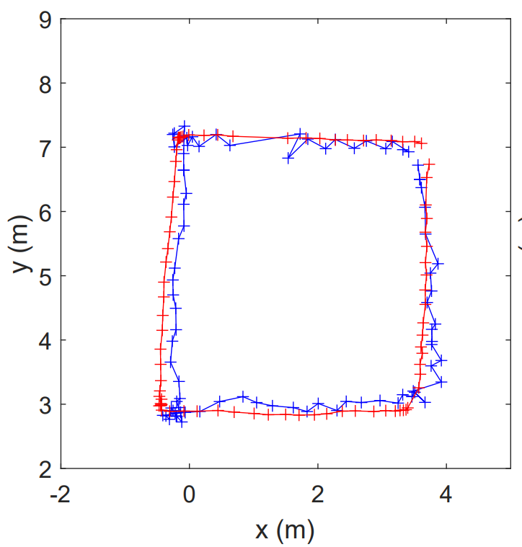
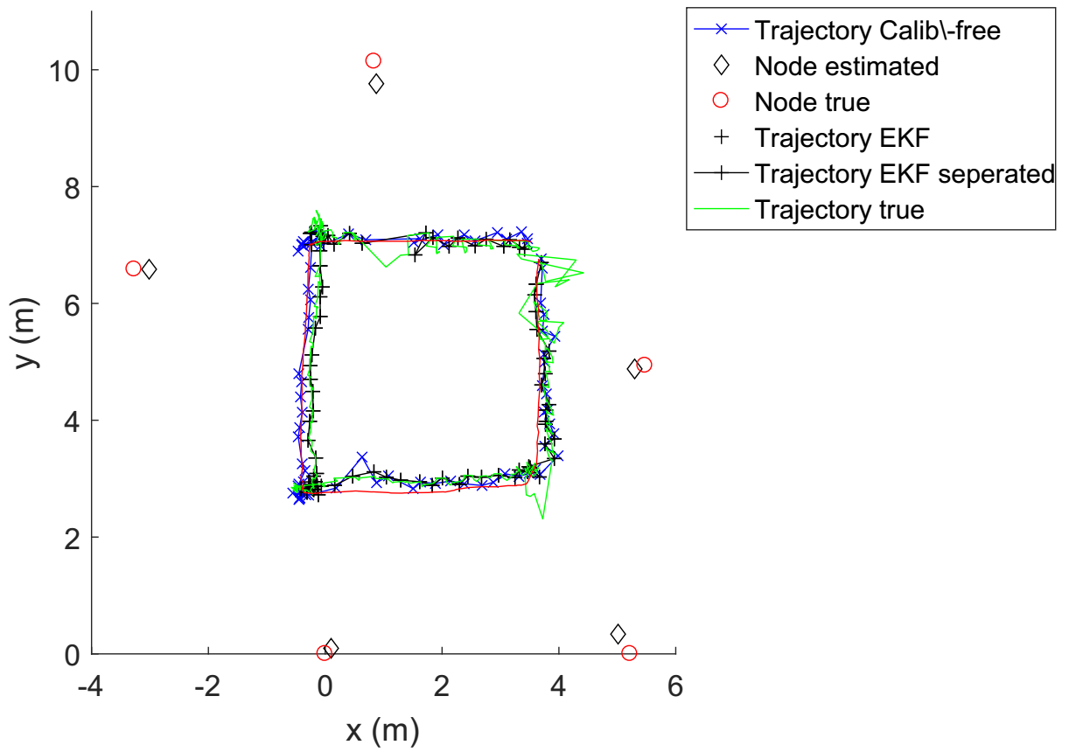
System Performance Evaluation
trajectory true
EKF sep'
color wrong
a
histograms of error,
see what distribution and why
also do for error of speed
ERROR (m) | RMSE | Min | Max
EKF | 0.2188 | 0.0073 | 0.4131
EFK Separated Form | 0.2454 | 0.0090 | 0.9167
Calibration-free Localization | 0.2126 | 0.0041 | 0.6312
table font size make bigger

Slide 20
Conclusion
System Improvement:
    sampling rate increased (by 7 times)
    data obtained rate increased (doubled)
System Performance Evaluation
    3 algorithms with RMSE 0.2188m, 0.2454m, 0.2121m

Slide 21
The End
Thank you for your attention!

Slide 22
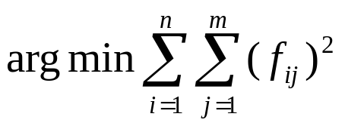
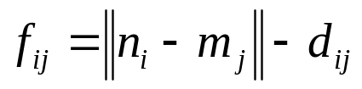
Scope of Work - Algorithm Development
- self-calibration
optimization method (Levenberg-Marquardt algorithm)

Slide 23
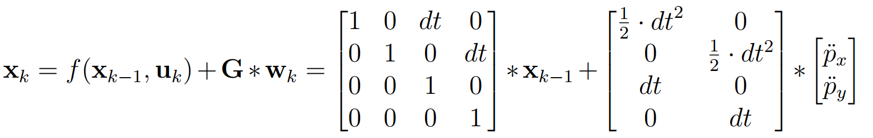

Scope of Work - Algorithm Development
update using one measurements set (contains 5 measurements)
normal EKF
EKF separation form
+4
+3
+1
+2

Slide 24
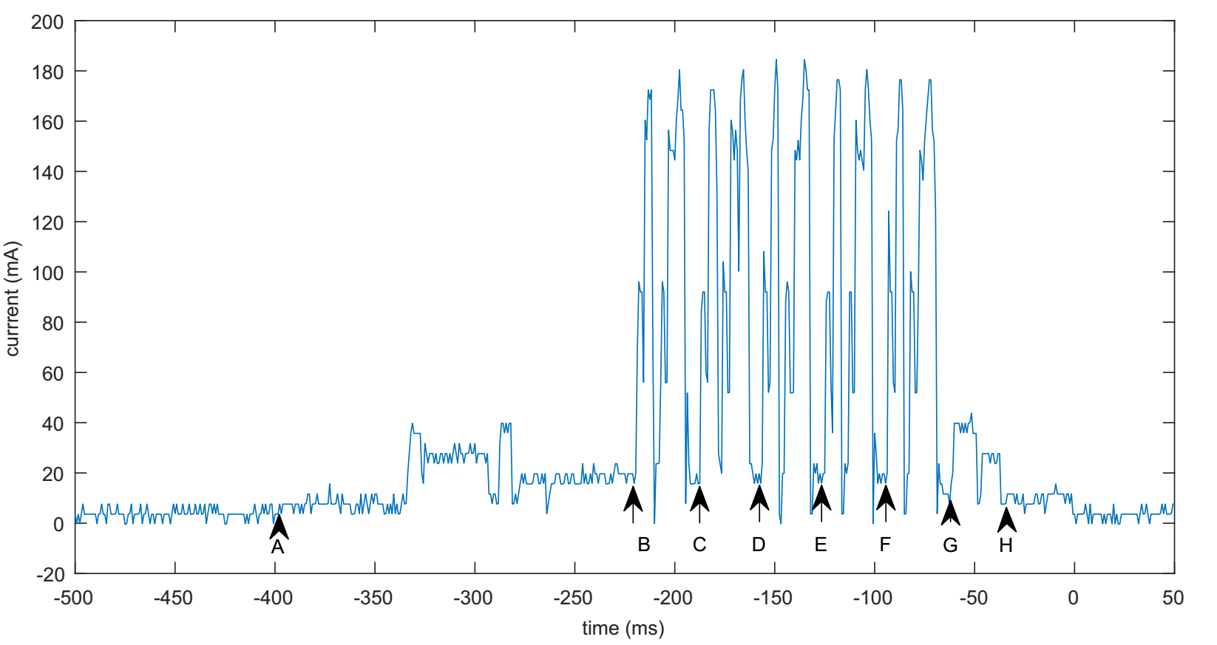
Scope of Work - Algorithm Development
sampling cycle of mobile tag (with 5 anchor nodes)
+1
+2

Slide 25





Calibration-free Localization
2D environment
Assume, n anchor nodes
m samples from tag's trajectory
in total variables
known: measurements
equation system can be solved when
2D environment
Assume, N nodes, M samples from tag's trajectory
Unknown: 2*(M+N)
Known: M*N measurements
solvable: 2*(M+N) <= M*N

Slide 26
Scope of Work - Algorithm Development
state transition model

Slide 27

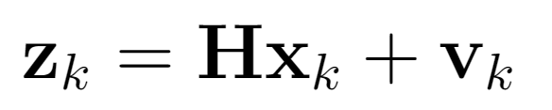
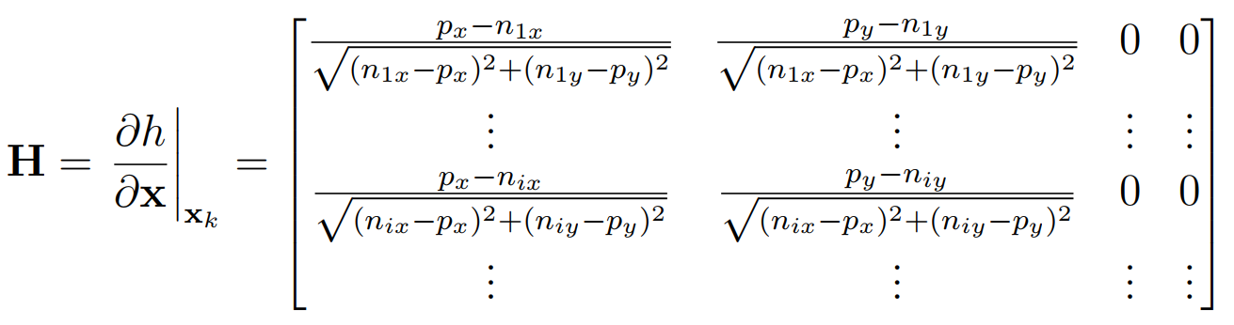
Scope of Work - Algorithm Development
observation model

