Slide 1

Data analysis with
Yiu Hong Ko (29-06-2025)

Slide 2
1
2
3
4
5
Research questions
Research design
Data collection
Data analysis
Report

Slide 3






Why Jamovi?
Free alternative to SPSS
Open-sourced, open-access
Flexibility, similar to R (syntax mode)
Replicability
Beginner friendly

Slide 4
Overview
10:00-12:30
Load data
Data and measure types
Compute variables
Descriptive statistics
Data visualization
Filter
Transform variables
13:30-16:30
Statistics
Modules
Long format vs. wide format
Syntax mode

Slide 5
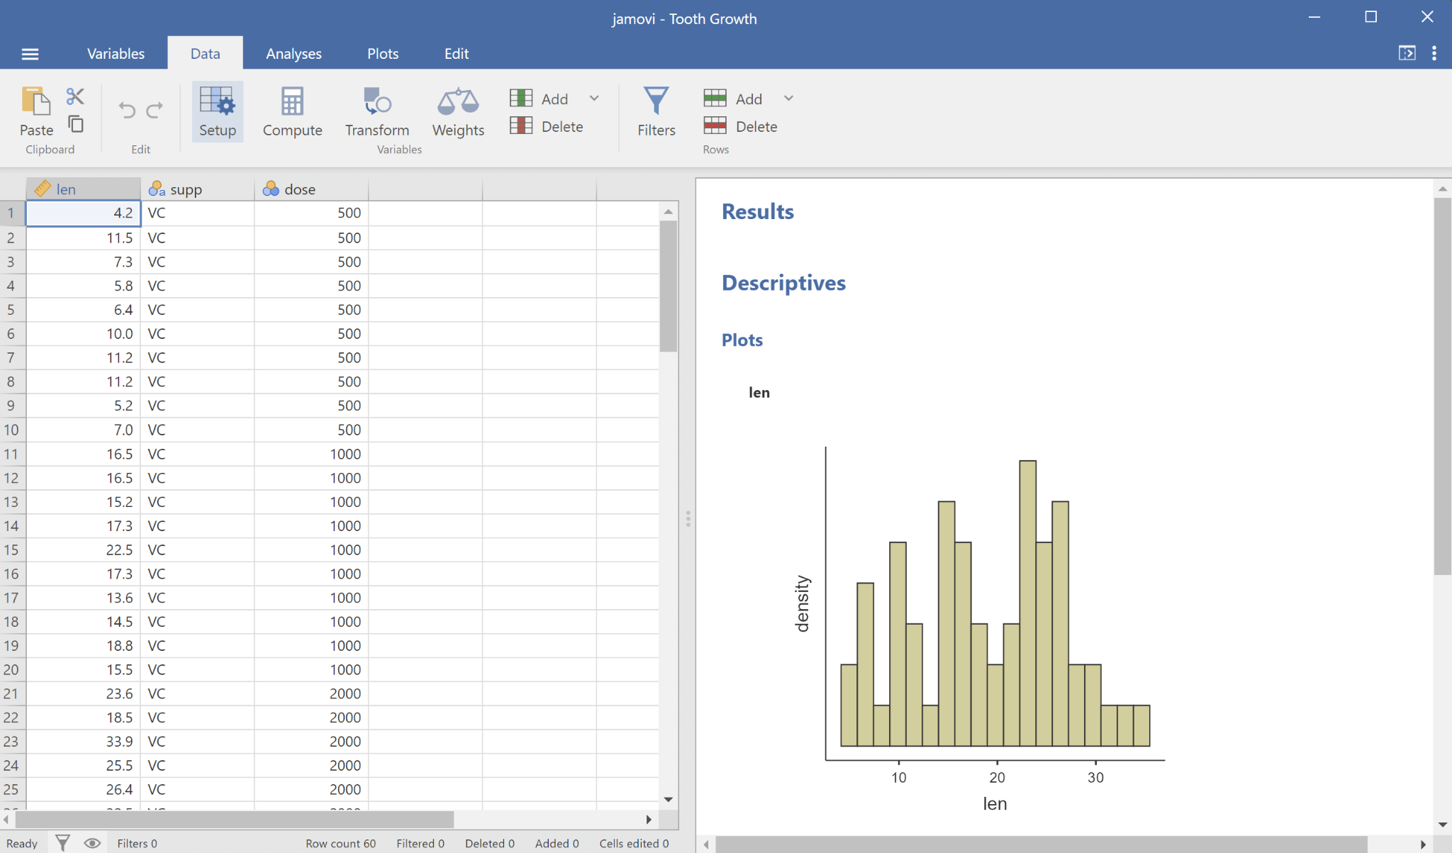
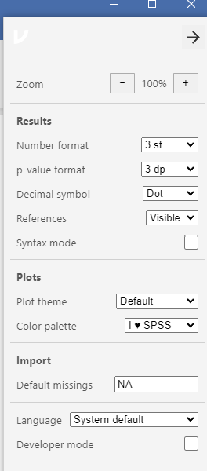

Slide 6
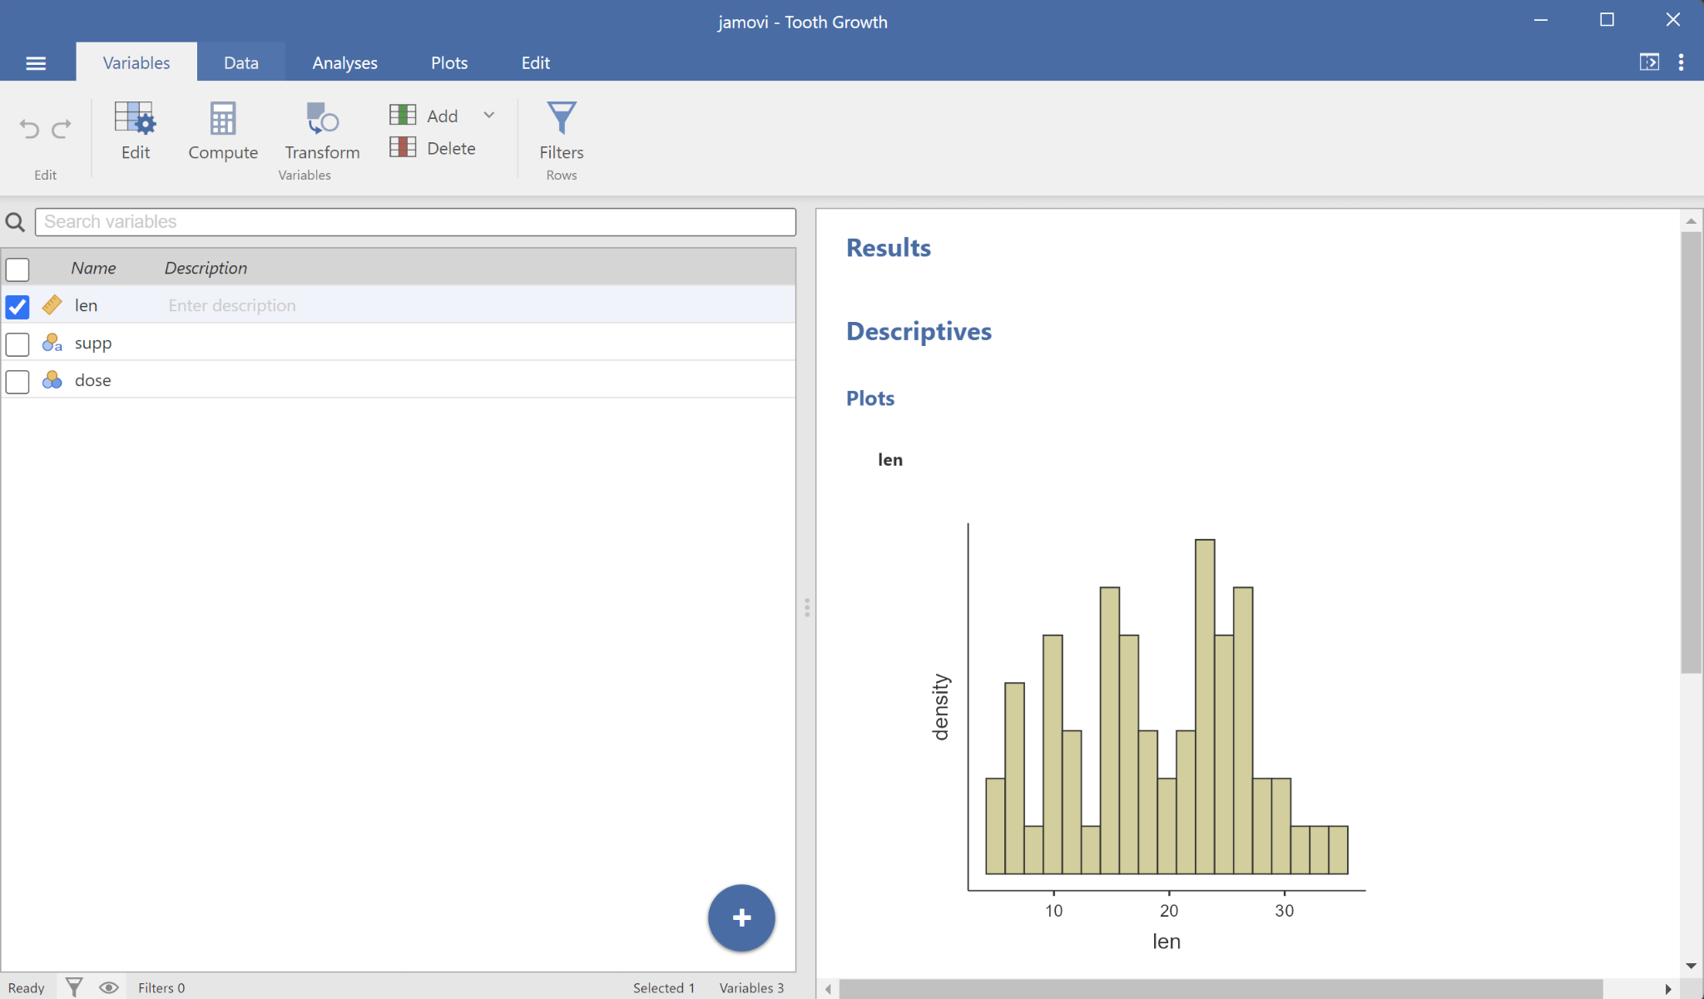

Slide 7
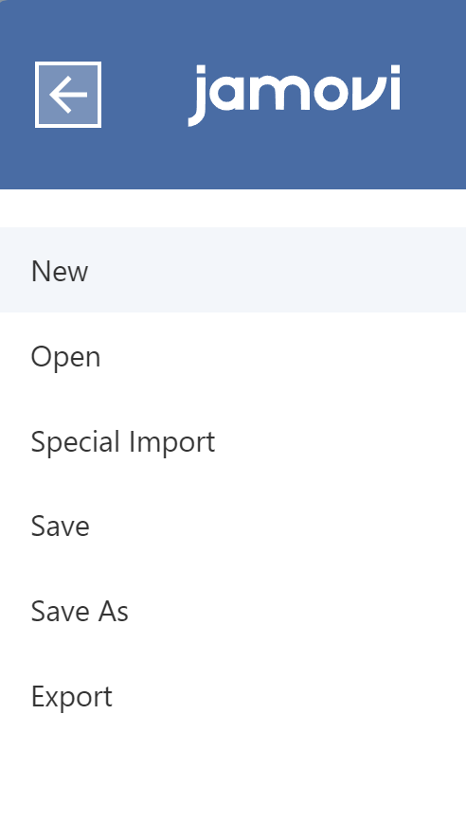
Load data
Open: Loading one single file
  Data Library
Special Import: Loading and stacking multiple files
  for combining datasets (e.g., one dataset for each participant)

Slide 8
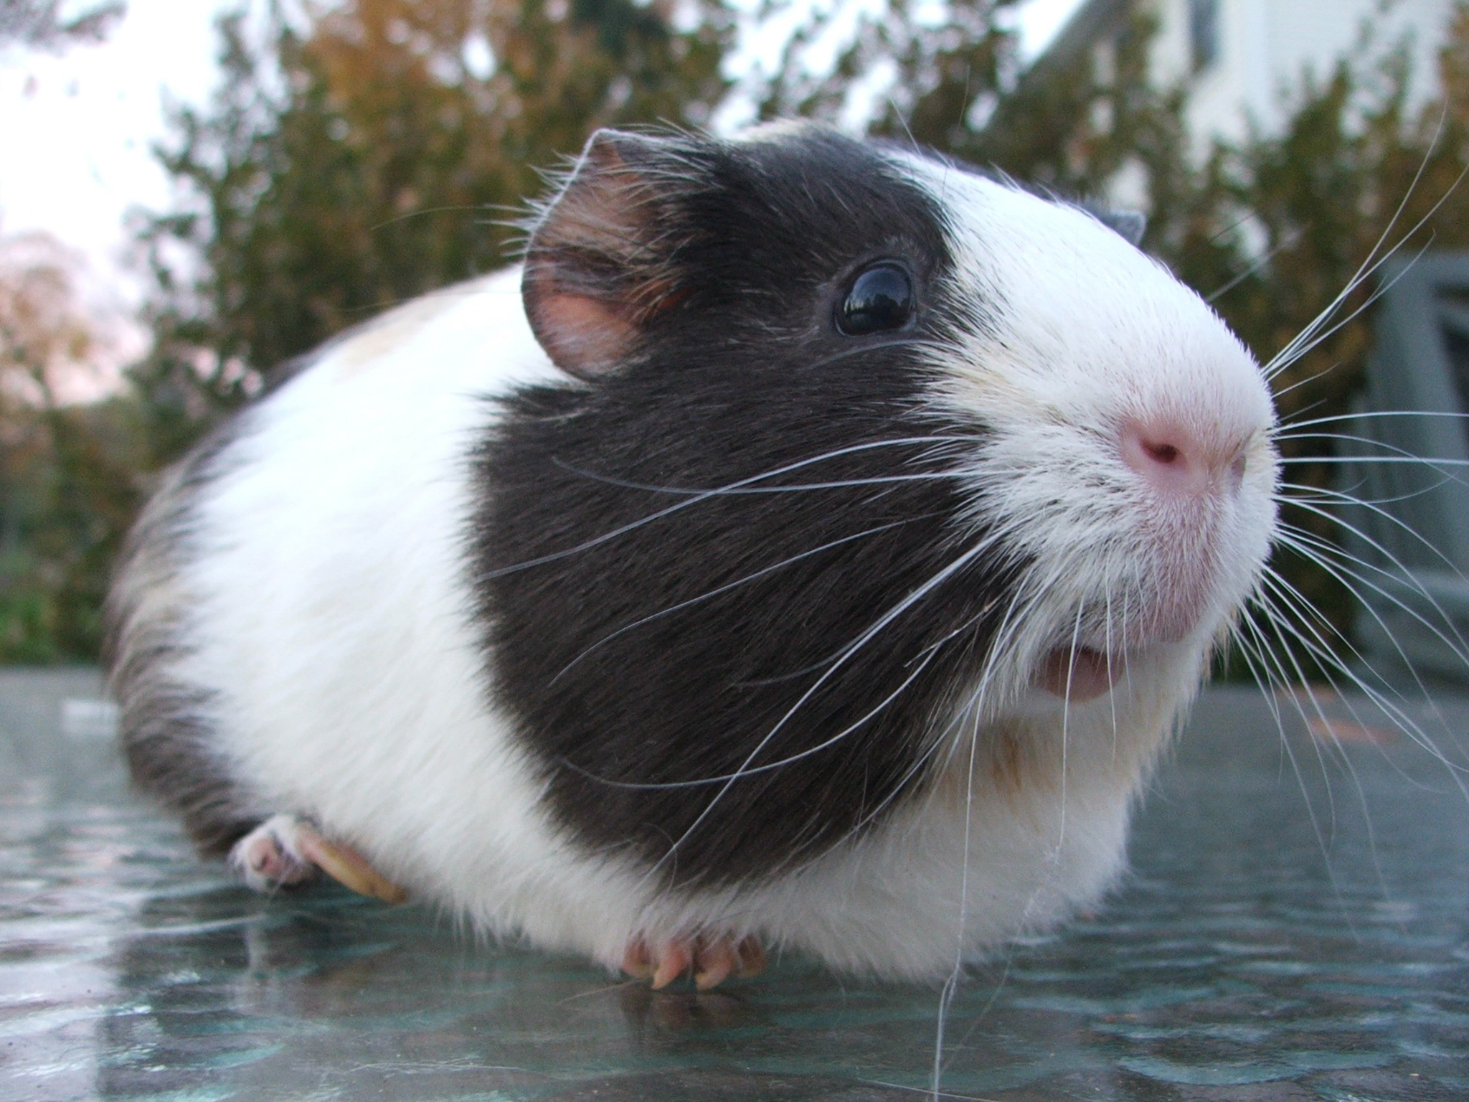
Exercise 1: load the Tooth Growth dataset
Guinea pig - Wikipedia
The Tooth Growth example contains the length of teeth from guinea pigs (the len column) fed different dosages (the dose column) of supplements: vitamin C or orange juice (recorded in the supp column as VC and OJ).
 | 500 | 1000 | 2000
VC💊 | 🐹🐹🐹🐹🐹 🐹🐹🐹🐹🐹 | 🐹🐹🐹🐹🐹 🐹🐹🐹🐹🐹 | 🐹🐹🐹🐹🐹 🐹🐹🐹🐹🐹
OJ🍊 | 🐹🐹🐹🐹🐹 🐹🐹🐹🐹🐹 | 🐹🐹🐹🐹🐹 🐹🐹🐹🐹🐹 | 🐹🐹🐹🐹🐹 🐹🐹🐹🐹🐹
🐹
🐹
🐹
🐹
🐹
🐹
🐹
🐹
🐹
🐹

Slide 9



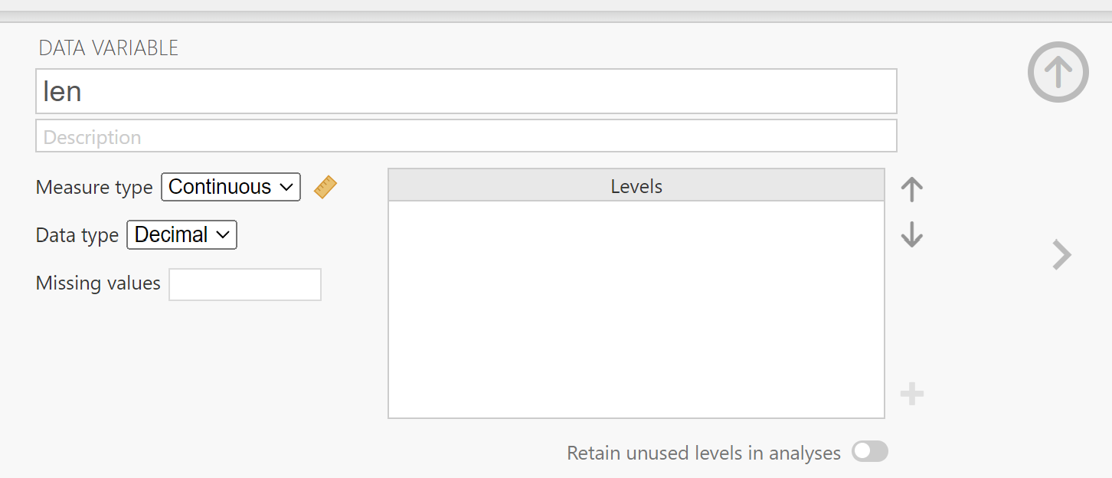

2. Data type and measure types
Data variables can be one three data types:
Integer
Decimal
Text
and one of four measure types:
Nominal
Ordinal
Continuous
ID
They are editable (to a certain extent)

Slide 10
3. Compute variables
E.g.,
Arithmetic:
  A + B
  CRT-SRT
Functions (across columns):
  MEAN(A, B)
  LOG10(len)
Variable function (across rows):
  VMEAN(len, group_by=dose)
Statistics, e.g., z-scores
  (dose - VMEAN(dose)) / VSTDEV(dose)
  Z(dose)

Slide 11
Exercise 2: Label and compute variables
Rename len to tooth_length
Label OJ as orange_juice, and VC as vitamin_c
Change the variable type of dose into ordinal
Reorder the levels of dose as 2000, 1000, 500 (instead of 500, 1000, 2000)
Label the levels of dose in mg (Hint: 1mg = 1000 mcg)
Compute len_z the z-score of len (Hint: Z(tooth_length))

Slide 12
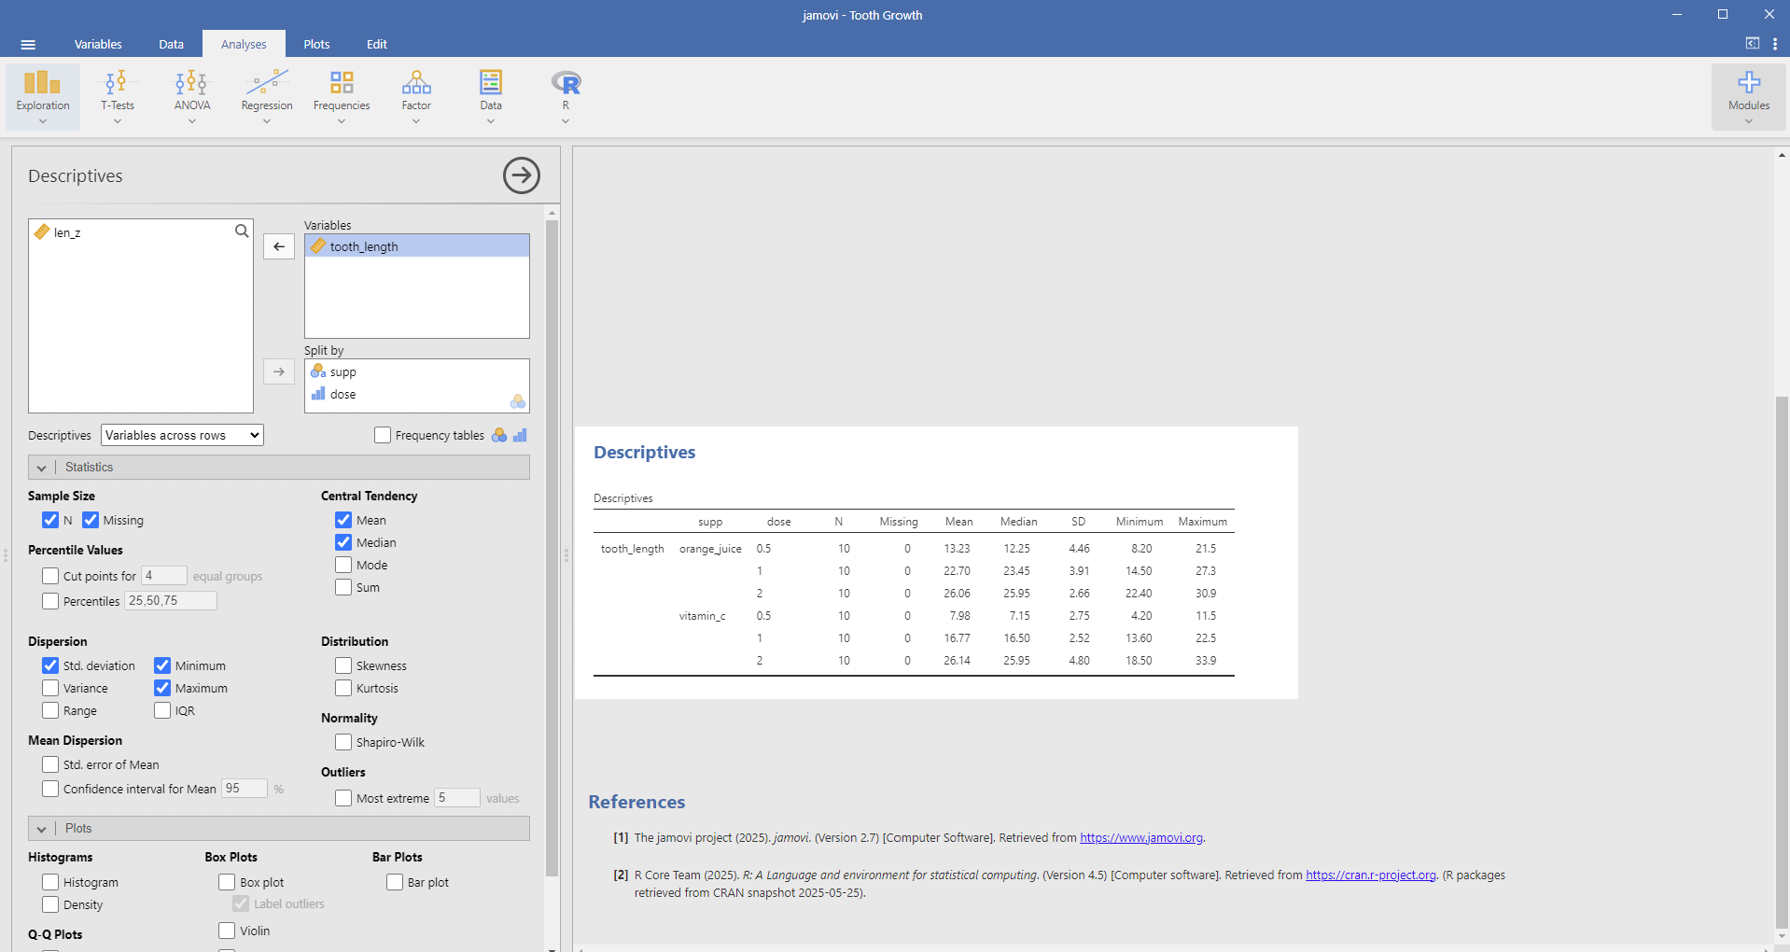
4. Descriptive statistics

Slide 13
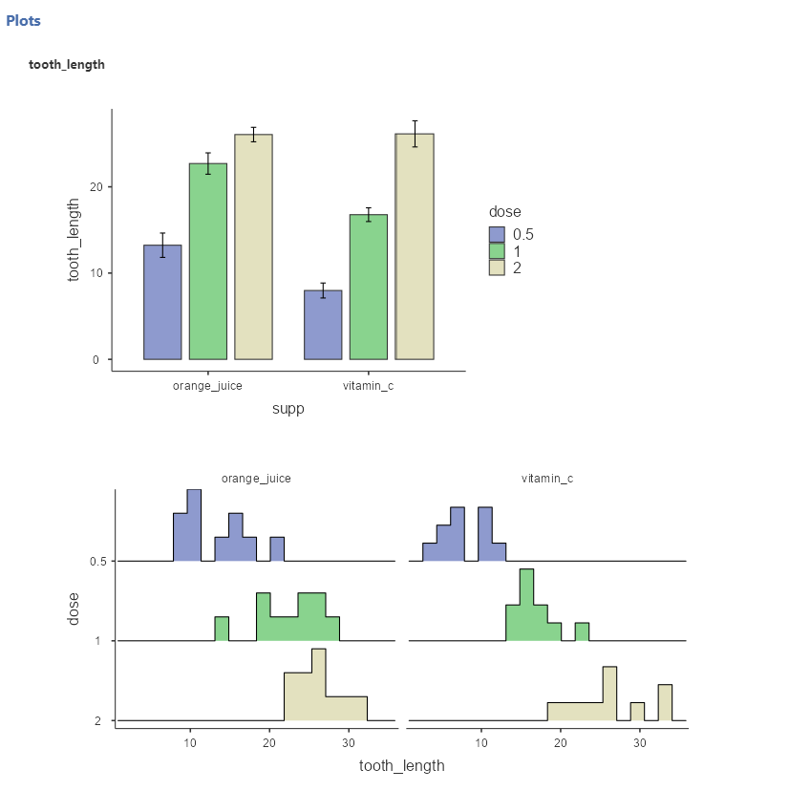
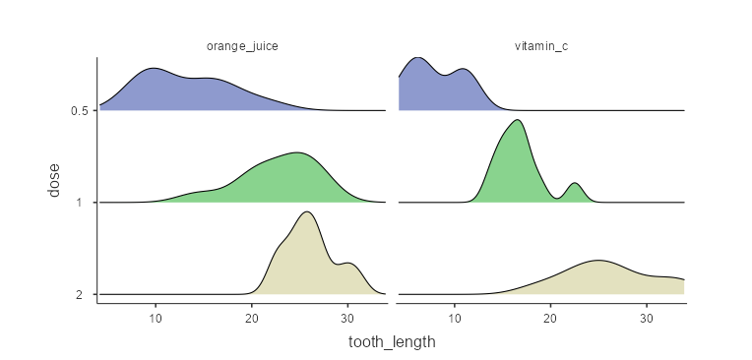
5. Data visualization
bar charts
histograms
density plots

Slide 14
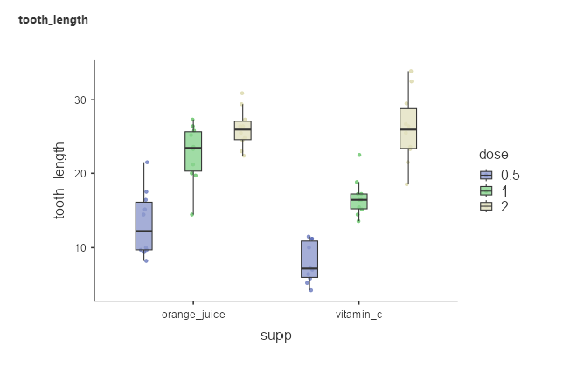
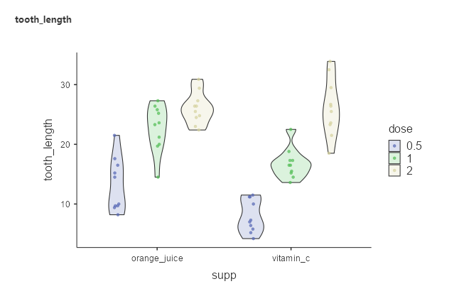
5. Data visualization
box plots
violin plots

Slide 15

Exercise 3: Bugs!
The extent to which men and women want to kill arthropods that vary in
freighteningness (low, high) and disgustingness (low, high).
Each participant rates their attitudes towards all anthropods.
With 372 rows and 6 variables
subject. Subject ID
gender. Female or Male
region. Region of the world the participant was from.
education. Level of education.
desire. The desire to kill an arthropod indicated on a scale from 0 to 10,
In the following conditions:
  LDLF: low freighteningness and low disgustingness;
  LFHD: low freighteningness and high disgustingness;
  HFHD: high freighteningness and low disgustingness;
  HFHD: high freighteningness and high disgustingness
Bug (Pokémon type) | Nintendo | Fandom
https://www.indrapatil.com/ggstatsplot/reference/bugs_long.html
Ryan, R. S., Wilde, M., & Crist, S. (2013). Compared to a small, supervised lab experiment, a large, unsupervised web-based experiment on a previously unknown effect has benefits that outweigh its potential costs. Computers in Human Behavior, 29(4), 1295-1301.

Slide 16
Exercise 3: Bugs!
Load the Bugs dataset from the data library
Check the data and measure types; correct them if needed
Compute a desire_to_kill rating by averaging the ratings across all conditions
Explore the summary statistics of this desire_to_kill variable
Based on data visualization, determine if desire_to_kill differs across:
  Gender
  Education
  Region
Categorize individuals (rows) into high vs. low desire_to_kill

Slide 17
6. Filter
With a clear rationale, outliers / invalid data could be excluded from the analysis
E.g., in the Bugs dataset, subject 11 has very low ratings across all conditions
  0, 2.5, 0, 0
It could be excluded with the filter function
As with other changes in the data, outputs will be automatically updated

Slide 18
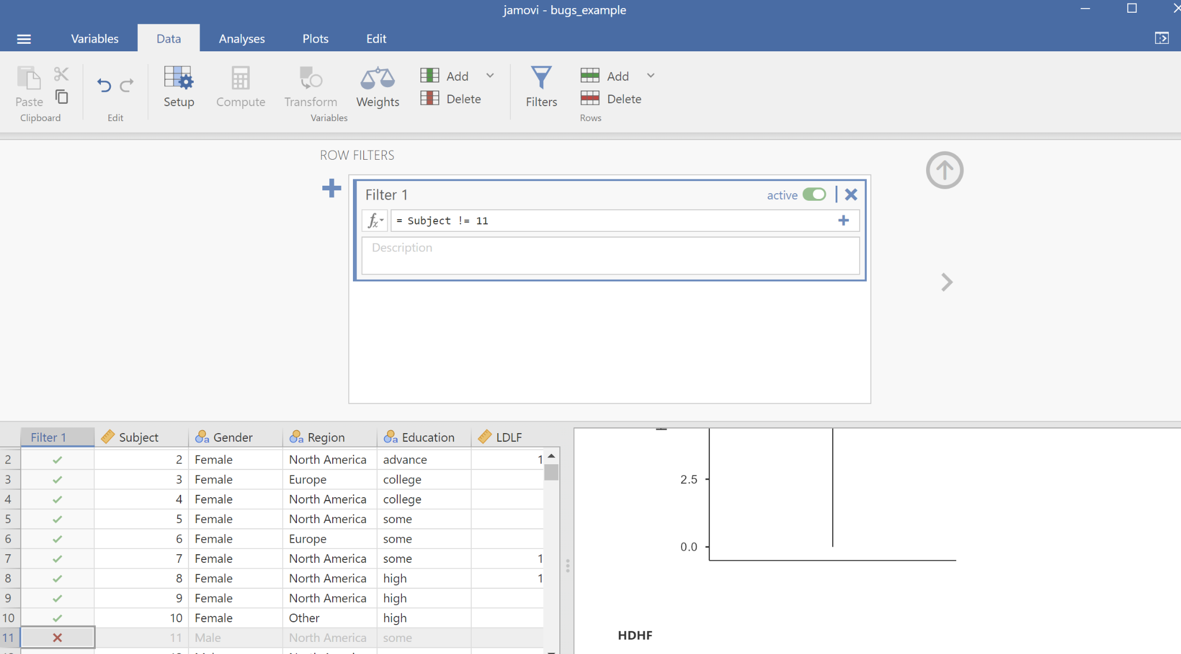
6. Filter
!= means “not equal”

Slide 19
7. Transform variables
Unlike compute, which could work on multiple variables, transform works on one variable. However, it could reuse transformation functions.
Typically used for recoding variables, or with functions applied to multiple variables repeatedly
E.g., median split could be applied to dichotomize variables (usually not recommended though)
  In the BUGS dataset, an individual could be categorized as “killer’ if the desire_to_kill rating is larger or equal to the median, and “not killer” if not

Slide 20
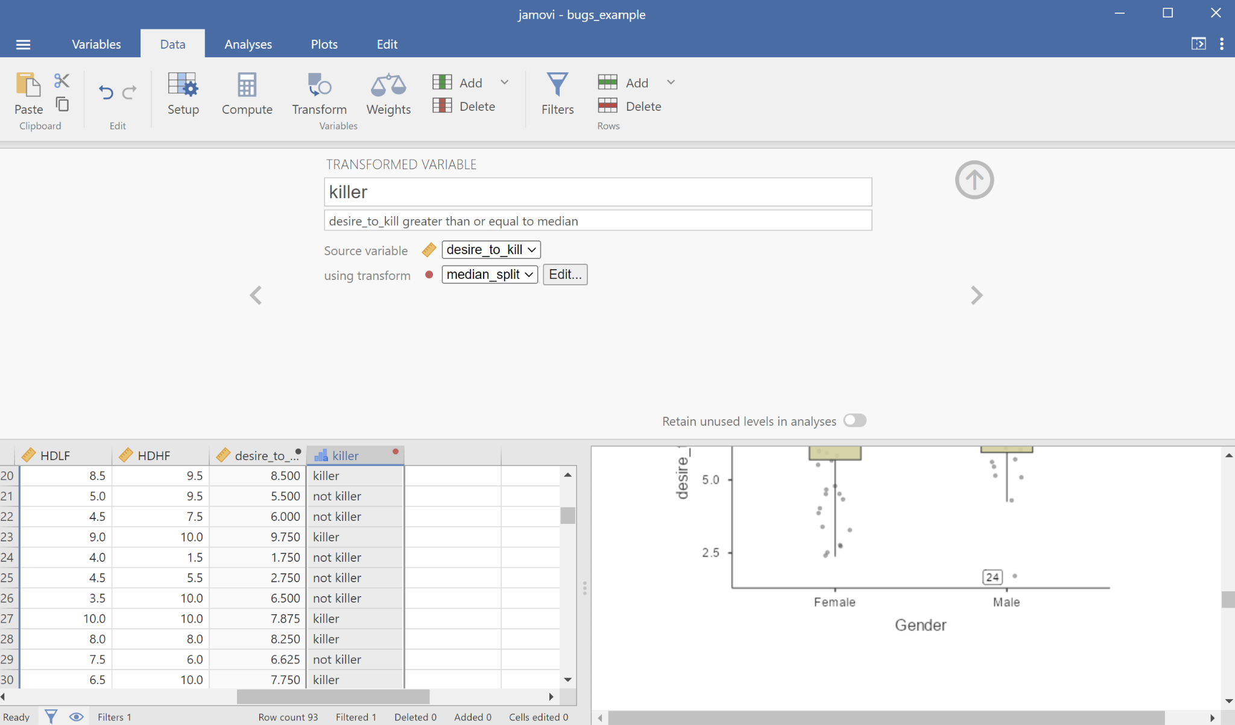
7. Transform variables

Slide 21
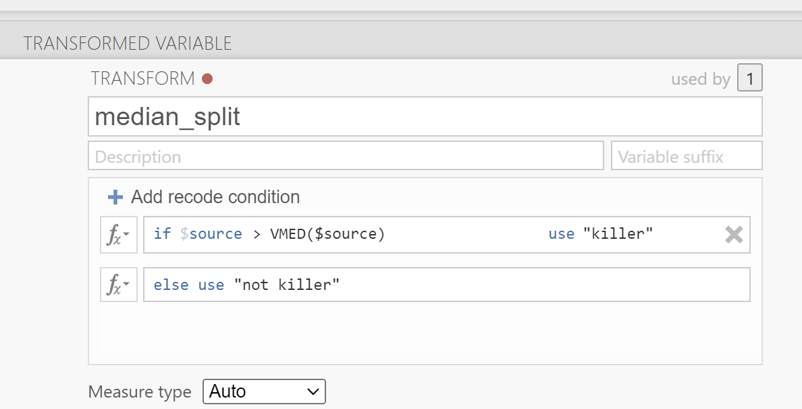
7. Transform variables

Slide 22
8. Statistics!
Unlike SPSS, Javmovi does not have as many analysis options
However, the outputs of the analysis are often clearer and follow the APA format
By design, the ways to execute them are similar to SPSS

Slide 23
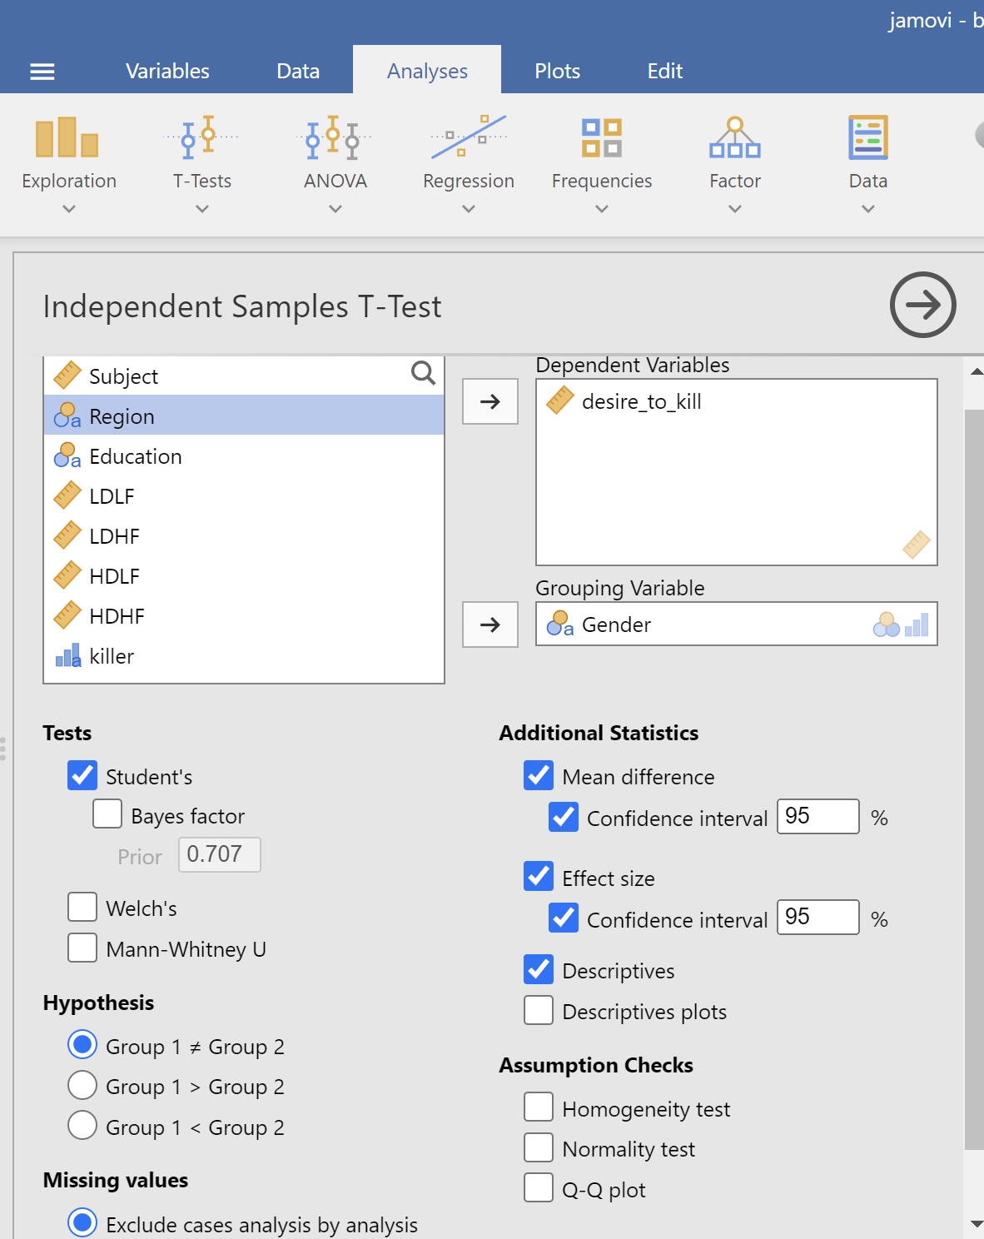
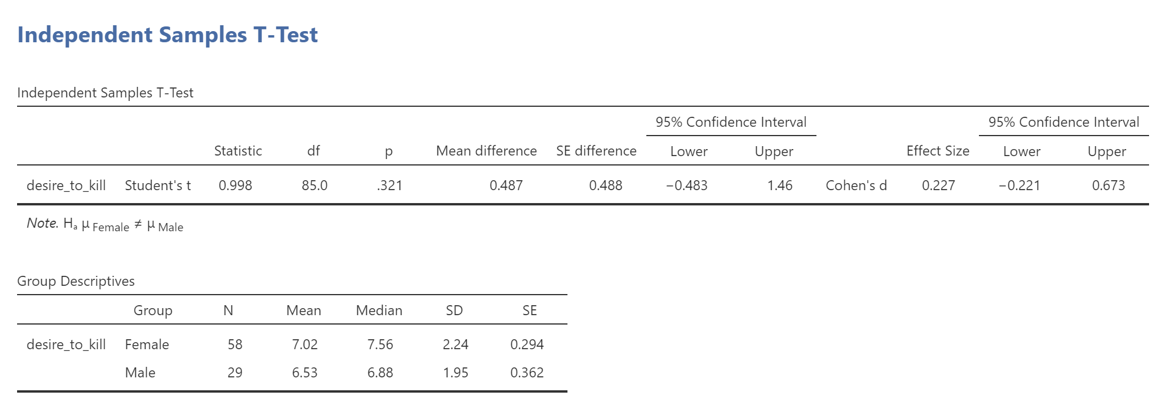
8. Statistics! - Independent t test
Does desire_to_kill differ across genders?

Slide 24
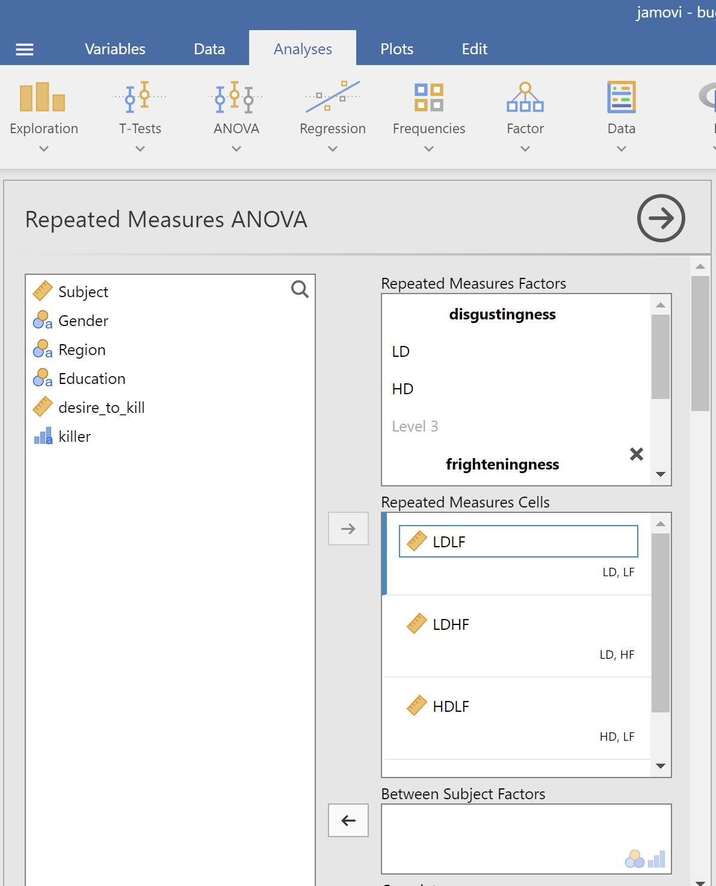
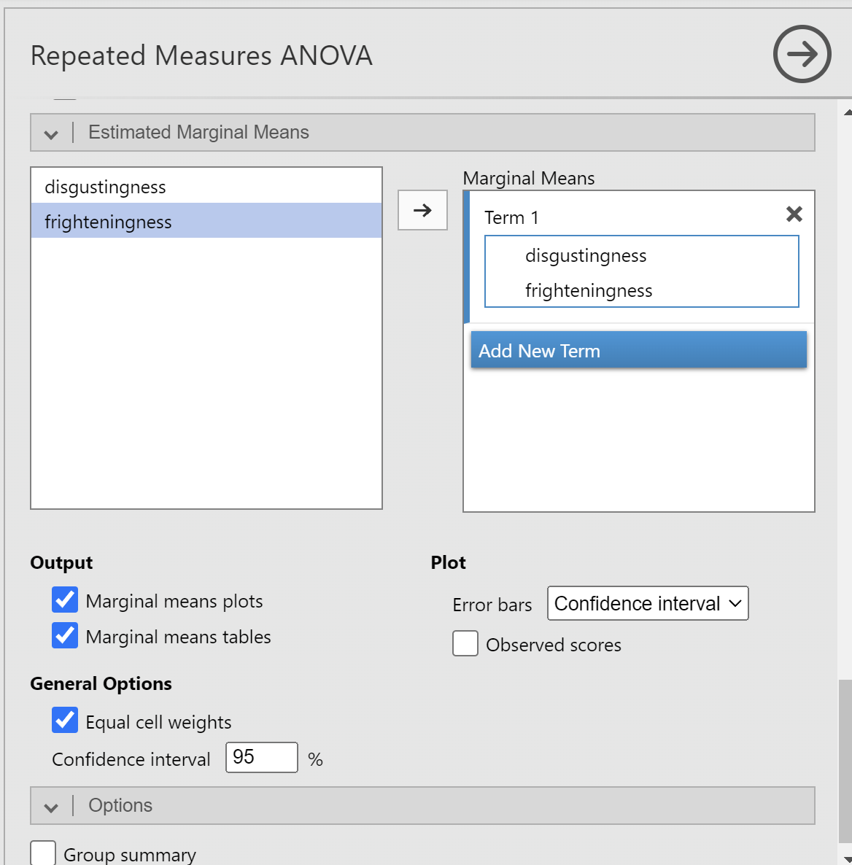
8. Statistics! - Repeated measures ANOVA
Do disgustingness and frighteningness affect desire_to_kill?

Slide 25
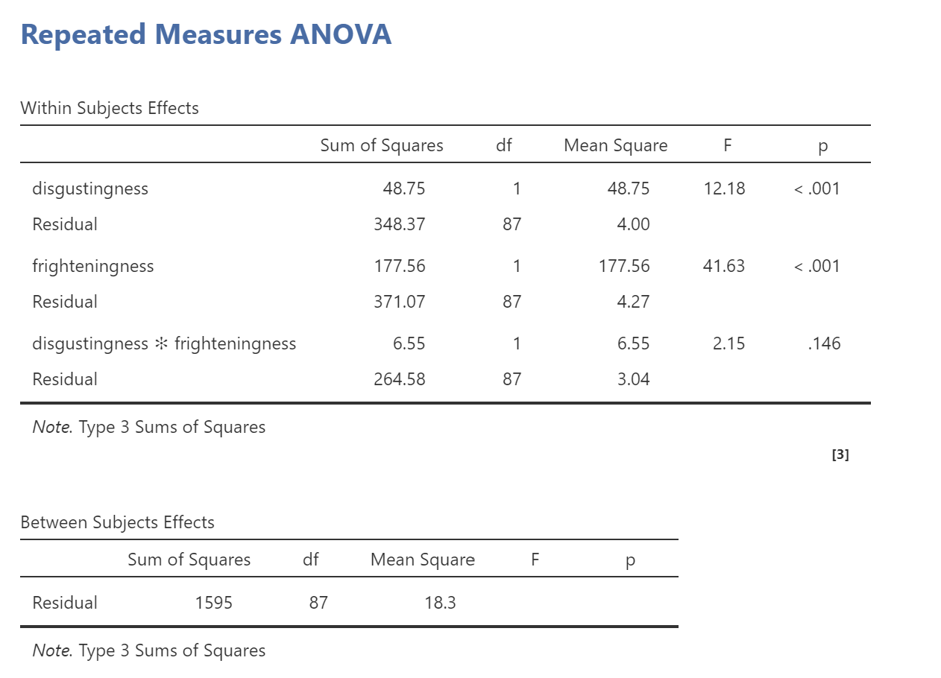
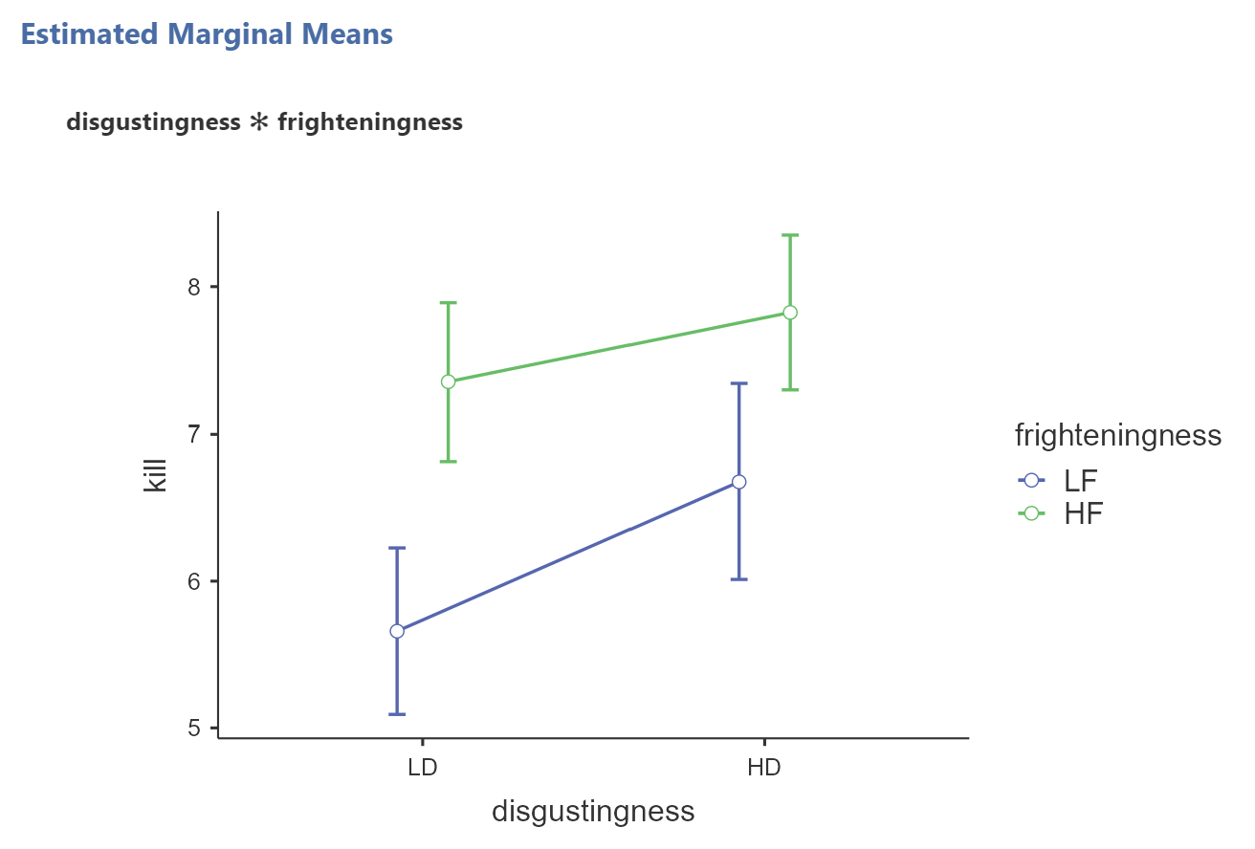
8. Statistics! - Repeated measures ANOVA

Slide 26
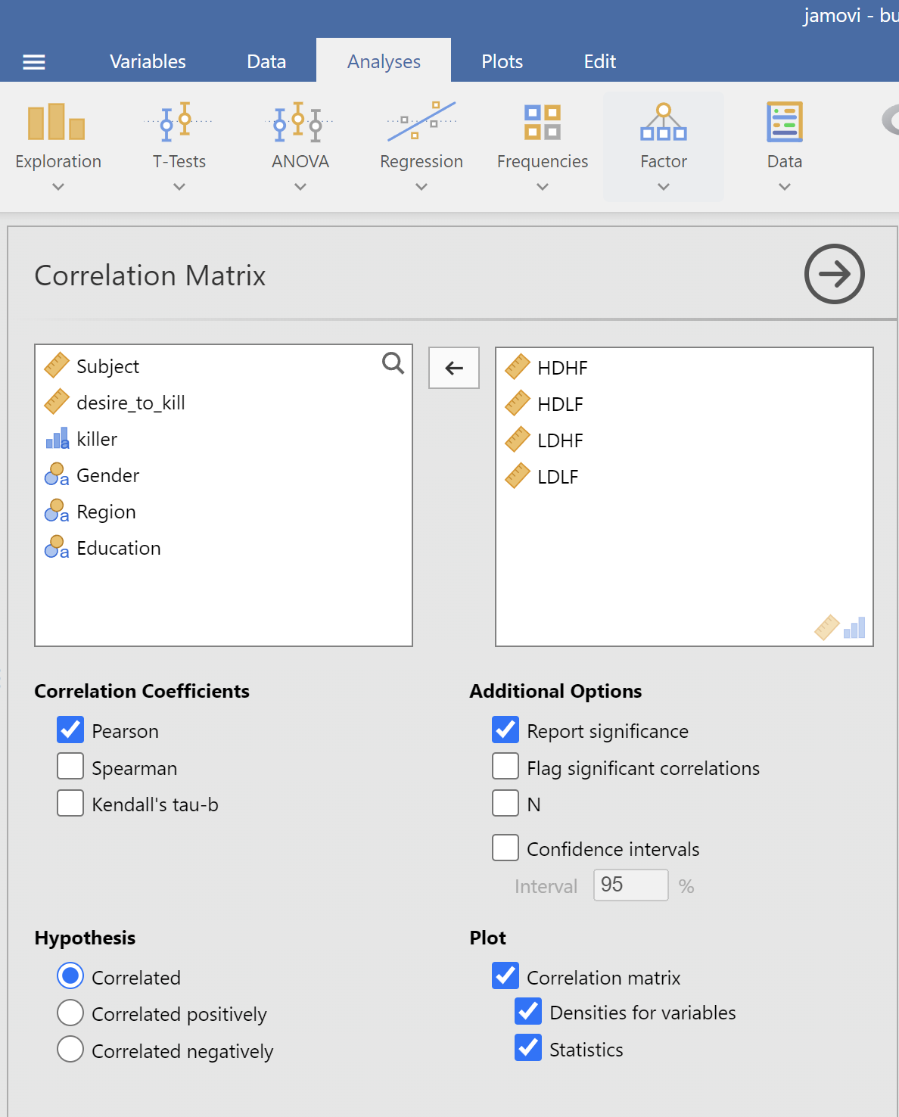
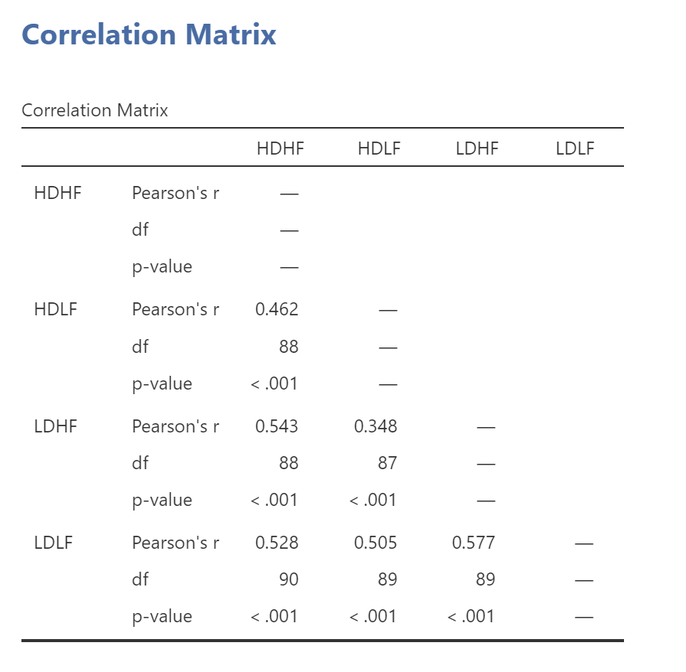
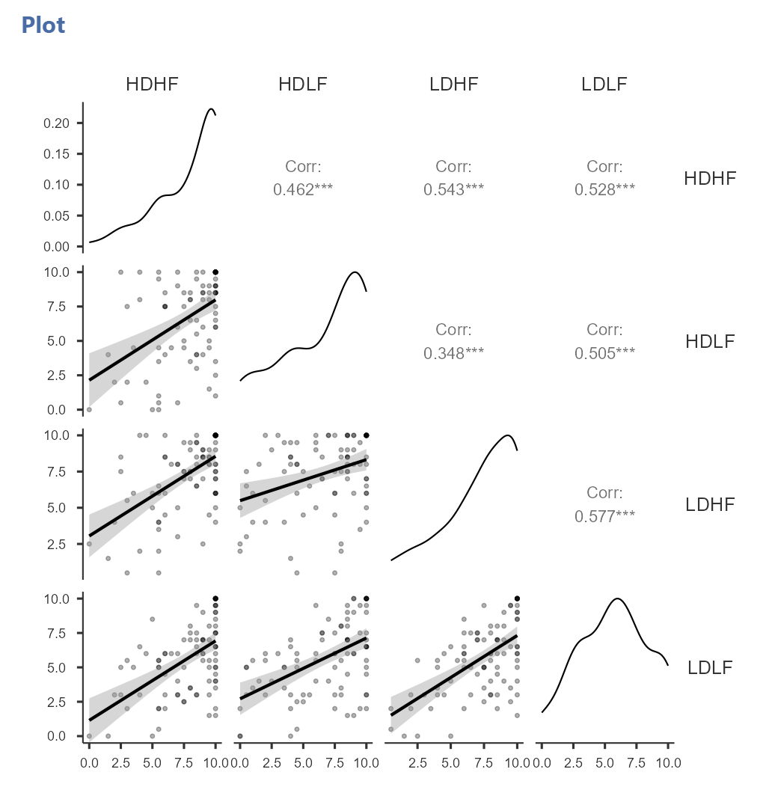
8. Statistics! - Correlation
Are the ratings across four conditions correlated?

Slide 27
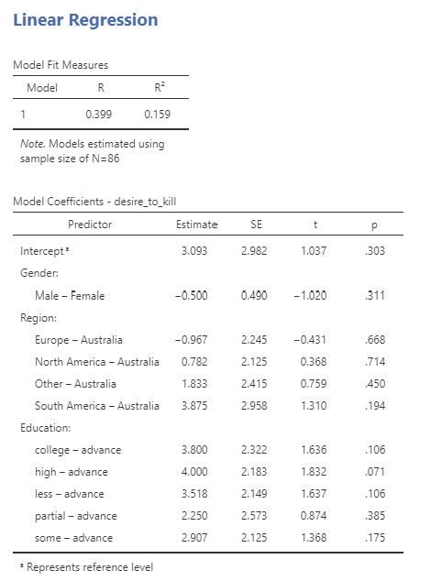
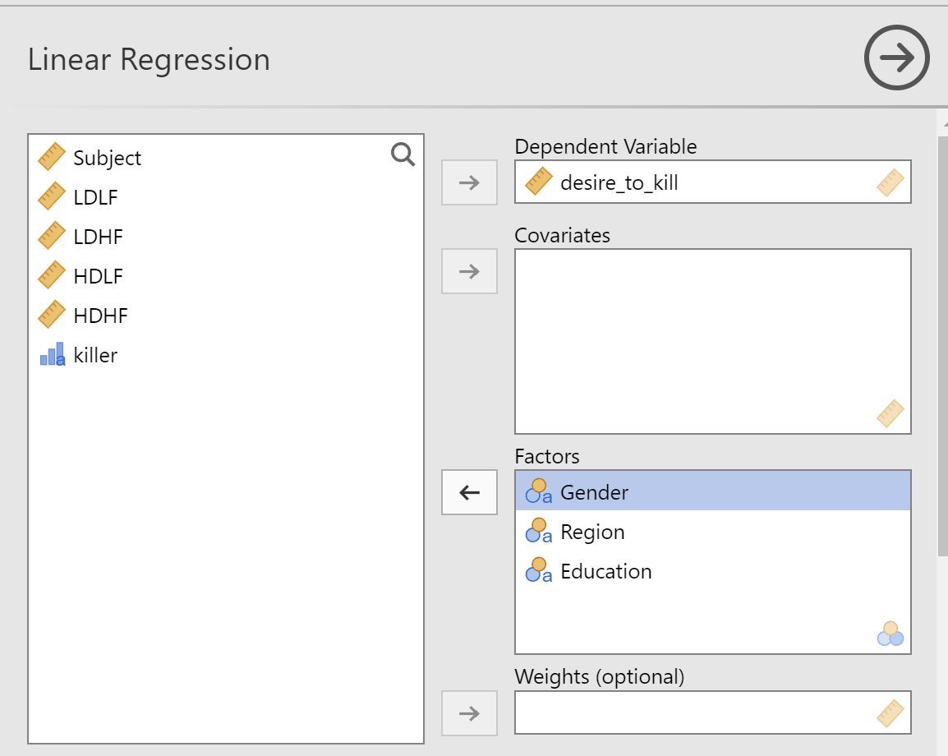
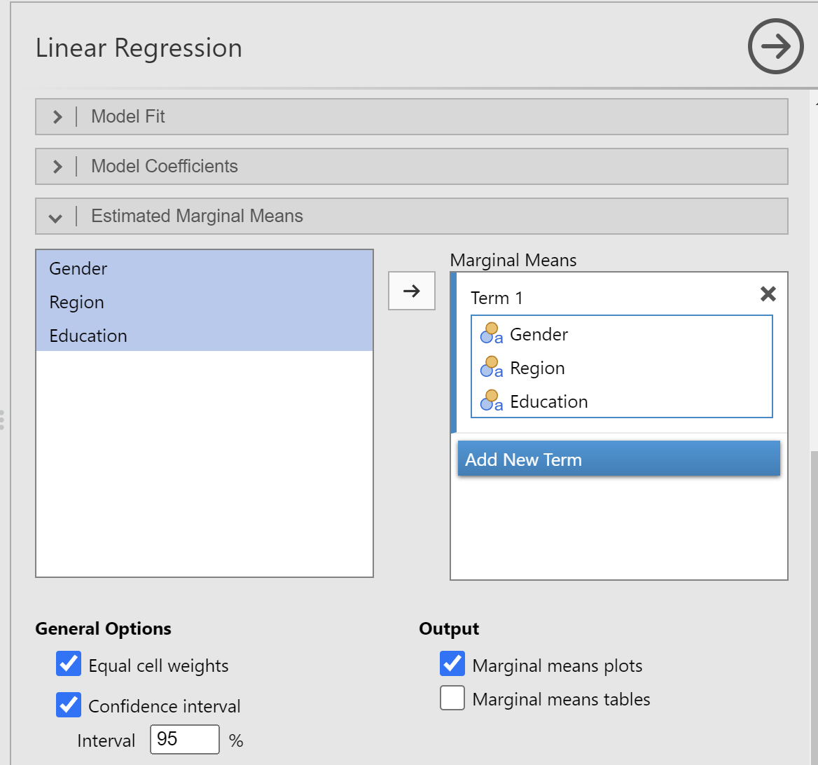
8. Statistics! - Regression
Do gender, region, and education predict overall desire_to_kill?

Slide 28
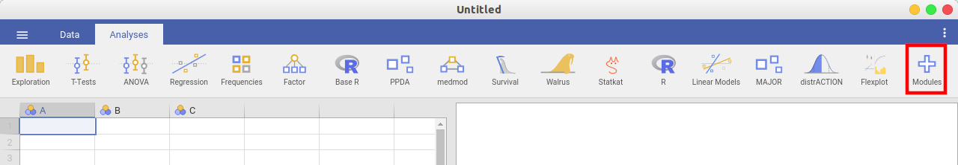
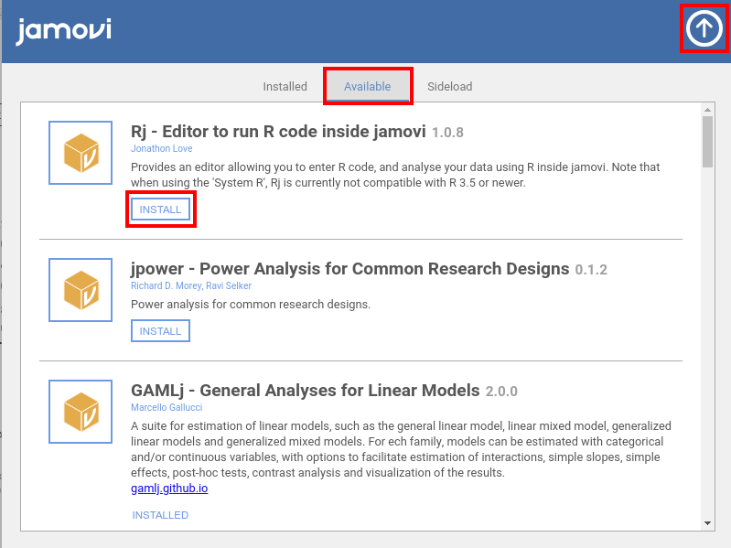
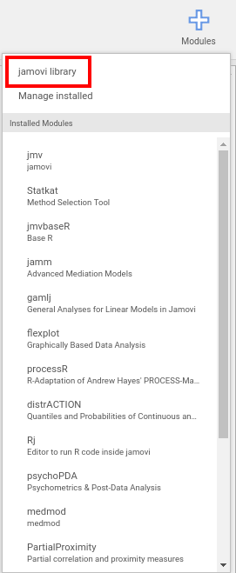
9. Modules
Rj
jTransform

Slide 29
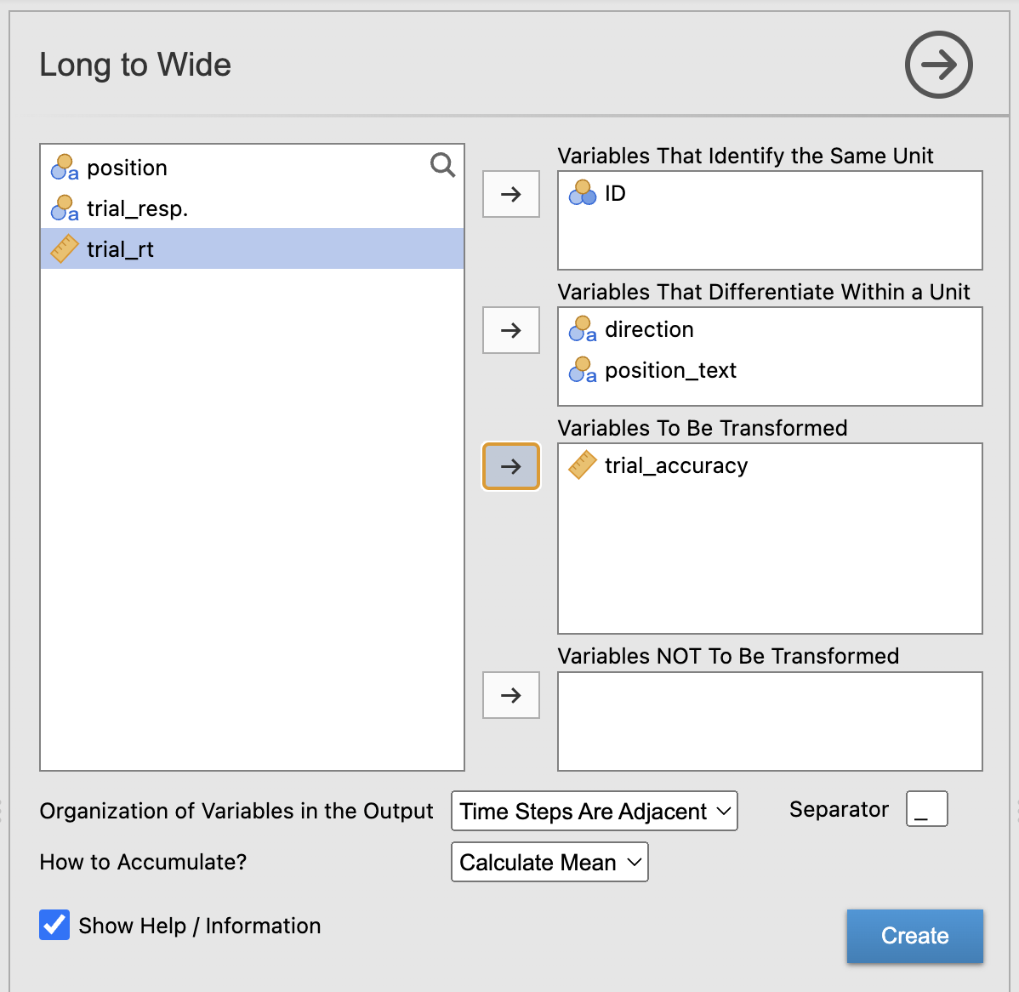
10. Long format and wide format
Data are often stored in the long or wide format
E.g.,
  behavioral tasks with multiple trials store data in the long format
  statistical packages sometimes expect data in the wide format
Jamovi doesn’t have a function for that
but the module jTransfrom can do that

Slide 30
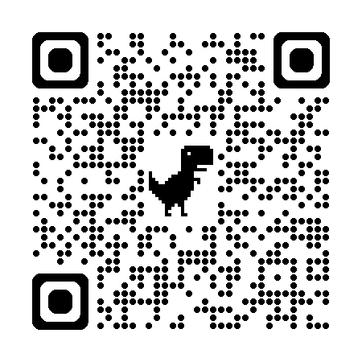
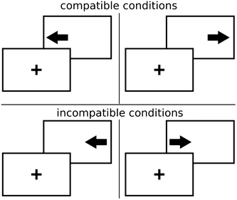
Exercise 4: Simon task
Download the data sets simon_data and gonogo_data from this link https://drive.google.com/drive/folders/12meW_MLh03t6F_aCJFA02S9Xd0tXZd_B?usp=drive_link
Open simon_data and Special Import all files
Stoet, G. (2017). Sex differences in the Simon task help to interpret sex differences in selective attention. Psychological research, 81(3), 571-581.

Slide 31
Exercise 4: Simon task
Convert positions coordinates to “left” or “right” (HINT: [-0.25, 0] = “left”)
Compute trial_accuracy (HINT: VALUE((direction == trial_resp.)))
Convert the long format data file into wide format, for accuracy and conditions respectively, and merge them into one

Slide 32
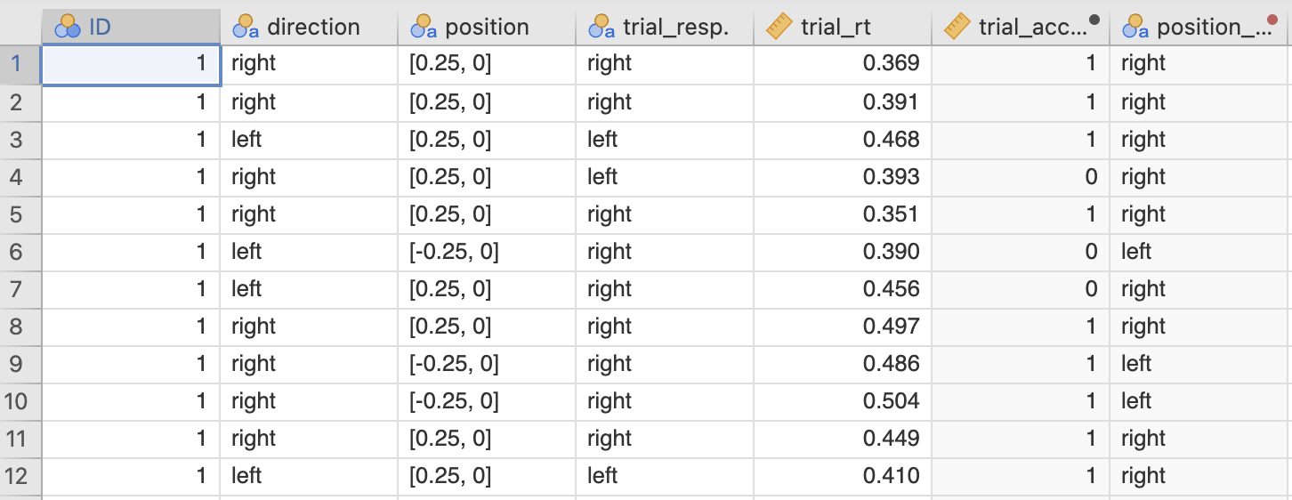
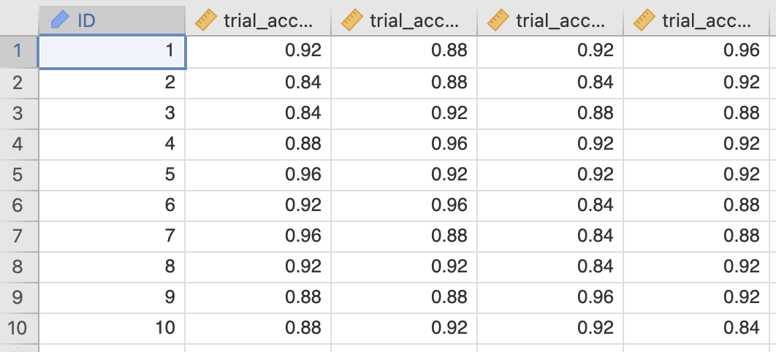
Accuracy by condition (direcion × position)
Long format:
Each measure is a row
Wide format:
Each participant is a row

Slide 33
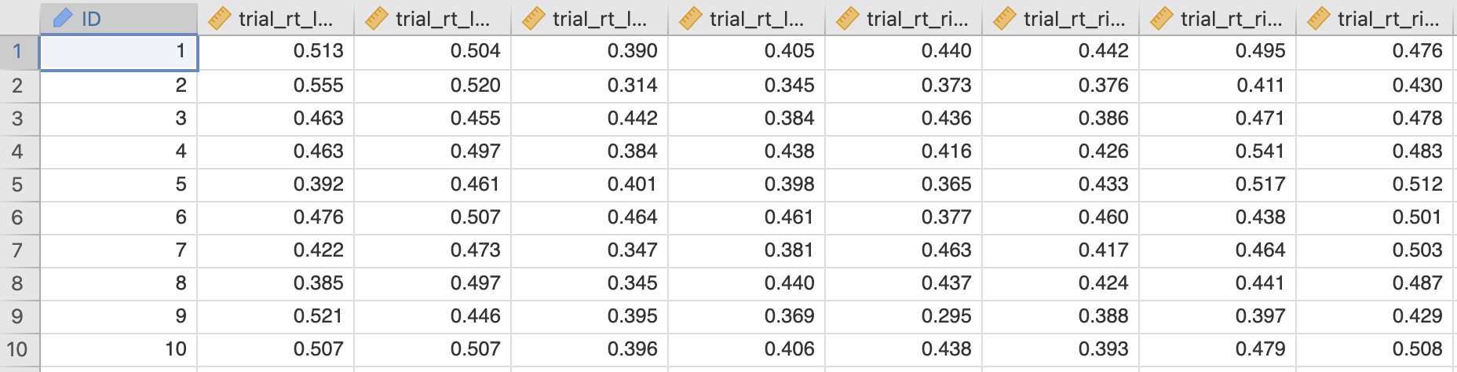
RT by condition (direcion × position × trial_accuracy)
Long format:
Each measure is a row
Wide format:
Each participant is a row

Slide 34
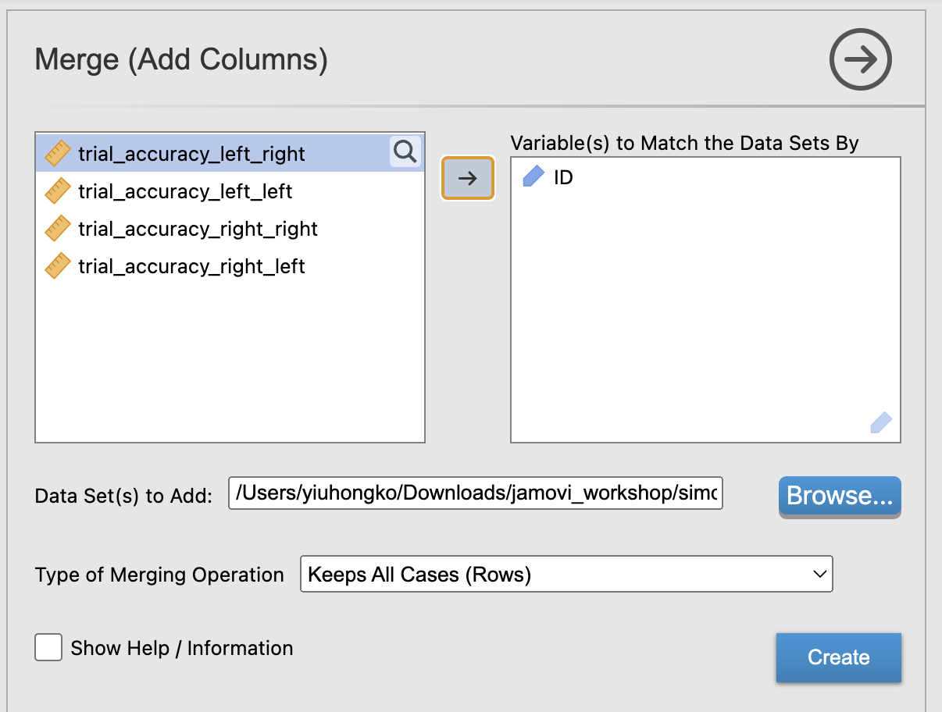
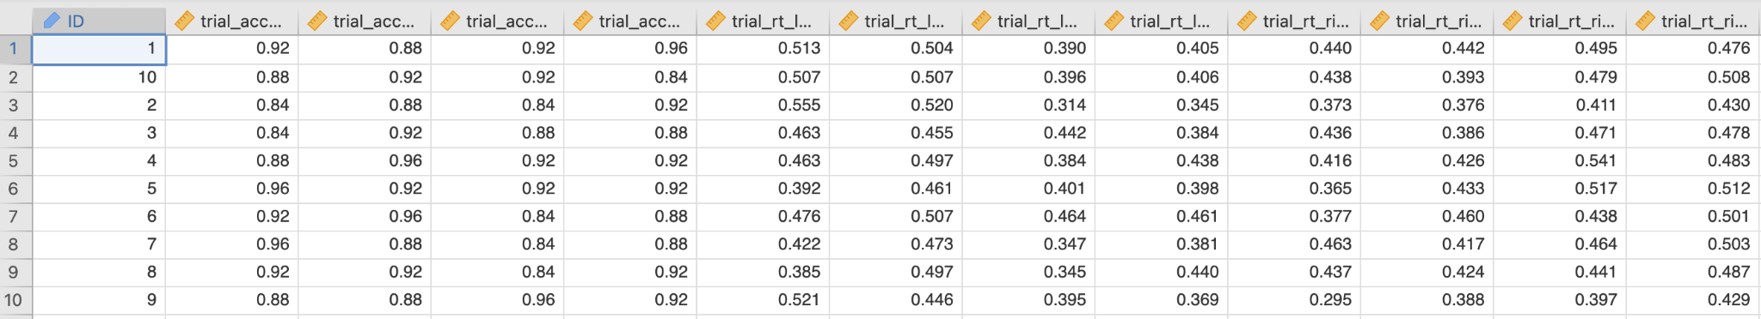
Merge

Slide 35
Exercise 4: Does congruence affect accuracy and RT?
Compute a variable that indicates congruence
Create a wide format of the data
Use a statistical test to determine if there’s any difference between congruence conditions in accuracy or RT

Slide 36
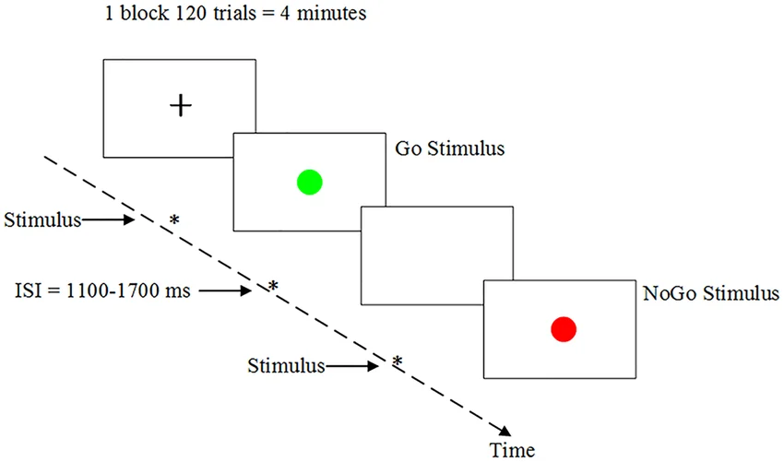
Final challenge!
Ten students completed a go/no-go task. To analyze their data, you need to:
Preprocess data
Import data
Rename variables and values if necessary
Compute trial_accuracy
Compute trial_outcome (Hit, FA, Miss, CR)
Data analysis
Does accuracy differ across go and no-go condition?
Does RT differ across hits and false alarm?
Find out how to calculate d’ and criterion c
Are the values of d’ and c significantly different from 0?
Guo, Z., Chen, R., Liu, X., Zhao, G., Zheng, Y., Gong, M., & Zhang, J. (2018). The impairing effects of mental fatigue on response inhibition: An ERP study. PloS one, 13(6), e0198206.

Slide 37
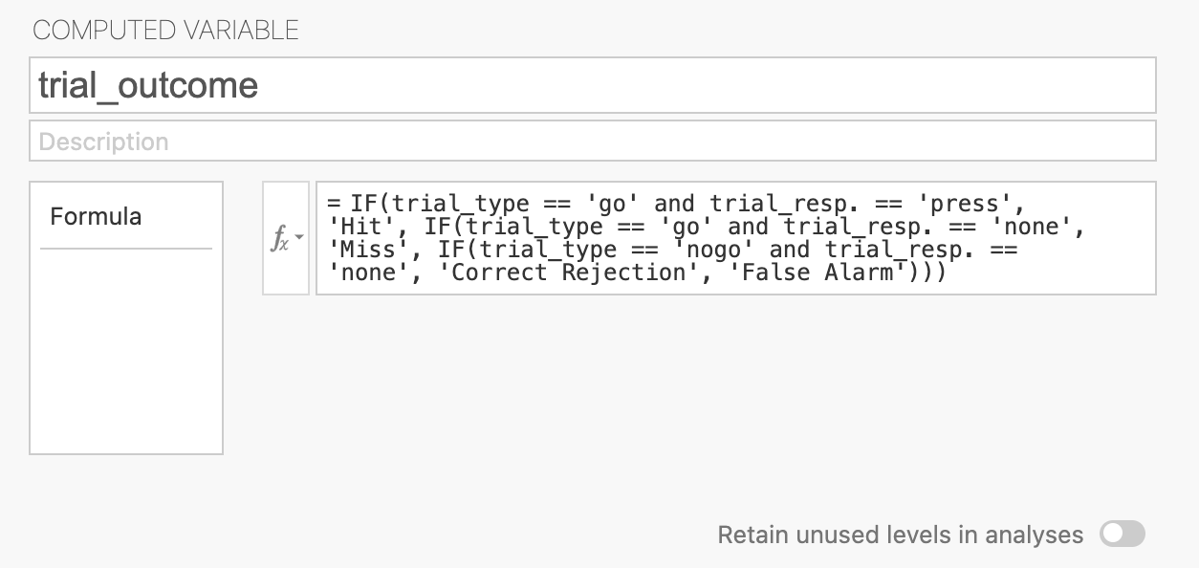
How to compute trial_outcome

Slide 38
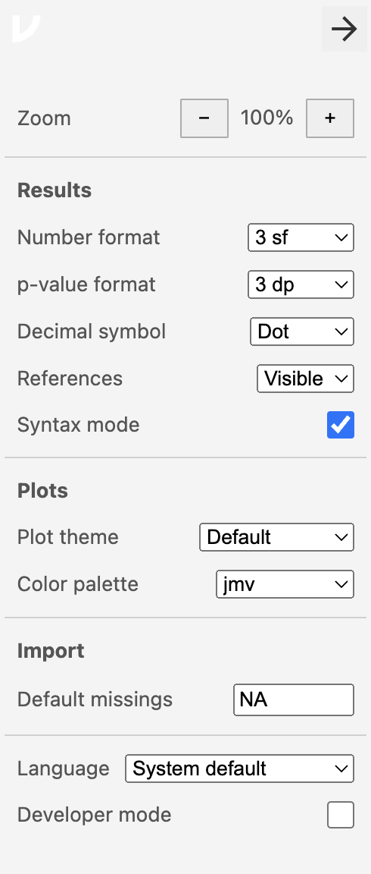
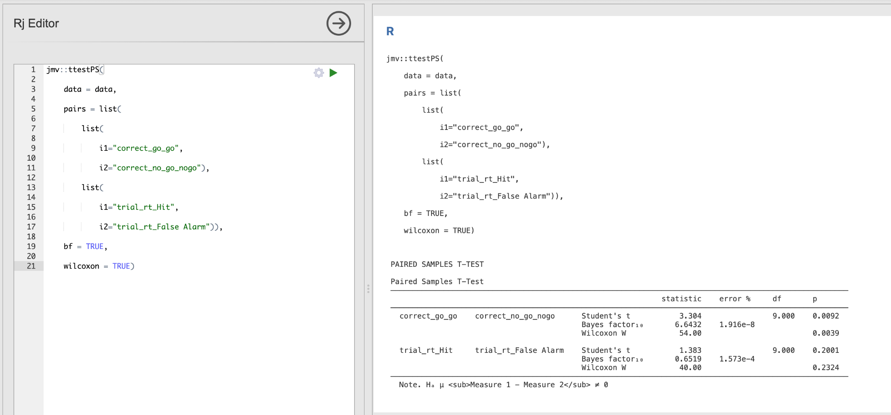
11. Jamovi syntax in R
Procedures on Jamovi could be recreated using the underlying R codes, which is available if Syntax mode enabled.
Find some code above the outputs in the result panel, and copy that to the Rj editor and run it!

Slide 39

If you’re interested in R
R: CRAN
RStudio: RStudio IDE | The Premier Free IDE for R
RStudio is an Integrated Development Environment (IDE) for R

Slide 40
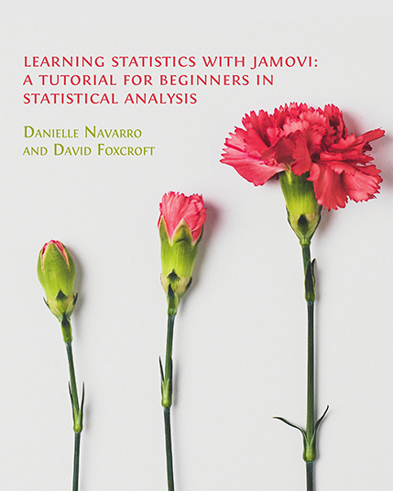
Resources
https://youtu.be/mZomeS0tLxY?si=YBIlvCYcFlOqeWh3
https://lsj.readthedocs.io/en/latest/
community resources - jamovi
Statistics in jamovi – Simple Book Publishing
jamovi Documentation

