Slide 1
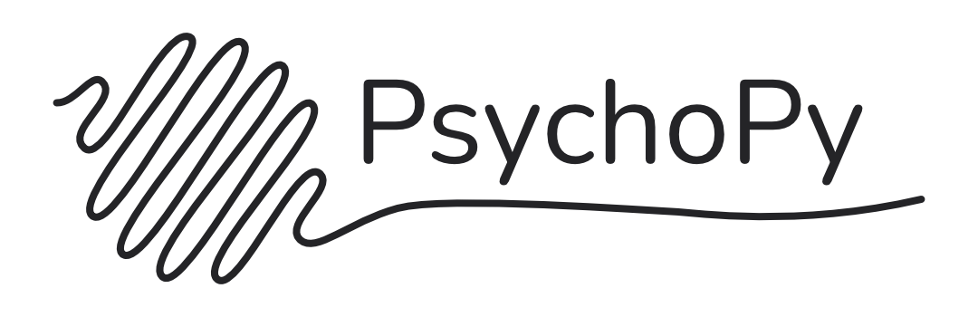
Building Behavioral Tasks with
28-29/5/2026 Yiu Hong Ko

Slide 2
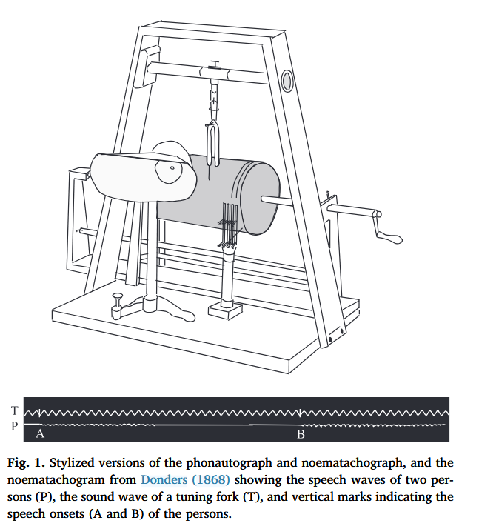
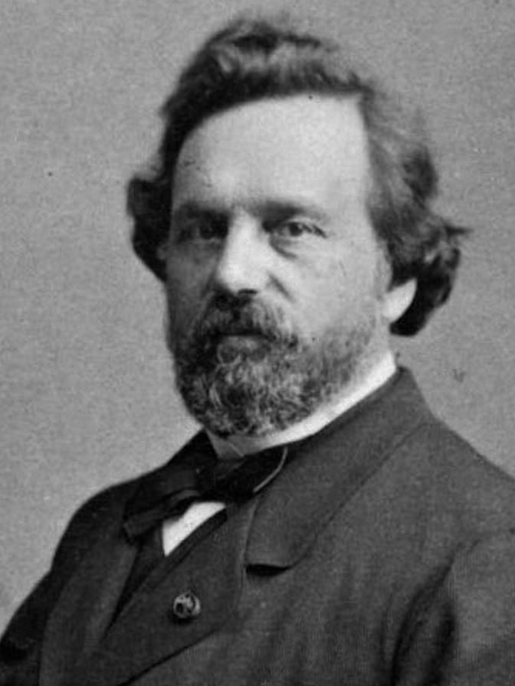
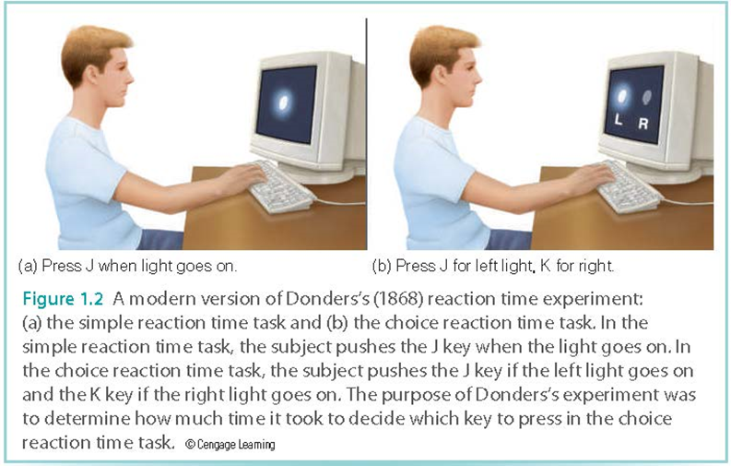
Why computer tasks?
Precision
  presentation of stimuli
  record of responses
Standardization
Replicability
Flexibility
Phonautograph (sound-self-graph)
Noematachograph (thought-speed-graph)

Slide 3



Why PsychoPy?
Commonly used programs are limited
Different computer programs are available
But PsychoPy is:
  Free
  Open-sourced, open access
  Graphical user interface (GUI)
  Python-based

Slide 4
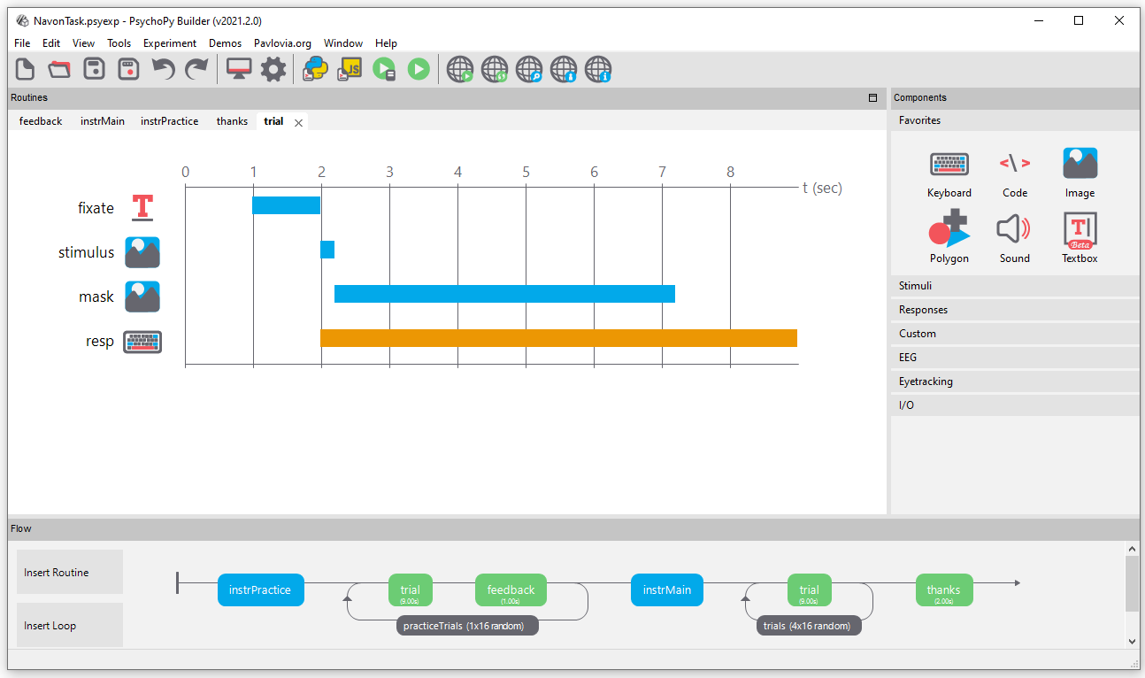
Builder
Components
Routines
Flow

Slide 5
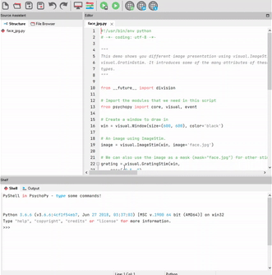
Coder
Source assistant (Directory)
Editor (Script)
Shelf (Console)

Slide 6
Let’s build a task!

Slide 7
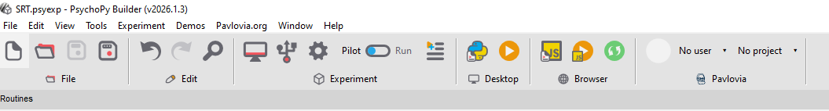
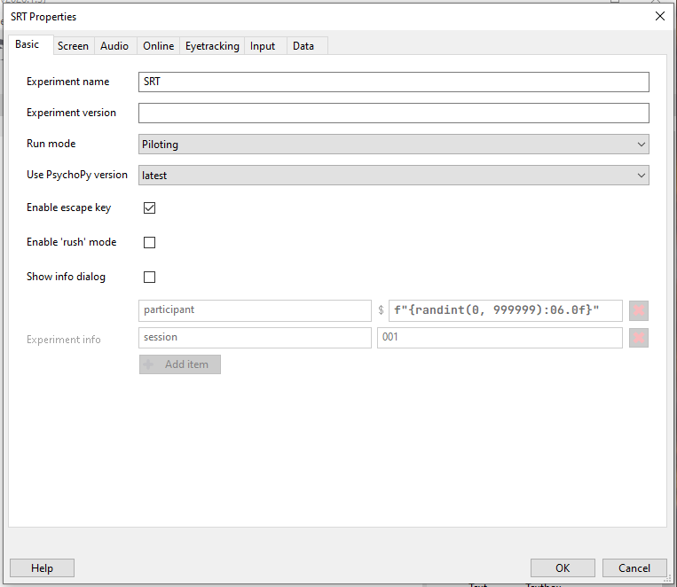
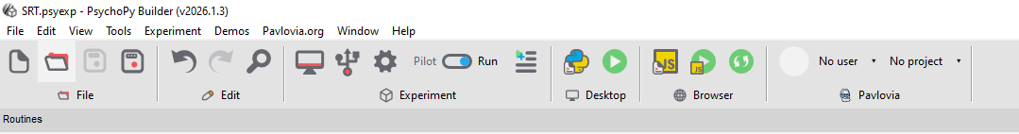
Enable full screen

Slide 8
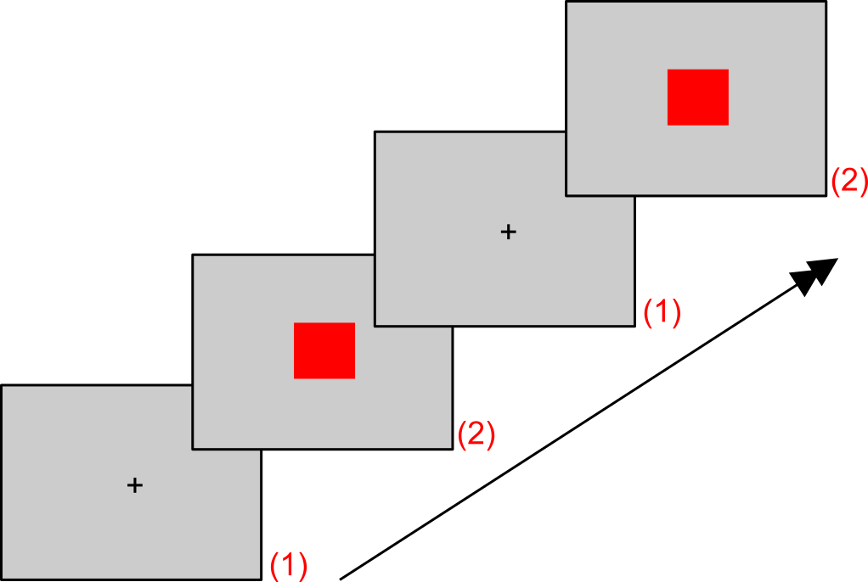
SRT – part one
A dot and a keypress

Slide 9
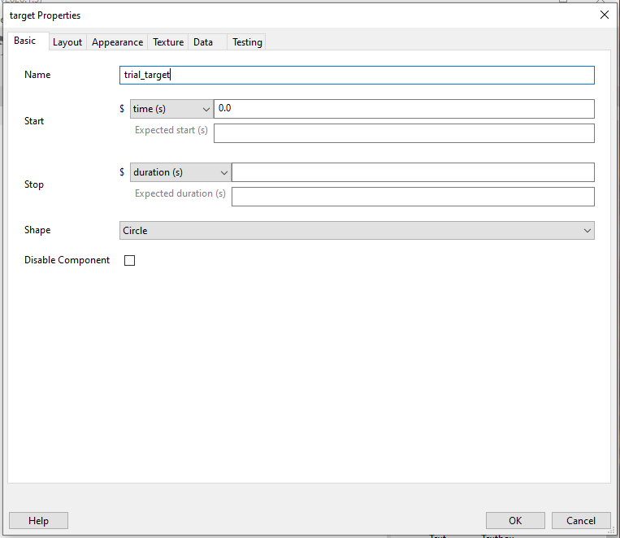
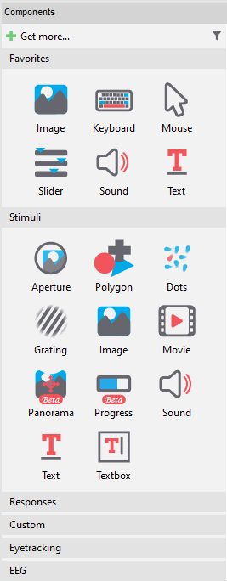
informative name
= unlimited time

Slide 10
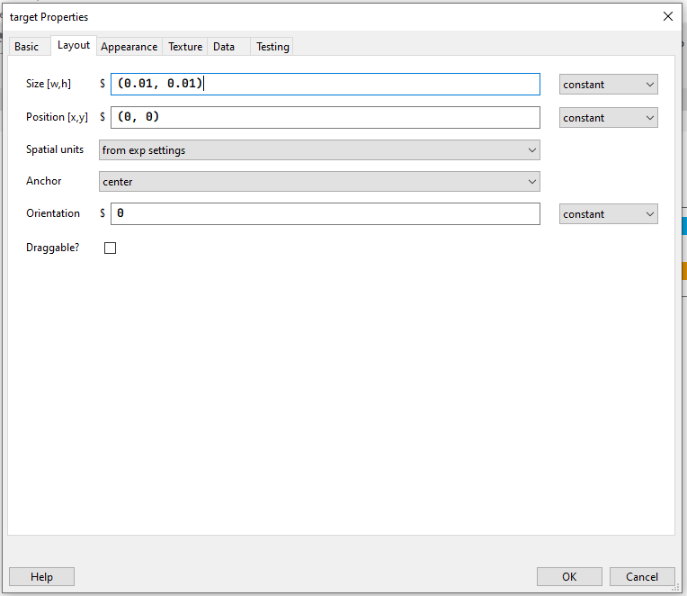
= 0.01 of screen height

Slide 11
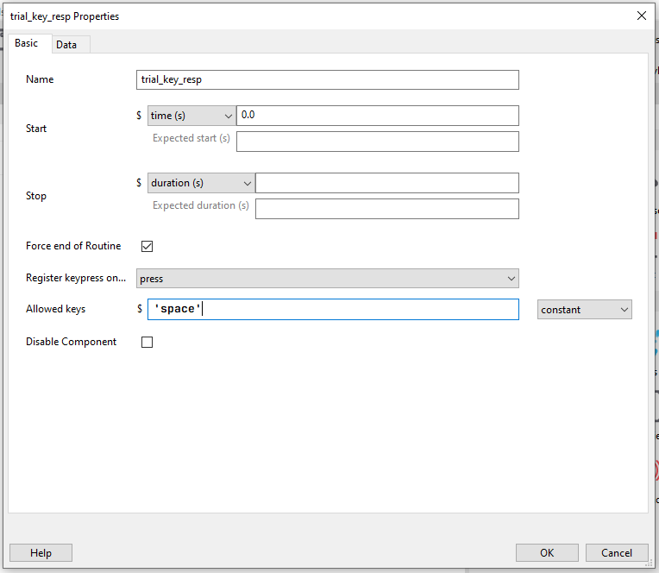
Name that you can remember
Empty = unlimited time
Empty = any key

Slide 12
Start experiment

Slide 13
SRT – part two
Instructions, a dot and a keypress, end

Slide 14
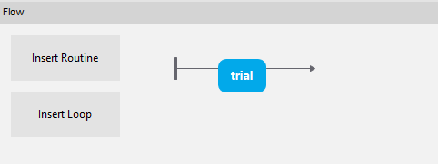
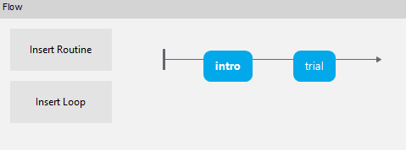

Slide 15
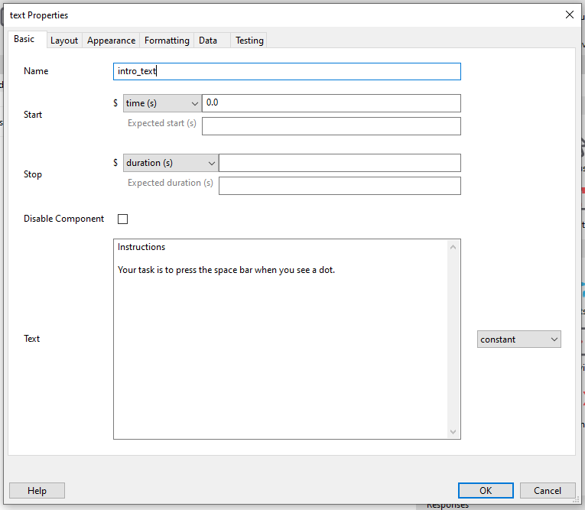

Slide 16
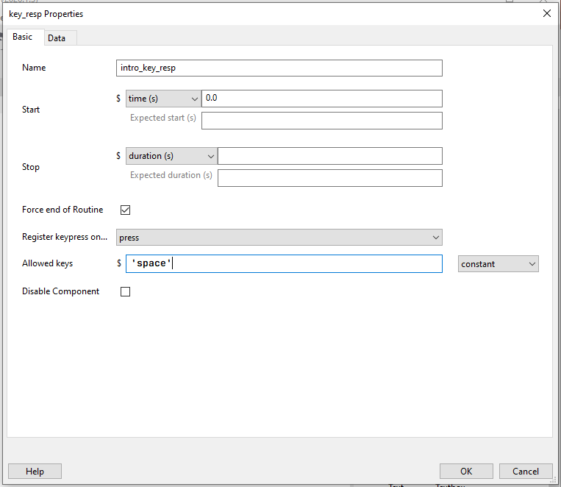

Slide 17
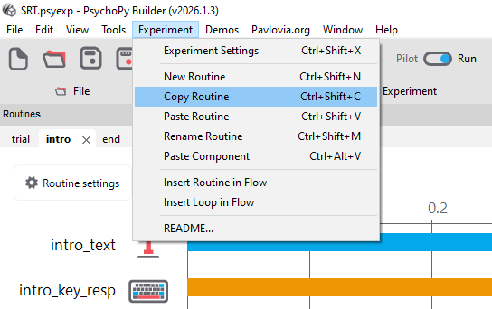

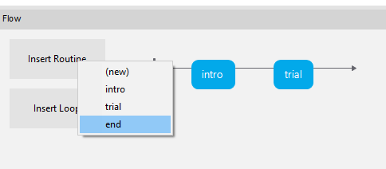
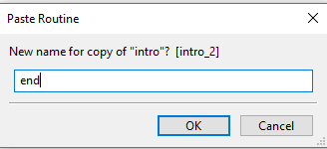

Slide 18
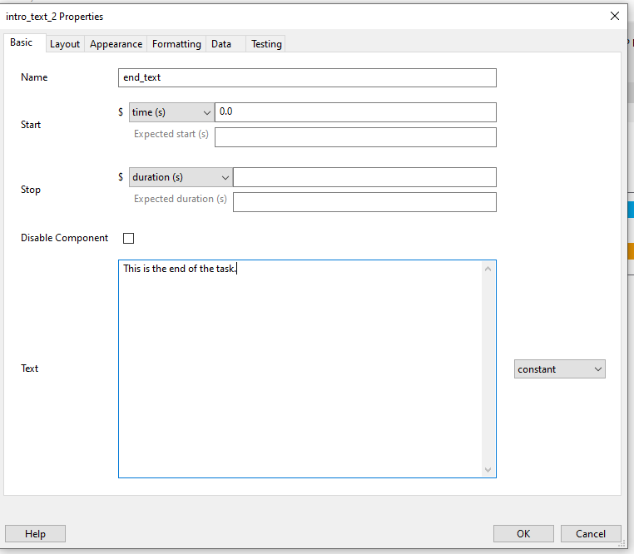
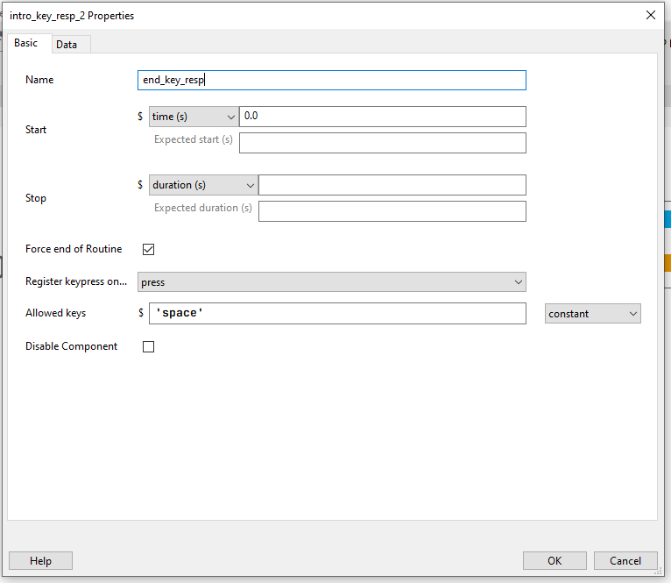

Slide 19
SRT – part three
Instructions,
[random ISI, a dot and a keypress] <-repeat this,
end

Slide 20
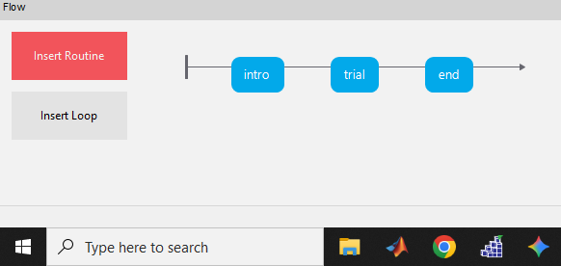
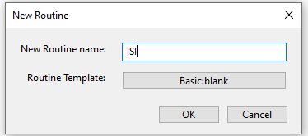

Slide 21
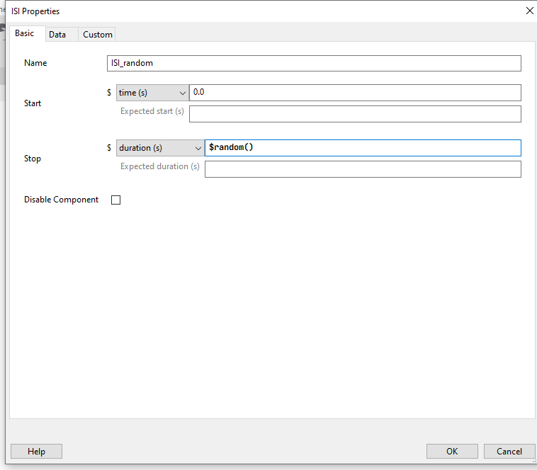
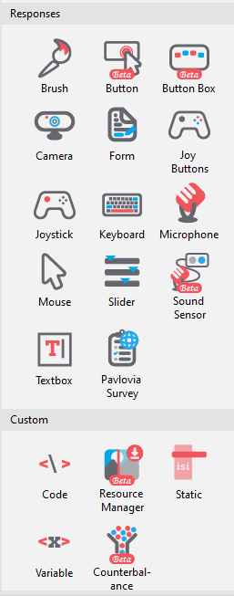
$: read as Python code

Slide 22
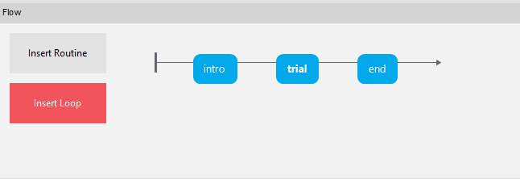
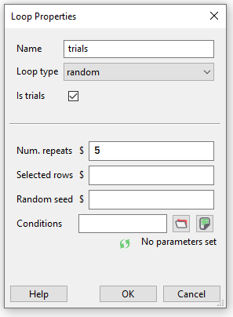
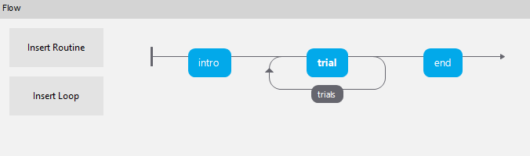

Slide 23
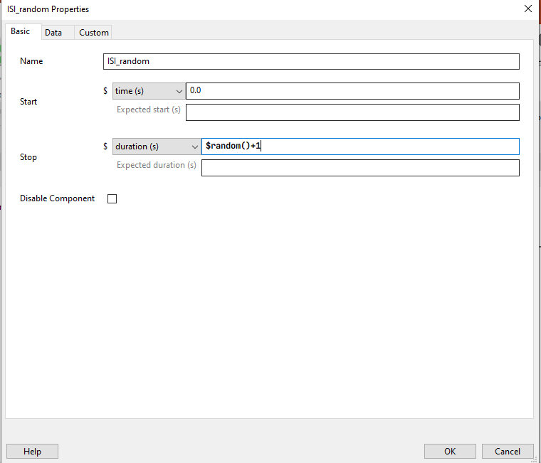

Slide 24
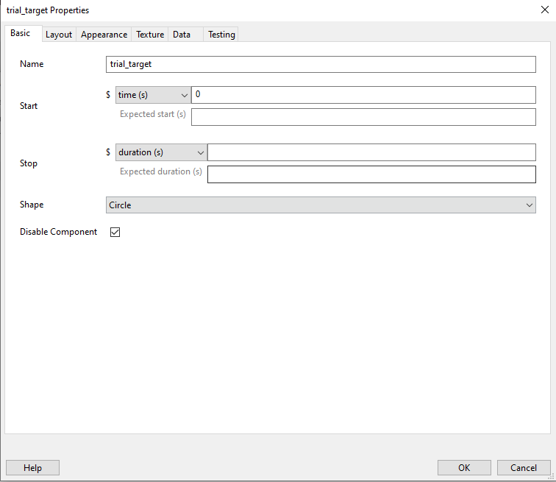

Slide 25
Challenge #1
Present something on screen somewhere, for some period of time, and require some responses
  Stimulus:
    Text
    Image
    Video
  Response:
    Keypress
    Mouse click
    Slider

Slide 26
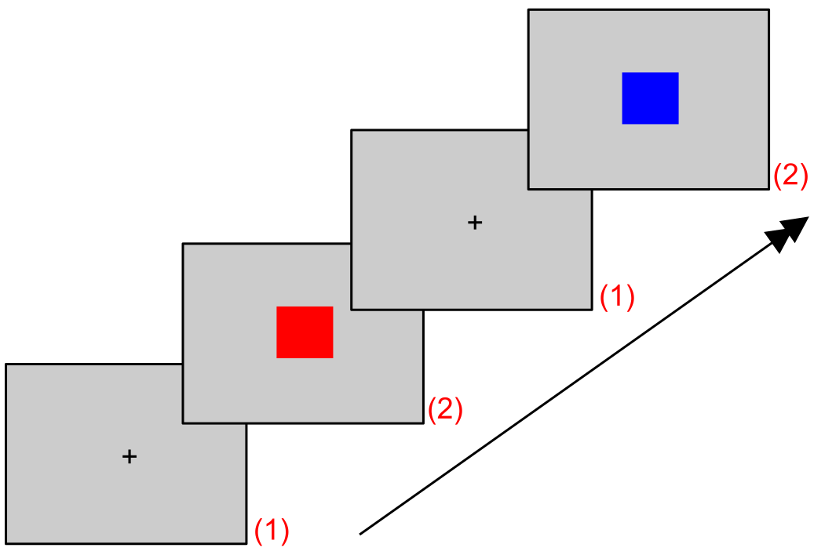
CRT
Instructions,
[random ISI, either stimulus A or B, and a keypress] <-repeat this,
end
https://www.neurobs.com/manager/content/docs/psychlab101_experiments/Choice%20Reaction%20Time/description.html

Slide 27
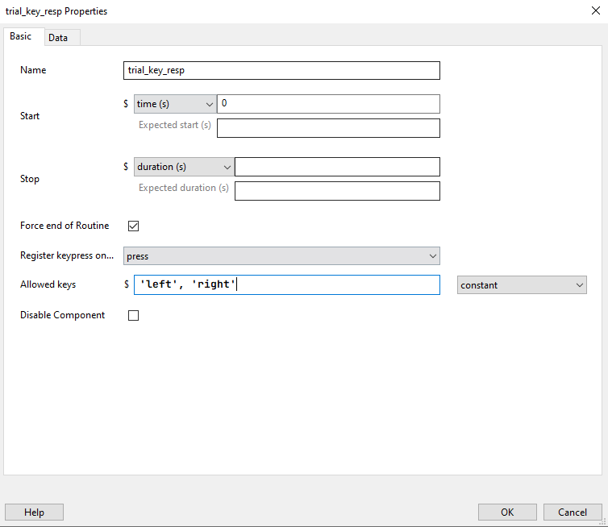

Slide 28
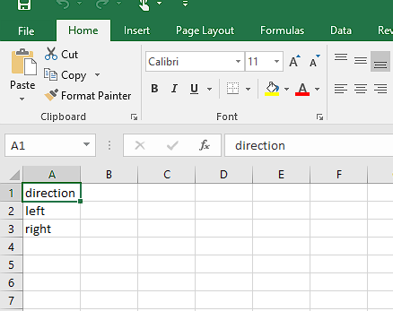
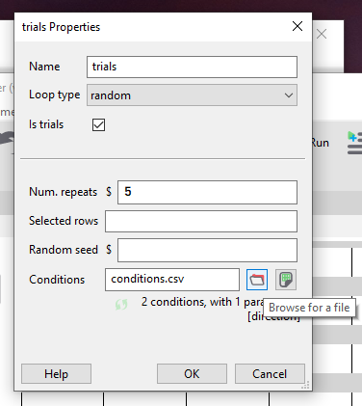
conditions.csv

Slide 29
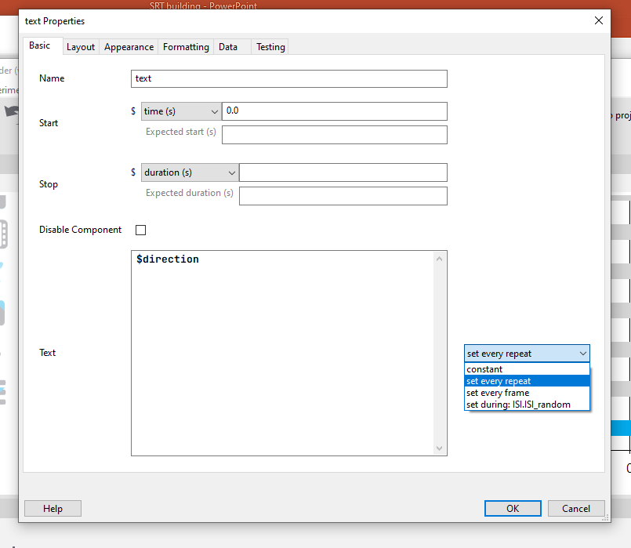

Slide 30
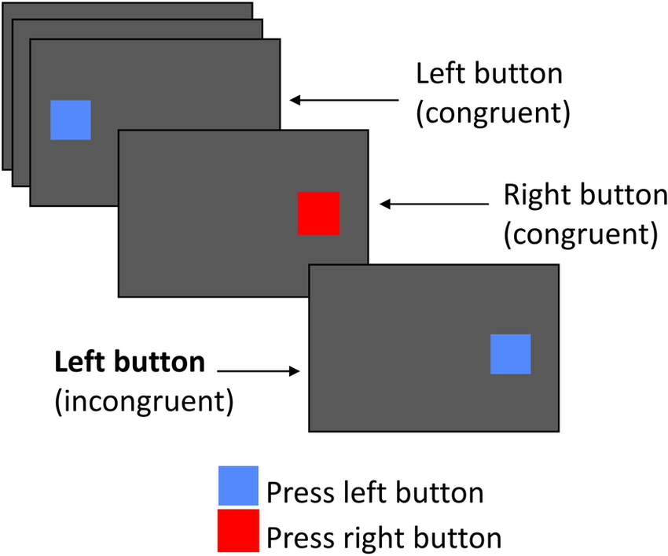
Simon task
Instructions,
[random ISI, either stimulus “left” or “right” on either left or right, and a keypress] <-repeat,
end
Jokinen, H., Laakso, H. M., Arola, A., Paajanen, T. I., Virkkala, J., Särkämö, T., Makkonen, T., Kyläheiko, I., Heinonen, H., Pitkänen, J., Korvenoja, A., & Melkas, S. (2025). Executive functions and processing speed in covert cerebral small vessel disease. European Journal of Neurology, 32(1), e16533. https://doi.org/10.1111/ene.16533

Slide 31
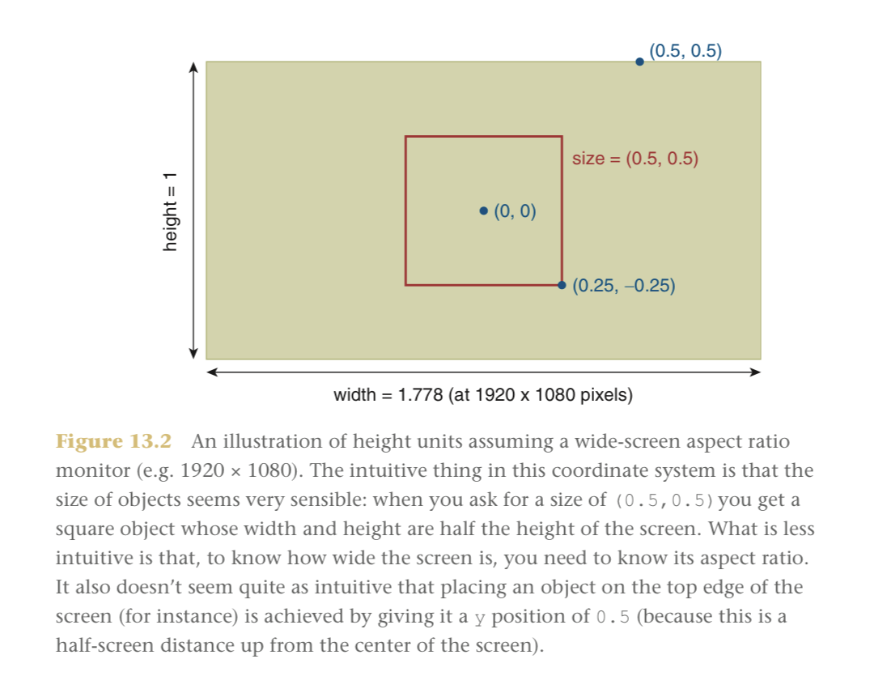
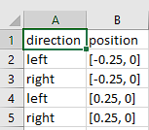
 | Text | Position
Condition 1 | Left | Left
Condition 2 | Right | Left
Condition 3 | Left | Right
Condition 4 | Right | Right
Peirce, J., Hirst, R., & MacAskill, M. (2022). Building experiments in PsychoPy (2nd ed.). Sage Publications.

Slide 32
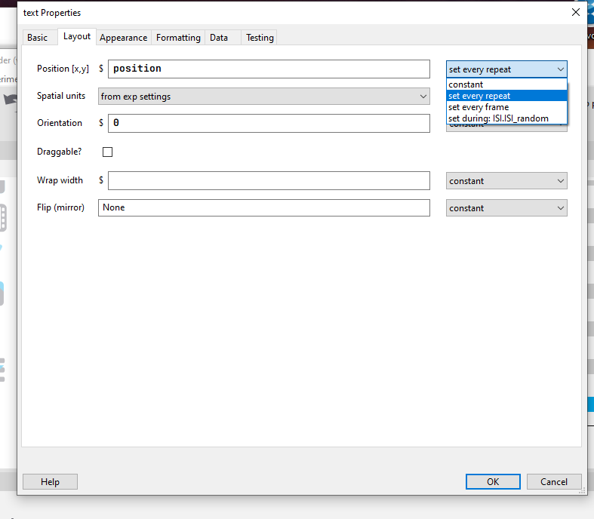

Slide 33
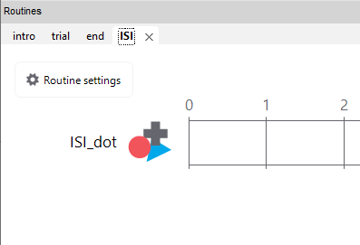

Slide 34
Challenge #2
Present something on screen somewhere, for some period of time, and require some responses, with different conditions
  Oddball task
  Go/No-Go Task
  Flanker task?
  Stroop task?

Slide 35
Data

Slide 36
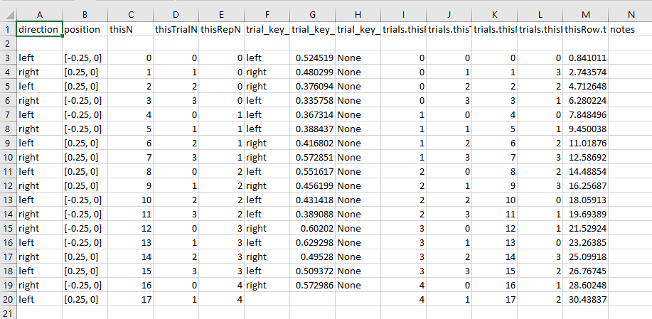
Data
Stimulus parameters
Response parameters
Routine parameters

Slide 37
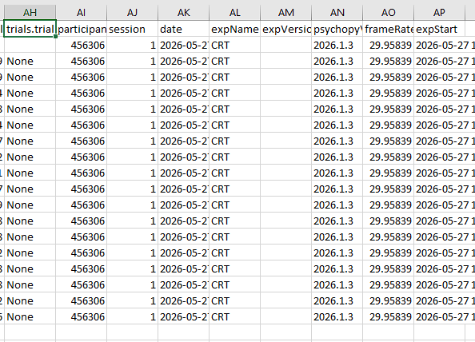
Session information

Slide 38
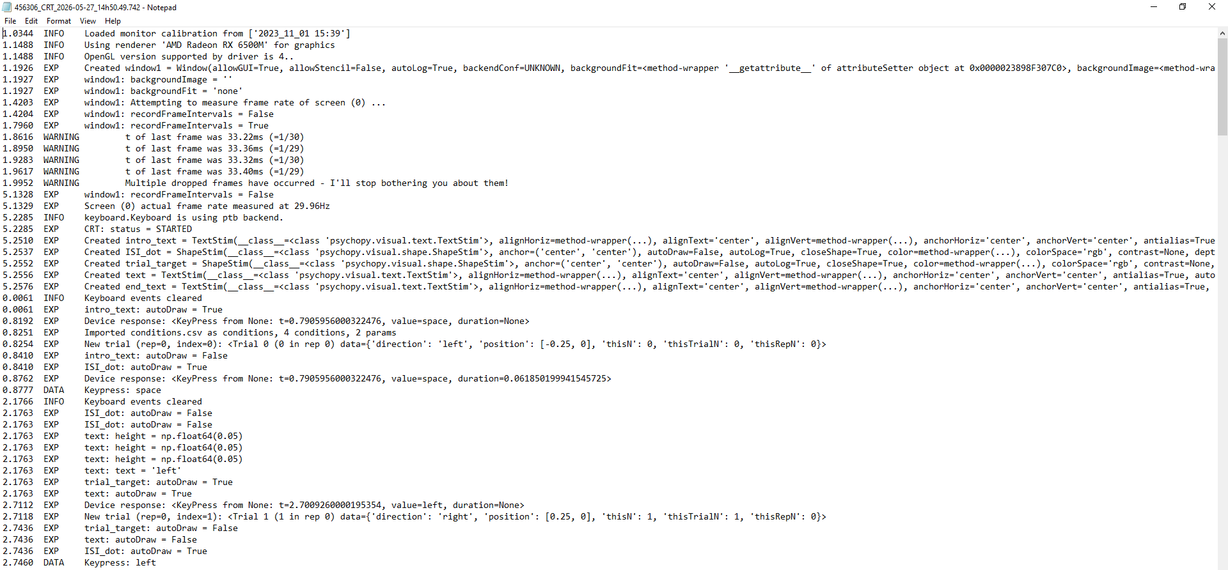
Log

Slide 39
Feedback
Instructions,
[random ISI, either stimulus “left” or “right” on either left or right,
and a keypress, followed by feedback “correct” “incorrect”] <-repeat,
end

Slide 40
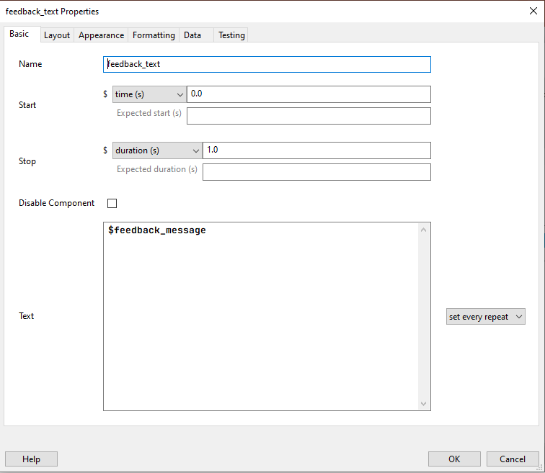

Slide 41
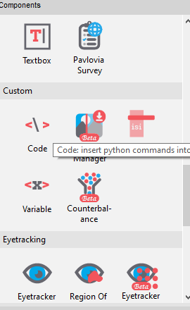

Slide 42
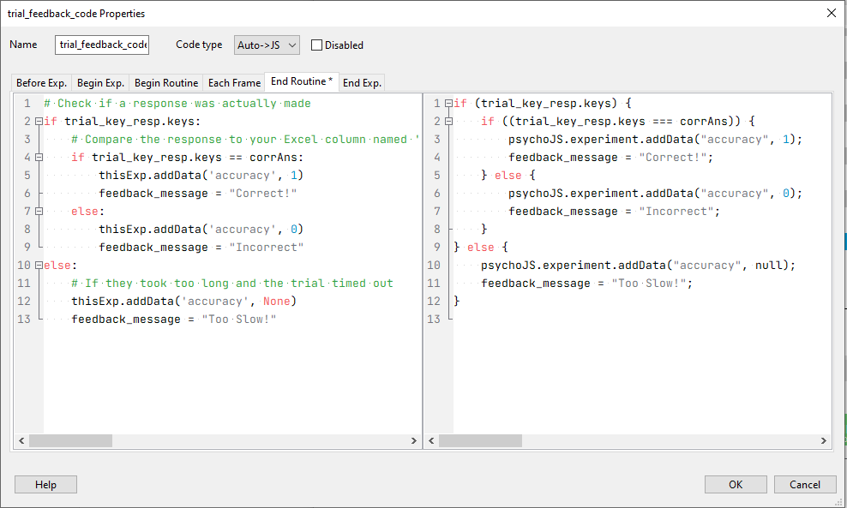

Slide 43
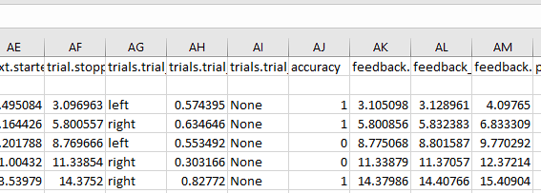

Slide 44
Challenge #3
Use AI to change the code block so that:
  “Correct!” is green
  “Incorrect!” is red
Use AI to add code block so that:
  A smiley face is presented as correct feedback
  A frowny face is presented as incorrect feedback

Slide 45
Practice
Extracted from the workshop “Creating an Experiment in PsychoPy” (https://workshops.psychopy.org/)

Slide 46
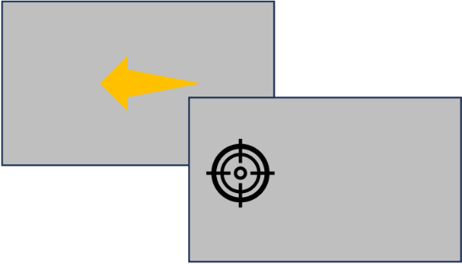

Setting up your trial
Example trials valid (top) Invalid trial (bottom)
Example: A Posner cueing task. An arrow cues the location of a target. The participant must respond using the left and right arrow keys.
What component make up this routine?
An arrow/cue
A target
A keyboard response (left/right keypress - respond to the location of the target)

Slide 47

Presenting Shapes: Add a “Cue”
Let's add our cue to the "trial" routine.
Cue stimulus: Add a polygon and leave the shape as "triangle". The cue starts at 0 seconds and lasts 1 second. in the layout tab set orientation to 90.
In the layout tab make the cue slightly smaller by setting size to (0.1, 0.1)

Slide 48

Presenting Shapes: Add a “Target”
Let's add our target to the "trial" routine.
Target stimulus: Add another polygon, set shape to be "circle". The target starts at 1 second and stays onscreen until a response is made.
To make a stimulus stay on screen until a response is made, leave the duration as blank. In the layout tab set the position to (0.5, 0).
Make the target slightly smaller by setting size to (0.1, 0.1)
The x, y coordinate for the centre of your screen is 0, 0. Positive x values are right and negative left. Positive y values are up and negative down. Therefore a position of (0.5, 0) will position your target on the right of the screen.

Slide 49

Understanding PsychoPy units
When controlling the size and position of your stimuli, you want to know what unit stimuli are presented in. You can see what unit your stimuli are using in the layout tab. You can see more about PsychoPy units here.
from exp settings: unit inherited from global experiment settings (see next slide). By default we use "height". This means that everything will be scaled proportionally to the window size. a size of 0.5 corresponds to 50% of the window height.
If you are using any unit other than "height" or "norm" you must configure your monitor settings in the Monitor Centre. For online experiments, we recommend "height" units because this means that stimuli will scale proportionally to the participants screen.

Slide 50


Your Experiment Settings
By selecting the cog icon at the top of the Builder app, you can access the global settings of your experiment.
In the "Basic" tab you can configure your experiment name, what version of PsychoPy you are using and add/remove fields in the "Experiment Info".
In the "Screen" tab you can set up the global units used in your experiment, if you want to use full screen, and which monitor from your Monitor Centre you want to use.
Everything in the "Experiment Info" will be presented as options in a dialogue box at the start of your experiment. So you can provide info such as participant ID.

Slide 51

Gather a Keyboard Response
Add a keyboard component to the trial routine, set the start time to 1 (start of the target) and allow “left” and “right” keys.
Keyboard responses also have a start time and duration, by default, the duration field is blank (meaning it will last indefinitely).
Force end of Routine: If checked, a keyboard response will end this routine, and the experiment will move on.
Allowed keys: A list of key names to watch (each name must be in quotations and separated by commas). if blank, all keys will be watched.

Slide 52
Check it works!
You can run your experiment by pressing the green "run" icon. You should see your cue appear for 1 second, then your target, which should remain onscreen until a response is made.

Slide 53

Setting up your trials spreadsheet
Most experiments consist of a series of trials. Before making an experiment think about what changes trial by trial and make a spreadsheet.
What changes trial-by-trial?
Arrow orientation (90 or 270 degrees)
Target location (x coordinate)
Column headers: Parameters that change trial-by-trial.
Correct answer (left or right)
Row values: The value of each parameter on each trial.

Slide 54


Repeating a routine e.g. a series of trials
Select "Insert Loop" and select either side of the routine(s) you want to repeat (for us this is the trial routine)
In the conditions field select the spreadsheet we created.
Conditions: A spreadsheet detailing what changes trial-by-trial (see previous slide)
nReps: the number of times the spreadsheet rows are repeated (if no spreadsheet this is just the number of times the loop repeats)
Selected Rows: Row indices from the spreadsheet to present

Slide 55
Repeating a routine e.g. a series of trials
loopType:
random - randomise rows of spreadsheet - within repetition.
full random - randomise across repetitions of the spreadsheet.
staircase/interleaved staircase - specialised adaptive procedures used typically in psychophysics.
Is Trials: if yes, add new row to data file for every repeat of this loop.
If you set nReps to 0 then everything inside that loop will be skipped. This is useful for debugging and branched designs (e.g. if you only want to show part of your experiment)

Slide 56


Updating stimuli trial-by-trial
We can now update our stimuli using the variables in our spreadsheet.
In the target stimulus, we can update the x coordinate using target_x_location.
Set the field to ”set every repeat”

Slide 57

Updating stimuli trial-by-trial
We can now update our stimuli using the variables in our spreadsheet.
In the cue stimulus we update the orientation using arrow_orientation.
If you are using a variable to update a component property start the field with a '$' sign only if that field does not already have a '$' in it.s field.
Set the field to ”set every repeat”

Slide 58
Check it works!
You can run your experiment by pressing the green "run" icon. You should now see the location of your target and the orientation of your cue change trial-by-trial.

Slide 59
Exercise
Add a new routine for your instructions
Present some text telling the participant what to do, allow them to press space to start the experiment.
Add a routine to say "Thanks" at the end of the experiment.
Add another field to your experiment settings to gather more information (e.g. handedness, age)

Slide 60

Presenting Text
Two components can be used for adding text. Text and TextBox. TextBox has the added benefit that you can use similar formatting to what you would with a text box e.g. anchor alignment.
You can also use the TextBox component to gather typed responses

Slide 61


Storing accuracy from keypress responses
To store whether a participant was correct or incorrect, you can use the column from your trials spreadsheet.
In your keyboard component select the "Data" tab.
Check "store correct"
in the correct answer field feed in the column from your spreadsheet.

Slide 62
Extending Builder with code
Sometimes you might want to add flexibility to your experiment in ways that might not be accommodated through the GUI interface. This is one of the reasons people may prefer to use code.
In PsychoPy, you can use code components to add flexibility where code is needed.
Example: I want to give my participant trial-by-trial feedback (e.g. "Correct!" if response was correct and "Incorrect" if response was incorrect). In this example we do not know what the text we present will be until a response is made, so we need some conditional IF/ELSE statement to set up our text.

Slide 63

Adding trial-by-trial feedback
Start by adding a new routine to your experiment called "feedback". It should appear after the "trial" routine, but it should occur on every trial, so it therefore needs to be within the loop.

Slide 64


Adding trial-by-trial feedback
The tab you add your code to is important. Here we don't know if you are correct until the beginning of your feedback routine. So we add the code there.
We then add two components to our "feedback" routine. A code component (in the "custom" section of Components) and a TexBox.
Code component
The code component checks if the answer was correct by inspecting your key_resp component, which now has the property corr. This will be 1 if correct and 0 if incorrect. So we use this to make a variable fb.
Text box component
We use the variable fb as the text in our TextBox component, make sure to set every repeat.

Slide 65
Go/no-go task
Mouse click
Trial feedback
Block feedback
Skipping routine

Slide 66
Questionnaire

Slide 67
Challenge #4
Create your own task!
Come up with a proper research question / hypothesis that you can answer using a task, e.g.,
  RT for stimulus A > stimulus B > Stimulus C, etc.
  Accuracy in condition X < condition Y, etc.
  Variable V is related to variable W, etc.

Slide 68
Resources

Slide 69


Slide 70

https://psychopy.org/index.html
https://psychopy.org/PsychoPyManual.pdf

