Slide 1
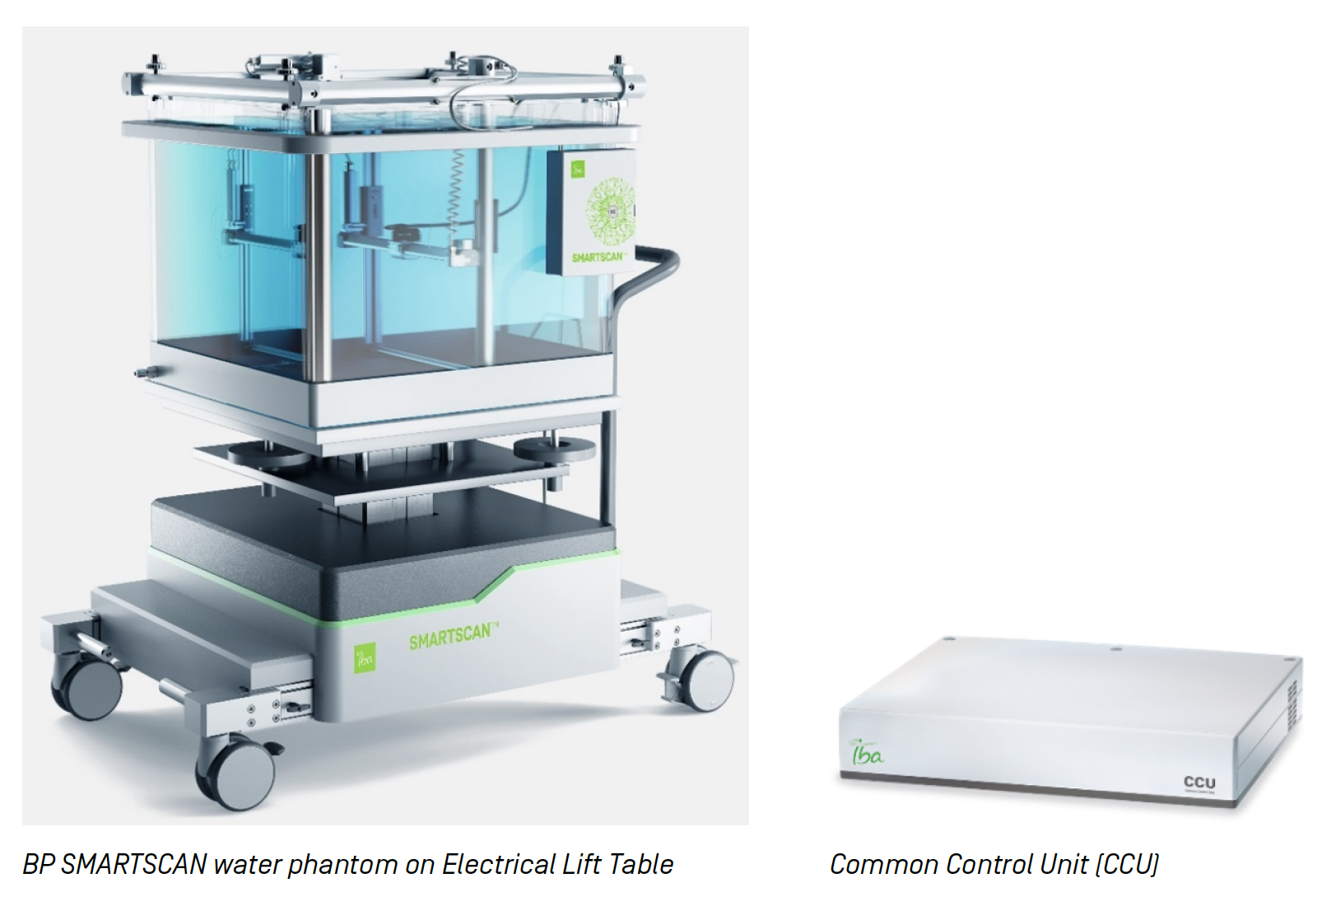
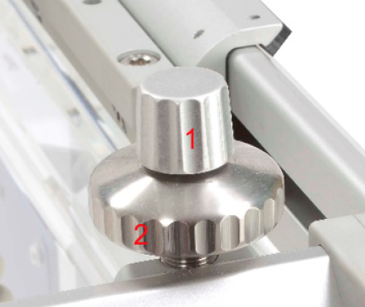
Leveling Frame
Integrated
handle
Connection Box
Lock Screw
Levelling
Screw

