Slide 1
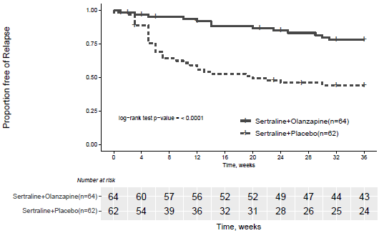
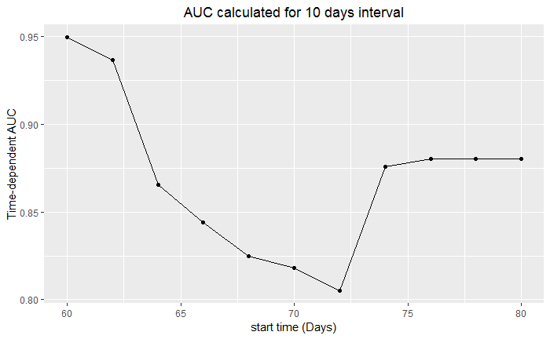
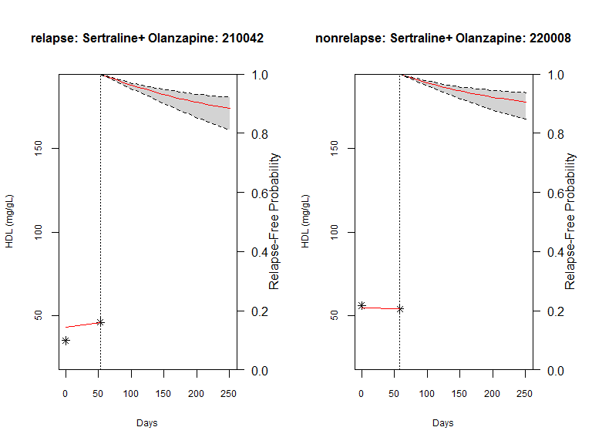

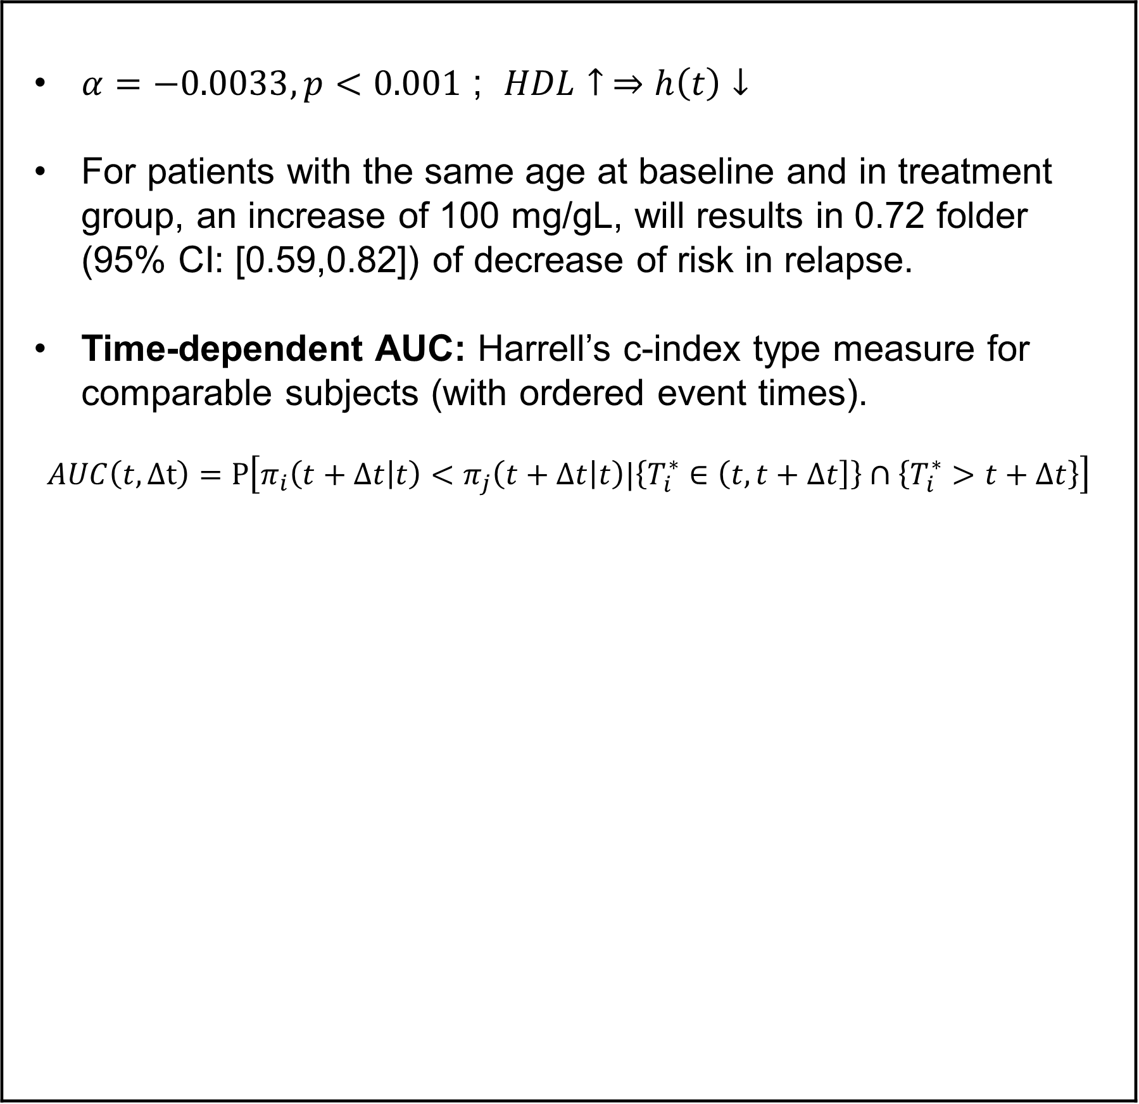

Dynamic prognosis of psychotic depression: a Bayesian joint modeling approach
Samprit Banerjee (Weill Cornell Medicine), Yiyuan Wu (Weill Cornell Medicine), George Alexopoulos (Weill Cornell Medicine), Alastair Flint (University of Toronto)
BACKGROUND AND OBJECTIVES
METHOD
RESULT
Patients with psychotic depression (PD) often experience unexpected relapses, even after reaching remission status from a major episode. A combination of antidepressant-antipsychotic achieves remission and continuation of antidepressant prevents relapse of depression, however, it is unknown if continuation of antipsychotics could further prevent relapse. STOP PD-II trial: (Inclusion): >18 yrs with PD who remitted (RCT) N=126 randomized to Sertraline(anti-depressant )+ Olanzapine(anti-psychotic) vs Sertraline(anti-depressant )+ placebo. Rationale: prognosis of relapse is of critical clinical importance and side-effects of S+O or S can inform the prognosis. Objective: we analyze the prognostic value of treatment in joint model of survival and longitudinal outcomes using Bayesian estimation.
Survival Model: Time to relapse in Cox PH Model with time-varying covariate HDL, treatment arm.
Longitudinal sub-model: HDL with patient-level random intercept and slope in LMM.
Joint model: $h_{i}(t)$=$h_{0}\left(t\right)exp⁡(γ∗trt+ α{ m}_{i}^{HDL}(t))$ where $m_{i}^{HDL}\left(t\right)$ is the longitudinal sub-model.
Estimation: JMBayes (assumption:) given random effects, longitudinal and survival process are independent
$$p\left(y_{i}, T_{i},δ_{i} \right|b_{i}, θ)=p\left(y_{i}\right|b_{i}, θ) p\left(T_{i}, δ_{i} \right|{ b}_{i}, θ)$$
$$θ :full parameter vector$$
Prediction based on randomly chosen set-aside test set
$α=−0.0033, p<0.001$ ; $HDL↑ ⇒h\left(t\right)↓$ For patients with the same age at baseline and in treatment group, an increase of 100 mg/gL, will results in 0.72 folder (95% CI: [0.59,0.82]) of decrease of risk in relapse. Time-dependent AUC: Harrell’s c-index type measure for comparable subjects (with ordered event times). $$AUC\left(t,Δt\right)=P\left[π_{i}\left(t+Δt | t\right)<π_{j}\left(t+Δt | t\right)|\left\{T_{i}^{∗}∈\left(t,t+Δt\right]\right\}∩\left\{T_{i}^{∗}>t+Δt\right\}\right]$$
 | Not relapsed | Relapsed
S+O | 5 | 5
S | 5 | 5
Prediction on test set
LIMITATION AND FUTURE WORK
Small relapse events ($n=47$) therefore low prediction accuracy in cross-validation.
Model uncertainty: a specific formulation of the association structure may be accurate for specific patients with particular longitudinal profile. Bayesian Model Averaging can produce better prediction.
Utilize multiple longitudinal outcomes or metabolic side-effects of medication (e.g. total cholesterol, LDL, weight etc.)
Current AUC is on training set (underestimate), therefore use prediction defined by a test set tailored for longitudinal prediction.
REFERENCE
1 Jeffrey D. Long, James A. Mills. Joint modeling of multivariate longitudinal data and survival data in several observational studies of Huntington’s disease. In: BMC Med Res Methodol; 2018.
2. Dimitris Rizopoulos. The R Package JMbayes for Fitting Joint Models for Longitudinal and Time-to-Event Data Using MCMC. In: journal of statistical software; 2016

