Slide 1
Toxic Comments Classification Web App
Project Owner: Aisha Dubhashi
Developer: Yiwei Sun
QA: Jerry Chen

Slide 2
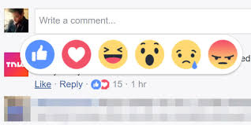

Motivation
Background
Online comments are informative
Problem
They can be misleading with negative online behavior
Solution
Classify the toxic comment with a Web App

Slide 3
Datasets
Datasets
Wikipedia comments that have been labeled by human raters for toxic behavior (toxic vs. non-toxic)
Train set
Test set
“Toxic 4240 obs.
Total - 9359 obs.
“Not Toxic 4240 obs.
“Toxic
848 obs.
Total - 1871 obs.
(20% of train set )
“Not Toxic 1023 obs.

Slide 4
Model & Success Criteria
Model
Word & Characters Tokenization and Stemming by TfidfVectorizer() in Python
Logistic Regression to predict Toxic (1) or Not Toxic (0)
Success Criteria
Performance of classification
Cross Validation Accuracy: 81.74%
Test Accuracy: 84.29%

Slide 5
Interesting Insight
Data
The word “Toxic” is not Toxic comment – Not a rude or disrespectful word
Model
To increase time efficiency, training set has been cut down to 1/8 and the model 10-fold cv accuracy only decreases 6%
Because of marginal effect for word tokenization

Slide 6
The End
Thank you very much for listening!
Contact Info:
Name: Yiwei Sun
Master of Science in Analytics (MSiA) 2018
Email: yiweisun2018@u.northwestern.edu

