Slide 1
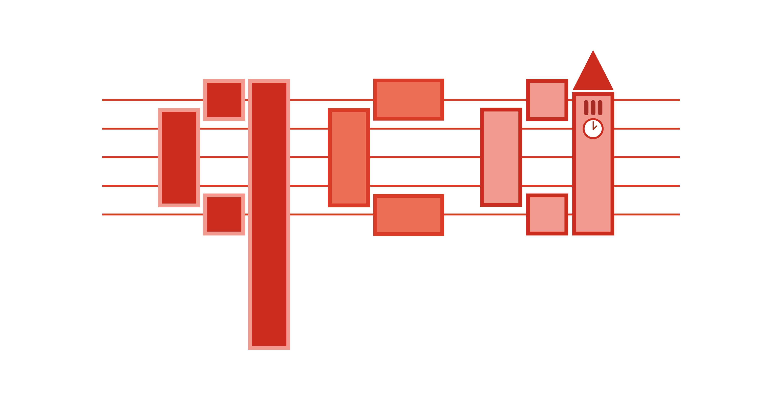
Fundamentals of
Quantum Computing
The Language of Quantum Information
Probability, bra-kets, & linear algebra

Slide 2
Probability.
(But probably not what you’d expect.)
1

Slide 3
Let’s consider a coin.
It has two sides.
We don’t know anything else about the coin.
(1) Let’s toss it.
What do we know about it before we look at it?
heads (H)
tails (T)
2
Notes:
We know nothing about the coin before we look at it, except that it can be one of the two sides.

Slide 4
Let’s consider a coin.
(2) Now we look at it.
What do we learn if it shows H (or T)?
(3) Toss it again.
What do we learn if it keeps landing on the same side?
Or on a different side?
heads (H)
tails (T)
3
Notes:
The more flips we do, the more information we get about the probability distribution for the coin. We also know about whether or not a probability of reaching a certain state is non-zero.

Slide 5
Now, consider a fair coin.
What is the probability that the coin is H or T in the following cases?
A fair coin is lying on a table, heads facing up.
A fair coin is tossed. We don’t look at it yet.
We look at the tossed coin and see that it’s tails facing up.
$$P(H)=1$$
50%
50%
$$P(H)=\frac{1}{2}$$
$$P(T)=\frac{1}{2}$$
A fair coin is one that results in 50% chance of landing on H or T after being tossed.
$$P(T)=1$$
4

Slide 6
Bits.
5

Slide 7
What is a bit?
Different physical representations of same abstract concept.
A binary digit.
0 or 1s.
http://electronics.stackexchange.com/questions/220620/what-is-this-high-power-switch-symbol
https://commons.wikimedia.org/wiki/File:SRAM_Cell_(6_Transistors).svg
Switch.
6T-SRAM cell.
6

Slide 8
1
0
Only two symbols are 'valid' in binary. Any two!
T
H
7

Slide 9
What is a bit?
$$\left(\begin{aligned}\text{Top entry is 1: is Heads.} \\ \text{Bottom entry is 1: is Tails.}\end{aligned}\right)$$
$$\left(\begin{aligned}0 \\ 1\end{aligned}\right)$$
$$\left(\begin{aligned}1 \\ 0\end{aligned}\right)$$
What about writing them as vectors?
8

Slide 10
Representing coins in binary
Our chosen encoding
Coin 1
Coin 2
$$H→\left(\begin{aligned}1 \\ 0\end{aligned}\right)→0$$
Pictorial
Binary
0
1
$$T→\left(\begin{aligned}0 \\ 1\end{aligned}\right)→1$$
$$\left(\begin{aligned}1 \\ 0\end{aligned}\right)$$
$$\left(\begin{aligned}0 \\ 1\end{aligned}\right)$$
Vector
$$⊗$$
Tensor product.
9

Slide 11
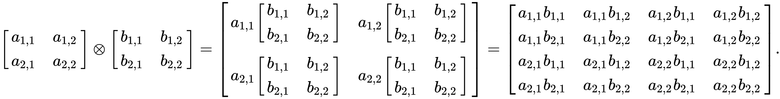
Gluing vectors together
$⊗$ is the 'tensor product', a kind of glue for vectors, sticking them together and making a resultant vector with a larger dimension.
10

Slide 12
Gluing vectors together
$$\left(\begin{aligned}H_{1} \\ T_{1}\end{aligned}\right)⊗\left(\begin{aligned}H_{2} \\ T_{2}\end{aligned}\right)=\left(\begin{aligned}H_{1}⋅H_{2} \\ H_{1}⋅T_{2} \\ T_{1}⋅H_{2} \\ T_{1}⋅T_{2}\end{aligned}\right)$$
With two coins, the tensor product gives us the overall state of those two coins!
How many possible states of N coins?
How many rows in the tensor product of N coins?
11

Slide 13
Gluing vectors together
$$\left(\begin{aligned}H_{1} \\ T_{1}\end{aligned}\right)⊗\left(\begin{aligned}H_{2} \\ T_{2}\end{aligned}\right)=\left(\begin{aligned}H_{1}⋅H_{2} \\ H_{1}⋅T_{2} \\ T_{1}⋅H_{2} \\ T_{1}⋅T_{2}\end{aligned}\right)$$
12

Slide 14
Naming vectors for ease
For ease, we can label vectors using this braket, or Dirac, notation.
$$|0⟩=\left(\begin{aligned}1 \\ 0\end{aligned}\right),|1⟩=\left(\begin{aligned}0 \\ 1\end{aligned}\right)$$
$$|a⟩$$
a ket
Anything goes in bras and kets:
$$|ψ⟩,|Wow!⟩,|:)⟩$$
$$⟨a|$$
a bra
$$⟨a|=|a⟩^{†}={\left(|a⟩^{*}\right)}^{T}$$
13

Slide 15
Braket notation
A few examples:
$$|a⟩=\left(\begin{aligned}1 \\ 0\end{aligned}\right)$$
$$⟨a|=?$$
$$|\text{Huh?}⟩=\left(\begin{aligned}1 \\ i\end{aligned}\right)$$
$$⟨\text{Huh?}|=?$$
$$⟨a|=|a⟩^{†}={\left(|a⟩^{*}\right)}^{T}$$
14

Slide 16
Braket notation conveys meaning about vector structure.
$$A=\left(\begin{matrix}a & b \\ c & d\end{matrix}\right)$$
Matrix-vector multiplication rewritten:
$$\left(\begin{matrix}a & b \\ c & d\end{matrix}\right)\left(\begin{aligned}e \\ f\end{aligned}\right)$$
$$|ψ⟩=\left(\begin{aligned}e \\ f\end{aligned}\right)$$
$$=A|ψ⟩$$
$$=\left(\begin{aligned}ae+bf \\ ce+df\end{aligned}\right)$$
15

Slide 17
Braket notation conveys meaning about vector structure.
$$|ψ⟩=\left(\begin{aligned}a \\ b\end{aligned}\right)$$
The inner product rewritten:
$$|ϕ⟩=\left(\begin{aligned}c \\ d\end{aligned}\right)$$
$$\left(\begin{aligned}a \\ b\end{aligned}\right)⋅\left(\begin{aligned}c \\ d\end{aligned}\right)$$
$$⟨0|1⟩=0$$
$$=\left(\begin{matrix}a & b\end{matrix}\right)\left(\begin{aligned}c \\ d\end{aligned}\right)$$
$$=⟨ψ|ϕ⟩=ac+bd$$
Scalar!
16

Slide 18
Braket notation conveys meaning about vector structure
$$|ψ⟩=\left(\begin{aligned}a \\ b\end{aligned}\right)$$
The outer product rewritten:
$$\left(\begin{aligned}c \\ d\end{aligned}\right)\left(\begin{matrix}a & b\end{matrix}\right)$$
$$|ϕ⟩=\left(\begin{aligned}c \\ d\end{aligned}\right)$$
$$=|ϕ⟩⟨ψ|$$
$$=\left(\begin{matrix}ca & cb \\ da & db\end{matrix}\right)$$
17

Slide 19
Making the shift to quantum information
How might we use vectors to do computation?
How do we move between vectors on a unit circle?
Bits of information can be represented as vectors.
$$|0⟩$$
$$|1⟩$$
Picture a unit circle.
18

Slide 20
Pauli gates.
$$I=\left(\begin{matrix}1 & 0 \\ 0 & 1\end{matrix}\right)$$
$$X=\left(\begin{matrix}0 & 1 \\ 1 & 0\end{matrix}\right)$$
$$Y=\left(\begin{matrix}0 & -i \\ i & 0\end{matrix}\right)$$
$$Z=\left(\begin{matrix}1 & 0 \\ 0 & -1\end{matrix}\right)$$
X
Y
Z
Eigenvectors of the Paulis.
$$\left\{\frac{1}{\sqrt{2}}\left(\begin{aligned}1 \\ 1\end{aligned}\right),\frac{1}{\sqrt{2}}\left(\begin{aligned}1 \\ -1\end{aligned}\right)\right\}$$
$$\left\{\frac{1}{\sqrt{2}}\left(\begin{aligned}1 \\ i\end{aligned}\right),\frac{1}{\sqrt{2}}\left(\begin{aligned}1 \\ -i\end{aligned}\right)\right\}$$
$$\left\{\left(\begin{aligned}1 \\ 0\end{aligned}\right),\left(\begin{aligned}0 \\ 1\end{aligned}\right)\right\}$$
20

Slide 21
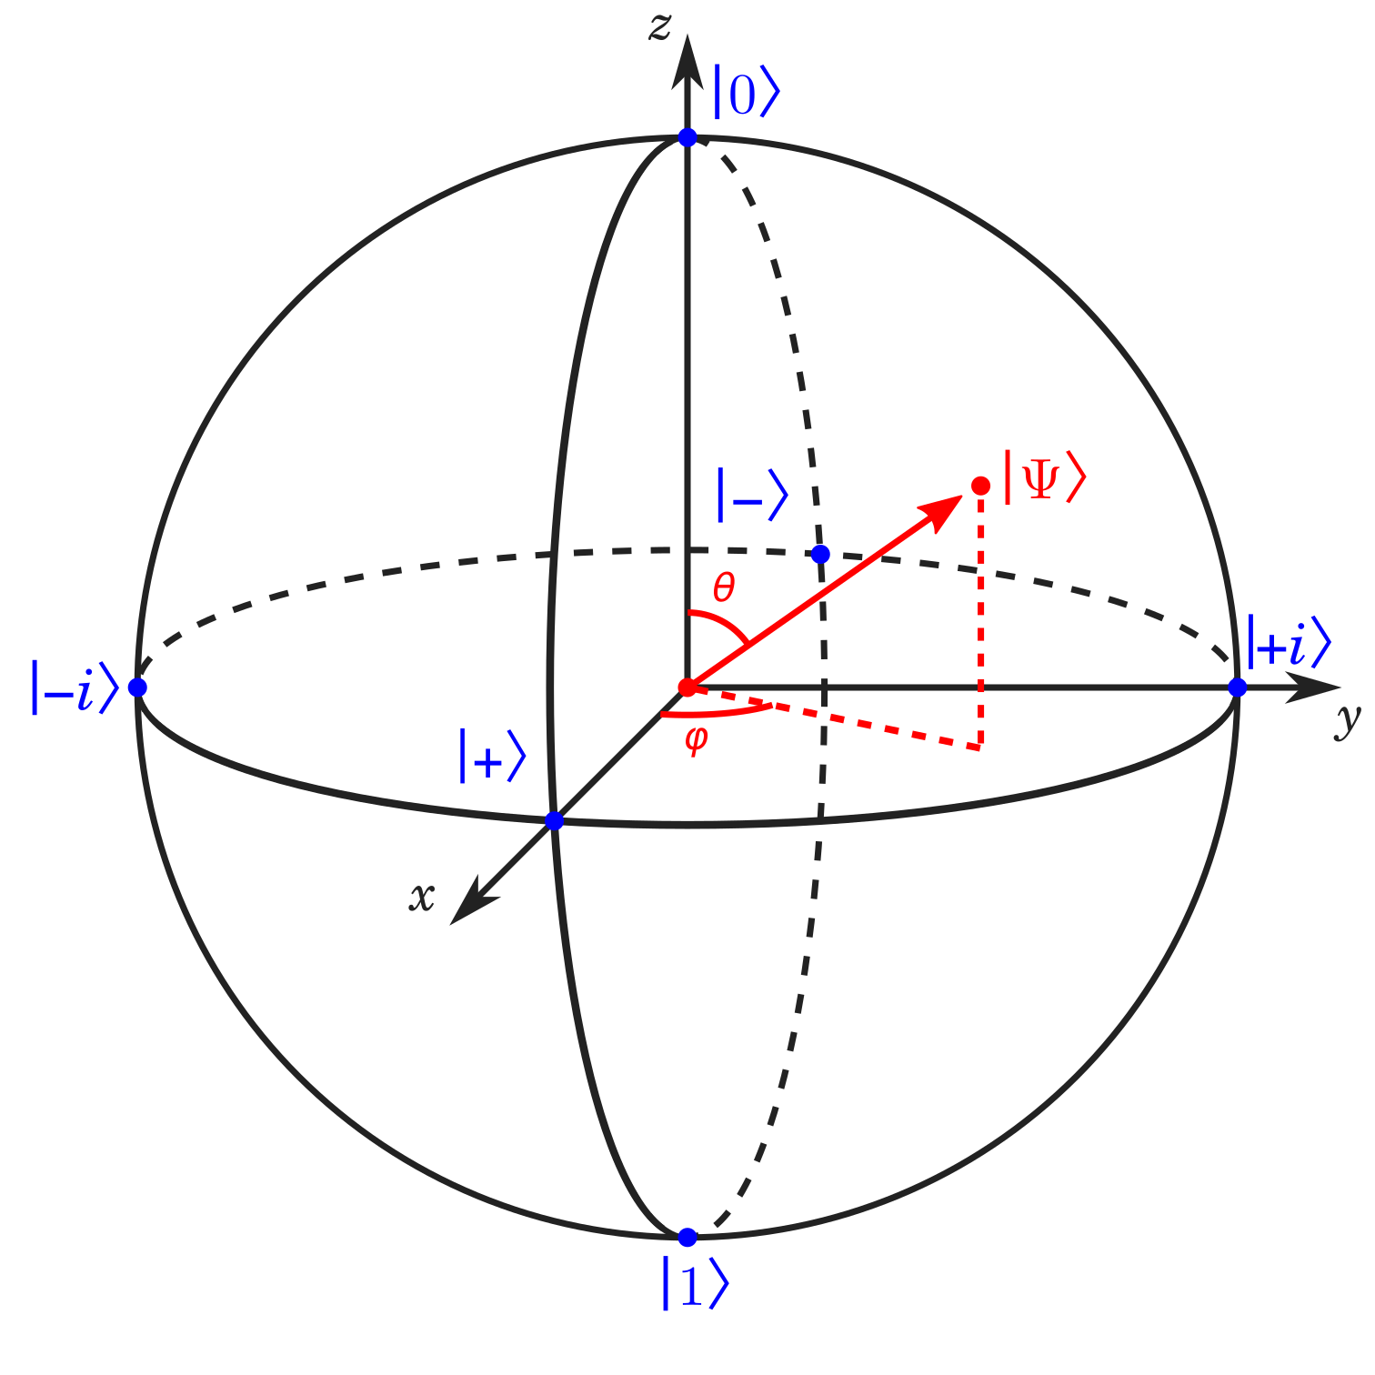
Qubits and quantum gates.
Qubits can be represented using the surface of a unit sphere.
Gates map collections of qubit states to other states.
1-to-1 mapping $⟹$ satisfy the reversibility condition.
Hence, single-qubit gates rotate a qubit!
https://prefetch.eu/know/concept/bloch-sphere/
19
Notes:
We know nothing about the coin before we look at it, except that it can be one of the two sides.

Slide 22
Bloch sphere demo.
First, let’s calculate why they’re eigenvectors.
Then, we’ll get a geometric sense for this.
Check out https://javafxpert.github.io/grok-bloch/
21
Notes:
The more flips we do, the more information we get about the probability distribution for the coin. We also know about whether or not a probability of reaching a certain state is non-zero.

Slide 23
1 qubit…2 qubits….
Let’s start with 1 qubit, named q1.$|q_{1}⟩=\left(\begin{aligned}a \\ b\end{aligned}\right)=a|0⟩+b|1⟩$ in the standard basis.
Because q1 lies on the unit sphere, we make sure that it has unit length: we’ll need the inner product (length check)!
$$⟨q_{1}|q_{1}⟩=(a^{*})(a)+(b^{*})(b)=|a|^{2}+|b|^{2}≡1$$
$$U_{q_{1}}$$
$$|0⟩$$
$$|q_{1}⟩$$
22

Slide 24
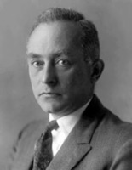
Probabilistic interpretation of quantum mechanics.
$$|q_{1}⟩=\left(\begin{aligned}a \\ b\end{aligned}\right)=a|0⟩+b|1⟩$$
If we measure this qubit in the standard basis,
$|⟨0|q_{1}⟩|^{2}=(a^{*})(a)=|a|^{2}$ is the probability of measuring a 0.
$|⟨1|q_{1}⟩|^{2}=(b^{*})(b)=|b|^{2}$ is the probability of measuring a 1.
This is the Born rule.
All probabilities of possible results must sum to 1!
23

Slide 25
Probabilities in action.
Say we now have 2 qubits, named q1 & q2.
Each has state:
$$|q_{1}⟩=\left(\begin{aligned}a \\ b\end{aligned}\right)=a|0⟩+b|1⟩$$
$$|q_{2}⟩=\left(\begin{aligned}c \\ d\end{aligned}\right)=c|0⟩+d|1⟩$$
We want to describe them as part of the same system.
We can try to use the tensor product (glue)!
Overall system state: $|q_{1}⟩⊗|q_{2}⟩=ac|00⟩_{1,2}+ad|01⟩_{1,2}+bc|10⟩_{1,2}+bd|11⟩_{1,2}$
$$U_{q_{1}}$$
$$|0⟩$$
$$|q_{1}⟩$$
$$U_{q_{2}}$$
$$|0⟩$$
$$|q_{2}⟩$$
24

Slide 26
But wait…!
$$\left(\begin{aligned}a \\ b\end{aligned}\right)⊗\left(\begin{aligned}c \\ d\end{aligned}\right)=\left(\begin{aligned}ac \\ ad \\ bc \\ bd\end{aligned}\right)$$
Does the probabilistic interpretation hold here?
i.e. do the squares of the coefficient magnitudes correspond to probabilities of the outcomes?
$$\left((ac)^{*}\right)ac+\left((ad)^{*}\right)ad+\left((bc)^{*}\right)bc+\left((bd)^{*}\right)bd$$
YES!
It’s almost like describing two separate (classical) coins.
25

Slide 27
That’s all for today!

