Slide 1
Qiskit Workshop
QCA Education

Slide 2
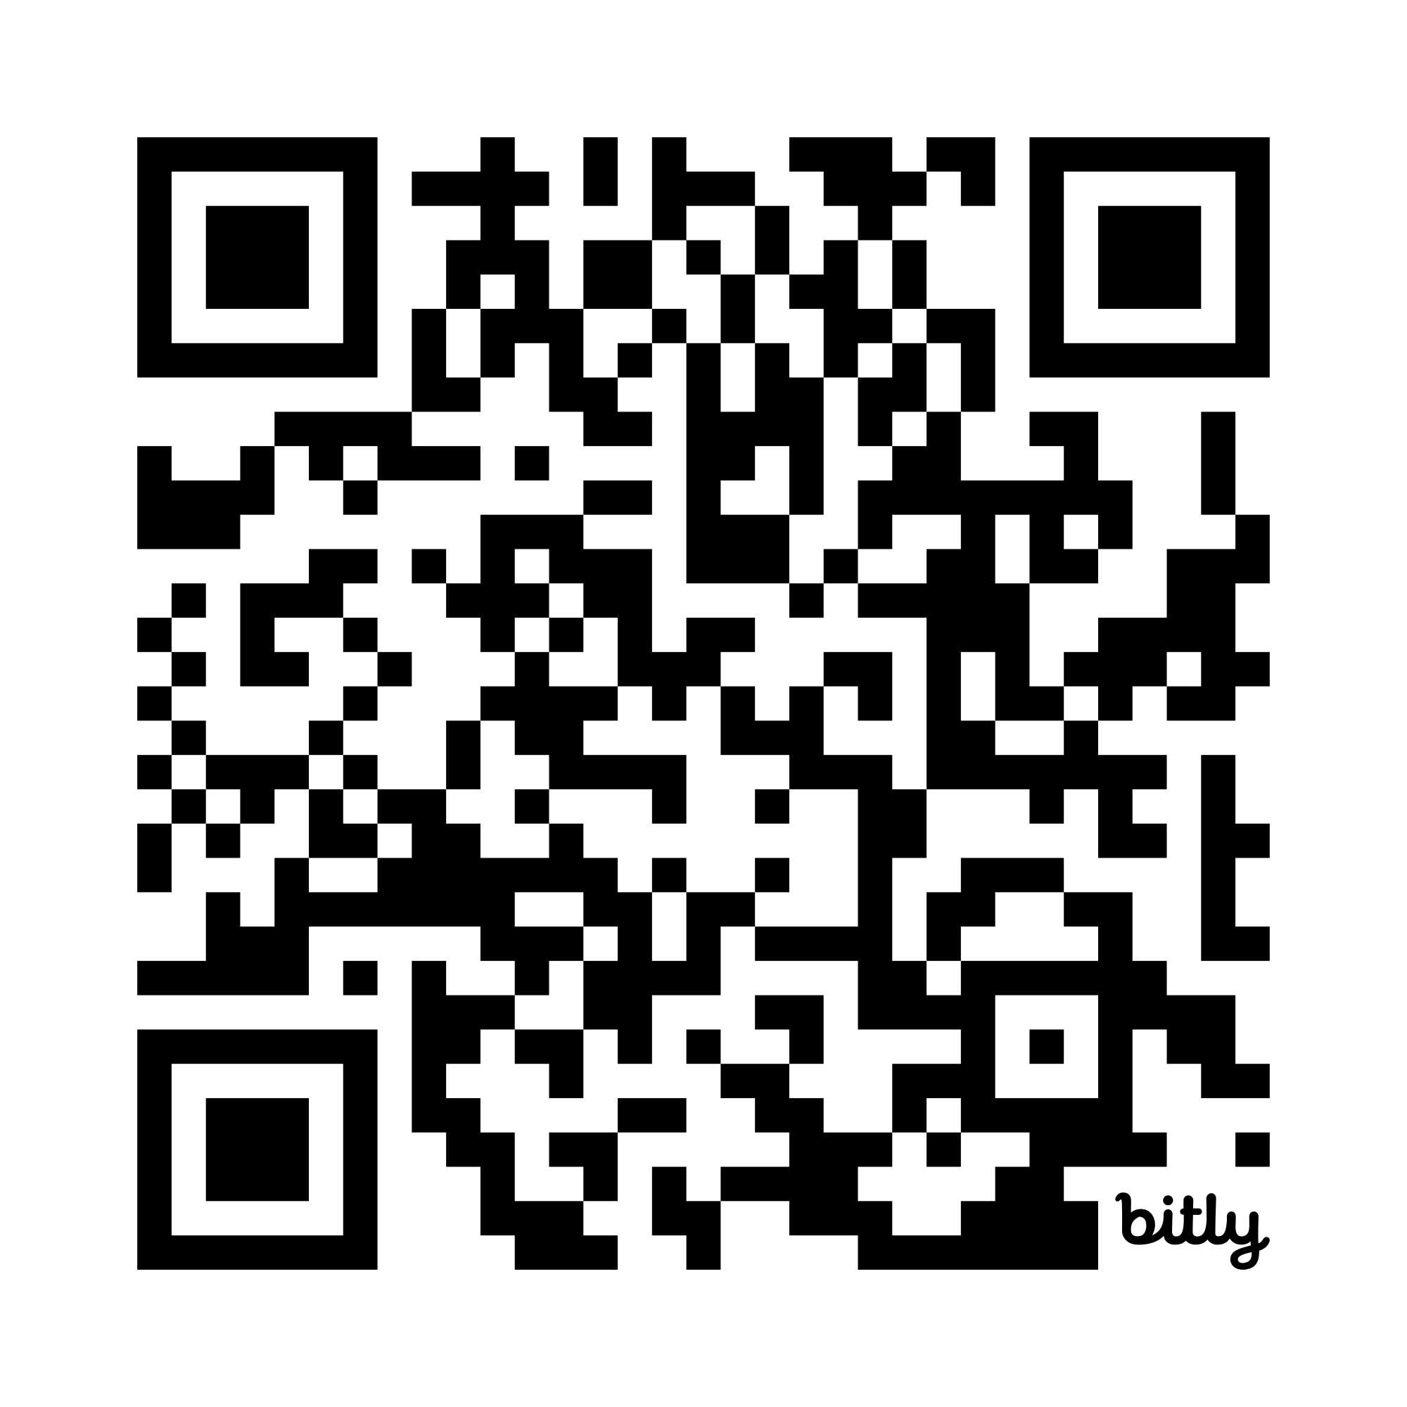
Access Python Notebooks
IBM Cloud Account: https://quantum.cloud.ibm.com Circuit Composer:
https://quantum.cloud.ibm.com/composer
Slides w/ Quantum Computing basics in GitHub Repo – ask me questions!
http://bit.ly/478vm0f

