Slide 1

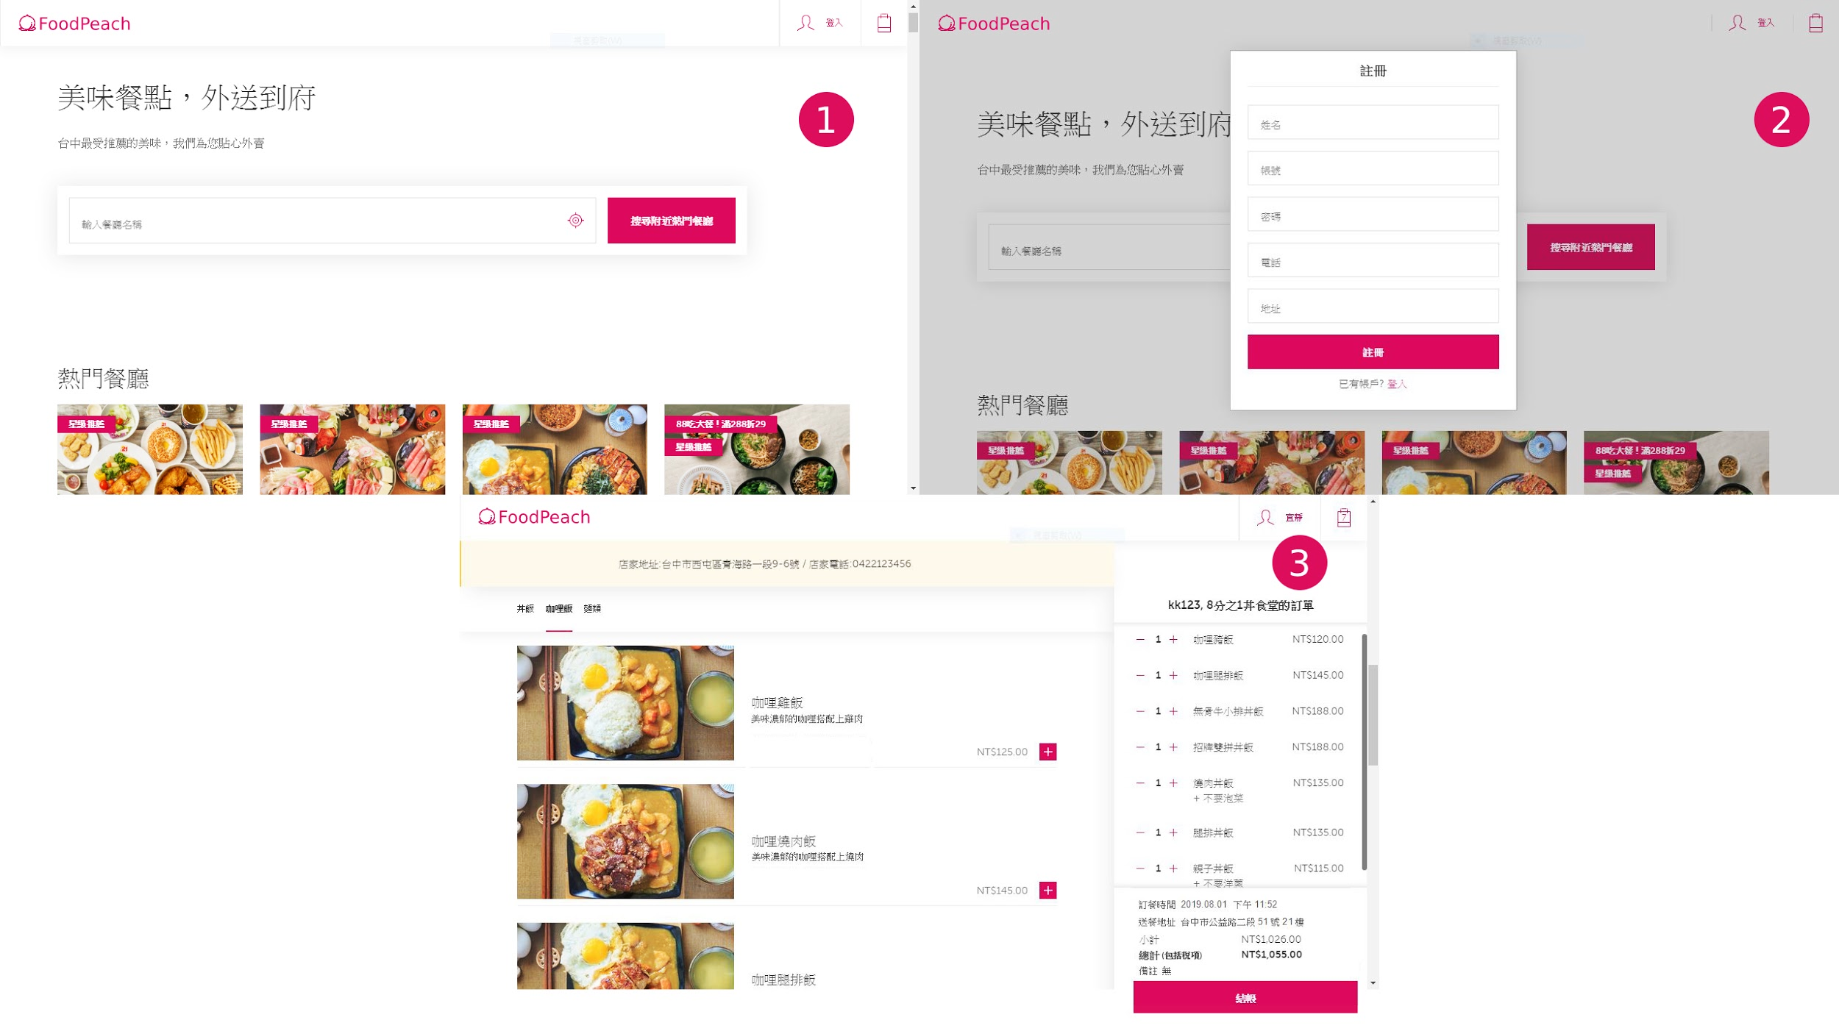




Slide 2


● 字典檔： https://tinyurl.com/y53na3nm

Slide 3

-- 搜尋店名，找出該店的所有商品
DELIMITER $$
CREATE PROCEDURE show_item(store_name varchar(50))
BEGIN
SELECT s.sl_name as '店名',
s.sl_address as '地址',
s.sl_phone as '電話',
p.pl_name as '菜名',
p.pl_img as '圖片',
p.pl_price as '單價',
p.pl_content as '簡介'
FROM store_list as s
LEFT JOIN menu_list as m on m.sl_id = s.sl_id
LEFT JOIN product_list as p on p.pl_id = m.pl_id
WHERE s.sl_name =store_name;
END$$

