Slide 1
MCSDS CS410 Project Authentic Cuisine Detector
Yi Xu (yix7@illinois.edu)
Nian Jiang (nianj2@illinois.edu)
Online repository: https://github.com/yix7/mcsds_cs410_project.git

Slide 2
Introduction:
In this project, we built an analytic system based on Yelp review dataset, which does:
Adjust the weight of each review accordingly when calculating the weighted average of a restaurant.
Mine review topics from all the user reviews, assign a topic to each review. Mark whether a review is food related or not based on the assigned topic. Increase the weight of reviews if food related.
Update the restaurant rating based on adjusted weight.
Mine the best dish names from positive sentiment reviews, from all the restaurants with an adjusted review rating of > 4.

Slide 3
Implementation:
Download yelp dataset from https://www.yelp.com/dataset
Parse yelp dataset with src/parse_dataset.py
Filter in all the Chinese restaurants with >= 100 reviews and >=3.5 average review rating.
Mine the topics all the reviews cover, and tag each review as food related or not, with src/adjustment_based_on_topics.py
Use LDA model to generate topics from the all the reviews.
Manually tag each topic as food or non-food related.
Check each review as food or non-food related based on the topic assigned.
Adjust review rating based on below criteria, with src/review_adjustment.py
If the review user has reviewed more Chinese food.
If the review user has more total review count.
If the review user has ever been an elite member.
The “useful” count of the review.
If the review rating is more deviated from baseline rating of the same user.
If the review is food related.

Slide 4
Implementation: (cont’d)
Mine all the positive sentiment reviews to get the best dishes from top-notch restaurants.
Mark all the 5-star reviews as positive sentiment. Mark all the 1-star reviews as negative sentiment.
Based on 5-star and 1-star reviews, train a model to identify the sentiment of a review.
Since it's not clear if a 2/3/4-star review is positive or negative, apply the model to 2/3/4-star reviews, and tag whether a review is positive or negative.
From all the positive reviews, get the unigram word distribution.
From the 1000 most frequent unigram words, manually tag whether each one is dish name related or not.
Filter out all the frequent words that are not dish name related from the reviews.
From all the filtered positive reviews, get the most frequent bi-gram and tri-gram words, and they are our best dishes.

Slide 5
Installations and Dependencies:
Programming Language: Python 3.x
Modules: pandas; numpy; filesplit; nltk; gensim; sklearn.
pip install pandas numpy filesplit nltk gensim sklearn
Given the large size of yelp data we are parsing, please use more than 16GB DRAM to avoid memory error. This tool was tested with 16GB DRAM.

Slide 6
How to Use:
Download yelp dataset from https://www.yelp.com/dataset. Please download the entire dataset (>4G) and un-tar the file. Place these 3 json files under the yelp_dataset folder. They will be used for this project.
yelp_academic_dataset_business.json
yelp_academic_dataset_review.json
yelp_academic_dataset_user.json
Parse yelp dataset:
python src/parse_dataset.py
Check the topics all the reviews cover and the topic of each review:
python src/adjustment_based_on_topics.py
Tag whether a topic is food related or not. Open output/mined_topics.csv and fill up the 3rd column. Enter 1 if user thinks this topic is food related, enter 0 if user thinks this topic is not food related.

Slide 7
How to Use: (cont’d)
Adjust business rating:
python src/review_adjustment.py
Find the best dish names:
python src/best_dishes.py

Slide 8
Results:
A classifier is created to identify if a review is positive or negative. Using the training and testing data from 1-star and 5-star reviews, we achieved a classifier with:
AUC score:0.947; Macro precision: 0.97; Macro recall: 0.947; F1: 0.958.
Adjusted business review rating is generated in file: output/adjusted_review_result.csv
Column exact_review_from_user lists the exact review ratings originally from Yelp. Note Yelp provides the rounded rating directly, to compare the exact original review rating, here we calculate it through averaging each individual rating from users.
Column adjusted_business_review_rating lists the review ratings after adjustment.
Columns [adj_based_on_food_review_count, adj_based_on_total_review_count, adj_based_on_elite_status, adj_based_on_useful_count, adj_based_on_avg_rating, adj_based_on_topic] are the weight adjustment for each review.

Slide 9
Results: (cont’d)
Comparing the rating before and after adjustment:
Max rating addition: 0.28
Max rating reduction: 0.27
Average rating change: +0.017
Below are the restaurants and their business id with maximum addition and reduction:
Restaurant | Rating Adjustment
Qwik's Chinese Bistro_46LhKfz6MPaLYoS0jegsdw | -0.271
Yunnan Garden_dVhGY-mNwTWQzK01Zxuclw | 0.284

Slide 10
Results: (cont’d)
From the eventual adjusted_business_review_rating, we can get the best restaurants, here we list the top 10:
Restaurant | Rating Before Adjustment | Rating After Adjustment
China Passion_BKg8YIGX_5YyUczmBAyyCQ | 4.605 | 4.59
Phoenix Express_t_SvwKRaMyNHj2NOMvMv1Q | 4.536 | 4.571
Veggie House_AtD6B83S4Mbmq0t7iDnUVA | 4.548 | 4.553
Kung Foo Noodle_O7_rXHN_-cFp0TgiMaNulw | 4.547 | 4.541
Pink Pepper Asian Fusion_B1tsu2zSVlY_g1QS-z4ILg | 4.604 | 4.54
Nuro bistro_GI1F8a__wktcfj6YVjTqAA | 4.582 | 4.539
Double 10 Mini Hot Pot_QlAPX3c0Vm2dU_w3puIAIw | 4.514 | 4.536
Simi's Cafe_W9y-Bl9030-rmfxSTmUD_g | 4.607 | 4.512
Singing Pandas Asian Restaurant & Bar_bWucOPNoIjd8ECdiDyVq9Q | 4.558 | 4.509
Pepper Cafe_Av5toUG7wweXfiX6FW4F0A | 4.626 | 4.507

Slide 11
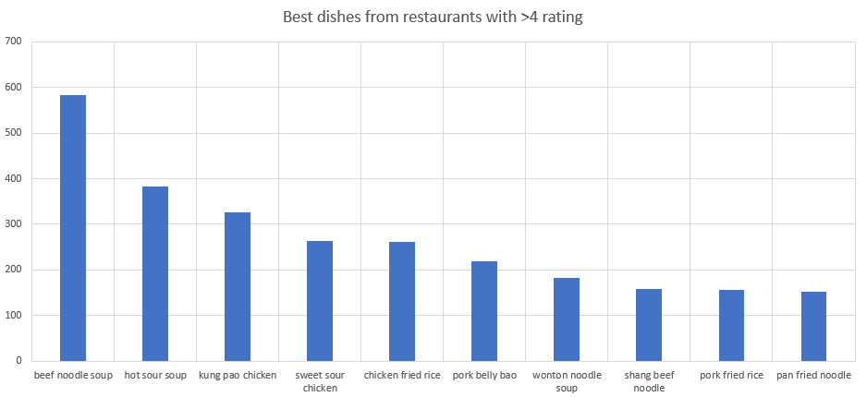
Results: (cont’d)
The best dishes from the best restaurants (>4 star rating, around 100 restaurants) are listed in below file:
output/4star_pos_reviews_most_common_trigrams.csv
The list is generated based on parsing the reviews with positive sentiments on the best restaurants. Below are the top dishes and the number of times they were mentioned in the review:

Slide 12
Developers:
Parse yelp dataset - Nian Jiang
Topic mining from review and assign specific topic to each review - Yi Xu and Nian Jiang
Adjust business review rating - Yi Xu and Nian Jiang
Mine the best dishes from positive sentiment reviews - Yi Xu

