Slide 1

DeepKeyStego: Protecting Communication by Key-dependent Steganography with Deep Networks
Zheng Li¹, Ge Han¹, Chengyu Hu² and Shanqing Guo*²
¹School of Computer Science and Technology, Shandong University
²School of Cyber Science and Technology, Shandong University

Slide 2
01
Motivation
Goal: protect privacy-sensitive communication against eavesdropping over public communication channels
Tranditional steganographic schemes are cool, but
designed with prescribed human based rules
effectively detected by existing steganalysis tools
Deep Neural Networks are applied to increasingly complex tasks,
end-to-end objectives that go beyond simple functional specifications
without being taught specific algorithms for these purposes.

Slide 3
02
Related Works
Classical Methods:
the Least Significant Bit (LSB) algorithm
WOW, HUGO, S-UNIWARD
DNN-based Methods:
steganographic generative adversarial network (SGAN)
ste-GAN-ography

Slide 4
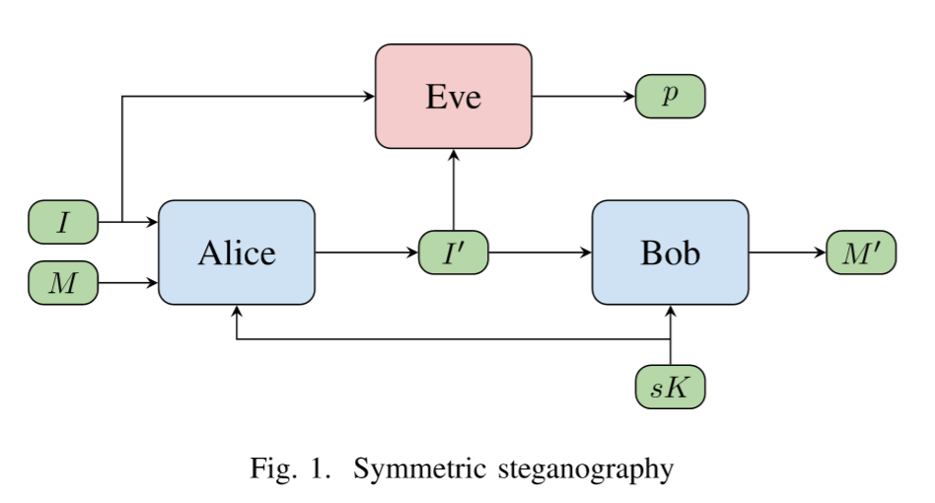
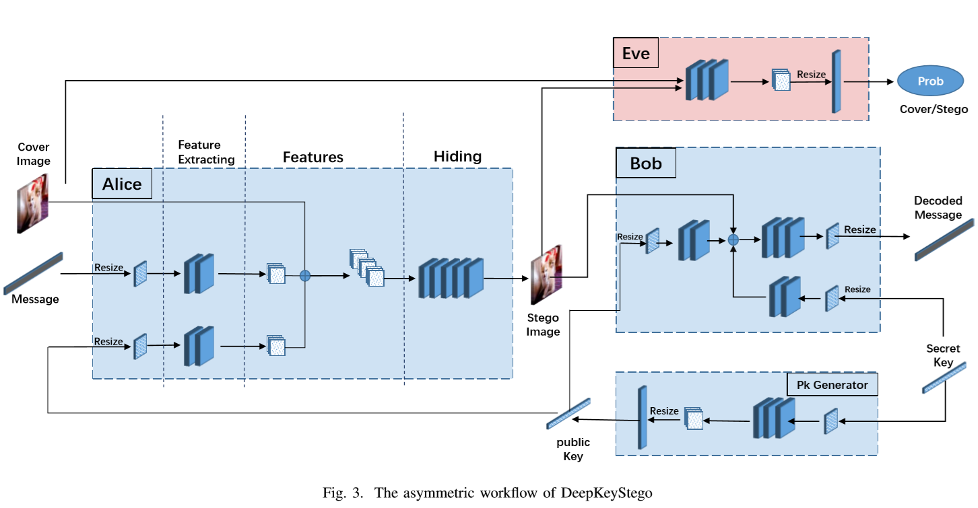
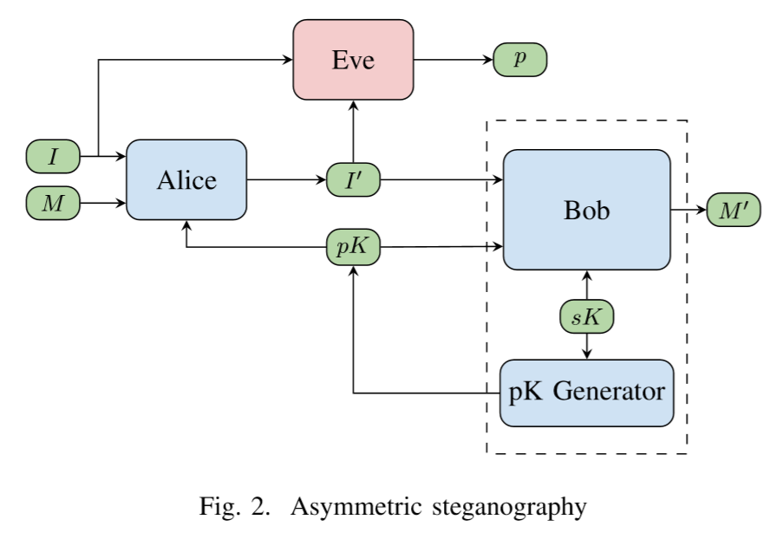
03
Framework overview
Two settings: symmetric and asymmetric
Four models: Alice, Bob, Eve, and pK Generator
Model Alice: an encoder that can hide the secret message into a cover image.
Model Bob: a decoder that can recover the secret message from stego image with the aid of key
Model Eve: a discriminative adversary that attempts to distinguish stego images from real ones
Model pK Generator: a public-key generator

Slide 5
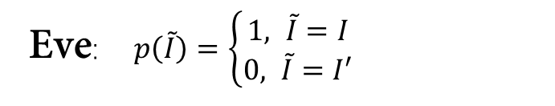

04
Loss Function
Alice, Bob and pk Generator:

Slide 6



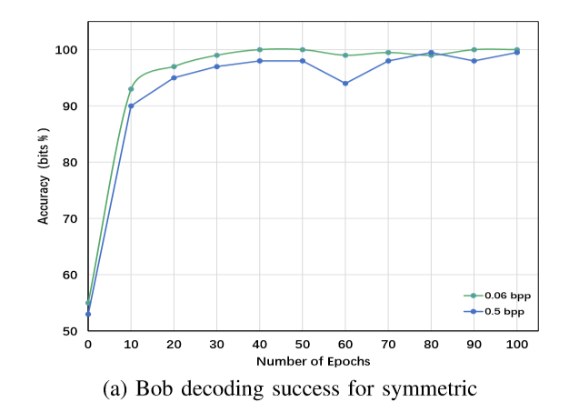
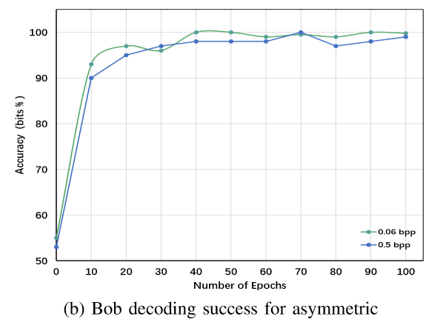
05
Implementation
Dataset:
ImageNet
Training Set: 80000, Testing Set: 10000
ImageSize: 128 * 128 *3
Key Length: 1024bits
Message Length: 1024bits or 8192 bits
o.o6bpp or 0.5bpp (the number of bits per pixel)

Slide 7
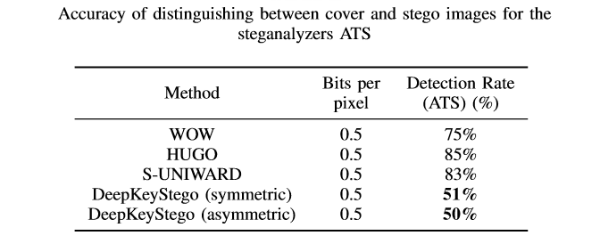
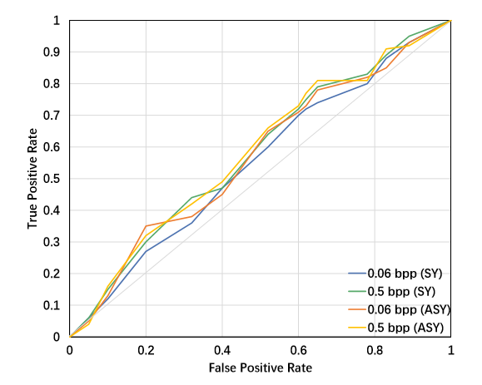
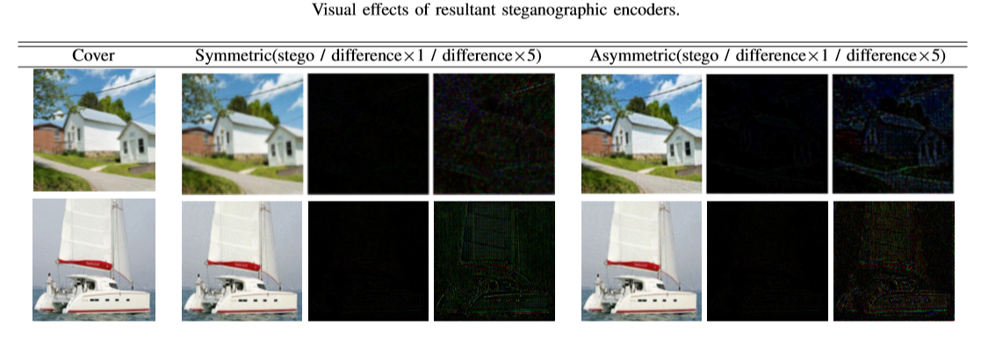
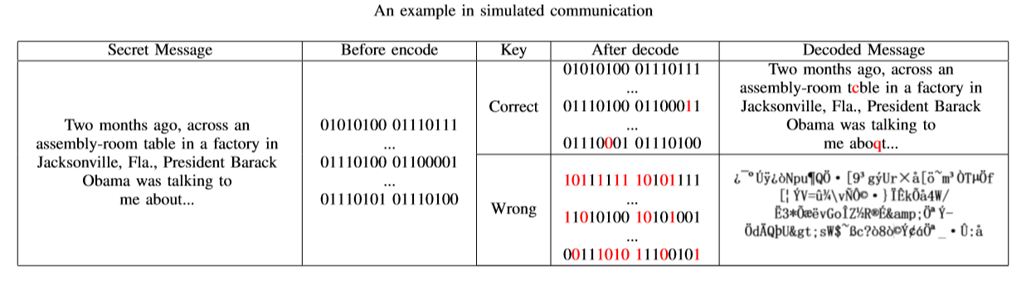
06
Evaluation
unrecoverability, the degree to which attackers can recover the content of secret messages
undetectability, the stego images can evade steganalysis detections
invisibility, the alteration made to cover images
invisibility, the alteration made to cover images
undetectability, the stego images can evade steganalysis detections
unrecoverability, the degree to which attackers can recover the content of secret messages
integrity, the performance of the decoder in a practical situation.
integrity, the performance of the decoder in a practical situation

Slide 8
07
Conclusion
Symmetric (secret-key) and Asymmetric (public-key) steganographic scheme are separately proposed
DeepKeyStego achieved excellent invisibility and outstanding undetectability better than previous methods.
taking advantage of keys to enhance the security of steganography against any adversary .
our scheme is effective and practical for information hiding in communication.

Slide 9
Thanks!

