Slide 1
Precision Health Bootcamp
Introduction to RNA-seq Data Analysis $−$ Part 1
November 14, 2022 – Yixiao Zeng

Slide 2
Plan
Intro
What is genomic data?
Genomic coordinates
Assemblies
Lifting over or reprocessing?
Manipulating data
GenomicRanges
biomaRt
Normalization
Why?
Common normalization techniques
Normalization in DEG analysis
Bioconductor packages
GenomicRanges
biomaRt
EdgeR

Slide 3
1- Intro
Genomic data

Slide 4
Key words
Gene
Genome
Genetic vs genomic vs epigenetic
Sequencing reads
RNA-seq
ChIP-seq
Technical replicate vs biological replicate
Expressing lengths in bp, kb, Mb

Slide 5
2- Genomic coordinates
Assemblies – liftOver vs reprocessing – biomaRt

Slide 6
What is an assembly?
“Reference genome”
What determines the coordinates
Complete(ish)
With everything we now… until we know more
Main chromosomes + contigs
Haploid
Only one strand
! Reverse strand
Genes expressed as +/-
Chr1:
NNNNNNNATCGACTATCGCGATGACAGTACGTANNNN
CTA is at chr1:13-15 (+)

Slide 7
What is an assembly?
“Reference genome”
What determines the coordinates
Complete(ish)
With everything we now… until we know more
Main chromosomes + contigs
Haploid
Only one strand
! Reverse strand
Genes expressed as +/-
Chr1:
NNNNNNNATCGACTATCGCGATGACAGTACGTANNNN
Gene A coordinates: chr1:20-29 but reverse
NNNNNNNATCGACTATCGCGATGACAGTACGTANNNN
NNNNNNNTAGCTGATAGCGCTACTGTCATGCATNNNN
end
start

Slide 8
Common assemblies
GRCh37/hg19 (2009)
GRCh38/hg38
Updated with patches ex: GRCh38.p13 (2019)
GRCm37/MGSCv37/mm9 (2010)
GRCm38/mm10 (2012)
GRCm39/mm39 (2020)

Slide 9
Using multiple assemblies
liftOver tool
Reprocessing
Easy and quick
Dependent on format
Imperfect and less precise
Some regions have conflicts (split)
RNA-seq
ChIP-seq
Can be long
Alignment is usually done in the first steps -> longer but works every time
Harmonizes processing
SNPs
Hi-C

Slide 10
3- Manipulating data
GenomicRanges – biomaRt

Slide 11
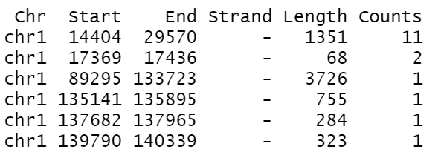
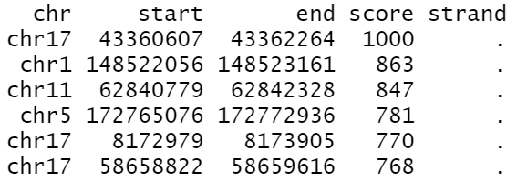
DATA
Which is the RNA-seq, which is the ChIP-seq and why?
What organism is it?

Slide 12
4- Normalization
Why? – Techniques and measures – DEG analysis

Slide 13
What is normalization? What is it for?
Scale to compare
Transform into a normal (gaussian) distribution*
*… or other distribution when needed
Red : 4
Green : 3
Red : 6
Green : 4
Red : 6
Green : 3

Slide 14
What is normalization? What is it for?
Scale to compare
Transform into a normal (gaussian) distribution*
*… or other distribution when needed
Red : 4/7 ≈ 57%
Green : 3/7 ≈ 43%
Red : 6/10 = 60%
Green : 4/10 = 40%
Red : 6/9 ≈ 67%
Green : 3/9 ≈ 33%

Slide 15
How to normalize?
RPM (reads per million)
# reads mapped to a gene * 10^6 / library size (total # mapped reads)
-> gene length not considered
RPKM/FPKM (reads/fragments per kb per million)
# reads mapped to a gene *10^6 / (library size * gene length in kb)
TPM (transcripts per million)
# reads mapped to a gene / gene length in kb

Slide 16
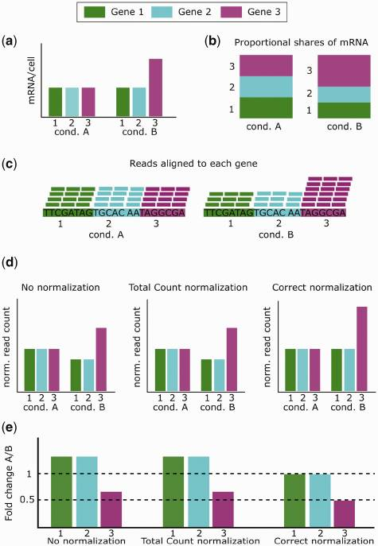
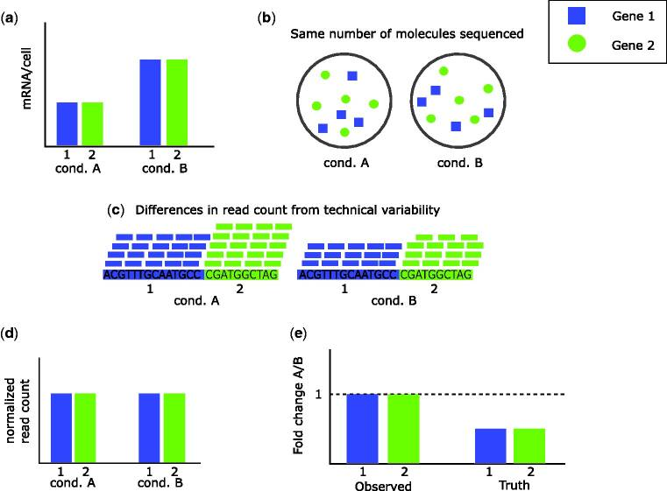
Normalization issues…
Evans, Ciaran et al. “Selecting between-sample RNA-Seq normalization methods from the perspective of their assumptions.” Briefings in bioinformatics vol. 19,5 (2018): 776-792. doi:10.1093/bib/bbx008
https://www.ncbi.nlm.nih.gov/pmc/articles/PMC6171491/

Slide 17
Using replicates
Technical or biological?
Introducing variance
Stats
Fold change (magnitude)
P-value (significance)
Assumptions on how genes should behave
The counts for sample i, gene j follow a negative binomial distribution
H₀: no gene is differentially expressed

Slide 18
DEG normalization – general steps DESeq2 / edgeR
Raw counts per gene
Filtering low-count genes
Identifying groups
Magic
Results (normalized counts, FC, p-value)
Low count genes introduce extra variance and interfere with stats
May be difficult to capture -> false sense of abundance
*May have poor biological meaning
Not suitable for miRNAs and tRNAs
What is the control
What is/are the treatment(s)

Slide 19
edgeR
Cares about…
Does not care about…
DEGs (relationship between conditions)
Sequencing depth/lib size
Sample-specific effects
Counts themselves
Gene length
GC content

Slide 20
edgeR
https://bioconductor.org/packages/release/bioc/vignettes/edgeR/inst/doc/edgeRUsersGuide.pdf
Robinson, Mark D et al. “edgeR: a Bioconductor package for differential expression analysis of digital gene expression data.” Bioinformatics (Oxford, England) vol. 26,1 (2010): 139-40. doi:10.1093/bioinformatics/btp616
https://www.ncbi.nlm.nih.gov/pmc/articles/PMC2796818/
McCarthy, Davis J et al. “Differential expression analysis of multifactor RNA-Seq experiments with respect to biological variation.” Nucleic acids research vol. 40,10 (2012): 4288-97. doi:10.1093/nar/gks042
https://www.ncbi.nlm.nih.gov/pmc/articles/PMC3378882/

Slide 21
edgeR – calcNormFactors()
Scale the lib size to minimize log-FC between samples
Assumption: more than half of genes are NOT DE
Avoids under-sampling problems when a few genes make up the majority of reads
Trimmed mean of M-values (TMM)
Pairwise comparison of two samples, for all genes, what is the relation between the # of counts of a gene and the total number of counts of the sample?
Robinson, Mark D, and Alicia Oshlack. “A scaling normalization method for differential expression analysis of RNA-seq data.” Genome biology vol. 11,3 (2010): R25. doi:10.1186/gb-2010-11-3-r25
https://www.ncbi.nlm.nih.gov/pmc/articles/PMC2864565/
Effective lib size = lib size * scaling factor
-> scaling factor < 1: high counts on few genes, lib size is reduced, upscaling of counts
-> scaling factor > 1: lib size is increased, downscaling of counts

Slide 22



edgeR – BCV
Relationship between the observed counts $y_{gi}$and the fraction $π_{gi}$ of the total reads $N_{i}$
Assumption: $y_{gi}$ for repeated sequencing of the same sample ~ Poisson distribution
As sequencing depth → ∞, TCV should ↓ and BCV should ~
Assumption: true gene abundance ~ Gamma distribution
-> read counts ~ negative binomial probability law
BCV approximated as $\sqrt{Φ_{g}}$, where $Φ_{g}$ is the dispersion
Technical CV² + biological CV²
(CV: coefficient of variation)

Slide 23
edgeR – BCV
Common dispersion estimate
All genes have the same dispersion
Trended dispersion estimate
Smooth function dependent on gene counts
Common dispersion for bins of genes with similar expression -> loess curve
Genewise/tagwise dispersion estimate
Genes have their own dispersion, dependent on gene length, sequence, expression level and/or function
Compromise between common dispersion and fully-individual dispersion by using a weighted likelihood empirical Bayes approach
Difficult (low-count) genes’ dispersion will tend towards common dispersion
estimateDisp()

Slide 24

edgeR – quasi negative binomial
Variant that better captures gene-specific BCV and TCV
Empirical Bayes approach to compensate # replicates
Reliable
Only 1 factor
exactTest()
Gene-specific
Global parameter

Slide 25
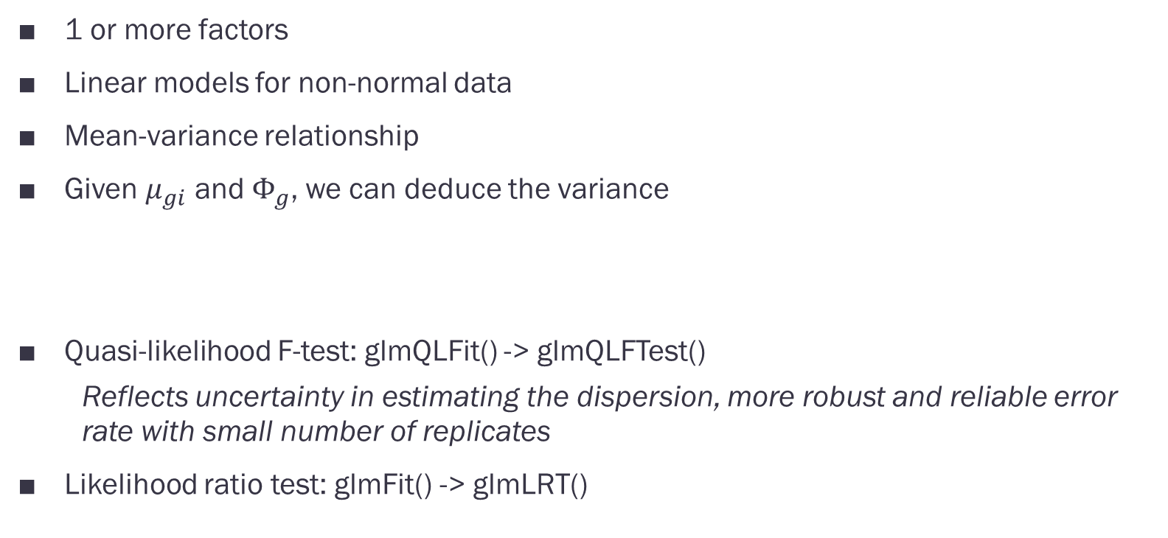
edgeR – Generalized linear models
1 or more factors
Linear models for non-normal data
Mean-variance relationship
Given $μ_{gi}$ and $Φ_{g}$, we can deduce the variance
Quasi-likelihood F-test: glmQLFit() -> glmQLFTest()
Reflects uncertainty in estimating the dispersion, more robust and reliable error rate with small number of replicates
Likelihood ratio test: glmFit() -> glmLRT()

Slide 26
edgeR – pipeline
Preparation (all steps are required) | DGEList() | Create the right object
 | filterByExpr() | Remove interference from low-count genes
 | calcNormFactors() | Get the effective lib size
 | model.matrix() | Identify groups
 | estimateDisp() | Get a dispersion estimate (required for variance estimate)
Fitting and testing (chose one) | exactTest() | 1 factor only
 | glmQLFit() + glmQLFTest() | 1+ factors
 | glmFit() + glmLRT() | No replicates?
 | topTags() | Get DEGs

Slide 27
RECAP
Assemblies determine coordinates
Lifting over is quick but less precise
Normalization can lead to false conclusions
-> chose a normalization according to the goal and assumptions
edgeR pipeline:
- filter low counts
- adjust effective lib size
- estimate the dispersion
- DEG analysis
Why?

