Slide 1
Precision Health Bootcamp
Introduction to RNA-seq Data Analysis $−$ Part 2
November 15, 2022 – Yixiao Zeng

Slide 2
Plan
PCA
What does it do?
How to use and interpret it
edgeR
What does it again?
DEG analysis
Data visualization with ggplot2
ggplot2*
Volcano plot
MA plot
heatmaps
Bioconductor packages
edgeR
CRAN packages
ggplot2
reshape2*

Slide 3
1- PCA
Principle – interpretation

Slide 4
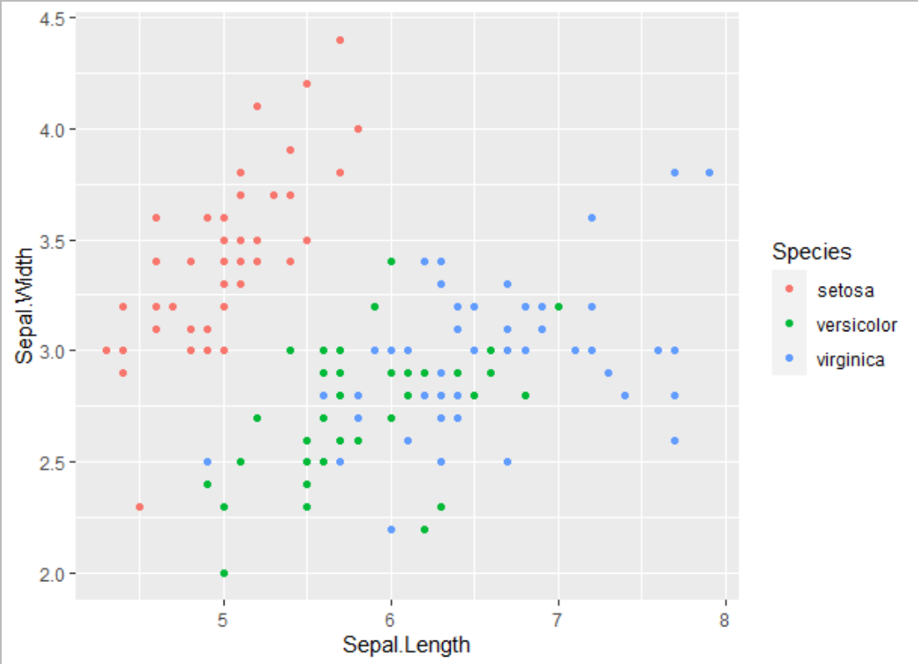
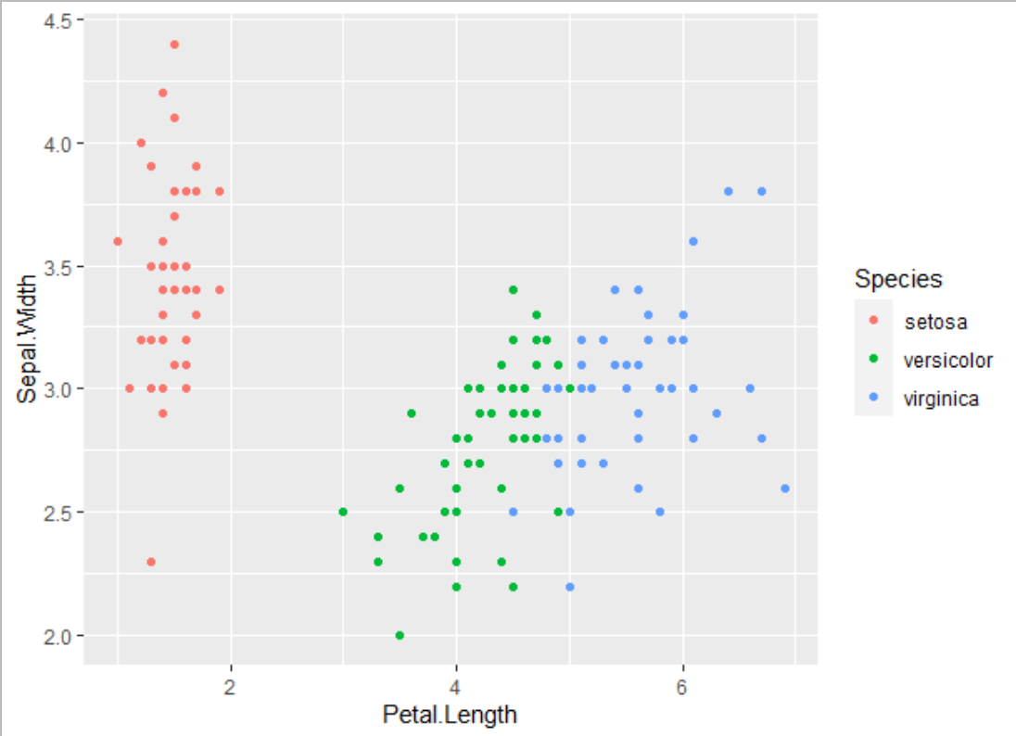
Principal Components Analysis
Problem: We have data with x dimensions and want to reduce it to y dimensions
Ex: 3 dimensions (Sepal length, sepal width and petal length) we want to see on 2

Slide 5
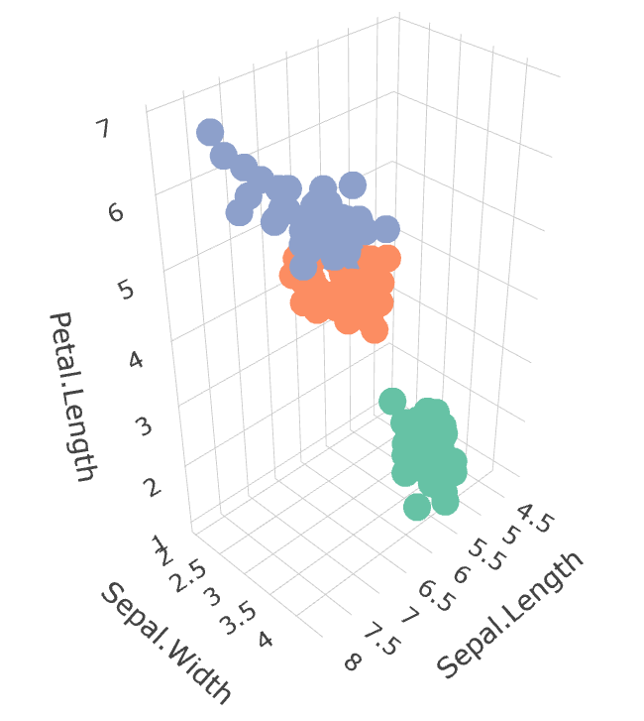
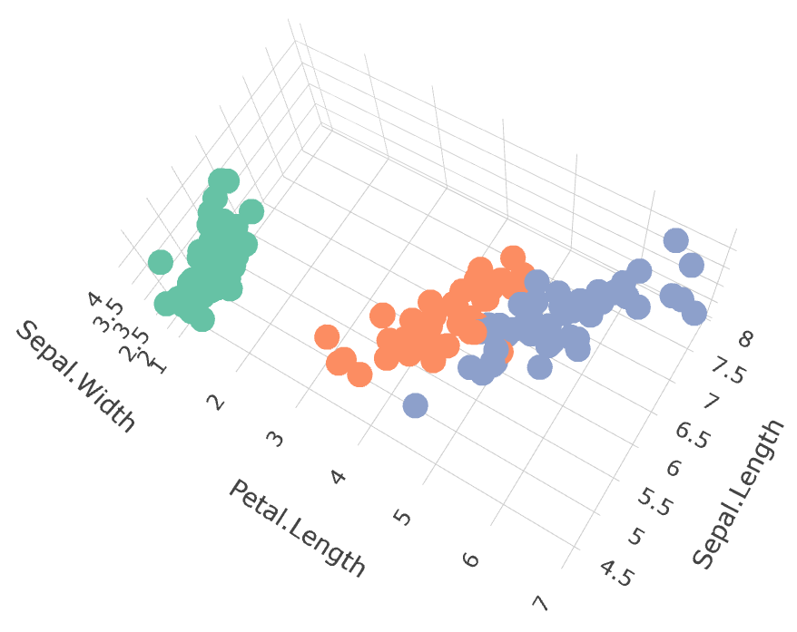
Principal Components Analysis
Goal: reduce x dimensions in y orthogonal vectors that capture most variation
PC2
~20% of variance
-0.1 Petal.Length + 0.2 Sepal.Width + 0.7 Sepal.Length
PC1
~75% of variance
0.8 Petal.Length – 0.1 Sepal.Width + 0.05 Sepal.Length

Slide 6
Principal Components Analysis
Linear -> easy to interpret and translate
What dimensions contribute most to the dimension?
Adding points to the space
Distance ~ difference
Principal component: axis
Eigenvector: vector containing the “weights” of each feature to create a PC
Relationship between values more important than the actual values
Sometimes, linear is not enough -> UMAP, tSNE

Slide 7
PCA in R
prcomp()
Takes a matrix or data frame (with numerical values)
The number of PC is customizable
Returns an object with
sdev: the standard deviation captured by each PC
rotation: eigenvectors matrix (cols: PCs, rows: features)
x: transformed data (coordinates of points in the PC space)
center: parameters used to center around 0 if done
scale: parameters used to scale if done

Slide 8
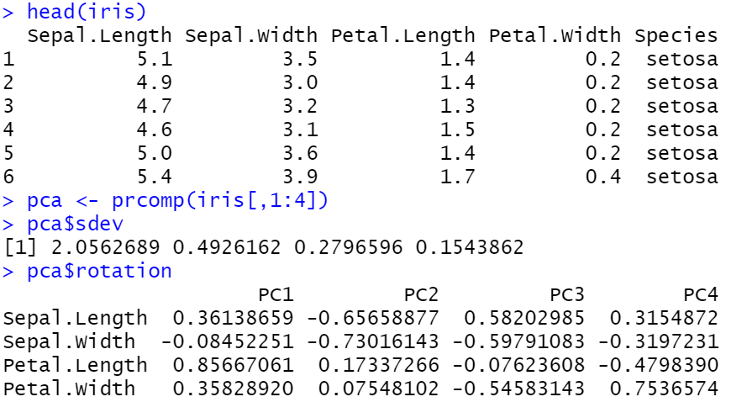
PCA in R

Slide 9
2- edgeR
Review – general use – comparing methods

Slide 10
edgeR – pipeline
Preparation (all steps are required) | DGEList() | Create the right object
 | filterByExpr() | Remove interference from low-count genes
 | calcNormFactors() | ?-1
 | model.matrix() | Identify groups
 | estimateDisp() | Get a dispersion estimate (required for ?-2)
Fitting and testing (chose one) | exactTest() | ?-3
 | glmQLFit() + glmQLFTest() | ?-4
 | glmFit() + glmLRT() | No replicates?
 | topTags() | Get DEGs

Slide 11
3- data visualization
Volcano plots – MA plots – heatmaps

Slide 12
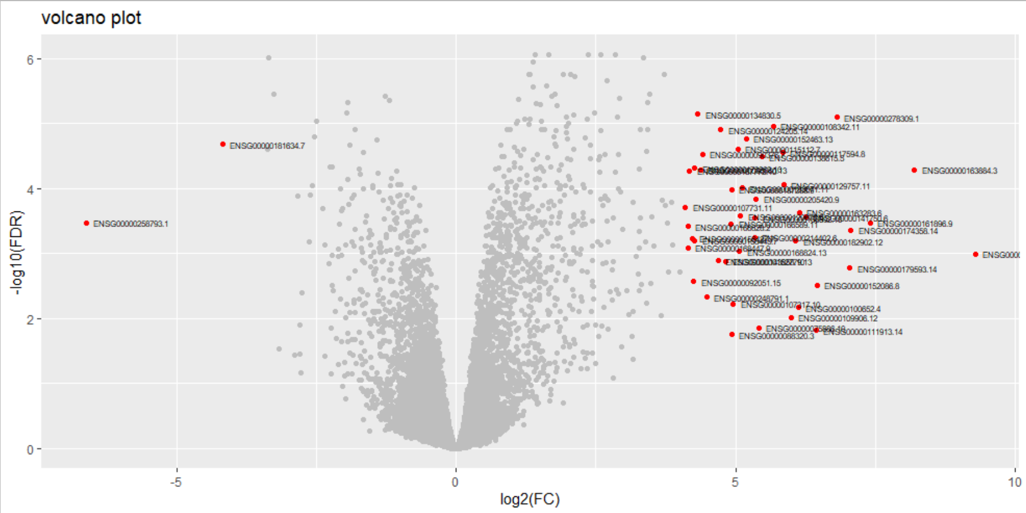
Volcano plot
X axis: Fold change (log2)
Y axis: pvalue/FDR (-log10)
Values of interest are at the top left (downregulation) and
top right (upregulation)

Slide 13
Volcano plot
Identify genes with FDR < 0.05 and logFC > 4
Trace lines at the FDR/FC threshold
Add gene names (symbols)
Control the colors
ggplot(data, esthetics) + geom_type()
Data: data frame
Esthetics: aes(x, y, …)
ggplot(data1, aes(length, height)) + geom_point() + geom_point(data = data2)
ggtitle (string): set title
ylab(string)/xlab(string): change axis titles
ggsave(file, plotname)

Slide 14
MA plot
Create an MA plot with the DEG data
Required
X: mean (log) of the normalized counts (logCPM)
Y: log2 FC
Chose among:
Color significant genes (pajd)
Add horizontal lines at +/- some FC
Axis title
Plot title
Tweak legend

Slide 15
Heatmaps (geom_tile)
Create a heatmap to show the variation in expression
Required
X: timepoints
Y: genes with abs(FC) > 4 and FDR < 0.05 between 0h and 5h
Color: log(mean CPM) for each tp
Hint: use apply and melt
Chose among:
Axis title
Plot title
Tweak legend (low = blue, high = red)
Remove y labels

Slide 16
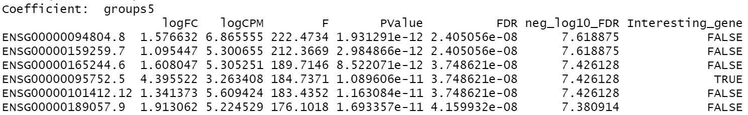
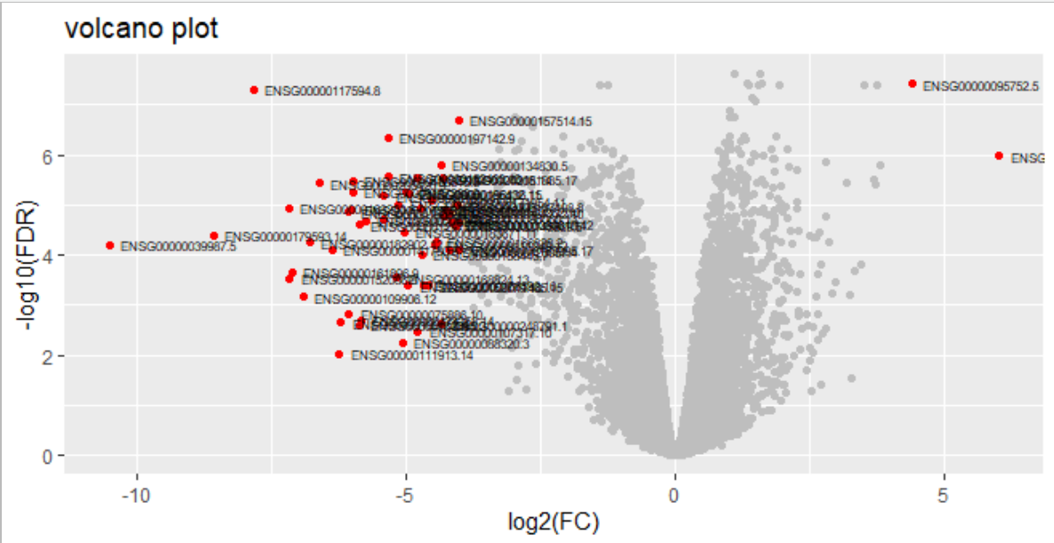
Analysis 1 – What’s wrong?
“While we had a majority of upregulated genes at 5h, we have a majority of downregulated genes after 12h after dexamethasone treatment”

Slide 17
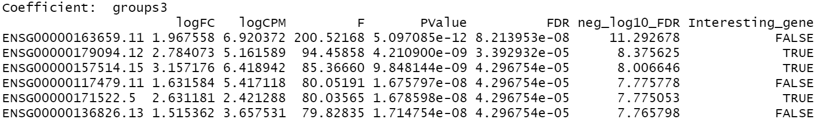
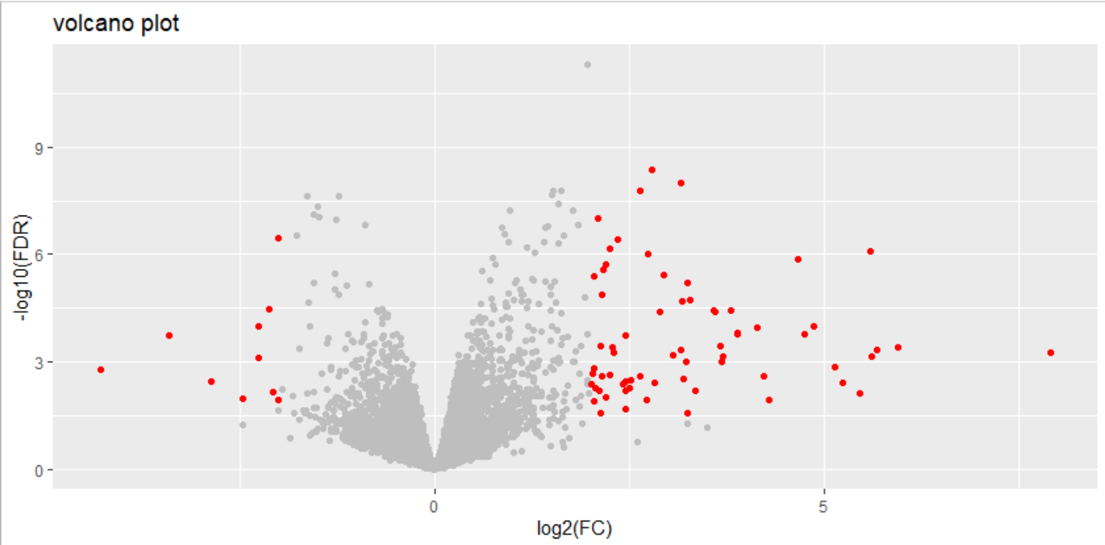
Analysis 2 – What’s wrong?
“The most interesting results are after 1h, as we see a number of downregulated and upregulated genes, even more than during the later timepoints.”

