Slide 1
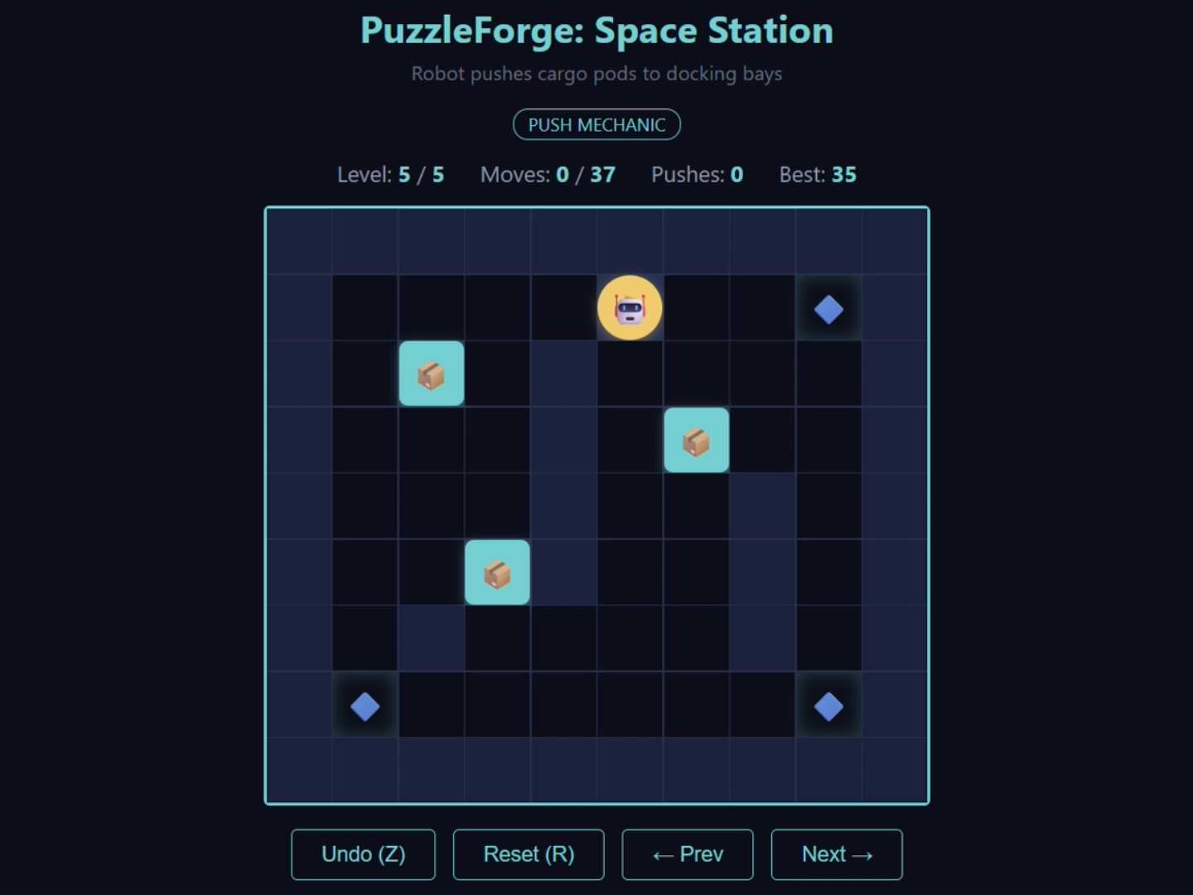
PuzzleForge
Yixiao Li · Kaizhen Tan · Hanzhe Hong
Agentic Puzzle Game Design & Generation System
94-815 Agentic Systems Studio · CMU Heinz · Track A
PROBLEM
APPROACH: 5-AGENT PIPELINE
▸ Creative + correct: designing solvable puzzles requires both -- LLMs can only do one
▸ LLMs can't verify: no way to know if a generated puzzle is actually solvable
▸ Slide physics: LLMs achieve only 30% solvability on ice-puzzle mechanics alone
Game Designer
Level Designer
Developer
QA Tester (BFS)
Debugger
▸ Design Layer: LLM generates concepts & layouts (creative)
▸ Implementation Layer: BFS solver verifies, deterministic routing, debug loop
▸ Principle: deterministic where possible, LLM where necessary
KEY INSIGHTS
BASELINE COMPARISON
▸ Multi-agent failures are emergent.
Each agent works in isolation; bugs appear in how they share state and respond to each other (F-004, F-006).
▸ Silent failure > crash.
except Exception silently broke the feedback loop for 3 cycles. Explicit error handling is essential (F-004).
▸ Not all failures are equal.
Treating cosmetic issues (diversity) same as critical issues (solvability) wastes bounded iteration budget (F-005).
▸ Verification beats prompting.
Slide solvability: prompt improvement alone = 30%. Add BFS solver + debug loop = 71%. Deterministic tools compensate for LLM weaknesses.
▸ Observability pays for itself.
Append-only trace log made it possible to diagnose every failure. Without it, silent bugs would be invisible.
 | Single LLM | Pipeline
Push | 100% | 90%
Slide | 30% | 71%
Overall | 65% | 82%
Verified? | No | Yes (BFS)
RECOMMENDATIONS
▸ Severity-aware routing: allocate debug cycles by failure severity, not equally. Solvability first, cosmetics last.
▸ Solver-guided generation: feed solver metrics (deadlock locations, states explored) to Level Designer during initial design, not just repair.
▸ Separate decision state from history: append-only logs for observability; reset-per-cycle fields for agent decisions.
▸ Human-in-the-loop gates: routing override + level editor in Streamlit dashboard for production use.
▸ Extend mechanics: add switch/teleport puzzles. Same architecture scales -- only solver and template need updates.
▸ Debug loop more than doubles slide
▸ solvability: 30% → 71% (+41 pp)
▸ 5x token cost buys verified correctness.
RESULTS (4 LIVE RUNS)
82%
90%
71%
overall solvability
push levels
slide levels

