Slide 1
Weekly Update: Analysis Complete, Paper Drafted
Do AI Adoption Signals Predict Company Performance?
Data collection DONE
Core analysis DONE
Paper FULL DRAFT (12 pp)

Slide 2
DESIGN
The Variables
X — AI adoption signals (4 families)
Signal | Source | Coverage | What it measures
Larridin scores (adoption / proficiency / impact / maturity) | Larridin Tracker, Jan 2026 | 514 | Composite evidence-based AI adoption, 1–5
Narrative concreteness (ours) | 10-K filings via LLM | 462 | Deployed, quantified AI vs. aspirational language
Investment intensity (ours) | 10-K filings via LLM | 447 | Scale of AI commitment — building or buying
AI-hiring builder rate (ours) | 31k job postings, Jun+Jul | 253 | Share of hiring that builds AI systems
Y — outcomes & Controls
Outcome | n | Controls (every regression)
Revenue growth YoY, Q1-2026 (primary) | 438 | Sector fixed effects (12)
Operating-margin change YoY | 348 | Firm size (log market cap at score date)
Forward stock returns, 1–4 months | 506 | Growth momentum (pre-signal revenue growth)
Design: cross-section — signals measured Jan–Mar 2026, outcomes realized afterward. Signals enter as percentile ranks.
CMU Capstone × Larridin | Weekly Update — July 2026
2

Slide 3
DESIGN
Methodology: Make the Signal Prove Itself
• Specification ladder — each signal must survive four increasingly demanding tests:
– (1) raw association → (2) + sector effects → (3) + firm size → (4) + growth momentum
• The momentum control is the key test: growing firms adopt more AI AND keep growing — spec (4) separates the two
• Rigor stack:
– HC3 robust standard errors; outcomes winsorized 1%/99%; signals rank-transformed
– Multiple-testing control (Benjamini–Hochberg FDR) across all signal × outcome tests
– Classifier validated vs. 657 independent labels (~90%); 87–90% of LLM evidence quotes verify verbatim
– Complete-case robustness + per-cell sample sizes reported everywhere
CMU Capstone × Larridin | Weekly Update — July 2026
3

Slide 4
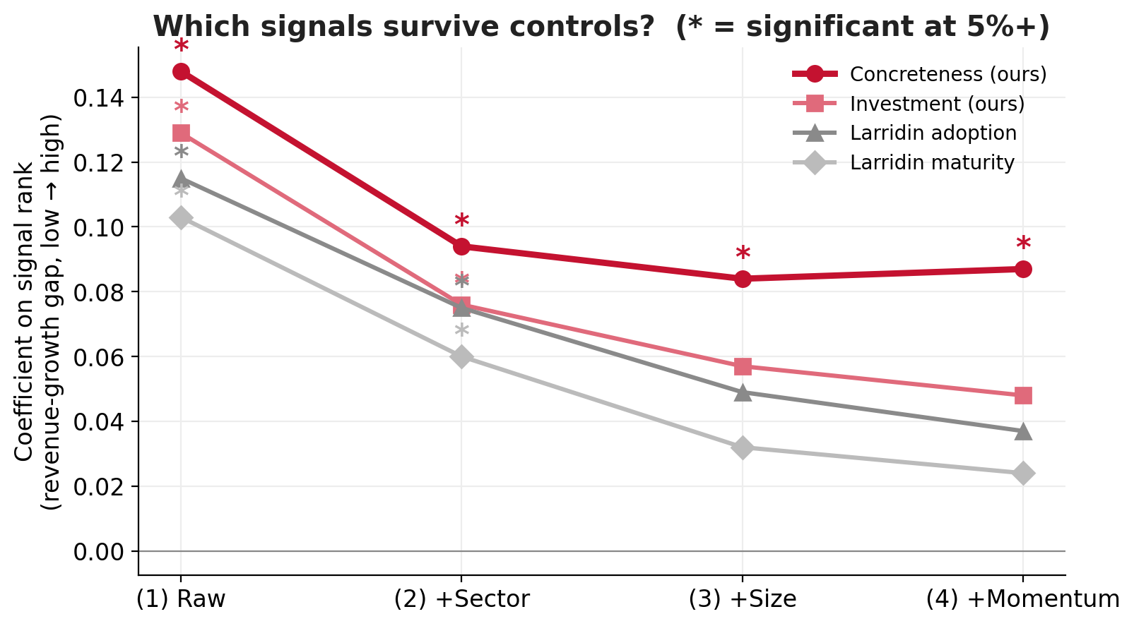
RESULTS · 1 OF 3
Headline: Concreteness Survives Everything
• All signals associate with revenue growth raw — the phenomenon is real
• Composite scores attenuate once size enters (they aggregate scale-correlated parts)
• Narrative concreteness survives all controls:
– +8.7pp revenue-growth gap, low → high (p = 0.007)
– passes FDR in the pre-specified primary family
• Sorts are monotone: conc 2 → 5 bins = 7.3% → 52% growth
CMU Capstone × Larridin | Weekly Update — July 2026
4

Slide 5
RESULTS · 2 OF 3
Growth Channel, Not (Yet) Margins or Prices
Outcome | Result | Interpretation
Revenue growth | Significant (conc +8.7pp***) | AI adoption is visible in top-line fundamentals
Operating margins | Null across all signals | AI is a growth story, not (yet) a cost story
Stock returns (4-mo) | Null after FDR | Public signals already priced — consistent with market efficiency
Value-chain heterogeneity (S&P 500, 4-category classification)
• AI-Infrastructure suppliers: +48.9% mean 4-month return; +36.8pp vs. peers with sector & size controls (p<0.0001)
• Concreteness→growth link significant WITHIN Physical-Asset/Late Adopters (p=0.03, n=214) —
– the signal works best precisely where AI claims are cheapest to make and hardest to verify
CMU Capstone × Larridin | Weekly Update — July 2026
5

Slide 6
NARRATIVE
The Story We Can Tell
1. The thesis holds
Evidence-based AI adoption measurement works: every signal family associates with real revenue growth. Top-quintile firms grew ~2x bottom-quintile.
2. Depth is the edge
Surface AI mentions carry nothing; composite scores capture the phenomenon; the deepest evidence-anchored dimension — disclosure concreteness — survives every control. Structured measurement is exactly what separates signal from noise.
3. The product roadmap
The concreteness dimension plugs straight into the Tracker; the hiring pipeline scales the POC to 536 companies monthly; each new score vintage compounds the dataset toward causal designs.
One-liner: “CMU-validated — evidence-based AI adoption measurement predicts real revenue growth, and measurement depth is what separates signal from noise.”
CMU Capstone × Larridin | Weekly Update — July 2026
6

Slide 7
PLAN
Status & Next Steps
DONE THIS WEEK
NEXT
• July hiring snapshot: 536 companies, 17.3k postings (month 2 of panel)
• Signal reliability estimate: ρ = 0.54 month-over-month
• Controls pulled (size, momentum) — full regression suite run
• Value-chain segmentation integrated
• Full paper draft: 12 pages, 6 tables, compiled
• Team review of paper draft → revisions
• Final presentation deck
• Optional: productivity outcome (employee extraction)
• Stretch: dashboard wiring (deprioritized vs. paper)
CMU Capstone × Larridin | Weekly Update — July 2026
7

