Slide 1
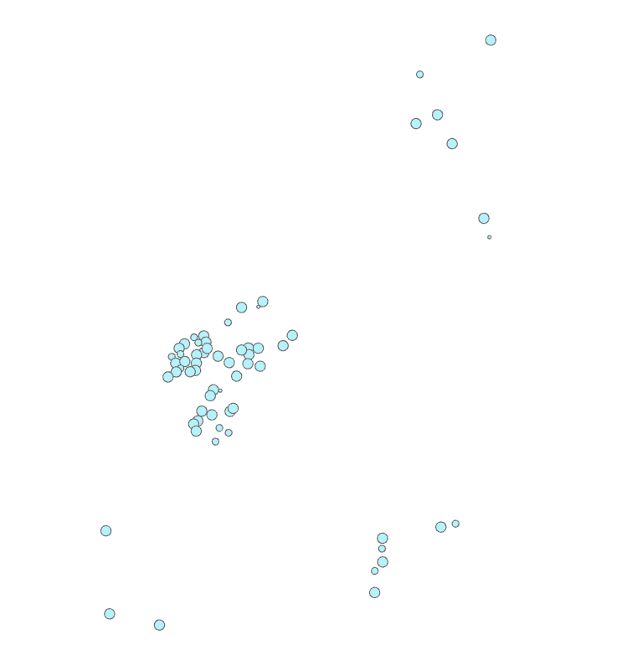
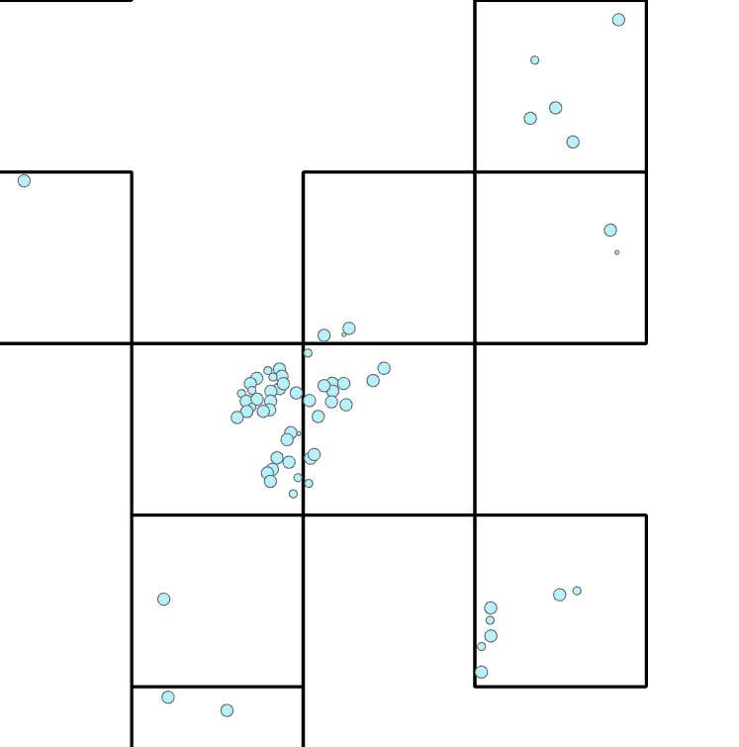
Dataset Split
1. Main Principles of Remote Sensing Dataset
① Prevent data leakage ②Spatial independence ③ Class Balance for each subset
Grid-based sampling
Integer Linear Programming (ILP) Problem
Sample distribution
K-means clustering
Create fishnet for each cluster

Slide 2
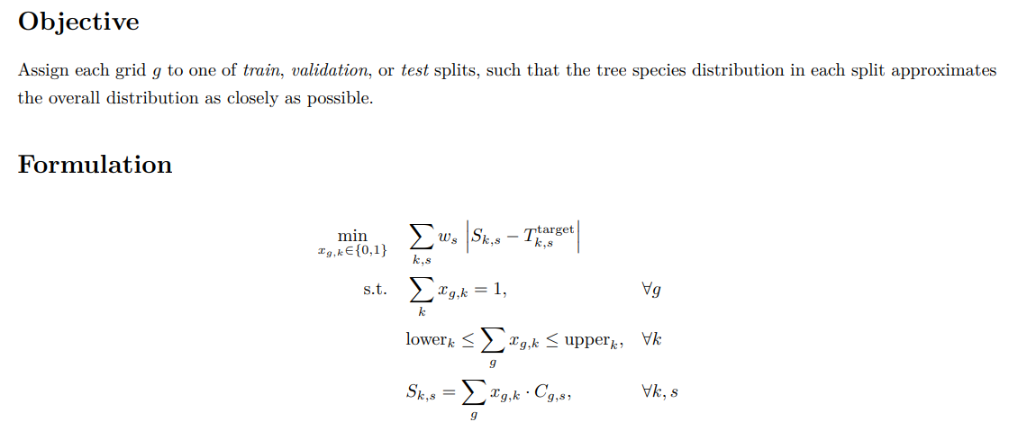
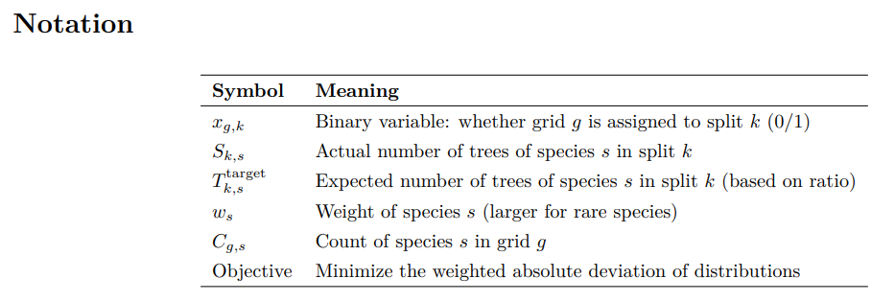
Dataset Split
2. Solve Integer Linear Programming (ILP) Problem
Assign each grid to one split
Table 1. Distribution matrix of all sample grids

Slide 3
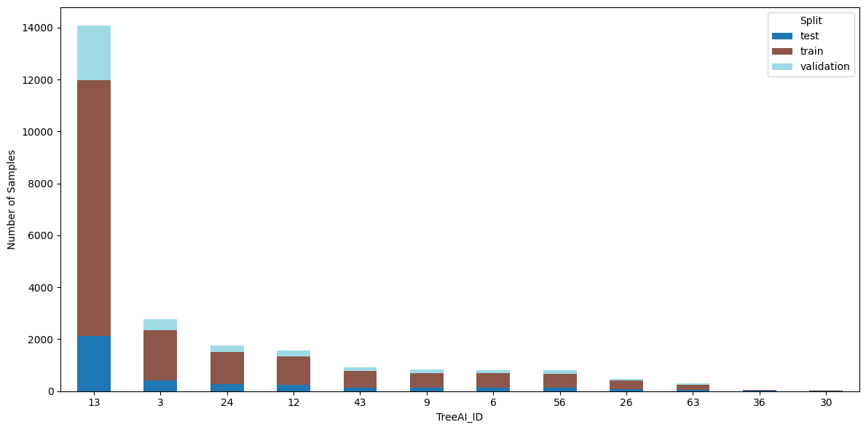
split | TreeAI_ID
 | 3 | 6 | 9 | 12 | 13 | 24 | 26 | 30 | 36 | 43 | 56 | 63
train | 1940 | 574 | 579 | 1094 | 9854 | 1237 | 334 | 27 | 42 | 646 | 555 | 206
test | 415 | 123 | 124 | 235 | 2111 | 265 | 72 | 5 | 7 | 139 | 119 | 44
validation | 416 | 123 | 124 | 234 | 2112 | 265 | 71 | 5 | 7 | 138 | 119 | 44
test/train | 0.214 | 0.214 | 0.214 | 0.215 | 0.214 | 0.214 | 0.216 | 0.185 | 0.167 | 0.215 | 0.214 | 0.214

Slide 4
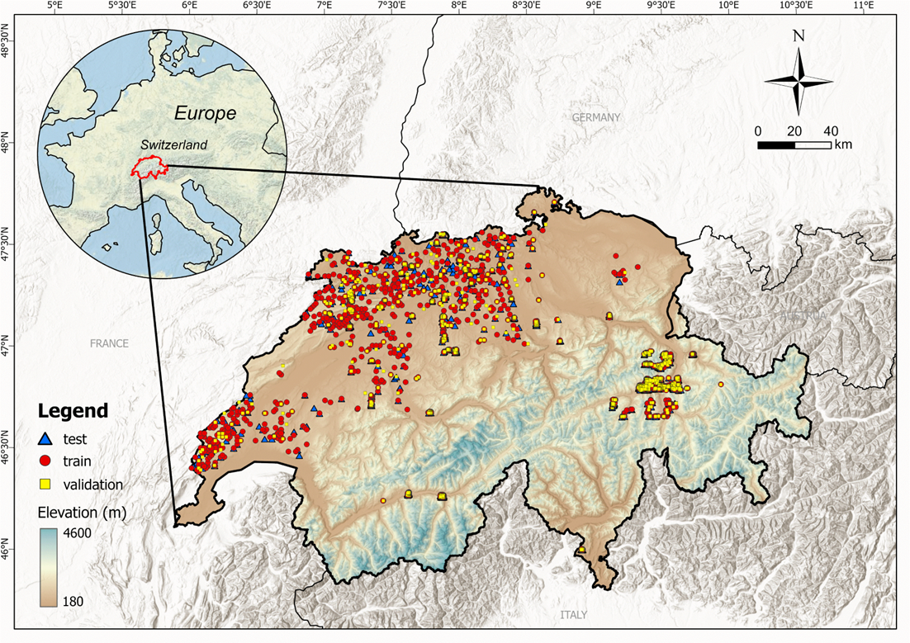

Slide 5
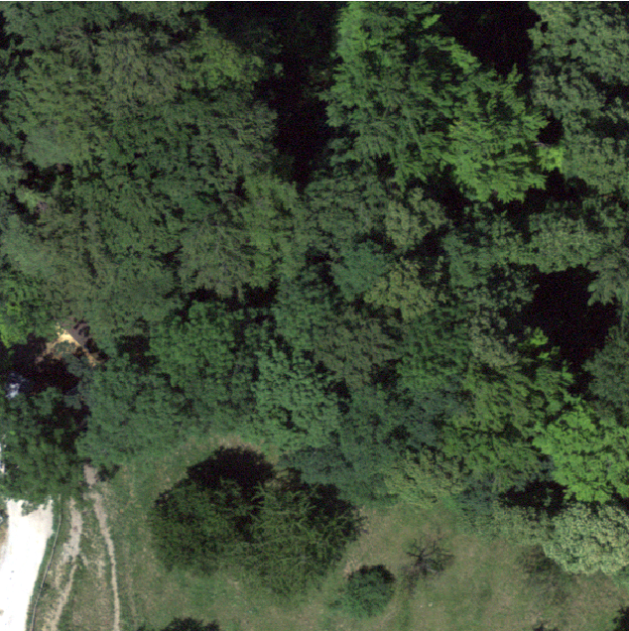
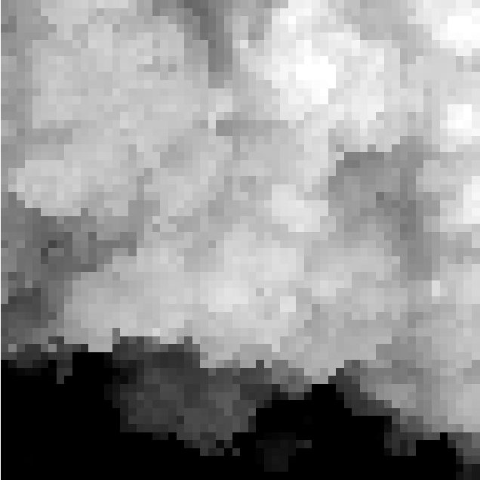

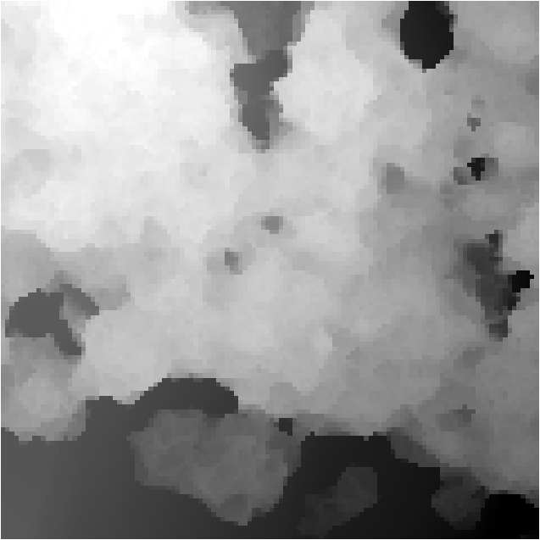










image
VHM
DEM
DSM
group
Satellite Embedding
Sentinel 1-TS
Sentine2 1-TS
HDF5 File
BIO 01
group
BIO 02
EPSG:2056
CH1903+/LV95
…
BIO19
CRS
CHELSA Climate

